Slide 1
Georgia Student Assessment Program 2019-2020 Fall Conference - Part 3
Accessibility and Accommodations
September 10, 2019
September 12, 2019
Notes:
Welcome to Fall Assessment Conference 3: Accessibility and Accommodations.

Slide 2
Agenda
General Principles
District Responsibilities
Five-Step Process
Proposed Guidelines for EL-TPC Plans
Notes:
Today, we will discuss the following topics related to Accessibility and Accommodations:
General Principles
District Responsibilities
Five-Step process for selecting and evaluating accommodations
Proposed guidelines for the assignment of accommodations within EL-TPC plans

Slide 3
General Principles

Slide 4
General Principles
Under the federal Individuals with Disabilities Education Act (IDEA), the Every Student Succeeds Act (ESSA) and the Georgia State Board of Education (SBOE) Rule 160-3-1- .07, all students, including students with disabilities (SWD) and English learners (ELs), must participate in the state’s academic content standards and assessments.
Notes:
According to Federal and state law and federal guidance all students must participate in the state’s academic content standards and assessments. To this end, the state designs assessments with features that address the access needs of the broadest range of students. To ensure students participate to the fullest extent possible in all statewide assessments, educators must also participate in a planning process that addresses the educational needs of all students, including English Learners and students with disabilities.

Slide 5
District Responsibilities

Slide 6
District Responsibilities
Local School Systems must have policies and procedures that require the administration of assessments that are not part of the state assessment program.
Students with disabilities may not be excluded from assessments administered to all students in a grade, class, or school.
Local school systems must continue to review all assessments administered at the system’s discretion and plan for accommodations and alternate assessment.
Notes:
Districts must have policies and procedures that also address the learner needs of all students. Students with disabilities may not be excluded from local assessments administered to all students in a grade, class, or school. Local school systems must continue to review all assessments administered at the system’s discretion and plan for accommodations and alternate assessments.

Slide 7
Five-Step Process

Slide 8
The Five Step Process
Expect students to access grade-level content standards
Learn about accessibility supports for instruction and assessments
Select accessibility supports for instruction and assessment for individual students
Administer accessibility supports during instruction and assessment
Evaluate and improve use of accessibility supports in instruction and assessment
Notes:
Ensuring all students have appropriate supports in the classroom and on assessments is a five-step process. Educators must be knowledgeable of content standards and expect all students to access grade-level standards. Next, teachers must learn about appropriate accessibility supports. Educators should ensure that students work toward grade-level standards by using a range of instructional strategies based on the varied strengths and needs of students. The student must be provided the selected accessibility supports (i.e., universal tools and accommodations) during instructional periods and test administration. Prior to the day of a test, the School Test Coordinator should ensure certain test examiners and proctors know what accessibility supports, especially accommodations, each student will be using and how to administer them properly. Accessibility supports must be selected based on the individual student’s needs and must be used consistently for instruction and assessment. State regulations require accurate coding of accommodations use on student answer sheets and within the online testing platform. Evaluation is the final step. Data on the use and impact of accessibility supports during assessments may reveal questionable patterns of the use of accessibility supports, as well as inform the continued use of some supports or the rethinking of others. Examination of the data may also indicate areas in which teachers and test examiners need additional training and support.

Slide 9
Step 1
Expect Students to Access Grade-Level Standards

Slide 10
Expect Students to Access Grade Level Academic Content Standards
To accomplish this step:
Educators must be familiar with standards and accountability systems at the state and district level and
Educators must know where to locate standards
Educational stakeholders must collaborate for successful student access.
Notes:
Teachers have the awesome responsibility of developing, implementing, and improving accessibility practices for students. This responsibility is so important because accessibility supports promote equal access to grade-level content. To ensure students have equal access to grade level academic content standards:
Educators must be familiar with standards and accountability systems at the state and district level and
Educators must know where to locate standards
Educational stakeholders must collaborate for successful student access.

Slide 11
Expect Students to Access Grade Level Academic Content Standards
Educators familiar with the needs of students should make accessibility decisions.
Special education teachers/504 Plan committee representatives
Language educators and facilitators
Assessment officials
General education teachers
Bilingual special education practitioners
School administrators
Parents/guardians
Notes:
District officials should ensure educators who are familiar with the needs of students work together to make accessibility decisions for them. Where appropriate, educator committees should consist of the following individuals:
Special education teachers/504 Plan committee representatives
Language educators and facilitators
Assessment officials
General education teachers
Bilingual special education practitioners
School administrators
Parents/guardians

Slide 12
Step 2
Learn About Accessibility Supports for Instruction & Assessments
Notes:
First, let’s look at the meaning of accessibility supports. Accessibility supports – administrative procedures, universal tools and accommodations – empower students with a multitude of choices, enabling them to access instructional and assessment content effectively. These individualized approaches to accessibility also place greater responsibility on educator teams and individuals who make decisions about which specific supports students need and should receive among a variety of accessibility choices.
Accessibility supports provided to a student during state assessments must also be provided during classroom instruction, classroom assessments, and district assessments; however, some instructional accessibility supports may not be appropriate for use on certain statewide, standardized assessments. In other cases, accessibility supports provided on statewide, standardized assessments may be slightly different from those provided in the classroom (i.e., digital notetaking on assessment). It is important that educators help students become familiar with the supports provided through the technology platform so that students are not using these tools for the first time on test day.

Slide 13
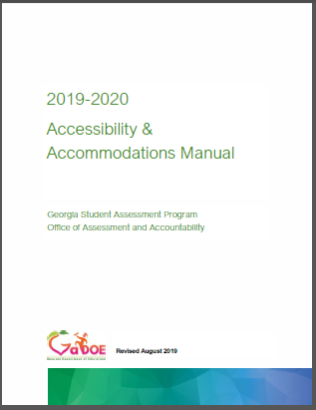
Accessibility Framework
Universal Tools
Administration Considerations
Universal Design
Accommodations
Notes:
The figure on this slide illustrates the conceptual framework underpinning the Georgia Accessibility & Accommodations Manual.

Slide 14
Universal Design
Universal Design
Application of these design principles makes instruction and assessments accessible to the broadest range of students
Clear Directions
Practice Opportunities
User-friendly Items and Activities
Notes:
The application of universally design ensures the needs of the broadest range of learners are considered during test development. Current technology enables educators to introduce computer-based instruction and assessment accessibility supports that facilitate individualized educational processes. The purpose of these supports is to reduce or eliminate the effects of barriers that prevent students from demonstrating what they know and can do. Accessibility supports provided in the classroom do not reduce expectations for learning. Some examples of UD include: clear directions, practice opportunities, and user-friendly items and activities.

Slide 15
Georgia Teachers
Standards
Item Writing
Item Reviews
Field Test
Operational Test
Reporting
Representative Groups
Participate in test development
Item alignment
Check for bias
Appropriateness
Notes:
Feedback from Georgia teachers is integral to ensuring students can access Georgia’s tests. During item review meeting, representative samples of teachers:
Ensure test items are aligned to content standards:
Ensure field test items are not biased against certain groups of students
Ensure items are appropriate test-takers
Teachers are also key to communicating test results to parents.

Slide 16
Administration Procedures
Administrative Procedures
Universal Design
Allow school district officials the flexibility to meet the needs of their students.
Establish Schedules
Allocate/assignment of resources
Computer Labs
Examiners
Notes:
The next accessibility category is Administrative Procedures. Detailed administration guidelines for Georgia’s assessments are included in assessment-specific test administration manuals. Administrative procedures give the principal or school test coordinator the flexibility to make specific decisions regarding test schedules, assignment of examiners, or computer labs.

Slide 17
Universal Tools
Universal Tools
Administrative Considerations
Universal Design
Supports that are available to all students as they access instructional or assessment content.
Embedded (Online)
Flag
Cross-Off Tool
Non-Embedded (Paper)
Scratch Paper
Audio Aid
Students should practice using these tools to determine when their use is appropriate.
Notes:
Universal tools are available to students participating in the Georgia assessment program to address their individual accessibility needs as they access instructional or assessment content. These supports are either embedded in the online test or provided by a test administrator at the local level during testing (i.e., scratch paper). Universal tools do not affect the construct being measured on the assessment.

Slide 18
Accommodations
Universal Tools
Administration Considerations
Universal Design
Accommodations
Accommodations:
Provide equitable instructional and assessment access for students with disabilities.
Reduce or eliminate the effects of a student’s disability or language proficiency
Do not change learning expectations
Only students who have an IEP, IAP, or EL/TPC plan are eligible for accommodations
Notes:
Accommodations are changes in the administration of an assessment in terms of how the student takes or responds to the assessment. In Georgia, accommodations may not alter, explain, simplify, paraphrase, or eliminate any test item, reading passage, writing prompt, or answer option. Further, accommodations may not provide verbal or other clues or suggestions that hint at or give away the correct response to the student.

Slide 19
Accommodations
Requirements
Should enable students to participate more fully in instruction and assessments and to better demonstrate their knowledge and skills.
Must be based upon individual student needs and not upon a category of disability, level of instruction, time spent in general classroom, EL status, or program setting.
Must be justified and documented in the student’s IEP, IAP/504 plan, or EL/TPC plan.
Must be aligned with and be a part of daily instruction; accommodations must not be introduced for the first time during the testing of a student.
Should foster and facilitate independence for students, not dependence.
Only accommodations listed as approved in Georgia’s Student Assessment Handbook may be used on state-mandated tests.
Notes:
The provision of accommodations must adhere to the following requirements:
Should enable students to participate more fully in instruction and assessments and to better demonstrate their knowledge and skills.
Must be based upon individual student needs and not upon a category of disability, level of instruction, time spent in general classroom, EL status, or program setting. Must be justified and documented in the student’s IEP, IAP/504 plan, or EL/TPC plan.
Must be aligned with and be a part of daily instruction; accommodations must not be introduced for the first time during the testing of a student.
Should foster and facilitate independence for students, not dependence.
Only accommodations listed as approved in Georgia’s Student Assessment Handbook may be used on state-mandated tests.

Slide 20
Allowable Accommodations
A = Administration procedures allowable for all eligible students.
S = Standard accommodation required for eligible students.
C = Conditional accommodation for required for eligible students.
Notes:
All allowable accommodations can be found in the Accessibility and Accommodations Manual (see page 21). The table of Allowable Accommodations identifies whether the provision of a specific support is a Standard Accommodation, Conditional Accommodation, or an Administration Procedure/Consideration.

Slide 21
Standard Accommodations
Those accommodations which provide access to students to demonstrate their achievement of target skills
Standard accommodations do not alter or encroach on the construct measured
As with any accommodation, it is important that the student require the accommodation and use it regularly during routine instruction and assessment
Notes:
Standard Accommodations are supports allow a student to demonstrate their achievement of target skills. The provision of Standard Accommodations do not alter or encroach on the construct measured. As with any accommodation, it is important that the student require the accommodation and use it regularly during routine instruction and assessment

Slide 22
Conditional Accommodations
These supports are more expansive accommodations that provide access for students with more severe disabilities who would not be able to access the assessment without such assistance.
Three accommodations are considered conditional for the Georgia Milestones Assessment:
Signing ELA passages (SWD only)
Oral reading of ELA passages (grades 3 – 12)
Use of a basic function calculator (SWD only) for students in grades 3-5 only
No student in grades 6-12 may use a calculator on the no-calculator subsection of test
Most students are expected to participate in standard administrations, with less than 3% receiving a conditional administration (State Board Rule 160-3-1.07)
Notes:
Conditional Accommodations are supports that encroach upon the construct being assessed. They are more expansive accommodations that provide access for students with more severe disabilities. Three accommodations are considered conditional for the Georgia Milestones Assessment:
Signing ELA passages (SWD only)
Oral reading of ELA passages (grades 3 – 12)
Use of a basic function calculator (SWD only) for students in grades 3-5 only.
Most students are expected to participate in standard administrations, with less than 3% receiving a conditional administration (State Board Rule 160-3-1.07).

Slide 23
Conditional Accommodations
Guidance on the appropriate use of conditional accommodations is provided in the Student Assessment Handbook
Only students meeting the guidance criteria are eligible for conditional accommodations
The educational plans for students qualifying for conditional accommodations must include specific goals that address the deficits which necessitate the accommodation

Slide 24
English Learners
Status | Served in ESOL | Code | Eligible for Accommodations under TPC Plan
Does not qualify for EL Services | No | None | No
Qualifies for EL Services | No | EL-Y | Yes
Qualifies for EL Services | Yes | EL-Y | Yes
Exited from services years 1 and 2 | No | EL-1 or EL-2 | Yes
Exited from services years 3 and 4 | No | EL-3 or EL-4 | No
Exited from services year 5 + | No | None | No
ELs who are in the two-year monitoring phase following their exit from language assistance services continue to be eligible for standard accommodations.
Conditional accommodations shall be used sparingly and shall not be assigned to EL-1 and EL-2 students. Specific to the accommodation of Extended Time, please note that specifying unlimited time is not appropriate or feasible.
Notes:
ELs who are in the two-year monitoring phase following their exit from language assistance services continue to be eligible for standard accommodations. Conditional accommodations shall be used sparingly and shall not be assigned to EL-1 and EL-2 students. Specific to the accommodation of Extended Time, please note that specifying unlimited time is not appropriate or feasible.

Slide 25
Special Accommodations

Slide 26
Special Accommodation Requests
In RARE circumstances a student with a disability may need an accommodation that is not on the approved list
Special Education Directors and System Test Coordinators should determine if a student has a unique need that is not addressed by the list of Allowable Accommodations.
If necessary, System Test Coordinators should submit a Special Accommodation Request no later than 6 weeks prior to the start of the test administration window.
System Test Coordinators are encouraged call the Assessment Division to discuss questions regarding the accessibility needs of one or more students.
Notes:
In RARE circumstances a student with a disability may need an accommodation that is not on the approved list. Special Education Directors and System Test Coordinators should determine if a student has a unique need that is not addressed by the list of Allowable Accommodations. If necessary, System Test Coordinators should submit a Special Accommodation Request no later than 6 weeks prior to the start of the test administration window. System Test Coordinators are encouraged call the Assessment Division to discuss questions regarding the accessibility needs of one or more students.

Slide 27
Special Accommodation Requests
Follow the procedures in the Student Assessment Handbook to submit a request for consideration
Such requests should be vetted locally first and should be requested only on an individual basis
We cannot approve any request which modifies test content

Slide 28
Step 3
Select Accessibility Supports for Instruction & Assessment
Notes:
To assure students are engaged in standards-based instruction and assessments, every educator must be knowledgeable about the state and district academic standards and assessments. Effective decision making about the provision of appropriate accessibility supports begins with making appropriate instructional decisions. In turn, making appropriate instructional decisions is facilitated by gathering and reviewing good information about the student’s access needs, disability, English language proficiency, and present level of performance in relation to local and curricular standards.
Decisions should be based on individual characteristics and needs. Accordingly, it is not appropriate to make blanket decisions for groups of students at particular language acquisition levels or with particular disabilities. When individualized accessibility decisions are made thoughtfully, they can advance equal opportunities for students to participate in the general education curriculum.

Slide 29
Select Accessibility Supports for Instruction & Assessment
The provision of appropriate accessibility supports begins with making appropriate instructional decisions.
Appropriate instructional decisions is facilitated by gathering and reviewing the student’s data:
Access needs
Disability
English language proficiency
Level of performance in relation to curricular standards
Notes:
To assure students are engaged in standards-based instruction and assessments, every educator must be knowledgeable about the state and district academic standards and assessments. Effective decision making about the provision of appropriate accessibility supports begins with making appropriate instructional decisions. In turn, making appropriate instructional decisions is facilitated by gathering and reviewing good information about the student’s access needs, disability, English language proficiency, and present level of performance in relation to local and curricular standards.

Slide 30
Step 4
Administer Accessibility Supports During Instruction & Assessment

Slide 31
Administer Accessibility Supports During Instruction & Assessment
School Test Coordinators are responsible for the overall conduct of assessment administration.
Coordinate and arrange accommodations and other supports before test day.
Communicate with examiners to ensure that examiners understand what accommodations students are scheduled to receive.
Ensure technology is working properly.
All staff involved in test administration must adhere to test security and administration policies and protocols.
Notes:
Once committees have identified the supports that individual students will use on assessments, they must communicate this information to School Test Coordinators as soon as possible. School Test Coordinator must map out the provision of accommodations and other student supports. They must ensure examiners understand the what accommodations students are scheduled to receive. If students are testing online, examiners must verify students' test tickets identify the appropriate accommodations and that all technology is working properly. All staff involved in testing must adhere to test security and administration policies and protocols. When test administration guidelines are not followed, it results in a Testing Irregularity.

Slide 32
GAA 2.0

Slide 33
Unique Administration Considerations
Advanced preparation time
Unlimited Pause and resume opportunities
Repeat of test items
6 Week administration window
Manipulatives
Familiar response & presentation modes
Individualized response time
Use of reinforcement & refocusing strategies
Notes:
The GAA 2.0 Assessment was designed with the expansive test administration procedures.

Slide 34
Unique Test Features
Scenarios engage student interest and activate background knowledge
Large simple graphics
Accessible font size
Scaffolding
Short simple sentences
Common proper names
Directive questions
Notes:
The GAA 2.0 also has the most extensive supports built within the assessment.

Slide 35
Georgia Milestones

Slide 36
Universal Tools: Milestones
Tool | Icon | Content Area
Periodic Table |  | Science
Reference/Formula Sheet |  | Math, Science
Highlighter |  | ALL
Sticky Note |  | ALL
Flag |  | ALL
Line Guide |  | ALL
Online Calculator |  | Mathematics; Science; Economics
Graphing Tool |  | Mathematics only
Cross-off Tool |  | ALL
Magnifier |  | ALL
Notes:
Georgia Milestones has multiple Universal Tools embedded within the online platform.

Slide 37
Video Sign Language
Video Sign Language is available for all content area tests.
The video development team consists of a deaf content expert, a bilingual interpreter, video production personnel and representation from the GaDOE.
The Georgia ASL guidelines are used by Georgia educators during the review of videos.
The guidelines provide specific information on how to achieve a balance between conveying the construct in a manner that reflects the linguistic rules and conventions of ASL while simultaneously maintaining the essential meaning of the item.
The guidelines are used in development of all operational and practice test videos.
All forms are updated based on feedback from educators.
Notes:
VSL forms are available for each Georgia Milestones Assessment.

Slide 38
Braille
Braille forms are available for all content area tests.
Teachers of students with visual impairments review all operational test forms for bias.
Tactile Graphics adhere to BANA standards.
Braille vendor ensures descriptions adhere to The Braille Authority of North America (BANA) standards.
Alternative Text is provided in Braille booklets for tables, charts, graphs, and other graphics as appropriate.
Notes:
Braille forms are available for all test forms.

Slide 39
ACCESS for ELLs

Slide 40
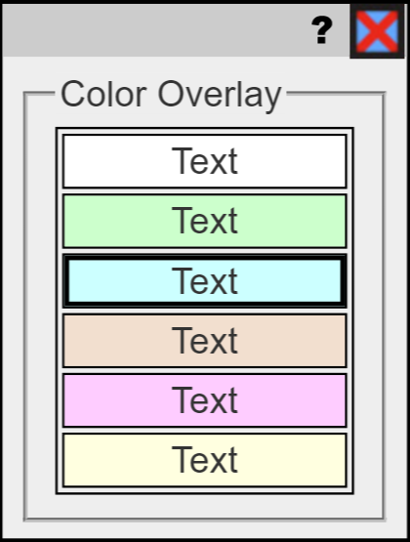
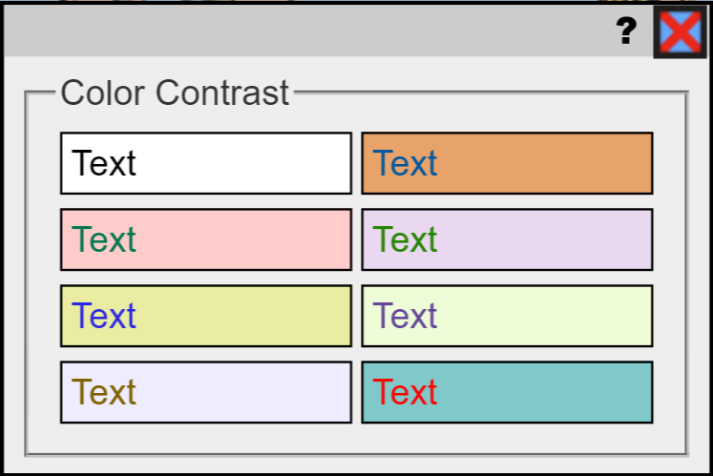
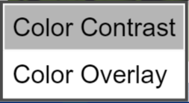
Universal Tools: Online
Embedded in the computer-based test or provided by TA
Do not need to be designated in WIDA AMS – all students may use these.
Notes:
Here are the ACCESS for ELLs universal tools available for online testing. Provided that students have become familiar with the universal tools, these should reinforce students’ abilities to demonstrate their knowledge and skills.
Educators must ensure that students have opportunities to practice using the tools and help students determine when a tool may be appropriate and useful. Some of the embedded supports, such as color contrast settings, may be novel to students, and the students may want to experiment with them..
In the Test Demo video on WIDA AMS, to be viewed prior to testing, students will see how to use these tools and practice using them prior to test administration to see if they will be helpful.

Slide 41
Universal Tools: Paper Test
Audio Aid
Highlighter
Line Guide
Magnification
Sticky Notes
Scratch paper
Notes:
Test administrators will provide these tools during the administration of the paper version of ACCESS for ELLs. Educators must ensure that students have opportunities to practice using the tools and help students determine when a tool may be appropriate and useful.
Making connections between learning strategies used during instruction and similar universal tools available on the assessment also may help students use them effectively.

Slide 42
Accommodations
 | Georgia
 | Read-Aloud |  | Extended Time | Technology Applications | Other
WIDA | Embedded | Non-Embedded | Extended Over Multiple Days | Recording Device | Sign Directions
 | Manual Control of Audio | Human Reader Options | Extended Speaking | Word Processor | Non-School Setting
 | Repeat Item Audio | Reader Repeats Options | Extended Testing |  | Scribe
 |  |  |  |  | Braille
 |  |  |  |  | Large Print
Notes:
Georgia’s Allowable Accommodations Table cross-references broad categories of accommodations by each state-mandated assessment. WIDA’s Access accommodations fall within Georgia’s broader categories of accommodations. For example, WIDA allows several very specific accommodation related to the Screen Reader functionality or Read-Aloud accommodation, including Manual Control of Audio, Repeat Item Audio, Human Reader, and Reader Repeats option. WIDA also allows 3 types of Extended Time accommodations, including Extended Time Over Multiple days, Extended Speaking , and Extended Testing. The remaining accommodations can either be grouped under Georgia’s Technology Applications accommodation or in other unique categories.

Slide 43
Step 5
Evaluate & Improve
Use of Accessibility Supports in
Instruction & Assessment

Slide 44
Evaluate & Improve Accessibility Supports in Instruction & Assessment
District-Level
Policies
Procedures
Professional Development
Supports
Student feedback
Student Level
Classroom Supports
Student Perception
Teacher Perceptions
Notes:
Collecting and analyzing data on the use and effectiveness of accessibility supports are necessary to ensure the meaningful participation of students in state assessments. Districts should develop evaluation plans that include questions related to the effectiveness of accessibility polices, procedures, and professional development activities. Formative data collected from students and teachers might provide critical information about their perception related to the provision of key supports in the classroom and on state assessments.
A committee responsible for continuous improvement efforts can address school- and system-level questions, while the student-level questions need to be considered by educators. It is critical to stress that formative evaluation is not the responsibility of just one individual. The entire IEP, IAP/504 or EL/TPC team should contribute to the information gathering and decision-making processes.

Slide 45
Decision-making Guidelines for the EL-TPC
Accommodating English Learners’ level of English Proficiency on State Assessments

Slide 46
What is the English Learner Testing Participation Committee (EL-TPC)?
IS
IS NOT
A team decision
Testing accommodations for the GA Milestones, GKIDS, and other classroom assessments.
Testing accommodations for English learners without disabilities
An individual decision
Testing accommodations for the ACCESS for ELLs
Testing accommodations for English learners with disabilities
2019-2020 Student Assessment Handbook
Notes:
The EL-TPC is a team of individuals the make decisions about the accommodations students should receive on Georgia Milestones, GKIDS, and classroom assessments. The plan only includes supports based on the student’s level of language proficiency. Additional information about this plan can be found in the Student Assessment Handbook.

Slide 47
GOAL of EL-TPC Guidelines
Build consistency across the state in the application of accommodations for English learners
Create a gradual release model:
As student’s level of English proficiency increases year to year, the number of testing accommodations decreases.
Accommodations should give English learners access, not advantage, in the testing experience.
Accommodations should reflect individual student need – One size does not fit all!
Notes:
ESOL/Title III staff has proposed guidance for the provision of accommodations for EL students based on their level of language proficiency as measured by ACCESS for ELLs. The goal of the proposed guidelines is to build consistency across the state in the application of accommodations for English learners and create a gradual release model. In the proposal, as a student’s level of English proficiency increases year to year, the number of testing accommodations decreases.

Slide 48
Proposed EL-TPC Decision-making Guidelines
Setting Accommodations | Most likely to benefit EL students at this ELP Level
 | ELP Levels 1.0 – 2.9 | ELP Levels 3.0 – 3.9 | ELA Levels 4.0 – 5.9
ESOL classroom | ✓
Small group | ✓ | ✓ | ✓
Preferential seating | ✓ | ✓
Individual or study carrell | ✓
Individual administration | ✓
Consider whether setting accommodations are necessary or not.
Consider student’s sociocultural adjustment needs.
Be careful not to over-accommodate.
Notes:
Educator teams should carefully consider whether setting accommodations are needed or not. Consideration should be given to a student’s sociocultural adjustment needs.

Slide 49
Proposed EL-TPC Decision-making Guidelines
Presentation Accommodations | Most likely to benefit EL students at this ELP Level
 | ELP Levels 1.0 – 2.9 | ELP Levels 3.0 – 3.9 | ELA Levels 4.0 – 5.9
Explain or paraphrase the directions for clarify (in English only) | ✓ | ✓
Oral reading of test questions in English only | ✓
Oral reading of ELA passages in English only* | Reading Proficiency < 2.0 AND Listening Proficiency ≥ 3.0
Repetition of directions in English only | ✓ | ✓
*Restricted to eligible EL students only; see guidance on next page for eligibility. For oral reading, screen reader is the preferred method of administration. Where a human reader delivers the accommodation, examiners must adhere to directions provided in the Read-Aloud Guidelines.
Notes:
According to the proposal, presentation accommodations may be of greatest benefit to students who have ACCESS scores in the beginning and intermediate levels.

Slide 50
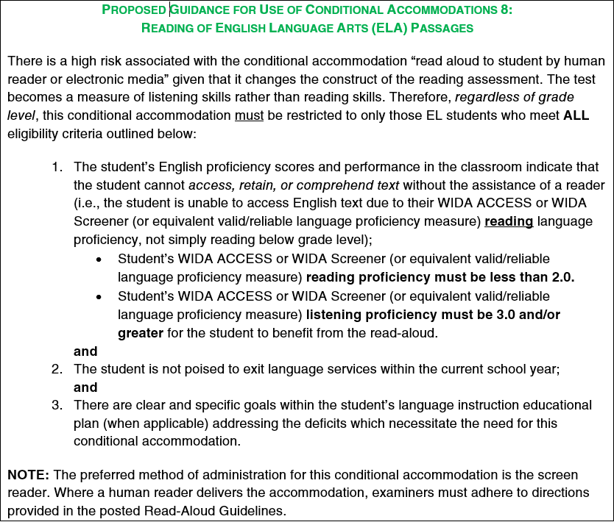
Proposed Guidance for Use of Conditional Accommodations 8: Reading of English Language Arts (ELA) Passages
Notes:
EL students must meet defined criteria to be eligible to receive the “reading of ELA passages.”

Slide 51
Proposed EL-TPC Decision-making Guidelines
Accommodation | Most likely to benefit EL students at this ELP Level
 | ELP Levels 1.0 – 2.9 | ELP Levels 3.0 – 3.9 | ELA Levels 4.0 – 5.9
Response Accommodations
Word-to-Word dictionary** |  | ✓ | ✓
Scheduling Accommodations
Frequent monitored breaks | ✓ | ✓
Extended time within the confines of the school day | ✓ | ✓ | ✓
**EL student must be literate in 1st language enough to use the dictionary effectively; Extended time must be provided in conjunction with this accommodation.
Extended Time is defined as time allotted within the confines of a school day.
(2019-2020 Student Assessment Handbook, p. 95).
Notes:
The guidance also suggest that the provision of scheduling accommodations might be most beneficial to students who have beginning and intermediate level ELP scores.

Slide 52
Questions or Comments?
State Contacts:
Mary Nesbit-McBride, Ph.D., Assessment Specialist
(404) 232-1207 or mnesbit@doe.k12.ga.us
Margaret Baker, Ed.D. Title III, Part A Program Manager
(678) 794-3695 or mbaker@doe.k12.ga.us
Crystal R. Callaway – Special Education Program Specialist
(404) 657-9969 or ccallaway@doe.k12.ga.us
Notes:
Now we are going to respond to questions that you posed during the presentation and any you may still have.

