Slide 1
System Test Coordinators’ Fall Conference Part 2
General Session
August 31, 2017

Slide 2
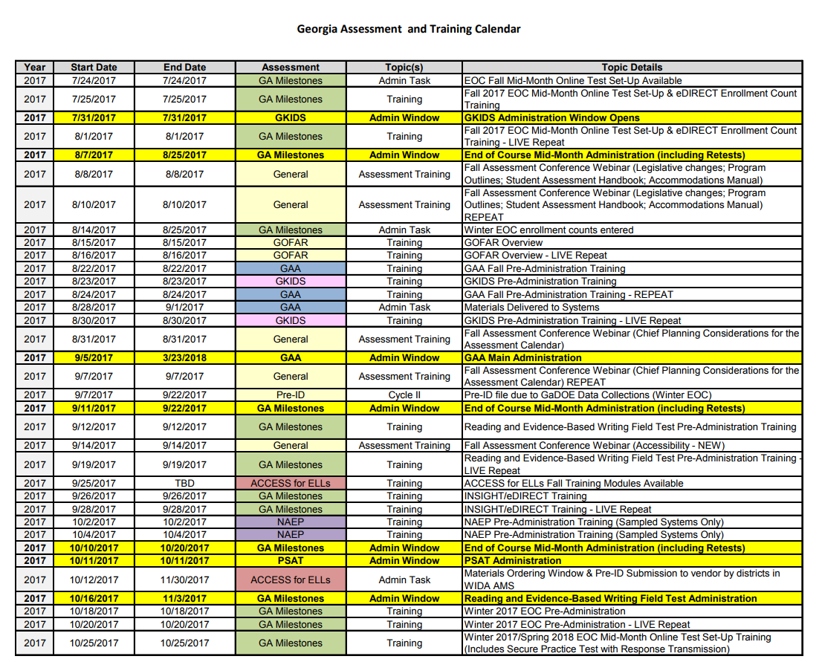
State Testing Calendar
Test Window
http://www.gadoe.org/Curriculum-Instruction-and-Assessment/Assessment/Pages/Information-For-Educators.aspx

Slide 3
District Assessment Plan
Calendaring
Communication
Administration
Reporting

Slide 4
Calendaring

Slide 5
Unpacking the Calendar

Slide 6
Filtering the work down
State Testing Window
District Input
State Training
District Training
School Training
State Admin Tasks
District Input
School Input
District Windows

Slide 7
Fitting it all Together
District Testing Calendar
GKIDS
Georgia Milestones
NAEP
ACCESS
GAA
District Holidays
District Benchmarks
Other Tests – ACT, AP, SAT, PSAT

Slide 8
Back mapping your Calendar
Practice Tests
Testing Dates
Key Dates (Graduation, Retest, Program Requirements, Close of school)
Training
Ordering Materials
Communications with schools, parents, staff

Slide 9
Communication

Slide 10
Communicate your Calendar
What
Testing Dates
Training Dates
Requirements
Reporting Dates
Who
Principals
District Administrators
Teachers
Parents
Community
How
Emails
Website
Flyers
Social Media

Slide 11
Testing Schedule vs Receipt of Student Results
Assessment | Testing Window | Reports Availability
GAA | 9/5/2017 - 3/23/2018 | Arrive 6/4/2018-6/8/2018
ACCESS for ELLs | 1/16/2018 - 3/2/2018 | Ships around 5/11/2016
Winter Milestones EOC | 11/27/2017 - 1/5/2018 | Preliminary, varies based on test date and administration mode; Science and Social Studies will be delayed
Spring Milestones EOG | 4/9/2018 - 5/18/2018 | Preliminary, varies based on test date and administration mode; paper, late June or early July
Spring Milestones EOC | 4/23/2018 - 6/1/2018 | Preliminary, varies based on test dates and administration mode; paper, third week of July
NAEP | 1/29/2018-3/9/2018 | Late 2018 to early 2019 (depending on subject area)
GKIDS | 8/1/2017-3/11/2018 | Late May 2018 – End of Year Summaries

Slide 12
Preliminary Reports
Summary Reports are embargoed until they are released by GaDOE. Preliminary reports can be immediately released to teachers, parents, and administrators.
Individual Student Results may be distributed at the district’s discretion
Inform school and system level staff how results will be distributed to parents
Be sure summer school staff know reporting timelines
Communicate on school and district websites the expected release dates
Share the link for Statewide Scores
Describe how the district plans to share school and district results.

Slide 13
Communication with School Test Coordinators
Ensure all staff involved with testing understand their roles and responsibilities as articulated in SAH
Ensure all staff know reporting procedures for testing irregularities
Ensure all examiners have valid PSC-issued certificate
Ensure all examiners know Standard 11: Testing – An educator shall administer state-mandated assessments fairly and ethically.
Ensure principals and superintendent complete proper certification forms at designated periods
Ensure you documentation that evidences procedures followed

Slide 14
Assessment Resources

Slide 15
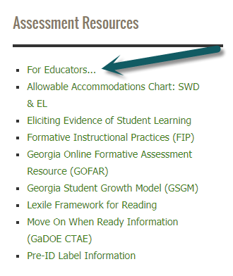
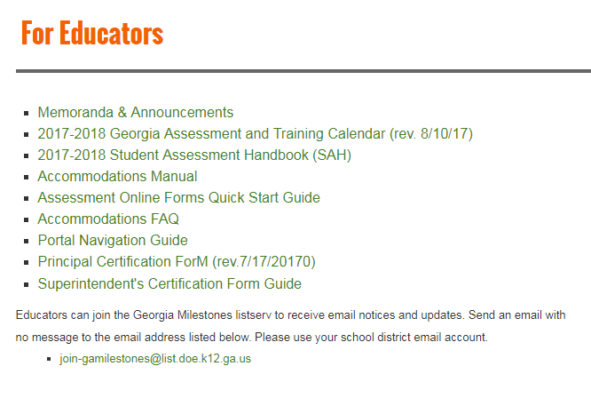
For Educators

Slide 16
EOG Resources
See also: http://ga.drcedirect.com

Slide 17
EOC Resources
See also: http://ga.drcedirect.com

Slide 18
ACCESS Resources

Slide 19
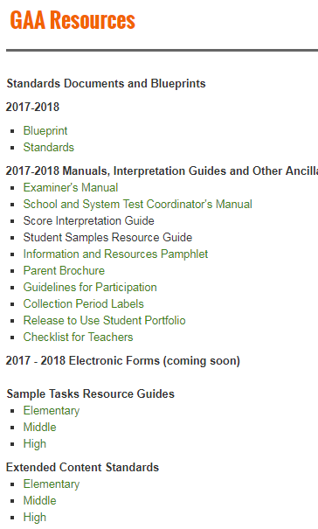
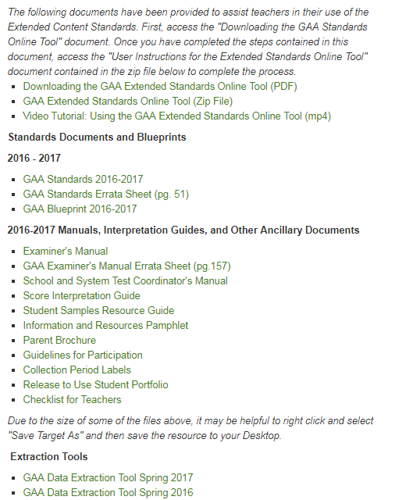
GAA Resources

Slide 20
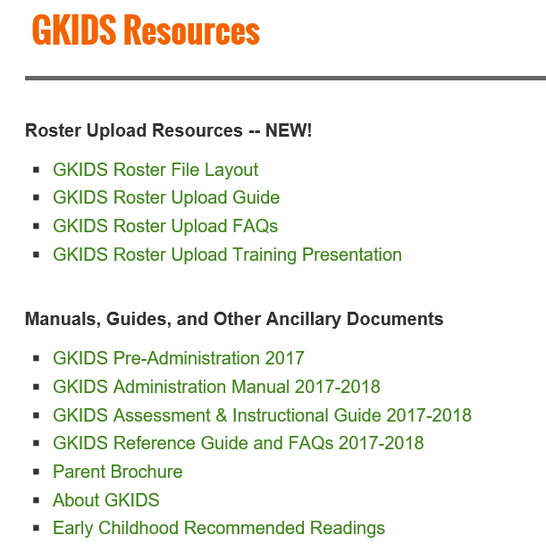
GKIDS Resources

Slide 21
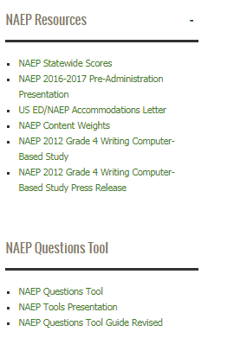
NAEP Resources

Slide 22
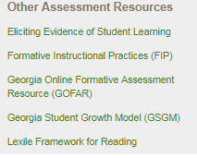
Other Assessment Resources

Slide 23
Technology

Slide 24
Building a Tech Team for Assessment
Members
System Test Coordinator
School Test Coordinators
System Technology Coordinator
School-level Technical Staff
Meet Regularly
Share training opportunities
Share technology requirements
Share testing windows and numbers of test takers

Slide 25
Things to consider for Testing and Technology
System Requirements for testing program
Devices for testing
Numbers
Accessories
Security
Requirements for students with accommodations
Servers for testing
Testing locations for students
Peak testing windows and times (share the testing schedule to include dates and number of students)

Slide 26
Keeping Students Connected
Bandwidth
District bandwidth
School bandwidth
Wireless Access Points
Competing for bandwidth
Bandwidth hogs such as videos, music, streaming services
Other devices (tablets, computers, phones, etc.)
Guest/Open access
Other district activities

Slide 27
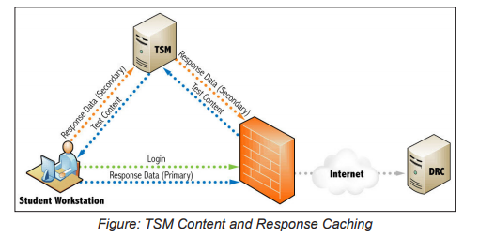
Keeping Students Connected
District Filters, Firewalls and Proxy Servers
Don’t forget to Whitelist URLs

Slide 28
Administration with Students

Slide 29
Best Practices for Students
Device Familiarity – Ensure students are familiar with the operation of the device they will use during testing.
Mouse
Keyboard
Touchpad
DRC INSIGHT Familiarity – Ensure students are familiar with the tools they will use during the online testing assessment.
Ensure that students have practiced with testing devices before testing.

Slide 30
DRC INSIGHT Navigation

Slide 31
Toolbar
Cross-Off
Sticky Note
Line Guide
Graphing Tool
Periodic Table
Pointer
Highlighter
Magnifier
Calculator
References
Use the online tools to assist you during the test.
You can use more than one tool at a time.
To close a tool, use your mouse and click on the tool again.

Slide 32
Tools
 | Pointer: Use the pointer tool to choose an answer.
 | Cross-Off: Use the cross-off tool to mark answers that you believe are NOT correct.
 | Highlighter: Use the highlighter tool to highlight important information within a test question.
 | Sticky Note: Use the sticky note to take notes within a test question.
 | Magnifier: Use the magnifier tool to enlarge the information on the screen.
 | Line Guide: Use the line guide tool to help you track a single line of text as you are reading.

Slide 33
Tools
 | Calculators: The basic calculator has the ability to perform the four arithmetic functions: addition, subtraction, multiplication, and division. The Scientific Calculator is a comprehensive calculator with the ability to perform square root, exponential, logarithmic, trigonometric, and factorial functions, as well as the four arithmetic functions. Not available for all items.
 | Graphing Tool: The Graphing Tool is designed to graph functions when solved for the “Y” variable and has the ability to give corresponding “Y” values for given “X” values.
 | References: Use the references tool to view reference materials like a formula sheet or a periodic table. These may help you answer test questions.
 | Periodic Table: You may find the Periodic Table helpful in answering test questions. You can view more detail about an element by clicking on the element’s box. The box will open a new window, and can be moved around to different parts of the screen by clicking on the box and dragging it to a new location.

Slide 34
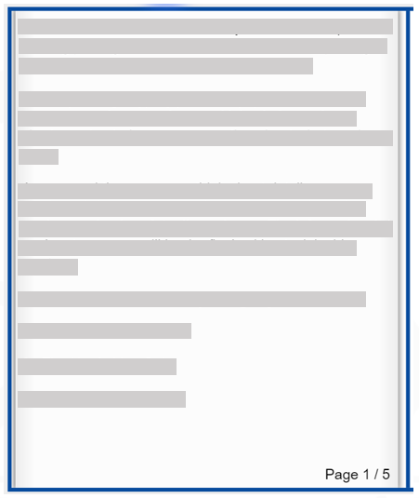
Navigating Pages for Reading Passages
The page turners are not identified within the online system. Please instruct your students on this feature.
Total pages
Current page
Click the left-bottom corner to navigate to the prior page (if available).
Click the right-bottom corner to navigate to the next page (if available).

Slide 35
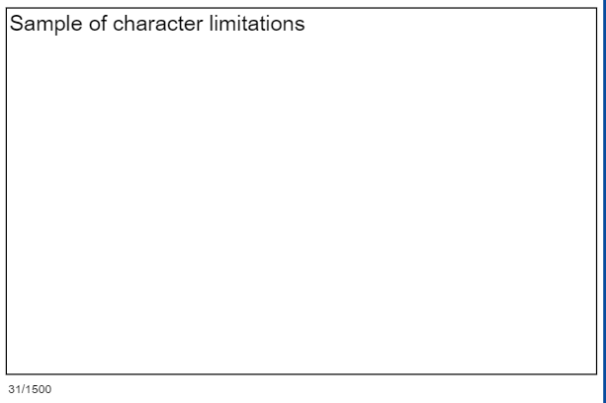
Constructed Response Character Limitations
Available response area
Current character count
Total characters available
Notes:
Constructed responses provide a display to identify character limitations. As you type, the current count of characters will display along with the total count of characters available.

Slide 36
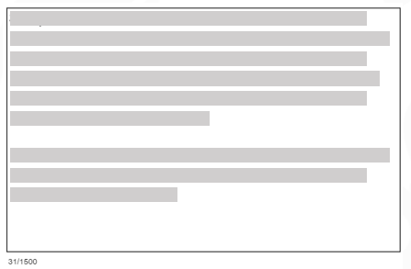
Constructed Response Mistakenly Deleting Responses (Reading/Math)
Student’s Response
Responses Deleted (By Mistake)
Press Ctrl+Z (or Command+Z on a Mac) to revert back to recently-deleted text.

Slide 37
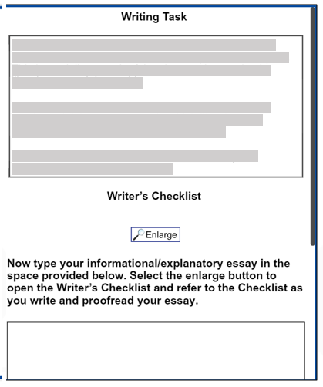
Writing Task
Directions
Writer’s Checklist
Informational/ Explanatory Essay
Passage Section
Vertical Scrollbar

Slide 38
Equation Builder (Math)
Current character count
Total characters available

Slide 39
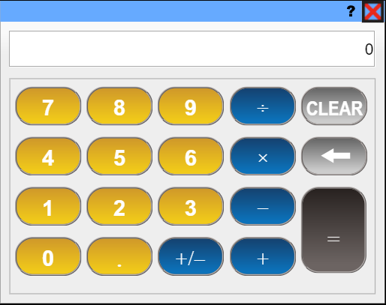
Basic Calculator

Slide 40
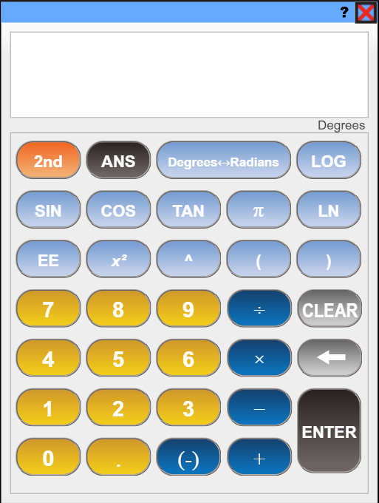
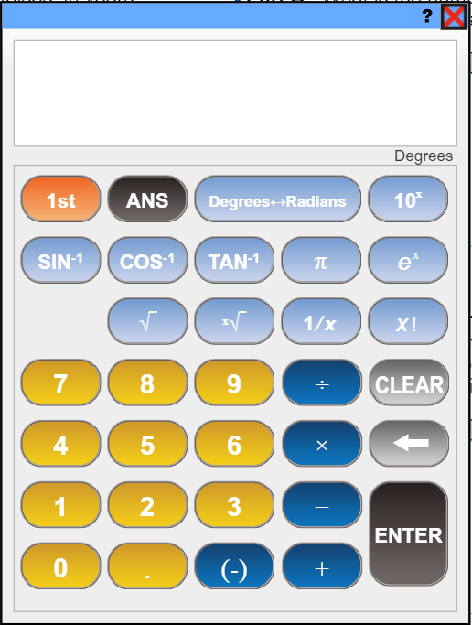
Scientific Calculator
Click to switch calculator views

Slide 41
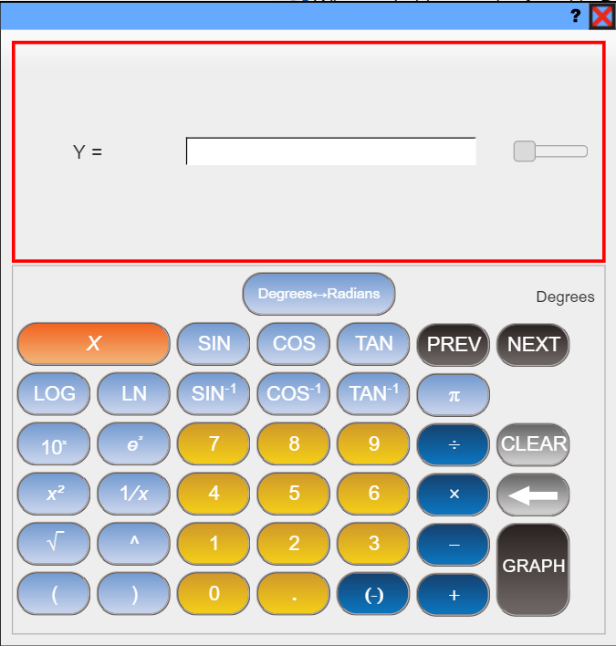
Graphing Tool

Slide 42
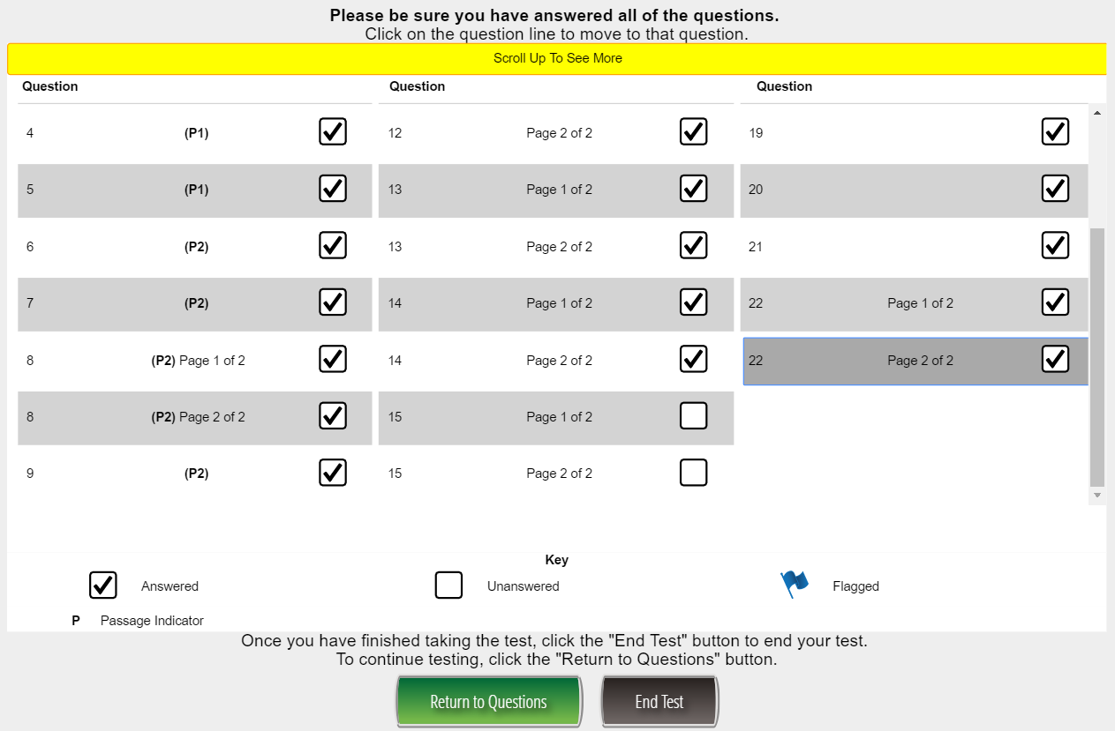
Exiting a Test Session Properly
At the completion of a test session, select
Ensure all questions have been answered.
Answered Question
Unanswered Question
Flagged Question

Slide 43
Exiting a Test Session Properly
If you have any unanswered questions, select and answer the remaining questions.
Once all questions have been answered, select to properly end the test session.

Slide 44
Test Practice for Online Administrations
Secure Practice Test
Tickets found in pdf format in General Information of eDIRECT
Practice Test with Response Transmission
Students scheduled and tests printed through Test Administration of eDIRECT
Experience Online Testing Georgia
No tickets needed
Test taken through INSIGHT platform
Available year-round
Test taken through INSIGHT platform
Responses are sent through TSM
Available 9/28/17-4/9/18
Test taken online at www.gaexperienceonline.com
Students, parents and teachers can all access this website
Sample of Section One ELA is presented
Available year-round from anywhere on the web

Slide 45
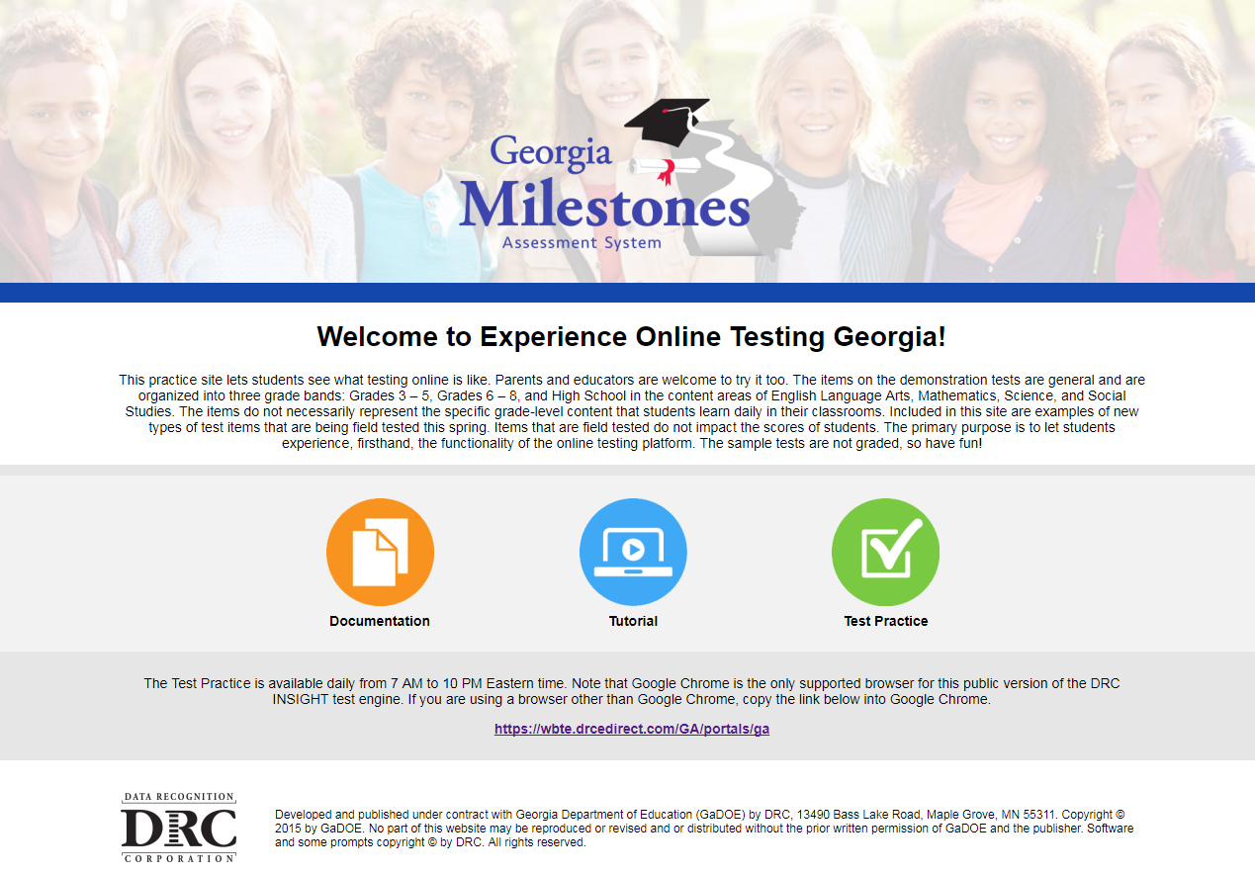
Experience Online
http://www.gaexperienceonline.com/

Slide 46
Testing and Special Student Populations

Slide 47
Accessibility
Schedule
Schedule Secure Practice Test
Identify
Identify method for ensuring students understand tools
Attend
Attend upcoming webinar

Slide 48
Testing and Special Student Populations
Schedule meeting with Special Education Director, EL coordinator & 504
Make arrangements for HHB students
Identify methods and timeline to ensure proper accommodations are selected in test management system(s)
Review procedures to monitor provision of accommodations

Slide 49
Flagged Papers

Slide 50
Flagged Paper Triggers
Student Provided Contact Information
Plagiarism
Student Copied Response
Wrong Form
Teacher Interference
Similar Wording
Formulaic Approach
Both Forms
Alert Papers
Sensitive Content

Slide 51
Alert Papers
Restrict “Alert” Papers
Students at risk of harm by self or others
Unresolved incidents of sexual abuse
Crisis pregnancy
Use of illegal drugs or uncontrolled use of legal medication or alcohol
Knowledge of a crime
Omits Internet security/means to contact
Management Process
GaDOE sends district immediate notification
Districts must acknowledge receipt
District must take immediate action
Test score can be distributed

Slide 52
Suspected Plagiarism
Copied Response
Student response shows evidence of being copied from another student response or some published source.
Management Process
Notification Letter will ask STC to determine origin of each student’s response
Was student A’s response copied by student B without student A’s knowledge or did both students obtain the answer from another source
If necessary, GaDOE will work with district to determine scope of the security risk
STC must be careful not to violate FERPA
Test scores are not distributed until matter resolved
District completes a Testing Irregularity form and makes recommendation.
If plagiarism confirmed, GaDOE invalidates the test(s).
Test score should not be distributed until matter resolved.

Slide 53
Suspected Plagiarism
Wrong Form/Both Form Plagiarism
Student has written about an item found on the other core form
Student has responded to the correct prompt, but the response also contains elements from the other form
Management Process
Notification Letter will ask STC to determine origin of each student’s response
Did one student unwittingly provide the answer for another student
Did the student’s response come from another means
District completes a Testing Irregularity form ASAP
Includes names of students sitting around the student
Test scores are not distributed until matter resolved
If necessary, GaDOE will work with district to determine scope of the security risk
If plagiarism did not occur, item is not scored—coded as “Off topic”
STC should speak to student and examiner about proper test behavior and security
If plagiarism confirmed, GaDOE invalidates the test(s)
The identified students’ test scores are not distributed until issue resolved

Slide 54
Suspected Plagiarism
Invalidations may result from:
Student attempting to view or copy another student’s responses to questions during testing.
Student using cell phones, electronic devices, and/or monitors to view, copy, share answers or post secure test information.
If there is a suspicion of cheating during testing, the students involved should be moved or redirected, but testing should not be suspended.

Slide 55
Teacher Interference
Formulaic Approach or Similar Wording
A considerable number of answers follow a similar formula
Pattern for writing and word choice suggests that students are being coached or influenced
Management Process
District must determine why students have a similar wording or writing pattern ASAP
Did the examiner cue students during the test
Did the teacher request that students use a specific formulaic method during testing or classroom instruction
District completes a Testing Irregularity form
GaDOE determines how to code the students’ responses
The identified students’ test scores are not distributed until issue resolved

Slide 56
Plagiarism: Copied Responses
Sue,
Reviewer’s of the Georgia Milestones Spring 2018 Assessment flagged the attached papers because the responses show evidence of being copied from another student’s test:
Lithocode TT05103963ZZ - Suspected Plagiarism
Lithocode BB05106394TT - Suspected Plagiarism
Please review the papers, determine the origin of each student’s response, and complete a Testing Irregularity as soon as possible. Please be sure not to distribute the scores of the identified students until this matter has been resolved.

Slide 57
Plagiarism: Wrong Form
Jan,
Reviewer’s of the Georgia Milestones Spring 2018 Assessment flagged the attached paper because the student was prompted to respond to one question but wrote about an item found on another test form. To do this, the student presumably looked at another student’s test materials.
Lithocode TT05103963ZZ - Suspected Plagiarism Wrong Form
Please review the paper, determine the origin of the student’s response, and complete a Testing Irregularity form that includes the names and GTIDs of the students that sat in close proximity (i.e., in front, behind, to the left, and right…) to the student who authored the flagged response. Because this student’s score report cannot be distributed until this matter has been resolved, please complete your investigation as soon as possible.

Slide 58
Teacher Interference
Bob,
Reviewer’s of the Georgia Milestones Spring 2018 Assessment flagged the attached papers because the suspected teacher interference. That is, each student’s answer followed a similar writing pattern or word choice that suggests students might have been coached or influenced on how to respond to the specific types of items.
Lithocode TT05103963Z1 - Teacher Interference
Lithocode TT05103963Z2 - Teacher Interference
Lithocode TT05103963Z3 - Teacher Interference
Please review the paper, determine whether an examiner cued students during testing, and complete a Testing Irregularity form that details your findings. Because this student’s score report cannot be distributed until this matter has been resolved, please complete your investigation as soon as possible.

Slide 59
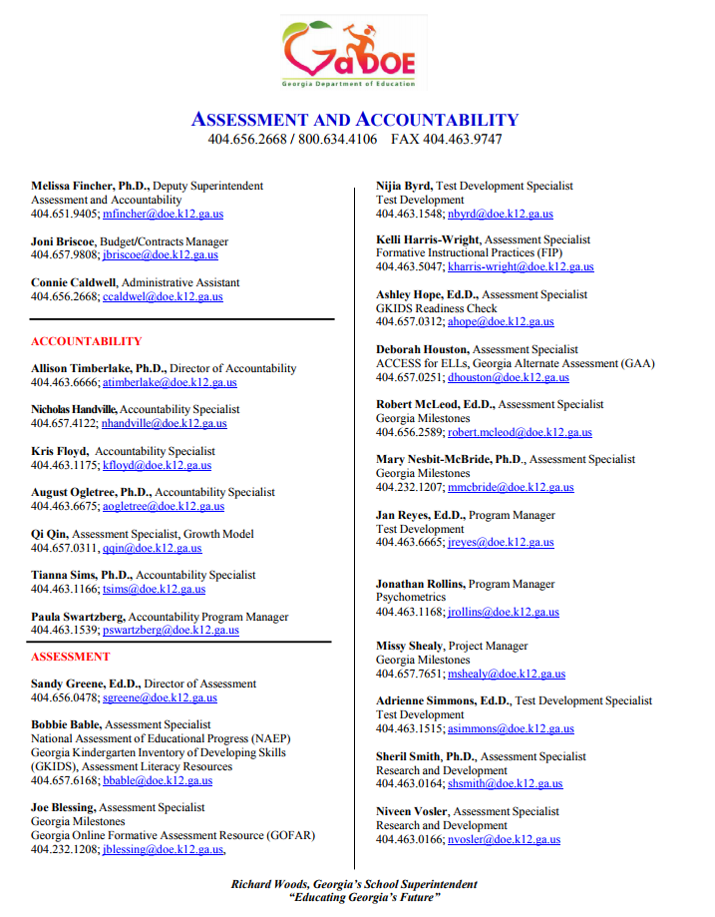
Assessment & Accountability Contact Information Toll-Free (800) 634-4106 and (404) 656-2668
http://www.gadoe.org/Curriculum-Instruction-and-Assessment/Assessment/Documents/General%20Presentations/Staff_Contact_List_June_2017.pdf

Slide 60
Questions

