Slide 1
Fall 2018 Assessment Conference Part 2 September 4 & 6, 2018

Slide 2
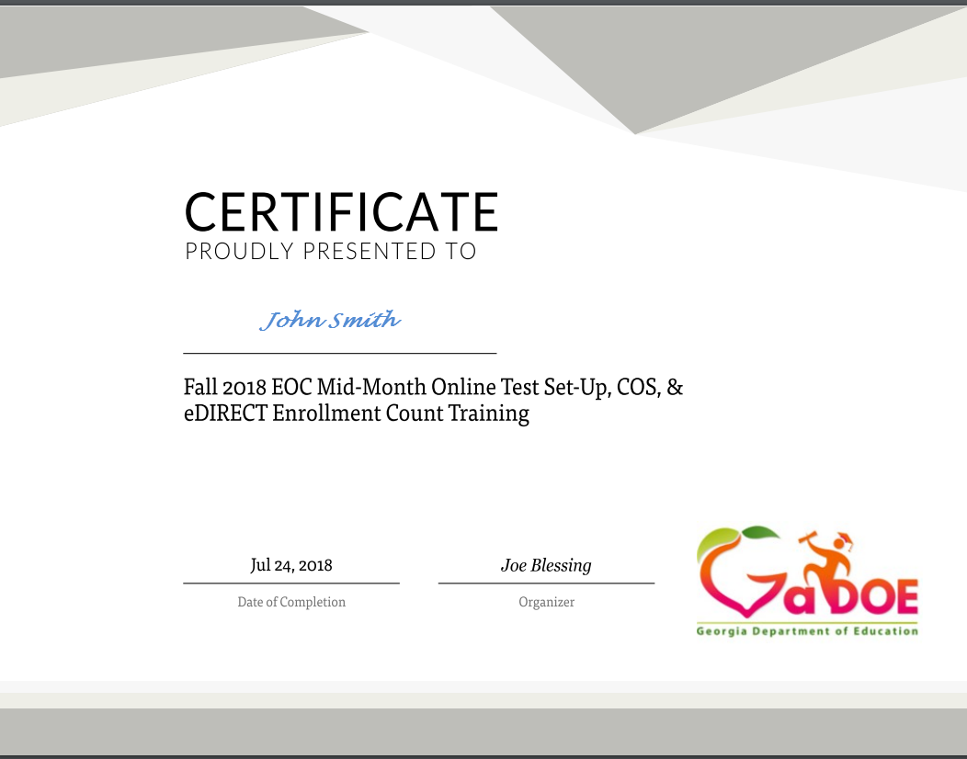
Webinar
All webinar recordings are available the day after the presentation. Click on the original registration link for any Assessment webinar to access the recording.
September 4: https://attendee.gotowebinar.com/register/7487594312230147330
September 6: https://attendee.gotowebinar.com/register/7298426635206218754
This presentation file can be found at http://testing.gadoe.org
Certificates are now sent from GoToWebinar after live training sessions. Those watching recordings will not receive a certificate.

Slide 3
District Assessment Plan
Calendaring
Communication
Administration
Reporting
Interpretation

Slide 4
Calendaring

Slide 5
State Testing Calendar
Test Window
http://www.gadoe.org/Curriculum-Instruction-and-Assessment/Assessment/Pages/Information-For-Educators.aspx

Slide 6
Fitting it all Together
District Testing Calendar
GKIDS
Georgia Milestones
NAEP
ACCESS for ELLs 2.0
GAA 2.0
District Holidays
District Benchmarks
Other Tests – ACT, AP, SAT, PSAT
Keenville

Slide 7
State Testing Windows
Assessment | Testing Window | Population | Report Expectations
ACCESS for ELLs 2.0 | 1/16/2019-3/8/2019 | EL Students | Mid-May
Georgia Milestones EOC | 4/22/2019-5/31/2019 plus mid-months and summer admins | All Students in Specific Courses | Preliminary, varies based on test dates and administration mode
Georgia Milestones EOG | 4/8/2019-5/17/2019 plus retest | All Students Grades 3-8 | Preliminary, varies based on test date and administration mode
Georgia Alternate Assessment 2.0 | 3/25/2019-5/3/2019 | 1% of Georgia Milestones Students | June
GKIDS | 7/9/2018-5/13/2019 | Kindergarten Students | Determined by school district
NAEP | 1/28/2019-3/8/2019 | Selected Schools and Students | Fall 2019
Keenville | All Year | K-2 Students | Teacher discretion throughout the year

Slide 8
Back mapping your Calendar
Testing Calendar
(Graduation, Retest, End of Year Activities, Close of school)
Training – District and School Level
Communications with schools, parents, staff
Assessment Reports
Student Assessment
Review of Technology

Slide 9
Fitting Partnerships Together
System Test Coordinator
GKIDS –
SIS Coordinators
Georgia Milestones – Technology Directors
NAEP –
Principals and School Test Coordinators
ACCESS for ELLs 2.0 –
ESOL/Title III Coordinators
GAA 2.0 –
Special Education Directors
District Holidays –
School Board
District Benchmarks – Curriculum Directors
Other Tests – ACT, AP, SAT, PSAT – Curriculum Directors
Keenville -
SIS Coordinator; SLDS access

Slide 10
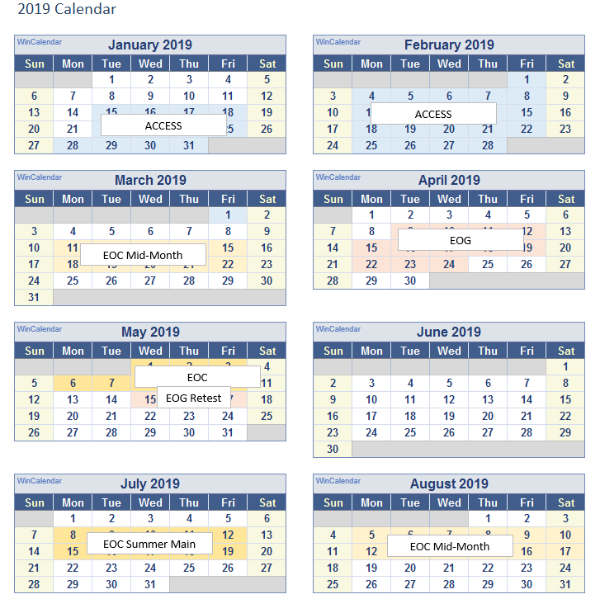
Sample District Schedule

Slide 11
Spring/Summer Testing Overlap
Spring 2019 GAA 2.0
Spring 2019 EOG
Spring 2019 EOC
Summer Retest 2019 EOG
Nov 7
Summer 2019 EOC
Dec 20
6 days
Today
2019
February
March
April
May
June
July
August
2019
18 days
24 days
16 days
Spring 2019 GAA 2.0
March 25 – May 3, 2019
25 days
Spring 2019 EOG
April 8 – May 17, 2019
Spring 2019 EOC
April 22 – May 31, 2019
Summer Retest 2019 EOG
May 13 – July 19, 2019
Summer 2019 EOC
June 17 – July 19, 2019

Slide 12
Georgia Milestones EOG Scheduling Flexibility
The local testing calendar can encompass the entire state testing window.
The system sets the order of administration for EOG grade level content. Each grade level can be scheduled independent of other grades.
The local calendar can be scheduled around spring break; however, if a grade-level content test starts before spring break, it must be completed before spring break.
*See the Student Assessment Handbook for additional details.

Slide 13
Georgia Milestones EOG Scheduling Flexibility Example
 | Monday | Tuesday | Wednesday | Thursday | Friday
April 8-12 | ELA 3, 5, 8 | ELA 3, 5, 8 | Math 3, 5, 8 | Makeup
April 15-19 | ELA 4, 6, 7 | ELA 4, 6, 7 | Math 4, 6, 7 | Makeup
April 22-26
April 29-May 3
May 6-10 |  |  | Science 5, 8 | Social Studies 5, 8 | Makeup
May 13-17
Spring Break
*EOG Retest window starts May 13

Slide 14
Georgia Milestones EOG Scheduling Flexibility Example
 | Monday | Tuesday | Wednesday | Thursday | Friday
April 8-12 | Math Section 1 | Math Section 2 | Makeup
April 15-19 | ELA Section 1 | ELA Section 2 | ELA Section 3 | Makeup
April 22-26
April 29-May 3 | Social Studies Section 1 | Social Studies Section 2 | Makeup
May 6-10 | Science Section 1 | Science Section 2 | Makeup
May 13-17
Spring Break
*EOG Retest window starts May 13

Slide 15
Projecting Spring Milestones Preliminary Reporting
Representative sample for new REBW content to determine reporting ELA and Reading
Representative sample needed to validate remaining content
Dates and counts needed to planning for hand scoring
District input needed
Survey will be sent the 3rd or 4th week in September
Need projected counts by EOC subject and EOG grade level content
Test dates need to be specific for each EOC subject and EOG grade level content not just a range

Slide 16
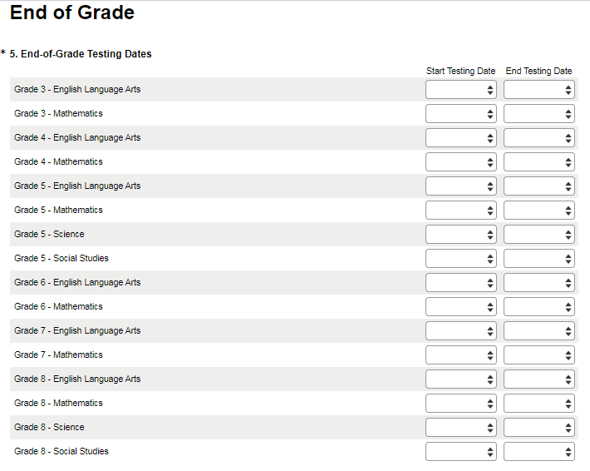
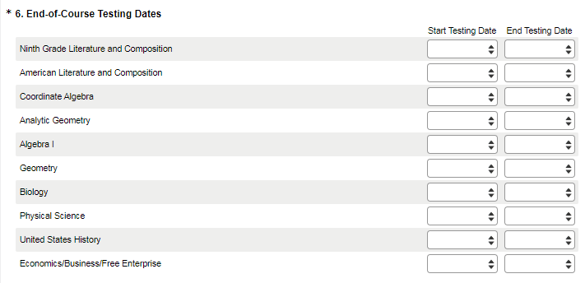
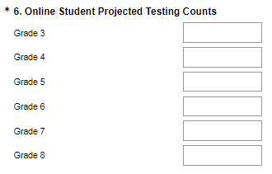
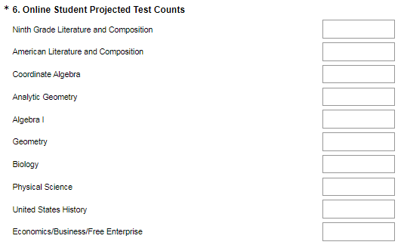
Preliminary Spring 2019 Enrollment Survey

Slide 17
Communication

Slide 18
Communicate your Calendar
What
Testing Dates
Training Dates
Requirements
Reporting Dates
Who
Principals
District Administrators
Teachers
Parents
Community
How
Emails
Website
Flyers
Social Media

Slide 19
State Testing Windows
Assessment | Testing Window | Population | Report Expectations
ACCESS for ELLs 2.0 | 1/16/2019-3/8/2019 | EL Students | Mid-May
Georgia Milestones EOC | 4/22/2019-5/31/2019 plus mid-months and summer admins | All Students in Specific Courses | Preliminary, varies based on test dates and administration mode
Georgia Milestones EOG | 4/8/2019-5/17/2019 plus retest | All Students Grades 3-8 | Preliminary, varies based on test date and administration mode
Georgia Alternate Assessment 2.0 | 3/25/2019-5/3/2019 | 1% of Georgia Milestones Students | June
GKIDS | 7/9/2018-5/13/2019 | Kindergarten Students | Determined locally
NAEP | 1/28/2019-3/8/2019 | Selected Schools and Students | Fall 2019
Keenville | All Year | K-2 Students | Teacher discretion throughout the year

Slide 20
Georgia Milestones Reports
Preliminary reports can be immediately released to teachers, parents, and administrators
Inform school and system level staff how results will be distributed to parents
Be sure summer school staff know reporting timelines
Summary Reports are embargoed until they are released by the GaDOE.
Communicate on school and district websites the expected release dates
Share the link for Statewide Scores
Describe how the district plans to share school and district results.

Slide 21
Assessment Administration

Slide 22
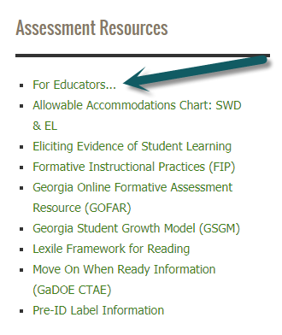
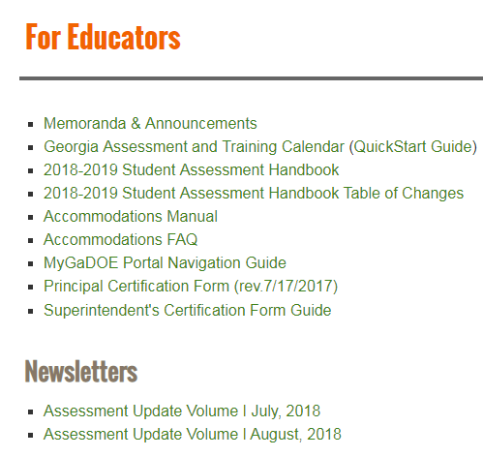
For Educators

Slide 23
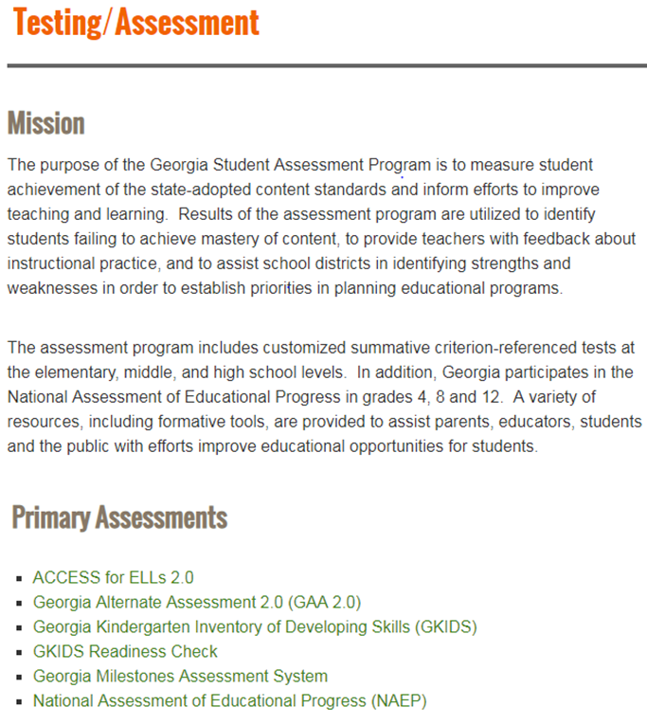
Assessment Resources

Slide 24
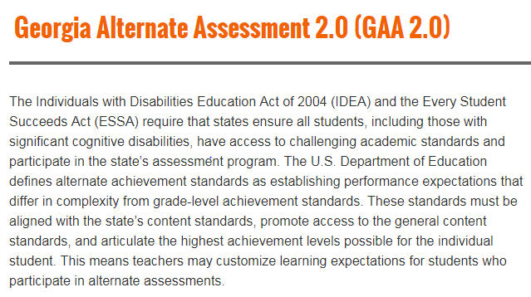
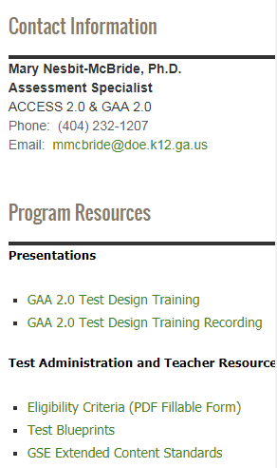
GAA Resources

Slide 25
Checklist for School Test Coordinators
Ensure all staff involved with testing understand their roles and responsibilities as articulated in SAH as they relate to the various testing programs.
Ensure all examiners have valid GaPSC-issued certificate.
Review the testing calendar to avoid conflicts with local school activities.
Ensure the testing calendar and reporting plan is readily available through common communication tools (e.g. district/ school website).
Develop a training plan for test administration and test security for each assessment program.

Slide 26
Technology

Slide 27
Fitting Partnerships Together
System Test Coordinator
GKIDS –
SIS Coordinators
Georgia Milestones – Technology Directors
NAEP –
Principals and School Test Coordinators
ACCESS for ELLs 2.0 –
ESOL/Title III Coordinators
GAA 2.0 –
Special Education Directors
District Holidays –
School Board
District Benchmarks – Curriculum Directors
Other Tests – ACT, AP, SAT, PSAT – Curriculum Directors
Keenville - SIS Coordinator; SLDS access

Slide 28
Building a Tech Team for Assessment
Members
System Test Coordinator
Special Education Director/ESOL Coordinator
School Test Coordinators
System Technology Coordinator
School-level Technical Staff
Meet Regularly
Share training opportunities
Share technology requirements
Share testing windows and numbers of test takers

Slide 29
Site Technology Readiness Checklist
Site planning team
Teachers, Test Administrators, Technology Coordinators, District Assessment Coordinators, EL Directors, Principals, Curriculum Directors
Consider Timeframes
2-3 Months Before Testing
1-2 Months Before Testing
2-4 Weeks Before Testing
1-2 Weeks Before Testing
Day of Testing
Categories
Communication
Site Planning, Scheduling, and Logistics
Technology – Device Setup
Technology – Network Configuration
Technology – COS Setup
Training

Slide 30
Let's Get Started
Determine District Needs
Update Bandwidth
Familiarize Students with Test Format
Implement Secure Practice Test
Reevaluate System Setup
Review System Requirements
Purchase Machines

Slide 31
Georgia Online Assessment Overview
Assessment | Vendor | Management System | Local Content Caching | Response Source
ACCESS for ELLs 2.0 | WIDA/DRC | WIDA AMS | Central Office Services* | Student login to INSIGHT*
Georgia Milestones | DRC | eDIRECT | Central Office Services* | Student login to INSIGHT*
Georgia Alternate Assessment 2.0 | Questar | Nextera | None | Teacher through website
GKIDS | Georgia Center for Assessment | GKIDS Data Entry and Reporting Website | None | Teacher through website
NAEP | NCES | None | None | Student login
Keenville | Georgia Center for Assessment | SLDS | None | Student login
*Software installation required

Slide 32
OS Breakdown Spring 2017-18 Milestones EOG and EOC

Slide 33
Site Technology Readiness Scope
“Tech Readiness” encompasses more than just technology

Slide 34
Things to consider for Testing and Technology
System Requirements for testing program
Devices for testing
Numbers
Accessories
Security
Requirements for students with accommodations
Servers for testing
Testing locations for students
Peak testing windows and times (share the testing schedule to include dates and number of students)

Slide 35
Keeping Students Connected
Bandwidth
District bandwidth
School bandwidth
Wireless Access Points
Competing for bandwidth
Bandwidth hogs such as videos, music, streaming services
Other devices (tablets, computers, phones, etc.)
Guest/Open access
Other district activities
District Filters, Firewalls, and Proxy Servers
Don’t forget to Whitelist URLs

Slide 36
Wireless Considerations
If the site is using wireless connectivity, the Technology team should complete a wireless site survey to assess sufficient wireless coverage in testing areas. The areas to review in this survey include:
Device Density
Radio Frequency Interference
Connection Consistency
2.4 GHz vs. 5 GHz Bands

Slide 37
Network Considerations
Understand that connection and bandwidth requirements are typically greatest at the beginning of the test.
Ensure the firewall and filters on the computer network are configured correctly.
Verify that there is available capacity for the number of students taking the test at the same time.
Take into account competing network bandwidth.

Slide 38
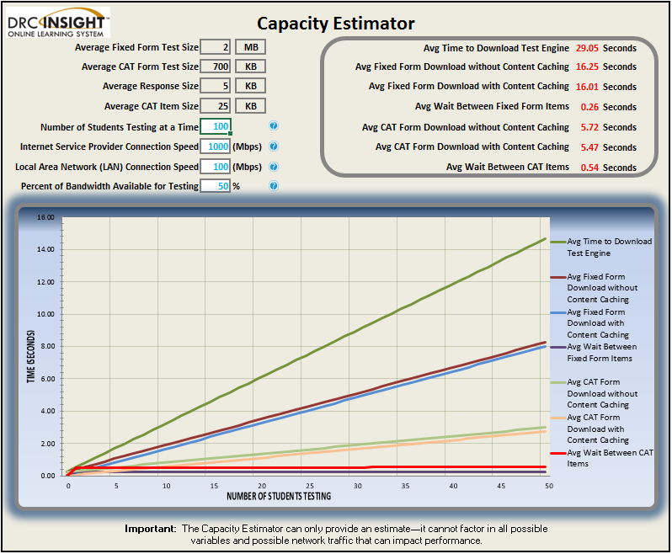
Milestones Capacity Estimator
Helps test sites plan for testing by factoring in the site’s unique network variables and showing how they can impact performance
Enhancement planned for Fall 2018 to add TTS and VSL

Slide 39
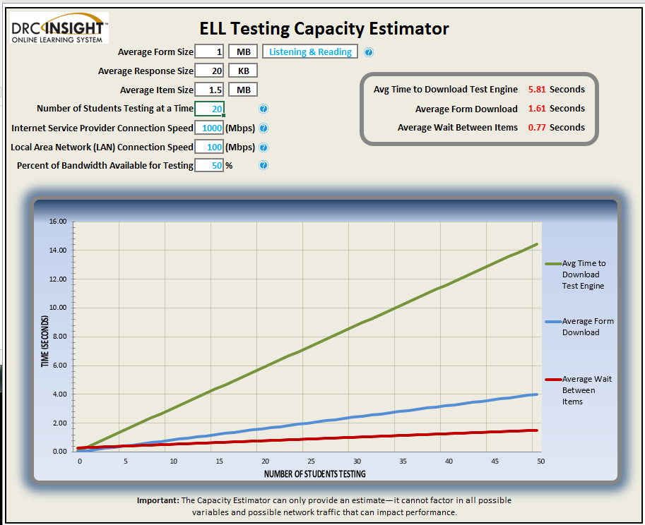
ELL Capacity Estimator
Gives specific data by domain.

Slide 40
Central Office Services (COS) Georgia Milestones Assessments ACCESS for ELLS 2.0

Slide 41
Benefits of COS Service Devices
Creating separate features, referred to as Content Management and Content Hosting, allows for additional flexibility.
Download only the content appropriate for a specific testing site.
Download content once for use by multiple COS Service Devices.
More testing devices supported per service device without manipulating settings on machine
500 testing devices per TSM
900+ testing devices per COS Service Device
All configuration and management of COS Service Devices completed in the COS-DTK page in eDIRECT
Ability to manage multiple testing programs on a single device.
Can support Georgia Milestones and WIDA ACCESS on the same device
Supports silent installations.

Slide 42
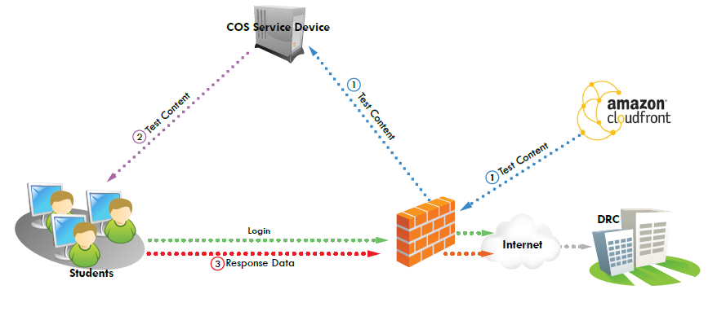
Keeping Students Connected
Enhanced Retries

Slide 43
Accessing the COS Dashboard
Tech Directors can use the dashboard to monitor district-wide testing from one location.
Also accessible to the System Testing Coordinator
Next training for COS installation and setup is September 25 and 27
Milestones and WIDA content can be managed from one location
Separates content management and content hosting

Slide 44
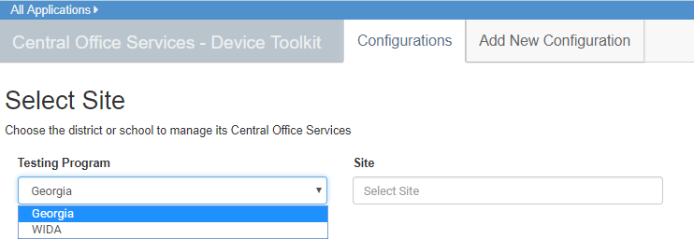
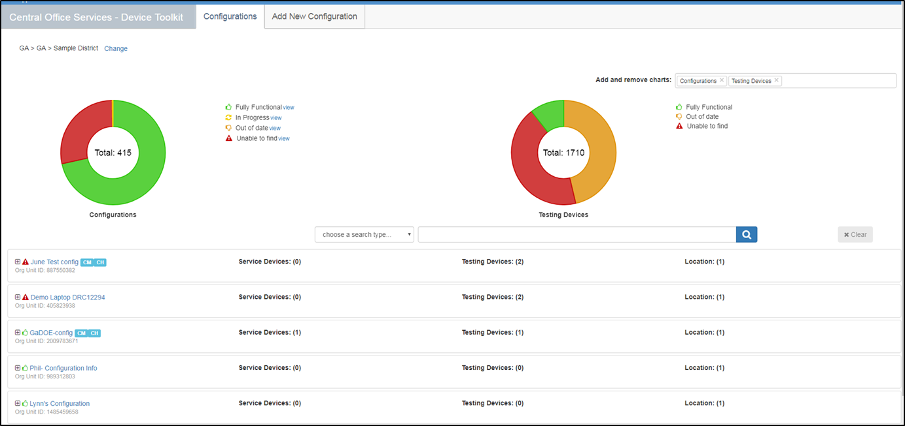
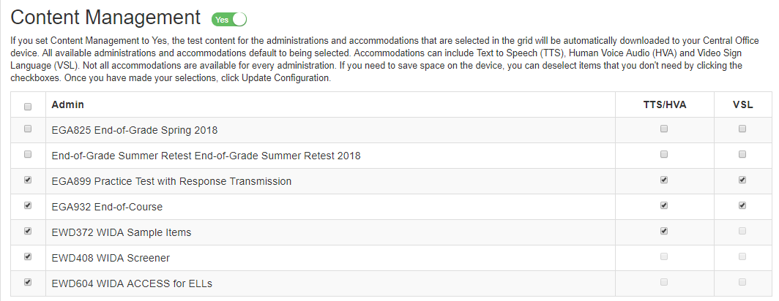
COS-DTK Dashboard
WIDA and Milestones content accessible through one login
Setup, monitor, and configure all COS devices from one dashboard
Manage WIDA and Milestones content for each COS device in one location

Slide 45
Accessing the Student Status Dashboard
Available to System and School Testing Coordinators if permissions are assigned
Recommend that Technology Coordinator have access to facilitate troubleshooting
Student Status tab also lists student Not Started, In Progress, and Completed; available for export to Excel or PDF

Slide 46
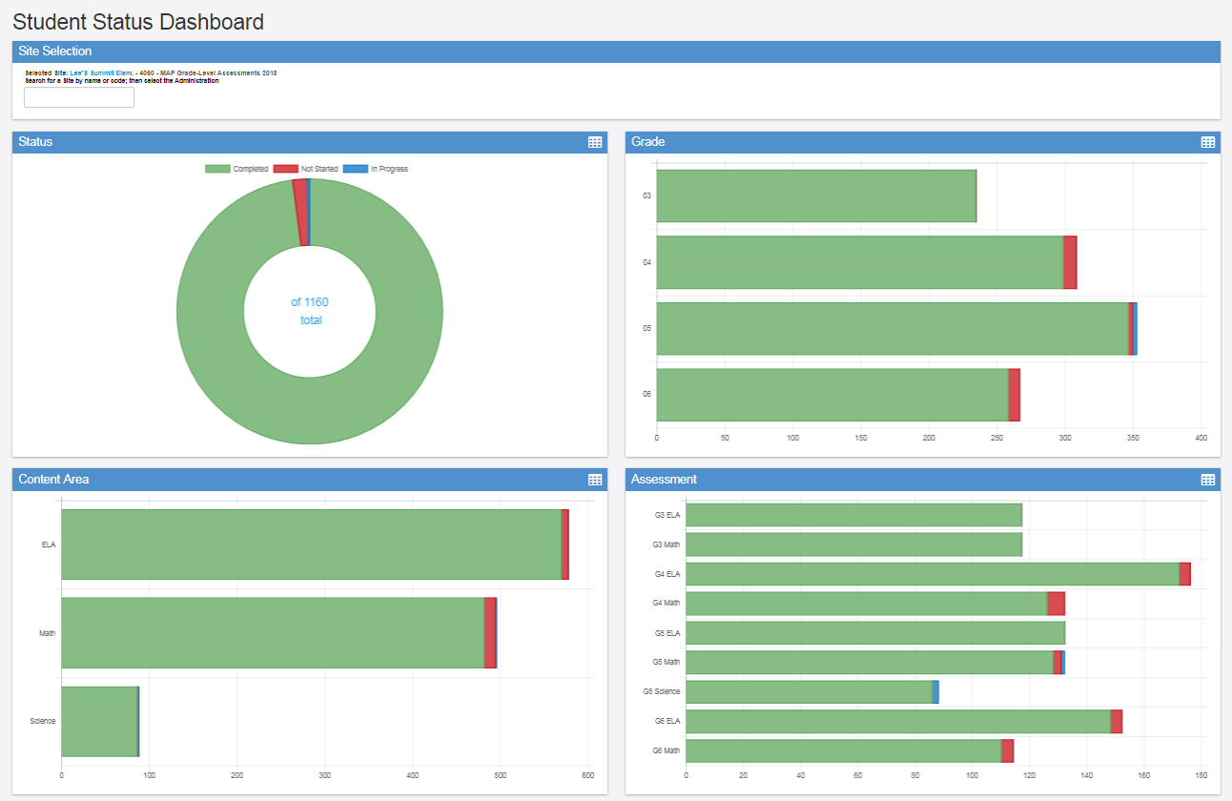
Student Status Dashboard
Detail by test session
46

Slide 47
Test Engine Update Fixes top reason for call to Customer Service
Georgia’s Top 10 Customer Service Tickets Spring 2018
Category/Subcategory | # of Tickets | Examples
Test Management > Active Flag | 1024 | Clearing active flag
Test Management > Test Progress | 358 | Has a student completed their test, where a student is in their test, telemetry requests, questions about certain test items/ screens.
Test Management > Unlock | 261 | Student's tests needing to be unlocked
Test Management > Invalid Username/Password | 164 | Questions regarding a student's username/password, where to login
Test Administration/Policy > Refer to Client/Vendor | 128 | State-related requests, students started w/o proper accommodation
Reporting > Test Results/Scoring - Viewing | 125 | Showing reports, see student scores on ISRs, when do student scores come out
Regeneration | 116 | Situations that would require a student's test to be regenerated > student exited after only doing practice question(s)
DRC Setup/Connectivity > TSM Setup | 112 | Downloading, installing, configuring, deploying, TSM
Test Management > Test Session Management | 109 | creating test sessions, deleting test sessions, editing test sessions, adding/removing students from test sessions
Client Setup/Connectivity > Hardware/Firewall | 107 | Whitelisting, turning off firewall, creating exception on firewall, DNS work
Total of Top 10 | 2504

Slide 48
Benefits of Enhanced Retries Instead of Response Caching
Many testing disruptions are caused by short breaks in wireless access.
Enhanced retries will allow the student to complete testing without interruption.
Problems with network connections within a building will also cause a break in the connection with the TSM.
Active Flags occur when students lose connection with the TSM and districts have to call DRC to resolve and slows testing for the student.
If the TSM loses connection with the network responses need to be manually sent from the TSM.
Response caching is not recommended due to Enhanced Retries.
Enhanced Retries will be available following the September Mid-Month.

Slide 49
Administration with Students

Slide 50
Best Practices for Students
Device Familiarity – Ensure students are familiar with the operation of the device they will use during testing.
Mouse
Keyboard
Touchpad
Online Administration Familiarity – Ensure students are familiar with the tools they will use during the online testing assessment.
Ensure that students have practiced with testing devices before testing.

Slide 51
DRC INSIGHT Navigation Georgia Milestones Assessments ACCESS for ELLs 2.0

Slide 52
ACCESS for ELLs 2.0 Online Test Practice
Log into the WIDA Portal
https://wbte.drcedirect.com/WIDA/portals/wida

Slide 53
ACCESS for ELLS 2.0 Online Listening Domain

Slide 54
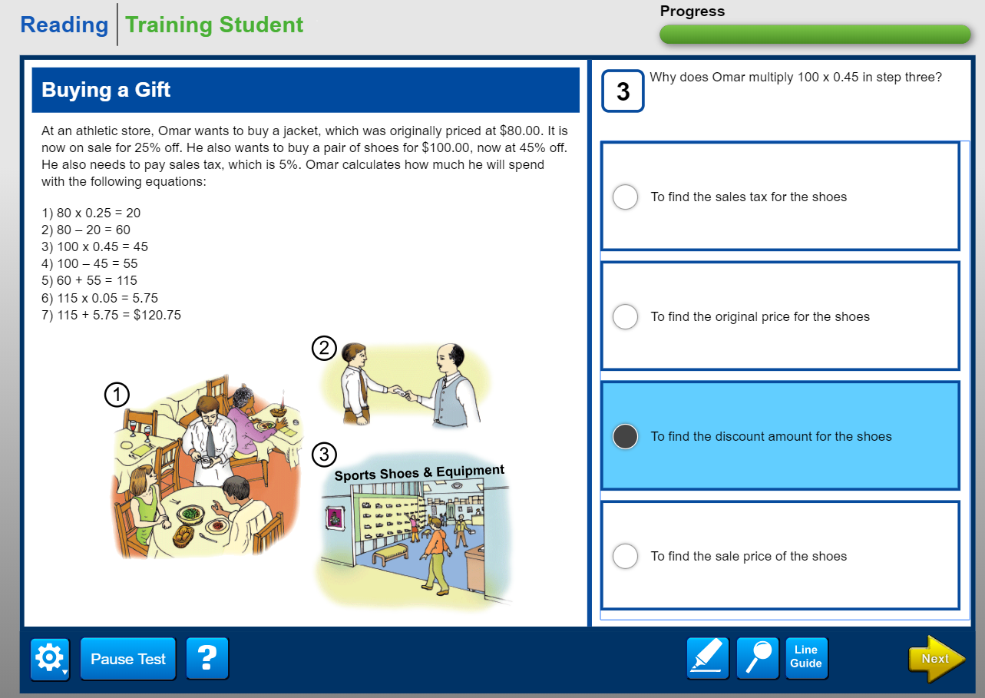
ACCESS for ELLs 2.0 Online Reading Domain

Slide 55
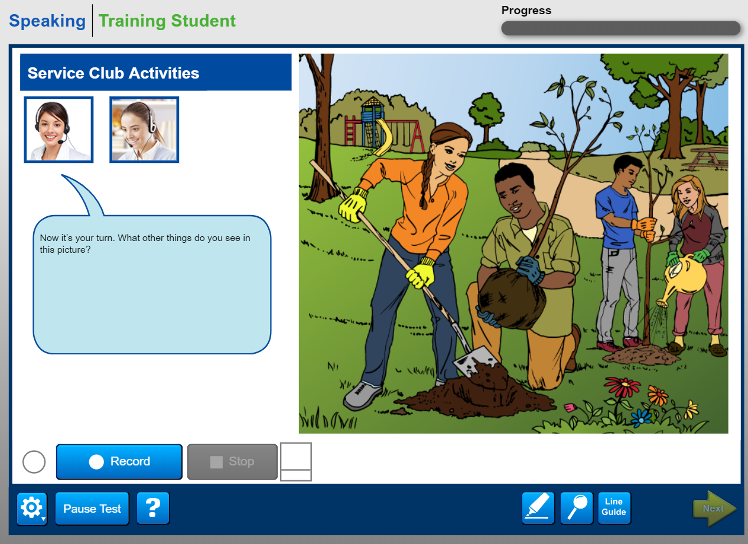
ACCESS for ELLS 2.0 Online Speaking Domain

Slide 56
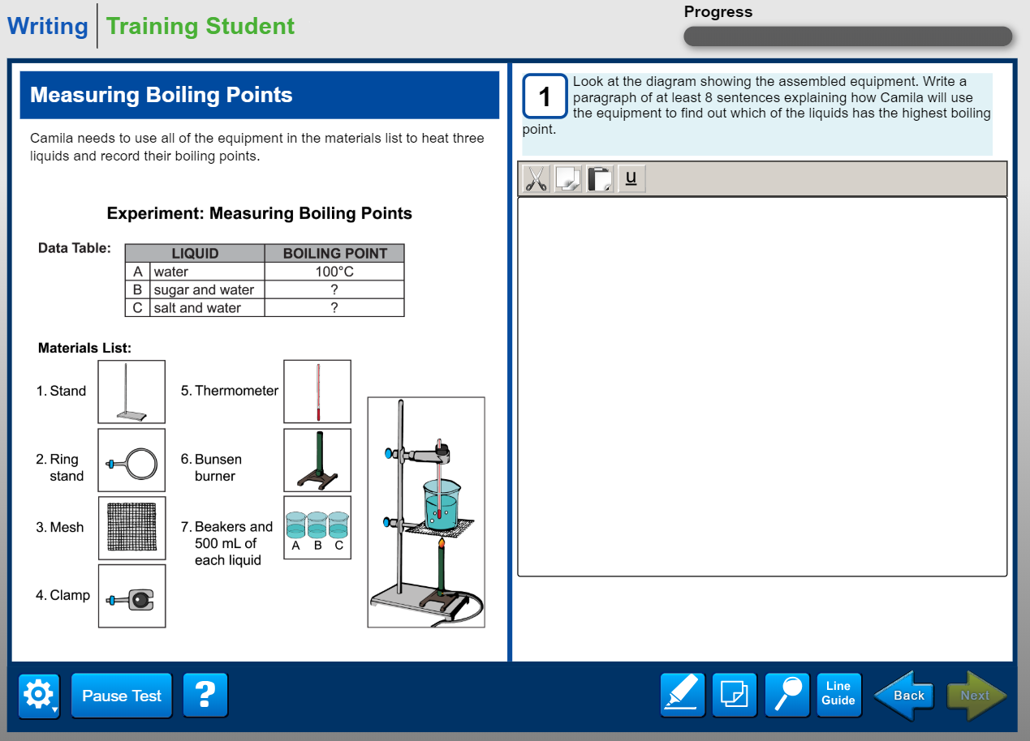
ACCESS for ELLs 2.0 Online Writing Domain

Slide 57
Experience Online Testing Georgia
http://www.gaexperienceonline.com/

Slide 58
Georgia Milestones Assessments - Toolbar
Cross-Off
Sticky Note
Line Guide
Graphing Tool
Periodic Table
Pointer
Highlighter
Magnifier
Calculator
References
Use the online tools to assist you during the test.
You can use more than one tool at a time.
To close a tool, use your mouse and click on the tool again.

Slide 59
Georgia Milestones Assessments - Tools
 | Pointer: Use the pointer tool to choose an answer.
 | Cross-Off: Use the cross-off tool to mark answers that you believe are NOT correct.
 | Highlighter: Use the highlighter tool to highlight important information within a test question.
 | Sticky Note: Use the sticky note to take notes within a test question.
 | Magnifier: Use the magnifier tool to enlarge the information on the screen.
 | Line Guide: Use the line guide tool to help you track a single line of text as you are reading.

Slide 60
Georgia Milestones Assessments - Tools
 | Calculators: The basic calculator has the ability to perform the four arithmetic functions: addition, subtraction, multiplication, and division. The Scientific Calculator is a comprehensive calculator with the ability to perform square root, exponential, logarithmic, trigonometric, and factorial functions, as well as the four arithmetic functions. Not available for all items.
 | Graphing Tool: The Graphing Tool is designed to graph functions when solved for the “Y” variable and has the ability to give corresponding “Y” values for given “X” values.
 | References: Use the references tool to view reference materials like a formula sheet or a periodic table. These may help you answer test questions.
 | Periodic Table: You may find the Periodic Table helpful in answering test questions. You can view more detail about an element by clicking on the element’s box. The box will open a new window, and can be moved around to different parts of the screen by clicking on the box and dragging it to a new location.

Slide 61
Navigating Pages for Reading Passages
The page turners are not identified within the online system. Please instruct your students on this feature.
Total pages
Current page
Click the left-bottom corner to navigate to the prior page (if available).
Click the right-bottom corner to navigate to the next page (if available).

Slide 62
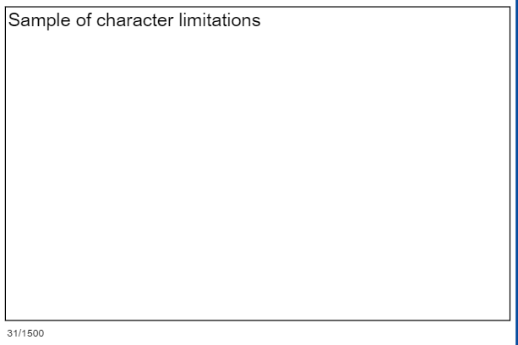
Constructed Response Character Limitations
Available response area
Current character count
Total characters available

Slide 63
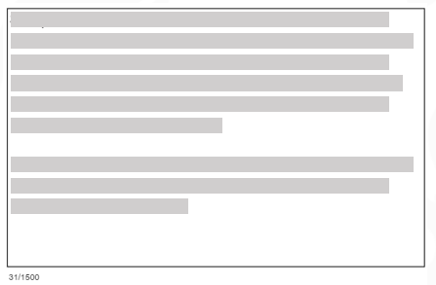
Constructed Response Mistakenly Deleting Responses (Reading/Math)
Student’s Response
Responses Deleted (By Mistake)
Press Ctrl+Z (or Command+Z on a Mac) to revert back to recently-deleted text.

Slide 64
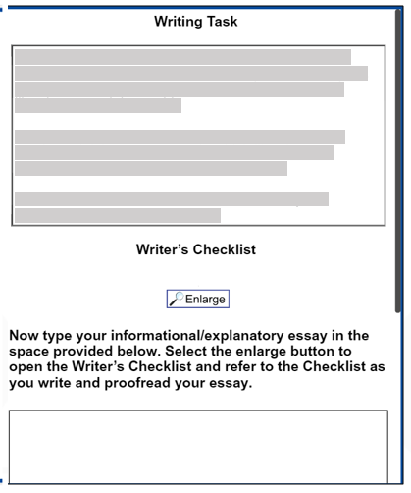
Writing Task
Directions
Writer’s Checklist
Informational/ Explanatory Essay
Passage Section
Vertical Scrollbar

Slide 65
Equation Builder (Math)
Current character count
Total characters available

Slide 66
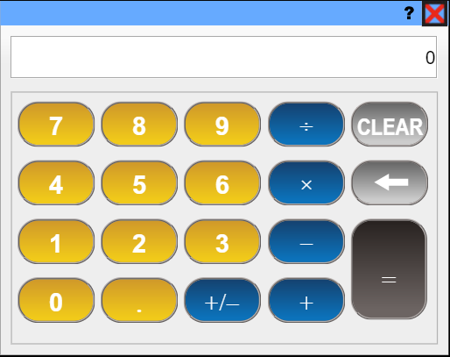
Basic Calculator

Slide 67
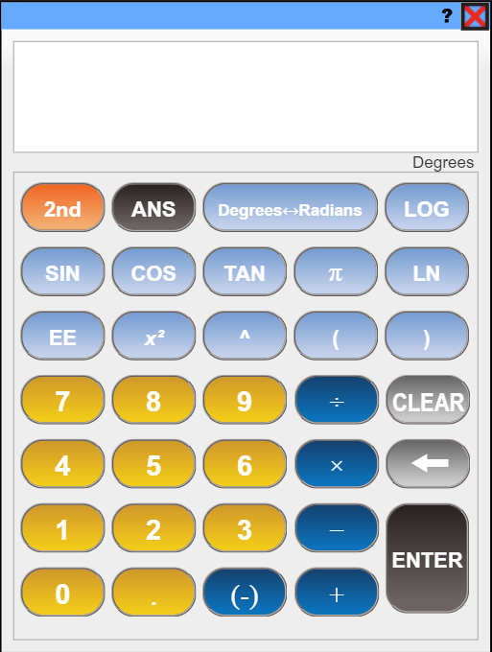
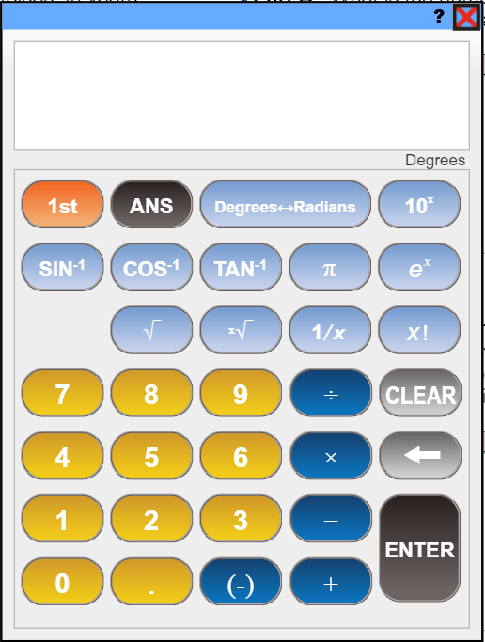
Scientific Calculator
Click to switch calculator views

Slide 68
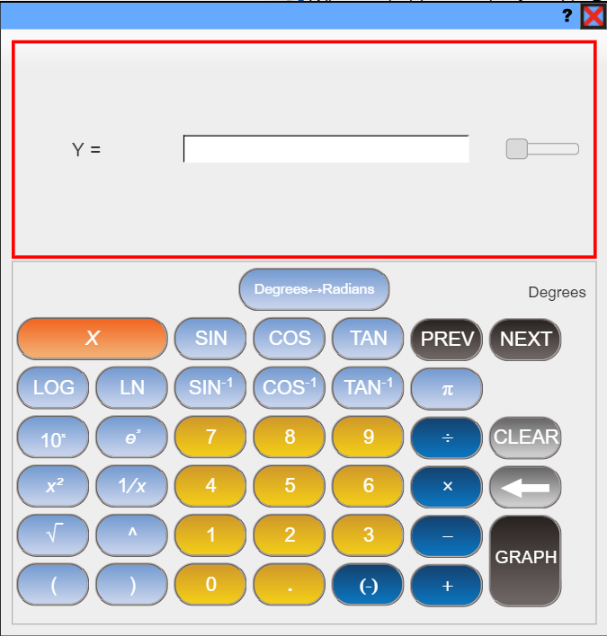
Graphing Tool

Slide 69
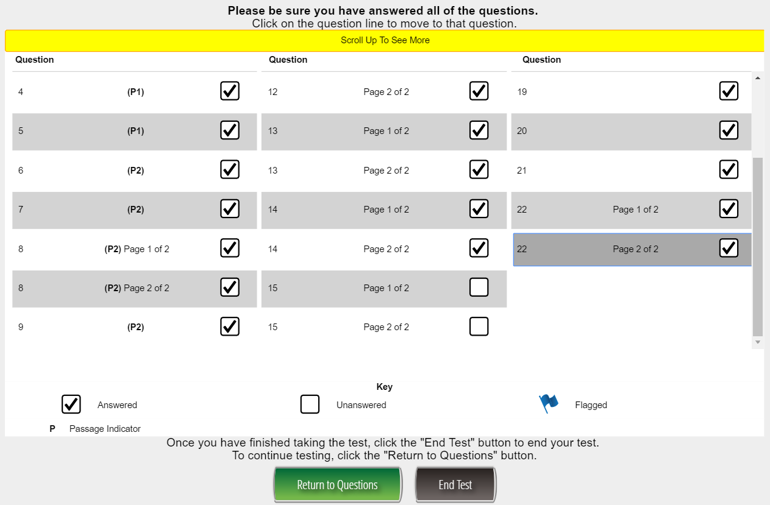
Exiting a Test Session Properly
At the completion of a test session, select
Ensure all questions have been answered.
Answered Question
Unanswered Question
Flagged Question

Slide 70
Exiting a Test Session Properly
If you have any unanswered questions, select and answer the remaining questions.
Once all questions have been answered, select to properly end the test session.

Slide 71
Georgia Milestones Assessments – Online Test Practice
Secure Practice Test
Tickets found in pdf format in General Information of eDIRECT
Practice Test with Response Transmission
Students scheduled and tests printed through Test Administration of eDIRECT
Experience Online Testing Georgia
No tickets needed
Test taken through INSIGHT platform
Available year-round
Test taken through INSIGHT platform
Responses are sent through TSM
Available 8/6/18 – 5/31/19
Test taken online at www.gaexperienceonline.com
Students, parents and teachers can all access this website
Sample of Section One ELA is presented
Available year-round from anywhere on the web

Slide 72
Assessment Administration Contact Information Toll-Free (800) 634-4106 and (404) 656-2668
Sandy Greene, Ed.D., Director of Assessment Administration
404-656-0478; sgreene@doe.k12.ga.us
Taiesha Adams, Ed.D., Assessment Specialist, Georgia Milestones
404-656-5975; taadams@doe.k12.ga.us
Bobbie Bable, Assessment Specialist, National Assessment of Educational Progress (NAEP), Georgia Kindergarten Inventory of Developing Skills (GKIDS), Assessment Literacy Resources
404-657-6168; bbable@doe.k12.ga.us
Joe Blessing, Assessment Specialist, Georgia Milestones, Georgia Online Formative Assessment Resource (GOFAR)
404-232-1208; jblessing@doe.k12.ga.us
Kelli Harris-Wright, Assessment Specialist, Formative Instructional Practices (FIP)
404-463-5047; kharris-wright@doe.k12.ga.us
Robert McLeod, Ed.D., Assessment Specialist, Georgia Milestones
404-656-2589; rmcleod@doe.k12.ga.us
Mary Nesbit-McBride, Ph.D., Assessment Specialist, ACCESS for ELLs 2.0, Georgia Alternate Assessment (GAA)
404-232-1207; mnesbit@doe.k12.ga.us
Missy Shealy, Project Manager, Georgia Milestones
404-657-7651; mshealy@doe.k12.ga.us
http://testing.gadoe.org

Slide 73
Questions

