Slide 1
Fall Assessment Conference – Part 3 Accessibility
Supports for Assessment
Georgia Student Assessment Program 2018–2019

Slide 2
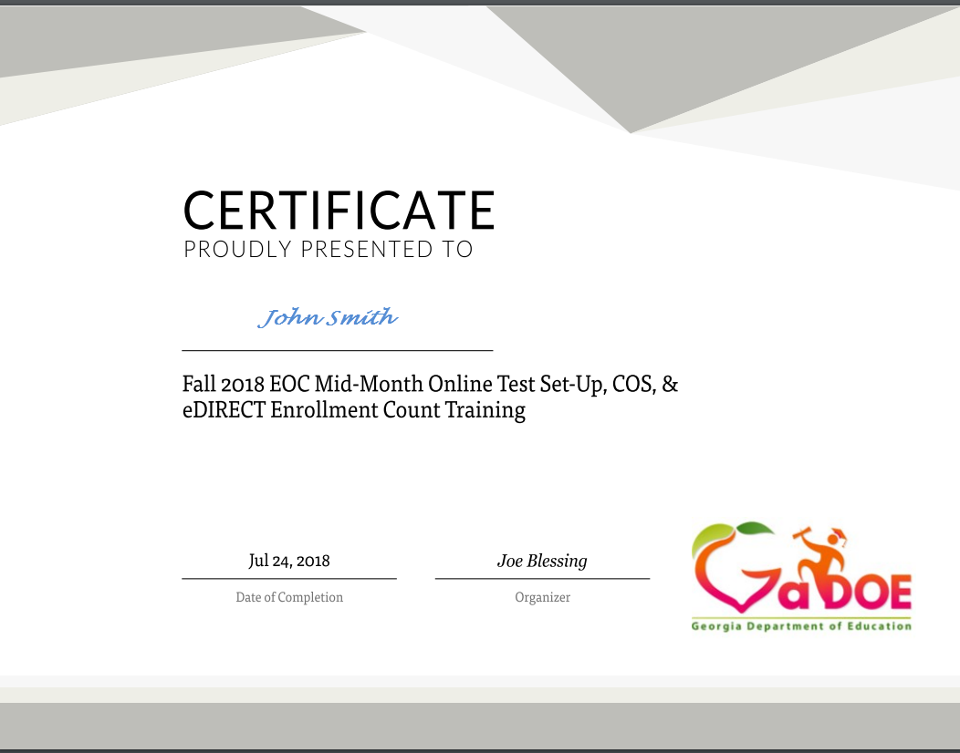
Webinar
All webinar recordings are available the day after the presentation. Click on the original registration link for any Assessment webinar to access the recording.
September 11: https://attendee.gotowebinar.com/register/2101040668267229954
September 13: https://attendee.gotowebinar.com/register/6814984566612689154
This presentation file can be found at http://testing.gadoe.org
Certificates are now sent from GoToWebinar after live training sessions. Those watching recordings will not receive a certificate.

Slide 3
Agenda
Overview
Test Development
Test Administration Procedures
Universal Tools
Accommodations
Resources
Questions

Slide 4
Overview
Georgia’s testing program, curriculum standards, and current technology allow the ability to
provide greater supports to all students;
General Education
English Learners
Students with Disabilities
Students with 504 Plans
review existing accessibility policies; and
highlight the decision-making process that can be used by educational teams to select, administer, and evaluate various student supports.

Slide 5
Paradigm Shift
Accessibility is now considered for students who previously would have been ineligible for specific accessibility features and accommodations.
Universal tools
Test Administration Procedures
Accommodations

Slide 6
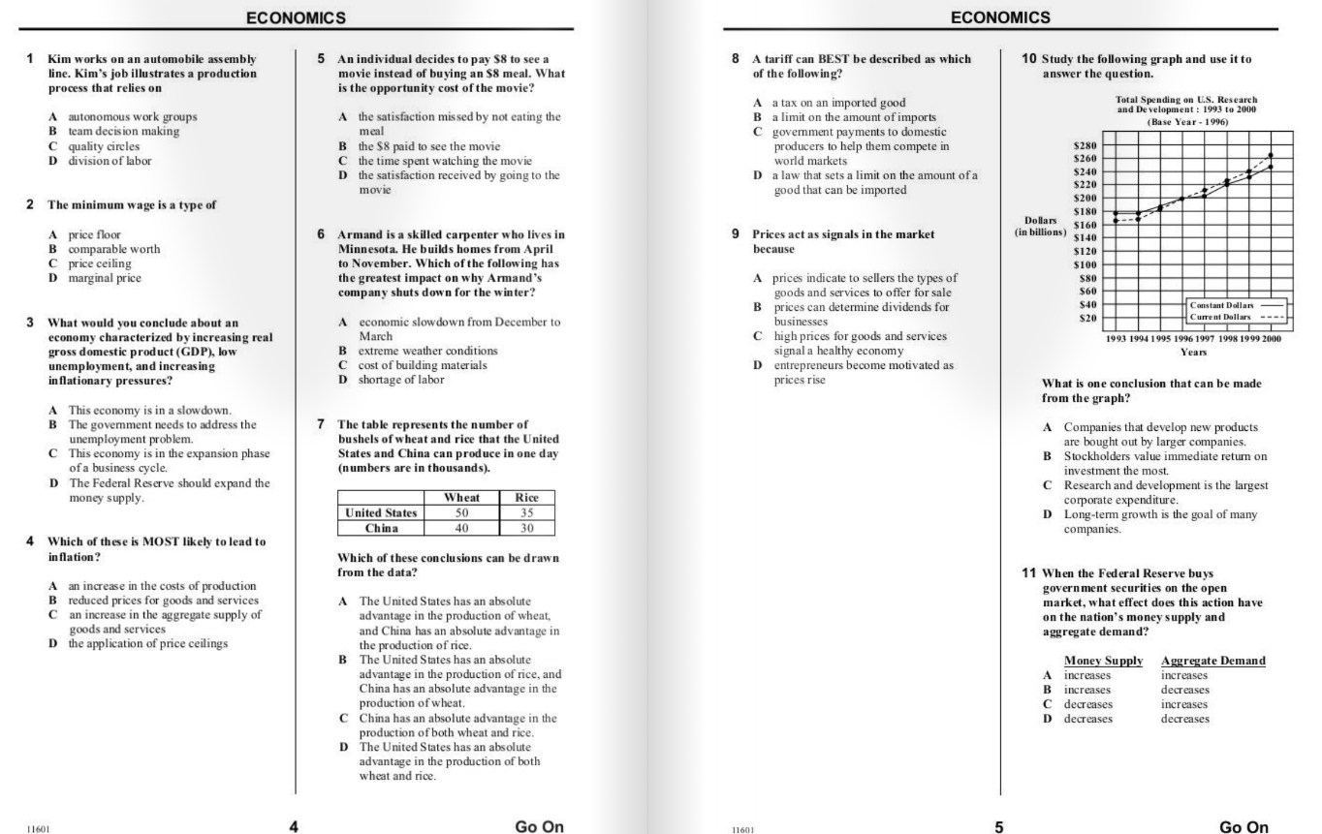
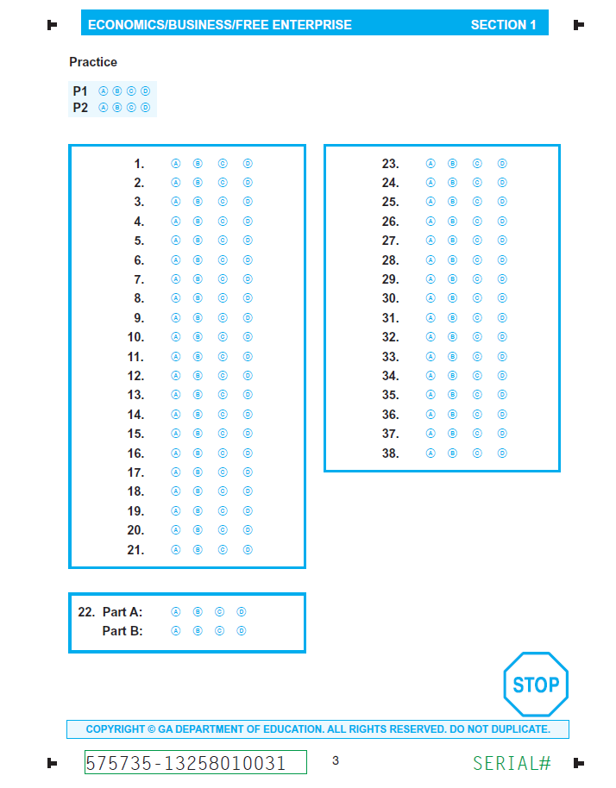
Paper Administration

Slide 7
Online Administration

Slide 8
Test Development

Slide 9
Checks for Accessibility
Clearly defined constructs
Item developers consider:
Testing modes
Accommodations
Online platform
Universal tools
Conduct field tests
Georgia teachers participate in content and bias reviews
Use principles of Universal Design

Slide 10
Universal Design
Element | Selected Steps
Inclusive Assessment Population | Test items are field tested with a wide range of students Designated accommodations are provided to students
Precisely Defined Constructs | Test constructs emanate for standards Teachers review items for alignment with standards and verify items are measuring the intended construct
Accessible, Nonbiased Items | Accessibility features are considered at the beginning of the item development process Statistical tests are used to ensure items are unbiased against subgroups of students Teachers review items for bias before items are used
Amenable to Accommodations | Presentation, Setting, Scheduling, and Response accommodations are available to eligible students
Simple, Clear, and Intuitive Instructions and Procedures | Teacher feedback was incorporated into the presentation of instructions and related test materials
Maximum Readability and Comprehensibility | Readability guidelines (e.g. sentence length and number of difficult words) are applied during item development
Maximum Legibility | All item elements are checked to ensure optimal location and spacing during form construction

Slide 11
Georgia Teachers
Participate in content and bias reviews
Over 100 Teachers representing
Every state region
Core content area
Ethnic Group
Teachers of special student populations
Verify appropriateness of test items
Review item performance data

Slide 12
Test Development
Standards
Item Writing
Item Reviews
Field Test
Operational Test
Reporting

Slide 13
Structure of Assessment
Variety of Item Types
Technology Enhanced Items
Allows for better discrimination between students with partial knowledge and students with no knowledge
Selected Response
Constructed Response
Extended Writing
GAA 2.0
NAEP
ACCESS for ELLS 2.0

Slide 14
Structure of GAA 2.0
Structure of GAA 2.0
Discrete tasks developed for each grade and content area.
Tasks written to three (3) levels of complexity, starting with the least complex part and increasing in complexity. Most students should be able to engage with and respond to at least one part of each task.
A scenario or passage is provided at the beginning of each task and serves as an introduction.

Slide 15
GAA 2.0 Features
Use of scenarios to engage student interest and activate background knowledge
Large simple graphics
Accessible font size
Short simple sentences
Avoids extraneous wording
Use of common proper nouns (names)
Directive questions

Slide 16
Three-Tiered Approach to Accessibility
Accommodations
Administration Procedures
Universal Tools

Slide 17
Support Types
Embedded Supports are delivered through the online platform.
Text-To-Speech
Line Guide
Non-Embedded Supports are independent of testing mode and provided by examiners.
Braille
Paper formula/reference sheet
Augmentative and Alternate Communication device

Slide 18
Administration Procedures

Slide 19
Administration Procedures
These procedures are allowed for all students provided that all testing and security requirements are met.
Care must be taken to ensure the use of these procedures does not lead to an irregularity.
Handheld Calculator
Printed Periodic Table
Printed Formula Sheets
Testing arrangement
Classroom vs lab setting
Decisions for test administration procedures must be made at the system-level.

Slide 20
Administration Procedures
Vary across assessments
Depend upon the constructs being assessed
Test design
Selected Supports
 | Milestones | ACCESS
Explain or paraphrase the directions | Accommodation | Test Administration Procedure
Human reader | Accommodation | Test Administration Procedure

Slide 21
Universal Tools

Slide 22
Universal Tools: Milestones
TOOL | ICON | CONTENT AREA
Periodic Table |  | Science
Reference/Formula Sheet |  | Math, Science
Highlighter |  | ALL
Sticky Note |  | ALL
Flag |  | ALL
Line Guide |  | ALL
Online Calculator |  | Mathematics; Science; Economics
Graphing Tool |  | Mathematics only
Cross-off Tool |  | ALL
Magnifier |  | ALL

Slide 23
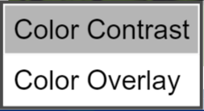
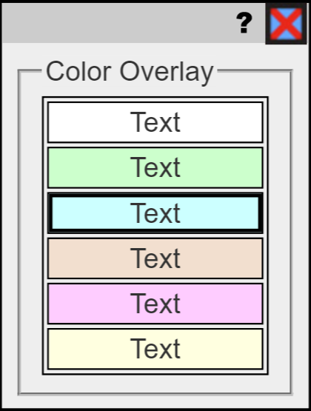
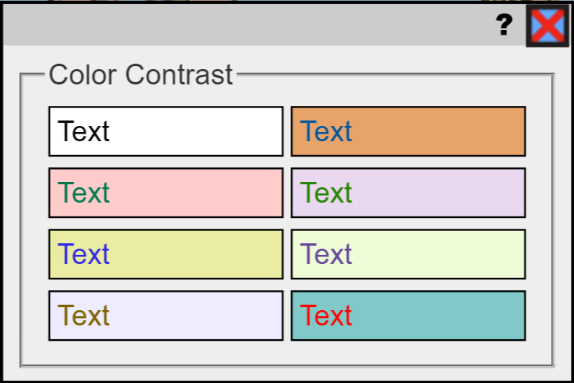
Universal Tools: ACCESS
Embedded in the computer-based test
Do not need to be designated in WIDA AMS – all students may use these.
Notes:
Here, continuing on page 13 of the participant packet, are the ACCESS for ELLs 2.0 universal tools available for online testing.
They are embedded in the computer-based test and can be used by all students. Some of these tools, such as color contrast settings, may be novel to students, and the students may want to experiment with them. Educators must ensure that students have opportunities to practice using the tools and help students determine when a tool may be appropriate and useful.
Making connections between learning strategies used during instruction and similar universal tools available on the assessment also may help students use them effectively. For example, while demonstrating the online assessment to students, talk about when they have used a highlighter during instructional activities, and demonstrate using it in the online test engine.
In the Test Demo video on WIDA AMS, to be viewed prior to testing, students will see how to use these tools and practice using them prior to test administration to see if they will be helpful.

Slide 24
Universal Tools: NAEP

Slide 25
Ensure Better Access
Tools designed to provide better access
Students should know how and when to use
Highlighter—mark key details and the main idea
Line Guide—track print top to bottom
Sticky Note—annotating text, recording thoughts questions
Cross off—eliminating choice, structure thoughts
Magnifier—enlarge information on the screen

Slide 26
Experience Online Testing Georgia
http://www.gaexperienceonline.com/

Slide 27
ACCESS for ELLs 2.0 Test Practice
Log into the WIDA Portal
https://wbte.drcedirect.com/WIDA/portals/wida

Slide 28
Ensure Better Access
Accessibility is tied to daily instruction
Teachers model in whole groups
Students exposure
Using classroom technology
Use media specialist/technology supports

Slide 29
Who will tools benefit?
Students with weaker organizational skills
Students who have challenges transferring and tracking information
Students have difficulty remembering information

Slide 30
Selected Georgia Standards
Grade 3 - ELAGSE3W6: With guidance and support from adults, use technology to produce and publish writing (using keyboarding skills) as well as to interact and collaborate with others
Grade 4 - ELAGSE4W6: With some guidance and support from adults, use technology, including the Internet, to produce and publish writing as well as to interact and collaborate with others; demonstrate sufficient command of keyboarding skills to type a minimum of one page in a single sitting
Grade 5 - ELAGSE5W6: With some guidance and support from adults, use technology, including the Internet, to produce and publish writing as well as to interact and collaborate with others; demonstrate sufficient command of keyboarding skills to type a minimum of two pages in a single sitting

Slide 31
Accommodations

Slide 32
Accommodations
Accommodations allow access…
they are practices and procedures in the areas of presentation, response, setting, and scheduling that provide equitable instructional and assessment access for students with disabilities
Accommodations reduce or eliminate the effects of a student’s disability or limited English proficiency
Accommodations do not provide an unfair advantage
Accommodations do not reduce or change learning expectations

Slide 33
Modifications
Modifications, on the other hand, involve:
Changing, lowering, or reducing learning or assessment expectations
May result in implications that could adversely affect a student throughout that individual’s educational career
Examples include
Requiring a student to learn less material
Revising assignments or tests to make them easier
Modifications are not allowed on Georgia assessments

Slide 34
Important Points
Allowable accommodations always grow out of the content and skills measured by the assessment and the purpose of the assessment
Teams and committees should consider the purpose and content of the assessment as well as the individual student’s need and circumstance when selecting accommodations
Inappropriate use of accommodations can (and does!) negatively impact student achievement

Slide 35
Accommodations
Accommodations provide access for demonstration of achievement
Allow participation
Do not guarantee proficiency
and therefore should not be selected solely as mean to help ensure proficiency
Must be required by the student in order to participate in the assessment
Must be provided during routine instruction and assessment in the classroom (both before and after the state tests are administered)

Slide 36
Accommodations
Some accommodations appropriate for instruction are not appropriate for assessments
It may be appropriate to use some instructional accommodations to provide access to grade level content, but these should be faded over time
The ultimate goal is always meaningful measurement of what the student has learned as a result of instruction

Slide 37
Accommodations
In Georgia accommodations MAY NOT
Alter, explain, simplify, paraphrase, or eliminate any test item, reading passage, writing prompt, or choice option
Provide verbal or other clues or suggestions that hint at or give away the correct response to the student
Only state-approved accommodations may be used on state-mandated assessments, following the guidance issued

Slide 38
Eligible Students
Students eligible for accommodations include:
Students with Disabilities
students with individualized educational plans
students served under Section 504*
English Learners
Students qualifying for language assistance services
EL students who are also SWD
Students who have exited language assistance services in the last two years (EL-Monitored)**
*Only in the rarest of circumstances would a 504 student qualify for a conditional accommodation
**ELL-M students are not eligible for conditional accommodations

Slide 39
Target Skills vs Access Skills
Target Skills: those skills and concepts the test is designed to measure
Access Skills: those needed by the student to demonstrate knowledge and application of the target skills
Accommodations do not alter target skills

Slide 40
Key Considerations
Different tests serve different purposes
Accommodations may be allowed for one test, but not for another…it has to do with the test’s purpose and what is it designed to measure
When considering an accommodation, consider the purpose of the test and what it is designed to measure

Slide 41
Key Considerations
It is important that we match the right student to the right tool
In making decisions we need to think about the student characteristics (disability/language proficiency) and how those characteristics interact with the specific content area
Decisions should be made individually and can differ by content area based on need

Slide 42
Key Considerations
For students with disabilities we should consider –
The characteristics of the disability or the combination of disabilities for the individual student
How the disability affects/impacts the learning of specific content
How the disability affects/impacts the demonstration of learning

Slide 43
Key Considerations
For English Learners we should consider –
The student’s level of English proficiency
The student’s level of literacy in English
The student’s level of native language proficiency
The student’s level of literacy in native language

Slide 44
Key Considerations
For English Learners who also have a disability we should consider –
Whether the need is based on
The individual student’s disability or
Language acquisition needs or
Some combination of both
Examples of all EL students with the same accommodations would be reason for concern as accommodations are based on individual student need.
The IEP team should include an ESOL teacher to help make appropriate decisions – services should be coordinated

Slide 45
Key Considerations
For all students we should consider –
The student’s need for the accommodation
The student’s experience with the accommodation
The accommodation was of benefit to the student
The student’s feelings and beliefs about the accommodation

Slide 46
Standard Accommodations
Accommodations which provide access to students to demonstrate their achievement of target skills
Standard accommodations do not alter or encroach on the construct measured
As with any accommodation, it is important that the student require the accommodation and use it regularly during routine instruction and assessment

Slide 47
Conditional Accommodations
More expansive accommodations that provide access for students with more severe disabilities who would not be able to access the assessment to demonstrate their achievement without such support
Should be used sparingly, per State Board Rule
Must be considered when interpreting scores

Slide 48
Conditional Accommodations
Guidance on the appropriate use of conditional accommodations is provided in the Student Assessment Handbook
Only students meeting the guidance criteria are eligible for conditional accommodations
The educational plans for students qualifying for conditional accommodations must include specific goals that address the deficits which necessitate the accommodation

Slide 49
Conditional Accommodations
Three accommodations are considered conditional for the Georgia Milestones Assessment:
Signing ELA passages (SWD only)
Oral reading of ELA passages (grades 3 – 12)
Use of a basic function calculator (SWD only) for students in grades 3-5
No student in grades 6-12 can use a calculator on the no-calculator subsection of test
Most students are expected to participate in standard administrations, with less than 3% receiving a conditional administration (State Board Rule 160-3-1.07)

Slide 50
Why must we attend to the guidance for conditional accommodations?
These accommodations were never intended to be available for all students
The guidance is designed to protect the accommodations for students who truly require them

Slide 51
Why must we attend to the guidance for conditional accommodations?
Anytime an accommodation is considered it is important to reflect what the test is designed to measure
The goal is meaningful (i.e., valid) measurement of student achievement
It is important to consider the long term effects of inappropriate accommodation use
Accommodations should foster independence, not dependence

Slide 52
Consider the Constructs
Each section of ELA tests has items that are designed to measure reading comprehension
Inherent in the state curriculum in the elementary and middle grades are reading strategies and skills
Each test has a range of passages on it
The Georgia Milestones mathematics tests in grades 3-5 are designed to measure computational skill and mathematical understanding
Inherent in the state curriculum in the elementary and middle grades are mathematics procedures and processes

Slide 53
Key Consideration
Conditional accommodations provide additional access to the test for certain students
students must still interact with text and numbers (basic calculator only for students in grades 3-5)
in this way, the accommodation facilitates the students’ access and is not a substitute for the skills measured

Slide 54
Oral Reading of ELA Passages: SWD
The use of this conditional accommodation for the English Language Arts Georgia Milestones, regardless of grade level, must be restricted to only those students with IEPs who meet the ALL eligibility criteria outlined below:
The student has a specific documented disability that severely limits or prevents his or her ability to decode text at any level of difficulty, even after varied and repeated attempts to teach the student to do so (i.e., the student is a non-reader, not simply reading below grade level); and
The student has access to printed materials only through a reader or electronic format during routine instruction; and
There are clear and specific goals within the student’s IEP addressing the deficits which necessitate the need for this conditional accommodation.

Slide 55
Signing of ELA Passages: SWD
The use of this conditional accommodation for the English Language Arts Georgia Milestones, regardless of grade level, must be restricted to only those students with IEPs who meet the ALL eligibility criteria outlined below:
1. The student is deaf and has a specific documented disability that severely limits or prevents his or her ability to decode text at any level of difficulty, even after varied and repeated attempts to teach the student to do so; and
2. The student has access to printed materials only through a sign-language interpreter or is provided with signed text or other electronic format during routine instruction; and
3. There are clear and specific goals within the student’s IEP addressing the deficits which necessitate the need for this conditional accommodation.

Slide 56
Oral Reading of ELA Passages: EL
The use of this conditional accommodation for the English Language Arts Georgia Milestones, regardless of grade level, must be restricted to only those EL students who meet ALL eligibility criteria outlined below:
1. The student’s English proficiency scores and performance in the classroom indicate that the student cannot access, retain, or comprehend text without the assistance of a reader (i.e., the student is unable to access English text due to their language proficiency, not simply reading below grade level); and
2. The student is not poised to exit language services within the current school year; and
3. There are clear and specific goals within the student’s educational plan addressing the deficits which necessitate the need for this conditional accommodation.

Slide 57
Why is reading of ELA passages restricted?
Students in the primary grades are learning to read
The curriculum standards in these grades include decoding and fluency – these things are completely compromised when the student does not read
High School students must demonstrate that they can read a range of text effectively to be college and career ready
It is imperative that we have a clean, accurate measure of student reading skill so that problems can be identified and appropriate services provided if needed

Slide 58
Reading of Test Questions
Many students who need accommodations are struggling readers (e.g. read below grade level)
Reading of the questions reducing the reading load and allows the student to focus on the passages
Given that we are not attempting to measure reading comprehension on other content area tests (Mathematics, Science, Social Studies), it is permissible to read any prompts that accompany the items
This should only be done when appropriate

Slide 59
Use of a Basic Function Calculator (SWD only)
The use of this conditional accommodation for the Mathematics Georgia Milestones for students in grades 3 - 5 must be restricted to only those students with IEPs who meet ALL eligibility criteria outlined below:
1. The student has a specific disability that prohibits him or her from performing basic calculations (i.e., addition, subtraction, multiplication, and division), even after varied and repeated attempts to teach the student to do so; and
2. The student is unable to perform calculations without the use of a calculation device, which the student uses for routine classroom instruction; and
3. There are clear and specific goals within the student’s IEP addressing the deficits which necessitate the need for this conditional accommodation.
Only a basic function calculator or function adapted calculator may be used; scientific calculators are not allowed

Slide 60
Resources

Slide 62
Special Accommodations Requests
In RARE circumstances a student with a disability may need an accommodation that is not on the approved list
Follow the procedures in the Student Assessment Handbook to submit a request for consideration
Such requests should be vetted locally first and should be requested only on an individual basis
We cannot approve any request which modifies test content
We cannot approve requests for “classes” of students

Slide 63
Resources
The following resources are available at:
http://www.gadoe.org/Curriculum-Instruction-and-Assessment/Assessment/Pages/Information-For-Educators.aspx
Student Assessment Handbook
Accommodations Manual for SWD
ACCESS for ELs Accessibility and Accommodations Guidelines
Georgia Alternate Assessment 2.0 Eligibility Criteria
http://www.gadoe.org/Curriculum-Instruction-and-Assessment/Assessment/Documents/GAA_2/Eligibility_Criteria_GAA.pdf
Georgia Instructional Materials Center
http://www.gadoe.org/Curriculum-Instruction-and-Assessment/Special-Education-Services/GIMC/Pages/default.aspx

Slide 64
Questions

Slide 65
Contact Information:
Sandy Greene, Ed.D.
Director of Assessment Administration
Assessment & Accountability
404.656.0478
sgreene@doe.k12.ga.us
Mary Nesbit-McBride, Ph.D.
Assessment Specialist
Assessment & Accountability
404.232.1207
mnesbit@doe.k12.ga.us
Taiesha Adams, Ed.D.
Assessment Specialist, Georgia Milestones
Assessment & Accountability
404.656.5975
taadams@doe.k12.ga.us
Crystal Callaway
Education Program Specialist
Special Education Services and Supports
404.657.9969
CCallaway@doe.k12.ga.us
Jacqueline Ellis, Ed.D.
Title III
ESOL Specialist
404.463.1858
jellis@doe.k12.ga.us

