Slide 1

Georgia Milestones Assessment System
DRC INSIGHT Installation/ eDIRECT Training

Slide 2
Introductions
GaDOE
  Sandy Greene, Ed.D., Director, Assessment
  Joe Blessing, Assessment Specialist
  Mary Nesbit-McBride, Ph.D., Assessment Specialist
  Robert McLeod, Ed.D., Assessment Specialist
  Chris Shealy, Director, Technology Services
DRC
  Anu Tummala, Program Management
  Michelle Gronemeyer, Program Management
  Evan Gedlinske, Program Management
  Stuart Bowlus, Program Management
  Missy Shealy, Program Management
  Phil Peterson, Customer Care

Slide 3
Agenda
Key Dates
Reading and Evidence-Based Writing Field Test
What’s New?
System Overview
  INSIGHT Installation and Configuration
  Testing Site Manager (TSM)
  Central Office Services - Device Toolkit (COS-DTK)
  Secure Browser

Slide 4
Key Dates
Testing Windows
EOC Fall Mid-Month | October 10 - 20 November 6 - 17
EOC Winter Main | November 27 - January 5 Test Setup Opens: October 31
REBW Field Test Administration | October 16 - November 3 Test Setup Opens: September 25
Secure Practice Test with Response Transmission | October 2 – April 9 Test Setup Opens: September 28
Training
INSIGHT Installation/eDIRECT Training for Georgia Milestones | September 26 https://attendee.gotowebinar.com/register/5192761804692350722 September 28 (Live Repeat) https://attendee.gotowebinar.com/register/3494898148103945474
End-of-Course (EOC) Winter Pre-administration Webinars | October 18 10:00 am https://attendee.gotowebinar.com/register/4894000306171251713 October 20 1:00 pm (Live Repeat) https://attendee.gotowebinar.com/register/5392742079065363457
Winter 2017 EOC Main/Spring 2018 Mid-Month eDIRECT Test Setup Training Webinars | October 25 9:00 am https://attendee.gotowebinar.com/register/4553776224163905026 October 27 1:00 pm (Live Repeat https://attendee.gotowebinar.com/register/5437088681547091714

Slide 5
Reading and Evidence-Based Writing Field Test
Dates shared in the Key Dates slide
Guidance for installable in this presentation is valid for the Field Test and Secure Practice Test with Response Transmission.
No additional Test Setup webinar is scheduled for the Field Test; if detailed guidance is needed utilize these resources
  eDIRECT User Guide located in eDIRECT under General Information>Documents>Manuals
  Spring 2017 eDIRECT Test Setup Training at https://attendee.gotowebinar.com/register/1141721158868018180 (registration link will access recording)
  Reading and Evidence Based Writing Field Test Pre-Admin Webinar at https://attendee.gotowebinar.com/recording/viewRecording/7827387379659690754/1166094039423390721/jreyes@doe.k12.ga.us

Slide 6
Reading and Evidence-Based Writing Field Test
Secure Practice Test with Response Transmission will be available if a district or school wishes to test network readiness prior to the administration (check Key Dates).
Important: if you work with the Upload Multiple Students option, the file layout for the REBW FT is different. Please use the File Layout PDF and Sample CSV File located in eDIRECT under the Reading and Evidence-Based Writing Field Test Administration on the Student Management>Manage Students>Upload Multiple Students page.

Slide 7
Technology and Testing
Testing and Technology teams should work closely together
Review training dates and times
Review testing schedule, number of testers, amount of time testing
Plan for Secure Practice Test sessions (earlier window for REBW)
Verify that any new district technology works with INSIGHT
  Check Firewall Settings
  Check on changes with Device Toolkit
  Verify new hardware and software works with INSIGHT

Slide 8
    What’s New?
    INSIGHT Software – July
    COS-Device Toolkit - August
    Mega TSM

Slide 9
    System Overview

Slide 10
System Overview
eDIRECT
Portal for interacting with DRC
Documents and Reports
Test Sessions and Status
Software downloads
DRC INSIGHT
Test Engine
Secure Browser
Testing Site Manager
  Content and Response Caching
  Readiness Tools

Slide 11
eDIRECT
Web portal used for Georgia Milestones: https://ga.drcedirect.com
  Used by System Test Coordinators to grant access to System Technology Coordinators and other system/school personnel
  Used by System Test Coordinators to update student information and print test tickets via Test Setup
  Used by System Technology Coordinators to access INSIGHT software installation tools
    Device Toolkit (DTK) link (redirects to new COS-DTK user interface)
    Testing Site Manager (TSM) software
    DRC INSIGHT software packages
    Permissions needed:
      Online Testing – Secured Resources
      Test Setup – Device Toolkit

Slide 12
Getting Started –
The Basics

Slide 13
Network Requirements
All testing devices should have access to the Internet and DRC servers using HTTP/HTTPS protocols on ports 80 and 443
All firewalls should allow connectivity on ports 80 and 443
Whitelist the following file types, both internally and externally: enc, exe (for updates), gif, html, jar, jpeg, xml
Prioritize/whitelist INSIGHT traffic on: firewalls, internet packet shaper, routers, switches, proxies, other network devices
Whitelist these URLs on content filtering systems or other proxy/firewall software that is used locally:
  http://ga-insight-client.drcedirect.com
  https://ga-insight.drcedirect.com
  https://ga.drcedirect.com
  https://wbte.drcedirect.com
  https://dtk.drcedirect.com
  https://api-gateway.drcedirect.com
  https://api-gateway-cloud.drcedirect.com
  https://cdn-download-prod.drcedirect.com
  https://cdn-content-prod.drcedirect.com

Slide 14
System requirements
DRC provides updates of system requirements every 3-4 months
  Goal to provide guidance based on device/ operating system vendor support plans
Please note – If you experienced satisfactory performance from the hardware you used for online testing in 2016-2017, both for student devices and for your TSMs, you should experience the same performance, or better, this year using the updated DRC INSIGHT secure browser and TSM software – IF the device/operating system vendor still supports the device/operating system
Details of the System Requirements are located in eDIRECT
  https://ga.drcedirect.com
  General Information/Documents/
  Document Type of Manuals

Slide 15
Getting Started – The Basics
Think about how you will group your testing machines
Testing Site Manager
  Decide where and how you will deploy it
  Install it
Setup Configurations in the Central Office Services - Device Toolkit (COS-DTK) for each group
Install DRC INSIGHT
  One installation for Milestones (EOC and EOG) and WIDA ACCESS for ELLs

Slide 16
Grouping Machines

Slide 17
Groups of testing machines
Think about how you will group your testing machines
  Location
  Lab/Cart
  Device OS
  Grade
  Other
  Consider using an organized naming convention
  You will use this information later in the COS-DTK to set up configurations.

Slide 18
Testing Site Manager (TSM)

Slide 19
Testing Site Manager
Decide where and how you will deploy the Testing Site Manager (TSM)
What’s the TSM?
  Suite of tools installed locally to support testing
    Content caching
    Response caching
    Readiness tools

Slide 20
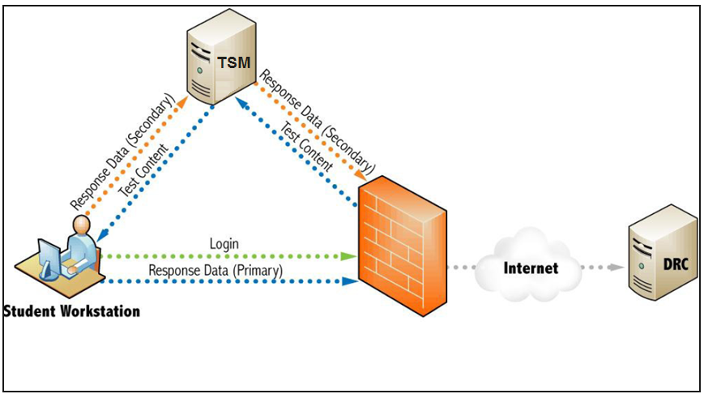
TSM diagram

Slide 21
TSM Caching
Content caching
  Allows test content to be downloaded prior to student testing
  Automatically updates whenever content is published (if TSM is running and connected to the Internet)
  Places content inside your network for quicker access during testing
    Content cached in an encrypted state
  Highly recommended whenever possible
  Mandatory for online audio (TTS)
    Need to check the TTS checkbox on the TSM for each admin

Slide 22
TSM Caching
Response caching
  Allows students to continue testing if Internet connection fails on test client
    Generally responses are sent to DRC upon navigation from item to item or every 45 second, whichever is soonest
    Response caching will store student responses temporarily
  DURING TESTING
    Monitor TSM for stored student responses
    TSM will attempt to transmit every 15 minutes but responses can also be manually transmitted
  AFTER TESTING
    At the end of each day and testing window, confirm there are no stored responses on the TSM

Slide 23
TSM – Response Caching
Benefits of Response Caching
  Response Caching allows students to continue testing if the student’s testing device loses connectivity to DRC, but still has connectivity to the Testing Site Manager (TSM). In this event, student responses are routed to the TSM until connectivity to DRC is restored.
  Sites with less reliable and available Internet connections benefit from having Response Caching in place.
Limitations of Response Caching
  Response Caching does not assist if there is a loss of local network connectivity between the student’s testing devices and the TSM - for example if the testing devices loses its wireless connection.
  Local network connectivity is where most testing sites experience issues

Slide 24
TSM diagram
If the wired or wireless connection is lost within the network, the TSM connection will also be lost and student will not be able to continue testing.
If the connection to the Internet is lost but connection to TSM is stable then response caching allows students to continue testing.

Slide 25
TSM – Response Caching
To ensure test integrity, all responses must be tracked during the test session. Response Caching adds a layer of complexity to this process. Once a test session is started with Response Caching enabled:
  A test session must remain associated with the same TSM until the test session is completed and each testing device is configured to a specific TSM, therefore, any testing device the student uses to resume the test must be associated with the same TSM on which the session was started.
  Resuming a test session after an interruption (whether planned or unplanned) requires additional steps, including ensuring all cached responses for the student’s test on the TSM are sent to DRC.

Slide 26
TSM – Response Caching
If a test session needs to be resumed on a different testing device/TSM combination:
  To address the risk of possible response loss, test administrators must verify all responses on the original TSM have been cleared and sent to DRC.
  DRC Customer Service assistance is needed to update the test session to allow it to continue on a different TSM.
Response Caching TSMs can not be load balanced requiring sites using load balancing Content Caching TSMs to configure separate Response Caching TSMs.

Slide 27
TSM – Response Caching
Recommendation: Use Response Caching only in sites where there is unreliable Wide Area Network (WAN) and/or Internet connectivity.
This recommendation is based on the following:
  Streamlines the student experience when re-entering a test session
  Test sessions can be resumed from any configured testing device
  Students can continue testing without requiring the clearing responses from TSM
  Removes dependency between test session and TSM
Response Caching addresses Internet connection loss
  Internet reliability and availability have greatly improved in recent years
  Over the last two testing years, for response types that can leverage response caching, less than .5% of them have benefited from response caching

Slide 28
TSM
Things to note:
  As a general guideline, one TSM should be deployed for every 150 simultaneous testers (on the 32-bit) and 500 simultaneous (on the 64-bit)
    Ultimately dependent on hardware, network speed, accommodations
  A given TSM can be used for both End-of-Course and End-of-Grade testing, but separate TSMs are required for the Georgia Milestones (EOC and EOG) and WIDA ACCESS for ELLs assessments.
  When running the TSM on a 64-bit Windows or Linux operating system, be sure to use the 64-bit versions of the TSM for maximum performance.
  A TSM can be used for content caching, response caching, or both.
  TSMs can be load balanced for content caching, but not for response caching.

Slide 29
TSM Scenarios
My TSM configuration was successful last year…
You should be able to keep the same configuration/equipment as long as your TSM and DRC INSIGHT software are up-to-date and you are using a supported operating system.
I'm testing fewer than 25 students concurrently…
The basic 32-bit configuration is suitable for a lab or two where you have smaller numbers of testers on the system at the same time.
I will be testing between 26 and 150 students concurrently…
You may find that your performance will be satisfactory using less than the 64-bit recommended setup, especially if testing fewer students concurrently or fewer students with online accommodations. The more students you test concurrently and/or the more students using online accommodations, the more you will see better performance by adhering to the 64-bit recommended setup.
I want to test more than 150 students concurrently…
You should plan to use the 64-bit version of the TSM on hardware at or near the recommended levels. Before testing, you should perform load simulation tests to verify your network and testing devices are performing well. Contact DRC Customer Service for more information on options for load balancing TSMs for content caching.

Slide 30
TSM Scenarios
I plan to load balance my TSM…
TSMs can be load balanced for content caching. For more information, contact DRC Customer Service.
I do not plan to use response caching…
Responses will be transmitted to DRC without a failover system on your local network. If a student experiences Internet connectivity issues, their testing session may be interrupted, requiring them to re-log in to their test session once the connectivity issue is resolved. No responses will be lost, but a student’s ability to complete the test session may be hampered.
I do not plan to use content caching…
Test content will be downloaded at the beginning of each student’s test session, which might cause a significant load on your Internet bandwidth. Consider staggering start times if possible. Students will not be able to test with the online audio accommodations.

Slide 31
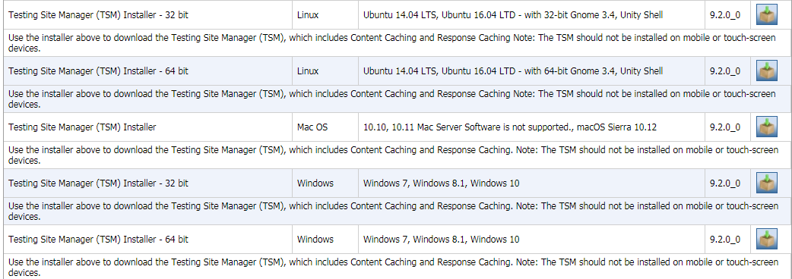
TSM Installation
From eDIRECT > General Information > Downloads tab

Slide 32
TSM Readiness Tools
  Load Simulation
    Verifies a good round trip connection between the testing device and DRC as well as estimates the time it takes to load a test and the time to submit/exit a test.
    Average load/submit times that exceed DRC’s recommendation may warrant further investigation.
  Ping Trends
    Pings DRC’s servers every 15 minutes.
    Periods when there is high latency may impact students’ testing experience and warrant further investigation.
  Details on these features can be found in the DRC INSIGHT Technology User Guide, Vol II

Slide 33
New: Mega Testing Site Manager (TSM)
The 64-bit version of the Testing Site Manager, installed on a device with additional computing resources, is able to be manually configured to support more that the standard 500 concurrent testers.
This reconfigured version is referred to as the Mega TSM. The number of concurrent testers that can be supported increases as the amount of computing resources allocated to the device increase.
These additional settings allow the machine to allocate more memory to the Java Virtual Machine (JVM).
Detailed instructions can be found on eDIRECT: https://ga.drcedirect.com/Documents/Unsecure/Doc.aspx?id=89f3d15f-fbff-4522-8c47-c668ed9474e8
Call the DRC HelpDesk if you have further questions
  Phone: (866) 282-2249
  Email: gahelpdesk@datarecognitioncorp.com

Slide 34
TSM Installation
Download TSM installers from eDIRECT
Installed on a computer within local network using an installation wizard
  Requires administrative rights
  Does not have to be a server-class machine
TSM computers should have static IP address
  Can be public or private (as long as in same range as testing devices)
Install TSM(s) and record TSM Server Domain and port numbers before setting up configurations in COS-DTK and before installing INSIGHT on student testing devices
  TSM Server Domain allows for a more resilient connection between test clients and TSM
    Replaces the use of IP addresses when naming a TSM in the Device Toolkit.
    Example: https://90673705-legacy-prod.drc-centraloffice.com:8443/
Software will update automatically if Enable Automatic Update (default) is checked during installation
    If a manual update is needed, access this link: http://localhost:8080/admin/manageTSM

Slide 35
TSM Installation, Options
Enable Content Caching
Enable Response Caching
Enable Automatic Updates (recommended)

Slide 36
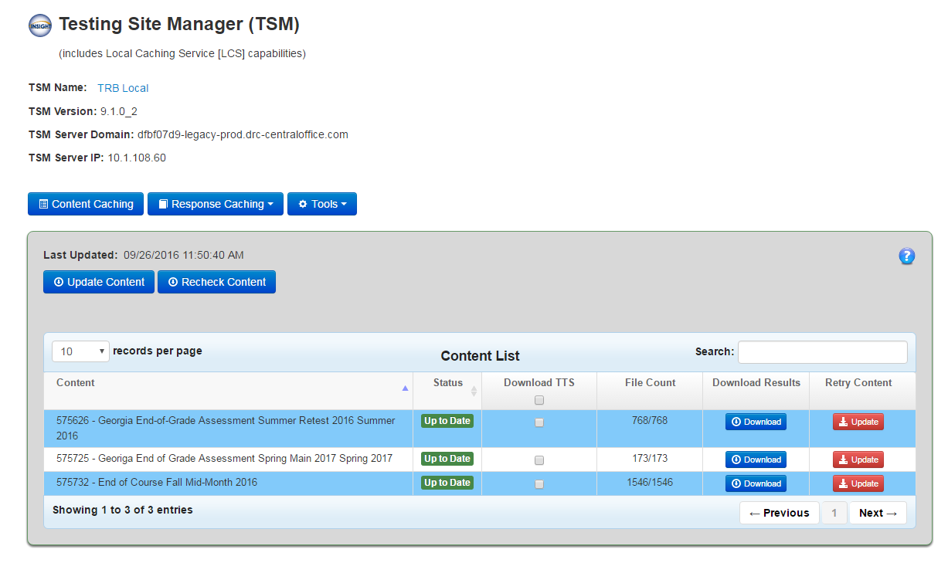
Accessing the TSM
Open using Shortcut or http//:localhost:8080 or http://ip address:8080
Be sure to check the TTS check box for each admin if you plan to use the TSM for online audio/read-aloud administration!

Slide 37
Central Office Services – Device Toolkit (COS-DTK)

Slide 38
Central Office Services - Device Toolkit (COS-DTK)
Setup configurations in the COS-DTK for each group
  Define configuration Unit per group of testing machines
  Define the TSM that will be used by that group (if applicable)
  Create Deployment Configuration Files (if applicable)

Slide 39
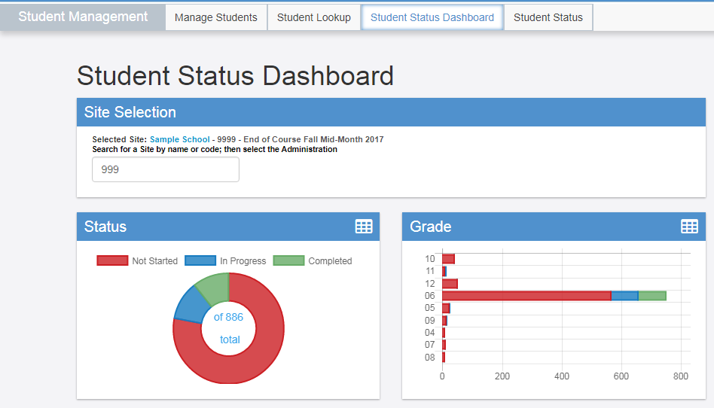
New eDIRECT Navigation Changes
Student Status Dashboard
  Moved under Student Management(August 30)

Slide 40
New: Central Office Services – Device Toolkit (COS-DTK) User Interface
Central Office Services – Device Toolkit (COS-DTK) User Interface
  The user interface allows for centralized management of the Testing Site Manager (TSM) devices
  A single configuration is now available for multiple testing programs (GA Milestones and WIDA ACCESS for ELLs)
  The configuration can be updated after it has been rolled out to the student devices
  Student Testing Devices can be moved from one configuration to another, without touching the student device.
  Implemented 8/30/2017

Slide 41
New: Central Office Services – Device Toolkit (COS-DTK) User Interface
All Organizational Units in the Device Toolkit have been transitioned to Configurations in the new COS-DTK
Verify that all Organization Units are now present as Configurations
If Multiple Testing Programs were configured to a single device in the DTK, this is now represented as a Single Configuration in the COS-DTK
All devices associated to an Organizational Unit in the DTK, were transitioned to the COS-DTK
  This could mean that devices no longer in user, were transitioned to the COS-DTK.
  These will show up as “Unable to Find” in the COS-DTK dashboard
  They can be deleted from the configuration through the interface

Slide 42
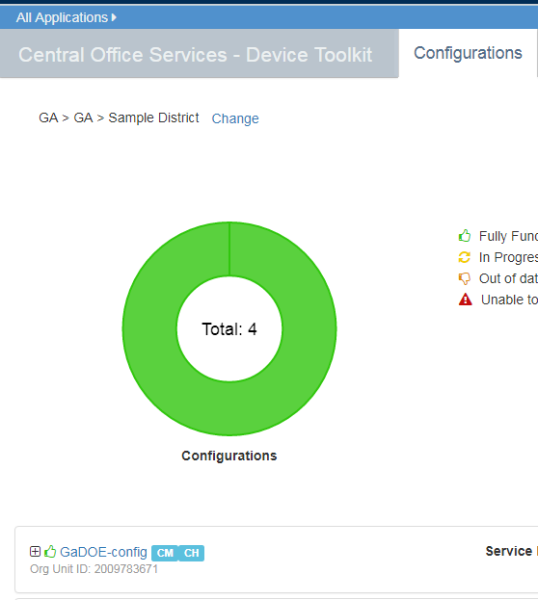
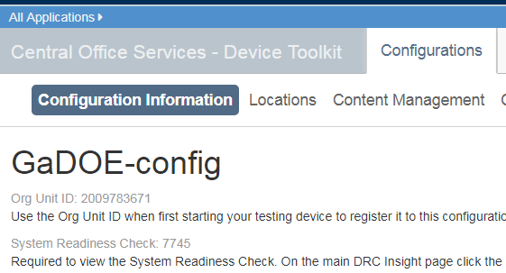
New: Central Office Services – Device Toolkit (COS-DTK) User Interface
  The alpha-numeric Org ID in the Device Toolkit has been transformed into a numeric Org ID in the COS-DTK

Slide 43
New: Central Office Services – Device Toolkit User Interface
Reference materials for the COS-DTK are available on eDIRECT:
  General Information/Documents/Manuals, https://ga.drcedirect.com
  COS-DTK Transition Guide, https://ga.drcedirect.com/Documents/Unsecure/Doc.aspx?id=fd1829b2-2419-475b-bb56-7ab72ae6fe70
  Technology User Guide Volume III, https://ga.drcedirect.com/Documents/Unsecure/Doc.aspx?id=b572ddbb-f248-4a08-b85e-32acd93fa720
  WIDA Transition Video, https://www.wida.us/devicetoolkit.aspx

Slide 44
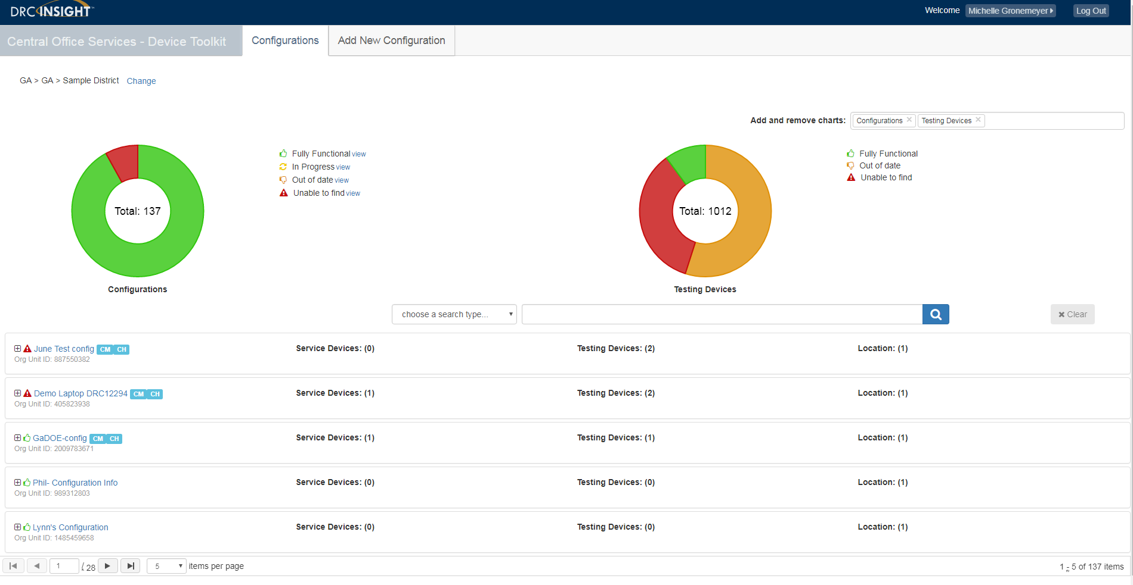
Central Office Services – Device Toolkit (COS_DTK)
DRC has integrated the Device Toolkit (DTK) with the new Central Office Services (COS) to create the COS-DTK interface

Slide 45
Central Office Services – Device Toolkit (COS_DTK)
Begins the transition to the Central Office Services to be introduced in the future
Provides centralized monitoring of the TSM and testing devices
Accessible from eDIRECT
Simplifies the process of testing more than one DRC testing programs
  Such as GA Milestones and WIDA ACCESS for ELLs 2.0
  Now can be managed together, versus two organizational units

Slide 46
Central Office Services – Device Toolkit (COS_DTK)
Organizational Units (ORG Units) are now configurations – the ORG unit code has been changed to reflect this transition – testing devices configured with ORG Units will continue to function
Centralized Dashboard
  Used for monitoring and management of configurations and their devices
  ORG units created in the Device Toolkit were transitioned to the COS-DTK
New configurations will be created in the COS-DTK interface
If a device was configured for two ORG Units prior to 8/30, those two ORG Units are now merged into a single configuration
The TSM settings (e.g. content caching) for each TSM remain the same post transition of 8/30.

Slide 47
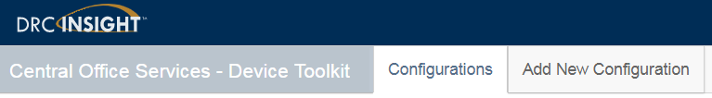
Central Office Services – Device Toolkit (COS_DTK)
After all new TSMs have been installed, use the COS-DTK to perform the following tasks:
Set up configurations
Associate TSMs with configurations
Deploy configurations to testing devices
Register the testing device with a configuration after you install and start INSIGHT on the testing device

Slide 48
Central Office Services – Device Toolkit (COS_DTK)
To start the COS – Device Toolkit:
  Sign on to eDIRECT
  Open All Applications
  Click Device Toolkit
NOTE: Access to COS – Device Toolkit require Device Toolkit permission. If you do not have this permission, contact your System Test Coordinator.

Slide 49
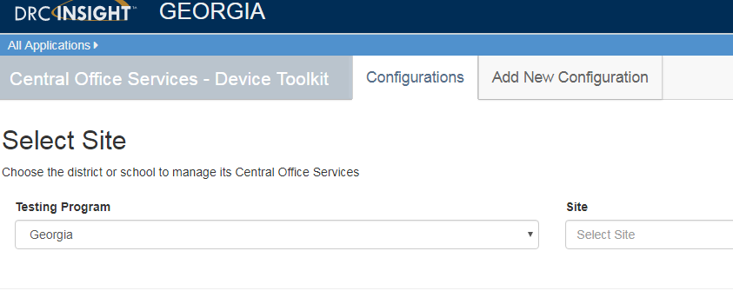
Central Office Services – Device Toolkit (COS_DTK)
When the Select site page displays, select a testing program from the Testing Program drop‑down menu.
Select a site (district or school) from the Site field by typing three or more letters of the site’s name.
Note: You only see the schools and/or districts that you can access.

Slide 50
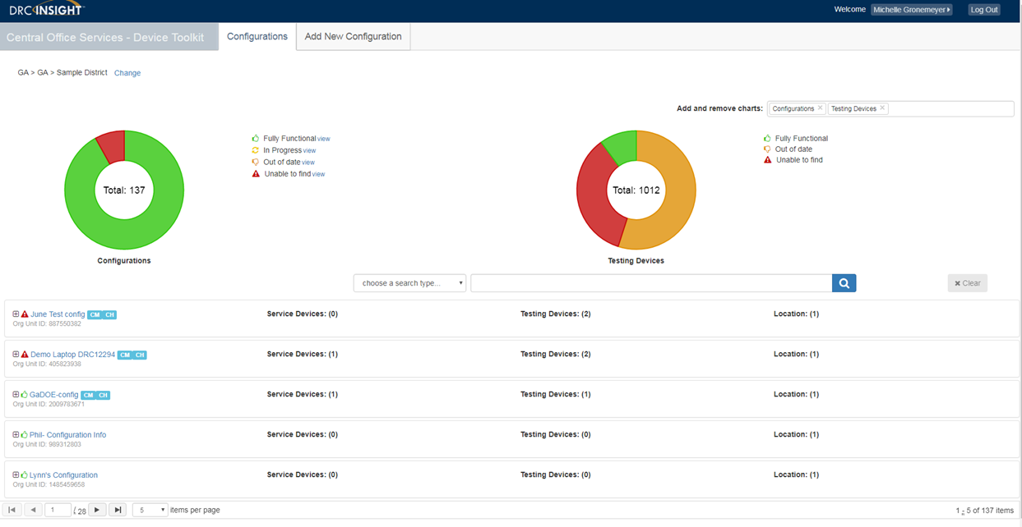
Central Office Services – Device Toolkit (COS_DTK)
Configurations tab
  Displays visual dashboard describing the configurations that currently exist in the COS-DTK
  Status information provided for each configuration and testing devices associated to the configuration
  Use this tab to drill down into the configuration to manage the configuration and its associated devices

Slide 51
Central Office Services – Device Toolkit (COS_DTK)
Configurations Chart
Chart Color | Icon | Configuration Status | Description
Green |  | Fully functional | All TSM and testing devices using a configuration are visible to the COS - Device Toolkit are either in use or ready for use
Red |  | Unable to find | Configured services that were last seen an hour ago or more
Yellow |  | In progress | One or more of the devices using the configuration is currently uploading or downloading test content
Orange |  | Out of date | The test content on one or more devices using the configuration is out of date

Slide 52
Central Office Services – Device Toolkit (COS_DTK)
Testing Devices Chart
Chart Color | Icon | Configuration Status | Description
Green |  | Fully functional | Testing device last seen within a month
Red |  | Unable to find | Testing device last seen a year ago or more
Orange |  | Out of date | Testing device last seen a month ago or more

Slide 53
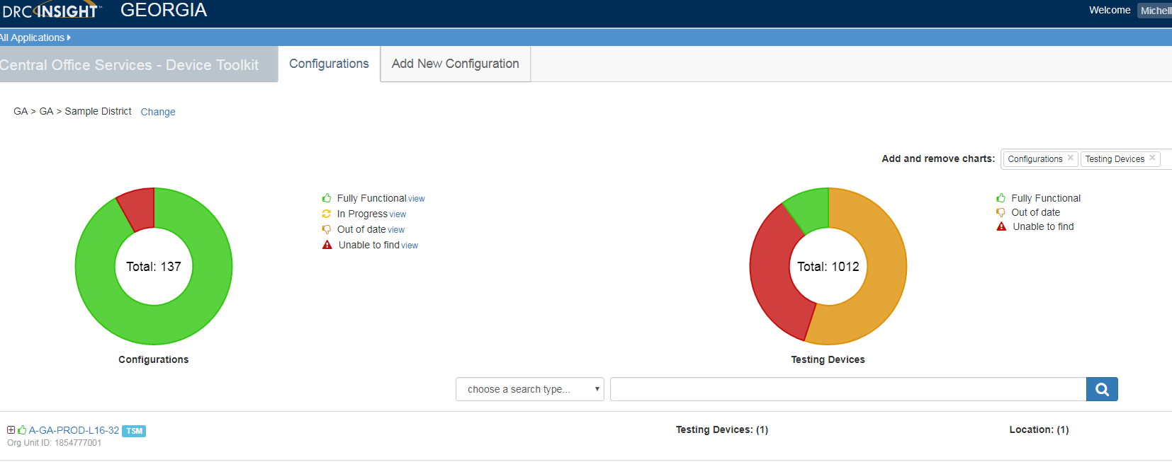
Central Office Services – Device Toolkit (COS_DTK)
Configurations tab
  To change testing programs or sites, click Change at the top of the page to re-display the Select Site page.
  The COS - Device Toolkit dashboard displays for the site you selected. You can display a configuration by clicking on the configuration name.

Slide 54
Central Office Services – Device Toolkit (COS_DTK)
Location indicates the testing program(s) associated with the configuration. More than one testing program can be managed within one configuration.
Configurations tab
Each row on a page displays a configuration name with icons indicating the number of devices using the configuration and the number of locations configured.
TSM icon ( ) indicates there are one or more TSMs associated with the configuration.

Slide 55
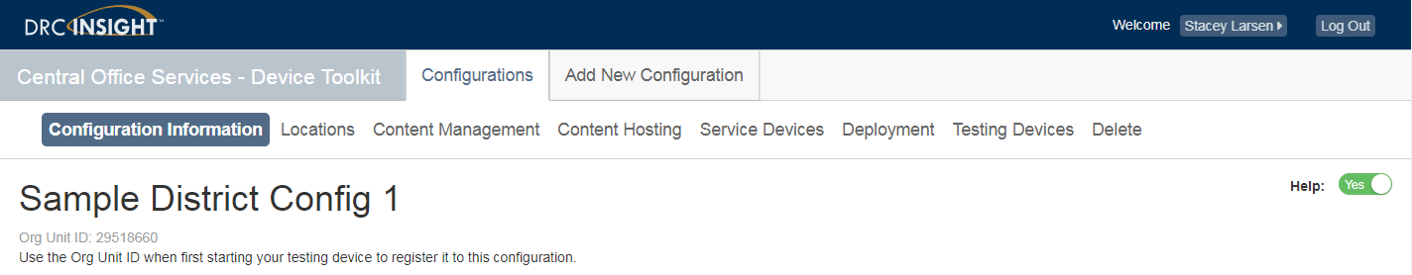
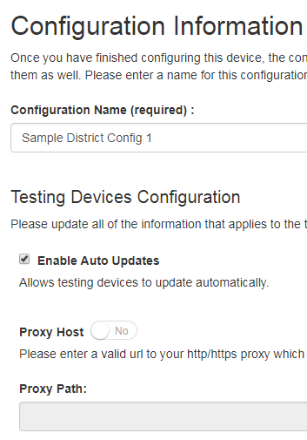

Central Office Services – Device Toolkit (COS_DTK)
Configuration Information provides details for the configuration you selected.
From this page you can:
Locate the ORG Unit ID for the configuration
Change the name of the configuration
Enable or disable automatic updates of the DRC INSIGHT testing software
Specify a proxy host.

Slide 56
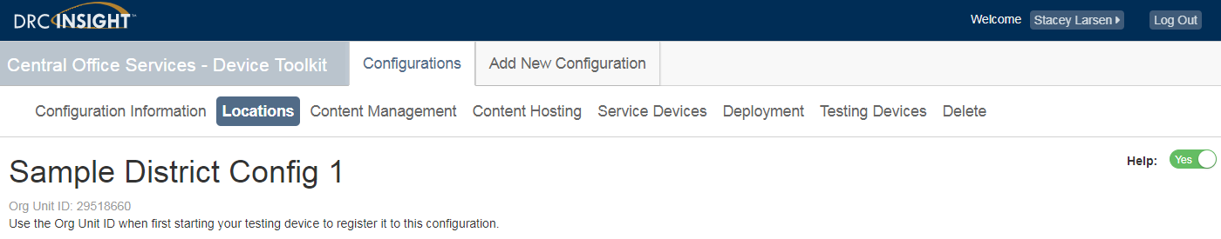
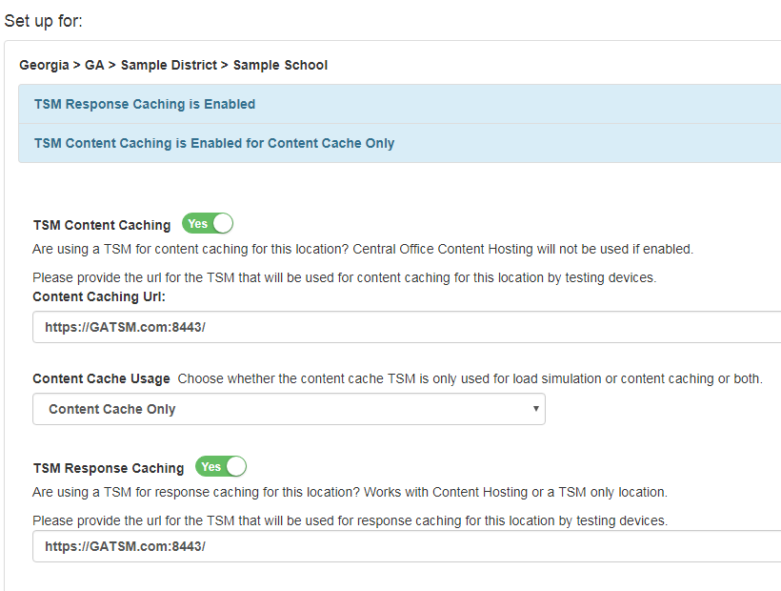
Central Office Services – Device Toolkit (COS_DTK)
Use the Locations Tab for the following:
Review/modify testing programs associated with the configuration
Add additional testing program to configuration
Update TSM settings

Slide 57
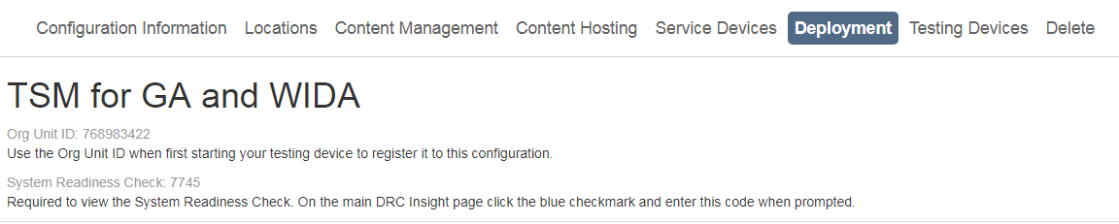
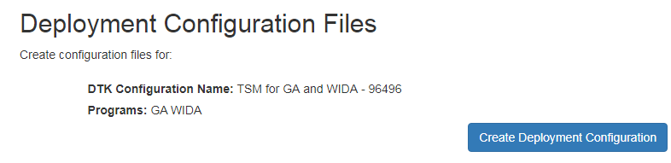
Central Office Services – Device Toolkit (COS_DTK)
You can use the COS - Device Toolkit to create a configuration deployment file (.zip file) containing configuration information for each testing device type (refer to Technical User Guide).
Alternatively, you can launch INSIGHT on a testing device and manually link it to a configuration.

Slide 58
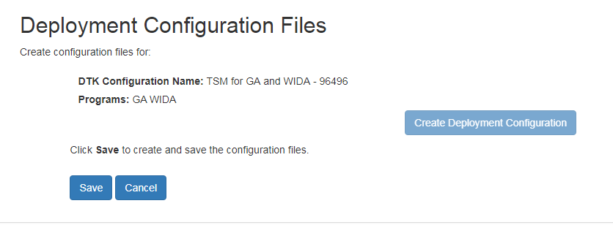
Central Office Services – Device Toolkit (COS_DTK)
Click Save to create a configuration file (or Cancel to cancel the process).
For a description of the files contained in this file, see “COS - Device Toolkit Deployment Files and Silent Installation” and “Example Deployment File Templates” in Technical User Guide.
For more information about deployment files see Volume IV: DRC INSIGHT.

Slide 59
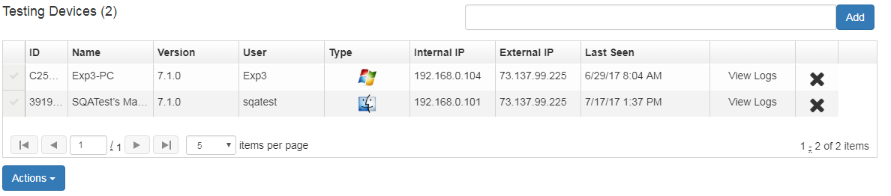
Central Office Services – Device Toolkit (COS_DTK)
Testing Devices - View the list of testing devices that are currently part of the configuration. On this tab, perform the following activities:
Move testing devices
Remove testing devices
Edit the configuration by adding testing devices
View the log files for a testing device

Slide 60
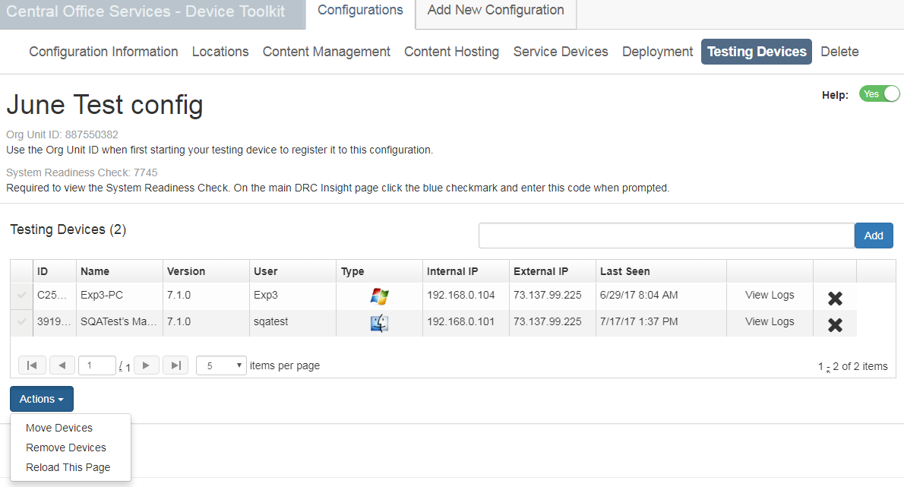
Central Office Services – Device Toolkit (COS_DTK)
Action | Description
Move Devices | Moves the selected testing device(s) to a different configuration. You are prompted to supply the Org Unit ID for the target configuration.
Remove Devices | Removes the selected testing device(s) from the current configuration. A dialog displays to confirm the removal. You also can remove a device by clicking the x in the right-most device field.
Reload This Page | Refreshes the display using the latest information about the current testing devices.

Slide 61
Central Office Services – Device Toolkit (COS_DTK)
Moving Testing Devices Between Districts and/or Schools
You can use the COS - Device Toolkit to move one or more testing devices between districts and/or schools without having to uninstall and reinstall each testing device.
To perform this process, you move the testing device from its current configuration (the source configuration) to a target configuration for a different district and/or school.
Detailed steps can be found in the Technical User Guide – Configuring Devices for Testing.

Slide 62
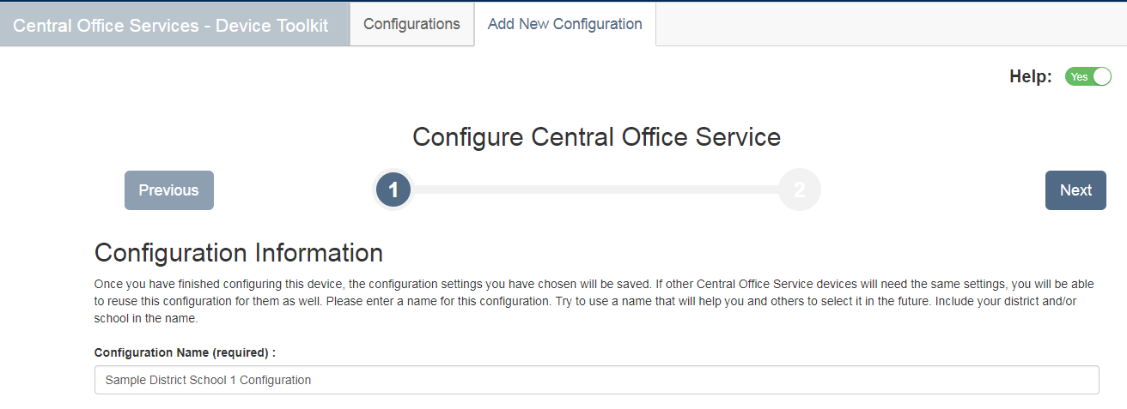
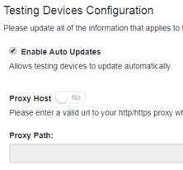
Central Office Services – Device Toolkit (COS_DTK)
ADD NEW CONFIGURATION
Click on Add New Configuration
STEP 1 – Identify Configuration
  Enter name for configuration
  Select Enable Auto Updates (recommended)
  Select Proxy Host and enter path (only if needed)
  Click Next
Toggle Help
to see tool tips provided on page

Slide 63
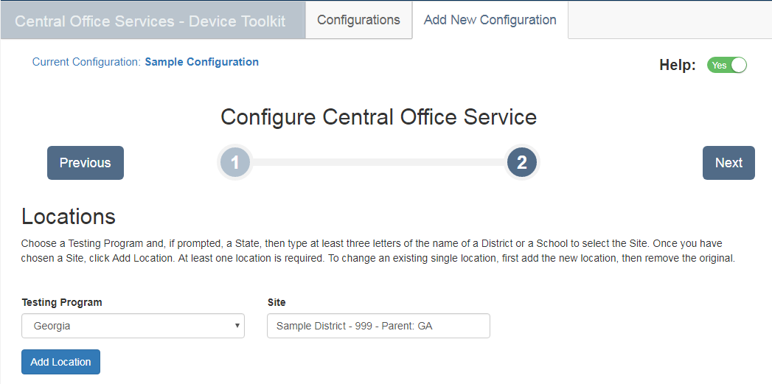
Central Office Services – Device Toolkit (COS_DTK)
ADD NEW CONFIGURATION (continued)
STEP 2 – Select Testing Program and Site
  Select Georgia for Testing Program
  Enter name of site
  Click Add Location

Slide 64
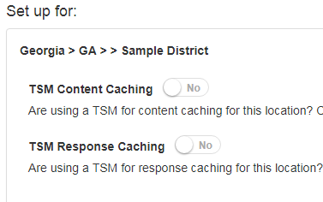
Central Office Services – Device Toolkit (COS_DTK)
Step 2 (continued)
Designate the use of Content Caching and Response Caching when using a TSM (tips on deciding to use Response Caching ahead in training)
Select TSM Content Caching
Content Caching stores test content on the TSM. When students login to test, cached content is retrieved from the TSM instead of from DRC’s servers, thereby reducing demands on Internet bandwidth
  Select TSM Response Caching
  Response Caching buffers and stores test responses on the TSM if testing computers stop communicating with the DRC INSIGHT servers

Slide 65
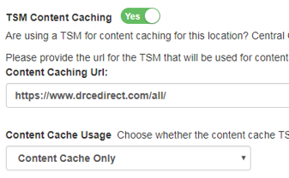
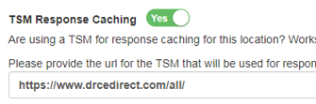

Central Office Services – Device Toolkit (COS_DTK)
TSM Content Caching
Enter or paste the TSM Server Domain name (from the TSM).
Format of domain name: Prefixed with https:// and followed by a colon, the port number, and a forward slash (/). Example provided below:
https://www.GATSM.com:8443/
TSM Response Caching
If desired, enter or paste the TSM Server Domain name (from the TSM).
Click Next when set up complete.

Slide 66
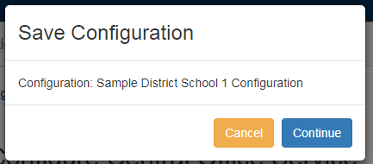
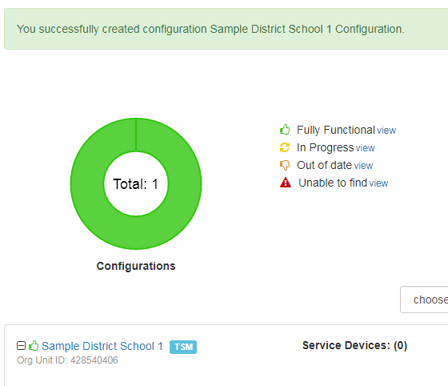
Central Office Services – Device Toolkit (COS_DTK)
Once the configuration is complete, click Continue.
The new configuration will appear in the list of configurations.

Slide 67
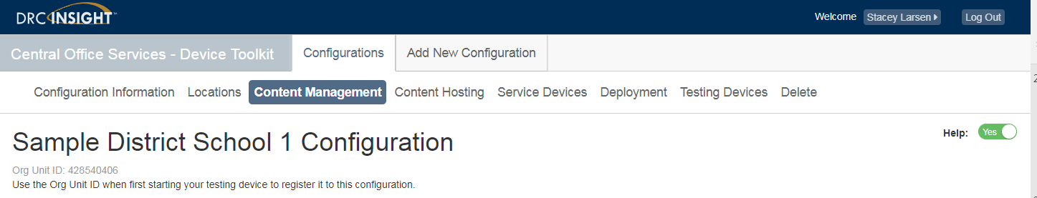
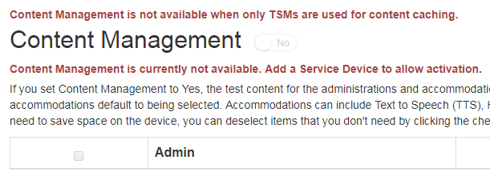
Central Office Services – Device Toolkit (COS_DTK)
Content Management will not be fully functional until the full Central Office Services deployment. More information and details to be provided in future training.

Slide 68
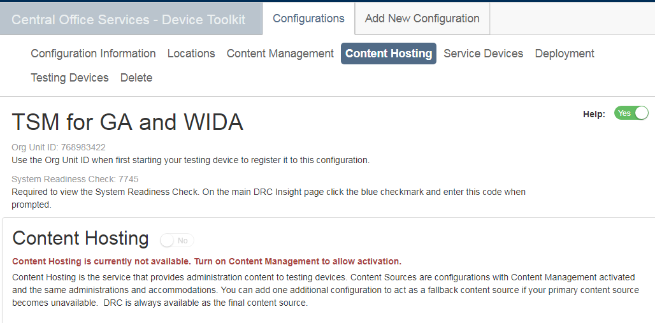
Central Office Services – Device Toolkit (COS_DTK)
Content Hosting will not be fully functional until the full Central Office Services deployment. More information and details to be provided in future training.

Slide 69
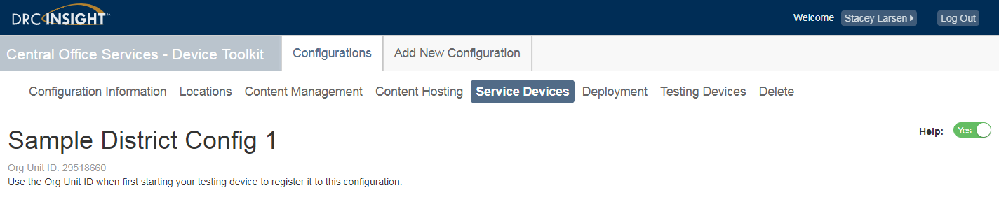
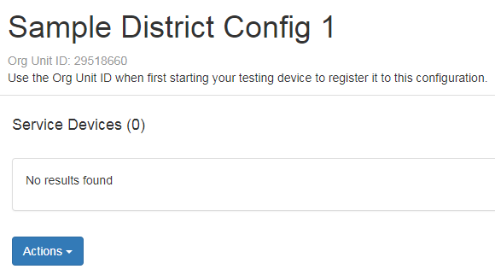
Central Office Services – Device Toolkit (COS_DTK)
Service Devices will not be fully functional until the full Central Office Services deployment. More information and details to be provided in future training.

Slide 70
INSIGHT Installation

Slide 71
INSIGHT Installation
Install INSIGHT
  Can be done manually on desktops and laptops
  Can be deployed to multiple desktops and laptops
  ChromeOS and iOS (iPad) specific deployments

Slide 72
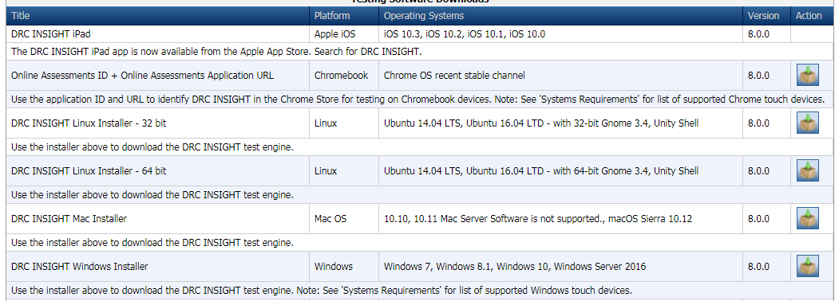
INSIGHT Installation
From eDIRECT > General Information > Downloads tab

Slide 73
New: Installable software
New software versions for Testing Site Manager (TSM) and INSIGHT client (released in July 2017)
  TSM Version 9.2
    If you previously installed the TSM with Auto-Update selected, it will automatically update to the new version on the next launch of the software
  Secure Browser version 8
    If you previously installed the Secure Browser with Auto-Update selected, it will automatically update to the new version on the next launch of the software
  Will be used for all subsequent 2017-2018 Georgia Milestones testing
  Both TSM and Secure Browsers must be updated prior to 2017-2018 testing
    For WIDA testing, the 9.2 version of the TSM will be required after September 28

Slide 74
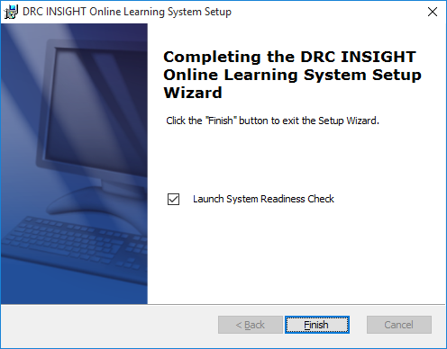
INSIGHT Installation, Options
Launch System Readiness Check
  Uncheck if you plan to deploy a configuration file to link to the configuration

Slide 75
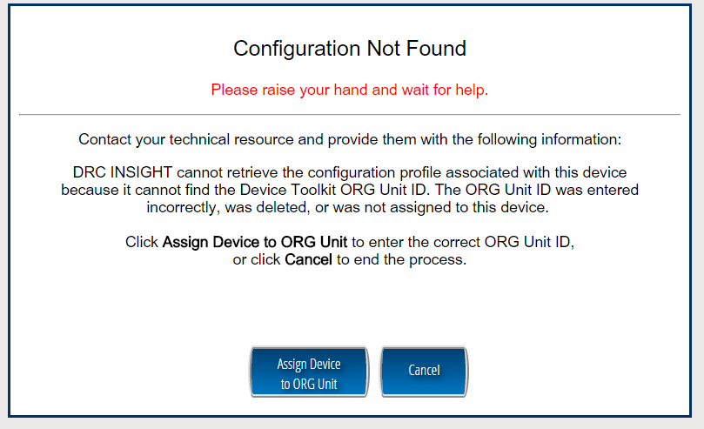
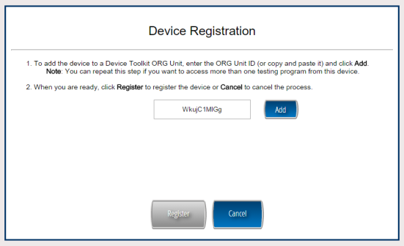
INSIGHT Installation
To manually install INSIGHT, enter the ORG Unit ID from the COS-DTK into the Device Registration screen.

Slide 76
Windows
If using the TSM, ensure that one or more TSMs have been installed on desktop or laptop computers.
Use the COS-DTK to create configurations
  Be sure to connect the TSM to each of the devices in the configuration.
Run the INSIGHT Windows Installer and accept the User Agreement and Default Settings.
If you plan on deployment, uncheck “Launch System Readiness Check.” This will prevent the software from launching and attempting to register to configuration.
  INSIGHT for Windows can be deployed using a Command Line or using ORCA.

Slide 77
MacOS
If using the TSM, ensure that one or more TSMs have been installed on desktop or laptop computers.
Use the COS-DTK to create configurations
  Be sure to connect the TSM to each of the devices in the configuration.
Run the INSIGHT Mac Installer and accept the User Agreement and Default Settings. Admin login is required.
The Mac installation package launches INSIGHT automatically.
INSIGHT for Mac can be deployed using a deployment tool such as Apple Remote Desktop.

Slide 78
Linux
If using the TSM, ensure that one or more TSMs have been installed on desktop or laptop computers.
Use the COS-DTK to create configurations
  Be sure to connect the TSM to each of the devices in the configuration.
Run the INSIGHT Linux Installer and accept the User Agreement and Default Settings.
Once the installation is complete, navigate to the directory and double-click the DRC INSIGHT Online Assessments icon to launch INSIGHT and register the device.

Slide 79
ChromeOS
Requires that Chromebooks are managed through Chrome device management
  Use Device Management to deploy the app to the appropriate devices and to invoke kiosk mode for testing (detail in Tech user Guide Vol IV)
If using the TSM, ensure that one or more TSMs have been installed on desktop or laptop computers.
Use the COS-DTK to create configurations
  Be sure to connect the TSM to each of the devices in the configuration.
Create the chromeos.json file in the DTK and upload using Chrome management.
Launch INSIGHT on the Chromebook and run the System Readiness Check to verify the device can connect to the TSM.

Slide 80
iOS (iPads)
App is only available through the App Store
Mobile Device Management is no longer required, but still recommended.
  Alternate method is to download the app directly from the App Store and configure it manually.
Automatic Assessment Configuration
  Preferred method for invoking kiosk mode
  Use in place of Guided Access, Single App Mode and Autonomous Single App Mode
  Built into INSIGHT app
  Automatically starts and stops
  Will automatically disable kiosk mode within 8 hours after unplanned exit from app
  Automatically disables features when the app starts
    Check Spelling
    Predictive Text
    Auto-Correction
    Auto-Capitalization

Slide 81
iOS (iPads)
If using the TSM, ensure that one or more TSMs have been installed on desktop or laptop computers.
Use the COS-DTK to create configurations
  Be sure to connect the TSM to each of the devices in the configuration.
  If MDM supports the Managed App Configuration feature, this can be used to configure multiple iPad devices.
  If MDM does not support the Managed App Configuration, use the MDM to deploy the software, but each iPad must be manually registered.
Install the DRC INSIGHT App on iPads.
  Download the app from the App Store
  Create the ios.plist configuration file in the DTK.
  Deploy the app and configuration file using MDM.
Launch DRC INSIGHT. The iPad devices are automatically registered with INSIGHT once launched.

Slide 82
Virtual Desktops/Thin Clients
INSIGHT has been used successfully on virtual desktop environments
  nComputing
  Citrix
  Wyse
  VMWare
The virtual desktop session must emulate one of the supported operating systems.
The virtual desktop server must have sufficient resources to support all students that will be testing concurrently.
Special attention must be paid to the security risks inherent to testing in a virtual desktop environment.

Slide 83
Virtual Desktops/Thin Clients
Please note:
  Virtual desktop environments are supported for the Georgia Milestones Assessments, they are not supported for WIDA ACCESS for ELLs Assessment.
  DRC does not support the use of online audio accommodations (Screen Reader, also called text-to-speech) in virtual desktop environments.
    In general, we have found that audio quality in such environments is poor, which could prevent the audio accommodation from functioning as designed.
    Other options for delivery of the audio accommodations in the Virtual Desktop/Thin Client environment
      Human reader in an online test administration
        Human readers must use the posted Read-Aloud Guidelines that appear on the Georgia Milestones GaDOE webpage under Test Administration & Educator Resources
      Use desktop, laptop, or other non-virtual desktops for students with audio accommodations
  You may use a virtual desktop to host a TSM, and virtual desktops running INSIGHT can connect to a TSM
  Because virtual desktop environment setups can vary, you may encounter unique issues
    When in doubt, contact Customer Service!!!

Slide 84
Preparing for Testing
Complete the setup of your TSMs, your configurations in the COS-DTK, and your INSIGHT installations on your test machines.
Run Load Simulations and Ensure that your TSMs are up-to-date with content
  Download content via the Update Content button:
    Check the TTS checkbox for oral administration
Ensure students access Online Tools Training (OTT)
  Hands-on opportunity to practice using testing tools
  Can be used to check that the testing engine is working
Online Audio Accommodations
  Ensure appropriate numbers of headphones are available for students
Ensure that paper testing materials have been ordered for all students that will not be testing online (e.g. students with Braille or Large Print accommodations)

Slide 85
Georgia Milestones versus ACCESS for ELLs
Both use the DRC INSIGHT platform
Both use the TSM and COS-DTK
  Require separate TSMs for each program
Both use the DRC INSIGHT secure browser and apps
  Can use the same installation of secure browser for both programs
Georgia Milestones content is significantly smaller
Georgia Milestones has a separate and dedicated Customer Service team

Slide 86
Thank you!
Helpful Documents
INSIGHT Technology User Guide (Volumes I-V)
Central Offices Services Device Toolkit Transition Guide
INSIGHT System Requirements
Mega TSM Configuration
  All found on eDIRECT: https://ga.drcedirect.com under General Information/Documents/Manuals
DRC Georgia Customer Care
Hours of Operation: 7:00 am - 8 pm EST
Phone: (866) 282-2249
Email: gahelpdesk@datarecognitioncorp.com

Slide 87
Questions?

