Slide 1
CCRPI & Georgia Milestones
Instructional Leadership Academy
October 2015
Melissa Fincher, Ph.D. Deputy Superintendent, Assessment & Accountability mfincher@doe.k12.ga.us

Slide 2
Georgia’s Student Assessment Landscape
Current Programs
Georgia Milestones Assessment System (Gr. 3-8 and HS)
Georgia Kindergarten Inventory of Developing Skills (GKIDS)
Special Population Programs
ACCESS for ELLs (K-12) and Alternate ACCESS for ELLs (1-12)
Georgia Alternate Assessment (GAA) (Gr. 3-8 and HS)
National Assessment
National Assessment of Educational Progress (NAEP) (Gr. 4, 8, and 12)
____________________________________________________________________________________________________________________________
Discontinued/Former Programs
CRCT [replaced by Georgia Milestones in grades 3-8]
End of Course Tests (EOCT) [replaced by Georgia Milestones in high school]
Georgia High School Graduation Tests (GHSGT)
Georgia High School Writing Test (GHSWT)
Writing Assessments (Grades 3, 5, and 8)
Number of Tests Required of ALL Students
2013 – 2014: 43
2014 – 2015: 32
Depending on the grade-level, students take 1 to 2 fewer tests.

Slide 3
Assessment & Accountability
The primary purpose of school is teaching and learning.
Assessment and accountability plays an important role, but importantly – that role is supporting, with the primary focus being teaching and learning.

Slide 4
CCRPI Update

Slide 5
CCRPI
Priority School: Content Mastery
bottom 5% of all Title I schools
Focus School: Achievement Gap
bottom 10% of all Title I schools
Opportunity
School District: CCRPI
below 60 for three consecutive years

Slide 6
Priority Schools
Entrance Criteria
1. Title I Schools
2. 3-year average of Content Mastery category performance
a. Category performance will be weighted by enrollment for schools with more than one grade band
b. Schools must have 3 years of data
3. Rank schools by 3-year average of category performance
4. Select lowest 5%
5. Add schools with graduation rates < 60% for 2 consecutive years
*2014 and 2013 4-year cohort graduation rate
6. Schools identified as Priority Schools in 2012 which did not meet the exit criteria will be re-identified as Priority Schools.
Exit Criteria
Priority Schools will exit Priority status when they:
1. no longer meet the definition of a Priority School and demonstrate a 5 percentage point increase in Content Mastery category performance; or
2. no longer meet the definition of a Priority School and have graduation rates (most recent year and prior year 4-year cohort rates) ≥ 60%
Data for schools that exit in the first year will be monitored for re-identification purposes.
Schools that were identified as Priority Schools in spring 2012 may exit if they no longer meet the definition of a Priority School and have increased their Content Mastery Category Performance by 5 percentage points or have graduation rates (most recent year and prior year 4-year cohort rates) ≥ 60%.

Slide 7
Focus Schools
Entrance Criteria
1. Title I schools
2. Must not meet the definition of a Priority school
3. 3-year average of Achievement Gap scores
a. Achievement Gap will be weighted by enrollment for schools with more than one grade band
b. schools must have 3 years of data
4. Rank schools by 3-year average of Achievement Gap scores
5. Select lowest 10%
6. Schools identified as Focus Schools in 2012 which do not meet the exit criteria will be re-identified as Focus Schools.
Exit Criteria
Focus Schools will exit Focus status when they:
no longer meet the definition of a Focus School and demonstrate a 2.5 point increase in the 3-year average of Achievement
Gap scores
a. 2014 3-year average will serve as the baseline
Schools that were identified as Focus schools in spring 2012 may exit Focus status if they no longer meet the definition of a Focus school and have increased their Achievement Gap points by 2.5 points or exceed the state level 3-year average of Achievement Gap Points.

Slide 8
Achievement Gap
The goal of measuring achievement gap reduction is to focus on increasing the achievement of the schools’ lowest achieving students relative to the state mean.
Who are the lowest achieving students in the school?
What are commonalities do you find in their achievement profile?

Slide 9
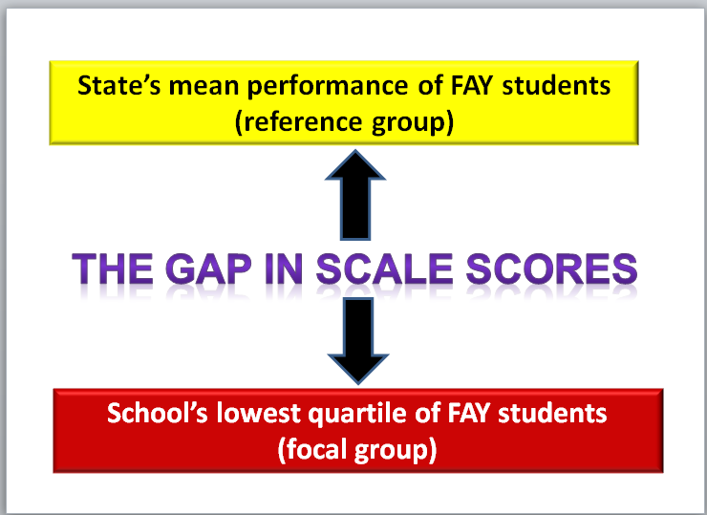
Achievement Gap
Notes:
Achievement gap looks at the lowest quartile or 25% of students in a subject area in your school or district. AG then compares that lowest quartile to the state mean scores for FAY students.
Achievement Gap is NOT the gap between typical subgroups of your school. Rather, it compares the lowest 25% of achievers in a school with the state average.
The Reference group is the state with a mean z score of 0.
The Focal group is the school’s lowest 25% of achievers.

Slide 10
Achievement Gap
Achievement Gap considers Gap Size and Gap Change. For these calculations, the scale scores for FAY students are converted to ƶ scores, a standardized score. This conversion requires the use of the state mean and state standard deviation.
Z scores offer a common scale allowing comparison across grades. Scores are relative to the state mean, which is 0. The standard deviation is 1. Negative Z scores are below the state mean; positive Z scores are above the state mean.
Notes:
For CCRPI purposes, we are interested in 2 elements of achievement gap:
First, we look at the size of the gap between your lowest quartile and the state mean, and second, we look a the gap for the current year and the previous year to see if and how much the gap has changed.

Slide 11
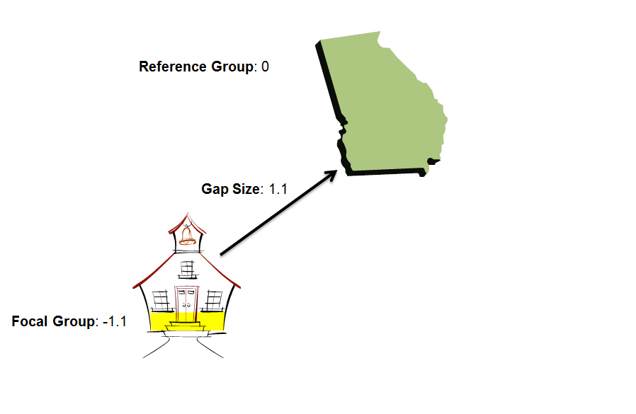
Gap Size
Notes:
To calculate the gap size , subtract the focal group – the school - from the reference group – the state. 0 minus negative 1.1 equals 1.1 for the Gap Size.

Slide 12
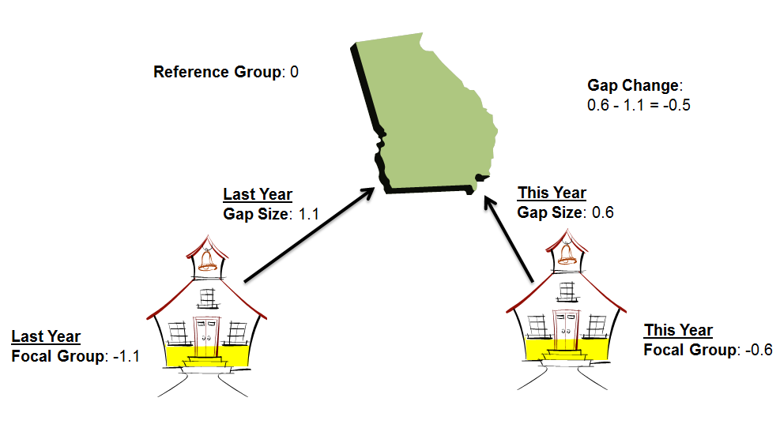
Gap Change
Notes:
To calculate gap change, you must first calculate gap size for the current year and the previous year. In this example, remember the size last year was 1.1. The size for this year is zero minus negative .6 which equals .6. Now you subtract last year’s size of 1.1 from this year’s size of .6 to get negative .5.

Slide 13
Achievement Gap
Achievement Gap points on the CCRPI are derived by first calculating the achievement gap size and the achievement gap change for a school.
Both the gap size and the gap change are assigned scores on a rubric, and the school receives the higher of the two scores.
Notes:
Here is a summary of how we calculate achievement gap.
Remember that the final subject score is the greater of the two scores. This provides an opportunity for schools to earn points by either having a small or non-existent current year gap or by decreasing the size of the gap from last year to this year.

Slide 14
CCRPI Update
At its September meeting, the SBOE approved revisions to the indicators and calculations for the 2015 and 2016 CCRPI given the implementation of Georgia Milestones.
These revisions were designed to give schools credit for the progress they are making towards the increased expectations for student achievement.
The Summary of Changes as well as the 2015 and 2016 Indicators can be found on the Accountability Webpage – second, third, and fourth links under Resources.
http://www.gadoe.org/Curriculum-Instruction-and-Assessment/Accountability/Pages/default.aspx

Slide 15
CCRPI Update
The two most significant changes were made to Content Mastery and the CCRPI Component Weights.
Content Mastery
Students achieving the Developing Learners level will earn 0.5 (one-half) point.
Students achieving the Proficient Learners level will earn 1.0 (one) point.
Students achieving the Distinguished Learners level will earn 1.5 (one and one-half) points.
CCRPI Component Weights
Increasing the contribution of Progress recognizes the work districts and schools are making toward the increased expectations for student achievement. Remember, growth is independent of proficiency classifications.
Previous Weights:
Achievement | 60%
Content Mastery | 40%
Post Readiness | 30%
Graduation Rate | 30%
Progress | 25%
Achievement Gap | 15%
New Weights:
Achievement | 50%
Content Mastery | 40%
Post Readiness | 30%
Graduation Rate | 30%
Progress | 40%
Achievement Gap | 10%

Slide 16
CCRPI Update
Other changes include:
Giving credit for both Proficient Learner and Distinguished Learner in the Post High School Readiness and Predictor for High School Graduation areas.
Benchmarking at the 95th percentile the following:
Attendance
Progress
Removing the redundant indicator for fifth and eighth grade students passing four courses in core content areas and scoring Exceeds.

Slide 17
Georgia Milestones Assessment System

Slide 18
Georgia Milestones
Paramount principles guiding Georgia Milestones:
be sufficiently challenging to ensure Georgia students are well positioned to compete with other students across the United States and internationally;
consistent signal about student achievement both within system (across grades and courses) and with external measures (NAEP; PSAT; SAT; ACT)
be intentionally designed across grade levels to send a clear signal of student progress/growth and preparedness for the next level, be it the next grade level, course, or college or career.
Comprehensive – Coherent – Consolidated

Slide 19
College or Career Readiness
Students who are college or career ready are on-track to possess the English language arts/literacy/ mathematics knowledge and skills needed upon graduation to enter directly and succeed in
entry-level credit-bearing postsecondary courses, without the need for remedial coursework; or
job training and/or postsecondary education necessary for his/her chosen career (e.g., technical/vocational program, community college, apprenticeship or significant on-the-job training).
The Department has worked with the University and Technical College Systems, as well as business and industry representatives, to define college and career readiness.

Slide 20
Georgia Milestones Online Testing 2014-2015 by the Numbers….
Online Administrations
Spring EOG: ~233,000 (30%)
Winter EOC: ~129,000 (73%)
Spring EOC: ~557,000 (71%)
Grand Total 2014-2015 School Year
Online Administrations: 919,636
Paper-Pencil Administrations: 819,078
Grand Total: 1,738,714
Overall % Online: 53%

Slide 21
Feedback Surveys
Survey Participation
EOG Online Students: 83,557 192 districts
EOC Online Students: 13,007 199 districts
EOG/EOC Teachers: 16,446 175 districts

Slide 22
Georgia Student Achievement
Reading
2013
NAEP – Grade 4: 34% at/above proficient
CRCT – Grade 4: 93% met/exceeded
2014
CRCT – Grade 4: 94% met/exceeded
2015
NAEP – Grade 4: 34% at/above proficient
GM ELA – Grade 4: 37% proficient/distinguished

Slide 23
Georgia Student Achievement
Reading
2013
NAEP – Grade 8: 32% at/above proficient
CRCT – Grade 8: 97% met/exceeded
2014
CRCT – Grade 8: 97% met/exceeded
2015
NAEP – Grade 8: 30% at/above proficient
GM ELA – Grade 8: 38% proficient/distinguished

Slide 24
Georgia Student Achievement
Mathematics
2013
NAEP – Grade 4: 39% at/above proficient
CRCT – Grade 4: 84% met/exceeded
2014
CRCT – Grade 4: 82% met/exceeded
2015
NAEP – Grade 4: 35% at/above proficient
GM – Grade 4: 39% proficient/distinguished

Slide 25
Georgia Student Achievement
Mathematics
2013
NAEP – Grade 8: 29% at/above proficient
CRCT – Grade 8: 83% met/exceeded
2014
CRCT – Grade 8: 82% met/exceeded
2015
NAEP – Grade 8: 28% at/above proficient
GM – Grade 8: 37% proficient/distinguished

Slide 26
Georgia Student Achievement
Reading
SAT – Class of 2013: 43%
SAT – Class of 2014: 44%
SAT – Class of 2015: 44%
ACT – Class of 2013: 43%
ACT – Class of 2014: 44%
ACT – Class of 2015: 46%
PSAT – 2012 Sophomores: 40% on track to be CCR
PSAT – 2013 Sophomores: 30% on track to be CCR
PSAT – 2014 Sophomores: 39% on track to be CCR
EOCT - 2013
9th Grade Literature: 86%
American Literature: 91%
EOCT - 2014
9th Grade Literature: 88%
American Literature: 93%
Georgia Milestones - 2015
9th Grade Literature: 38%
American Literature: 35%

Slide 27
Georgia Student Achievement
Mathematics
SAT – Class of 2013: 42%
SAT – Class of 2014: 41%
SAT – Class of 2015: 42%
ACT – Class of 2013: 38%
ACT – Class of 2014: 38%
ACT – Class of 2015: 38%
PSAT – 2012 Sophomores: 32% on track to be CCR
PSAT – 2013 Sophomores: 35% on track to be CCR
PSAT – 2014 Sophomores: 35% on track to be CCR
EOCT – 2013
Coordinate Algebra: 37%
EOCT - 2014
Coordinate Algebra: 40%
Analytic Geometry: 35%
Georgia Milestones – 2015
Coordinate Algebra: 34%
Analytic Geometry: 33%

Slide 28
Uses of Georgia Milestones
Uses of the test results
communicates student achievement
grade promotion (grades 3, 5, and 8)*
course final exam (20%)*
accountability (CCRPI – TKES – LKES)
college & career readiness signal
*State Board of Education waived for 2014-2015 school year.
Given the uses of the test results, concerns expressed include:
the online interruptions during the Spring EOG
the impact of increased expectations on growth

Slide 29
Spring 2015
Online interruptions and delays, particularly – but not exclusively – for students using screen reader application
So what is being done to address this?
To investigate the impact of these delays, a forensic analysis is being completed by an independent third party.
A mode comparability study is also being conducted to ensure students were not advantaged or disadvantaged by the mode of administration (online/paper-pencil).

Slide 30
Achievement vs. Growth
Achievement
How well students are meeting state expectations
Snapshot look at student performance
Growth
How students are progressing from year to year
Takes students’ starting points into consideration
GSGM ≠ gain score model
GSGM uses the scale not the performance classification
Growth is independent of proficiency cuts

Slide 31
Types of Scores
Scale Scores
Range varies depending on grade level and content area
Achievement Levels
Achievement Level Cuts
Developing Learner: 475
Proficient Learner: 525
Distinguished Learner: varies from 555 to 610
Grade Conversion Scores (EOC Only)
Grade Conversion Score Ranges
Beginning Learner: 0-67
Developing Learner: 68-79
Proficient Learner: 80-91
Distinguished Learner: 92-100
Domain Signals

Slide 32
Norm-Referenced Scores
Supplemental Information:
National Percentile Rank (NPR)
NPR Range (based on SEM)
Norm Curve Equivalencies (NCE)
Provided on summary reports only
Remember:
A sample of norm-referenced items were administered, not an intact form.
Norm-referenced Testing (NRT) data should be utilized as an indicator or barometer of student performance relative to their peers nationally.
NPRs from Georgia Milestones may not be used for gifted program identification.

Slide 33
Achievement Levels
Beginning Learners do not yet demonstrate proficiency in the knowledge and skills necessary at this grade level/course of learning, as specified in Georgia’s content standards. The students need substantial academic support to be prepared for the next grade level or course and to be on track for college and career readiness.
Developing Learners demonstrate partial proficiency in the knowledge and skills necessary at this grade level/course of learning, as specified by in Georgia’s content standards. The students need additional academic support to ensure success in the next grade level or course and to be on track for college and career readiness.
Proficient Learners demonstrate proficiency in the knowledge and skills necessary at this grade level/course of learning, as specified in Georgia’s content standards. The students are prepared for the next grade level or course and are on track for college and career readiness.
Distinguished Learners demonstrate advanced proficiency in the knowledge and skills necessary at this grade level/course of learning, as specified in Georgia’s content standards. The students are well prepared for the next grade level or course and are well prepared for college and career readiness.

Slide 34
Developing Learners
Developing Learners demonstrate partial proficiency in the knowledge and skills necessary at this grade level/course of learning, as specified by in Georgia’s content standards. The students need additional academic support to ensure success in the next grade level or course and to be on track for college and career readiness.
The Developing Learner achievement level consists of students who have demonstrated partial proficiency; they have a partial command of the knowledge and skills inherent in their grade level or course content standards. These students can be successful in future learning but will likely need some type of focused remediation in their weaker areas; they do not, necessarily, need a support class. Their learning should be monitored to ensure their success and to increase their opportunity to reach proficiency.
In short, this achievement level allows for the recognition of those students who have demonstrated some command, albeit partial, of the grade-level expectations but have not yet reached the full command necessary to signal proficiency. Proficient students demonstrate a strong, solid command of the grade-level or course content and skills.

Slide 35
EOG Scale Score Range
Content Area | Grade | Lowest Obtainable Scale Score (LOSS) | Developing Learner Cut Score | Proficient Learner Cut Score | Distinguished Learner Cut Score | Highest Obtainable Scale Score (HOSS)
English Language Arts | Grade 3 | 180 | 475 | 525 | 581 | 830
 | Grade 4 | 210 | 475 | 525 | 574 | 775
 | Grade 5 | 210 | 475 | 525 | 587 | 760
 | Grade 6 | 140 | 475 | 525 | 599 | 820
 | Grade 7 | 165 | 475 | 525 | 592 | 785
 | Grade 8 | 225 | 475 | 525 | 581 | 730
Mathematics | Grade 3 | 290 | 475 | 525 | 580 | 705
 | Grade 4 | 270 | 475 | 525 | 585 | 715
 | Grade 5 | 265 | 475 | 525 | 580 | 725
 | Grade 6 | 285 | 475 | 525 | 580 | 700
 | Grade 7 | 265 | 475 | 525 | 580 | 740
 | Grade 8 | 275 | 475 | 525 | 579 | 755

Slide 36
EOG Scale Score Range
Content Area | Grade | Lowest Obtainable Scale Score (LOSS) | Developing Learner Cut Score | Proficient Learner Cut Score | Distinguished Learner Cut Score | Highest Obtainable Scale Score (HOSS)
Science | Grade 3 | 275 | 475 | 525 | 566 | 695
 | Grade 4 | 230 | 475 | 525 | 578 | 730
 | Grade 5 | 160 | 475 | 525 | 595 | 780
 | Grade 6 | 175 | 475 | 525 | 610 | 780
 | Grade 7 | 215 | 475 | 525 | 589 | 745
 | Grade 8 | 165 | 475 | 525 | 593 | 785
Social Studies | Grade 3 | 275 | 475 | 525 | 560 | 680
 | Grade 4 | 250 | 475 | 525 | 570 | 700
 | Grade 5 | 290 | 475 | 525 | 555 | 665
 | Grade 6 | 295 | 475 | 525 | 560 | 670
 | Grade 7 | 280 | 475 | 525 | 564 | 685
 | Grade 8 | 240 | 475 | 525 | 572 | 715

Slide 37
EOC Scale Score Range
Content Area | Lowest Obtainable Scale Score (LOSS) | Developing Learner Cut Score | Proficient Learner Cut Score | Distinguished Learner Cut Score | Highest Obtainable Scale Score (HOSS)
9th Grade Literature & Composition | 220 | 475 | 525 | 587 | 735
American Literature & Composition | 190 | 475 | 525 | 590 | 750
Coordinate Algebra | 215 | 475 | 525 | 594 | 790
Analytic Geometry | 185 | 475 | 525 | 596 | 810
Biology | 140 | 475 | 525 | 609 | 820
Physical Science | 145 | 475 | 525 | 604 | 815
U. S. History | 215 | 475 | 525 | 590 | 765
Economics | 140 | 475 | 525 | 610 | 830

Slide 38
Domain Signals
English Language Arts
Reading Status
Below Grade Level
On Grade Level or Above
Lexile Score
Writing Scores
Extended Writing Task – rubric score by trait
Ideas, Organization & Coherence [number of points earned out of 4]
Language Usage and Conventions [number of points earned out of 3]
Narrative Writing [number of points earned out of 4 possible]

Slide 39
Domain Signals
Mathematics, Science, Social Studies
Remediate Learning
Monitor Learning
Accelerate Learning
Domain Performance:
What is the likelihood the student would achieve proficiency on the test given his/her performance in the domain?

Slide 40
Promotion & Retention
2015-2016 School Year
Reading – Grades 3, 5, and 8
Student performance on the reading portion of the ELA test will be used to provide a grade level reading determination:
Below Grade Level or On/Above Grade Level
The determination is based on the linkage of the Lexile scale to Georgia Milestones. To be eligible for promotion, students must demonstrate reading skill at the beginning of the grade-level stretch-band. The stretch-bands were developed to signal the reading level at each grade students need to achieve to be college and career-ready upon graduation.

Slide 41
Promotion & Retention
2015-2016 School Year
Reading – Grades 3, 5, and 8
Students who receive Reading and Vocabulary domain designation of Below Grade Level need remediation and are eligible to retest in ELA.
Generally speaking, this will be students in the Beginning Learner achievement level and some at the lower end of Developing Learner.
Students who achieve the beginning range of Developing Learner demonstrated sufficient writing and language skills to increase their achievement level but may still be reading below grade level.
The reading domain classification is based on the student’s performance on the reading items.

Slide 42
Promotion & Retention
Spring 2015 Preliminary Reading Performance
Preliminary Reading Performance
Grade | Below Grade Level | On/Above Grade level
3 | 32% | 68%
4 | 41% | 59%
5 | 34% | 66%
6 | 40% | 60%
7 | 29% | 71%
8 | 30% | 70%
9th Grade Lit | 26% | 74%
American Lit | 30% | 70%

Slide 43
Promotion & Retention
2015-2016 School Year
Mathematics – Grades 5 and 8
Students must achieve the Developing Learner achievement level to be considered eligible for promotion.
These students have demonstrated partial proficiency of the grade level concepts and skills and can proceed to the next grade level when provided focused instructional support in the needed areas; their learning should be actively monitored to ensure their success.
Student who achieve the Beginning Learner should receive remediation and be provided the opportunity to retest. These students need substantial academic support.

Slide 44
Achievement Level Descriptors
Sample Grade 3 ELA
ALD | Standard | Beginning Learner | Developing Learner | Proficient Learner | Distinguished Learner
Policy |  | Beginning Learners do not yet demonstrate proficiency in the knowledge and skills necessary at this grade level/course of learning, as specified in Georgia’s content standards. The students need substantial academic support to be prepared for the next grade level or course and to be on track for college and career readiness. | Developing Learners demonstrate partial proficiency in the knowledge and skills necessary at this grade level/course of learning, as specified in Georgia’s content standards. The students need additional academic support to ensure success in the next grade level or course and to be on track for college and career readiness. | Proficient Learners demonstrate proficiency in the knowledge and skills necessary at this grade level/course of learning, as specified in Georgia’s content standards. The students are prepared for the next grade level or course and are on track for college and career readiness. | Distinguished Learners demonstrate advanced proficiency in the knowledge and skills necessary at this grade level/course of learning, as specified in Georgia’s content standards. The students are well prepared for the next grade level or course and are well prepared for college and career readiness.
Range |  | A student who achieves at the Beginning Learner level tends to read and comprehend informational texts and literature that do not meet the demands of grade level texts that would signal this student is on track for college and career readiness and requires substantial instructional support to improve reading skills. | A student who achieves at the Developing Learner level tends to read and comprehend informational texts and literature of low-to-moderate complexity and sometimes struggle to meet the demands of grade level texts that would signal this student is on track for college and career readiness and requires some instructional support to enhance reading skills. | A student who achieves at the Proficient Learner level reads and comprehends informational texts and literature of moderate-to-high complexity and is meeting the demands of grade level texts that signal this student is on track for college and career readiness. | A student who achieves at the Distinguished Learner level reads and comprehends informational texts and literature of high complexity and is meeting and often exceeding the demands of grade level texts that clearly signal this student is on track for college and career readiness.
 | 3.RL.1 | Answers simple questions to demonstrate understanding of texts. | Answers questions to demonstrate understanding of texts, referring to texts as the basis for answers. | Asks and answers questions to demonstrate understanding of texts, referring explicitly to texts as the basis for answers. | Asks and answers complex questions to demonstrate understanding of texts, referring explicitly to texts as the basis for answers.

Slide 45
Achievement Level Descriptors
Sample Grade 3 Mathematics
ALD | Standard | Beginning Learner | Developing Learner | Proficient Learner | Distinguished Learner
Policy |  | Beginning Learners do not yet demonstrate proficiency in the knowledge and skills necessary at this grade level/course of learning, as specified in Georgia’s content standards. The students need substantial academic support to be prepared for the next grade level or course and to be on track for college and career readiness. | Developing Learners demonstrate partial proficiency in the knowledge and skills necessary at this grade level/course of learning, as specified in Georgia’s content standards. The students need additional academic support to ensure success in the next grade level or course and to be on track for college and career readiness. | Proficient Learners demonstrate proficiency in the knowledge and skills necessary at this grade level/course of learning, as specified in Georgia’s content standards. The students are prepared for the next grade level or course and are on track for college and career readiness. | Distinguished Learners demonstrate advanced proficiency in the knowledge and skills necessary at this grade level/course of learning, as specified in Georgia’s content standards. The students are well prepared for the next grade level or course and are well prepared for college and career readiness.
Range |  | A student who achieves at the Beginning Learner level demonstrates minimal command of the grade-level standards. | A student who achieves at the Developing Learner level demonstrates partial command of the grade-level standards. | A student who achieves at the Proficient Learner level demonstrates proficiency of the grade-level standards. | A student who achieves at the Distinguished Learner level demonstrates advanced proficiency of the grade-level standards.
 | 3.NBT.1 3.NBT.2 3.NBT.3 | Understands place value to 1000 and multiplies single-digit numbers. | Adds and subtracts within 1000. | Uses place value relationships to round numbers, multiplies whole numbers by multiples of ten, adds and subtracts fluently, and explains arithmetic patterns. | Recognizes that each place value, left to right, is ten times the one before it, rounding to specific whole-number place values, and multiplies multiples of ten by each other.

Slide 46
Trends from Spring 2015 Constructed Response Items

Slide 47
ELA Constructed Response: Noteworthy Trends
Students responding to items that require comparing the viewpoints/main ideas of two authors/passages may only focus on explaining the viewpoint/main idea of one of the authors/passages.
Students may provide a basic answer to the prompt without providing supporting details from the passage(s).
Students may provide details from the passage(s) without addressing the question in the prompt.

Slide 48
ELA Constructed Response
Sample Grade 3 ELA Constructed Response
How are the main points in “The Story of Money” different from the main points in “Make Your Money Work for You”?
Use details from BOTH passages to support your answer. Write your answer on the lines on your answer document.

Slide 49
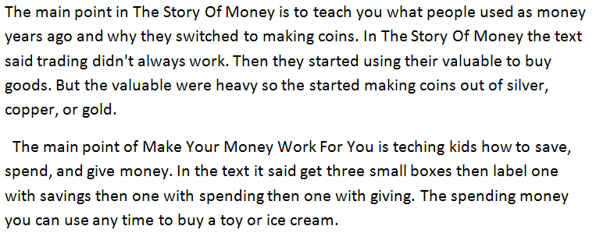
ELA Constructed Response: Sample Response #1
Score: 2
Example of a student response receiving full credit

Slide 50
ELA Constructed Response: Sample Response #2
Score: 1
The student has answered the question but has not provided any specific details from either of the passages.

Slide 51
ELA Constructed Response: Sample Response #3
Score: 0
The student response refers to the main point of only one of the two passages.

Slide 52
ELA Narrative: Noteworthy Trends
Students may restate or summarize the existing text in narrative form rather than provide an original narrative response.
For prompts that ask the student to provide a narrative from a specific point of view, students may provide a narrative from a different point of view.
For prompts that ask the student to rewrite the story with a different ending or a different point of view, students may copy large portions of the given text with minimal changes.
Student responses may have only limited narrative elements or may use narrative elements such as dialogue in ways that do not effectively advance the narrative.

Slide 53
ELA Narrative
Grade 7 ELA Narrative Prompt
Imagine that, after reading “The Importance of Tribal Masks,” you are going to create an African tribal mask. Write a letter to a friend describing your mask, what it will look like, and the significance of each feature.

Slide 54
ELA Narrative Sample Response #7
Score: 1
The student has provided a summary of the text rather than responding to the prompt (write a letter to a friend).

Slide 55
ELA Narrative
Grade 3 Narrative Prompt
At the end of the story, Max decides to start a dog-washing business. Write your own story about Max’s first day washing dogs.
Be sure to include ideas from the text when writing your own story. Type your answer in the space provided.

Slide 56
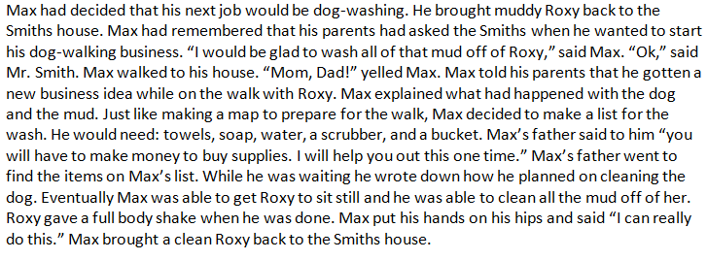
ELA Narrative: Sample Response #1
Score: 4
Example of a student response receiving full credit

Slide 57
ELA Narrative: Sample Response #2
Score: 1
The student has provided a summary of events from the text rather than an original narrative about the events after the story.

Slide 58
Argumentative/Opinion Writing: Noteworthy Trends
Students may provide an essay that introduces a claim, but provide little development with few details drawn from the passages.
Students may copy or closely paraphrase large portions of the prompt or passages (with or without attribution) while providing little original work (also seen in Informative/Explanatory Writing).
Students may present both sides of the argument without choosing a side (or simply writing an Informative essay) or may choose both sides.
Students may choose support from only one of the two passages (i.e., whichever passage best supports their claim or opinion).
For grades 7 and 8 and High School: Students may present only one side of the argument, omitting a counterclaim.

Slide 59
Argumentative/Opinion Writing: Sample Response #3
Score: 1, 1
Text in blue is a restatement of the text from the prompt. Text in yellow is copied or closely paraphrased from the passages. The student does not attribute any of the copied text.
Sample from 9th Grade Literature & Composition

Slide 60
Informative/Explanatory Writing: Noteworthy Trends
Students may provide an informative essay with some details drawn from the passage but with little organizational structure.
Students may provide little development with few details drawn from the passages or with support drawn from only one passage.
Students may copy or closely paraphrase large portions of the prompt or passages (with or without attribution) while providing little original work (also seen in Argumentative/Opinion Writing).

Slide 61
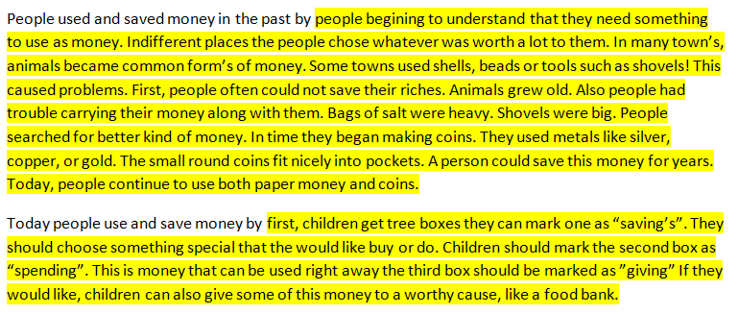
Informational/Explanatory Writing Sample Response #1
Sample from Grade 3
Score: B (Copied)
Text in yellow is copied or closely paraphrased from the passages. The student does not attribute any of the copied text.

Slide 62
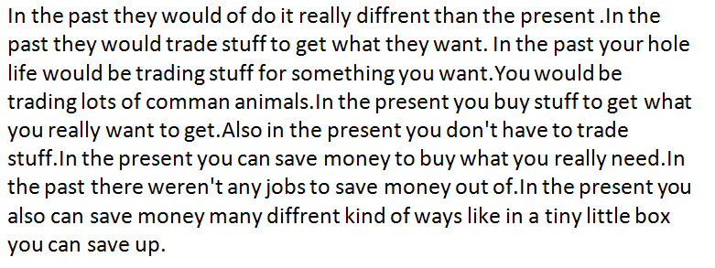
Informational/Explanatory Writing Sample Response #2
Sample from Grade 3
Score: 2, 2
The student provides a minimal introduction and then a list of details.

Slide 63
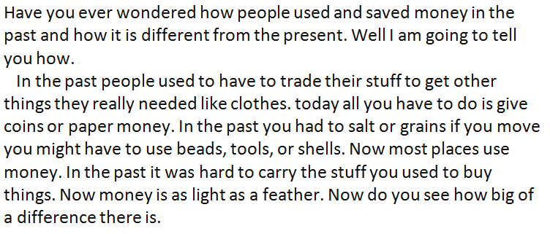
Informational/Explanatory Writing Sample Response #3
Sample from Grade 3
Score: 2, 2
The student provides an informative essay that draws details from only one of the two passages.

Slide 64
Math Constructed Response: Noteworthy Trends
For multistep processes, students were sometimes able to start the process correctly but were unsure how to complete the process.
Students would sometimes arrive at the correct answer using an unexpected process. Many prompts allowed for the students to take multiple correct approaches for full credit.
Students would sometimes not provide a complete explanation or a complete process for how they arrived at the answer.

Slide 65
Math Constructed Response: Noteworthy Trends
Students may confuse formulas, such as confusing area with volume or perimeter with area.
Students may not know key math terms or confuses terms (e.g., complimentary vs. supplementary; or diameter vs. radius)
When asked to provide an explanation, students sometimes tended to restate the information given.
Students used the wrong operation – when in doubt, add.
Students do not answer the question that is asked:
Example: the prompt provides a scenario and asks for the probability of two different outcomes both occurring; the students provides the two individual probabilities instead.

Slide 66
Math Constructed Response
Grade 5 Math Constructed Response
Peyton has a goal to walk 10,000 steps each day. On Tuesday afternoon, Peyton walked 7,338 steps. She averages 2.5 feet per step.
Part A How many more feet does Peyton need to walk to reach her goal of 10,000 steps? Write your answer in the space provided on your answer document.
Part B Explain with words or numbers how you found your answer. Write your answer in the space provided on your answer document.

Slide 67
Math Constructed Response: Sample Responses #1 and #2
Score: 2
Two examples of full credit responses using different, valid processes

Slide 68
Math Constructed Response: Sample Response #3
Score: 0
The student has the first step in the process correct (finding the number of steps remaining) but has an incorrect step when converting steps to feet (dividing by 2.5 rather than multiplying).
Item: How many more feet does Peyton need to walk to reach her goal of 10,000 steps? Explain with words or numbers how you found your answer.

Slide 69
Math Extended Response: Sample Response #4
Score: 1
The student has the correct answer but does not provide a complete explanation of the process used.

Slide 70
Math Extended Response: Sample Response #5
Score: 1
The student has an incorrect response but does have a correct complete process.

Slide 71
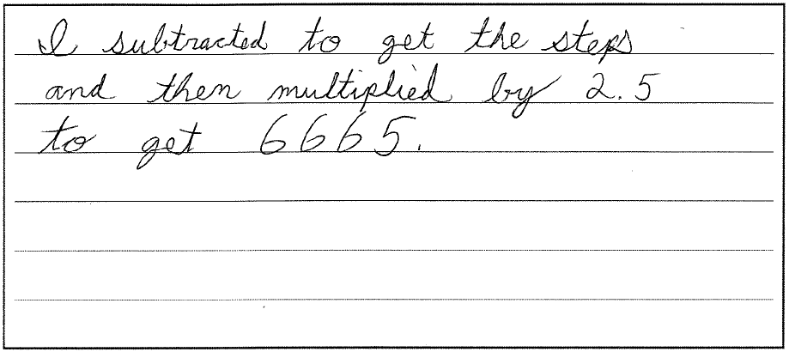
Math Extended Response: Sample Response #6
Score: 1
The student has an incomplete but valid process. The answer is incorrect (6665 instead of 6655).

Slide 72
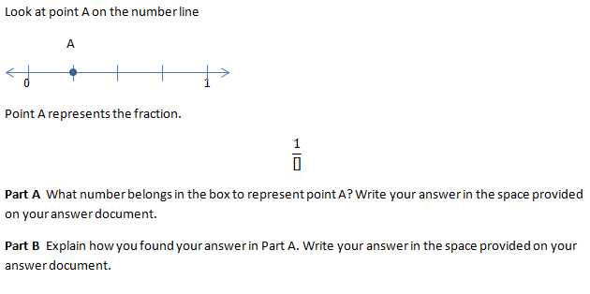
Math Constructed Response
Grade 3 Math Constructed Response

Slide 73
Math Constructed Response: Sample Response #1
Score: 1
The student has an incorrect answer but has a correct explanation in which the denominator is equal to the number of equal parts.

Slide 74
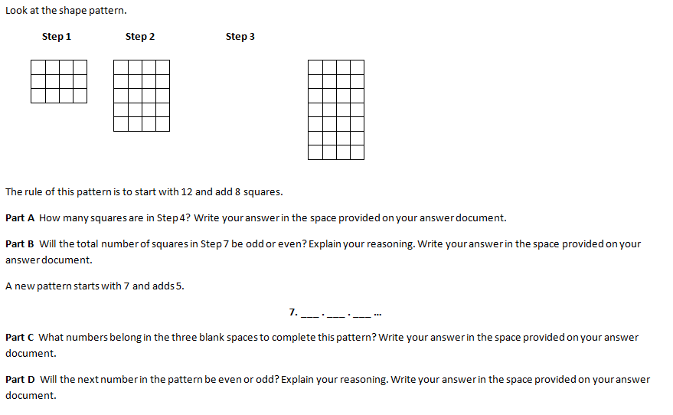
Math Extended Response
Grade 4 Math Extended Response

Slide 75
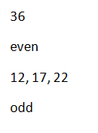
Math Extended Response: Sample Response #1
Score: 2
The student has provided the correct answers for all four parts, but parts B and D require correct explanations to receive credit.

Slide 76
Math Extended Response
Grade 5 Math Extended Response
Chris has 70 .jpeg files on his computer. Each file is 6.8 megabytes in size.
Part A What is the total size, in megabytes, of Chris’ .jpeg files? Write your answer in the space provided on your answer document.
Part B If Chris deletes 8 .jpeg files, what will be the total size, in megabytes, of Chris’ remaining .jpeg files? Explain how you found your answer. Write your answer in the space provided on your answer document.
Part C Amaya has 81 .jpeg files which are a total of 583.2 megabytes in size. If each .jpeg file is the same size, what is the size, in megabytes, of each of Amaya’s .jpeg files? Write your answer in the space provided on your answer document.

Slide 77
Math Extended Response: Sample Response #1
Score: 3
The student has an incorrect answer for Part A. The answer in Part B is incorrect, but it is based on the incorrect answer in A, so credit is given for both the process and the answer in Part B. The answer for Part C is correct.

Slide 78
Math Extended Response: Sample Response #2
Score: 2
The correct response for Part A is given. The student subtracts 6.8 from 476 seven times instead of eight. Credit is given for the process but not for the answer of 428.4. Part C is not answered.

Slide 79
Questions & Answers

