Slide 1
Georgia Milestones
Spring 2015
Online Assessments
Technical Set-up Training
December 11, 2014
1:00 pm – 3:00 pm
Webinar Etiquette:
- Please use the Audio Setup Wizard in the Tools Menu to configure and test your audio settings before the presentation begins.
- To eliminate interference from background noise in your area, please leave the Talk Button on mute if you are not speaking.
- Due to the number of participants, we request that questions be submitted via Chat at the designated times in the presentation.
Notes:
DOE will present this slide
Phones muted during training – use chat window
(DOE will start webinar session and give Moderator privileges to CTB Presenter, et al prior to the meeting, upload the slides and start the recording)
This is the GA Milestones Spring EOG and EOC Technical Set-up Training. This is geared towards getting your sites ready for the Spring administrations and the Statewide Readiness Test. Although it is mainly directed towards Technology Coordinators, Test Coordinators are welcome as they can learn about the functions Technology Coordinators must complete for a good student experience.
Thank you for joining this training today. Let’s get started.

Slide 2
Introductions
Georgia Department of Education
Tony Eitel, Director, Assessment Administration
Dr. Robert McLeod, Assessment Specialist
CTB/McGraw-Hill
Kim Block, Senior Program Manager
Nadia Greer, Program Associate
Frank McClure, Customer Care Project Lead
Yogesh Vazirani, Online Implementation Manager
Renita Kelley, Briljent Presenter
Charity Flores, Senior Program Manager
Dr. Mary Nesbit-McBride, Assessment Specialist
Michael Huneke, Assessment Specialist
Ed Molin, Senior Program Manager
12/11/2014
2
Notes:
DOE will present this slide
(Identify participants present on the call)
Presenter: Renita Kelley - Briljent

Slide 3
Agenda
Roles and Responsibilities
Network and Workstations Requirements
Workstation Cleanup
Support Resources
Checkpoint Process
System Overview
Statewide Readiness Test (SRT)
Spring EOG and EOC Test Information and Important Dates
TDC Installation Process
12/11/2014
3
Notes:
Thank you _________ (Mary). As _____ (Mary) said, I am a trainer with Briljent, and today we’ll review the technical aspects of online testing. Let’s go ahead and get started.
Here is the agenda for todays session.
First, we’ll discuss the Spring EOG and EOC Test Information, Important Milestones and dates around them.
Then, we’ll review the Roles and Responsibilities for Test and Technology Coordinators.
After that, we’ll give you an overview of the new Test Delivery Client (TDC) followed by the Network and Workstation Requirements for testing.
Then, we’ll review the steps for site readiness.
We’ll also discuss some considerations for site preparation.
And finally, we’ll finish up by offering some support resources and a Question and Answer session.
As a reminder, we’d like you to use the chat window for any questions that you have throughout the webinar.

Slide 4
EOG and EOC Spring Online Test - 3 Step Process
Today’s focus Checkpoint 2
Checkpoint 1
RTS data entry open
Checkpoint 2
Site Readiness Training
December 11th and 18th
Test Delivery Client (TDC)Installation
Site Readiness Test
January 13th
Site Support and Troubleshooting
Checkpoint 3
Test Administration System (TAS) Training
March 16th and 23rd
Test Setup/ Assignment
Final Workstation Check
Site Certification
Practice and Operational Test Tickets
Slide 4
Notes:
The checkpoint process (shown here) is meant to assist systems and schools with guidance as we prepare for the test administrations.
Checkpoint 1 focuses on the Registration and Technology Survey (RTS). The window is currently open so please log in and provide contact, workstation and network information for all your schools and any other sites that plan to administer the spring EOG and EOC tests online.
Please note that this is a Critical Process Step that should be completed by every System that will administer the Spring EOG and EOC tests online. The information provided here gives CTB necessary information about your workstations and network and helps their technology staff assist you during the troubleshooting activities. So please login and provide your site’s information.
Checkpoint 2 is the focus of our session today. The goals for Checkpoint 2 are to install the Test Delivery Client and Site Certification by verifying a few of the workstations. Today is the first session. The second session will be held on December 18th
We have a new TDC for spring EOG and EOC tests which is now available for download. We will provide you with details during this presentation about how to download that client and install it.
VERY IMPORTANT TO NOTE: This client will also be used to administer your Site Readiness Test on January 13th and Spring EOG and EOC administrations. This is different from the current TDC that you are using to administer the Winter EOC and will continue to use for Spring Mid-Month. Unlike before, the two clients can reside simultaneously on the workstations and DO NOT affect each other’s performance. The look and feel of the new TDC will be different and you will be able to distinguish between them. It is important to note that you will not be able to use the new TDC for winter or spring Mid-Month.
We will have two training sessions for Checkpoint 3. The focus will be on the Test Administration System (TAS), the final content installation, and the final workstation check. These sessions will happen in March.
If you need to access the PowerPoint or the recorded training, please go to the CTB Georgia portal at: www.ctb.com/ga. Look for the PPT and recording trainings under the spring administration.

Slide 5
Common Terminology
Checkpoint 2
Step 2 in the readiness assessment process. Load testing client and participate in Statewide Readiness Test.
Statewide Readiness Test (SRT)
A test to simulate student testing traffic. This test provides an opportunity to confirm readiness at the local level, the CTB servers and the ISP/route between the two.
CTB Secure Testing App
The new version of the Test Delivery Client (TDC), which is the locally installed software application used by students to take online tests.
Notes:
On this slide, you’ll find common terms you should be familiar with, such as Checkpoint 2, Statewide Readiness Test (SRT), and CTB Secure Testing App.
Checkpoint 2 is Step 2 in the readiness assessment process. Load testing client and participate in Statewide Readiness Test.
The Statewide Readiness Test (SRT) is a test to simulate student testing traffic. This test provides an opportunity to confirm readiness at the local level, the CTB servers and the ISP/route between the two.
CTB Secure Testing App is the new version of the Test Delivery Client (TDC), which is the locally installed software application used by students to take online tests.
Read the screen

Slide 6
Spring EOG and EOC Test Window
Tests
GA Milestones Spring EOG Online Tests
Test Administration
GA Milestones Spring EOC Online Tests
Operational: March 30th, 2015 to May 1st, 2015
Spring EOG
Spring EOC
Practice: March 16th, 2015 to May 1st, 2015
Operational: April 27th, 2015 to June 5th, 2015
Practice: April 13th, 2015 to June 5th , 2015
12/11/2014
6
Notes:
Now I’d like to discuss the EOG and EOC Online Test administration. As you can see, the test administration dates are listed here. Please note that administrative activities in preparation for testing can take place at any time after the TAS (Test Administration System) is made available. These dates you see here are the state defined windows for student test taking.

Slide 7
Student Data for Spring Administrations
EOC
CTB Online Pre-code window from March 9th 2015 to April 3rd 2015
Student Pre-code data provided from in the State Pre-ID file
EOG
Manual entry of students in TAS
Manual entry of students in TAS
CTB Online Pre-code window Feb 23rd 2015 to March 6th 2015
Student Pre-code data provided from in the State Pre-ID file
12/11/2014
7
Notes:
Now, lets talk about loading student data. You have 3 options –
State Pre-ID file
CTB Online Pre-code window for EOG and EOC. Please note the separate windows mentioned here on the slide.
Manual entry of student data in the Test Administration System (TAS).

Slide 8
Important Dates
Milestones | Dates
Checkpoint 1 - RTS Registration and Technology Survey (RTS) Checkpoint 1 | Dec 8th to Jan 30th 2015
Checkpoint 2 – TDC (Preliminary Release) Test Delivery Client (TDC) for Windows, Mac and Chromebooks | Dec 10th 2015
Checkpoint 2 - TDC Test Delivery Client (TDC) for Linux and App for Android tablets | Jan 30th 2015
Checkpoint 2 - TDC Test Delivery Client (TDC) App for iPad | Jan 30th 2015
Notes:
Here are some upcoming milestones and important dates to remember:
Checkpoint 1 should be completed in the Registration and Technology Survey (RTS) by January 30th.
The Test Delivery Client (TDC) will need to be installed as part of Checkpoint 2, The preliminary version for the purpose of statewide readiness test was released on December 10th.
We’ve also included TDC release dates for various other types of devices, such as iPad, Linux, and Android.

Slide 9
Important Dates
Milestones | Dates
Checkpoint 2 – Statewide Readiness Test Availability of Test Tickets (ISOFT) | Jan 5th 2015
Checkpoint 2 – Statewide Readiness Test Test Date | Jan 13th 2015 10:00 – 11:00 am E.S.T
Checkpoint3 - TAS Test Administration System (TAS) Operational Accounts – Student Management ,Test Scheduling, Operational Test Tickets | March 16th 2015 (EOG) April 13th 2015 (EOC)
Technical Setup Training – Session 2 (Repeat) | Dec 18th, 2014 10:00 am – 12:00 pm, EST
12/11/2014
9
Notes:
Here are some additional key dates for the statewide readiness test.
The instructions and troubleshooting support documents will be available on December 16
The Statewide Readiness Test Tickets will be made available by January 5th via the secure file sharing ISOFT link on the My Programs Navigator page when you login to www.ctb.com
The statewide readiness test will take place on Jan 13th from 10:00 – 11:00 am EST.
Checkpoint 3 is the release of TAS. More information about that will be provided in the training sessions in March.

Slide 10

Online Test Roles Overview
Roles Overview
System Test Coordinator
Assessment policies, procedures and possible test scheduling, adding and authorizing new users
School Test Coordinator
Test scheduling, student management, test administration, and coding and invalidations, Add/Edit users at School Level
School Technology Coordinator
Setting up hardware and installing software for each school computer. On site, offering support during Readiness Test and the Spring online testing.
System Technology Coordinator
Equipment and ISP, proxy servers, firewalls and WAN connections at each school
Notes:
Here is an overview of the test administration roles:
As you’ll see in the top-left corner, the System Test Coordinator is responsible for assessment policies, procedures and possible test scheduling.
In the top-right corner, you’ll see that the School Test Coordinator/Test Examiner is responsible for test scheduling, student management, test administration, and invalidations
In the lower left corner, you’ll see that the School Technology Coordinator is responsible for setting up hardware and installing software for each school computer.
And finally, in the lower right corner, you’ll see that the System Technology Coordinator is responsible for equipment and ISP, proxy servers, firewalls and Wide Area Network (WAN) connections at each school.
The roles listed here are typical for an online test, however, depending on the size of the school system it’s possible that some people may have dual roles, or the responsibilities may overlap between roles.

Slide 11
Roles Overview (Statewide Readiness Test)
Test Coordinator
Monitor and Report on SRT Experience
Review SRT Results with Tech Coordinator – Compile Feedback to CTB
Team with Technology Coordinator to Administer the SRT
Understand Statewide Readiness Test and Plan for the Event
Review Test Delivery Client Installation Guide and Checklists
Install TDC / Confirm Installation
Monitor and Report on SRT Experience
Review SRT Results with Test Coordinator – Compile Feedback to CTB
RTS - Checkpoint 2 Readiness Panel Signoff
Technology Coordinator
Notes:
This slide outlines the roles and responsibilities of the Test and Technology Coordinators.
Both the Test and Technology Coordinators have tasks to complete during Checkpoint 2 and the Statewide Readiness Test. Test Coordinators should review and plan for the Statewide Readiness Test. Test Coordinators should team with the technology coordinator in administering the Statewide Readiness Test. During the Statewide Readiness Test, the Test coordinator should work with the technology coordinator to monitor the test process and report on issues. Finally, following the Statewide Readiness Test, the test and technology coordinators will compare notes from the test process and report back to CTB on the issues faced, if the issues could not be resolved locally.
Responsibilities for the Technology coordinator include installing the test delivery client and preparing for the Statewide Readiness Test at the site. This includes verifying that workstations are ready for testing. The technology coordinator will also be involved during the Statewide Readiness Test in conjunction with the test coordinator, as mentioned earlier. The final step for the technology coordinator is to login to the RTS application and check completion for Checkpoint 2.

Slide 12
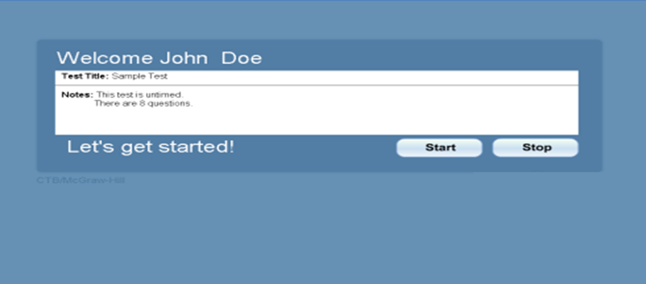
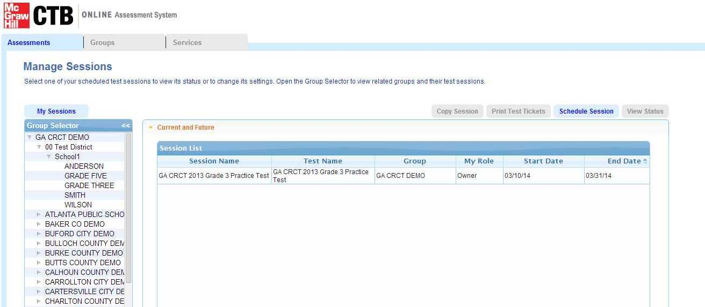
Online System Overview
  Student testing software (TDC)
  Lock down browser
Test Delivery Client (TDC)
  Student data management
  Test assignments
  Testing status
Test Administration System (TAS)
Notes:
The Georgia Online Testing Program consists of 2 main components, the Test Delivery Client (TDC), and the Test Administration System (TAS) website.
The TDC is the software that students will use to take the online testing. It includes a locked down browser component, which is a security feature that keeps students from minimizing the software or accessing any other windows during testing.
The TAS is a web-based app where Test Coordinators can log in and update student data, handle test assignments, and check on testing status.

Slide 13
Test Delivery Client Agenda
New 2015 TDC – CTB Secure Testing App
Preliminary Release of the client
Updated Release for Spring 2015 Operational Test by end of January
Ancillary Software No Longer Required (Java, Flash and Air)
HTML 5 based Lockdown Browser
Will be used for Statewide Readiness Test
Notes:
A new version of the TDC software, called the CTB Secure Testing App has been released. This will be used for the Statewide Readiness Test on Jan 13th
Please note that this is a preliminary release of the application. You can use this to test your network, your proxy settings, your network deployment packages and as noted for the Statewide Readiness Test.
We are still adding/upgrading the security features of the application to better align with the various operating systems, such as Windows, MAC, Chromebooks, iPads, Android tablets and Linux. A newer updated version with enhanced security will be made available by the end of January. A memo will be sent out to all System Test Coordinators when the updated release is made available.
The new CTB Secure Testing App is an HTML 5-based lock down browser, which means that the ancillary software (Java, Flash, and Air) are no longer required. You do not have to uninstall Java, Flash or Air. Although the new TDC does not require Java, Flash, or Air, other locally installed applications may require them, such as the Media Player or other Multi-Media software.

Slide 14
Test Delivery Client Agenda
New 2015 TDC – CTB Secure Testing App
Newly Supported Devices includes Chromebooks, iPads and Androids
Please Wait Message/Functionality Changed
No Pre-positioning of Content required
No Custom Installation Option Needed – MSI Package for Network Installation Available
Notes:
Please note that there are no more separate custom install options. The MSI packages are available to push through using Network deployment.
Also, you are no longer required to pre-position content packages when installing the TDC software. All of the content will be accessed in a secure manner at the time of the test.
Newly supported devices include Chromebooks and Androids. Along with the iPad, these mobile devices will have apps available via each device’s app store.
In the past, students saw a “Please Wait” message when their test sessions were interrupted. Although we are still insuring that student responses are saved, we have changed the functionality and the message that students will see when their test sessions are interrupted.

Slide 15
Online Testing Application FAQ
Q :- When will the new Application be available?
  The preliminary version is currently available to download for Window, Mac and Chromebooks.
  An updated version with enhanced security will be released by end of January
  App for Linux, iPads and Android tablets will be available by Jan 30th 2015
  Q :- Can we use the new TDC to administer Winter EOC and Spring Mid-Month?
  No. You will need to use the current TDC 15.1 for administering your Winter EOC and Spring Mid-Month tests. Students will not be able to take the EOC tests even if they launch the new application inadvertently
  Q :- When should we remove TDC 15.1 from our workstations ?
  Both applications can co-exist on a workstation without affecting each other’s performance.
  It is recommended that you remove TDC 15.1 from your workstations and network only after you have completed ALL your Spring Mid-Month administrations. Steps to perform the uninstallation will be discussed later in the presentation
Notes:
Here are a few Frequently Asked Questions regarding the new Online Testing Application.
The first question is, when will the new Application be available?
The answer is that the preliminary version is currently available to download for Window, Mac and Chromebooks.
An updated version with enhanced security will be released by end of January
App for Linux, iPads and Android tablets will be available by Jan 30th 2015
The next question is, can we use the new TDC to administer Winter EOC and Spring Mid-Month?
The answer is, no. You will need to use the current TDC 15.1 for administering your Winter EOC and Spring Mid-Month tests. Students will not be able to take the EOC tests even if they launch the new application inadvertently
The last question is, when should we remove TDC 15.1 from our workstations ?
The answer is that both applications can co-exist on a workstation without affecting each other’s performance.
It is recommended that you remove TDC 15.1 from your workstations and network only after you have completed ALL your Spring Mid-Month administrations. Steps to perform the uninstallation will be discussed later in the presentation
** Read through FAQ above **

Slide 16
Network Requirements
Network Requirements
Bandwidth
T1, high-speed cable, or high-speed DSL recommended
Minimum 1.5 Mbps upload and download
Firewalls
Port 80 and 443 must be open
Proxy Servers
Do Not Cache Dynamic Pages
Prioritize traffic to and from *.ctb.com
Web Content Filtering
Exclude *.ctb.com from content filtering
LAN
Allow both HTTP and HTTPS traffic for *.ctb.com
Wireless OK – Do not overload WAP
Do not block MP3 files – used for Text to Speech (TTS)
Allow traffic from *.readspeaker.com; IPs: 79.136.80.253 & 79.136.80.254
Users must have credentials if proxy authentication is enabled
Notes:
Here are the network requirements for online testing:
First, confirm the network bandwidth. The minimum is 1.5 Mbps (megabits per second) upload and download speed. T1, high-speed cable, or high-speed DSL are recommended.
The next step is to setup the firewall. Ports 80 and 443 must be opened. Ctb.com also needs to be whitelisted. If you wish to enter IPs, please see the addresses listed here on this slide.
Regarding proxy servers, make sure you do not allow caching of dynamic pages. Also, allow both HTTP and HTTPS traffic for *.ctb.com (star dot ctb dot com) and *.readspeaker.com (star dot readspeaker dot com), and exclude these domains from content filtering. Also confirm that users have credentials if proxy authentication is enabled. We’ve also provided IP addresses if needed for certain equipment on your network.
As for web content filtering, we ask that you please do not block MP3 files. The TDC uses MP3 files to deliver the audio for the text to speech accommodated students.
Finally, using wireless is okay for online testing, just make sure you consider the distance from the Access Point and the number of connections to that access point.

Slide 17
Student Workstation Minimum Requirements
Workstation Requirements
Type | OS | Hardware | Screen Size/Resolution
Windows | Windows 7 Windows 8, 8.1 | 1.3 GHz Processor 1 GB RAM, 2 GB Recommended 1 GB Disk Space Available | Screen – “10-inch class” Resolution - 1024 x 768
MAC OS X | Lion 10.7.5 (Intel) Mountain Lion 10.8.x(Intel) Mavericks 10.9.x (Intel) Yosemite 10.10.0 (Intel) | 1.3 GHz Processor 1 GB RAM, 2 GB Recommended 1 GB Disk Space Available | Screen – “10-inch class” Resolution - 1024 x 768
Linux | Fedora (Red Hat) 16 Ubuntu 12 | 1.3 GHz Processor 2GB RAM, 4 GB Recommended 1 GB Disk Space Available | Screen – “10-inch class” Resolution - 1024 x 768
Notes:
Here we have the workstation requirements for the TDC.
Several versions of Windows are supported as well as MAC and Linux operating systems.
Please refer back to this slide for processor and RAM/memory requirements for the testing software.
The workstation minimum requirements document will be located in the Technology section of the CTB GA Portal at www.ctb.com/ga
The operating system requirements for Windows are Windows 7, Windows 8, and 8.1
The hardware requirements are 1.3 Gigahertz Processor, 1 Gigabyte RAM. 2 Gigabyte Recommended, 1 Gigabyte Disk Space Available
The screen size and resolution requirements are 10 inch class with 1024 x 768 resolution
The operating system requirements for MAC OS X are Lion 10.7.5 (Intel), Mountain Lion 10.8.x (Intel), Mavericks 10.9.x (Intel), and Yosemite 10.10.0 (Intel)
The hardware requirements are 1.3 Gigahertz Processor, 1 Gigabyte RAM, 2 Gigabyte Recommended, 1 Gigabyte Disk Space Available
The screen size and resolution requirements are the same for all types and that is again, 10 inch class with 1024 x 768 resolution
The operating system requirements for Linux are Fedora (Red Hat) 16 and Ubuntu 12
The hardware requirements are 1.3 Gigahertz Processor, 2 Gigabyte RAM, 4 Gigabyte Recommended, 1 Gigabyte Disk Space Available
The screen size and resolution requirements are again, 10 inch class with 1024 x 768 resolution
** Review the workstation requirements above **

Slide 18
Student Workstation Minimum Requirements
Workstation Requirements (Contd.)
Type | OS | Hardware | Screen Size/Resolution
iOS | iOS 6 iOS 7 iOS 8 | iPad 2+ | Screen – “10-inch class” Resolution - 1024 x 768 *No iPad mini Guided access must be on / Assistive Touch must be off
Android | Version 4 (Ice Cream Sandwich) (Jelly Bean) (Kit Kat) | 1GB RAM | Screen – “10-inch class” Resolution - 1024 x 768 Device must be configured to use single app mode
Chromebook | Chrome OS 30+ |  | Screen – “10-inch class” Resolution - 1024 x 768
Thin Client Configurations | NComputing (Windows 7, Windows 8) | (Same as Windows) | Screen – “10-inch class” Resolution - 1024 x 768
Notes:
Continuing with the workstation requirements:
The operating system requirements for iOS are as follows: iOS6, iOS7, and iOS8
The hardware requirements call for iPad 2 or newer
The screen size and resolution requirements are 10 inch class with 1024 x 768 resolution
*No iPad mini, guided access must be on / Assistive Touch must be off
The operating system requirements for Android are as follows: Version 4 (Ice Cream Sandwich), (Jelly Bean), or (Kit Kat)
The hardware requirements 1 Gigabyte RAM
The screen size and resolution requirements are 10-inch class with 1024 x 768 resolution, and the device must be configured to use single app mode
The operating system requirements for Chromebook is Chrome OS 30 or newer
The screen size and resolution requirements are 10-inch class with 1024 x 768 resolution
And finally, the operating system requirements for Thin Client Configurations is NComputing (Windows 7, Windows 8).
The hardware requirements are the same as Windows and the screen size and resolution requirements are 10-inch class with 1024 x 768 resolution
** Continue reviewing the workstation requirements above **

Slide 19
Workstation Prep
The following conditions must be met on each workstation:
Administration permissions may be required to install the TDC software. This condition is locally driven.
The TDC must be installed, and the TDC executable must be runnable by the user account logged into the workstation during testing.
The logged in user must have write access to the TDC installation directory so that the TDC Log File can be updated.
MP3 Player must be tested and working in order for students to receive Text-to-Speech accommodations.
Notes:
There are some key considerations when installing the Test Delivery Client.
The following conditions must be met on each workstation:
– Administration permissions may be required to install the TDC software. This condition is locally driven.
– The TDC must be installed, and the TDC executable must be runnable by the user account logged into the workstation during testing.
– The logged in user must have write access to the TDC installation directory so that the TDC Log File can be updated.
– MP3 Player must be tested and working in order for students to receive Text-to-Speech accommodations.
** Review items in the light orange boxes **

Slide 20
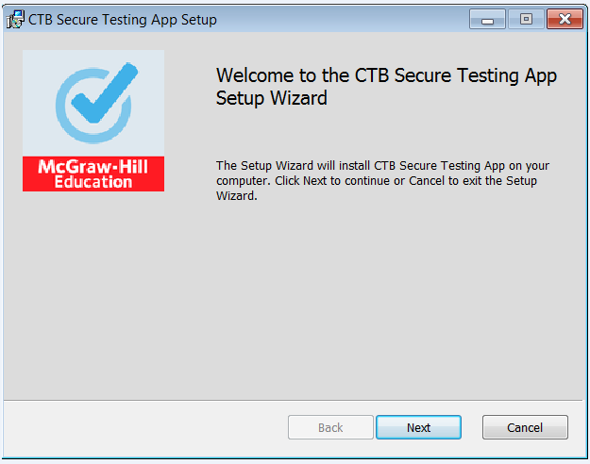
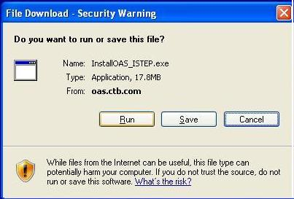

Install the TDC- Standard Install
TDC Installation
Installation for Windows and Mac:
Operating System Platform | Live Links
WINDOWS 7, 8 and 8.1 | Refer to the Installation Guide posted at www.ctb.com/ga under Spring 2015 – Online Testing.
MAC 10.7.5, 10.8, 10.9 and 10.10 (Intel)
1. Access and Download the Install file (.exe or .msi file extensions)
3. Follow Prompts
2. Launch and Click Run
Slide 20
Notes:
The steps to install the CTB Secure Testing App on a PC are to first, access the software installation link in the installation guide document. Please go to the www.CTB.com/ga portal and look for it under Spring 2015 – Online Testing, under “Technology”

Slide 21
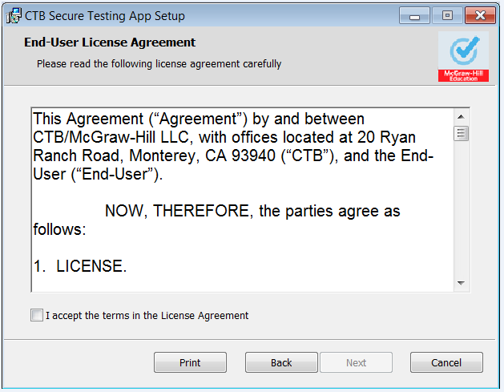
Install the TDC – Standard 4 Elements
TDC Installation
Step 1: Start Installation
Step 2: Accept Terms and Click Next
Slide 21
Notes:
The installation process for the new TDC has been simplified. There are only a few screens. Start the installation process, review and accept the license agreement, and then click Next.

Slide 22
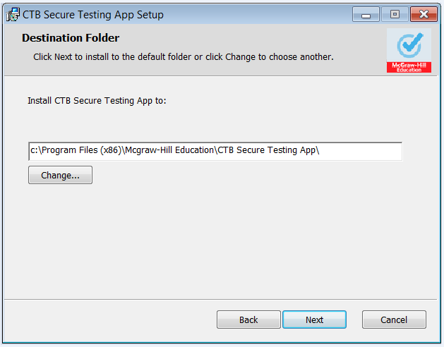
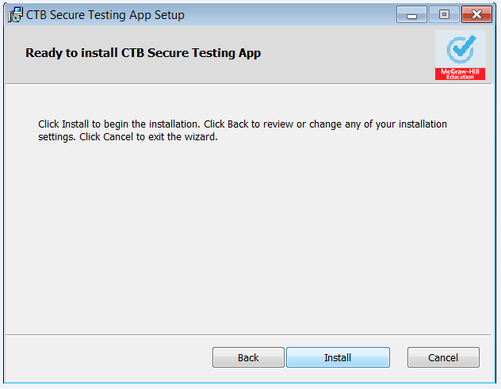
Install the TDC – Standard 4 Elements
TDC Installation
Step 3: Accept default path and click Next.
Step 4: Click Install to begin Installation.
Slide 22
Notes:
Accept the default installation folder and click Next. Then, and click install to begin the installation.

Slide 23
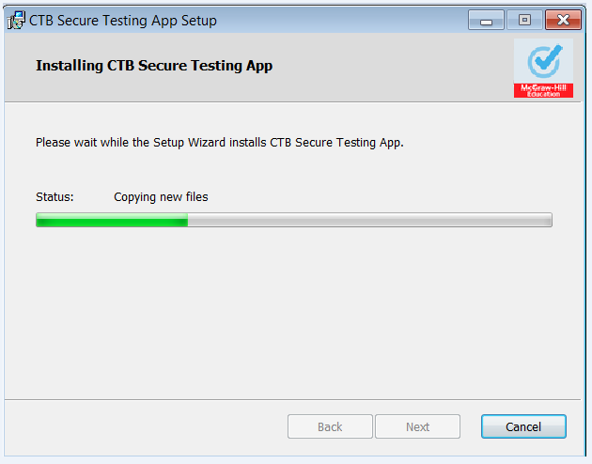
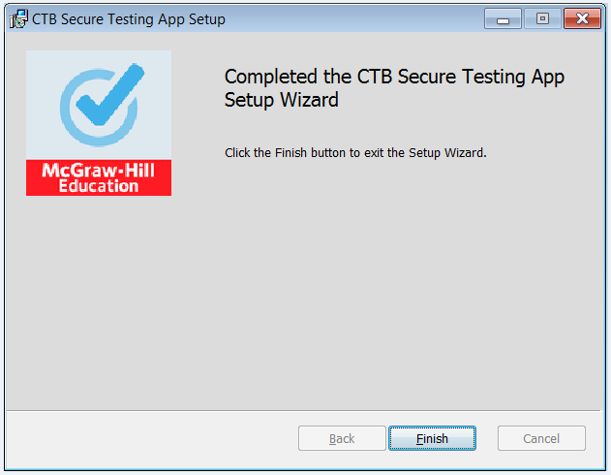
Install the TDC – Standard 4 Elements
TDC Installation
Step 5: Click Finish to complete Installation.
Slide 23
Notes:
Click Finish to complete the installation. It should be noted that an MSI package will be released for those who want to roll the application out via a network installation. Because there is no content to pre-position, the small CTB Secure Testing App is the only software that needs to be installed.

Slide 24
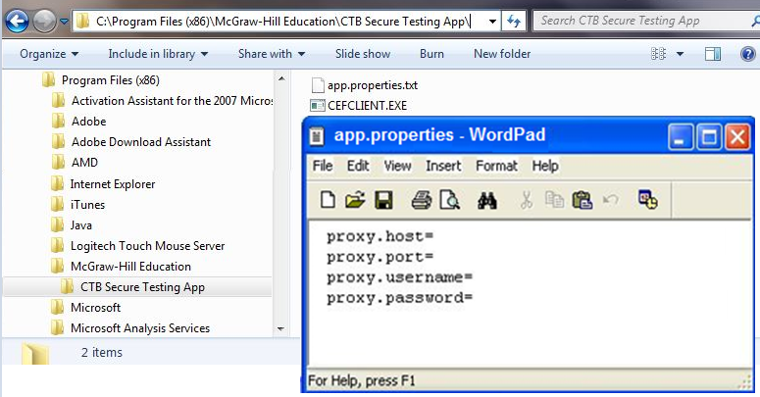
Install the TDC -Standard Configure
TDC Installation
Configure - Proxy Properties (if applicable at site)
Navigate to App.Properties file location.
Open file, add entries and save
Slide 24
Notes:
Next, for those sites that require proxy authentication, find and open the app.properties file, add the required credentials, and then save. To find this file, navigate to the installed location; within Program Files, look for the McGraw Hill Education folder, then the CTB Secure Testing App folder as shown on the slide. The app.properties file can be opened and saved using Notepad or WordPad. In some cases, only the proxy.host and proxy.port are required. This depends on the proxy configuration at the local site.

Slide 25
TDC Installation
What about the content?
  Content prepositioning is no longer required
  When a student logs in to a test, the test framework (encrypted XML file) is downloaded to the student workstation
  The content is cached on the local workstation for the next student who takes the same test (cached content is encrypted)
  Test framework XML file contains only text for test instructions and questions, images are downloaded as needed
  Same test start-up time as before
Notes:
Continuing with the TDC Installation process, what about the test content? It is no longer necessary to preposition the test content on each testing workstation. When each student logs in to take a test, the test framework is downloaded in the form of an XML file. The test framework XML file contains only the text needed to construct the test. Images are downloaded as needed when the student moves through the test. After the student completes the test, the test content is cached locally for the next student who takes the same test. The content is encrypted at all times, including when cached locally. No extra time is expected when launching the CTB Secure Testing App and logging into tests.

Slide 26
System Check – Launch and Login
System Check - Launch TDC and Login
Verify setup on a few workstations.
Launch Test Delivery Client software.
Login using Test for Username and Password and Georgia Access Code. Two questions are available to the Guest user account for verifying installation.
If the application launches and you are able to login and view 3 sample questions, then the installation has been verified.
Slide 26
Notes:
If the application launches and you are able to login and view two questions, then the installation has been verified.
Use “Test” for Username and Password and “Georgia” for Access Code.
You can do further verification of your network and workstation setup after you receive the readiness test tickets for your site. The type of test ticket to use depends on which content has been loaded to the objectbank folder. This confirmation process will work regardless of which type of installer was used. If you login with a SRT ticket, and the Welcome screen appears as shown on this slide, then the network and workstation have been properly configured. This site should now be ready for online testing.

Slide 27
Mobile Device Setup Requirements
Hardware
iPad®2 or newer, No iPad® mini’s
Monitor/ Speakers
Operating System
iPad® – iOS6 or newer
Additional Requirements
Guided Access use is required to allow iPad use for the TDC application only. Other apps cannot be started while Guided Access is on
Minimum screen size – 10” Class (No iPad® mini)
Resolution - 1024 x 768
Sound On and Headset for “Text To Speech” Accommodated Students
Chromebook
Android with 1GB of memory
Android OS version 4.0.3 – 4.4.x
Chrome OS 30+
Android – Single App Mode turned on
Notes:
If any site plans to use iPads for testing, the devices must be an iPad 2 or newer with iOS6 or newer installed. The device must be in the 10” class of machines, therefore, iPad Minis cannot be used for online testing. Guided access must be turned on in order to lock down the TDC.
Android devices must have at least 1GB of memory and the operating system must be between 4.0.3 and 4.4.x. Android devices with version 5, Lollipop, OS are not supported. Androids must be locked into single app mode in order to lock down the TDC.

Slide 28
iPad Setup – Test Delivery Client Install
Mobile Device Setup Installation
Step 1 -
Download CTB Secure Testing App (TDC) from Apple Store
Step 2 -
Install TDC App
Step 3 –
Launch TDC and Verify the Installation
Download and Install Client app
Launch the CTB Secure Testing App.
Launch App Store for
  Apple
  Android or
  Chrome
iPad: Launch Guided Access and enter the Passcode.
  Android: Configure the device to use Single App Mode.
App Access Code
An access code will be provided to all testing contacts via a memo prior to release of CTB Secure Testing App software apps. You only need to enter the access code one time.
Locating TDC
  Search in Education apps
  Name – CTB Secure Testing App
Verify the Installation:
  Login using Guest for the Username, Password, and Test Access Code.
  Two test questions will be available to verify installation.
Download (free)
Notes:
Access the new test delivery client from the store for each mobile device. Search the Education sections of each store for the app. The app name is “CTB Secure Testing App.”
After installing the app on the mobile device, enter an access code to localize the app to Georgia. The app access code will be shared with the System Test Coordinator (STC) via a memo announcing the availability of the new CTB Secure Testing App when the apps for iPad and Android are released. The App Access code will also be included in the Installation Guide.

Slide 29
iPad Setup
Guided Access Information (from Apple iPad ® user guide)
http://manuals.info.apple.com/en_US/iPad_User_Guide.pdf
Use Guided
Access:
(per Apple)
Guided Access limits iPad® [use] to a single app, and lets you control which app features are available.
Disable the iPad® hardware buttons.
Notes:
If you are unfamiliar with guided access, please refer to the Apple user guide. The link is displayed on the slide. Per Apple, you can use guided access to (1) limit iPad® use to a single app, and (2) control which app features are available; it can also disable the iPad hardware buttons.

Slide 30
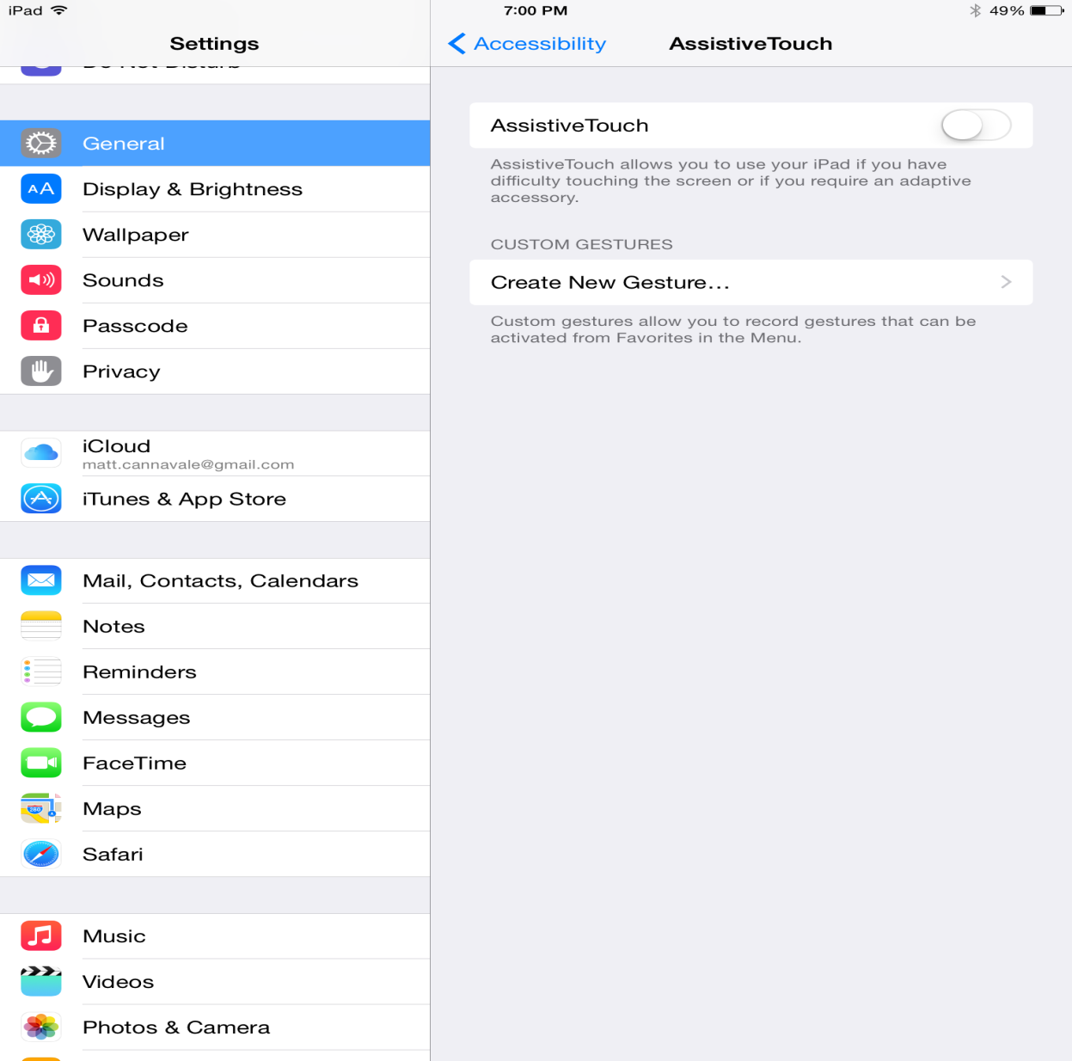
iPad Setup
1
3
Turned off
2
Notes:
This slide shows you how to ensure that Assistive Touch is turned off.
On the iPad, go to Settings, under Setting tap General, Accessibility, and then ensure that the Assistive Touch slider is in the off position.

Slide 31
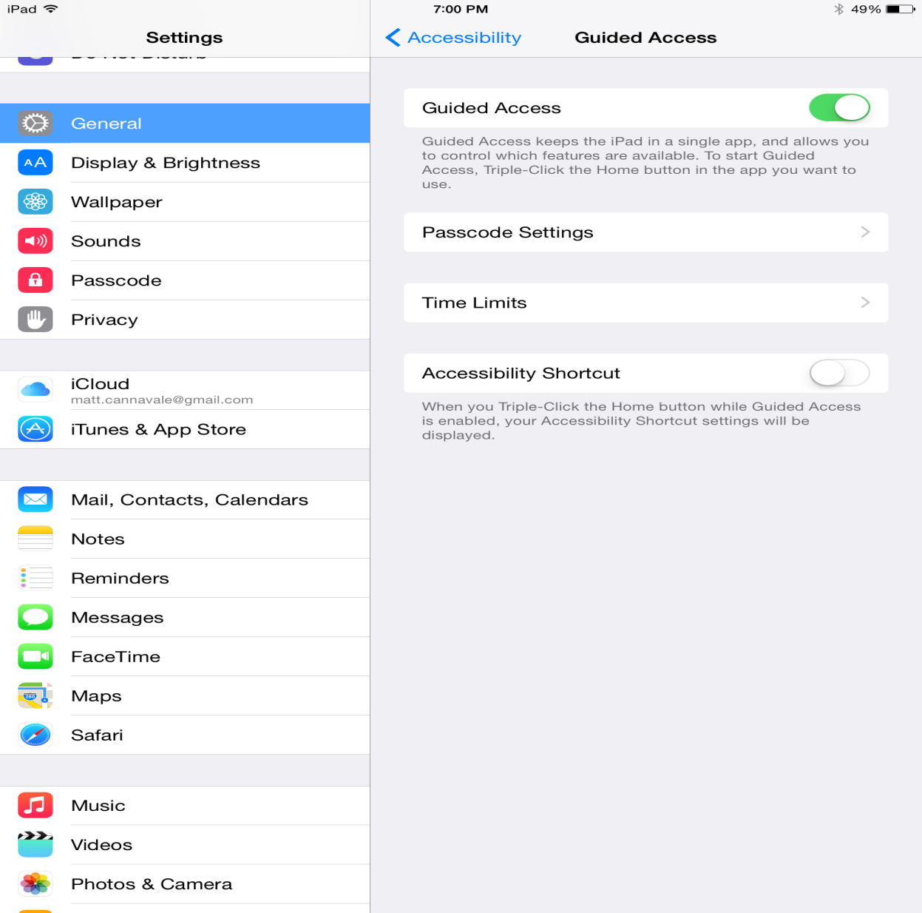
iPad Setup
1
3
Turned on
2
4
Notes:
This slide shows you how to ensure that Guided Access is turned on.
To turn it on, turn the slider for Guided Access to the on position, and then select Passcode Settings.

Slide 32
iPad Setup – Proxy Server Considerations
iPad Setup – Proxy Server Considerations
Proxy Server Considerations:
Sites with Proxy Server(s): The TDC makes HTTPS requests.
There is a difference between an HTTP proxy and an HTTPS proxy.
Apple only allows manual setting and configuration for an HTTP connection in iPad, no HTTPS.
Since it is only possible to define an HTTP proxy server, these credentials are not be used for HTTPS connection requests. Subsequently, whenever the TDC app fires an HTTPS request, it will be blocked by the Proxy Server.
Option to Resolve: If the app will be used on a network that has a Proxy Server, add the following URLs in the list of exceptions so that the Proxy Server will not request authentication for those URLs. The URLs are:
https://*.ctb.com/
https://*.readspeaker.com/
Slide 32
Notes:
There are some unique proxy server considerations when using iPads for online testing to consider that I would like to walk you through:
Sites with Proxy Server(s): The TDC makes HTTPS requests.
There is a difference between an HTTP proxy and an HTTPS proxy.
Apple only allows manual setting and configuration for an HTTP connection in iPad, no HTTPS.
Since it is only possible to define an HTTP proxy server, these credentials are not be used for HTTPS connection requests. Subsequently, whenever the TDC app fires an HTTPS request, it will be blocked by the Proxy Server.
Option to Resolve: If the app will be used on a network that has a Proxy Server, add the following URLs in the list of exceptions so that the Proxy Server will not request authentication for those URLs. The URLs are:
https://*.ctb.com/
https://*.readspeaker.com/
** Speaker – read the notes on the slide **

Slide 33
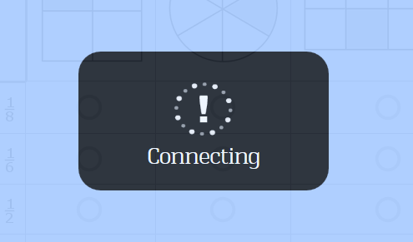
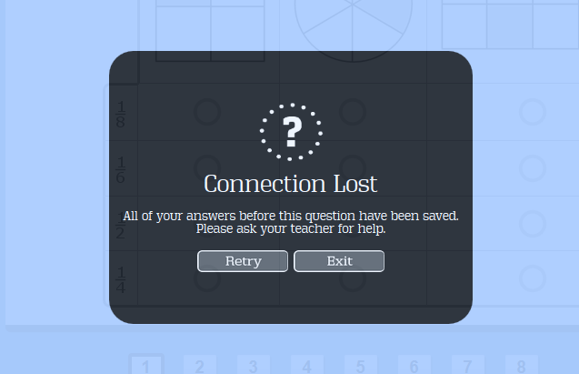
Connection Interruption
This message is displayed when connection is lost
This message is displayed when connection cannot be restored
Notes:
We have changed the way the “Please Wait” functionality works in the new TDC.
When the connection is lost a “Connecting” message is displayed as shown on the slide. The “Connecting” message will display for up to about 30 seconds before considering the student completely disconnected. During this time, the system is checking for an internet connection without requiring the student to do anything. If the system can reconnect, the message will disappear and the student can continue testing. If the system has been unable to find a connection after the 30 second period, then a "Connection Lost" message will display. From the "Connection Lost" message, students can retry the connection or exit the testing client.
The student can then be moved to a different machine to continue their test if it’s a workstation issue or log back into the same machine if connectivity is restored.
There is a “heartbeat” connection to the CTB servers in the new TDC just like the old one. An auto-save feature saves updates to student answers every minute. Student answers are submitted to the server upon moving to another item so if they lose their connection, the only answer that is at risk is the current one.

Slide 34
Statewide Readiness Test Elements
Statewide Readiness Test
Testing and Support
About the Test
Test
Activities
Slide 34
Notes:
Next, we will cover the following Statewide Readiness Test topics: “About the test”, Test Activities, and finally, Testing and Support.

Slide 35
About the Test Goal
Statewide Readiness Test – About the Test
Goals
Exercise online testing workstations concurrently to confirm; network capacity and readiness at schools, readiness of CTB servers and confirm the link between schools and CTB.
January 13, 2015, 10:00 a.m. - 11:00 a.m. Eastern
Statewide Readiness Test Date/Time:
Timeframe:
Approximately 45 minutes concurrently to confirm readiness at sites.
Test in progress and test taker engaged for 30 mins.
Basic Troubleshooting:
Connectivity, workstation setup, and capacity. Make note of all issues experienced.
Statewide Readiness Test Participants:
Administrators, School teachers and students (no need to use all 1020 simulated profiles)
Statewide Readiness Test answers will not be scored.
Content
Items will be selected from the Non-Secure Practice Tests on LearnOAS website
Slide 35
Notes:
The goal of the Statewide Readiness Test is to exercise online testing workstations concurrently to confirm: network capacity and readiness at the schools, readiness of the CTB servers, and confirm the link between the schools and CTB. The statewide readiness test will take place on January 13 from 10am to 11am Eastern Time.
Following the readiness test instructions that are provided, each test taker should remain logged into the test for approximately 30 minutes. The forty five minute time frame of the readiness test is to allow for test takers to enter the room, launch the testing client and begin and end the test.
Test takers during the statewide readiness test are not restricted to only students. Administrators and school teachers can also participate. The statewide readiness test will not be scored.
Again the goal of this Readiness Test is to exercise workstations and examine infrastructure. It is not to test Student Proficiency. The items that will be selected for this test will be from the Non-secure practice tests on the LearnOAS website.

Slide 36
About the Test Goal
Statewide Readiness Test – About the Test
Logins and Test Access:
1,020 simulated student profiles per school. Not required to use all 1,020 test tickets.
Student Login ID consists of System ID School ID, the word “Student”, and a sequential number from 0001 to 1020
Test Ticket documents can be accessed using your CTB.com account credentials. Download from the Secure File Sharing
Password – common to all users – test
Credential are not case sensitive
Test Access Code is specific to the school- The access code for each school will be the School ID and the word “test”
Example: 10104145student0001
Example 4145test
50 test tickets with screen reader accommodation will be provided per school. The sequence number will start from 1021 to 1070
Secure File Location/ISOFT
Slide 36
Notes:
CTB has generated and provided 1,020 test tickets for each school. It is not necessary to use all of these logins. Only the number of concurrent workstations planned for online testing should participate in the statewide readiness test. The extra logins can be used by the technology staff to check local workstations.
50 test tickets with screen reader accommodation will be provided per school. The sequence number will start from 1021 to 1070. Please use at least 2-3 tickets with screen readers during the readiness test.
The test tickets will be loaded to the Secure File sharing location by January 3rd. This site is accessible by your CTB.com login credentials. Test tickets follow a pattern for each school. The pattern is – the system ID followed by school ID, followed by the word “student,” followed by a 4 digit sequential number starting at 0001. The password is common for all users across the state and is the word “test.” The Test Access Code is specific to the school but common to all users at a particular school. The Test Access code pattern is the school ID and the word “test.” An example of a test access code for a school with an ID #4145 would be 4145test. The login credentials are not case sensitive, therefore, test takers can use upper or lower case when entering credentials.

Slide 37
Statewide Readiness Test – About the Test
Statewide Readiness Test Jan 13th
  Windows and Mac OS
  Chromebook App
  Available By Jan 30th for Local Readiness Test
  Linux OS
  iPad App
  Android App
Notes:
The statewide readiness test on January 13th will utilize all Windows, Mac, and Chromebook workstations you will be using for testing. The remaining apps for Linux, iPad, and Android will be released by January 30th, and schools may conduct a local readiness test on those machines once they have them set up for testing.

Slide 38
Statewide Readiness Test – Activities
CTB
Provide SRT Tickets with login ID, password and Test Access Code (TAC)
Monitor SRT testing progress and status
Provide troubleshooting and support during and following the SRT
Follow-up with corps and schools after SRT
Schools
Plan for SRT
Verify workstation and network setup
Provide Test Tickets and Access Code to test takers
Administer SRT
Note problems – Report issues to CTB
Install TDC software and setup network
Create SRT sessions
Provide TDC software
Slide 38
Notes:
The steps on this slide are activities that both CTB and the Schools will execute prior to, during and after the statewide readiness test.
The activities for CTB include the following:
Provide SRT Tickets with login ID, password and Test Access Code (TAC
Create SRT sessions
Provide TDC software
Monitor SRT testing progress and status
Provide troubleshooting and support during and following the SRT
Follow-up with corps and schools after SRT
The activities for Schools include the following:
Plan for SRT
Install TDC software and setup network
Verify workstation and network setup
Provide Test Tickets and Access Code to test takers
Administer SRT
Note problems – Report issues to CTB during the SRT
** Read the steps under “CTB” and then the steps under “Schools” **

Slide 39
Statewide Readiness Test – Activities
Before Test Day
Plan/schedule the Statewide Readiness Test.
Select test takers: administrators, teachers or students
Access test tickets containing SRT login IDs, passwords, and test access codes from ISOFT and print (PDF)
Involve Technology and Test Coordinators in the planning phase
Print troubleshooting support document and provide to test coordinators and staff members involved with SRT
Plan for protocol/phone tree in the event issues occur during the SRT
Install TDC software and Setup network.
Slide 39
Notes:
The activities that would occur before the testing day would be:
Plan/schedule the Statewide Readiness Test.
Install TDC software and Setup network.
Select test takers: administrators, teachers or students
Access test tickets containing SRT login IDs, passwords, and test access codes from ISOFT and print (PDF)
Involve Technology and Test Coordinators in the planning phase
Print troubleshooting support document and provide to test coordinators and staff members involved with SRT
Plan for protocol/phone tree in the event issues occur during the SRT
** Read the tasks in order **

Slide 40
Statewide Readiness Test – Activities
On Test Day
Provide test takers with SRT test ticket
Administer SRT
Technology and Test Coordinators monitor testing process and record issues
Implement protocol/ phone tree if a site experiences issues on test day
Provide local basic troubleshooting
Slide 40
Notes:
The activities that would occur on the testing day would be:
Provide test takers with SRT test ticket
Administer SRT
Technology and Test Coordinators monitor testing process and record issues
Implement protocol/ phone tree if a site experiences issues on test day
Provide local basic troubleshooting
** Read the tasks in order **

Slide 41
Statewide Readiness Test – Activities
After the Test
Report SRT issues to CTB
Work with CTB Support team to resolve issues
RTS Application – Mark successful completion of Checkpoint 2
Slide 41
Notes:
Additional activities that would occur after the testing day would be:
Report SRT issues to CTB
Work with CTB Support team to resolve issues
RTS Application – Mark successful completion of Checkpoint 2
** Read the tasks in order **

Slide 42
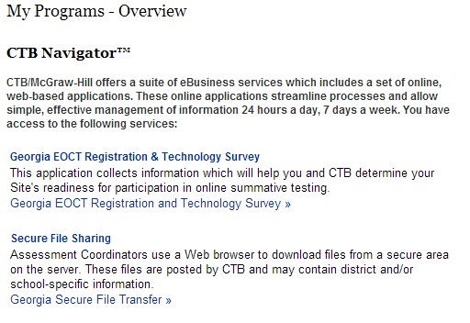
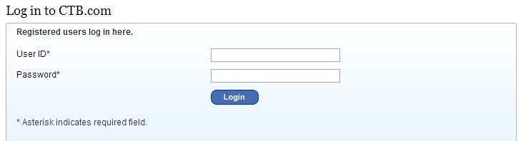
Statewide Readiness Test – Test Tickets
Login to ctb.com
Click on Secure File Transfer
Notes:
Now let’s review the location where you will need to go to pick up your Statewide Readiness Test Tickets
Login to CTB.com using your credentials.
Click on Secure File Transfer

Slide 43
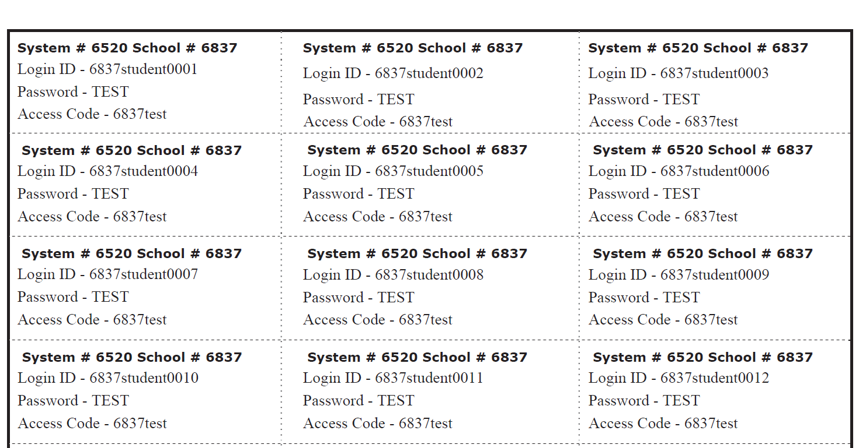
Statewide Readiness Test – Support Documents
Statewide Readiness Test – Test Tickets
Statewide Readiness Test
Statewide Readiness Test Tickets:
Access from ISOFT (Secure File Sharing) via CTB.com credentials
Slide 43
Notes:
This slide shows an example of the statewide readiness test tickets found on the Secure File Sharing website. Again, the link is available using your CTB.com login credentials. Tickets will be available by January 5th.

Slide 44
Statewide Readiness Test Support Documents
Minimum System Requirements document
Client Installation Guide for Windows, Mac and Chromebook
Test Administration Directions
Troubleshooting Guide
Common Error codes
This Presentation Slide Deck
Recording of Training Session
Notes:
Here is the list of documents that have been posted or will be made available shortly at www.ctb.com/ga.

Slide 45
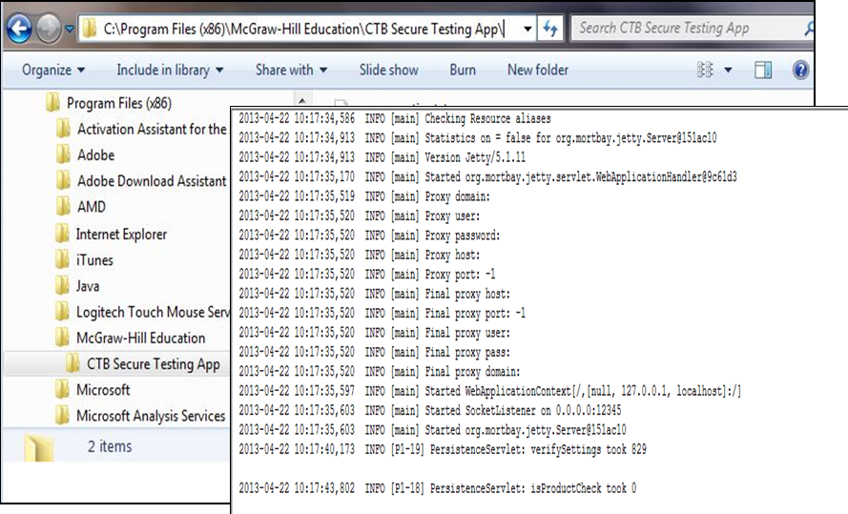
TDC Log File Review
Troubleshooting - TDC Log File Review
[install location]\Program Files (x86)\McGraw-Hill Education\CTB Secure Testing App\
Navigate to TDC log file location.
Slide 45
Notes:
Let’s take a moment to talk about an important troubleshooting step –
In order to resolve a reported issue, when you call the CTB Georgia Helpdesk, the agent may request that you send the TDC log file from a testing workstation experiencing the reported problem. The agent will provide directions for locating and submitting the necessary log file. The CTB Secure Testing App log files can be found by navigating to the installation folder: Program Files, McGraw-Hill Education, then the CTB Secure Testing App folder. There may be several log files in the folder. The agent will direct you to the required log file.

Slide 46
Workstation Prep – 2013 Cleanup
Workstation Cleanup Prior to Spring 2015
Standard Install
Uninstall TDC 15.1 (content files will be removed automatically)
Delete shortcut from all desktops
Custom Install
Slide 46
Notes:
Next we will review a few steps to clean up your workstations prior to the Spring 2015 EOG and EOC assessments.
PLEASE NOTE: As a reminder the current TDC that you are using for Winter EOC tests will also be used for Spring Mid-Months Testing until March 13th, the last day of your Spring Mid-Month window.
These steps should only be done after you have completed ALL of your Spring Mid-Month Administrations. You will no longer need the Old TDC version 15.1 after Spring Mid-Month.
This applies to sites that installed TDC version 15.1 or any other earlier versions of TDC.

Slide 47
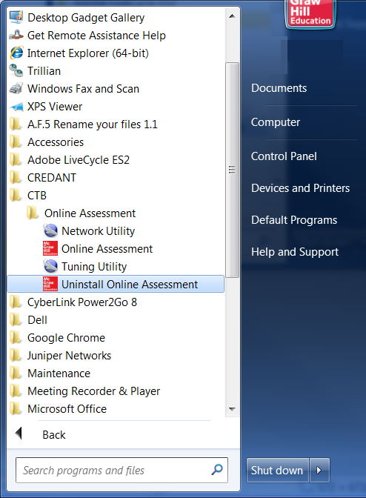
Workstation Prep – 2013 Cleanup
Workstation Cleanup Prior to Spring 2015
Standard Install
  Uninstall TDC 15.1 (removes content, too)
  From Desktop,
  Click Start,
  All Programs,
  Locate CTB Folder,
  Choose Uninstall,
  Follow Prompts
PC Option
Slide 47
Notes:
For standard installed clients, the PC example on the slide shows navigating to the CTB folder by clicking start, then All Programs. Open the CTB folder, choose the Uninstall option and follow the prompts as you can see on the screen.

Slide 48
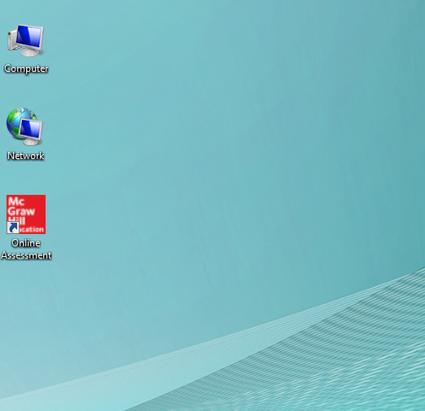
Workstation Prep – 2013 Cleanup
Workstation Cleanup Prior to Spring 2015
Custom Install
  Delete Desktop Shortcuts from All Workstations
  Delete the old TDC shortcut from all workstations so that students do not launch the wrong software application.
Slide 48
Notes:
Custom install users will need to insure the shortcut is removed from the desktop on each student workstation.

Slide 49
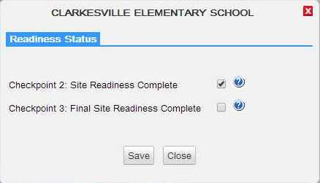
RTS – Readiness Panel
Notes:
Once you have successfully completed your participation in the Statewide Readiness test on Jan 13th please mark the Checkpoint 2 checkbox, as shown on this slide, for each school in your system.

Slide 50
Lessons Learned
Ensure that ALL of your student records are accounted for in either one of the two pre-code opportunities
For students that will be testing online ensure that are flagged appropriately in the state pre-id or the CTB Online pre-code system
Two opportunities to provide Student Data for EOG and EOC – State Pre-ID file and CTB Online Pre-code
Review the system requirements document to ensure that your site meets the expectations to conduct online testing successfully
ALL students should be given the opportunity to take a secure Practice Test in the Test Administration System (TAS) before the Operational Test.
Notes:
Let’s talk a little bit about some of the lessons we learned as a result of some of the issues we have encountered during the current Winter EOC administration.
It is important for System Test and Tech Coordinators to:
Review the system requirements document to ensure that your site meets the expectations to conduct online testing successfully
There are two opportunities to provide Student Data for EOG and EOC – (1) State Pre-ID file and (2) CTB Online Pre-code
Ensure that ALL of your student records are accounted for in either one of the two pre-code opportunities
For students that will be testing online, ensure that they are flagged appropriately in the state pre-ID or the CTB Online pre-code system
ALL students should be given the opportunity to take a secure Practice Test in the Test Administration System (TAS) before the Operational Test.

Slide 51
Positive Testing Experience
For a Positive Testing Experience…
Text To Speech –Volume on and MP3 files allowed.
Allow *.CTB.com
Restore software (Deep Freeze, etc.) configured to retain test data after reboot
All other applications closed on testing machines during the test
Restrict intensive bandwidth use during testing (VoIP, Payroll, Drop box) DO NOT stream educational content during testing
For a Positive Testing Experience…
Laptop protocol – Use AC power, wired access, wireless check
Screen savers/power management set to a longer timeout
Verify few workstations prior to testing
Anti-virus software full scans and updates scheduled after testing hours
Notes:
For a positive testing experience, please take a few moments to review these additional elements.
The items in the orange boxes are required.
The items in the blue boxes are considerations to keep in mind during testing.
Let’s review the orange box items:
Deepfreeze type restore software can be used but if the testing client is not in the image, make sure that deepfreeze is configured to retain test data in the event of a reboot.
In regards to text to speech – workstation or device volume must be turned on and MP3 files allowed through the network to the logged-in workstation user.
Confirm that (star) *.ctb.com has been allowed/whitelisted.
Finally, all other applications should be turned off during testing.

Slide 52
Online Testing Support Resources
Test Coordinators
Students locked out of the system before completing the test
CTB.com/ga
Technology documentation
Troubleshooting Guide
CTB Support
Questions about site readiness
Technical issues that do not appear to be local
Issues creating/obtaining user accounts for the system
Assistance with application functions
DOE
Testing policies and procedures
12/11/2014
52
Notes:
We’ve highlighted several support resources here for online testing:
Test Coordinators can fix issues with students locked out of the system before they’ve completed their test.
You can visit the CTB Georgia portal at www.ctb.com/ga for support documentation.
CTB technical support is also available for any questions or issues related to testing technology.
For any questions regarding policy or procedure, please contact the Department of Education (DOE).
The information provided here is a basic guideline. If in doubt you can always contact CTB Support and we will assist you the best we can or refer you to the appropriate resources.
A Troubleshooting Guide will also be posted to the www.ctb.com/ga website; this guide also includes recommendations for who to contact when a problem occurs during testing
Here are a few troubleshooting examples:
Problem: A student is interrupted during testing and the connection cannot be re-established on the current workstation → Solution: Move the student to a different workstation.
Problem: A student logged out of the test accidentally before finishing the test → Solution: A Test Administrator can reopen the student’s test session.

Slide 53
Managing Online Testing Issues
Unexpected
Events
Technological
Test Administration
Resolution Approach
Contact GADOE
Local Issues
Local Site Collaboration /Troubleshooting
    LAN / WAN / ISP
    Bandwidth intensive applications
CTB Customer Service Assistance
  General TAS / TDC functionality
  questions/ issues
Notes:
From a local perspective there a several categories of problems to be aware of and their possible resolution approach.
During the Test Administration & while the students are testing, our CTB support team will be there to assist with normal functionality questions or issues.
Technological issues like internet connectivity, LAN, WAN, ISP troubleshooting should be done in collaboration with local IT staff, CTB’s tech support and other resources.
For unexpected events like severe weather conditions or your site completely losing Internet connectivity, please contact the DOE to determine the best way to proceed with testing.

Slide 54
Resources
Administration Policies and Procedures Assistance
Georgia Department of Education
-Dr. Mary Nesbit-McBride, Assessment Specialist
404-232-1207 MNesbit@doe.k12.ga.us
-Dr. Robert McLeod, Assessment Specialist
404-656-2589 RMcLeod@doe.k12.ga.us
Michael Huneke, Assessment Specialist
404-232-1208 MHuneke@doe.k12.ga.us
Website:
http://www.gadoe.org/Curriculum-Instruction-and-Assessment/Assessment/Pages/Georgia-Milestones-Assessment-System.aspx
EOC Support
Phone: 866-282-2249
Hours of Operation:
6:30 am - 6:30 pm EST
CTB/Georgia Help Desk
GeorgiaHelpDesk@ctb.com
http://www.ctb.com/ga or
http://www.ctb.com/netcaster/categoryIndex.html?directoryId=8413&categoryId=8583
12/11/2014
54
Notes:
For policy and procedure questions, please contact the Department of Education (DOE). For all other questions, or if you are unsure of who to contact, reach out to the CTB helpdesk. Documentation for Test Administration as well as Technology set-up will be available on the CTB Georgia portal at: www.ctb.com/ga

Slide 55

Q & A
12/11/2014
55
Notes:
At this time, I’d like to give the floor back to _____ (Mary) to wrap up today’s training session. If you have any final questions, please submit those questions via the chat panel now.

Slide 56
Spring EOG and EOC Online Test
Thank you for your participation!
12/11/2014
56

