Slide 1
GaDOE – School Counseling and Career Readiness Team
Articulated Credit Agreements – a new opportunity for Georgia’s High School Students!

Slide 2
So what is Articulated Credit?…
​The purpose of the Articulated Credit Agreement Initiative between the Georgia Department of Education and the Technical College System of Georgia is to provide Georgia's students with the opportunity to receive college credit as a result of successful completion of specific CTAE high school courses taken in a CTAE pathway and an external assessment or credential in that pathway. These agreements recognize the efforts of students while in high school and allows them to receive credentialing in their chosen field more quickly and without duplication of coursework between high school and technical college curriculum.
These agreements provide high school students the opportunity to get advanced standing in a Program of Study at the Technical College without having to participated in Dual Enrollment
Rather than an agreement between a school or district and a specific unit of the TCSG, these Articulation Agreements are Memorandums of Understanding that are applicable statewide.
The GaDOE and the TCSG have committed to creating as many of these statewide agreements as possible.

Slide 3
And where can you find these agreements and supporting resources?...
The Articulation Agreements and other resources have their own page on the DOE website.
Go to the GaDOE website
Click on the Offices and Divisions link
Click on the link to Career, Technical and Agricultural Education
Click on the School Counselors Tab
Click on the Articulation Link on the left side of the page

Slide 4
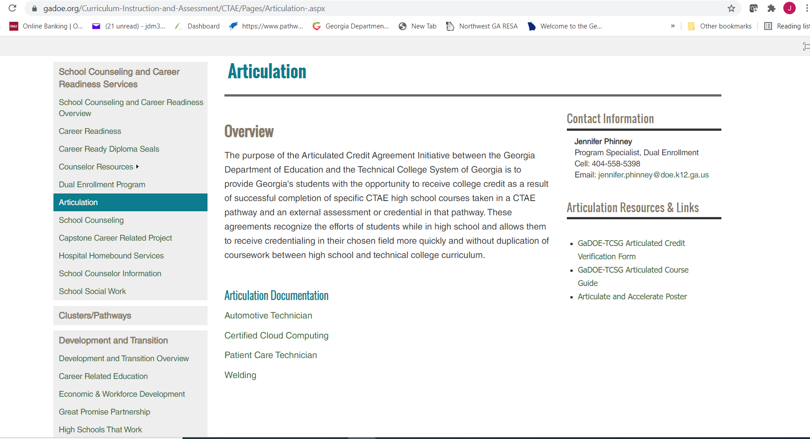

Slide 5
Resources for Articulated Credit…
Articulation Verification Form (to submit with application and proof of final assessment)
GaDOE/TCSG Articulation Course Guide – a summary of the criteria for each agreement that the student needs to meet to earn the credit
“ARTICULATE AND ACCELERATE” Marketing flyer/poster – to use at parent nights, in advisement, general marketing of articulated credit agreements to students and their families

Slide 6
The plan for future Articulation Agreements…
We are working with the Technical College System of Georgia to create more Agreements
We currently have 4 that are approved and available immediately:
Automotive Technician
Cloud Computing
Patient Care Technician
Welding
In the pipeline:
Construction
Early Childhood Education
NCCER Welding
Criminal Justice

Slide 8
Articulated Credit is ….
An agreement between the Technical College System of Georgia and the Georgia Department of Education
Offers Georgia’s high school students the opportunity to earn college credit by successfully completing specific high school courses in a CTAE Pathway and an external assessment or credential
Provides our students the opportunity to earn certificates, credentials or degrees more quickly and without duplicating coursework

Slide 9
Steps for Accessing and Receiving Articulated Credit

Slide 10
Step 1
Successfully complete the required courses in your chosen CTAE pathway to qualify for the articulated credit

Slide 11
Step 2
Successfully pass the required credentialing assessment, exam, or demonstration required to earn the articulated credit
This Photo by Unknown Author is licensed under CC BY

Slide 12
Step 3
During your senior year, apply to the Technical College of your choice
This Photo by Unknown Author is licensed under CC BY-SA

Slide 13
Step 4
Ask your counselor for the Articulated Credit Verification Form and fill it out.
Upload the Verification Form and Exam/Credential Certificate with your TCSG application

Slide 14
Step 5
Receive acceptance from the Technical College of your choice
Additional documentation or demonstration may be required by the local TCSG institution for the credit to be awarded
And that’s it! You’re done!
This Photo by Unknown Author is licensed under CC BY

Slide 15
Contact Information:
Jennifer Phinney
Program Specialist for Dual Enrollment
Jennifer.Phinney@doe.k12.ga.us
404.558.5398

