Slide 1
Moving On Up: Best Practices in Transitioning Students to the Next Level
Maria Grovner
Georgia Department of Education
Education Program Specialist
April 15, 2015
Notes:
Slide 1: Thank you for joining us today. I am Maria Grovner and I am the education program specialist for school counselors and social workers here at the GA Dept. of Education. Today’s webinar is Moving On Up: Best Practices for Transitioning Students to the Next Level.

Slide 2
Session Overview
School Transition Team & Plan
Vertical Teaming
Smorgasbord of Transition Activities
Parental Involvement
Summer Opportunities
During the School Year Activities
Suggested Resources
Notes:
Slide 2: Listed here are the topics we will be discussing today. As you begin to prepare for next year, we realize that you are preparing students to transition to the next level of their lives. Elementary to Middle, Middle to High and High to postsecondary, military or work force. This webinar will provide you with some ideas that you can implement at your school either the rest of this school year or put into effect next school year. Hopefully you will look at the ideas presented and determine how it can be implemented at your particular work level.

Slide 3
Transition Team
Suggested Transition Team Participants
Transitioning school personnel (teachers, administrators, school counselors, parent liaison)
Families
Students
PTA/PTO members
Community agencies (library, Boys and Girls Club, etc.)
Afterschool programs
Local businesses (small business owners, large business chains, etc.)
Community leaders (city/county council members, etc.)
High Schools may want to add college/university personnel
Team can meet quarterly to discuss strategies and plan activities.
Notes:
Slide 3: Oftentimes we as professional school counselors think that we have to do things on our own. However that’s not always the case. One of the things that can be done as you are working on your student transition program is to put together a transition team. A team of school personnel and other stakeholders to help implement transition activities. These are some of the people that can be on your transition team. When you look at the transition team, you may think why some of these groups of people listed are. For example, why would you need community agencies? If you think about your beginning of the year activities, you may want community agencies to come and offer free screenings for the students, school supplies giveaways. If it’s a for profit organization, maybe they will be willing to sponsor some of the activities that have a cost for the back to school event for a chance to get their names out to the parents and students for their particular afterschool program or tutoring services.

Slide 4
Vertical Teaming
Initially start out with counselors from all the schools that feed into each other. Some school principals do it. Why not school counselors?
Set a specific schedule for meeting and alternate host sites. That way the counselors from the other schools get an opportunity to see the school their students attended or will attend.
Have an agenda and focus for each meeting. Decide on issues that are pertinent to your area and what can be done from the school community. Be prepared to share these ideas with your administration team. That way they won’t have an issue allowing you out of the building because you are sharing school improvement ideas.
Four hours should be enough time for meeting….With an hour of time built in for action planning. Avoid busy times of year for school (i.e. beginning of year, end of semester, testing, end of year).
FOLLOW UP WITH EACH OTHER
Eventually, arrange for teachers to meet by transitioning levels to discuss procedural concerns and academic expectations.
Notes:
Slide 4: Imagine that it is the last day of school. You’ve been waiting on this day for a long time and so have your 5th, 8th and 12th graders. Now think what are your greatest concerns about the students you are sending on to the next level? Are there academic, behavior, social or even emotional concerns? What can be done about this concern you may have? The type of teaming in the previous slide is what I would call horizontal teams within the particular school. Of equal value, however, is the vertical team, which reaches beyond the school walls and promotes teamwork among elementary, middle, and high school counselors, which feeds a group of students into another school. The key is to build on the collaboration, cooperation, and communication vertical teaming establishes as you the counselors address the concerns you may have thought about or will think about and focus on meeting the needs of the students.
Collaborating with your fellow school counselors gives you an opportunity of what to watch out for and can help you plan activities and initiatives for the incoming class. It also lets you know about siblings and other particular classification of groups. The counselors can share any anecdotal information that may be helpful to the receiving school counselors. Comments may range from “she’s great and will do well” to “his parents are going through a divorce so he needs a set of eyes on him.” Be cautious about what you write down if you are going to discuss individual concerns/situations with the incoming school. Due to records possibly being subpoenaed, using phrases to jog your memory may be helpful when meeting with the school counselors face to face. The goal is to see which students have already surfaced (for behavior, academics or simple needs) and which ones we need to seek out (currently invisible yet potentially desperate for support). Whatever the case may be, the process allows you to learn more about the students.
It’s also important to note that if anything is shared with you that administration needs to be made aware of, then share that information with them. Possibly consider getting together with your fellow counselors during pre-planning, September, December (to discuss holiday assistance), early-February for articulation and May to wrap up year related to the students.
When you have students transitioning past high school, it is best practice to meet with some possible employers and college professors to find out what they are looking for so you can go back and redeliver the information to your students and your faculty so they can assist in getting the point across to students.

Slide 5
Getting the Teachers Involved
Initiate collaboration between grade level teachers about curriculum and teacher expectations…Teacher Swap-a-Day
Department Chairs meet with subject area teachers to discuss scheduling and expectations for teachers to share with students
Advisement Program
Notes:
Slide 5: Once you all have met and have some ideas, it’s best to arrange for the teachers to meet by levels to discuss procedural concerns and academic expectations. What kinds of things are they looking for from their students? One idea is to do a Teacher Swap a Day. Say 6th or 9th grade teacher go and “teach” a 5th or 8th grade class and can provide students with information about their academic expectations. They will hear it come directly from the teacher’s mouth. High School department chairs can go over to the middle school and talk with the middle school teachers and provide updates about their department next year or specific initiatives related to the academic program. Students will probably be a little more attentive when they hear it directly from the teacher’s mouth.
The advisement program, if your school has one, is a great opportunity for students to learn more information about a particular issue related to transition. A whole series of lessons can be developed around that theme in which teachers can deliver. Once again you do not have to tackle this huge responsibility by yourself.

Slide 6
A Smorgasbord of Transition Activities
Notes:
Slide 6: Transition activities are not activities that should just be done three months of the school year. Effective school transition programs needs to be yearlong and can have a certain focus for the month, which would possibly ease some of the students anxiety about transitioning to the next grade and ease their parents’ concerns.
On the next few slides, I have a variety of transition activities that you can tailor to fit your grade level. I don’t want to read them all to you, but when you get this Power point and when it is uploaded to the GADOE website, then you will have your own copy of the transition activities. Hopefully one pops out and catches your eye.

Slide 7
AUGUST: Review existing transition activities; Develop transition activities calendar | SEPTEMBER Students: Parents: | OCTOBER Students: Parents:
NOVEMBER Students: Parents: | DECEMBER Students: Parents: | JANUARY Students: Parents:
FEBRUARY Students: Parents: | MARCH Students: Parents: | APRIL Students: Parents:
MAY Students: Parents: | SUMMER Students: Parents:
Notes:
Slide 7: When you’re putting together your plan of transition activities for the year, creating a table or calendar similar to this could keep you and the transition team organized. Maybe in the cells you can jot down activities for the students AND for the parents. For the parent activities, I personally don’t think you need to have something every month, but at least once a quarter. Remember no matter what level a child is transitioning to, parents have fears and anxieties as well. We will discuss parents’ involvement in transition activities shortly. So on to the smorgasbord of transition activities.

Slide 8
ACADEMIC
Have students follow the bell schedule of receiving school for a period of time.
Students should experience some level of teaming or changing classes
Allow high school upperclassmen to act as academic tutors for sixth and ninth grade students.
Advisement Lessons…20 to 30 minutes/Elementary Level (specials)
Set high expectations for students performing below grade level.
Successful schools require students to redo work, provide extra support or stay after school to complete unfinished coursework.
Establish a way to provide extra-time and extra-help programs to assist students.
Explicitly teach a variety of time management strategies for students.
Help students develop a future-focused plan for success in school.
NINTH GRADE ACADEMY
Notes:
Slide 8: I have organized the transition activities into several headers to make it easier to understand. Academic, Social, Resources, Visits and Communication are the headers. With all the transition activities, I would like for you to ask yourself a few questions. Is there a way you can adapt the activities listed to your particular level---elem to middle; middle to high; high to postsecondary/work/military? Are there ones you currently do now that you can revamp the way you do it? How can you involve your feeder school in your planning of these activities?
Research has found that when students take part in a school’s transition program with several diverse articulation activities, fewer students were retained in the transition grade.
The one thing that defines the most successful transition programs is the shared commitment to the academic preparation of students. They recognize that an effective instructional program, a rich, rigorous and challenging curriculum, and a commitment to providing students with additional time and support if needed, makes students more successful. In addition to special orientation programs, the transition team should plan some intervention programs to support students that begin to experience difficulties with academics, social situations, peer dynamics, or other unexpected situations.
One of the transition activities that has become quite popular is having a 9th grade academy. A Ninth Grade Academy is usually a year long, uniquely designed school program that provides ninth graders with the resources and support they need. Most have a great deal of flexibility in providing support for ninth grade students. Because of the way most are set up, it definitely provides the opportunity for greater collaboration among the staff.

Slide 9
SOCIAL
Spirit Wear related to the next school
Students leaders helping out at lower school’s activities
Host an activity camp for students in lower grades
Design constructive opportunities that promote positive social relations
Arrange for incoming students to have a student mentor at receiving school. For larger schools, might need to have a targeted group of students.
Schedule an end-of-year celebration activity
Schedule a beginning of the year social for families and students of students in grades 6, 9 and 12
Student Panel: All You Want/Need to Know About 6th Grade, 8th Grade or college
Notes:
Slide 9: To ease the anxiety that students or families may feel, it is important for the transition team to plan activities intended to help set the climate for a positive experience. The team should offer activities that are fun and engaging as well as accepting of all students. The activities can also provide an opportunity for students to begin to view their peers as leaders and help them identify others to go to for support.
Some activities may be one-time orientation events that are planned for a particular audience or with a specific goal in mind. If planning an event with parent participation, transition teams may want to consider that the event might be a family’s only opportunity to receive this information.

Slide 10
RESOURCES
Resource Guide that outlines support services
During a classroom guidance/core curriculum lesson, have students visit the website for the upcoming school…”(Mascot) Cyber Hunt”
Virtual tours of your school for families new to the area and post to website. Share with realtors.
NEED ADMIN APPROVAL/SUPPORT: Implement the upcoming school discipline code for the second semester (or even last nine weeks) for transitioning grade so that students will know what to expect and how discipline may be different in the upcoming school.
Make next grade’s textbooks available for the students and families to examine. If online, provide them with information on how to access it. Can be done at a parent night event in the spring.
Develop packets of sample tests, HW assignments, student work or topics of study for incoming students to take home, examine and discuss with their parents.
Create guides or handbooks to help students and teachers plan and prepare academically for the transition from one grade to the other (especially 8th to 9th)
Notes:
Slide 10: Making any major transition requires tools that can depended upon for help. For an adolescent, a life transition such as this requires support to help students feel confident and comfortable in their new environment. This can be provided through activities and resources to guide students during the transition. Items such as a school handbook or a map of the high school are useful resources. Also, high school newspapers or newsletters may help acquaint students with the culture of the new school. Even something as simple as allowing the transitioning class to see a yearbook from the receiving school might get them excited about what’s to come…especially when they see some of the activities from performance groups or extracurricular activities pictures. For 8th to 9th, I remember the county I was in producing a freshman book for each 8th grader that had FAQs about high school life, description of courses, understanding a transcript, page to map out individual graduation plan, etc. I used the book as part of my career lesson before introducing them to the individual graduation plan that they had to complete on the computer. It was also during this time that I had them do a CyberHunt (related to scavenger hunt) from the receiving school’s website. You can have them locate answer a few questions about some pertinent topics and then just let them spend time “exploring”. Questions such as how many extracurricular activities are listed? Name 3 clubs/organizations you see that you would like to become involved with at the school. Who is the principal? Who will be your counselor? All information they can gather and become aware of in advance and then they may decide on their own time to go back and explore the school’s website.

Slide 11
VISITS
Curriculum Fair: Set up booths designed to introduce the next grade level’s curriculum, club offerings, electives, magnet school offerings. Have copies of syllabi available to view.
Take students on a tour of the school. Visit classrooms in session. Meet key people.
While on tour, build in time for an informational session (counselor and current students speak). Address questions that may have been prepared in advance.
Plan for students to shadow students at receiving school. If population is too large, identify a few students who may have a hard time with transitions to do the shadowing. Help ease their anxiety.
Extracurricular Fair (MS/HS)
Job Fair for those not attending post secondary schools (Post HS)
Work with athletic department to host a “grade” night at a sporting event. Most times students may not have ever set foot in next school’s building. Visiting can help relieve some anxiety.
Notes:
Slide 11: What do I do if I get lost? Will my locker be on one side of the school and my classes on the other side?
Where are the rest rooms? This slide outlines some activities that can address these and other questions related to getting students in the building or on campus. Even though touring the school is an excellent idea, you may have some students whose anxiety level heightens because they feel that they will have to remember where all the rooms are when school resumes in the fall. So be sure to ensure them that there will be assistance in the fall to help them navigate around at least the first week of school. Consider one of the activities listed about allowing students to shadow students at the receiving school. If your school population is too large for student shadowing, from your vertical team talks, the counselor may identify a few students that have anxiety issues and transitioning may cause that anxiety to rise. Arrange for those few students to possibly come and shadow, even if it is for a half day. A beginning of the year social can be something as simple as an ice cream social for families, teachers, and the transitioning grade level students to something as big as Bingo & Barbecue all which is an informal opportunity for students and parents to be on campus talking informally with school personnel and doing some fun yet informative activities.

Slide 12
COMMUNICATION
Advice Letters/Pen Pals
If your school prints newsletters, distribute to students and their parents at the feeder school. Have a way for parents to sign up for newsletter if it is electronic. Share the way of signing up with the parents.
Senior Exit Survey
Work with one of the teachers for students to write a letter about their expectations, apprehensions, concerns and hopes for entering the next level.
Invite students to talk to the incoming students about school.
Counselor visit a few of the 5th /8th grade holiday performance programs. Early recognition.
Weekly announcements that can include questions & preparation topics
Work with counselor of receiving school to provide them with a list of students who will possibly need extra academic and social support. Make up one word headings. *Be cautious about what is put in writing.*
Notes:
Slide 12: There is a lot of anxiety among students and their families about the transition to a new school. One of the most effective ways to mediate this anxiety is to provide ample information beginning early on and continuing throughout the transition. Schools have traditionally done a good job providing information about the logistics of transitioning to next level. Students meet with counselors, learn about course requirements, and make decisions about classes they will take, visit the school, and have an on-site orientation the first day of school. While such activities are important, the evidence is that information alone is not nearly sufficient for most students and their families. You can actually hone in on a specific topic for that month to communicate with parents.

Slide 13
Employability Skills Needed for Post High School
Initiative
Teamwork
Communication
Using technology
Solving problems and using initiative
Being able to self manage
Learning for life
Planning and organizing
http://www.dol.state.ga.us/georgiabest.htm
Georgia Department of Labor
Work Ethic Certification
GeorgiaBEST is not taught as an individual course, but it embedded in other classes.
FREE
Notes:
Slide 13: While many students are graduating and preparing for the future with the appropriate academic credentials, many still lack the soft skills and work ethic components needed to succeed in today's workforce. In fact, a study shows that 69 percent of all first-time hires lose their job because of a lack of soft skills. With so many students vying for the same available positions, students need an advantage. Upon graduation from high school, many students find themselves on the road of life with little direction. That’s one reason why it’s very important for us as educators to have a career awareness program that students can participate in while in school. In today's world of work, students need specific skills that many business leaders and community members feel are lacking in today's graduating students. The acquisition of these employability skills also known as soft skills, is what we, along with the teachers, can help instill into the students to make them marketable and most of all employable. Something to think about from the counselor standpoint is how can you incorporate these skills into the lessons you may do with the students. The communication skill could be as simple as us helping them understand that there is a difference between expressing text lingo in a conversation with their friends and a conversation with a potential employer or even in formal writing. A series of lessons can possibly be created around these employability skills and delivered to students over the course of one or two years. Also as another resource, right here in Georgia we have what is known as GA Best cosponsored through GA Dept. of Labor. The link on this page will take you to the site or you can google it yourself. Georgia BEST provides the advantage our students need. Through Georgia BEST, students can earn a Work Ethic Certification. This certification will serve as validation to employers that those students have successfully displayed strong work habits that will foster success in higher education and in the workplace. These students will have a stronger understanding of the importance of soft skills. This will also help prepare students for the transition to college. There is a high school curriculum and a middle school curriculum. Best part about it is that it can be embedded into the courses or stand alone as part of an advisement program. Many of your schools may already be participating in GA Best and I would appreciate you providing your input if you are one of the 200 plus high schools that are participating in Georgia BEST.

Slide 14
Transitioning After High School
Postsecondary Education Options – college, adult education, a technical/trade school, apprenticeship programs
Employment Options – job shadowing, internships, job fair, seminars in conjunction with Department of Labor on job seeking tips.
http://www.dol.state.ga.us/forms_and_publications.htm
Independent Living Skills – money management, home economics, health and safety skills, hygiene, and transportation
Community Participation – Voter Registration Drive and understanding voting process, Selective Service, Building up their community when they return from postsecondary study
Notes:
Slide 14: Along with the employability skills mentioned in the last slide, this slide lists some other topics that’s important to share with students as they prepare to leave high school. Some of these topics can be delivered before 12th grade year like postsecondary options. One of the transition activities mentioned earlier was a possible job fair for the 12 graders…especially those not pursuing post-secondary or pursuing it locally. You can also work with the Department of Labor on getting representatives to come out to talk to the students or visit their website for some publications specific for job seekers and related to job search and career guidance.
As I mentioned earlier, these are not skills you have deliver to students by yourself. Work with the teachers and use your community resources to help deliver these life skills.

Slide 15
Task completion: Requesting final transcripts, filling out forms, taking placement tests, arranging transportation to and from college or career/technical schools.
Help students develop a personal adjustment plan to address difficulties with leaving familiar surroundings and adjusting to changing relationships with peers and family.
Help students identify materials and supplies and develop plans that include early financial planning and college shopping checklists.
Notes:
Slide 15: For those going to college and career/technical schools, the summer between high school graduation and postsecondary matriculation can be difficult, and students typically receive little or no support during this time. During this gap between high school and college, students must stay focused on their goals and keep track of tasks that are necessary to complete the enrollment process. Giving students support during this critical time can help them make the transition successfully. These are just a few suggestions on how you can help them with the transition from high school to college. Pulling together a group of students who have been admitted to college to help them with these tasks might be appreciated by the students and the parents as well.

Slide 16
Collaborate with other high school counselors in your district or surrounding counties to develop and implement:
Summer transition programs for students attending the same college or career/technical school to create cohorts so students can support one another at school.
Parent transition meetings: Help parents support one another and their students through sharing rides, coordinating visits and tours, and providing personal support during this transition.
Notes:
Slide 16: This slide lists yet another way you can help students and their parents ease some of anxiety they may have about college. Bring them together with other parents or students who may be going to the same post-secondary institution. Better yet, bring back some HS alumni who may be attending that particular institution and have them discuss college life with the students and the parents to discuss some ways of coping with the new adjustment.

Slide 17
Parental Involvement: Invite, Include, Communicate, Model
Electronic Newsletter for the parents of students that will be transitioning. Can include hints on “How to be Successful in ___________School”.
Coffee with the Counselor/Chat with the Counselor
Parent meetings: Not only to learn about what’s upcoming, but a series throughout the year for parents of students in grades 6th, 9th and those transitioning to college…especially dealing with developmental stage students will be going through. What to Expect… Series
Parent Orientation Break Out Sessions (six sessions, choose three)
Math Night: Allow parents to see curriculum their child will be taught. Have them participate in a few problem solving activities. #CommonCore #NewMath
Notes:
Slide 17: Another group of people important in the transition process are the parents. Often, middle level and high schools fail to involve parents when planning transition programs. Parents who were involved during their children’s elementary school years are eager to stay active in their children’s education; however, too often the only avenues open to them are in areas related to fund-raising. For those who have never had a child attend your particular level, it can cause anxiety for them as well. So in our transition activities, we must do activities that can ease their anxiety level as well. For students whose parents have never been to college, helping them get through the process is extremely important. A rule of thumb to think about with parents in this process is to invite, include communicate and model. By including parents in the design of a transition program, schools gain valuable allies in helping ease students’ anxiety about the move. We all know that as students get older, their attitude and hormones start to change. We can help parents with the change by offering workshops on helping parents to understand that this is the developmental period where their child is trying to figure out who they are, who they want to be and how they fit into their social world around them. As I mentioned in a previous slide on the academic transition activities (slide 8), one thing that defines the most successful transition programs is the shared commitment to the academic preparation of students. And sometimes we may have to do that with the parents and that’s where the Math Night activity comes into play. We all know that common core has changed the way some concepts are taught and we must get find ways of educating the parents so they can understand some of the basics of the concept.

Slide 18
During the Year for Parents
Archive webinars for parents on different topics of interest.
Invite parents to spend a day at the school to experience student life.
Word of Mouth: Ask parents to call other families and invite them to the school for meetings, events or celebrations. Each one, reach one.
Notes:
Slide 18: We know that parental involvement tend to decrease in the middle and high school levels. One way to combat this is to continuously let parents know they are welcomed. As the tagline said in the last slide INVITE, INCLUDE. Invite them to the school. Include them in the school activities that you may need parent volunteers for. Parents can be your biggest supporter in terms of parental participation at an event. Have them come sit in on their child’s classes. Have them spread the “good word” around the community about what’s happening at your school. We already know that they talk about school happenings at places like the ballpark. If you don’t want to have ongoing workshops for the parents, consider prerecording a webinar series for them on various topics of interest. Communicate with them about how to access the webinars. Although the activities for the parents provided here are not as extensive as those for students, remember that a successful transition program must include this adult component.

Slide 19
Summer Transition Opportunities
Camp College for those transitioning to college setting
Camp____ (based on mascot)
One-day session--6 hours
Four days a week—half day
Summer Postcards to students
Social Activity for students and families
Special day for students to come up for an activity sponsored by a particular department…Science teachers do a lab.
Notes:
Summer transition programs are usually designed to help take away the fear students may have. These type programs can help the students look at the transition in more of a fun way. If your school currently has one, are you involved with it? If not, you should be. Once again it helps for the students to know who you are and what services you can provide to them. You may not even want to come the entire week…maybe just the first and last day.
Throughout the amount of days you choose, the students can learn how to check their grades, academic skills, what they can do if they encountered unpleasant social situations. When I spearheaded the one at my former school, we had a session the students attended that was called social skills. It was during that session that we discussed social encounters they may face at school and the positives, negatives and how to handle.
You should communicate dates early enough to parents so they can plan their vacation around it.
For rising sixth graders, allowing rising eighth-graders and even the 8th graders who just left to volunteer as group leaders can be helpful. High school students may be willing to volunteer for summer camp programs if they know they can earn volunteer hours. Most camps charge a fee to parents and that can be used to take care of the staff’s salary as well as snacks and supplies. On the last day, have some sort of activity to where the parents are invited.
Even the most high-achieving students often face unanticipated difficulties in their first semester of college that may put them at risk for failure or struggle. Problems often arise from the enormous jump in independence required in a college environment. Students are immersed in a living/learning experience that offers a real "taste" of college life, college-level work, and the challenges they will encounter in the fall. They develop a clear understanding of their personal learning strengths and needs, and discover how resources and self-advocacy can support their success in college. Perhaps a summer “camp college” for them can be implemented to address some of those concerns and issues.
Recent studies show that students transitioning from high school to college are frequently underprepared for the academic rigor of college life. One recent national survey revealed that the emotional health of college freshmen has dropped to the lowest level in 25 years. As college advisors have noted, part of this downward trend appears linked to students’ difficulties managing time and implementing effective study habits. Another possible camp college session. There are a few colleges that will allow students to be admitted provisionally, and then come to summer school and if they successfully pass summer school, they can be admitted officially.
Once again you do not have to spearhead a summer transition activity alone…that’s where your transition team can come into place. I know we haven’t talked about transitioning students who are entering kindergarten that much, but this is one summer transition activity that my daughter thoroughly enjoyed when she entered kindergarten attending kindergarten camp at her school for three days for four hours. Knowing that she felt comfortable about entering the school building and having met some friends during camp, really put me at ease on her first day even though he had been in a pre-K program.

Slide 20
During the Year Activities
Arrange a special session for students who may be new to the area and did not go to one of the feeder schools.
Provide a series of workshops designed and taught by successful upperclassmen. Ask student leaders or club members to identify skills they have found helpful in their classes. *Advisement*
Explore school’s textbooks. Help students understand how it is organized.
Review and discuss the school’s student handbook. Discuss school’s academic and behavioral expectations.
Reinforce academic skills such as note-taking and study skills.
Teach life skills such as how to be responsible, communicate effectively, and manage time efficiently.
Continue some of the social activities.
Notes:
Slide 20: Once the school year starts and the students are settled into their respective transition grade level, it’s important to continue activities to help them be successful or the students may easily slip and have academic or social pitfalls. Here are just a few of the activities that can be done with them during the actual school year. When you have students who move in over the summer or even throughout the year, they may feel a little overwhelmed with their move….especially since most of the students in the grade level have been together for years. What I used to do was a “New Student Social”. I would do one at the end of each month after getting a list of new students from the registrar. For the first month, that would take care of the students who registered over the summer and did not attend the feeder school. A presentation with them about the school and the expectations as well as light refreshments (donuts/juice) can make them feel welcome. I would repeat at the end of each month for the remaining months. The first and second month usually had the highest number of students. Just as a mentioned about inviting parents in…consider inviting the “new to the school” parents in as well.
Doing a series of workshops with the students on how to be successful in their grade can be beneficial. This can be something you do, teachers can do during advisement, or even get upper level students to come in and discuss skills they use to help them be successful in their studies. This can be done once a month. If you use all three presenters mentioned, one would only have to do it three times a year.

Slide 21
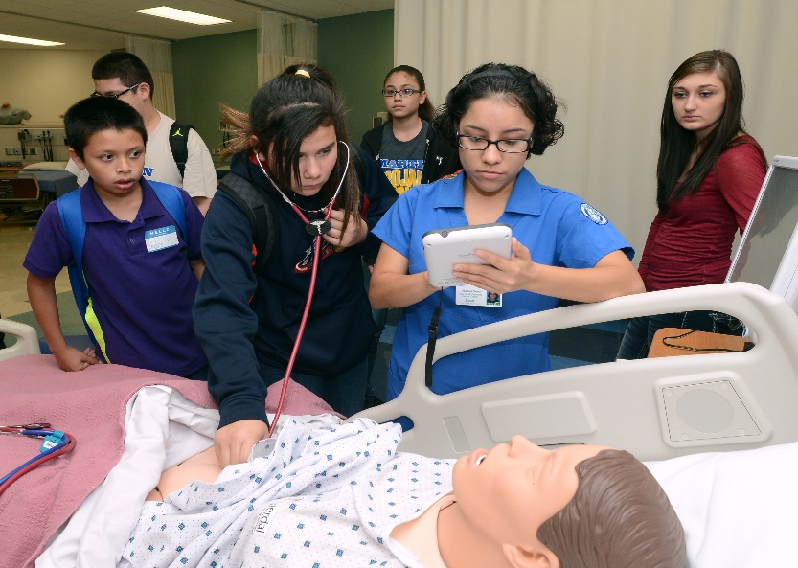
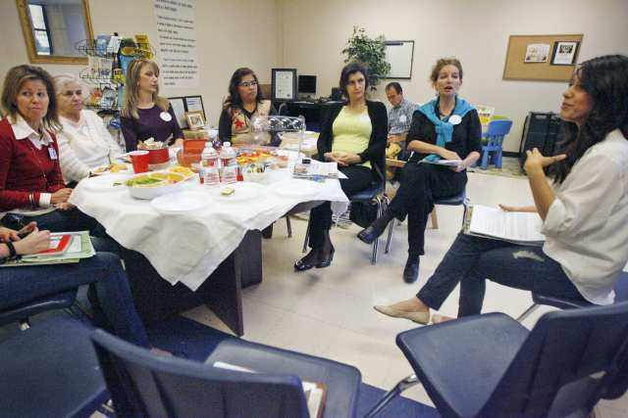
What is one NEW transition activity you hope to do next year?
For Students:
For Parents:
Parents attending Continental, Conversation & the Counselor... Conversations on topics pertinent to transitioning grade level.
8th Graders touring local high school and observing what is a done in a Healthcare Science Technology class.
Notes:
Slide 21: As I get ready to close out today’s webinar, I would like for you to think ahead and think about one NEW transition activity you would like to try and implement this year if it’s not too late or definitely next year for STUDENTS and for PARENTS. Remember effective transition programs are yearlong and not just two or three months in the school year. Once you think of some of these ideas, feel free to email them to me or post as a response in the chat box. I will compile them all and you will have more activities that can be added to your smorgasbord of transition activities.

Slide 22
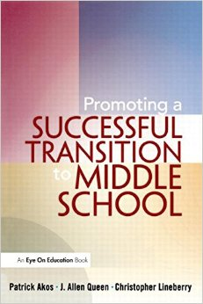
Suggested Resources
Notes:
Slide 22: I wanted to share these three pieces of literature with you all. These are three books that I found useful (along with the internet) as I was preparing this presentation. You can google the books’ name and find out ordering information. I know two of the books showed up as costing $10.

Slide 23
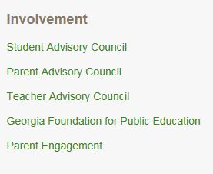
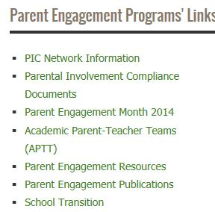
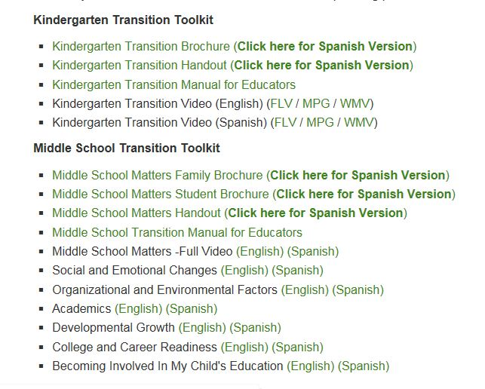
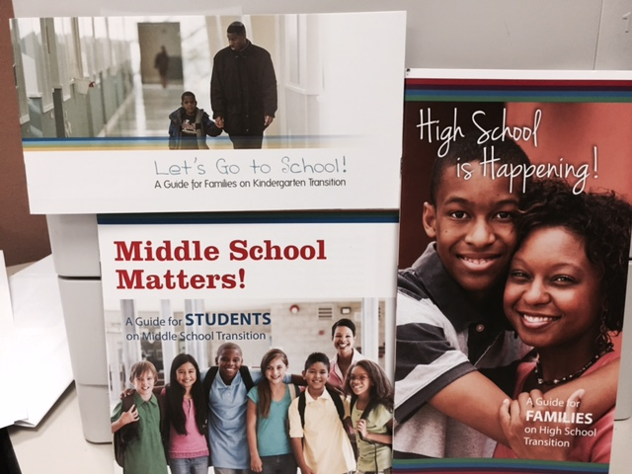
www.gadoe.org
NEW: High School Transition Toolkit & Videos Coming Soon!! Keep checking!!
Notes:
Slide 23: Another set of resources is available on the DOE’s website and is FREE for you to share with parents or incorporate into your parent presentations. This slide shows you how to navigate to it. On this site, you will be able to print the Kindergarten and Middle School brochures and view videos. HOT OFF THE PRESS and just received today is the high school guide for families on one side and for students on the other side. The high school guides and videos will be uploaded later this week hopefully. The DOEs parent engagement office is willing to mail to high schools and 8th grade counselors a limited quantity of these guides AT NO COST TO YOU. Other guides will have to be printed off. You will see the person’s contact info when you visit the website.

Slide 24
Next Webinar:
2016
2015
This webinar will take you on a journey reflecting on your school counseling program THIS year and guide you in developing a roadmap and goals for next school year in an effort to continue building your comprehensive school counseling program.
May 13, 2015 from 2:PM-3:PM
To register, click this link: https://attendee.gotowebinar.com/register/5896309590485036545
Notes:
Slide 24: Thank you for participating in today’s webinar. I hope you were able to get some ideas that you can incorporate into your program either this year or definitely next year in regards to transitioning your students to the next level. Please be sure to register and join us for next month’s webinar. This webinar will take you on a journey reflecting on your school counseling program THIS year and guide you in developing a roadmap and goals for next school year in an effort to continue building your comprehensive school counseling program. Have a great rest of the week and get your taxes in if you haven’t already.
We have a few minutes if someone would like to offer some information about what they do to help students transition successfully or if you have any questions.

