Slide 1
AP English Literature Open Forum
Louisville 2016

Slide 2
Chief Reader Report Commentary Consistent from Year-to-Year
GENERAL
Managing complexity Examining meaning as complex and nuanced.
Organizing responses in such a way that they are driven by insights, not devices.
Moving from the particular to the broad – not just listing devices, but linking to meaning.
Moving from the broad to the particular – not just talking meaning, but examining devices.
Responding to the prompt.
Examining the nuance of tone.
Using the context.
VERSE
Analyzing instead of just stating what is in the poem or summarizing.
Analyzing the structure of a poem beyond just stanzaic structures.
Engaging a variety of poems.

Slide 3
Chief Reader Report Commentary Consistent from Year-to-Year
PROSE
Examining the relationship of point of view (narrator) on meaning.
Identifying and linking aspects of character development to meaning.
Examining complexities in prose – often a result of a single reading under the assumption that it is easy to “get.”
Answering all parts of the prompt with sufficient evidence and explanation.
Engaging complex prose (diction & syntax) – often representative of earlier works (i.e., pre-20th century).
OPEN
Linking specific details from the text to the meaning of the work as a whole and not just listing them.
Making generalized and oversimplified statements about characters or texts.
Texts from different periods and genres.

Slide 4
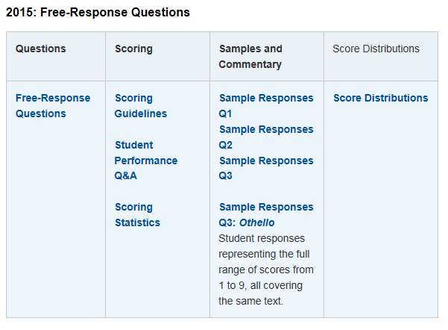
Less than 1% of Online FRQ Users Accessing Student Performance Q&A (Chief Reader Report)

Slide 5
Questions answered for each FRQ in the Chief Reader Report (Student Performance Q & A)
What was the intent of this question?
How well did students perform on this question?
What were common student errors or omissions?
Based on your experience of student responses at the AP Reading, what message would you like to send to teachers that might help them to improve the performance of their students on the exam?

Slide 6
AP Teacher Community, Course Audit, and AP Central
https://apcommunity.collegeboard.org/group/apenglish/
http://www.collegeboard.com/html/apcourseaudit/
http://apcentral.collegeboard.com/apc/public/courses/teachers_corner/2124.html

Slide 7
Questions Asked
What is College Board doing about the IB program “interfering” with the AP program? Nothing
What is College Board doing about dual enrollment “interfering” with the AP program? Nothing
Both of these issues are controlled by the local school government.
College Board does have research that shows that kids who take AP classes rather than dual enrollment classes perform better as college students.

Slide 8
More Questions
Are any changes coming to the AP English Literature and Composition curriculum and/or test? No changes are planned. If anything changes, we will have two years’ notice
Will the essays ever be scored online? There are no plans to score the essays online. While the cost might be lower, inter-rater reliability drops when essays are scored online.

