Slide 1
Their Eyes Were Watching God
Zora Neale Hurston

Slide 2
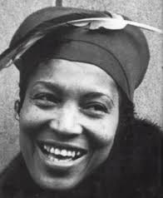
Zora Neale Hurston: 1891-1960

Slide 3
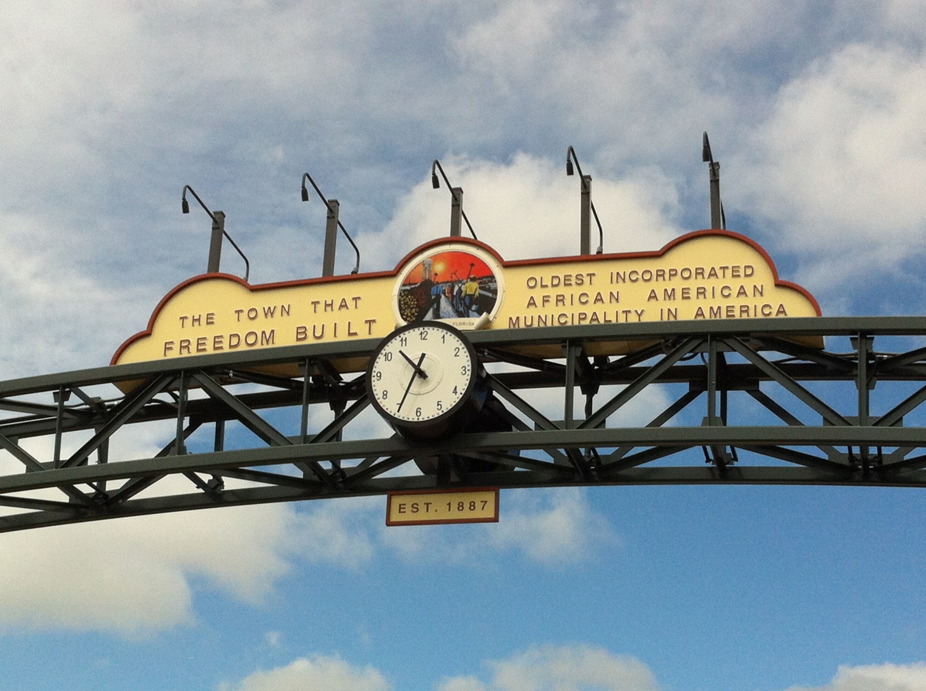
Native Daughter of Eatonville, Florida

Slide 4
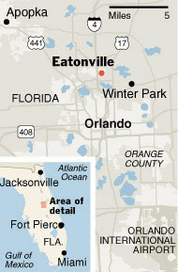
Eatonville, Florida
Eatonville is a town in Orange County, Florida, United States, six miles north of Orlando. It is part of the Orlando–Kissimmee metropolitan statistical area. The town includes the Eatonville Historic District.

Slide 5
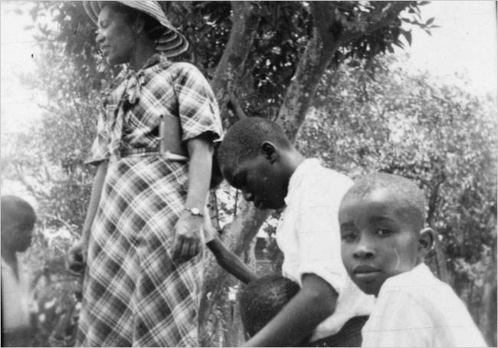
Eatonville, Florida
The woman in this photo taken in 1935 is Zora Neale Hurston.

Slide 6
ZoraFest: Annual January Celebration in Eatonville, Florida

Slide 7
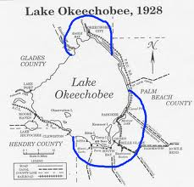
Okechobee Hurricane -1928

Slide 8
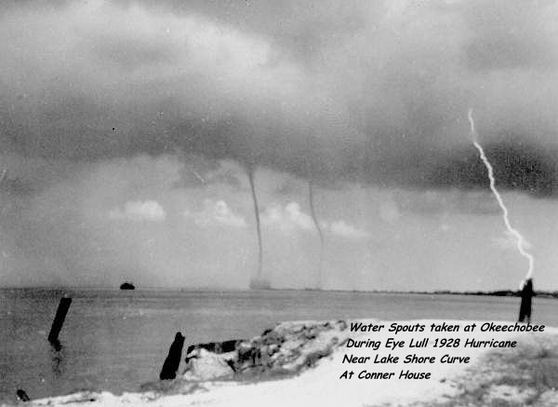
Okechobee Hurricane Devastation

Slide 9
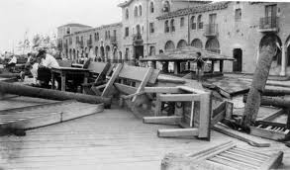
Okechobee Hurricane Devastation

Slide 10
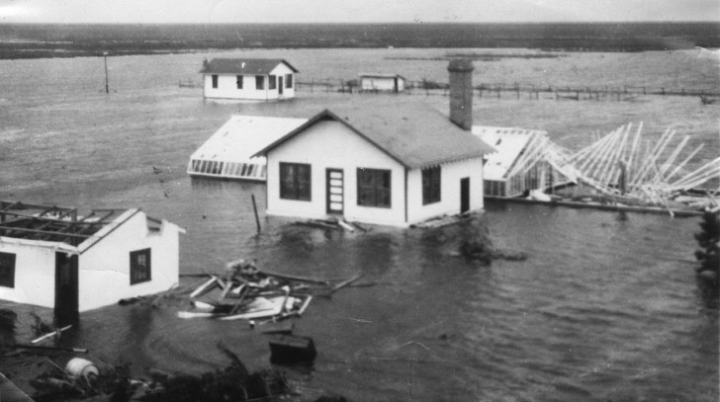
Okechobee Hurricane Devastation

Slide 11
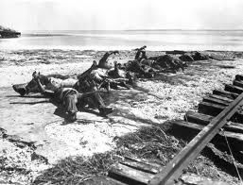
Okechobee Hurricane Devastation

Slide 12
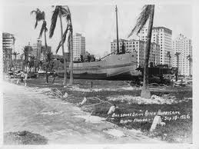
Okechobee Hurricane Devastation

Slide 13
Basics
Setting: Florida, primarily West Florida, Eatonville, and the Everglades
late 19th century to 1928
Main events: building of Eatonville
Okechobee Hurricane of 1928
Major Characters: Janie Crawford
Jody Starks
Teacake (Vergible Woods)

Slide 14
Language
Speech versus silence
When does one speak and when does one hold her tongue? Janie’s voice is an important element of the story.
Poetic formality of narrator’s voice versus the dialect of the Florida blacks
Why does Hurston combine the two very different uses of language? What is the purpose of this particular delivery?
Use of other rhetorical devices: metaphor, synecdoche, sensory imagery, foreshadowing, irony

Slide 15
Symbols
the pear tree
Janie’s hair
animals
hurricane

Slide 16
Subjects
Race and racism
Community
Female struggle for voice in a male-dominated society
Love and relationships
Power of nature
(As you read the novel, develop themes for these
subjects.)

Slide 17
Quotes about the Novel
Andrea Rushing (former Harvard and current Amherst professor): “[the novel] affirms black cultural traditions while revising them to empower black women.”
Mary Helen Washington (University of Maryland professor): “Here, finally was a woman on a quest for her own identity . . .”
Doris Grumbach (author and critic): “the finest black novel of its time” and one of the finest of all time.”
Alice Walker (author of The Color Purple) had this inscription placed on Hurston’s gravestone: “Zora Neale Hurston/’A Genius of the South’/Novelist/Folklorist/Anthropologist/1901-1960”

