Slide 1
AP Lit. Writing Strategies
Theme vs. Topic & Concentration on Tone
Emily Mowery
emowery@floydboe.net

Slide 2
Topic vs. Theme
T-chart
A THEME is not . . . A THEME is . . .
A summary of the plot or poem’s paraphrase Present in the beginning, middle, and end
A moral or lesson Author’s social commentary
An emotion Discussion of the emotion in the text
An obvious, general statement Layered, offering room for discussion
A human truth that may be ugly or immoral

Slide 3
Theme Writing Activity
Teacher Modeling, Small Groups, Independent
Brainstorm a list of topics related to a particular reading
ANY TEXT APPLIES
(AP Question 2 prompt, Poetry prompt, or current classroom novel study)
Ask students to convert the list of topics to themes
Support the theme with text evidence from beginning, middle and end

Slide 4
Examples from Poisonwood Bible
TOPIC THEME
Famly
Culture
Mother’s Love
Faith
Each family member’s strength is revealed through adversity
Cultural awareness is essential to survival
Sacrificial love tests humility and grace to endure
Faith in oneself is the only course for self-actualization

Slide 5
Tone Word Bank
Tone/Attitude Words
87 Tone/Attitude Words to expand the students’ vocabulary beyond:
Happy Mean
Sad Emotional
Dark Positive
Light-hearted

Slide 6
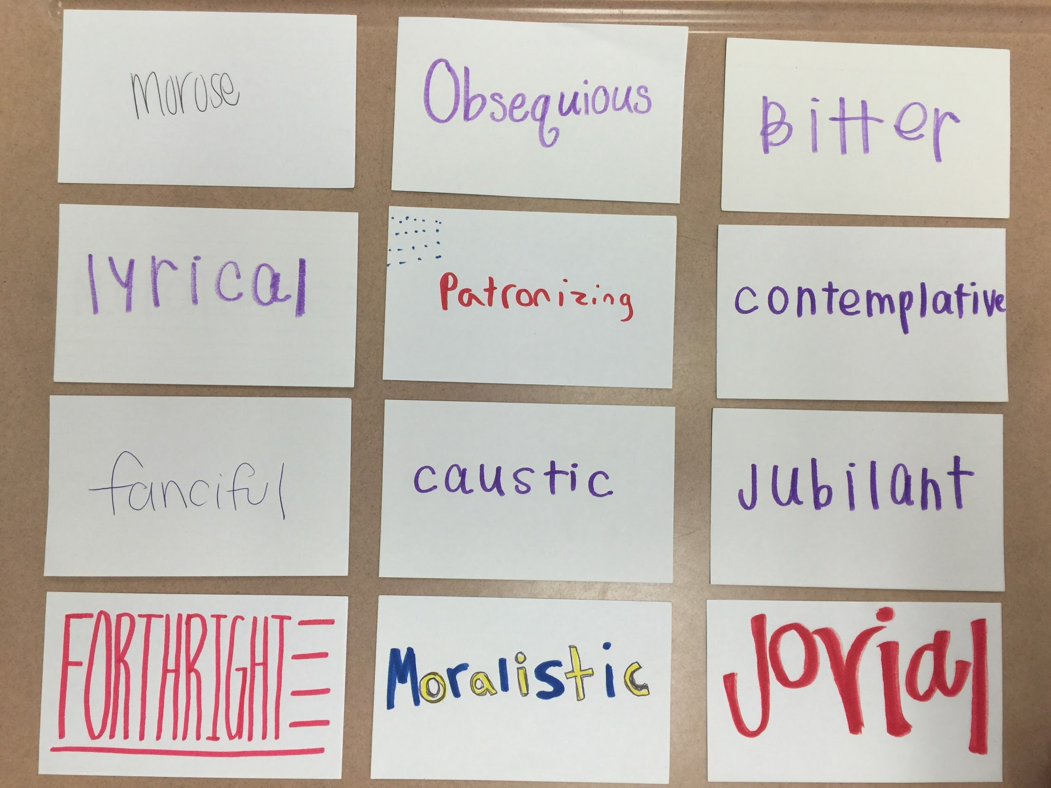
TONE
Activities, using tone words on index cards

Slide 7
Playing with Tone through Dialogue
Can be one class day (50 min.) or a starter activity on subsequent days.
Directions:
Choose from a basket, one tone word per student.
Pair with a peer several different times: SIMILAR tones, OPPOSITE tones
Writing dialogue, limiting students to a few settings (park bench, lunchroom, concert, courtroom, doctor’s office waiting room)
Each student concentrates on his or her tone word only.
Collect dialogue from student groups. Make a guessing game for the class, sharing student dialogues and discussing the differences between tones.

Slide 8
Differentiation
Add multiple layers in the dialogue, where a student’s persona has to move between tones within the same brief dialogue.
Example: Dr.’s Office Waiting Room
Persona: Patient waiting for test results
Tones: Confident and Quizzical to Anguished and Accusatory

Slide 9
AP TEST Prep. Application
Many prompts incorporate tone in the Q1 poetry or Q2 Analysis essay prompts
Practice identifying tone and its impact on the whole of the work with
“Birthday Party” 2005 Prompt, Q2

Slide 10
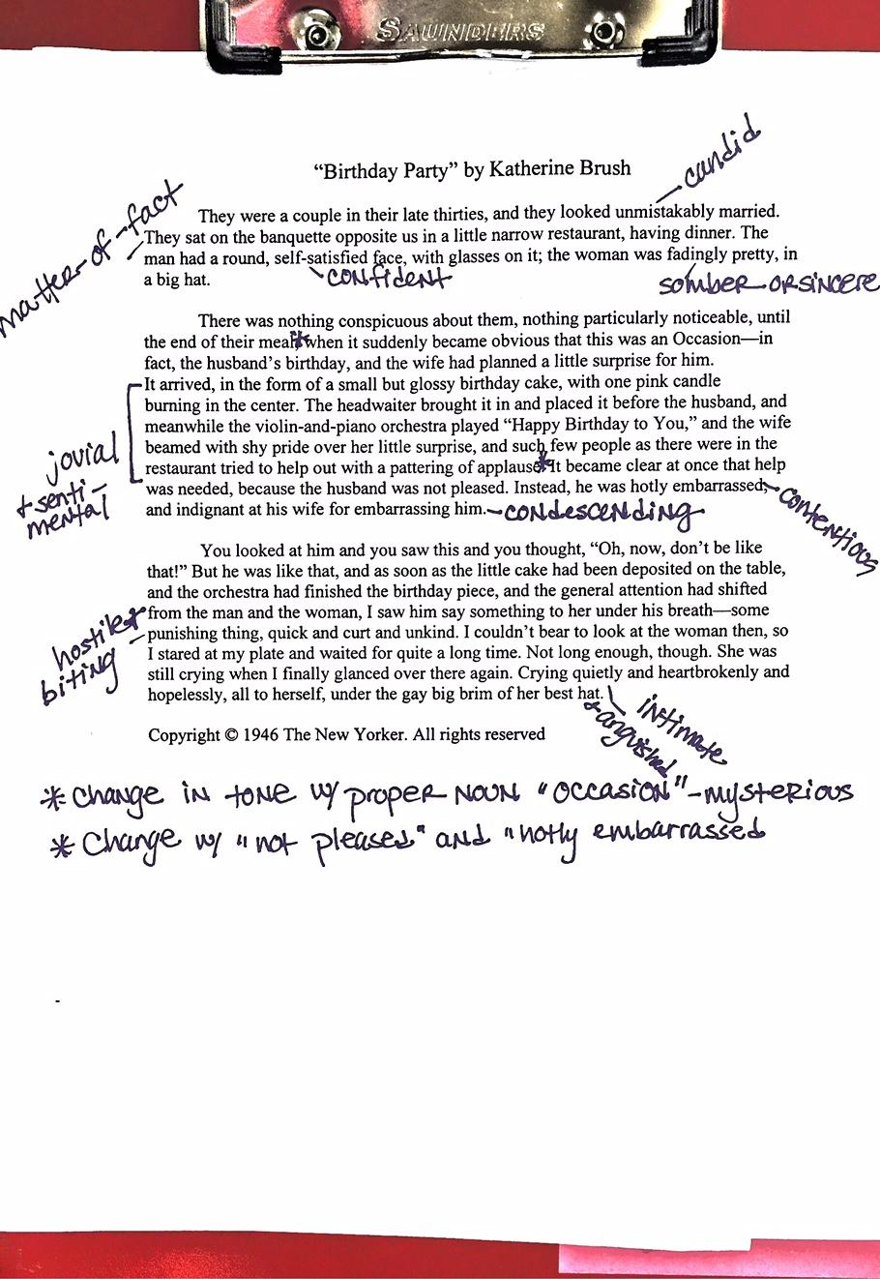

Slide 11
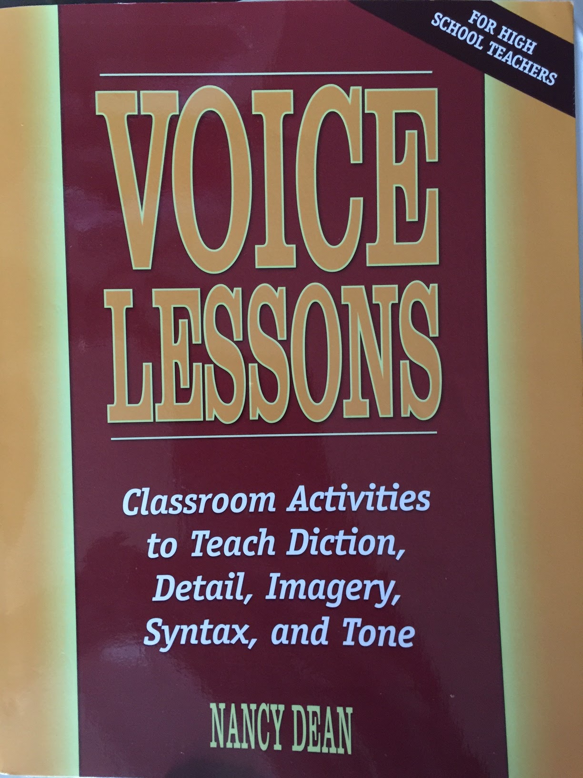
Tone Resources
Matching Tones in A Tree Grows in Brooklyn
Matching Tones Activity
Matching Tones Activity Answer Explanation

