Slide 1
The New Move On When Ready Dual Enrollment Program
Gary Mealer, Transition Career Partnership Coordinator, GaDOE
Making it better for our future graduates!
Notes:
Good afternoon, I am excited about you being here today at the training.
We are in a period of time in education where flexibility, change and adaptability are the just expected.
This makes the 4th time we have had a major change in dual enrollment in the 8 years I have been involved with it.
Look at these two future HS students and can you even imagine what DE will look like for them?

Slide 2
Why The Changes?
Too many different programs with different regulations/guidelines/funding sources/etc.
Eliminate the confusion for counselors, parents, students, administrators
Create equal funding for all dual students
Simplify and speed up the payment process for students and colleges
Simplify advisement by creating one course list

Slide 3
Background
Dual Enrollment Task Force established by the Governor
Leadership from USG, TCSG, GADOE, GSFC, PSC, GOSA, legislators and the Governor’s Office.
Provided recommendations to remove barriers to dual enrollment participation
SB 2 and SB 132 were introduced in the 2015 legislative session
SB 132 was based on the Task Force recommendations
Both bills signed by the Governor April 2015
SB 132 includes the SB 2 provisions
Effective July 1, 2015 (Fall 2015 semester)

Slide 4
2015 Legislation
SB 132 – Move On When Ready (MOWR) Program
High school students may enroll while in 9th – 12th grades
Earn dual credit
Wide range of courses
SB 2 – New High School Graduation Option
Students complete at least the following state required high school courses or their equivalent:
Complete an associate degree, technical diploma or two technical certificate programs in a career pathway and all training prerequisites for any state, national, or industry occupational certifications or licenses required to work in the field
Awarded a high school diploma and a college credential(s)
1 health and PE course
2 English
2 math
2 science
2 social studies
(any associated End of Course (EOC) tests for each)
Note: Only public school students participating in MOWR are required to take EOC tests.
Both SB 2 and SB 132 are effective as of July 1, 2015

Slide 5
Accel
HOPE Grant Dual Enrollment
Move On When Ready
The New
Move On When Ready
(MOWR) Program
Program Goals:
Simplify three programs into one program
Expand dual enrollment opportunities for students
Full time or part time attendance
Expanded grade levels to include all 9th – 12th graders

Slide 6
MOWR Secondary Benefits
Expanded course offerings in elective and CTAE areas
Courses can be taught on either the high school or college campuses
Reduction to only one approved course list
Local system keeps FTE funding
Transportation Grants created and available
New graduation option created

Slide 7
MOWR and HOPE and Zell Miller Scholarship
Core courses are included in student’s HOPE high school GPA for HOPE Scholarship and Zell Miller Scholarship eligibility
Core coursework taken meets Academic Rigor requirements and given a weight of 0.5
College transcript begins as MOWR student
Dual Credit Hours are not counted toward the Attempted Hours or Combined Attempted Hours limit for HOPE and Zell Miller Scholarship
Dual Credit Hours are not counted toward the Paid Hours or Combined Paid Hours limit for HOPE and Zell Miller Grant and Scholarship
Notes:
Gary
Talk about the IMPACT this program has HOPE & Zell scholarships
Locate Course Directory on Gacollege411
Discover Who is GATRACS

Slide 8
MOWR Eligible Students
No residency requirement—out of state possible
Meet admissions requirements and deadlines at participating postsecondary institution
May attend more than one postsecondary institution at a time and receive awards at both
Maintain satisfactory academic progress at college level

Slide 9
MOWR Eligible Students
All students attending public or private high schools in Georgia or a home study program operated in accordance with O.C.G.A. 20-2-690(c)
Sign a MOWR Student Participation Form with the high school or home study program
Complete MOWR Application Form
Participation available during all four years of high school enrollment ( 9th, 10th, 11th and 12th grades)

Slide 10
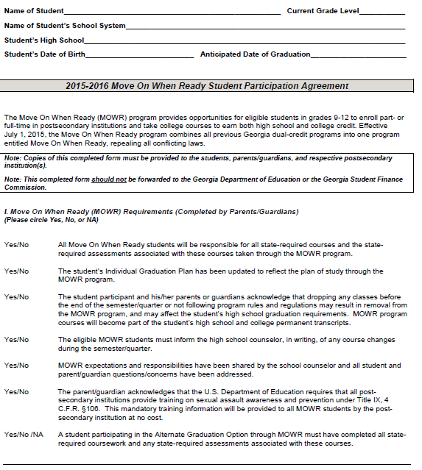

Slide 11
MOWR Application
Located on MOWR webpage on GAcollege411
Paper (pdf) version to be completed by home study students and students with no SSN
Online version to be completed by eligible public and private high school students
Move on When Ready Student Application Deadlines are determined by local systems and/or postsecondary institutions
Must submit an application for each postsecondary semester or quarter of participation in the MOWR Program
Notes:
Student must complete application for each term
High school set up to send Electronic application must do so
High schools that are not will send a paper application
Games Academy and Advanced Academy of Georgia completes paper app.
Now my esteemed colleague, Johnny Edwards, will walk you through the processing of the Accel Application. Johnny?

Slide 12
MOWR Application
Three Sections
The MOWR Application is completed in three sequential steps
Section 1: The student completes a MOWR application at www.GAcollege411.org, online or prints the pdf version
Section 2: The participating high school or home study program must certify the student’s application and list the courses the student is planning to pursue for dual credit
Section 3: The participating postsecondary institution must certify the student’s application and approve the postsecondary courses for MOWR
Sequence applies to both the electronic and paper MOWR applications
Notes:
Three sequential steps
True for paper and electronic

Slide 13
MOWR School Participation Agreement
Georgia public or private eligible high schools
Home study programs within the State of Georgia operated in accordance with O.C.G.A. 20-2-690(c)
Eligible postsecondary institutions
Participation Agreements to be submitted annually by July 1 (scan and email, fax or mail only to GSFC)
Students will not be allowed to participate in MOWR until the Participation Agreement confirmed by GSFC

Slide 14
MOWR Eligible High School Responsibilities
Provide general MOWR information no later than February 1 of each year to eligible high school students and parents
Provide MOWR information to each eighth grade public school student at the time of developing the individual graduation plan
Provide academic counseling
Obtain written consent from parent
Record on the student’s high school transcript dual credit earned

Slide 15
Eligible Postsecondary Institution
A unit of the University System of Georgia;
A branch of the Technical College System of Georgia;
A SACS accredited, private postsecondary institution located in Georgia that is eligible to participate in the Tuition Equalization Grant Program.

Slide 16
Georgia Department of Education
Shall
Make general MOWR program information available/accessible to public, private school and home study programs
Provide counseling guidelines for MOWR to public and private eligible high schools
Develop MOWR forms (with approval from GSFC)
Annually assist in updating the MOWR course directory and provide updated information to GSFC by July 1.

Slide 17
Course Work Under MOWR
Students will receive credit and funding only for courses listed in
the MOWR Course Directory Directory located on GAtracs
(Georgia Transfer Articulation Cooperative Services)
Summer school participation begins Summer 2016
Students receive both secondary and postsecondary credit
Courses can be taught on the high school or college campuses or through Distance Learning
Courses can be scheduled outside or the regular school day hours

Slide 18
MOWR Course Directory
Located on the MOWR webpage on GAcollege411.org
All approved postsecondary courses and comparable high school courses to be used as the dual credit
Directory lists each participating postsecondary institution
Once the college is selected, the drop-down box lists all approved courses for that participating institution
Courses are listed by categories then alpha order by the postsecondary course number field
Notes:
Directory list courses approved GADOE
Only Pay for classes on that list- every elig. college has approved courses
Students can find the COURSE DIRECTORY on GAcollege411
Let’s find out who is GATRACS and Accel Program

Slide 19
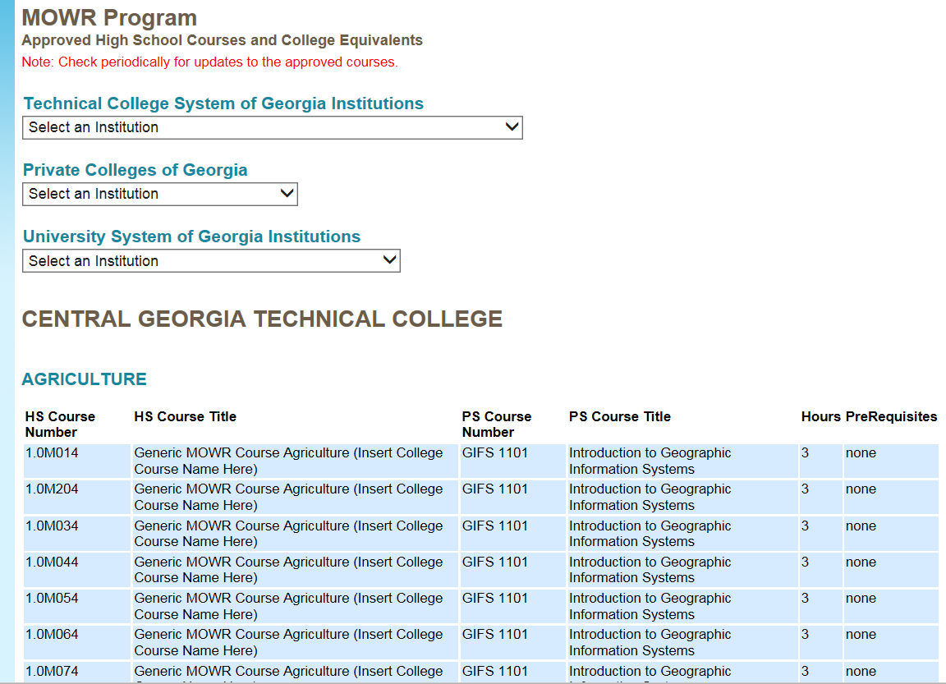
MOWR Course Directory
Notes:
There are the high school courses and the college equivalent
How about Public colleges?

Slide 20
MOWR Ineligible Coursework
Taken as Joint Enrollment-college credit only, not funded
Exemption by Examination Coursework such as testing, training or experience
Courses not on the approved MOWR Course List
Out of state college coursework

Slide 21
GATRACS MOWR Approval Process
USG
TCSG
Ind. Colleges
Initiate request through GATRACS Approval Process
USG Student Affairs
TCSG System Office
Approves/Denies
DOE Point Person
Approves/Denies
DOE Program Manager
Approves/Denies
Downloads TXT file from FTP server and sends to GSFC
GATRACS

Slide 22
MOWR Course Listing on GACollege411

Slide 23
Choosing a MOWR Course Match

Slide 24
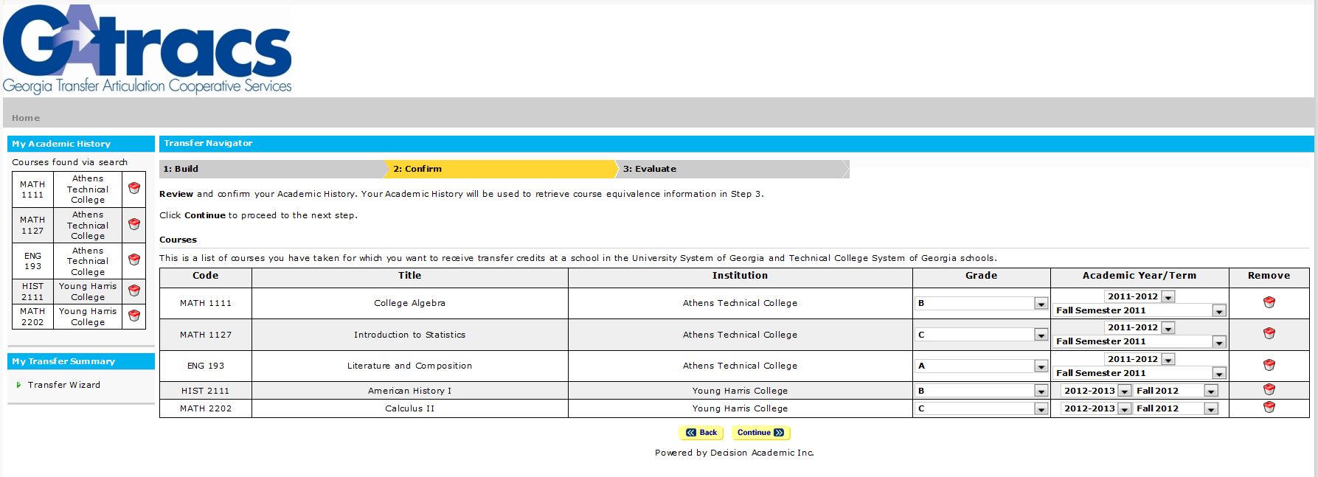
Transfer Portal
Use GATRACS to
Build a student’s course history
Include course credit from Georgia’s University System, Technical College and Independent institutions

Slide 25
Required Enrollment
Student must be enrolled full-time, 6 FTE segments, in order to earn full local FTE funding
This can be done by:
Combination of high school and MOWR courses. Must include 4 courses if on 4x4 block or 6 courses if on 6 or 7 period day
Full time MOWR student at the college with minimum of 4 courses between 12-15+ credit hours
Travel time or other non-instructional periods are not funded, only instructional periods

Slide 26
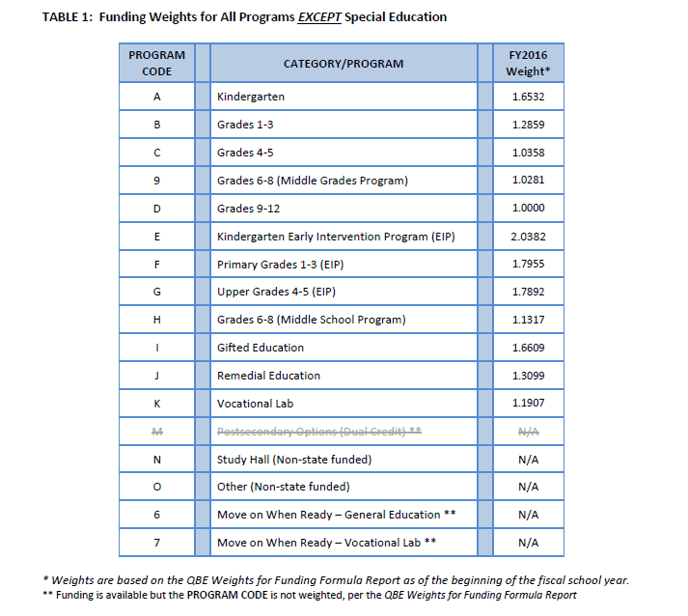
FTE Funding Weights and Program Codes
List of all program codes for FTE Reporting

Slide 27
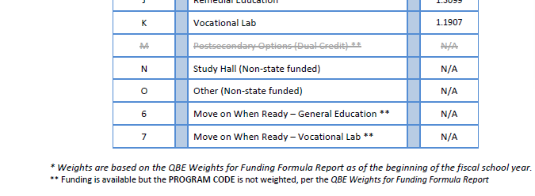
“M” code no long valid
There is not a weight assigned, 6 will be based on D weight and 7 based on K weight.

Slide 28
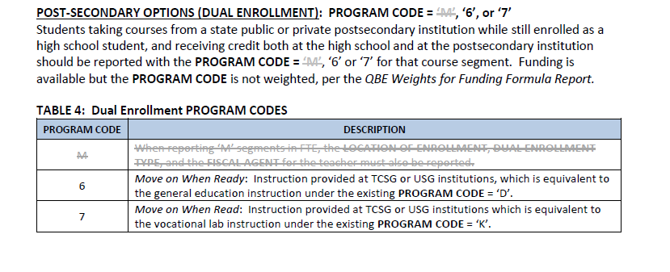
MOWR Program Codes

Slide 29
MOWR Program Codes
PROGRAM CODES are used to determine the weight that will be assigned to the number of FTEs earned in funding an instructional program area. A school system may claim segments for students that meet program criteria and are being served according to program guidelines. To claim FTE funding segments, the student must be regularly scheduled for service or program instruction on the day of the count. Students who are not regularly scheduled for service or program instruction on the day of the count must be reported according to the program weight that indicates the actual services they receive on the FTE count day. School systems may not alter a student’s schedule to capture a specific weight for the FTE count day.

Slide 30
Non Funded FTE
OTHER (NON-STATE FUNDED): PROGRAM CODE = ‘O’
PROGRAM CODE = ‘O’ should be reported as a segment code for services that do not fall into any other program code listed or do not meet Georgia Performance Standards requirements.
Students participating in the Joint Enrollment Program should be reported with the PROGRAM CODE = ‘O’. This program allows students to take courses at a state public or private postsecondary institution while still enrolled in high school; however, credit is only earned at the postsecondary institution.

Slide 31
MOWR Program Definitions
The Eligible Postsecondary Institution cannot charge the student any Mandatory Fee costs.
The Eligible Postsecondary Institution can charge the student Course Related Fees or Supplies or require the student to have the required course related items.
The Eligible Postsecondary Institution cannot charge the student any Non-Course Related Fees.
Tuition and books are provided.
Dual credit course means a postsecondary course taken by high school student which the student receives secondary credit from their high school
Notes:
Gary

Slide 32
Move on When Ready Financial Awards GSFC Pays The College
Tuition
Public Institutions: standard undergraduate tuition rate up to 15 hours per institution will be awarded for Move on When Ready students
Private Institutions: $250 per semester hour, $187 per quarter hour, or standard tuition (whichever is less) will be awarded for Move on When Ready students enrolled in up to 15 semester hours and 12 quarter hours per term
Mandatory Fees
$50.00 per term, semester or quarter
Notes:
This is what the PS will receive and this is to cover all the cost from the MOWR student. Students cannot be charged for any balance or difference of these charges.

Slide 33
Move on When Ready College Financial Awards cont.
Book Cost Awards
Books must be provided by the postsecondary institutions at no cost to the student.
$25 per semester hour (up to 15 hours) will be awarded.
$15 per quarter hour (up to 12 hours) will be awarded.
Postsecondary Institutions may charge for a lost or damaged book owned by the institution.
Book payments will be made to each institution the student is enrolled.
Notes:
Books have to be provided to student. How, is up to the PS institution.
PS will receive some compensation for books.
Students can be charged for damaged or lost books.

Slide 34
Upcoming - MOWR Transportation Grant
Participating Public High Schools eligible to apply
September 30, 2015 – GSFC will release the Request for Transportation Grant Application
November 30, 2015 – Application Packets from high schools due to GSFC
January 29, 2016 – GSFC will notify those Participating Public High Schools that applied
Awarded public high schools will be required to sign a transportation agreement

Slide 35
Upcoming - MOWR Transportation Grant
Public High Schools awarded Transportation Grant funds
February 2016 High schools should incorporate the MOWR Transportation Grant Award in their planning for the Academic Year 2016-2017 and communicate to parents and students the opportunities and available transportation
Disbursement of funds
Fall Semester 2016 – August, 2016
Spring and Summer Semesters 2017 – January, 2017

Slide 36
REFERENCES
GSFC 2016 MOWR Award Chart:
https://www.gsfc.org/main/publishing/pdf/2016/FY2016-AwardChartsCombined.pdf
GSFC 2016 MOWR Regulations
http://www.gsfc.org/main/publishing/pdf/2016/2016-Move%20On%20When%20Ready.pdf
GSFC – GASFAA Presentations – May 2015
http://www.gasfaa.org/docs/toc_conferences.html
GSFC 2016 Definitions for State Programs
http://www.gsfc.org/main/publishing/pdf/2016/2016-State%20Programs%20Definitions.pdf

Slide 37
College and University Contacts
Independent college and university contacts – http://www.georgiacolleges.org/media/mowr
Technical College System contacts – https://tcsg.edu/fordualcredit.php
University System Contacts - http://www.usg.edu/inst/directories/move_on_when_ready_contacts/

Slide 38
Contacts
Gary Mealer
MOWR, Transition Career Partnership and JROTC Program Specialist,
Georgia Department of Education
1752 Twin Towers East, 205 Jesse Hill Jr. Dr. SE, Atlanta, GA 30334
Phone: (404) 463-8197 or (706) 695-8725 email: gmealer@doe.k12.ga.us
Dianne Lassai Barker Secondary Education Initiatives Coordinator,
Technical College System of Georgia 1800 Century Pl. N.E., Suite 400, Atlanta, GA 30345 Phone: 404.679.1688 email: dbarker@tcsg.edu
Sarah Wenham
Director of Student Access,
Board of Regents of the University System of Georgia
270 Washington Street, S.W., Atlanta, Georgia 30334
Phone: (404) 962-3115 email: sarah.wenham@usg.edu

Slide 39
Contact
Pennie Strong
770-724-9014 or pennies@gsfc.org
800.505.GSFC
MOWR Participation Agreements Information: SAS@gsfc.org
Regulations Questions : ProgramAdmin@gsfc.org
MOWR Invoice Assistance: OandD@gsfc.org

