Slide 1

2015 Fall Curriculum Leaders’ Conference
Student Success:
Imagine the Possibilities
Georgia Department of Education
Division for Special Education Services and Supports
Zelphine Smith-Dixon, Ed.D.
Assistant Director

Slide 2
Federal and State
Monitoring Focus
The primary focus of monitoring is:
  Improving educational results and functional outcomes for all children and youth with disabilities
  Ensuring that States meet the program requirements within IDEA, with a particular emphasis on those requirements most closely related to improving educational results for children with disabilities.

Slide 3
Results-Driven Accountability: Shifting the Balance
OSEP has revised its accountability system to shift the balance from a system focused primarily on compliance to one that puts more emphasis on results.

Slide 4

Join me as I share an excerpt from the Georgia Story about our Sweet Georgia Peaches.

Slide 5


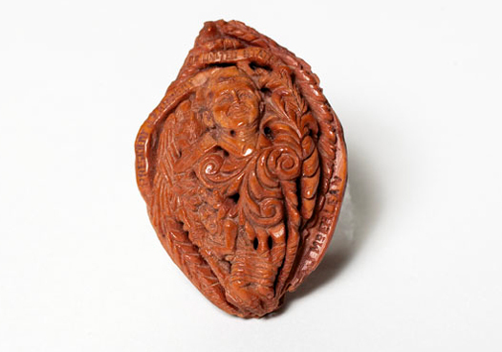
In order to tell the story of your sweet peaches, you have to carve the layers down to the pit!
Collage
Portrait
Get to the root of the problem!

Slide 6
Student Enrollment compared to
SWD Enrollment
How do the racial/ethnic subgroups represented in SPED compare to Total Enrollment?

Slide 7
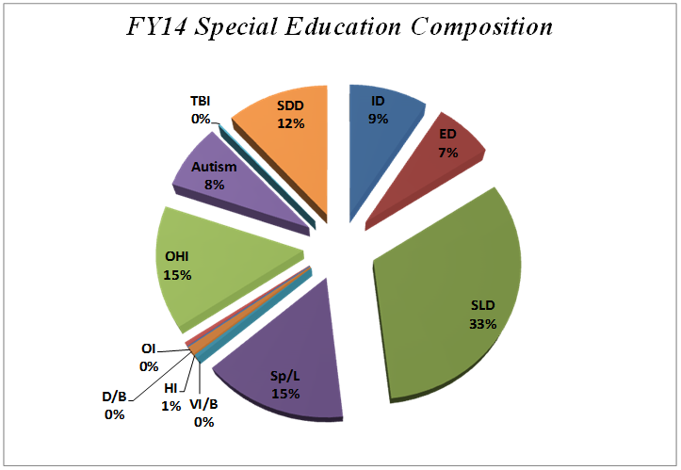
Does that change the perceived face of SWD in the Georgia Story?
What disability categories are more prevalent?
SLD, SLI, OHI, and SDD are the highest enrollment categories!
State of Georgia
Enrollment by Disability Categories

Slide 8
Visual Impairment | 655
Other Health Impairment | 28,294
Deaf | 659
Hearing Impairment | 1,183
Orthopedic Impairment | 865
Specific Learning Impaired | 62,131
Emotional/Behavioral Disorder | 12,952
Profound Intellectual Disability | 656
Severe Intellectual Disability | 1,401
Moderate Intellectual Disability | 4,961
Mild Intellectual Disability | 10,005
Significant Developmental Delay | 22,201
Traumatic Brain Injury | 417
Autism | 14,913
Speech/Language Impairment | 29,490
Deaf/Blind | 23
Blind | 159
Total Primary | 190,965
8.9% of Total SWD Enrollment
.987% (<1%) of Total Student Enrollment
Of these categories, which students demonstrate subaverage general intellectual functioning?

Slide 9
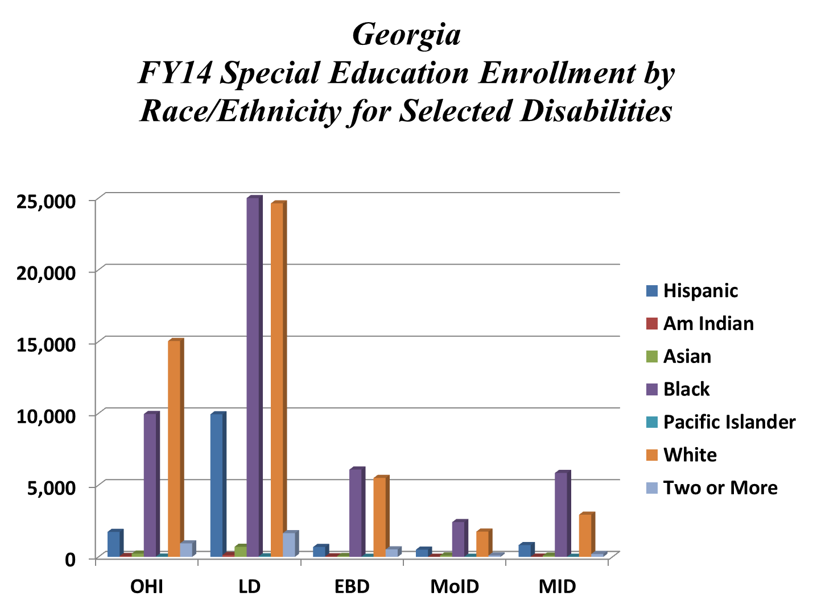

Slide 10
67.65% of SWD (age 6-21) are males!
What is the distribution of males and females?

Slide 11
Let’s begin the Georgia Story about our Sweet Georgia Peaches by scanning the final chapter-first.
Let’s begin with the end in the mind.

Slide 12
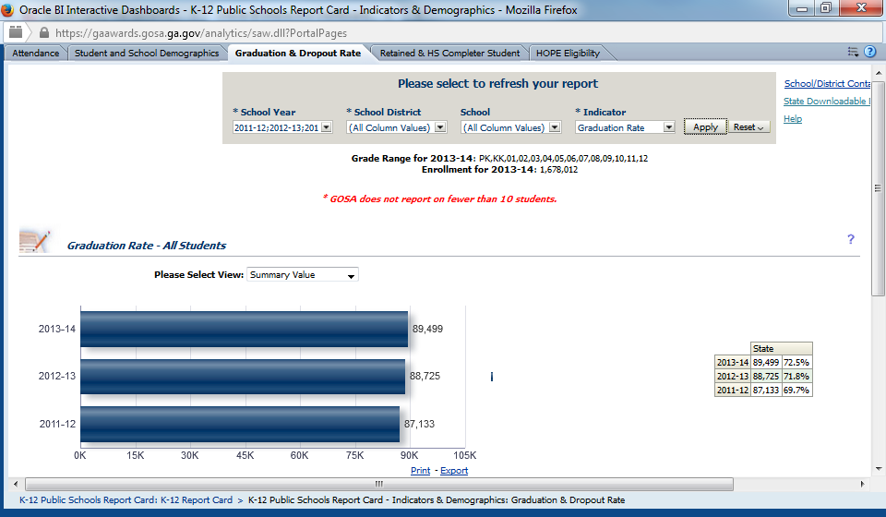
Graduation Rate
Considering the PK-12 Pipeline, what percent of “All Students” graduate with a general education diploma?

Slide 13



Student Success Club AKA “Sweet Peach Exclusive”
5,027 Sweet GA Peaches were inducted into GA’s “2014 Student Success Club” as HS Completers
36.5%

Slide 14
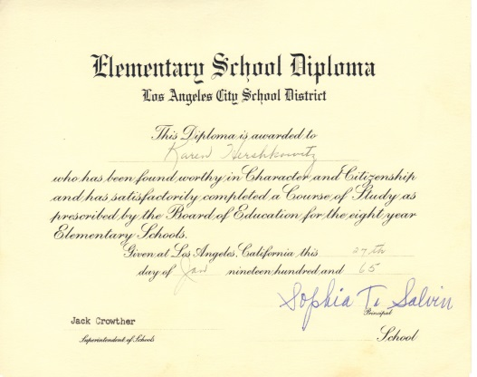
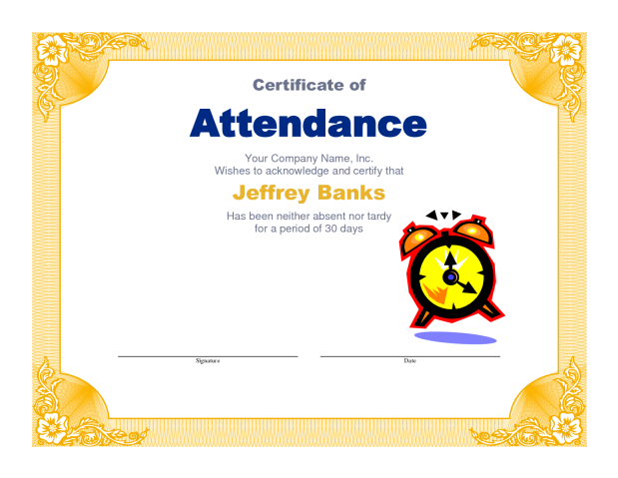
“E” for Effort Club
But Wait…There are other Sweet GA Peaches in the
Completer Club who weren’t so Successful!
At least 1,777 SWD were inducted into GA’s 2014 “E for Effort Club” as having received Sped Diplomas
Special Education Diploma

Slide 15

“E” for Effort Club
Black Students with Disabilities represented over half of all SWD who received a Special Education Diploma.
Special Education Diplomas
Black Students represented over half of Total Enrollment who received a Certificate of Attendance!
Certificate of Attendance

Slide 16
Walt Disney Club
Students with Disabilities who disengage but wait for age 16 to drop out of school-just like Walt Disney! Well, not exactly, ages 14 and 15 are becoming honorary members. ☹
3.7%
(19,561)
All Students Dropout Rate
5.9% (3,579)
SWD Dropout Rate
Notes:
n 1918, while still in high school, future Oscar-winning film producer and theme park pioneer Walt Disney began taking night courses at the Academy of Fine Arts in Chicago. Disney dropped out of high school at age 16 to join the army, but because he was too young to enlist, he joined the Red Cross with a forged birth certificate instead. Disney was sent to France where he drove an ambulance that was covered from top to bottom with cartoons that eventually became his film characters. After becoming the multimillionaire founder of the Walt Disney Company and winning the Presidential Medal of Freedom, Disney received an honorary high school diploma at age 58.

Slide 17

Phantom of the Opera Club “Middle School Dropout”
Can you believe how many of our Sweet Georgia Peaches fall in between the cracks of the P-12 Pipeline?
2.7% (21,986)
All Students 7-12 Dropout Rate
4.1% (3,944)
SWD 7-12 Dropout Rate
2013-14 “ All Students “ 2,425 Grades 7 & 8
2013-14 “SWD” 365 Grades 7 & 8
GA’s 4-Year Trend for All Students - 9,462
GA’s 4-Year Trend for SWD – 1,430

Slide 18
Class of 2014
12th Grade
Assessment Data
 | Total Performance Scores | Performance 1 “Not Meeting Standard”
Assessment Scores belonging to 12th Grade SWD | 1468 | 952
Who were the nonperforming 12th Grade Students with Disabilities?
57.67% (549/952) were Black SWD.
70.69% (673/952) were male SWD!
40.33% (384/952) were Black Males with Disabilities!

Slide 19
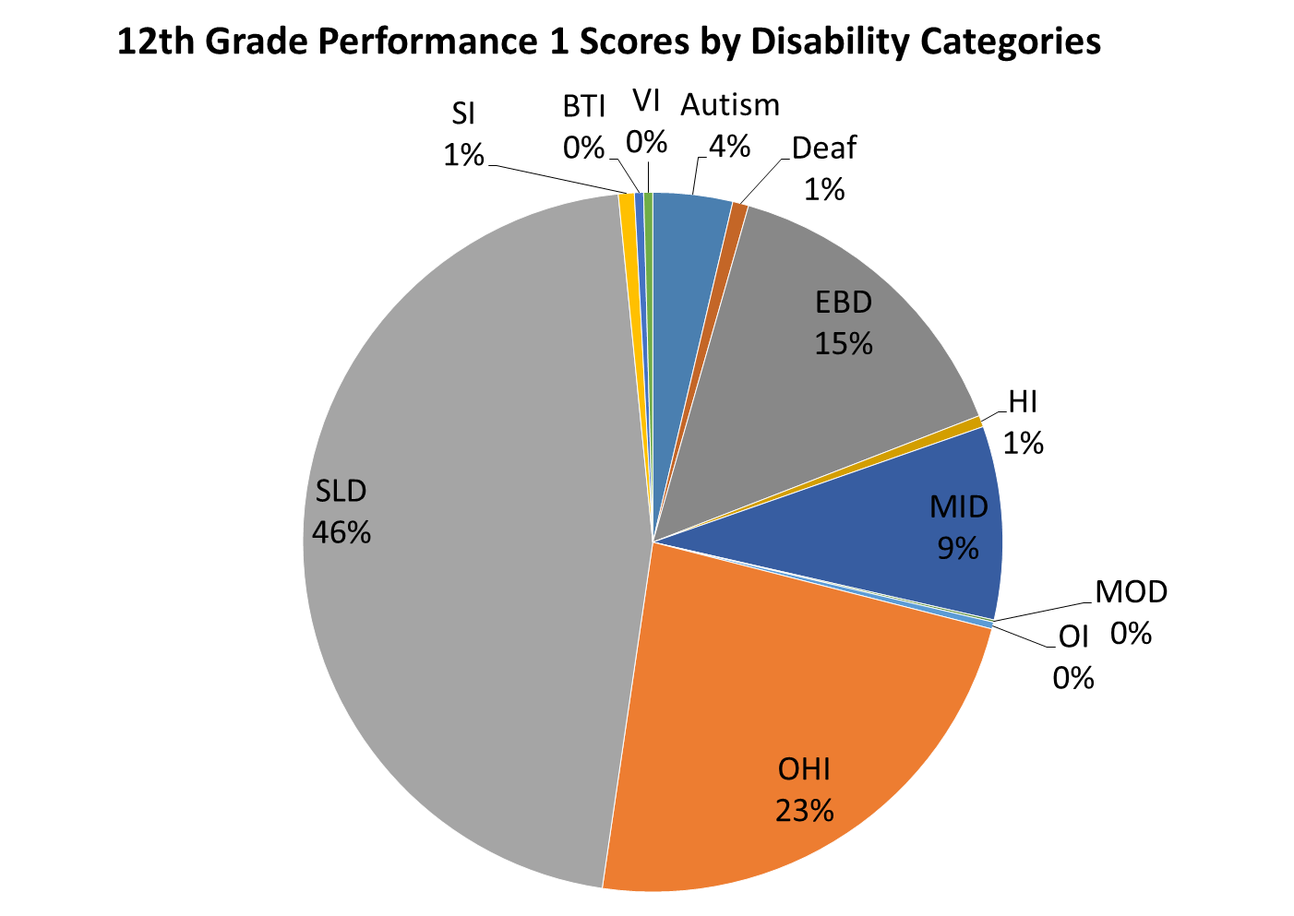
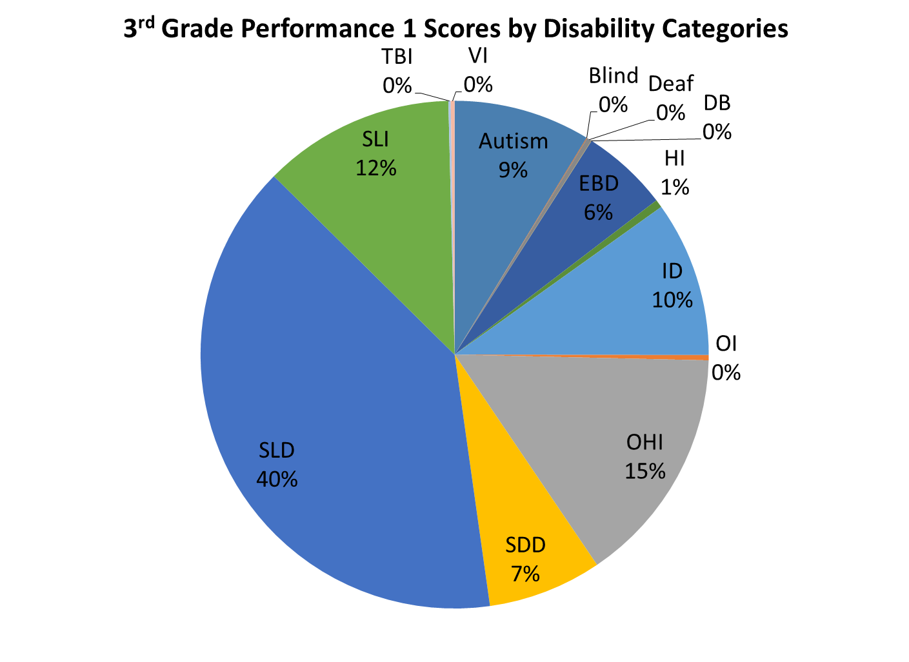
Let’s suppose Georgia does nothing different! Considering 2014 Performance 1 Scores by Disability Categories, What can we predict for the Class of 2023?

Slide 20

How can we rewrite the “beginning” of the story to get the “ending” we want?
First, we have to figure out which chapters to delete next time?

Slide 21
2014 Cohort Longitudinal Data

Slide 22
2014 Cohort Longitudinal Data

Slide 23
2013-2014 Student Support Team (SST) Data
Unknown Variable – Tier 2 Students
10% Sped
2.8% Tier 3
How is it working for us?

Slide 24
2015 SST Stats
58,966 (3.3% of the Total Student Population)
51 LEAs reported Zero students
14 LEAs reported a range of 1 - 10 students
4 LEAs reported a range of 11 -20

Slide 25


PK-12 Pipeline

Slide 26
Technical Problems
Adaptive Challenges
Easy to Identify
Simple Problems
Difficult to Identify
Layered Challenges
Quick Solutions
Few Changes
Complex Solutions
Change in values, beliefs...
Expert or authority can solve the problem!
People with the problem do the work of solving it!
Are you planning to address Technical Problems or Adaptive Challenges with some Technical Fixes?

Slide 27
Annual Event Graduation Data for Students with Disabilities
 | Dropout | HS Diplomas | Certificate/Sped | Grad Rate
FY14 | 3552 | 5214 | 3061 | 44.1%
FY13 | 3526 | 4630 | 3262 | 40.6%
FY12 | 3579 | 4866 | 3118 | 42.1%
Total | 10,657 | 14,710 | 9,441

Slide 29
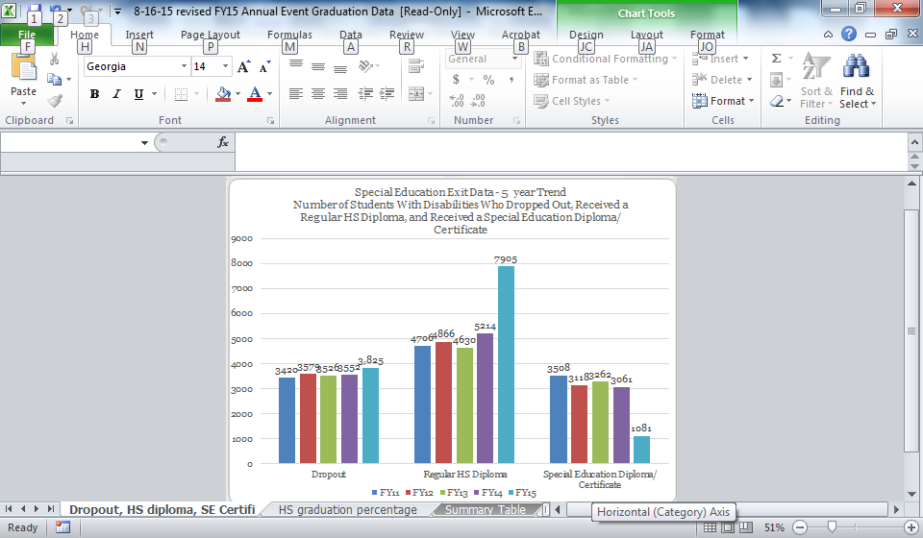
Georgia’s Trend Data

Slide 30
Simple Math Problem
4361 (Grades 7-12) SWD dropped out of school during FY15
3825 (Grades 9-12) SWD dropped out of school during FY15
536 SWD (Grades 7-8) Dropped out of School during FY15
365 SWD…during FY14

Slide 31
Analysis of GA’s Bottom Quartile for Math (3-8)
Approximately 58% DNM
42% Proficient
19.5% SWD
84.8% ED
42.9% of these students missed 6 or more days

Slide 32

How can Georgia’s Curriculum Leaders help us solve this adaptive challenge?

Slide 33
Barriers
“It’s really an equity issue”
Access to the General Curriculum for All Students
  Universal Design for Learning (UDL)
  Differentiated Instruction
  Interventions and Supports
Access to Positive School Climate for All Students
  Learning environments that nurture the whole child
Access to Specially Designed Instruction for Students with Disabilities
  Appropriate services and supports

Slide 34
Question
Does GA have a student completion issue or a student retention issue?
Isn’t the student retention issue more about student engagement and relationships?

Slide 35

Do all students have equitable access to the general curriculum?
Student Focus

Slide 36

Curriculum is the skills and knowledge that
students are to learn. Sounds simple enough…right!

Slide 37
The Challenge
All teachers need access to the Written Curriculum. Sometimes teacher guides and resources, otherwise known as the Supported Curriculum, become the Taught Curriculum.
Lots of experts have contributed research from the Recommended Curriculum that became the Tested Curriculum.

Slide 38
The Challenge
At the end of the day, it all comes down to the Learned Curriculum. If students are not demonstrating competency with the desired knowledge and skills, then we must revisit the Taught Curriculum.
Sometimes, the issue is not the Taught Curriculum but the Hidden Curriculum. What are the climates and cultures of schools really teaching our students? Toxic climates will sabotage the Taught Curriculum every time.

Slide 39
The Challenge
PSA: There is not an Individualized Education Program Curriculum!
The destination and expectations for the Learned Curriculum do not change based on race/ethnicity, socioeconomic status, disability, etc. The routes may vary based on unique challenges, deficits, or preferences.

Slide 40
Teacher Focus
Do teachers have access to written curricula that are aligned to standards?
Do teachers have access to inclusive planning opportunities to create weekly plans that meet the needs of all students?
Do teachers have access to effective instructional practices to implement the curriculum?

Slide 41
School Leader Focus
What is the role of building leadership in developing, implementing, and evaluating local curriculum?

Slide 42
District Leader Focus
What is the role of district leadership in developing, implementing, and evaluating local curriculum?

Slide 43
District Leader Focus
Does this focus extend to Specially Designed Instruction (SDI) for Students with Disabilities?

Slide 44

District Leader Focus
Specially designed instruction means adapting, as appropriate to the needs of an eligible child under this part, the content, methodology, or delivery of instruction--
To address the unique needs of the child that result from the child's disability; and
To ensure access of the child to the general curriculum, so that the child can meet the educational standards within the jurisdiction of the public agency that apply to all children

Slide 45
Critical Connection
65% of Georgia’s children with disabilities (ages 6-21) are served inside of the regular class 80% or more of the day.

Slide 46
Actionable Next Steps
Connect with the Student Success work in your local district
  50 Districts have been identified to receive Intensive Technical Assistance from the state.
Examine local practices to ensure they are as inclusive as possible
  Remember, the bottom line is the difference between the taught curriculum and learned curriculum.

Slide 47
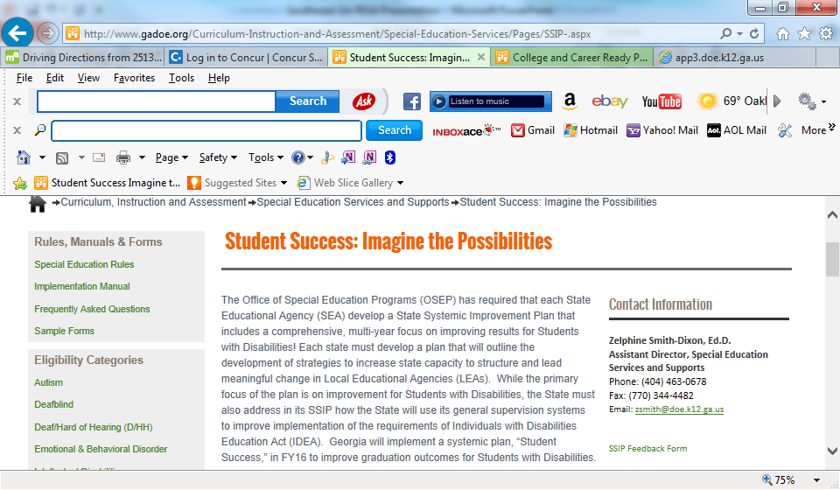
Student Success Webpage

