Slide 1
RTI for ELLs in Georgia: Research to Practice A professional learning webinar series Spring 2011
SESSION 1
Feb 16, 2011, 3-4:30pm

Slide 2
Welcome and Introductions
Dr. Kimberly Anderson, REL-SE at SERVE Center at UNCG
Cori Alston, GaDOE
Participants: groups w/ facilitators, individuals (next slide)
Notes:
Would we like to put in Carole, Mae, Amy’s names as well? Or will Cori be the only GaDOE facilitator?
Here we can do an Elluminate Instant Poll to take a poll of how many teachers there are, administrators, etc. participating—this way we can better tailor the presentation

Slide 3
Counting ALL Participants
Please do this to officially “sign in” to this webinar:
Go to the Chat Window
Type your district name and school name or organization name
Type your name and the names of every person in attendance with you
Send it to “This Room”

Slide 4
Who are we?
Teachers
ESOL/Title III coordinators
RTI/SST coordinators
Administrators
Counselors
LEA Office or DOE
Pk-5, 6-8, 9-12, post-secondary IHE
Statewide Organizations
Other?
Notes:
Count “raised hands” for how many of each group in attendance.

Slide 5
REGIONAL EDUCATION LABORATORY- SOUTHEAST (REL-SE)
Operated by SERVE Center at UNCG
Serving AL, GA, FL, MS, NC, SC, 2006 – 2011
Executive Director, Dr. Ludwig van Broekhuizen
Toll Free: 800-755-3277 www.serve.org
Georgia liaison: Dr. Kim Anderson
Notes:
5

Slide 6
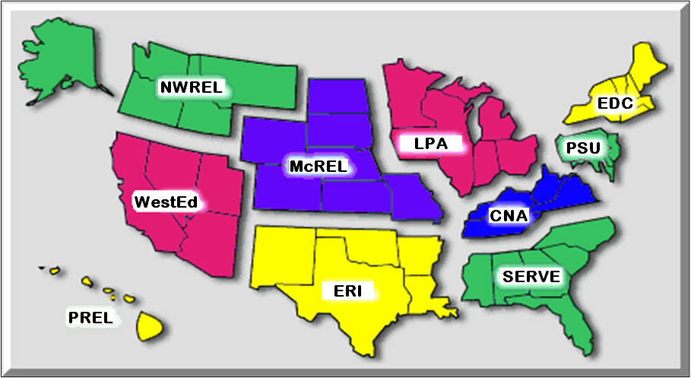
The Regional Educational Laboratory (REL) System

Slide 7
REL-SE’s MISSION
To serve the educational needs of the Southeast, using applied research, development, dissemination, and training and technical assistance to bring the best available evidence and proven practices into local, district, state, and regional school improvement efforts

Slide 8
REL-SE Services
Outreach and Dissemination of Research, Evaluation, and Policy Info.
Technical Assistance to SEAs and LEAs
“Issues & Answers” publications
RCT Experimental Studies on interventions of relevance to our region
Quick Turnaround Data Analysis

Slide 9
AGENDA
Overview of the series: Kim Anderson
RTI and ELLs in GA: Pat Blenke, Cori Alston
RTI and ELL online resources: Cori Alston
Reflection and Discussions
Current successes/challenges with RTI for ELLs
Hopes for the future of RTI for ELLs
Expectations for this webinar series
Looking ahead to Session 2: Kim Anderson

Slide 10
Series Overview

Slide 11
Overview of the Series
7 professional learning webinars on RTI for ELLs
Co-hosted by REL-SE and GaDOE, with support from USED Institute of Education Sciences (IES)
Builds upon trainings on RTI that GaDOE and REL-SE have been delivering since 2008
Addresses the GA RTI Guidance Manual and research-based practices for ELL instruction, intervention, assessment, and RTI
Session materials will be archived at GaDOE and SERVE websites

Slide 12
Overview of the Series, cont.’
Goal is to provide GA educators with increased knowledge of research and practice that can improve the implementation of RTI for ELLs.
Target audience: SEA staff, district ESOL/Title III and RTI staff, school administrators, school ELL and RTI/SST specialists, teachers, faculty at IHEs, others with interest in RTI for all students.
Brings together nationally recognized research experts and Georgia educators.

Slide 13
SERIES OVERVIEW
 | 1 | 2 | 3 | 4 | 5 | 6 | 7
Date Topics All Sessions 3-4:30 pm | Wed. 2/16/11 Introduction Intro to series RTI in GA, and where ELL services fit in the GA POI Challenges, successes so far | Wed. 2/23/11 Instruction What the research says about effective instruction for ELLs in standards-based classrooms (Tier 1), across grade levels and content areas | Tues. 3/15/11 Intervention Effective strategies for RTI in reading, literacy and English language instruction for ELLs | Thurs. 3/31/11 Intervention A culturally and linguistically responsive RTI framework | Wed. 4/13/11 Assessment-- Summative Content area and ELP summative assessment data: How can these two types of data inform RTI? | Thurs. 4/28/11 Assessment-- Formative Key formative assessment practices for ELLs and application to RTI | Wed. 5/11/11 Application & Implications Processing the series Next steps for professional learning
Presenters | GaDOE Title III staff REL-SE staff | Dr. Claude Goldenberg, Stanford U | Dr. Sylvia Linan-Thompson, UT Austin | Dr. Janette Klingner, U of Colorado at Boulder | Dr. Carrie Parker, REL-NE & I Adrienne Walker, GaDOE | Dr. Rebecca Kopriva, WCER | GaDOE Title III staff REL-SE staff

Slide 14
series overview session 1 session 2 session 3 session 4
INTRODUCTION
2/16/11
INSTRUCTION
INTERVENTION
3/15/11
INTERVENTION
3/31/11
Intro to series
RTI in GA, and where ELL services fit in the GA POI
Challenges, successes so far
2/23/11
Effective strategies for RTI in reading, literacy and English language instruction for ELLs
Effective instruction for ELLs K-12 across content areas (RTI Tier 1)
A culturally and linguistically responsive RTI framework
Resources
14
Notes:
I will get my editors at SERVE to fix the spacing for session 2

Slide 15
SERIES OVERVIEW SESSION 5 SESSION 6 SESSION 7
SUMMATIVE
ASSESSMENT
FORMATIVE
ASSESSMENT
4/28/11
APPLICATION
IMPLICATIONS
SHARING
5/11/11
4/13/11
Content area and ELP summative assessment data: How can these two types of data inform RTI?
Key formative assessment practices for ELLs and application to RTI
Processing the series
Next steps for professional learning

Slide 16
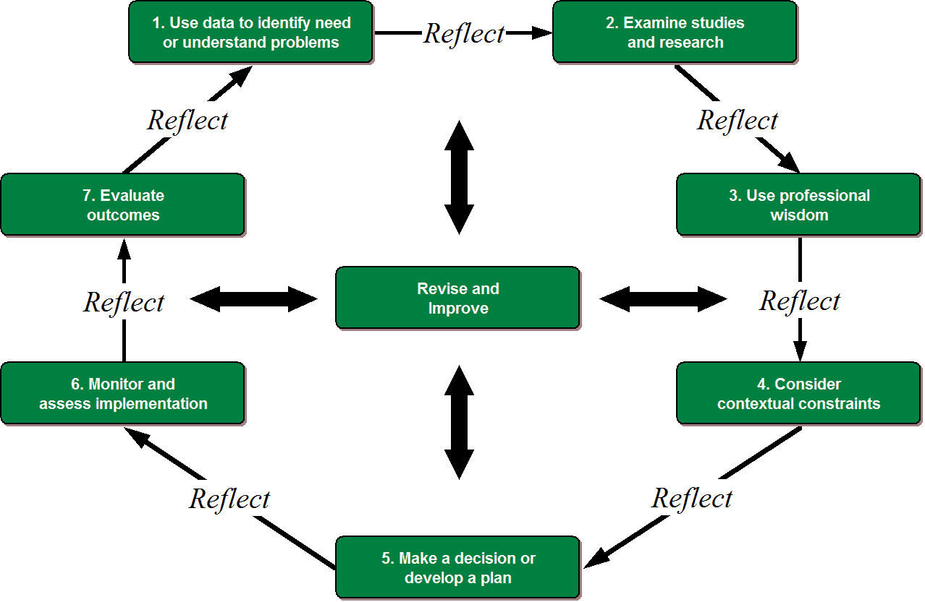
Where does the series fit in the EBDM Cycle? (Evidence-Based Decision Making)
16
Notes:
This Series focuses on Step 2, basing our decisions in a knowledge of current, rigorous research.

Slide 17
Overview of RTI in GA

Slide 18
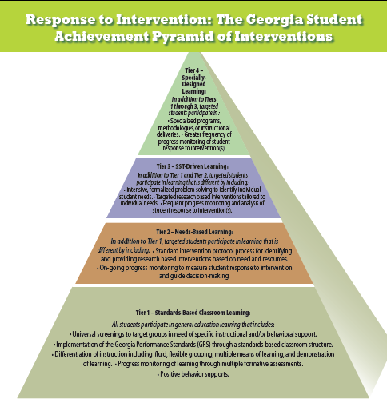
Notes:
The look of this pyramid reflects the RTI core foundation:
Strong Tier 1 standards-based classroom instruction for all students
Students needing additional interventions are supported in addition to Tier 1 instruction
All students are in Tier 1 and few numbers require intervention in Tiers 2-4
RTI is the process of aligning appropriate assessment with purposeful instruction for all students.
Based in the general education classroom where teachers routinely implement a strong and rigorous standards based learning environment.
Tiered approach to providing layers of intervention to students needing support, systematically progress monitoring the student’s response to the intervention, and adjusting instruction and interventions appropriately based on student response
18

Slide 19
Response to Intervention
Process of aligning appropriate
assessment with purposeful instruction
for all students
Notes:
RTI addresses behavior as well as academics.

Slide 20
What is the problem? What does the data show?
Why is this happening?
Curriculum Issue?
Instructional Issue?
Student Issue?
What is our plan? What are we going to do?
What interventions are needed?
How will we measure success?
Implement the plan
Who will do what, where, when, and how often?
How will fidelity of implementation be determined?
Did the plan work? What does the data show?
Notes:
Problem Solving cycle.
Occurs at all Tiers of the Pyramid (not just Tier 3).
Tier 1 – grade level or content area groups routinely use common assessment data to discuss teaching and learning and decide instructional steps based on students responses to instruction.
Tier 2 – intervention personnel interact with the school data team to consistently monitor student progress within the intervention and the transfer of learning from the intervention to the core classroom.
Tier 3 – SST team focuses on the individual student and individual needs to continue to design support

Slide 21
Tier 1 Non-negotiables
Tier 1 STANDARDS-BASED CLASSROOM LEARNING:
All students participate in general education learning that includes:
Universal screenings to target groups in need of specific instructional and/or behavioral support.
Implementation of the Georgia Performance Standards (GPS) through a standards-based classroom structure.
Differentiation of instruction including fluid, flexible grouping, multiple means of learning, and demonstration of learning.
Progress monitoring of learning through multiple formative assessments.
Positive behavior supports.
Notes:
RTI addresses behavior as well as academics.

Slide 22
Tier 2 Non-negotiables
NEEDS-BASED LEARNING:
In addition to Tier 1, targeted students participate in learning that is different by including:
Standard intervention protocol process for identifying and providing research based interventions based on need and resources.
On-going progress monitoring to measure student response to intervention and guide decision-making.
Notes:
learning is different and in addition to the core instruction
focus is the transfer of learning from the intervention to the core classroom
Progress monitoring data is used to determine if the student is responding at the rate as determined by the data team
Adjustments to intervention made based on student responses

Slide 23
Tier 3 Non-negotiables
SST-DRIVEN LEARNING:
In addition to Tier 1 and Tier 2, targeted students participate in learning that is different by including:
Intensive, formalized problem solving to identify individual student needs.
Targeted research based interventions tailored to individual needs.
Frequent progress monitoring and analysis of student response to intervention(s).

Slide 24
Tier 4 Non-negotiables
SPECIALLY-DESIGNED LEARNING:
In addition to Tiers 1 through 3, targeted students participate in :
Specialized programs, methodologies, or instructional deliveries.
Greater frequency of progress monitoring of student response to intervention(s).
Notes:
English Language Learners
Although the nature of the RTI Pyramid indicates all students begin at Tier 1 and move upward through the tiers only if the interventions at the previous tiers are not sufficient to allow them to achieve, Title III under NCLB does not permit delayed eligibility testing for language minority students. Neither should language assistance be delayed in order to allow students to progress "normally" through the tiers.
Eligibility for ESOL services automatically should be considered a Tier 4 Intervention. For the purposes of serving the student effectively and efficiently, the language minority student enters the Pyramid at the Tier 4 and as the student progresses with language development and academic proficiency, the level of interventions needed to support the student will decrease accordingly.
Gifted Learners
Advanced learning needs can be addressed in the general education classroom by providing instructional interventions prior to identifying students for specialized educational services. By documenting instructional interventions, the RTI process allows high-achieving students access to differentiated curriculum, flexible pacing, cluster grouping, and other universal interventions available to all students in the regular classroom.
Special Education
The Department frequently receives questions about timelines for eligibility determination related to RTI. As stated in Tier 3, the length of an intervention will vary by case, but most cases will occur over a six to twelve week period. For students being considered for eligibility in areas other than SLD, the key consideration is that interventions have been given a reasonable amount of time to work and that there are enough data points over time to provide a sound basis for making decisions about how the student is responding to the intervention.
For students who may eventually be considered for Specific Learning Disabilities eligibility:
Note that the required time period is twelve weeks. Interventions must be implemented for 12 weeks before a student can eventually be found eligible for special education services for a learning disability, but it does not all have to take place in Tier 3/SST. Additional weeks of interventions can take place during the specified evaluation period for Special Ed eligibility. Interventions from Tier 2 may also count toward the required 12 weeks for students being considered for SLD eligibility
The Department also receives questions about vision and hearing screenings. Typically, these are obtained in Tier 3, but it may be beneficial to screen vision and hearing in Tier 2 to rule out possible sensory issues which could have an impact on the student's response to interventions.
Parents maintain their due process right to request an evaluation. However, eligibility for special education should not be considered without documentation of prior instructional interventions. A Student Support Team bypass procedure does exist (see Georgia Rule 160-4-2-.32) for rare cases when indicated by the severity of the disability or extreme circumstances.

Slide 25
Georgia’s Focus on RTI
Establishing a common understanding
Supporting data driven decision making at the school and classroom level
Ensuring a culture of providing immediate interventions for students
Identifying and implementing interventions that impact achievement

Slide 26
Where ESOL services fit in the GA POI
As a specialized delivery model, ESOL is a Tier 4 intervention.
“ELL” is a temporary status. The greater the English skill, the lesser need for interventions.
Result: In time, ELLs move DOWN the RTI pyramid.
Notes:
I’m imagining this will be a slide or a few slides w/ basic points on ELLs in the POI

Slide 27
Where ESOL services fit in the GA POI
With the classroom teacher, ELLs should be receiving Tier 1 and/or 2 interventions.
Results from Tier 2 interventions should be documented for progress monitoring purposes.
Tier 4 ESOL services do not preclude SST services, if found to be necessary.
Notes:
Tier 2 examples: changing how materials are presented, the time allotted for task completion, the manner in which the ELL can respond. From a testing perspective, some samples of these types of accommodations can be found on the ELL Testing Participation Committee form under Presentation and Response Accommodations.

Slide 28
Online RTI and ELL resources currently available
http://public.doe.k12.ga.us/ci_services.aspx?PageReq=CIServRTI GaDOE RTI manual and resources
http://public.doe.k12.ga.us/ci_iap_esol.aspx GaDOE Title III/ESOL resources
www.nccrest.org for Culturally Responsive RTI
ies.ed.gov for ELL What Works Clearinghouse
www.rti4success.org webinar on RTI for ELLs
http://ritter.tea.state.tx.us/math/training/mell.htm for Math interventions and best practices for ELLs

Slide 29
Current challenges and successes implementing RTI for ELLs in GA
Participant discussion

Slide 30
Participant Discussions
5 min. chat Facilitators lead their groups Individuals and facilitators use chat box
Our current successes and challenges with RTI for ELLs
Our hopes for the future of RTI for ELLs
Our expectations for this webinar series

Slide 31
Looking Ahead to Session 2

Slide 32
Session 2 Wednesday, February 23, 2011 3-4:30pm
Focus: What the research says about effective instruction for ELLs in standards-based classrooms across grade levels and content areas (RTI Tier 1)
Presenter: Dr. Claude Goldenberg, Stanford University
Accessing the webinar: same URL as today’s session

Slide 33
Questions? Contact Info:
Cori Alston, GaDOE
calston@doe.k12.ga.us
404-656-2067
LaShaun Odom, GaDOE
lodom@doe.k12.ga.us
404-463-0505
Dr. Kim Anderson, SERVE/REL-SE
kanderson@serve.org
404-657-6174

