Slide 1
Performance Dashboards for Education
Data Tools to Assess Achievement and Progress to Increase Effectiveness of Districts and Schools

Slide 2
Notes:
Presenter: Bridget Johnson

Slide 3
Notes:
Presenter: Bridget Johnson

Slide 4
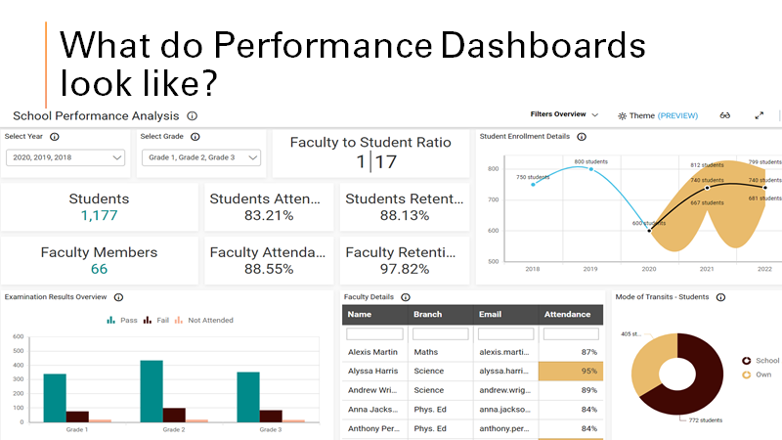
Notes:
Presenter: Bridget Johnson
Example of what a Performance Dashboard looks like.

Slide 5
Notes:
Presenter: Bridget Johnson

Slide 6
Georgia Insights
Georgia Insights is an initiative of the Georgia Department of Education, focused on improving the clarity and accessibility of district and school-level data through public-friendly and easy-to-use dashboards.
From discipline and attendance to perception and bullying, the Georgia Insights School Climate dashboard allows users to see the data behind the school climate star rating.
https://www.georgiainsights.com/
Notes:
Presenter: Rena

Slide 7
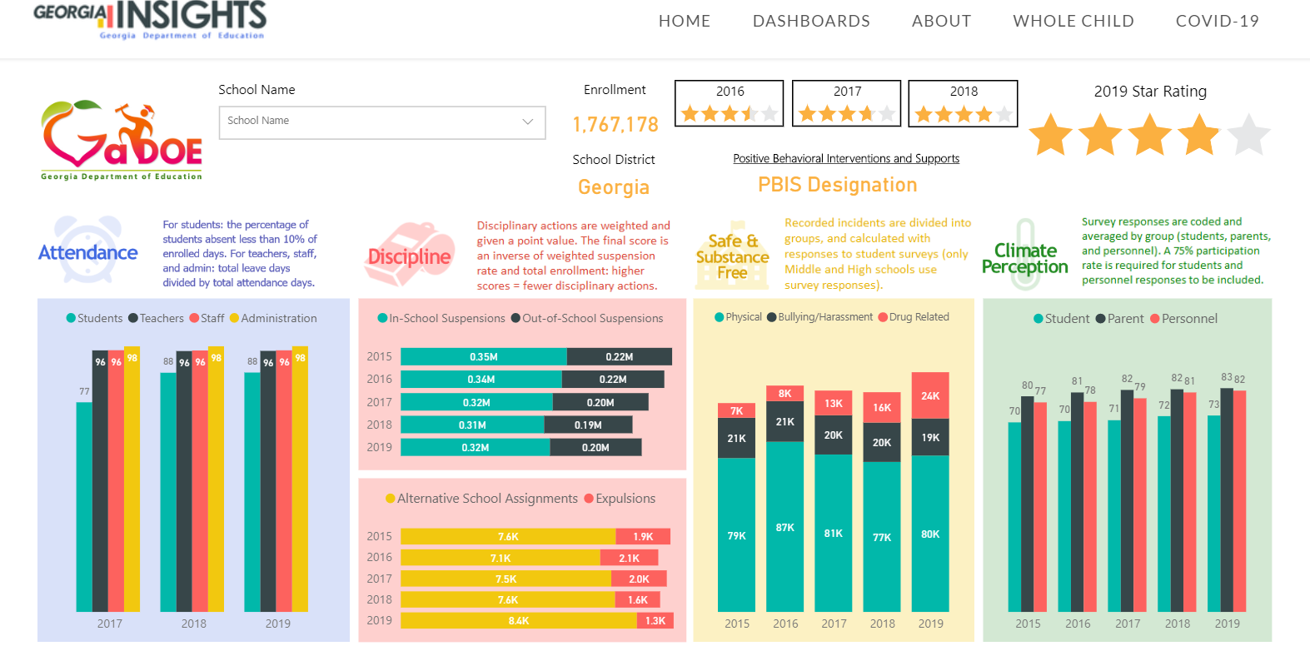
Tool Name: Georgia Insights - Climate
Notes:
Rena: The various uses for Georgia Insights include Culture, GMAS, Financial, Literacy, etc.

Slide 8
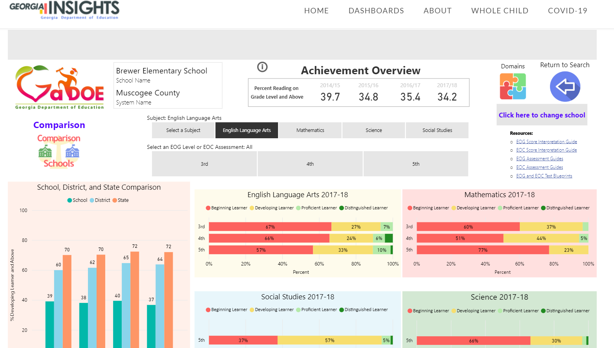
Tool Name: Georgia Insights - Achievement
Notes:
Presenter: Rena

Slide 9
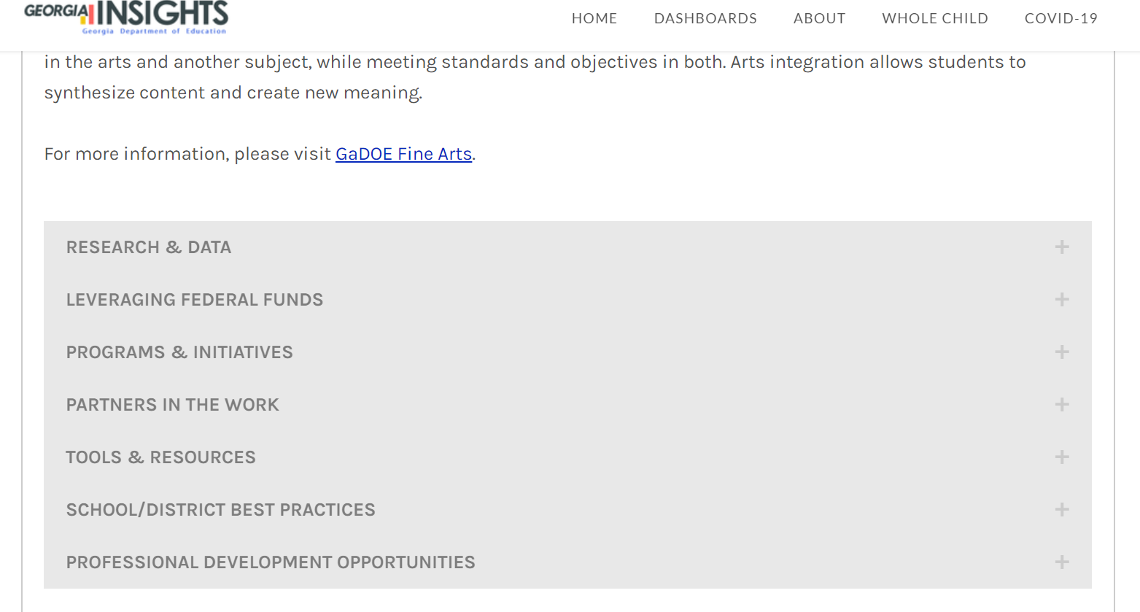
Notes:
Rena: Georgia Insights gives additional information such as if you wanted to focus on the whole child. I could click on whole child at the top then attributes in reference to the whole child can be researched.

Slide 10
Kids Count for Georgia
The Kids Count website is a national database supported by the Annie E. Casey Foundation, housing data pertaining to child wellbeing. It is not so much a dashboard as a national data repository for the purpose of allowing community and educational leaders to gain insight into the larger community and socioeconomic factors impacting their students.
The database contains information on basic demographics by age, race and ethnicity. You can then explore trend data on children by parental employment status, poverty, marital status (single parent households), whether they receive public assistance, housing situation, as well as many other economic issues. This data base also contains information on school enrollment and some achievement performance indicators.
The database can be sorted for the entire state, county, school district, city, and/or congressional district, providing essential information at a large overview scale, as well as granular down to the school district. It can help establish the "Marketplace" view of a school in which a consultant may be working.
Sources for more information: ​https://datacenter.kidscount.org/data#GA/2/0/char/0
Notes:
Wayne will be the Presenter

Slide 11
Notes:
Wayne will present

Slide 12
With just three clicks I was able to find and download a spreadsheet showing graduation rate by district and ethnicity for the past 9 years.
County | Dekalb | Black | 2011 | Percent | 0.5815
County | Dekalb | Black | 2012 | Percent | 0.5677
County | Dekalb | Black | 2013 | Percent | 0.602
County | Dekalb | Black | 2014 | Percent | 0.625
County | Dekalb | Black | 2015 | Percent | 0.7127
County | Dekalb | Black | 2016 | Percent | 0.6964
County | Dekalb | Black | 2017 | Percent | 0.734
County | Dekalb | Black | 2018 | Percent | 0.7603
County | Dekalb | Black | 2019 | Percent | 0.7404
Notes:
Wayne will be the presenter

Slide 13
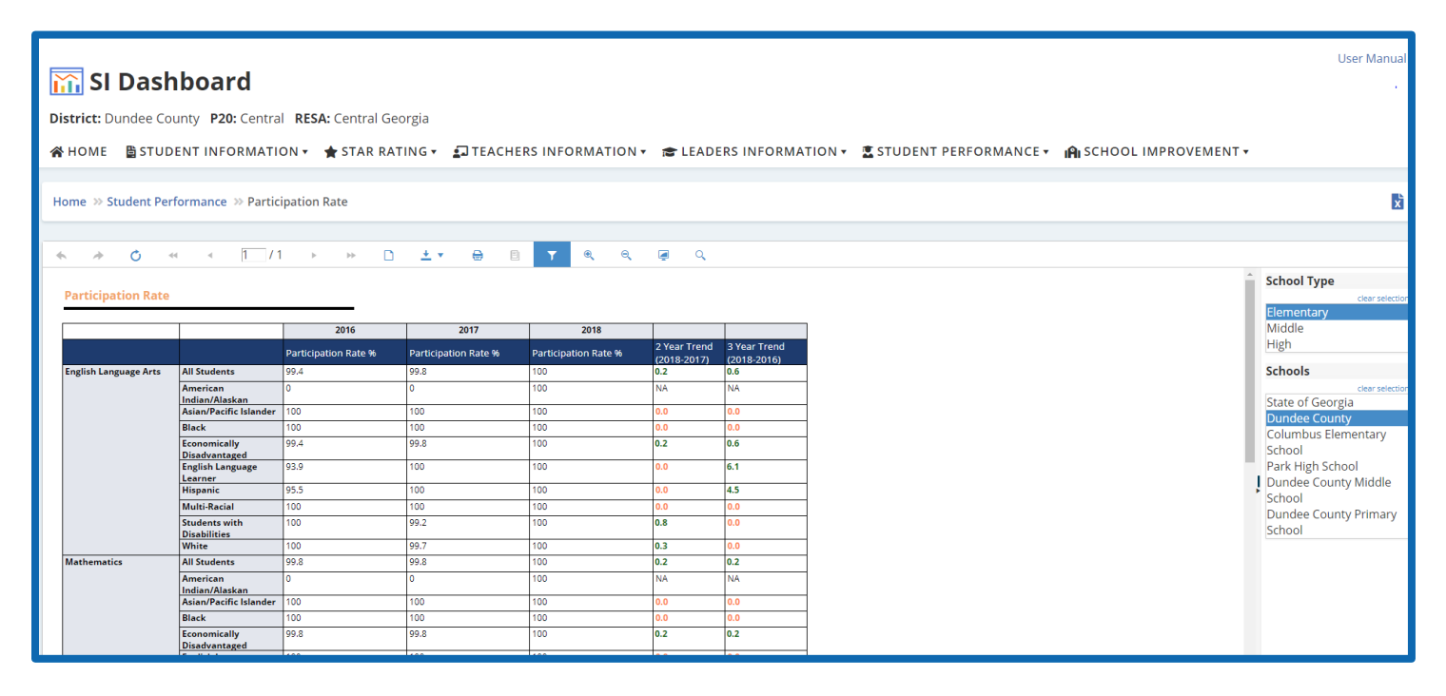
Tool Name: SLDS - SI Dashboard
-This SI Dashboard will provide an insight of different data variables reflected at a school, district and at the state level.
-The SI Dashboard allows LEA users to take a deeper dive into Georgia data variables for the purpose of informing school improvement efforts and informing equity decisions. This dashboard has six pages – 1) Student Information, 2) Star Rating, 3) Teacher Information, 4) Leader Information, 5) Student Information and 6) School Improvement – that allows state users, district users, and school users to explore the different data variables across the years. The Dashboard was created using data from FY 2016, FY 2017, and FY 2018.
Notes:
Joyce: Purpose, Uses, and 1 example

Slide 14
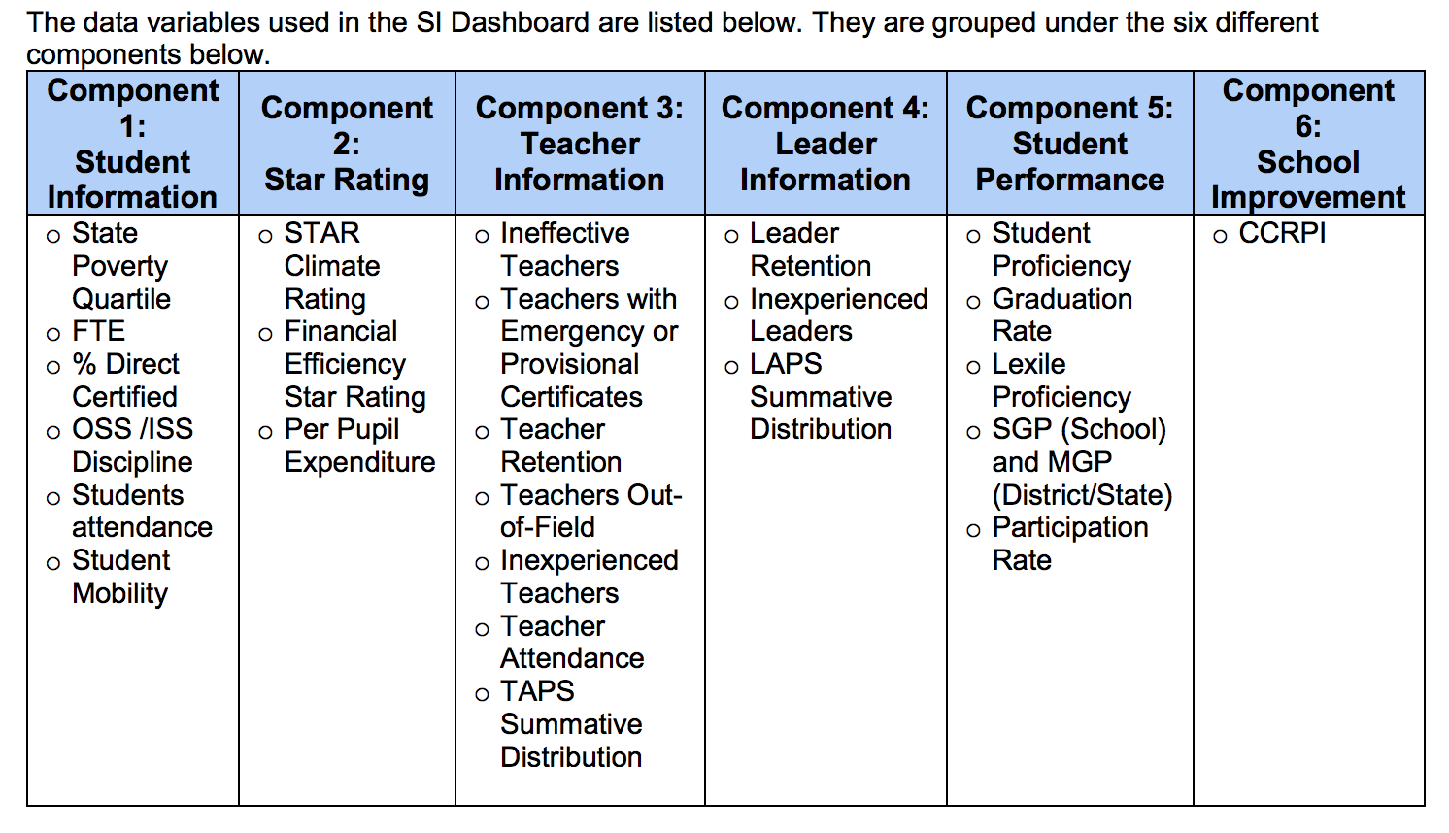
SLDS - SI Dashboard
Sources for more information: School Improvement (SI) Dashboard
Notes:
Joyce: Attributes, Source, and 1 example

Slide 15
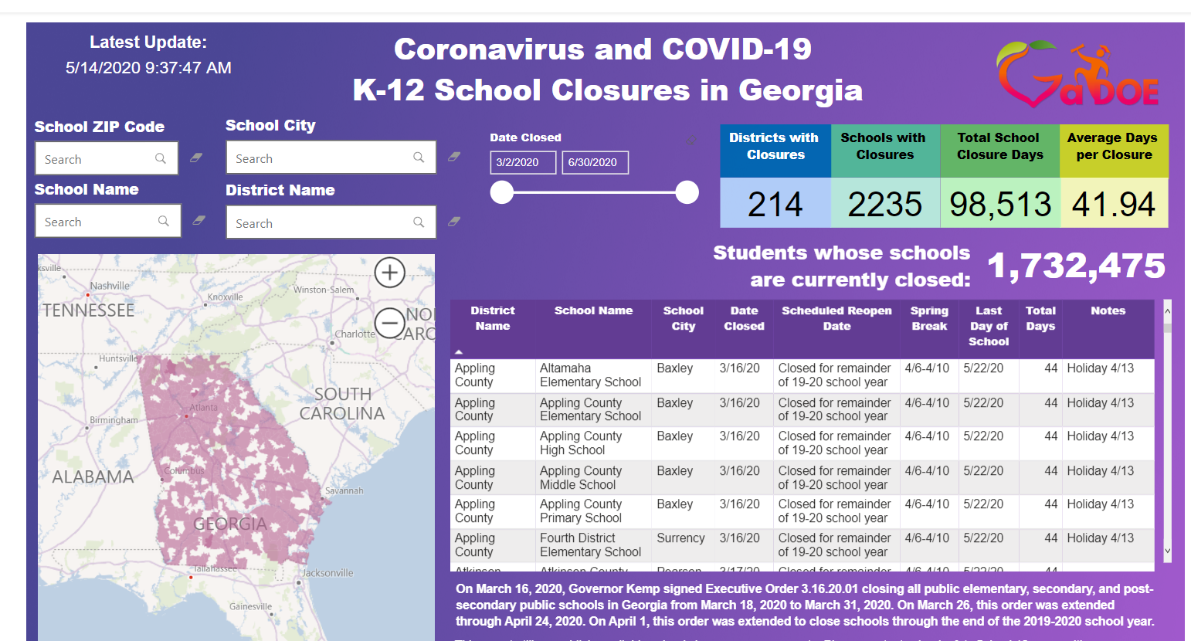
Tool Name: Coronavirus and Covid-19 Updates
Purpose:​
Attributes:​
Uses:​
Sources for more information:​
Notes:
Presenter: Dianne

Slide 16
Coronavirus Updates Dashboard
The purpose of this dashboard is to inform the public of the school and district closures as the result of the pandamic of Covid-19, as well as the number of students impacted by those closures.
The page assists the public in submitting queries about regions and districts and allows them to filter for specific districts and schools.
The page will assist the public in determining how much school was missed and how to make decisions about future schooling during the pandemic.
Additional resources can be found at
RResources
Georgia Department of Education's COVID-19 Coronavirus webpage
Georgia Department of Public Health's COVID-19 Daily Case Counts
Notes:
Presenter: Dianne

Slide 17
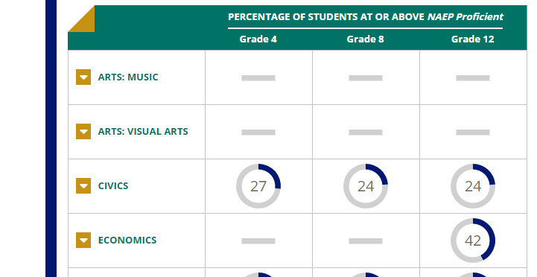
Tool Name: The Nation's Report Card
Purpose:​ To report nationwide performance over time in the United States
Attributes:​ NAEP results by subject, grade, and time for the last 51 years. Assessment results from 4th, 8th, and 12th grades for Civics, Geography, Reading, Mathematics, Science, History, and Writing.
Uses:​ Comparing state to state performance, subgroup performance, research databases, queries for drill down, and multiple dashboards to examine public, private, and charter schools
Sources for more information:​ The site provides in-depth data tools allowing users to perform deep dives into the data from all the years
Notes:
Presenter: Tony

Slide 18
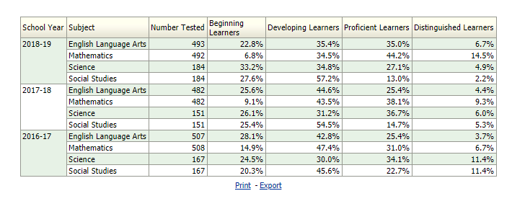
Tool Name: GOSA Dashboard
The purpose of the GOSA Dashboard is to allow education stakeholders to examine education statistics for individual schools and districts. In some cases, stakeholders may require school- and district-level data for all schools.
Several data bases are available through this dashboard including:
K-12 Student Discipline Dashboard - The Discipline Dashboard summarizes district- and school-level discipline data for all public schools in Georgia.
Georgia Higher Learning and Earnings - The Georgia Higher Learning and Earnings (GHLE) project provides information on earnings information for Georgia technical college and college/university graduates who work in Georgia after earning their degrees.
Georgia School Grades Reports - The Georgia School Grades Reports website provides school reports for all public elementary, middle, and high schools in Georgia. The reports include A-F letter grades based on school performance as well as other information about schools, such as performance on state tests, the make-up of the student body, and the graduation rate.
Notes:
Presenter: Richard

Slide 19
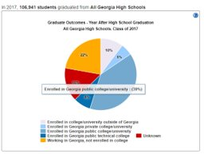
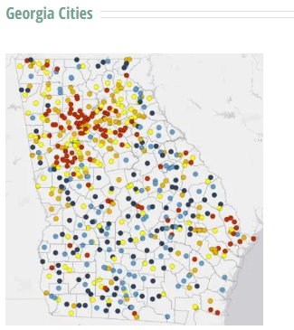
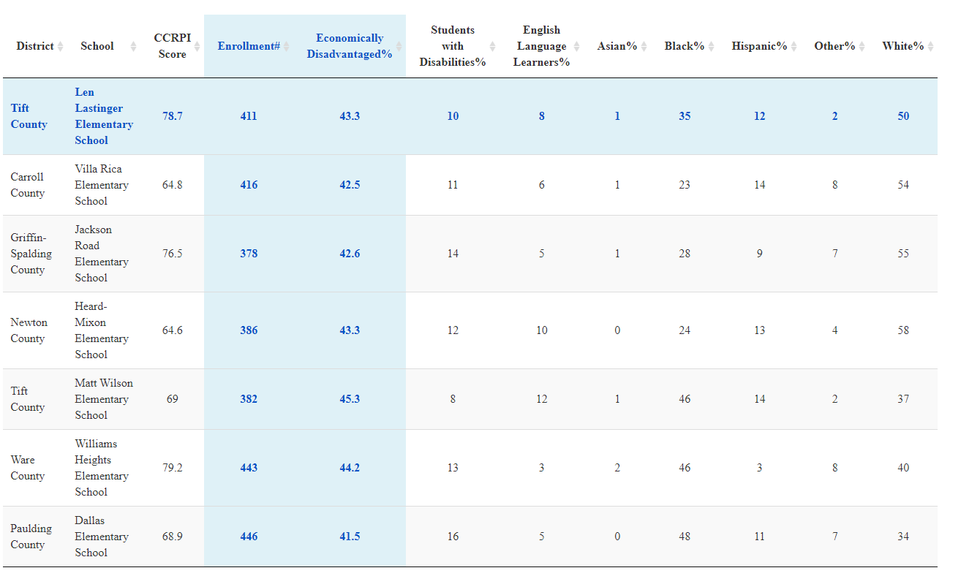
Tool Name: GOSA Dashboard
​High School Graduate Outcomes Dashboard - This dashboard shows what high school graduates do after graduation. For each public high school, this interactive dashboard shows:
The percentage of graduates enrolled in college/university or working,
The top in-state and out-of-state colleges by enrollment, and
The percentage of students who earn a credential or degree within five years.
Interactive Education Data Map - The Interactive Education Data Map provides stakeholders a customizable, visual representation of data throughout the state. The map includes district-level data on:
Student mobility
Student demographics
Standardized test performance
College and Career Ready Performance Index (CCRPI) scores
Community demographics
Schools Like Mine Dashboard - The Schools Like Mine application allows parents, educators, and community members to find schools with similar student populations to their school. It also lists the school’s letter grade and College and Career Readiness Performance Index (CCRPI) to allow for comparison of performance between the “like” schools.
Notes:
Richard

Slide 20
Notes:
Presenter:

Slide 21
Final Questions
1. How skilled are we in helping schools adopt and use these tools?​
As a team, we decided that we are relatively skilled at helping schools adopt and use these tools. The tools are very easy to navigate.
2. What do we need to learn about these tools to help those we guide? ​We need to learn the following about these tools in order to help those we guide:
How often is the dashboard updated?
Can we filter the data?
Does the tool offer subgroup data?
How does the tool connect with the community?
How well is the school performing as suggested by this tool?
Notes:
Presenter: Linda

Slide 22
Final Questions
3. What are the implications for our practice? The implications are as follows:
To assist Leadership Teams in giving them access to critical information/data.
Can be used as a visual tool to help schools track, analyze and display key information.
Offers schools an opportunity to explore root causes
Allows schools to review data to determine the areas of strength, as well as, areas in need of improvement.
Too much data can be overwhelming
4. How might our organization use these internally to improve our performance and results?
Historical Data
School Improvement Plans
Comprehensive Needs Assessments
Lagging Data
Data Trends
Root cause analysis
Display, compare and analyze data
Monitoring and sharing strategies
Notes:
Presenter: Linda

