Slide 1
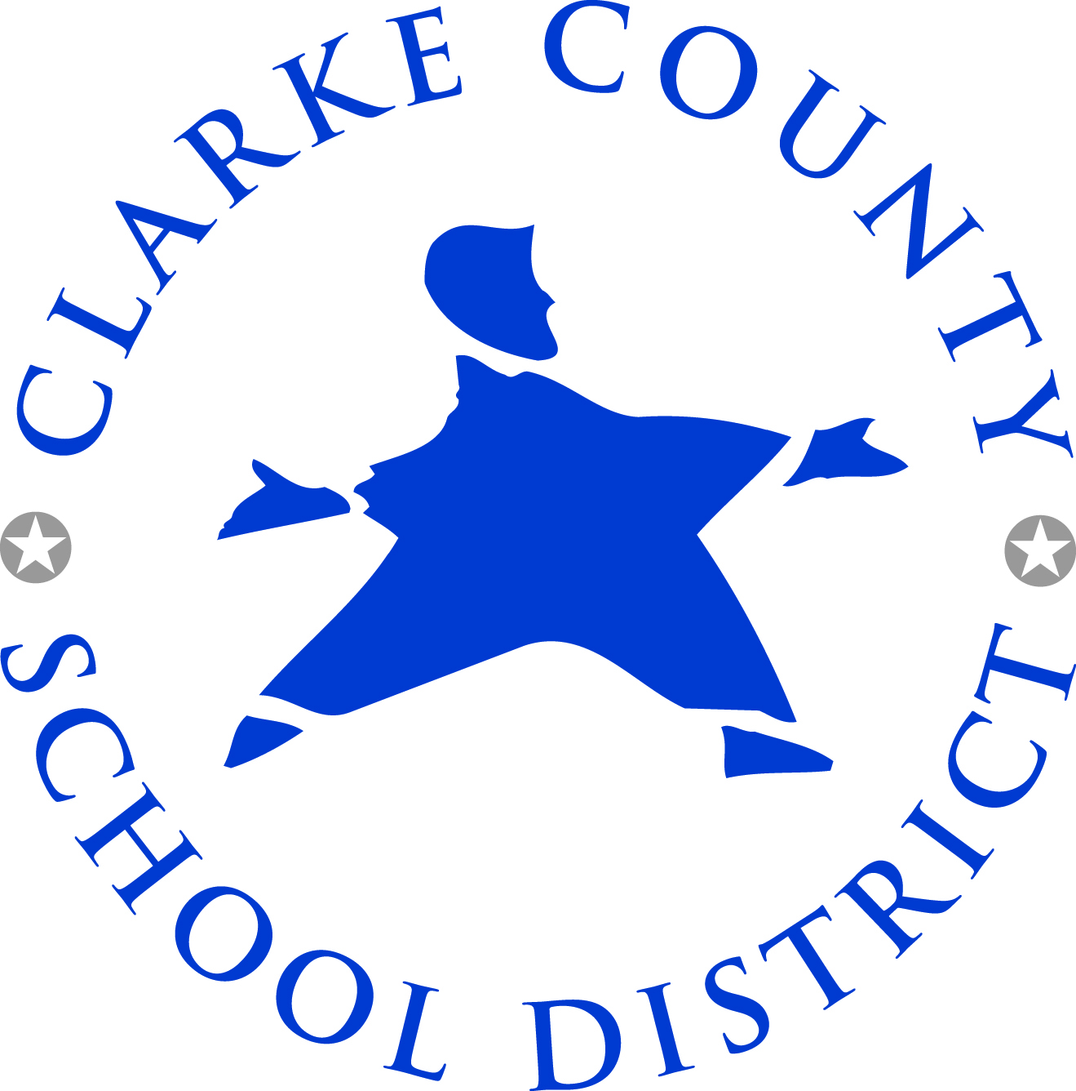
Clarke County
School District Accountability Report
6.14.2017

Slide 2
Vision
Our vision is for all students to graduate as life-long learners with the knowledge, skills and character to succeed in our community and the global society.

Slide 3
Mission Statement
In partnership with families and the community, our mission is to inspire students to achieve at high academic levels through challenging and innovative learning opportunities that support the development of students’ individual talents.

Slide 4
District-Wide Strategic Goals
Select, support and retain a highly dedicated, talented, and diverse professional workforce.
Create dynamic learning experiences for all students to close the achievement gap and to prepare them for college and careers.
Strengthen neighborhood schools through strong collaboration with parent, district, and community members to support student academic growth, socio-emotional development, and physical well-being.
Strategically leverage resources to improve district programs and implement new initiatives.

Slide 5
District-Wide Focus Areas
Collaborative Planning Model using the District’s Commitments for High Student Performance
Innovative Instructional Delivery Strategies
Personalized Supports through the Response to Intervention (RTI) Process
Engagement of Student Creativity and Interests
Positive Learning Environments that Support Social-Emotional Development and Physical Well-Being of Students

Slide 6
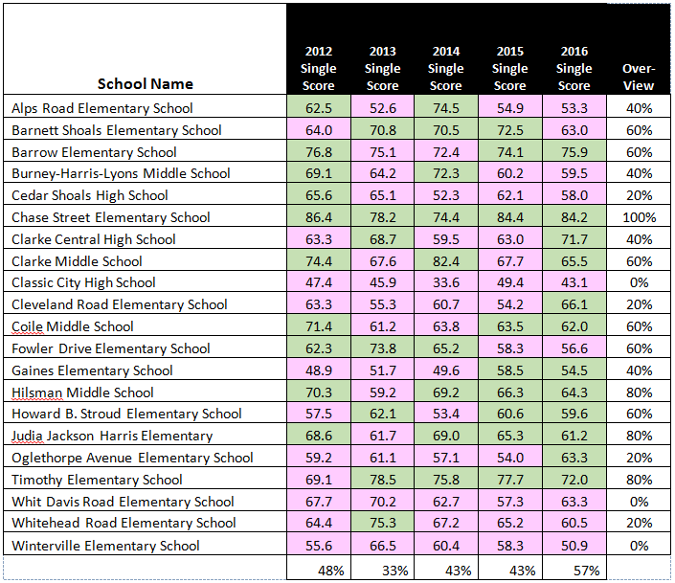
CCRPI Scores and Beating the Odds

Slide 7
CCRPI Scores and Beating the Odds
 | 2012 CCRPI Score | 2013 CCRPI Score | 2014 CCRPI Score | 2015 CCRPI Score | 2016 CCRPI Score
Chase Street Elementary School | 94.2 | 85.9 | 81.1 | 92.2 | 94.2
Gaines Elementary School | 50.4 | 52.7 | 50.6 | 59.8 | 57.2
Classic City High School | 47.4 | 46.4 | 35.4 | 49.9 | 43.6
Green means school “Beat the Odds” Red means school did not “Beat the Odds”
Chase Street Elementary “Beat the Odds” five years in a row
Classic City High and Gaines Elementary had a CCRPI score below 60 for the past 3 years

Slide 8
Changes in Leadership
 | 2012 | 2013 | 2014 | 2015 | 2016 | 2017 | 2018
Chase Street Elementary School
Gaines Elementary School |  | C |  |  |  |  | C
Classic City High School |  |  | C |  |  |  | C
C = Change in Leadership

Slide 9
Year-to-Year Teacher Retention
 | 2012 | 2013 | 2014 | 2015 | 2016 | 2017 | 2018
Chase Street Elementary School | 83% | 84.6% | 89.2% | 93% | 91% | 95.6% | TBD
Gaines Elementary School | 70.1% | 74% | 68.9% | 71.8% | 62.5% | 77.5% | TBD
Statewide Elementary School Average | 85% | 85% | 84.4% | 83.5% | 83% | 81.9% | TBD
Source: Georgia Professional Standards Commission
Mid-Year School Personnel Analysis

Slide 10
Year-to-Year Teacher Retention
 | 2012 | 2013 | 2014 | 2015 | 2016 | 2017 | 2018
Classic City High School | 63.6% | 87.5% | 50% | 100% | 72.7% | 100% | TBD
Statewide High School Average
Source: Georgia Professional Standards Commission
Mid-Year School Personnel Analysis

Slide 11
Professional Development Initiatives
The Professional Development School District (PDS) is a partnership between CCSD and the University of Georgia (UGA) College of Education that provides a framework for on-site professional learning throughout the district through Professors-in-Residence and UGA pre-teacher placement.
Need for expanded involvement with Gaines and Classic City
Literacy-Focused Professional Learning has been a district-wide focus through intensive coaching and mentoring. Gaines teachers were part of the Striving Readers Comprehensive Literacy (SRCL), along with 17 other district schools, and the Get Georgia Reading Initiative to help students read on-level by 3rd grade.
Need to expand literacy efforts at high school to include Classic City
Math & Science Professional Learning has been a district-wide focus through intensive coaching and mentoring. Chase Street teachers were part of the Math and Science Partnership (MSP), which focused on building content knowledge through a partnership with UGA and the Northeast Georgia Regional Educational Service Agency (RESA). Over the past year, Chase Street and Gaines math teachers received professional development from Math Solutions.
Need to expand math and science efforts at Gaines
CCSD provides Teacher Leadership Opportunities through district-level curriculum development teams and Teacher Advisory Board with active participation from teacher-leaders at all schools. The district has the longstanding Rising Stars Leadership Program in collaboration with RESA.
Need to expand leadership opportunities for all teachers
Monthly Professional Learning Community sessions are held on a monthly basis throughout the year. These sessions are embedded in the culture of CCSD. In addition, CCSD sets aside district and school professional learning days throughout the year.

Slide 12
Extended Day and Year Initiatives
After School Programs include district-wide 21st Century Community Learning Center programs at elementary level in partnership with the Boys and Girls Clubs of Athens; the Physical Activity and Learning (PALS) program at Chase Street in partnership with UGA; and the After School Program (ASP) at Chase Street.
Need for increased after school opportunities at Gaines and Classic City.
Summer Programs include the district-wide Title I-funded Camp Invention with a location within walking distance of Gaines; and Camp DIVE, which is a collaboration with UGA.
Need for increased summer enrichment opportunities for high school students
The 1:1 Technology Initiative provides a device for every student in CCSD in grades 3-12, creating opportunities for learning anywhere at any time.
Need to evaluate impact of technology and expand to grades K-2

Slide 13
Student Support Initiatives
The Student Code of Conduct was rewritten in 2017 with help from the Georgia Appleseed Center for Law and Justice to bring about a change in school culture district-wide. The code aims to be less punitive and more educational with the ultimate goal of helping more students graduate.
Begin consistent and fair implementation of Student Code of Conduct at all schools
Positive Behavioral Interventions and Supports (PBIS) - an evidenced-based, data-driven framework proven to reduce disciplinary incidents, increase a school’s sense of safety, and support improved academic outcomes.
Continue implementation with fidelity at all schools
Other Behavior Support Programs include Mindset Training to facilitate insight, raise awareness, enhance skills, and ultimately certifies professionals in a system of preventing and managing aggressive behavior; the Second Step program to develop social-emotional skills in students; and partnerships with UGA to develop a model of prevention, focused intervention and professional development on behavior. In addition, the district now has a district-wide Professor-in-Residence from UGA Safe and Welcoming Schools to support school climate initiatives.
Continue implementation of these supports at all schools
Parent & Community Involvement goes beyond activities within the school building, but expands through community-based learning programs. The focus of the CCSD charter system and its Local School Governance Teams is to create innovations that build the capacity of schools and communities to support student success.
Expand parent and community involvement at all schools

Slide 14
THANK YOU!
Contact with questions:
James Barlament, Charter System Director
barlamentj@clarke.k12.ga.us
706-546-7721, ext. 20742

