Slide 1
K-12 Mathematics Standards Review Process
December SBOE 2019
Matt Jones, Chief of Staff

Slide 2
Background
Summer 2019: Governor Kemp announced he was partnering with the State School Superintendent to review/revise the current ELA/mathematics standards
Established a Citizens Review Committee
“Kemp said he plans to soon name a citizens review panel that will participate in the standards review process.”

Slide 3
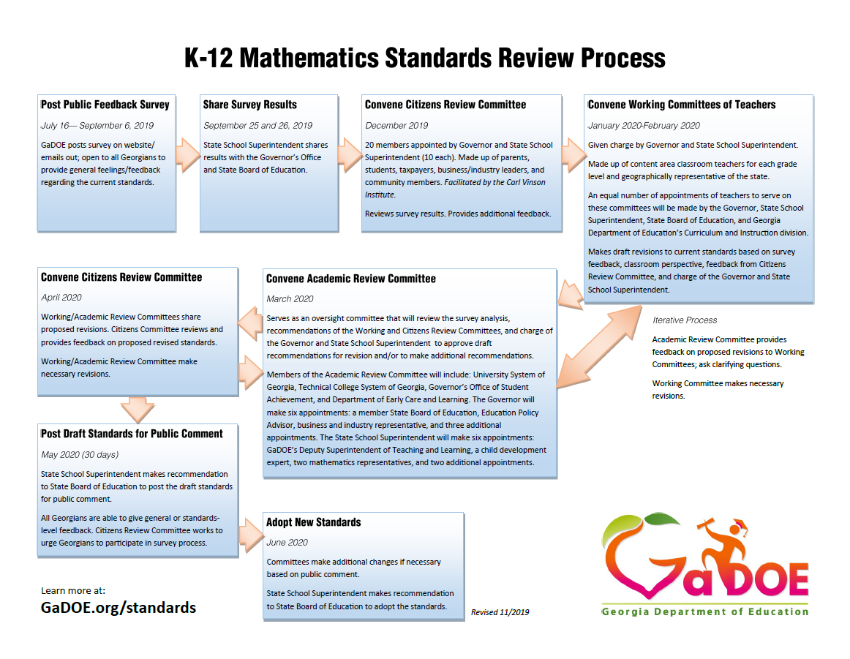
K-12 Mathematics Standards Review Process

Slide 4
K-12 Mathematics Standards Review Process
Timeline
July 16th – Sept 6th
Post public feedback survey -- completed
Sept 25th & 26th
Share survey results -- completed
Dec 2019
Convene Citizen Review Committee -- completed
Jan – Feb 2020
Convene Teacher Working Committee

Slide 5
K-12 Mathematics Standards Review Process
Timeline (cont.)
Mar 2020
Convene Academic Review Committee
Apr 2020
Convene Citizen Review Committee
May 2020
Post draft standards for public comment
Jun 2020
Adopt new K-12 mathematics standards

Slide 6
Citizen Review Committee
Make up: 21 members; parents, students, business leaders, educators, and concerned citizens
Appointments: Governor and Superintendent
Roles/Responsibilities:
Be a voice — providing feedback, insight, and input — on behalf of Georgia’s students, parents, business leaders, and concerned citizens.
Articulate the K-12 Mathematics Standards Review Process and the roles of the Academic Review Committee and the Working Committee of Teachers.

Slide 7
Citizen Review Committee
Roles/Responsibilities (cont.):
Inform the work of the Working Committee of Teachers by reviewing the results of the stakeholder survey for mathematics providing feedback and adding to the key themes of the survey.
Review the recommended revisions of the revised standards made by the Working Committee of Teachers and provide feedback.
*Facilitated by the Carl Vinson Institute

Slide 8
Citizen Review Committee
Meetings facilitated by the Carl Vinson Institute
Meeting agenda, presentation, notes/feedback, and committee members will be posted online
1st Meeting – Gathering feedback
Welcome and charge – Governor Kemp and Superintendent Woods
Reactions and observations to standards survey data
Facilitated and breakout discussions with committee members
2nd Meeting – Providing feedback
Review the recommended revisions to the current mathematics standards

Slide 9
K-12 Mathematics Standards Review Process
December SBOE 2019
Matt Jones, Chief of Staff

Slide 10
Overview of the Committees: Teachers
Make up: 190+ mathematics teachers from across Georgia; teams of 8-12 for each grade level and course
Appointments: Governor, Superintendent, SBOE and GaDOE
Roles/Responsibilities: Review and revise the current K-12 mathematics standards, making recommendations to the Citizen Review, Academic Review, State School Superintendent, and State Board of Education
Meetings: January and February 2020

Slide 11
Overview of the Committees: Teachers
Grade Span | 2015 Standards Review | 2019 Standards Review
K-2 | 7 teachers | 24 teachers
3-5 | 6 teachers | 30 teachers
6-8 | 7 teachers | 30 teachers
High School | 13 teachers | 109 teachers
Total | 33 teachers | 193 teachers

Slide 12
K-12 Mathematics Standards Review Process
December SBOE 2019
Matt Jones, Chief of Staff

