Slide 1
Georgia Department of Education-Facilities Services
GASFA
October 23-26, 2022

Slide 2
GaDOE Facilities Services Staff
Mike Sanders
Sarah Morris
Tony Cook
Gerald Williams, Greg Snapp
Kelland Waldrep
Suzie Standifer
John Ramage, Deborah Robertson, Len McCoy, Doug Suits, Mickey Schuber
Todd Cason—will join the team in January

Slide 3
GaDOE Facilities Services Staff
Combined years of DOE Facilities Staff experience in education/DOE service…….
430 years or 39 years/person
Consultants – 233 years

Slide 4
GADOE Facilities Services Responsibilities
Local Facility Plan Development
Funding
Site Approvals
Facility School Registry (FSR)
Architectural Review
Provide guidance

Slide 5
Role of the DOE Consultant
Teacher (Consultant teaches you how the Capital Outlay Program operates)
Verifier (Consultant verifies decisions made by local system)
Supporter (Consultant provides ongoing support)
233 years of experience for free

Slide 6
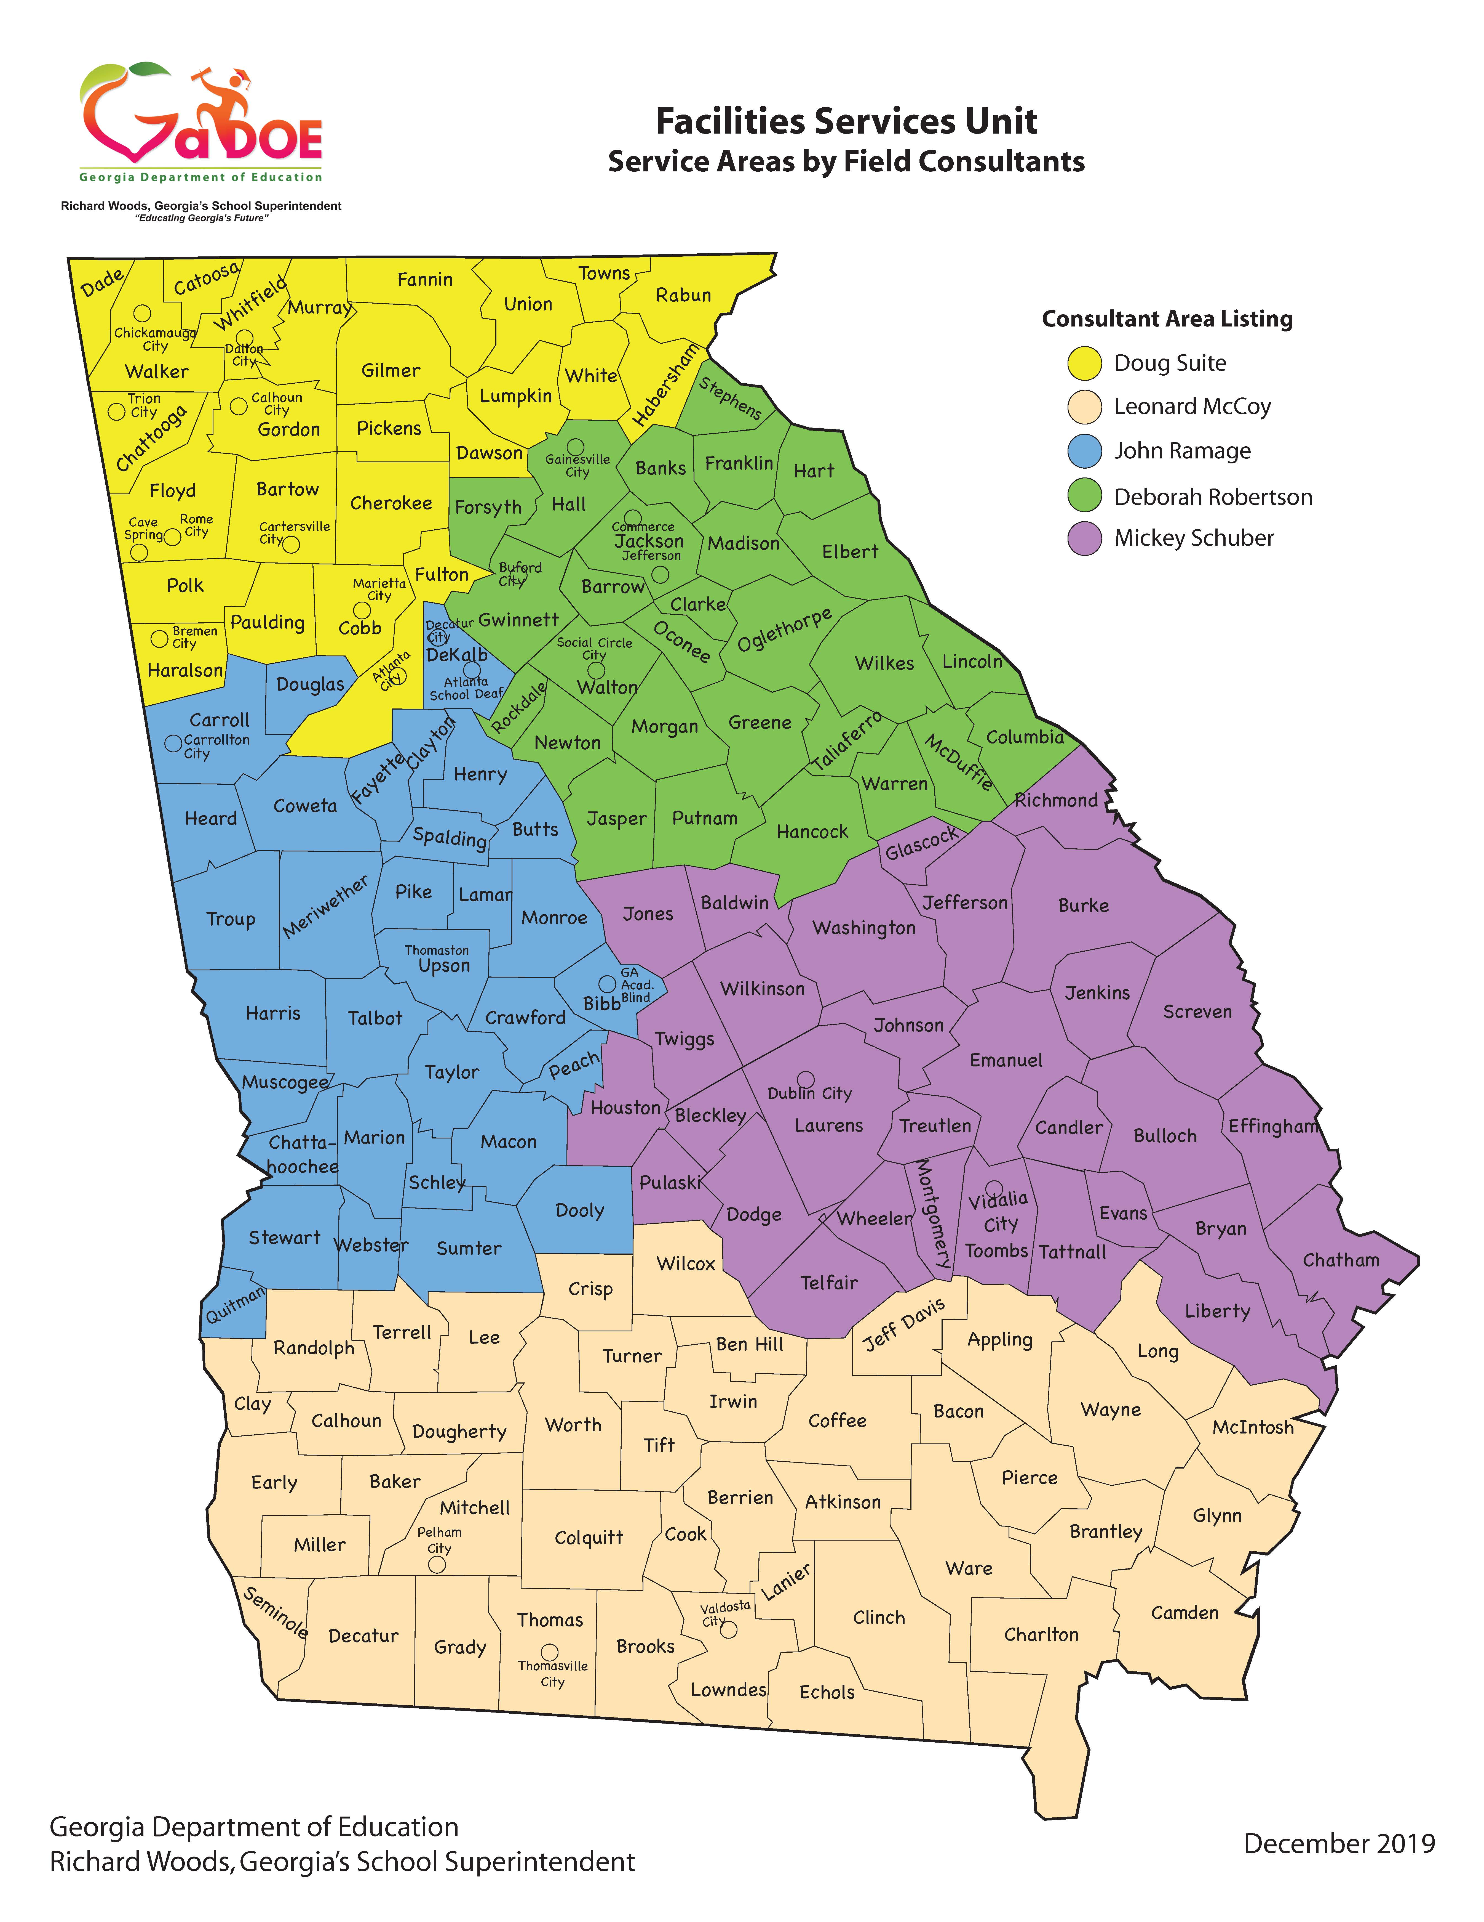

Slide 7
Role of the Local Facilities Director
180 local school districts
Duties and Responsibilities differ!
Facilities, Transportation, Discipline, Student Services, etc.
The responsibility to follow the law and state board rules falls on the local school district and their leaders!
Know how/where to find the answers.
GaDOE Facilities Services Field Consultants and GaDOE are available to provide guidance.

Slide 8
Role of the Local Facilities Director
1. Check your Entitlement Sheet to verify it is correct.
2. Check the Overview Tab in your facilities plan to verify it is correct.
3. Check your FTE Projection.
4. Check all the tabs in your facilities plan to make sure your system gets its fair share of the $300 million dollar pie.
5. Trust but verify!

Slide 9
What is Capital Outlay?
The State of Georgia provides funding assistance for local school systems in the construction of new schools, additions to existing schools, as well as renovations and modifications to existing facilities.
This assistance comes in the form of several funding programs, which systems qualify for based on need as shown in a long-range facility plan which considers student enrollment, verified by periodic state-mandated FTE counts.
The funding programs are not meant to be sole fund sources for building projects, but rather as state-local funding partnerships to accomplish system facility objectives.

Slide 10
Capital Outlay: 20-2-260
Establishes the premise of safe and adequate schools
Directs the Georgia Department of Education (GaDOE) to develop and administer rules to this end
Requires 5-year Local Facility Plan to participate in Capital Outlay
$300 Million requested of the legislature annually to fund renovations, modifications, new classrooms and new facilities
Based on eligible need

Slide 11
Procurement
GA Code 36-91-20, 36-91-21, 36-91-22
Become familiar with each of these
Bookmark for quick reference
Consult your attorney

Slide 12
Reimbursement Deadlines -FY19
FY19 funding will expire in 2023
This includes:
FY19 Capital Outlay Projects
FY19 Facility Safety Grant
Submit all reimbursement requests by March 2023

Slide 13
2024 Appropriation Request
•FY 2024 Applications
$267 Million State Funds Requested Supporting $1 Billion (Total Costs)
$136 million for 16 new facilities
Remaining $131 million supports:
Additions for 7 facilities
54 renovation projects
151 modification projects

Slide 14
Federal Funding Guidance
American Rescue Plan (ARP) Act, 2021
ESSER III Implementation Plan Overview
Construction related work (facility upgrades) completed with these funds must meet the requirements of state law and state board rules as well as the federal requirements
Davis Bacon Act – YES!
Eligible need identified in a system’s Local Facility Plan and completed using Federal dollars should be removed from the LFP

Slide 15
Federal Funding Guidance
School facility repairs and improvements to enable operation of schools to reduce risk of virus transmission and exposure to environmental health hazards, and to support student health needs.
Inspection, testing, maintenance, repair, replacement, and upgrade projects to improve the indoor air quality in school facilities, including mechanical and nonmechanical heating, ventilation, and air conditioning systems, filtering, purification and other air cleaning, fans, control systems, and window and door repair and replacement.
Note: GaDOE has staff dedicated (not Facilities Staff) to assist and answer questions related to the use of these funds.
We continue to work together to provide service and answer questions related to this fund source.
Conversations continue with state and federal audit groups on the use of the funds and requirements that will be in place (Davis-Bacon Act is definite)

Slide 16
Federal Funding Guidance
Letter of Assurance

Slide 17
Federal Funding Guidance
Davis-Bacon Act
Davis-Bacon prevailing wages, including fringe benefits, must be paid on all hours worked on federally-funded projects in excess of $2,000;
Contractor/subcontractors’ obligation to pay at least the prevailing wage listed in the contract wage determination can be met by paying each laborer the applicable prevailing wage entirely as cash wages or by a combination of cash wages and employer-provided bona fide fringe benefits;
Apprentices (or trainees) may be employed at less than the Davis-Bacon prevailing wage rate(s) listed in the contract wage determination only when they are in an apprenticeship program registered with the Department of Labor (“DOL”) or with a state apprenticeship agency recognized by the DOL;
Contractors/subcontractors are required to pay covered laborers weekly and submit weekly certified payroll records to the contracting agency; AND
Those contractors/subcontractors employing covered laborers are also required to post the applicable Davis-Bacon wage determination with the Davis-Bacon poster on the job site in a prominent and accessible place where they can be easily seen by the laborers.

Slide 18
HB1355 Childhood Lead Exposure Control Act
Updates state law to:
Comport with nationally recognized guidelines
Revise definitions
Revise provisions relating to abatement of lead poisoning hazards
Expand written advisement requirements
Provide for a funding contingency

Slide 19
Site Application Process
Kelland Waldrep – Education Research & Evaluation Specialist

Slide 20
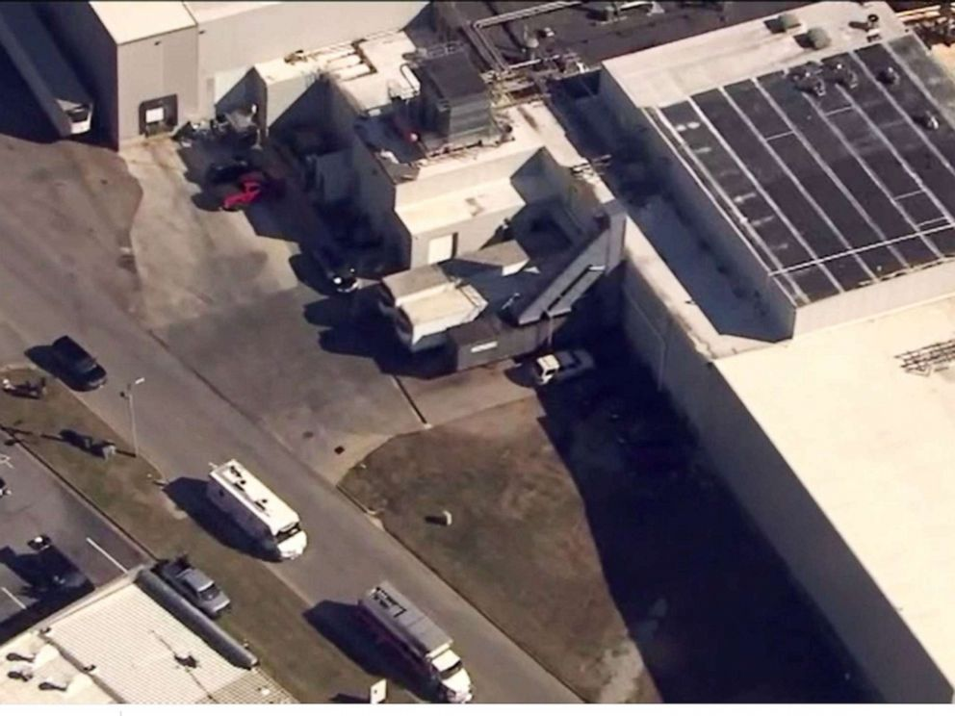
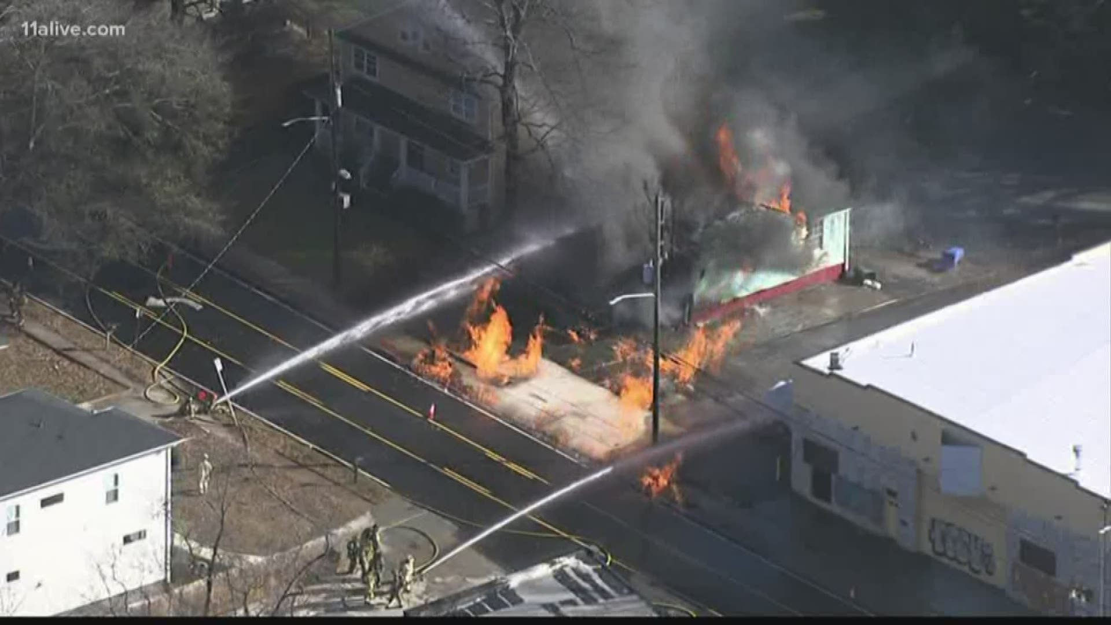
Why is Site Approval Necessary
Chemical Leak – Hall County
Gas Line Explosion – Fulton County

Slide 21
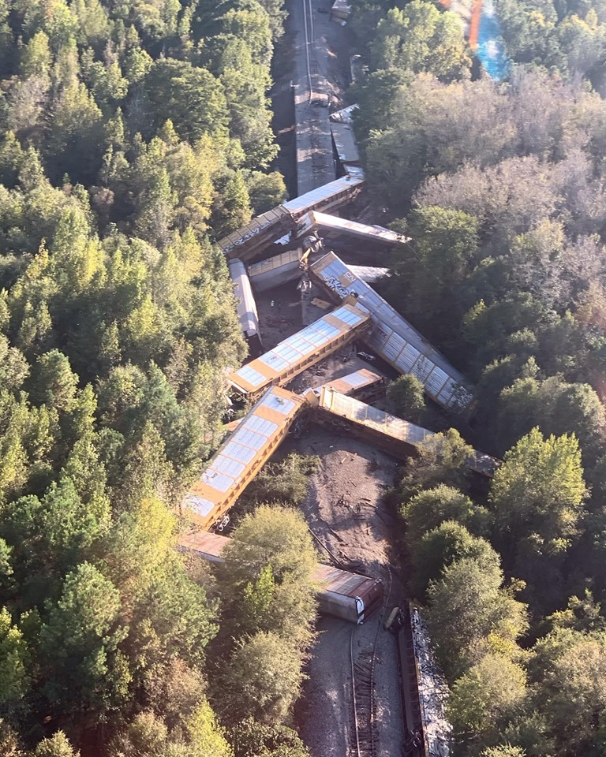
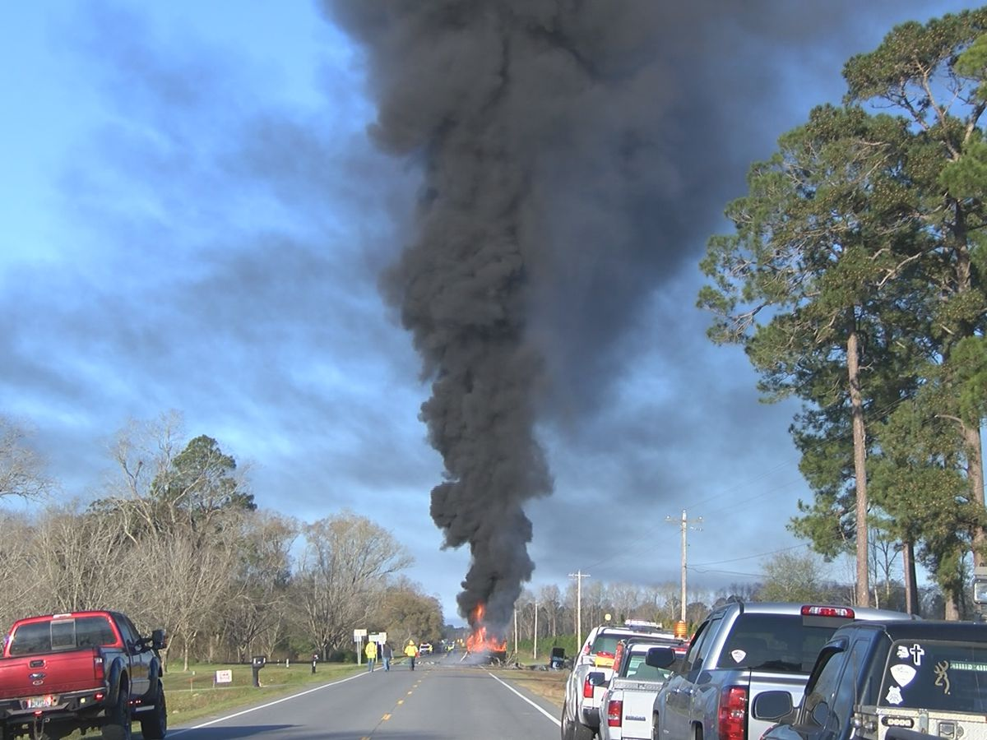
Why is Site Approval Necessary
Train Derailment – Houston County
Gas Tanker Explosion – Evans County

Slide 22
Site Approval
When do you get a site approved?
All new sites on which an educational facility will be constructed.
Additional acreage purchased for an existing educational site.
Existing sites on which a new educational facility will be constructed, or leased,
Privately owned site on which public school students will be attending.
Addition to an existing approved facility.

Slide 23
Minimum Acreage
A variance of the minimum useable acreage requirements may be made by the Facilities Section Director when requested by the local Board of Education or the Charter School Board of Directors. The reduced acreage shall be considered appropriate in accommodating the facility, parking and outdoor recreational areas. An architectural plat or a site plan locating all needed areas on the plat should be prepared.
K-5 – Minimum 5
6-8 – Minimum 12
9-12 – Minimum 20
Plus 1 acre for every 100 FTEs

Slide 24
Utilities
Electricity, gas water, sewage, telephone, high speed internet access are essential to the operation of an instructional facility and must be accessible to the proposed site. Cost associated with obtaining these utilities should be considered as part of the total site purchase.

Slide 25
Requirement Documents
Completed Site Approval Application
All required signatures must be present.
Superintendent
Board Chair
Field Coordinator
Water and Sewage Representative (or letter)
Building Code Representative – If required.
Electronic Version - May be electronically signed or the document may be printed, signed, and rescanned.

Slide 26
Signatures
Local Sewer Department may be signed by a member of the local Health Department, Regional Health Department or local water/sewer representative. This signature verifies that there is suitable sewer capacity in the area to handle the school and that an adequate supply of potable water is available.
Building Codes Official Signature is only required if an existing structure is going to be used. This signature verifies that the structure is safe and zoned for use as a public school in the State of Georgia.

Slide 27
Required Documentation
All site approvals must be accompanied by a letter of assurance that acreage for buildings and structures is outside the 100-year floodplain or the Costal High Hazard Area. This letter of assurance must be from the Floodplain Management Coordinator of the Georgia Department of Natural Resources.

Slide 28
Contact Information for the Georgia Department of Natural Resources:
Georgia Department of Natural Resources
Floodplain Management Office
4220 International Parkway, Suite 101
Atlanta, Georgia 30354
Phone: 404-362-1757

Slide 29
Cooperation between the school system, the Georgia Department of Transportation and/or local road department is necessary to plan and complete road improvements related to the opening of a facility. The school system will need to send a notification letter to the Georgia Department of Transportation, and local road department stating the proposed plans for the site and requesting that an evaluation be performed on the roadway.

Slide 30
A copy of the letter must be submitted to the Department of Education, Facilities Section with your package for site approval.
Contact Information for the state Department of Transportation:
State Aid Office
Georgia Department of Transportation
One Georgia Center
600 West Peachtree Street, NW
Atlanta, Georgia 30308

Slide 31
A copy of the rough plat or site plan of the proposed site with the building footprint positioned
A copy of an official flow test results from a fire hydrant nearest to the site – report should include residual and static pressures.

Slide 32
Secure the services of an engineering firm to conduct a Phase I Environmental Site Assessment (ESA). This is to determine if there are hazards within 3 miles of the proposed school site. If the Assessment determines that hazards exist, it is required that the engineer perform a Risk/Hazard Analysis which should follow the Department of Education’s guidelines.

Slide 33
Hazards
Railroads
Major highways
Oil or petroleum transmission lines and storage facilities
Natural gas transmission and distribution lines larger than 10” with a PSI of 200 or greater
Hazardous chemical pipelines
Propane storage facilities
Lakes, rivers, dams, reservoirs, or other bodies of water

Slide 34
Hazards
Oil or petroleum transmission lines and storage facilities
Natural gas transmission and distribution lines larger than 10” with a PSI of 200 or greater
Hazardous chemical pipelines
Propane storage facilities
Railroads
Major highways

Slide 35
Airports, approach and departure paths
Industrial or manufacturing facilities
Lakes, rivers, dams, reservoirs, or other bodies of water
Potential flooding because the property is located within the 100-year flood plain or dam breach zone.
Nuclear waste storage facilities
Munitions or explosive storage or manufacturing

Slide 36
Water towers adjacent to the site
Active or abandoned mines or quarries
Remedial hazardous waste sites
Landfills and dumps
Sewage treatment plants
Power plants
Military installations

Slide 37
If any of the hazards are present within a mile of the site, the engineers MUST address the impact the hazard would have on the site in a worst-case scenario using an acceptable modeling program.
A probability analysis is not acceptable.

Slide 38
The engineer must make suitable specific mitigative recommendations to make the facility safe for a public school in the State of Georgia. It is required that the engineer close this section with a Suitability Statement stating that the site is safe, in consideration of the mitigations, in the professional judgment of the engineer, for a public school in the State of Georgia.
The engineer sign and affix their professional seal to the report.

Slide 39
9. If the property is being purchased by the school, a copy of the warranty deed shall be submitted to the Facilities Unit.
If the property is being leased by the school, a copy of the executed lease agreement shall be submitted to the Facilities Unit.

Slide 40
Electronic Submission
Obtain an Electronic Version of the application. Contact Kelland Waldrep at kwaldrep@doe.k12.ga.us OR visit
https://www.gadoe.org/Finance-and-Business-Operations/Facilities-Services/Pages/Facilities-Services-Resources.aspx
Complete application by following directions in pages 1-5 of document. All questions/information items must be completed.
All required signatures must be present.
Signatures may be electronic, or the document may be printed, signatures obtained, and the document scanned and submitted.

Slide 41
Submit Electronic Version
Documents may be placed in a drop box and a link sent to kwaldrep@doe.k12.ga.us
OR
Send individual electronic documents including the electronic application to:
Kelland Waldrep at
kwaldrep@doe.k12.ga.us
Each required document must be a separate PDF file.

Slide 42
Facility and School Registry (FSR)

Slide 43
Site Facility and School codes
Site Code
The code given to the piece of land in which a facility may be located. A site may have multiple facilities located on it.
Facility Code
The code given to a building or group of buildings on one campus.
School Code
A school is a group of learners. The code is given to the school located in a facility. There may be multiple schools located within a building.

Slide 44
Facility School Registry (FSR)
The database is the backbone of data collected for or about students.
The site itself is foundation for all other data collections.
The facility is then attached to the site.
The school is then attached to the facility so that student reporting can continue as needed by GaDOE and the local school system.

Slide 45
Why separate Facility and School Codes?
In the past, there was one code that was used for both facility and school.
For AYP and other reporting reasons, changes to grade levels housed at a facility/school caused a new code to be issued.
All facilities history, funding and planning are tied to the facility code.
It was necessary to establish a facility code separate from a school code to stabilize the facility code.

Slide 46
Obtaining a Site/Tract Code
Submit Site Application and all required documents to the GaDOE Facilities Section
Application and documents will be reviewed
Site Code will be generated by the GaDOE Facilities Section
Approval Letter will be sent to Superintendent

Slide 47
Facility Code
A facility code describes the buildings located on a site/tract.
The facility code will be issued by the GaDOE Facilities Section after a copy of a warranty deed or lease for the site/tract is received.
The facility code will not change.

Slide 48
School Code
The School Code describes the group of learners housed at a facility. It may change when the group of learners changes.
One facility may house more than one school.
The school code is requested by school system employees through the Portal. It is not needed until the fiscal year the facility is ready to be occupied.

Slide 49
What does a Facility Coordinator do?
The Facility Coordinator is given permission to update and edit Facility and School information in the Portal from July 1 to October 1 of each year.
Each update or edit will automatically go to the DOE Portal Manager for review and approval.
No new School Codes or Program Codes will be issued after the October FTE Count.
Facilities can be opened and existing School and Program Codes can be moved.

Slide 50
Updating FSR
Window for updating FSR begins July 1, 2022 Ends September 23, 2022.
Requirements for creating new School Codes.
Request a New School\Program Code form from Kelland Waldrep at kwaldrep@doe.k12.ga.us

Slide 51
Updating FSR
Review grades assigned to school and facility
Review the address of the facility and the school
Review school phone number
Review/update school principal
Hint principal must be credentialed in GaDoe Portal
Review names of facilities and schools
Hint – Name the facility to match the school

Slide 52
FSR Certification
FSR Certification of Records must be completed to report FTE I.
FSR Certification of Records will begin September 5th and end September 23rd.
The Superintendent of your school system must certify that the records are correct.
Certification of Records MUST not be confused with the Vacant Facility Survey.

Slide 53
Questions, Comments
& Concerns

Slide 54
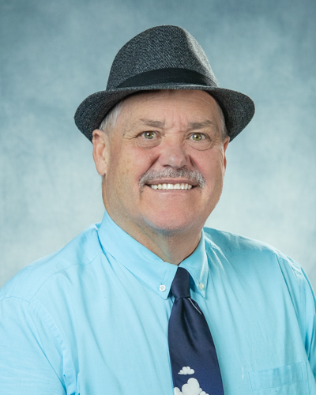
Contact Information
Georgia Department of Education
Facilities Services Unit
Kelland Waldrep
kwaldrep@doe.k12.ga.us
478-697-1783
Email Questions to:
facilities.questions@doe.k12.ga.us

Slide 55
WIIN Act Grant: Clean Water for Georgia Kids program

Slide 56
What is the WIIN Grant?
•The Water Infrastructure Improvements for the Nation Act or “WIIN Act” of 2016 authorizes the Environmental Protection Agency (EPA) to establish a voluntary grant program to assist local and tribal educational agencies and childcare programs in testing for lead in drinking water at schools and childcare programs
•This is a federally grant-funded program to provide resources to train and test lead in drinking and cooking water at schools and provides recommendations for taking action to reduce lead in drinking water.
•The Program is a partnership between The Georgia Department of Education and RTI International with funding from the United States Environmental Protection Agency

Slide 57
What does the funding cover?
•Testing costs and support
•Recommendations for risk mitigation
•Does NOT cover risk mitigation costs right now

Slide 58
How will this be accomplished
•School systems will attend a pre-enrollment webinar which will show them:
How to enroll
How to sample your water
How to ship the sample back
Live Q&A session
•School systems will then enroll online
•Test kits will be mailed out with instructions
•Samples will be taken and returned

Slide 59
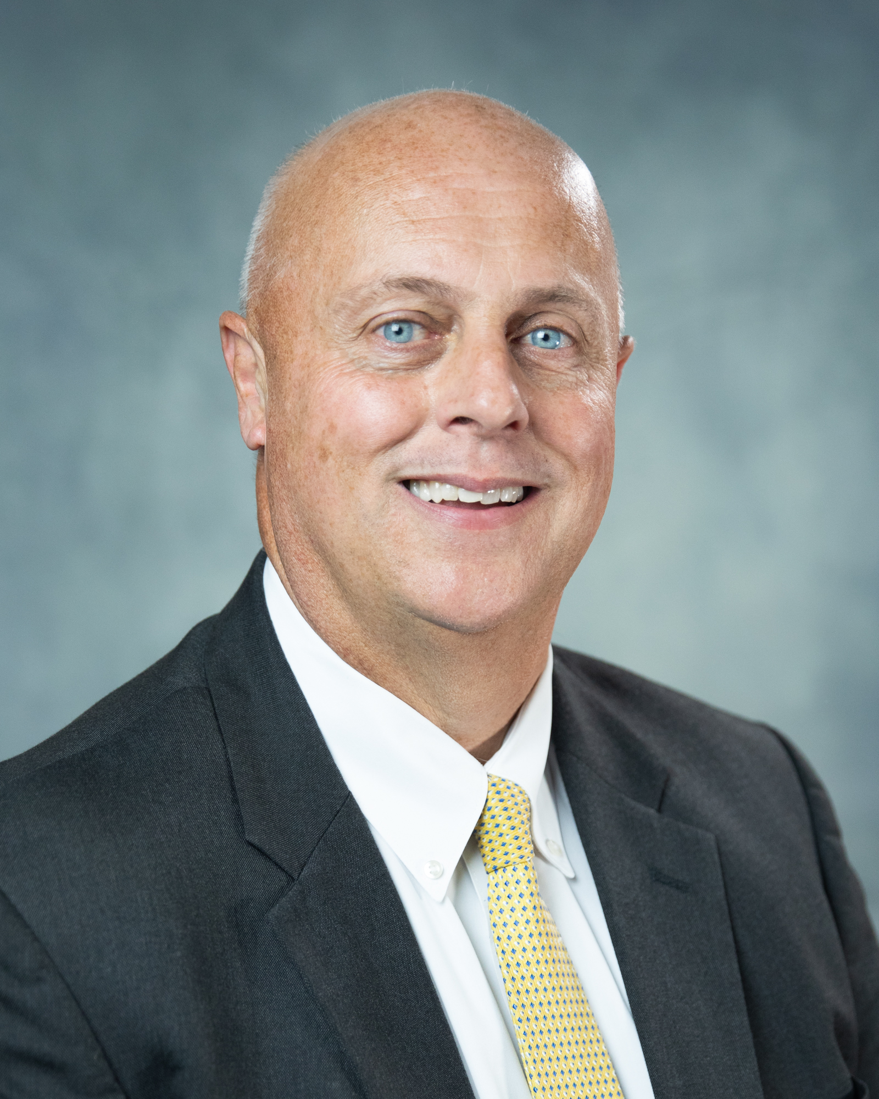
Contact Information
Georgia Department of Education
Mike Sanders
Director of Facilities Services and Pupil Transportation
michael.sanders@doe.k12.ga.us
678-378-6434
Email Questions to
facilities.questions@doe.k12.ga.us

