Slide 1
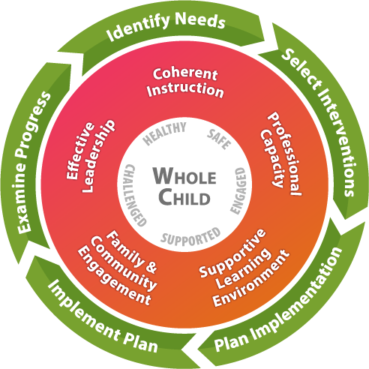
Federal Grants Management – Let’s Take the Test!
GCEL Conference 2020 Vision: Looking to the Future
March 9-11, 2020
Savannah, GA

Slide 2
Presenters
Amber McCollum
Georgia Department of Education
Federal Programs
IDEA Program Manager
amccollum@doe.k12.ga.us
Dr. Margaret Baker
Georgia Department of Education
Federal Programs
EL Programs Manager
mbaker@doe.k12.ga.us
Jill Curtis
Georgia Department of Education
Federal Programs
Title IV, Part A Education Program Specialist
jill.curtis@doe.k12.ga.us
Clarice Howard
Georgia Department of Education
Federal Programs
Title I, Part A Education Program Specialist
choward@doe.k12.ga.us
Joy Gentry
Georgia Department of Education
Federal Programs
Title II, Part A Education Program Specialist
jgentry@doe.k12.ga.us

Slide 3
How much do you know about the administration of federal grants?
Let’s take the Federal Grants Management Test and see…!!

Slide 4
Federal Grants Management Test
Time and effort policies and procedures must:
Be in writing
Be supported by policies only
Include Personnel Activity Report (PAR) and semi-annual certification examples
A & C only
CFR 200.430 (1)

Slide 5
Time and Effort: Standards for Documentation of Personnel Expenses §200.430
If records meet the standards: the non-federal entity will NOT be required to provide additional support or documentation for the work performed. §200.430(i)(2)
BUT, if “records” of grantee do not meet new standards, the Department may require PARs. §200.430(i)(8)
PARs are not defined!!

Slide 6
Time and Effort
GaDOE allows two ways to report time and effort
Type 1: Period Certification
Single Cost Objective
May be completed twice a year OR once a year as detailed in your district’s written procedures
Supporting documentation is still required
Signed after the fact by employee or supervisor with knowledge of the work performed
May be completed by for an individual or group (both forms available on the GaDOE Website)
Type 2: Personnel Activity Report (PAR) also known as time logs
Multiple Cost Objectives
Can be submitted to supervisor quarterly or monthly as detailed in your district’s written procedures
Flexibility for time and effort must be addressed in the district’s internal controls
Updated 8.25.17

Slide 7
Time & Effort: Standards for Documentation of Personnel Expenses §200.430
Charges for salaries must be based on records that accurately reflect the work performed, and must:
Be supported by a system of internal controls which provides reasonable assurance charges are accurate, allowable and properly allocated
Be incorporated into official records
Reasonably reflect total activity for which employee is compensated - not to exceed 100-percent
Encompass all activities (federal and non-federal)
Comply with established accounting polices and practices
Support distribution among specific activities or cost objectives

Slide 8
Federal Grants Management Test
2. A cost is reasonable if:
It is the lowest price
It is on sale
It follows the procurement rules set by LEA
All of the above
2 CFR 200.404

Slide 9
Federal Grants Management Test
Direct charging a grant accountant would be unallowable if the accounting costs are generally classified as indirect costs.
True
False
2 CFR 200.413 (c)(4)

Slide 10
Federal Grants Management Test
For a cost to be allowable to a Federal grant award, it must meet the following criteria:
Supports the purpose of the grant
Necessary, Reasonable, and Allocable to the Federal grant award
Determine in accordance with generally accepted accounting principles
All of the above
CFR 200.403

Slide 11
Federal Grants Management Test
If there is a conflict of interest with a vendor, you are prohibited from contracting with that vendor.
Yes, you are prohibited!
You might be prohibited depending on the amount of the contract.
You might be prohibited, depending on the contract deliverables.
It is not prohibited; you may still do it!
CFR 200.318 (c) &312

Slide 12
Federal Grants Management Test
An LEA purchases a computer lab with IDEA funds that meet the threshold for equipment under the State rules. Occasionally, students in the Title I tutoring program use the computer lab as well.
This is permissible as long as:
The shared use is minimal, and it does not interfere with the special education students’ ability to use the computer lab
The activities of the Title I students are allowable under IDEA
Anyone may use the computer lab
It is not permissible
CFR 200.313 (c)

Slide 13
Federal Grants Management Test
7. A cost or price analysis must be performed in connection with every purchase.
True
False
2 CFR 200.323

Slide 14
Federal Grants Management Test
8. An LEA no longer needs a piece of equipment purchased for a Title III program. Which of the following may the equipment be used with?
Other programs supported by U.S. Department of Education funds
A program supported by the U.S. Department of Labor, if other programs supported with funds from the U.S. Department of Education also do not need the equipment
Both A and B
Neither, the equipment needs to be disposed of
2 CFR 200.313

Slide 15
Federal Grants Management Test
9. Which word best completes this sentence?
Regardless of cost, the grantee must maintain effective control and “safeguard all _____________ and assure that they are solely for authorized purposes.”
Tablets
Equipment
Assets
Supplies
2 CFR 200.302(b)(4)
Notes:
Assets include Equipment, computing devices, and “pilferable” items

Slide 16
Federal Grants Management Test
10. Which of the following policies and procedures must be in writing under EDGAR?
A. Procurement
B. Employee Benefits
C. Allowable Costs
D. All of the Above
E. A & C Only
2 CFR 200.318(a); 2 CFR 200.302 (b) (7)

Slide 17
Federal Grants Management Test
11. Staples has a deal on tablets that if you purchase a $350 tablet, you can send off for a $100 rebate. How much may you charge the federal grant for the tablet?
A. $250
B. $350
C. $450
D. You may charge A or B to the grant.
2 CFR 200.406

Slide 18
Federal Grants Management Test
12. Contractors are responsible for adherence to applicable federal program requirements in the federal award.
Always
Sometimes, depending on the contractor
Sometimes, depending on the costs
Never
2 CFR 200.330

Slide 19
Federal Grants Management Test
13. Drawdowns are not required. DOE will send the LEA the money.
True
False

Slide 20
Federal Grants Management Test
14. What are the components for a federal program contract?
Name, Date, and Signature
Rate, Time frame, and Location of Service
Deliverables and Payment Condition
A, & B only
B & C only
A, B, & C
2CFR 220.319 c

Slide 21
Federal Grants Management Test
15. Federal cash management includes guidance from which of the following?
UGG
Edgar
GEPA
CFR
All the above

Slide 22
Federal Grants Management Test
16. Supplement not supplant only applies to carryover.
True
False
ESSA Sec. 1118 (b)(1), Sect. 1307, Sec. 2301, Sec. 3115, Sec. 4110

Slide 23
Federal Grants Management Test
17. Which of the following is not a funding option?
A. Traditional
B. Transferability
C. Consolidating
D. Corrective Action

Slide 24
Federal Grants Management Test
18. If you have private schools participating in any federal programs, you calculate their proportionate share of funds and then give it to them to expend on their own.
True
False
Sec. 1117(a)(5) and 8501 (a)(5)

Slide 25
Federal Grants Management Test
19. Financial records, supporting documents, statistical records and other records pertinent to a Federal grant must be retained for a period of ________ years.
Two
Three
Four
Five
2 CFR §200.333

Slide 26
Any Questions?

