Slide 1
Coordinating and Designing Services for Migrant Drop Outs and Out-of-School Youth

Slide 3
Profile of an Out-of- School (OSY) Youth
Are often highly mobile and hidden from the community
Have dropped out from or never enrolled in U.S. schools
Are between the ages of 16 and 22.
Are majority male
Usually live on their own, with friends and/or with coworkers
Are mostly in the area for a short time while they work and have very limited access to resources, such as transportation and health care.
Some are disengaged and uninterested in pursuing educational programs, but many are interested in participating in short-term programs and obtaining educational materials.

Slide 4
Why did they discontinue their education?
Economic reasons; could not afford to attend school or had to work to support family.
Long distances between schools and their homes
A large number of OSY never attended school
Lacked credits towards graduation or problems enrolling due to age.
Unmotivated
Family Reasons (Pregnancy or marriage)
Lack of access to information regarding alternative programs
Language barriers
Notes:
Simple visual for assisting in determining starting for delivering intervention/services for OSY.
Link Matrixto something on this page.

Slide 5
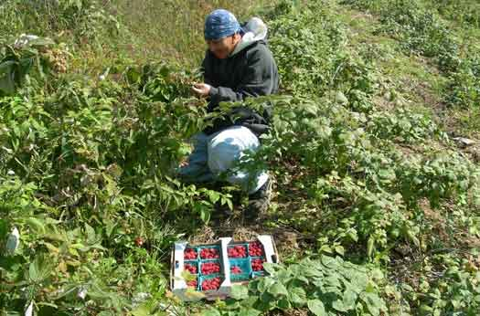
Why serve OSY?
Limited English Proficient (LEP)
Unmet health/social needs
Disengaged /alienated from schools/learning because of bad experiences and/or lack of success/financial challenges
Family responsibilities: their families depend on them for income or they have children
Little to no access to federal or state resources
Lack of education and English skills affects economic and social status.
Some may be PFS
Notes:
WHY TARGET OSY?
fastest growing segment of the Migrant Education Program
more than ever OSY are single instead of moving and living with families
unique needs resulting from migrant lifestyle
high risk of being pushed out and forgotten
need advocates to motivate and assist with accessing needed services
little to no access to federal or state resources
lack of education and English skills affects economic and social status.

Slide 6
Framework for Serving OSY
Consult the Protocol for Serving OSY located on the website
This Protocol is intended to help guide you in your work with OSY
Initial interview and data collection
Use the OSY Profile to determine OSY needs and interests
The OSY Profile can be accessed on the MEP website or here.
Choose the starting intervention
Use the Student Services Plan (second page of the Profile) to develop a plan for services and establish goals with your OSY.
Choose a delivery model
Set times and frequency
Set goals
Deliver services according to plan
Notes:
Will provide steps for each task

Slide 7
OSY/DO Profile - Reminders
The current profile can be found on the MEP website.
A profile must be completed on all OSYs (OSY and DO)
Make sure to complete ALL sections of the profile. If something does not apply, write N/A in that field.
Keep profile information filed in your District for documentation purposes.
Update profile as needed. This is a living document and should be used as such.
Notes:
The information shared on the OSY Profile is shared with GOSOSY and is an important element for meeting the Data Collection requirements of the GOSOSY Consortium; therefore, it is important the information that is collected is accurate and up-to-date.
We will soon be asking you to send in Profiles that were completed after the last collection date.
(Remember SS code 708 indicates the profile was completed.)

Slide 8
Protocol for Working with OSY/DO

Slide 9
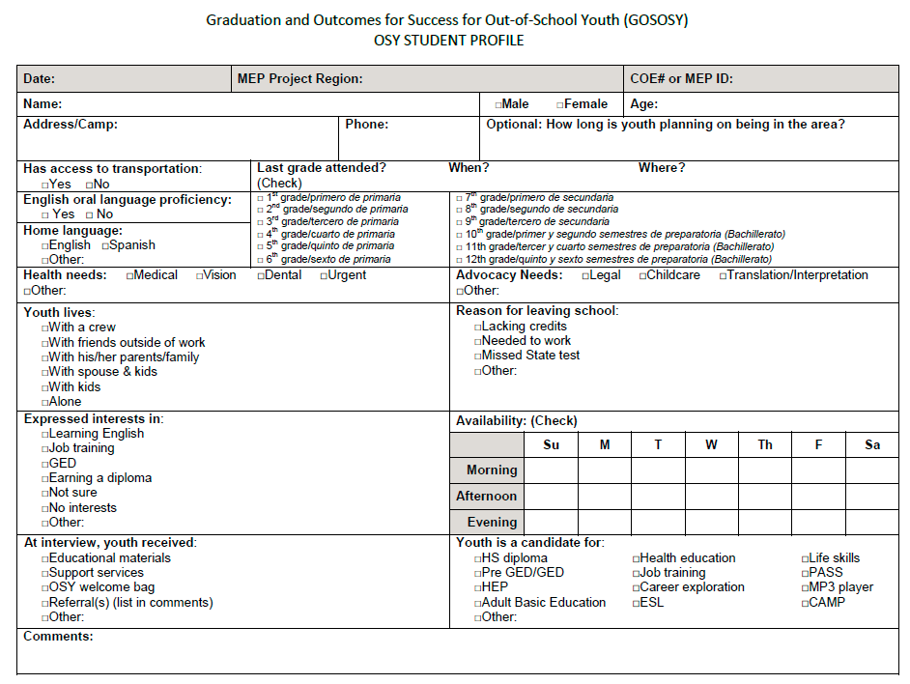
SAMPLE
Notes:
Model – Ask someone that will be “animated” to volunteer to help you complete the profile. Projector will be used…
Ask the person to answer each question on the profile as if they were an OSY and model how you would complete the profile, emphasizing filling out ALL categories and placing an N/A, where not applicable.
R1 North – Pam G or Josue
R1 South - Litza
R2 - TBD

Slide 10
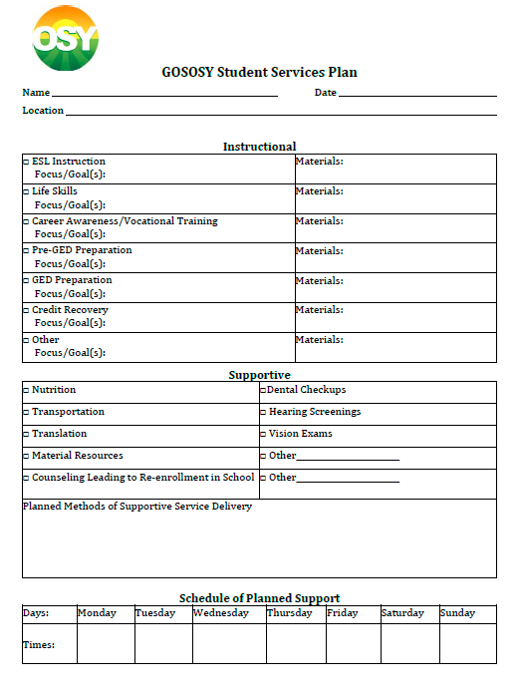
SAMPLE
Notes:
Ask the same participant to assist you in completing the Student Services Plan based on the needs identified on the OSY Profile.
Be sure to model that the plan is directly related to the OSY’s needs and expressed interest.
Be sure to reflect flexibility on when you can offer services.

Slide 11
OSY Profile Collection
States are asked to submit data collected from their use of the OSY Student Profile to the OSY Consortium.
You will be required to submit this data to your State OSY representative three times per year (Fall, Spring, and Summer)
In an effort to simplify the process of calculating data and percentages, an Excel spreadsheet is provided here.
You can transfer the numbers you have collected on your local State OSY Data Profile Forms and simply enter them into the Excel form.
You will need to enter your aggregate numbers into Columns B, F, J and N, and they will be automatically converted into percentages.
Please contact Sabrina Rivera Pineda at 404-576-3133 or spineda@doe.k12.ga.us if you have further questions or require assistance with any of these forms.

Slide 12
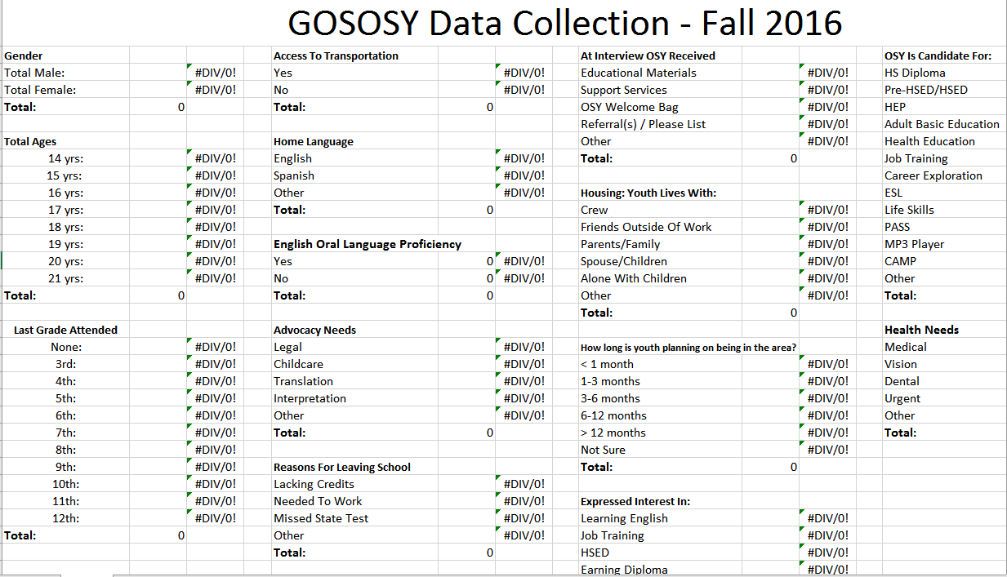
SAMPLE

Slide 13
Serving OSY in Georgia Using GOSOSY Resources
Why reinvent the wheel?
There are many available resources developed by the National OSY Consortium, also known as GOSOSY
Just visit osymigrant.org and click on the
“Practioner” tab.
You will find a variety of materials and
resouces to help you serve your OSY
effectively.
Many resources are available in
both English and Spanish and are
completely free and reproducible.
Pre and posts test are even included!

Slide 14
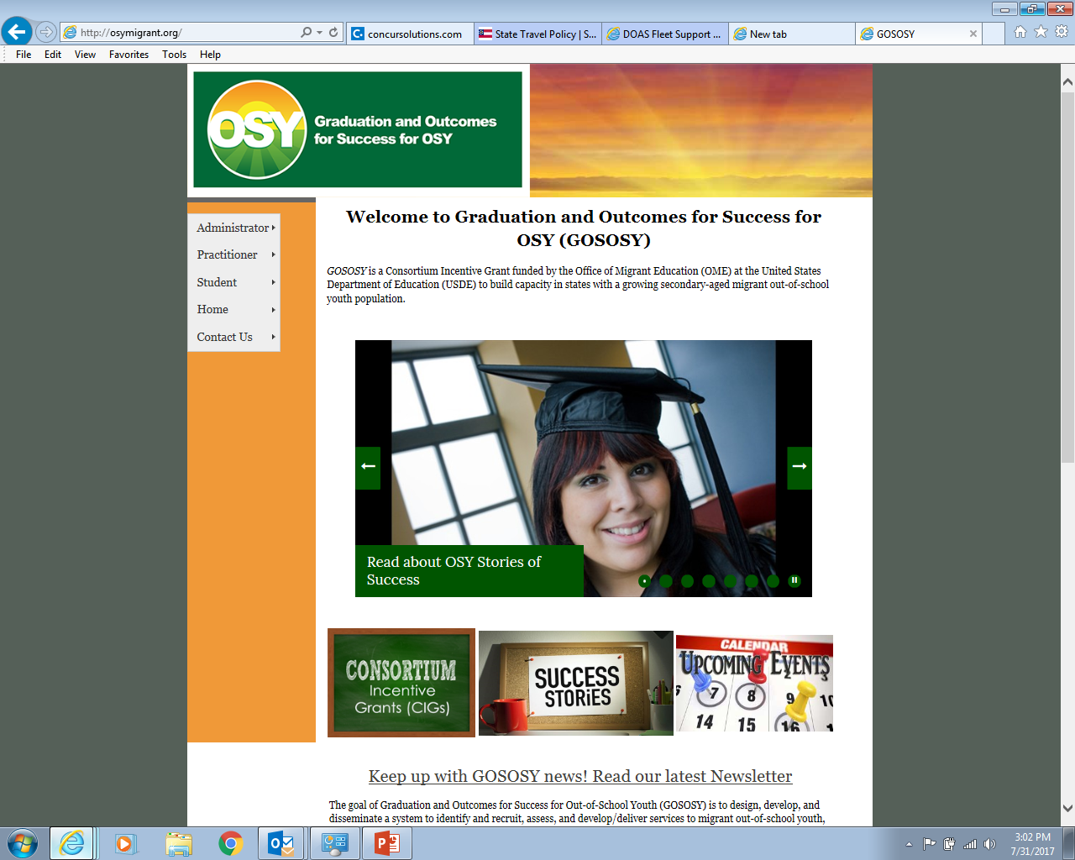
Available Resources:
Access curriculum for OSY
Help OSY Set and Achieve their Goals
Network with Practitioners Across the Country
Read OSY Success Stories
osymigrant.org
Notes:
There are many resources available on the GOSOSY website that are available to serve your OSY; there is no need to re-invent the wheel.
All of the resources are FREE and have pre and post tests. Many are stand-alone lessons, that can be taught in a series or individually to better meet the needs of your OSY population.
Go to the “Practitioner” tab, then “instructional Resources” – there you will find a variety of resources ranging from basic reading and math skills lessons to pre-GED.
This is a very valuable resource that we have available to us, but it is underutilized. Let’s take advantage of it!

Slide 15
IF OSY wants English language lessons, then…use the screener:
Notes:
Refer participants to the OSY Language Screener packet. Ask them to take a couple of minutes to review the testing packet.
Overview – the screener is meant to be a quick way to determine an OSY’s English language proficiency. It gives you a quick “snapshot” of an OSY’s English ability.
It helps you determine what to focus on when providing instruction as well as what materials to use.
For a student with little proficiency, the screener may take 5 minutes or less.
For a student who is more proficient, the screener will take 15-20 minutes. Please note that the Writing portion of the screener is optional. (Part 6)
The screener is available on the GOSOSY website, under Instructional Services.
It is important that we use this screener, rather than trying to determine their proficiency on our own.

Slide 16
Notes:
Not all students will take all parts of the screener.
All will take Parts 1, 2, and 4.
Only those who are more proficient will take parts 3 and 5. Part 6 is intended for OSY with higher language proficiency, who want to improve their writing.
Refer to the graphic on the slide if further explanation is needed.

Slide 17
GOSOSY Instructional Resources
Reading
Reading On the Move is a series of stand-alone lessons, written at a 3rd – 5th grade reading level, geared toward out-of-school youth (adult oriented) to introduce or strengthen basic reading skills.
Activities throughout the lessons emphasize proven, research-based, teaching strategies, including active student involvement, consideration of the student’s background, establishment of a relationship between the author and the student, linkage of reading and writing skills, and presentation of vocabulary in context.
Also included in the lessons are basic study skills and practice using reference materials.
An assessment, which may be used to measure student mastery of the content, is provided for each lesson.

Slide 18
GOSOSY Instructional Resources
Math
Math On the Move: developed by the Geneseo Migrant Center, is a series of Pre-GED math lessons geared to out-of-school youth (adult oriented).
Consists of 24 lessons, in either English or Spanish, which are designed to be used as stand-alone segments to address a particular skill area, although each builds upon assumed knowledge addressed in prior lessons.
These materials are not copyrighted, and can be reproduced without permission.
Math for Living: Ten stand-alone lessons in English and Spanish are designed to improve financial literacy and life skills with examples, practice problems, and vocabulary relating to work, smart shopping, and budgets, as well as information on obtaining the resources for college.
Created for use in the MASTERS (Mathematics Achievement and Success Through Engagement in Resources for Migrant Students) Consortium Incentive Grant project, the lessons are non-sequential and written at a middle school reading level. Activities reinforce basic math skills while teaching practical concepts that apply to both everyday life and successful careers.
10/30/2017
18

Slide 19
Additional resources and reminders
There are many additional resources on the GOSOSY website, including life skills and mental health lessons.
Please be sure to monitor your OSY progress using the resources provided through the GOSOSY website and/or your locally developed assessments.
Please note that this information will be collected and reported to the GOSOSY Consortium in order to meet the requirements of the grant.
Your collaboration and timely submission is appreciated in order to ensure compliance.
For additional information on serving OSY using GOSOSY materials and resources, as well as using data collection documents, please listen to the following webinar:
https://attendee.gotowebinar.com/recording/1435194012944586497
10/30/2017
19

Slide 20
Israel Cortez
Program Manager
jcortez@doe.k12.ga.us
(404) 272-8780
Sabrina Rivera Pineda
Resource Specialist, Region 1 North
spineda@doe.k12.ga.us
(404) 576-3133
Cindell Mathis April Roberts
Resource Specialist, Region 1 South Resource Specialist, Region 1 North
cmathis@doe.k12.ga.us aroberts@doe.k12.ga.us
(470) 218-3471 (470) 316- 8726
Miriam Blaisdell Ndaayezwi Mary Claire Tarpley
Resource Specialist, Region 2 Resource Specialist, Region 2
mndaayez@doe.k12.ga.us mctarpley@doe.k12.ga.us
404-693-3256 678-340-0025
Education of Migratory Children
Georgia Department of Education
http://gadoe.org
Follow us on Twitter: @georgiamep @gadoenews and
Like us on Facebook: http://www.facebook.com/gadoe
“Educating Georgia’s Future"
Contact us!

