Slide 1
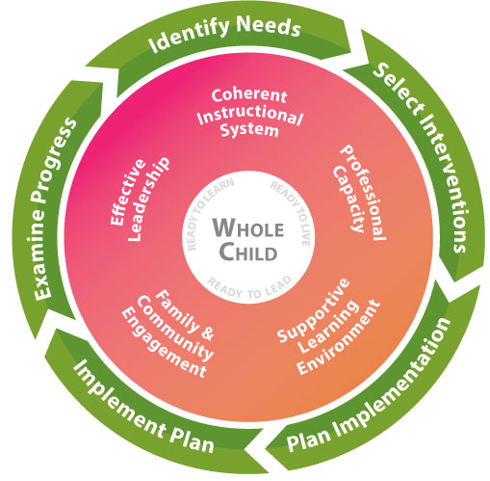
Title I Part C -MEP
Is part of the Georgia’s Systems of
Continuous Improvement

Slide 2
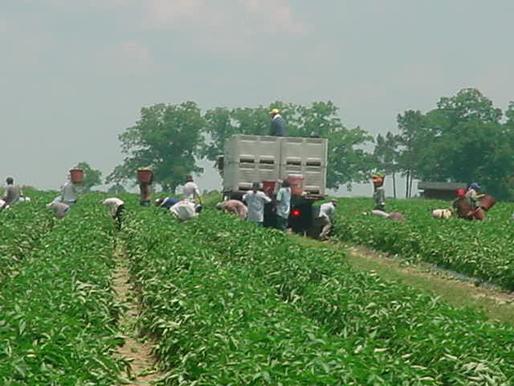

Title I, Part C
Education of Migratory Children
An Overview for Georgia School Districts

Slide 3
Agenda
History of the Migrant Education Program (MEP)
Program Elements
  Georgia MEP Operating Structure
  Eligibility
  Recruitment
  Services
School District Responsibilities

Slide 4

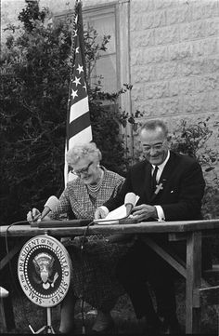
MEP History
1960
“Harvest of Shame”, a CBS documentary, aired on Thanksgiving night and highlighted the plight of migrant farmworkers in America. This brought increased attention to this group.
1966
Title I, Part C: Education of Migratory Children Education Program is included in the Elementary and Secondary Education Act as amended by Every Student Succeeds Act

Slide 5
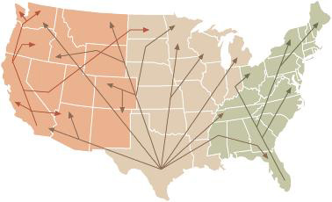
Farmworker Migration in the U.S.
This map shows typical migration streams: East, Central and West
Based on growing cycles and work availability, migrant families are mobile all during the year with more frequent moves during peak growing seasons
Some families move in a consistent pattern each year
Schools in Georgia are aware of local growing cycles and migrant family mobility patterns

Slide 6
Where are migrant children and youth in Georgia?
Migrant children and youth reside in all parts of the state: rural, suburban, and urban.
Some school districts have a larger number of migrant children and youth as compared to other districts during the school year; some districts only have migrant children during the summer months.
All school districts in the state are prepared to work with migrant children and youth.

Slide 7

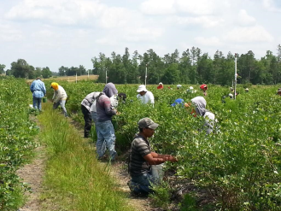
What is the Migrant Education Program (MEP)?
The purpose of the MEP in Georgia (and the United States) is to ensure that migrant children fully benefit from the same free public education provided to all children and that the unmet education-related needs resulting from their migrant lifestyle are met.

Slide 8
What is the Federal Definition of a “migratory child”?
According to sections 1115(c)(1)(A) (incorporated into the MEP by sections 1304(c)(2), 1115(b), and 1309(3) of the ESEA, and 34 C.F.R. § 200.103(a)), a child is a “migratory child” if the following conditions are met:
1. The child is not older than 21 years of age; and
2. The child is entitled to a free public education (through grade 12) under State law, or the child is not yet at a grade level at which the LEA provides a free public education, and
3. The child made a qualifying move in the preceding 36 months as a migratory agricultural worker or a migratory fisher, or did so with, or to join a parent/guardian or spouse who is a migratory agricultural worker or a migratory fisher; and
4. The child moved due to economic necessity from one residence to another residence, and from one school district to another.

Slide 9
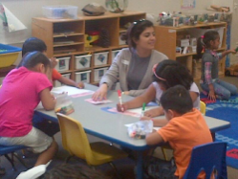
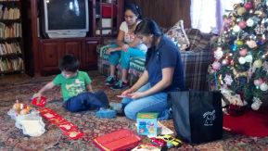
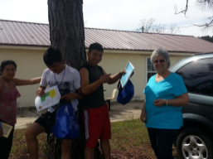
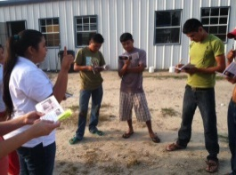
Who is served by the MEP?
Eligible migrant participants
  Students enrolled in grades K-12
  Preschool children ages 3-5
  Out-of-School Youth (OSY)
    Broad category that includes children and youth not enrolled in school
    Most OSY are ages 16-21, not enrolled in school, and are working in agriculture in our state.
      Unaccompanied or emancipated youth
      H2A Worker Visa

Slide 10
Georgia’s Responsibility
The Georgia Department of Education is the direct recipient of Title I, Part C funds and is therefore responsible for ensuring the appropriate and best use of these funds.

Slide 11
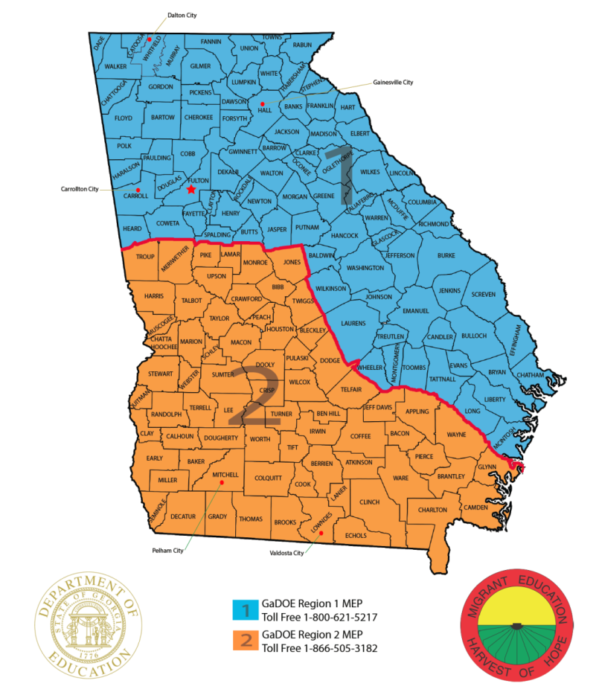
Georgia MEP
Georgia has two migrant regions with a GaDOE satellite office in each:
  First District RESA
  Coastal Plains RESA
GaDOE employees in these offices provide direct support to LEAs working with migrant children and youth.

Slide 12
MEP Funds in Georgia
Direct funded districts
  Districts with a Title I, Part C allocation of more than $15,000
Consortium districts
  Districts with a Title I, Part C allocation of less than $15,000
  Consortium district funds are pooled together and services are provided from our fiscal agent, Abraham Baldwin Agricultural College (ABAC)
  The ABAC MEP operates the same way as a direct funded district migrant program. The difference is that the children and youth live around the state instead of within a single school district.
The GaDOE is ultimately responsible for ensuring the appropriate use of MEP funds for migrant children and youth.

Slide 13
Migrant Personnel
State Staff (GaDOE)
  Regional and State Coordinators
  Resource Specialists
  Recruiters
  Data Specialists
Local Staff
  Student Service Providers (SSP)
  Recruiters
Work directly with LEAs to provide services to MEP children and youth; monitor implementation
Identify potential migrant children and youth statewide
Work with state migrant database COEstar
Recruit and provide supplemental academic and support services to eligible children in the district
Identify potential migrant children and youth in the district

Slide 14
Further Defining the Role of Local
Migrant Education Program Staff
(Paraprofessional SSPs, Teachers)
Provide supplemental academic and support services
Identify and recruit new migrant participants
Consult on a regular basis with classroom teachers regarding tutoring
Tutor students based on teacher’s guidance
Monitor K-12 migrant student academic progress
Maintain a weekly schedule, reflecting any changes
Document daily tutoring and support services in detail
Compile and return all GaDOE MEP reports by specified deadlines
Attend all required GaDOE MEP trainings and workshops
Provide services or ensure services are provided to preschool children and out-of-school youth
14

Slide 15
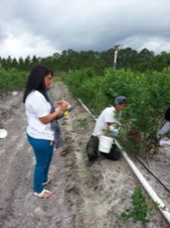
How are migrant participants identified?
Identification and recruitment (ID&R) is a unique feature of the MEP.
Before a migrant participant may be served by the program or counted for funding purposes in the program, his or her eligibility must be documented on a certificate of eligibility or “COE”.
Only trained personnel may complete this eligibility interview and the COE.
School districts contact trained local or state migrant staff to complete the eligibility interview and the COE.

Slide 16
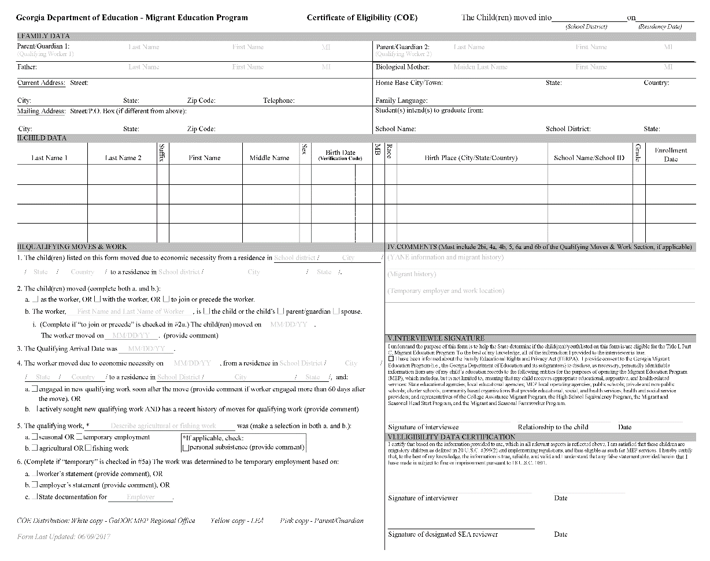
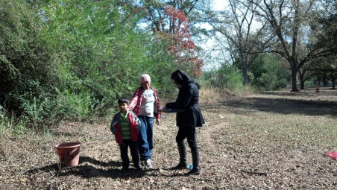
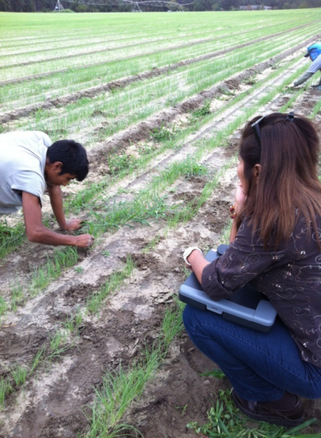
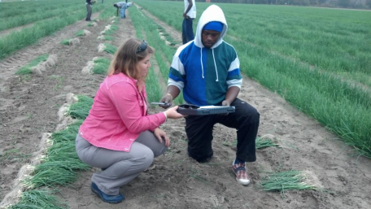
How are migrant participants identified (cont’d)?
Certificate of Eligibility (COE)
Face-to-face interview

Slide 17
How are migrant participants identified (cont’d)?
The Occupational Survey form is a major part of MEP identification and recruitment.
All schools in Georgia are required to use the Occupational Survey form during new student registration and back-to-school registration.
This form is completed by parents/guardians.
Schools review and based on responses, send the survey to the trained district SSP/MEP contact or MEP regional office for a follow-up interview and potential COE.
Schools follow the directions on the bottom of each survey for document processing.

Slide 18
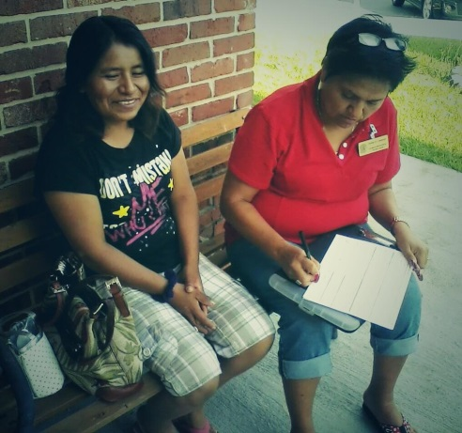
How are migrant participants identified?
Occupational Survey
Interview and completion of the COE

Slide 19
Occupational Survey
  Available languages:
  English, Spanish, French,
  Karen, Haitian Creole,
  Korean, Vietnamese,
  Somali, Nepali, Chinese
  Burmese, Arabic, Amharic

Slide 20
MEP Eligibility Notification
In Georgia, the GaDOE will always make eligibility determinations.
School districts are notified of the arrival and confirmation of eligible migrant children or youth in two ways:
  A copy of the COE is mailed
  Updated migrant reports are loaded to the portal
Additionally, regional or ABAC consortium staff make frequent contact with school districts and review current enrollments.

Slide 21
What do teachers and school personnel need to know?
Risk factors for migrant families:
Isolation - migrant families may live in isolation from the community in which they work
Family separation – families may separate so that children can finish a semester or year in school
Socioeconomic disadvantages – poverty, health problems, etc.
Educational background of parents – one of the lowest of any occupational group
Language barriers
Graduation rate – one of the lowest in Georgia

Slide 22
What do teachers and school personnel need to know (cont’d)?
The U.S. Department of Education established 7 Areas of Concern Unique to Migrant Children and Youth. These concerns guide the work of the MEP in Georgia:
Educational continuity
Instructional time
School engagement
English language development
Educational support in the home
Health
Access to services

Slide 23
What do teachers and school personnel need to know (cont’d)?
PRIORITY FOR SERVICES (PFS). In providing services with funds received under this part, each recipient of such funds shall give priority to migratory children who have made a qualifying move within the previous 1-year period and who—
(1) are failing, or most at risk of failing, to meet the challenging State academic standards or
(2) have dropped out of school.

Slide 24

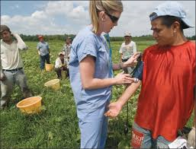
What do teachers and school personnel need to know (cont’d)?
The Special Educational Needs of Migrant Children and Youth include:
Gaps in learning resulting from repeated moves
Credit accrual deficiencies
Continuity of education from state-to-state and district-to-district
Language barriers
Limited emergency health and medical issues impacting academic performance

Slide 25
What do teachers and school personnel need to know (cont’d)?
Types of MEP supplemental services provided include:
Classroom support – inclusion and pull-out
Before and after school programs, summer school
One on One tutoring
Home tutoring
English language acquisition support
College preparation
Limited Emergency Health Services

Slide 26
What do teachers and school personnel need to know (cont’d)?
The MEP is entirely a supplemental educational program.
Migrant children are first included in all other support services provided by the district.
Migrant children are categorically eligible to receive free lunch based on MEP eligibility.
Consortium districts need to work closely with the staff from ABAC. ABAC will organize any MEP funded supplemental academic services needed.

Slide 27
What do teachers and school personnel need to know (cont’d)?
Act quickly to identify academic needs and put supplemental support plans in place to close learning gaps while they are enrolled in the district.
Understand the impact of poverty: substandard housing, lack of school materials, family responsibilities, and nutrition.
Monitor self-confidence and self-esteem.
To prevent drop outs, monitor credit accrual and develop plans for course completion and/or coordination with sending receiving districts/states.

Slide 28
Where can teachers and school personnel find additional resources and information?
GaDOE MEP Website: http://www.gadoe.org/School-Improvement/Federal-Programs/Pages/Migrant-Education-Program.aspx
  State Comprehensive Needs Assessment Report
  State Service Delivery Plan
  Identification, Recruitment, and Data Collections Handbook
  GaDOE MEP Regional Offices
  MEP Publications and Forms
  Other MEP related webinar sessions

Slide 29
What do teachers and school personnel need to know (cont’d)?
If questions arise, please speak with your school district migrant contact or call one of our MEP regional office coordinators:
Region 1 Margarita Munoz
        mmunoz@doe.k12.ga.us; 404-272-8762
Region 2 Marisela Trejo
        mtrejo@doe.k12.ga.us; 404-561-7819

Slide 30
Contact Information
Israel Cortez
Program Manager
Title I, Part C – Education of Migratory Children
Georgia Department Of Education
221 N. Robinson St.
Lenox, GA 31637
(866) 505-3182
(229) 546-3248
404-272-8780 Cell
FAX (229) 546-3251
jcortez@doe.k12.ga.us
www.gadoe.org

