Slide 1
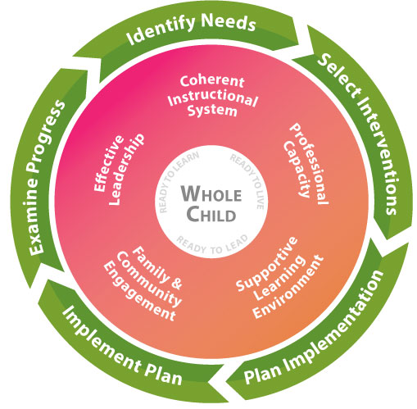
Title I Part C -MEP Is part of the Georgia’s Systems of Continuous Improvement

Slide 2
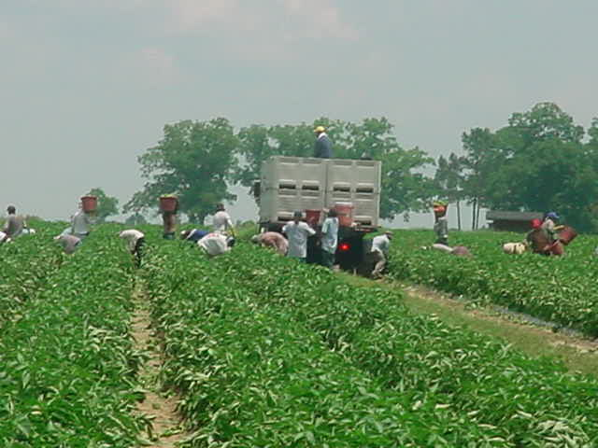
Maximizing Schedules for Title I, Part C Migrant Education Program (MEP) Local Staff (SSPs and Recruiters)

Slide 3
Session Objectives
Learn about the various service delivery designs in use in Georgia
Learn about the ways to set up schedules within different service delivery designs
Review examples of successful local MEP staff schedules
Understand the role of “flexibility” when creating schedules

Slide 4
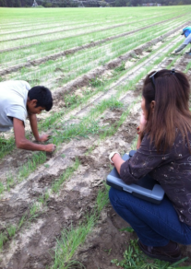
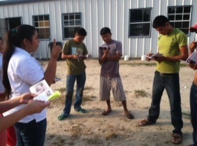
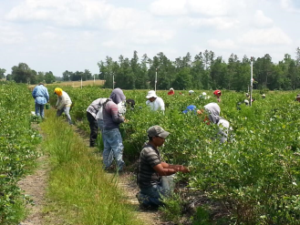
What is the Migrant Education Program (MEP)?
The purpose of the MEP in Georgia (and the United States) is to ensure that migrant children fully benefit from the same free public education provided to all children and that the unmet education-related needs resulting from their migrant lifestyle are met.

Slide 5
Title I, Part C Migrant Education Program

Slide 6
What is the Federal Definition of a “migratory child”?
According to sections 1115(c)(1)(A) (incorporated into the MEP by sections 1304(c)(2), 1115(b), and 1309(3) of the ESEA, and 34 C.F.R. § 200.103(a)), a child is a “migratory child” if the following conditions are met:
1. The child is not older than 21 years of age; and
2. The child is entitled to a free public education (through grade 12) under State law, or the child is not yet at a grade level at which the LEA provides a free public education, and
3. The child made a qualifying move in the preceding 36 months as a migratory agricultural worker or a migratory fisher, or did so with, or to join a parent/guardian or spouse who is a migratory agricultural worker or a migratory fisher; and
4. The child moved due to economic necessity from one residence to another residence, and from one school district to another.

Slide 7
Legal Authority for Priority For Services (PFS)
Statute: Elementary and Secondary Education Act (ESEA) of 1965, Title I, Part C-Sections 1304(b)(5) and 1304(d)
Code of Federal Regulation: 34 CFR 200.84
Guidance: MEP Guidance, October 2010, Pages 69-71

Slide 8
PFS
PRIORITY FOR SERVICES. In providing services with funds received under this part, each recipient of such funds shall give priority to migratory children who have made a qualifying move within the previous 1-year period and who
Are failing, or most at risk of failing, to meet the challenging State academic or
Have dropped out of school.

Slide 9
Priority for Services (PFS)
Failing , or most at risk of failing , to meet the challenging State academic standards
PFS
Interrupted schooling indicator
+
=
OR
Have Dropped out of school
MEP-eligible children must exhibit both factors in order to be considered PFS.
In our state, we work to ensure PFS status is determined within the prescribed time period (2 weeks) so that services for these needy children can be put in to place.
Notes:
Review slide

Slide 10
Service Delivery Designs
During the school day: Inclusion and Pull-out
Extended day programs
Before/after school programs
Saturday programs
In-home instruction (e.g., the MEP provides family/literacy services to the child at home)
Summer or intersession programs; and
Distance learning programs (e.g., web-based or portable courses).

Slide 11
Inclusion and Pull Out
During the school day
Advanced planning and collaboration with the classroom teacher
Additional instructional time – in addition to the CORE instructional time
Peer tutoring program
Faculty tutoring
Hiring academically high-achieving college students
Hiring retired teachers
Volunteers

Slide 12
Bulloch County Tutoring Program
Georgia Southern University /Community Liaisons - recruits GSU volunteers to work with EL/Migrant students.
Community Liaison recruits volunteers for a minimum for 6 to 9 weeks, 1-2 hours a week.
The volunteers' areas of academic strength are identified.
Community Liaison surveys the school teachers in the district to determine the need for volunteers and content areas that need to be addressed.
Spring - 39 volunteers logged in over 200 hours.
Fall - 400 hours of volunteer time.
5th year of utilizing this resource.
Tutor is in the classroom or media center always under the supervision of a certified teacher.
Tutor works either one on one or with a small group to better explain complex standards.
Days and times:
Monday/Wednesday 9:41-11:11
Thursdays 12:15-1:15
Monday/Wednesday 10:00-12:00

Slide 13
Extended Day Programs
Before and Afterschool
Focus on gaps in learning
Acceleration of learning
Additional practice
Previewing

Slide 14
Extended Day Programs
Before and after school
Students who participate in before or after school programs are more likely to demonstrate increased academic performance, improved attendance and be more excited to learn and achieve.
Parents can drop off their children to, or pick up their children from a safe environment.

Slide 15
Toombs County After School Program
Time: January 12 - March 19. Monday-Thursday- 3:30PM to 5:00 PM
Locations: 5 locations for the program - LPS, LUES, TCES, TCMS, and TCHS.
Tutors: Certified teachers familiar with CCGPS/GPS content. 3 tutors at LPS, LUES, TCMS, 1 at TCES, and 1 full time (manned by 2 part-time math teachers) at TCHS.
Students: Serve K-12. Priority goes to those students who are PFS, then those who are not served by an SSP during the day, then any other left.
Content: Tutors help with homework, remediation and enrichment on any skills that students need.
Cost: Shared fuel costs with 21st Century CCLC.

Slide 16
Gordon County Tutoring Program
Tutoring at two elementary schools.
Tutoring delivered by three certified teachers: two at Tolbert Elementary, and one at Fairmount Elementary.
At Tolbert Elementary School, the services were provided after school from 2:30-3:30, twice a week, on Tuesdays and Thursdays.
Students in 2nd, and 3rd grade were served.
The students were separated by grade level and received instruction from the two certified teachers.
At Fairmount Elementary, 1st grade students received tutoring instruction three days per week, for 45 minutes, first thing in the morning. These two students were served by one certified teacher.

Slide 17
Saturday Programs
Saturday Programs-
Can be geared toward providing additional learning opportunities for specific core content-reading, writing, math, science, etc.
Help students who are experiencing trouble with classes during the week – additional instructional time
Help students who have missed instruction due to migrant lifestyle – it gives them the chance to catch up with their peers
Students have the opportunity to receive instruction from different teachers

Slide 18
In-Home Instruction
The MEP provides family literacy services and academic tutoring to the child at home.
Students receive the exclusive and personalized tutoring they need.
Students feel at ease learning in the surroundings of their own home.
Serves as a way to prepare students for regular school experience.

Slide 19
Summer and Intersession Programs
Allow students to catch up and progress to the level of their peers
Make up credits
Preview material
Smaller classes help some students to learn better
Provide individualized attention
Help students to work on the subject or subjects that they have failed
May increase student social language
Available for migrant students in GA for the summer months only

Slide 20
Distance Learning
Distance learning programs (e.g., web-based or portable courses of instruction)
Students can study more subjects-make up credits
Are more flexible than traditional styles of classroom instruction
Students work at their own pace
Flexible schedule
A student may learn better at his own pace and in a different format than traditional schooling options offer

Slide 21
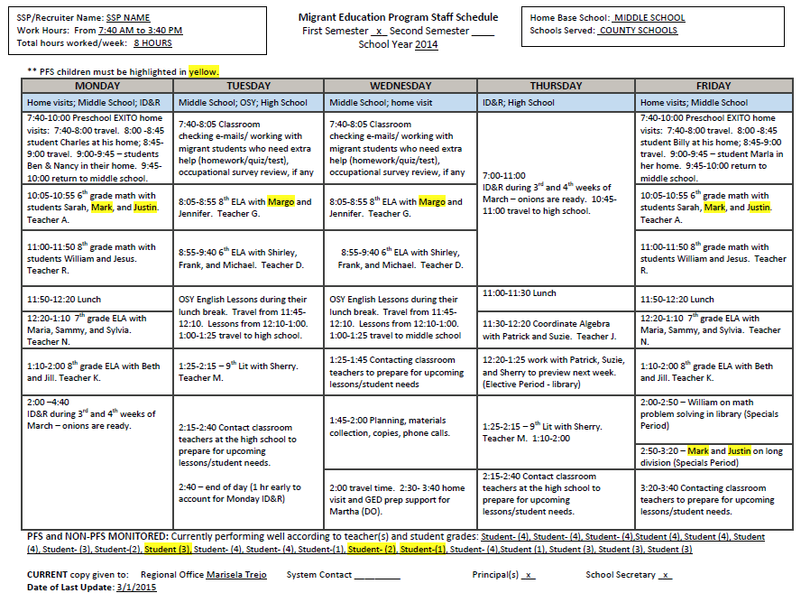
Sample MEP Staff Schedule
Preschool
OSY
Increased recruiting due to peak season
Flexible hours
Coordinating with teachers

Slide 22
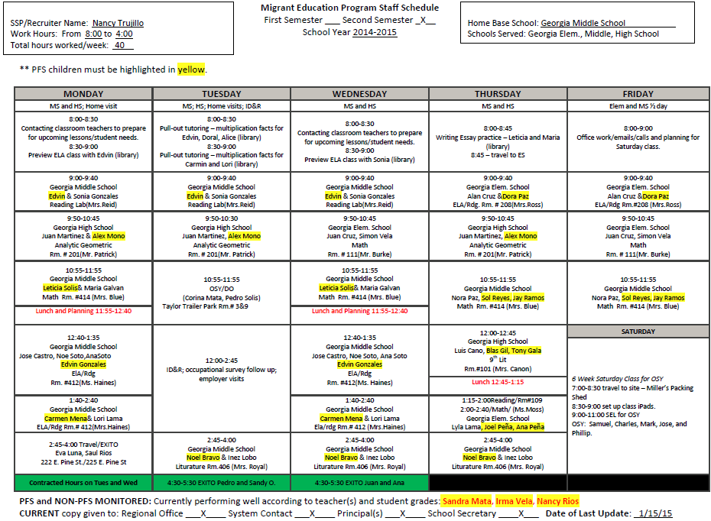
Sample MEP Staff Schedule
Maximizing Time
ID&R
Flexible Scheduling; OSY
Preschool

Slide 23
Tips for Designing MEP Staff Schedules
LEAs must first address the needs of PFS migrant children who are failing, or at risk of failing, to meet the State’s challenging academic content and achievement standards, and whose education has been interrupted during the regular school year.

Slide 24
Tips for Designing MEP Staff Schedules
Supplemental Services
Academic
Support
Schedules for Staff
Flexible to include time to provide services (academic and support) before and after school, evenings, and weekends
Flexible to recruit (based on local ID&R plan) at different times and days during the week and varying intensity based on monthly migration patterns
Specific and intentional time for OSY and PS
SSPs - inclusion or pull-out as the delivery model – can be flexible and a combination of both
Tutoring – before and after school, Saturdays

Slide 25
Tips for Designing MEP Staff Schedules
Avoid making school day schedules that are not fluid and flexible: PFS served first
Vary the number of times an SSP works with a child during the week
Group migrant students to increase services to those needing support
No required “seat-time” for supplemental services – duration and intensity of support can be adjusted to maximize impact of SSP on all participants in the district

Slide 26
Tips for Designing MEP Staff Schedules
Review students’ grades regularly (progress reports, report cards, grade summaries, etc.)
Refer to IPs for information on gap/need, frequency of sessions, length of time per session, projected outcome, etc.
Communicate with migrant students’ teachers often and intentionally; support this communication process
Ensure that classroom teachers understand the roles of the MEP and MEP staff
Review high school transcripts and graduation plans
Check/assist with credit recovery
Review graduation and testing requirements

Slide 27
Tips for Designing MEP Staff Schedules
Update schedules, as needed
Make changes when students enroll or depart
Check the progress of monitored PFS students regularly, and adjust your schedule if these students need additional support
Keep an updated copy: SSP, migrant contact, school principal(s), MEP regional office
In addition to schedule, keep a daily log of activities. Include all home visits and recruiting activities.

Slide 28
Tips for Designing MEP Staff Schedules
Account for all of the time in the schedule(s)
Include the names of all of the schools served
For each tutorial block, include the time, teacher, grade level, subject/course, and student(s)
Highlight in yellow all Priority for Service (PFS) students
List the names of PFS students who are not being tutored and are being monitored only at the bottom of your schedule

Slide 29
Title I, Part C Migrant Education Program

Slide 30
Questions?
Contact us …………..
Israel Cortez, jcortez@doe.k12.ga.us
Marisela Trejo, mtrejo@doe.k12.ga.us
Margarita Munoz, mmunoz@doe.k12.ga.us
Sabrina Pineda, spineda@doe.k12.ga.us
Cindell Mathis, cmathis@doe.k12.ga.us
April Roberts, aroberts@doe.k12.ga.us
Mary Clare Tarpley, MCTarpley@doe.k12.ga.us
Miriam Ndaayezwi, mndaayez@doe.k12.ga.us

