Slide 1
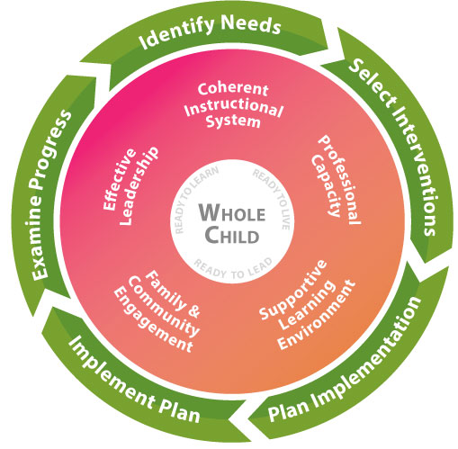
Coordinating and Designing Services for Preschool Migrant Children

Slide 2
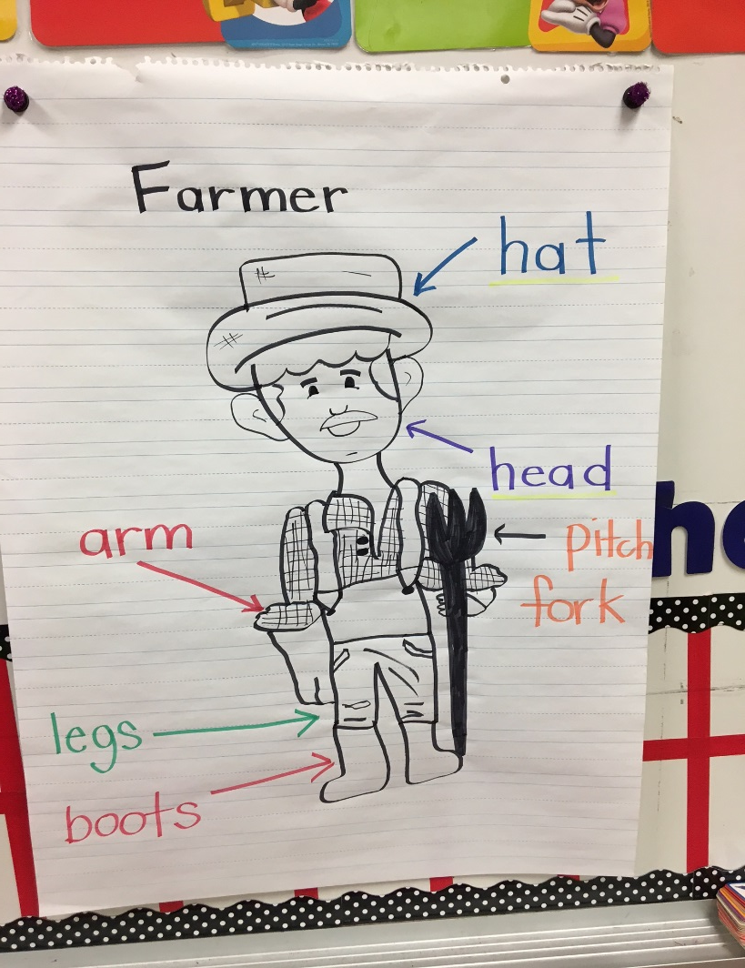
Making a Difference
Why did you choose a career in education? Many people go into education because they want to make a positive impact on the lives of children.
Migrant Preschool School Readiness services can make a BIG difference in the life of a child.
Children who start school knowing as much of the information as possible on the checklist will learn much more easily and have greater success in school.

Slide 3
Overview
Community Partnerships
Service Models
Facility-based or Home-based
Preschool Implementation Plan (IP) Examples
GaDOE MEP School Readiness Resources
Curriculum & Resource Ideas
Professional Development for SSPs

Slide 4
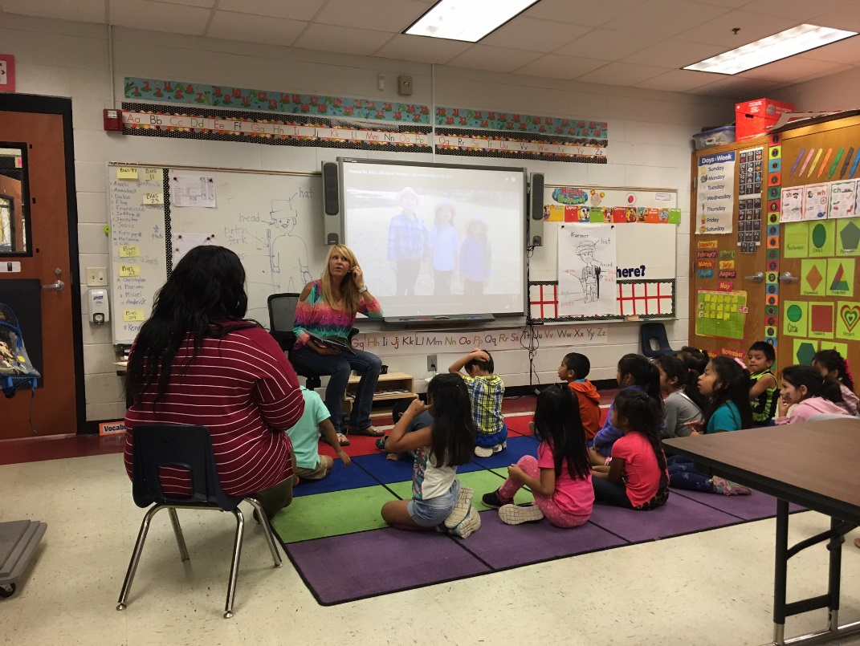
Coordinate with Existing Community Services
Children benefit from increased exposure to learning environments. Whenever possible, help families enroll their children in programs such as these:
Head Start
Preschools
Pre-K programs
Accredited Day Care

Slide 5
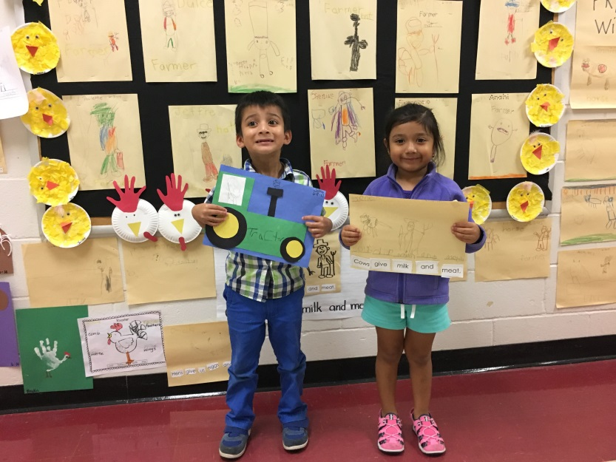
MEP Service Models
Which model is best for your LEA?
Facility-based
Home-based
Summer School
Combination
Other

Slide 6
Implementation Plans
IP EXAMPLES
Classroom (facility-based)
Home Visits (home-based)
EXITO program
Summer School

Slide 7
EXITO Program

Slide 8
EXITO Activities

Slide 9
MEP School Readiness Resources
Review these documents to guide the services you provide to preschool participants and families:
Preschool Checklist of School Readiness Skills
Home Visit Planning Document
Home Based Instruction Protocol
All documents are available on the GaDOE MEP website: http://www.gadoe.org/School-Improvement/Federal-Programs/Pages/School-Readiness-and-OSY-Services.aspx

Slide 10
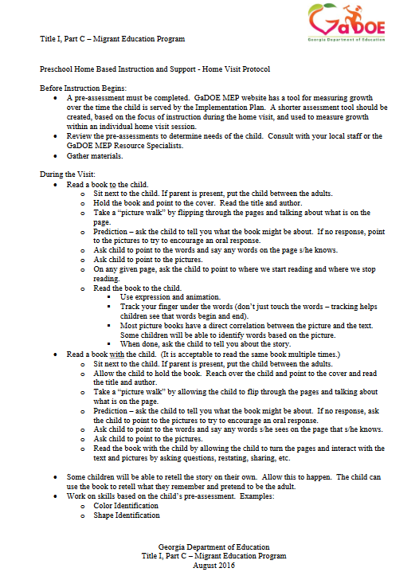
Home Based Instruction Protocol

Slide 11
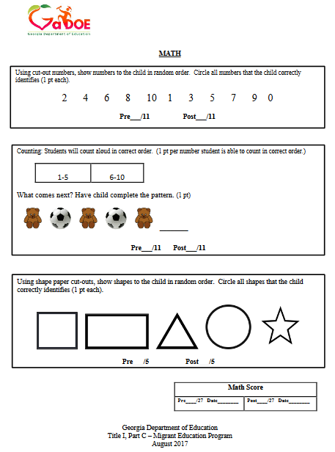
Preschool Assessment

Slide 12
Home Visit Planning Document

Slide 13
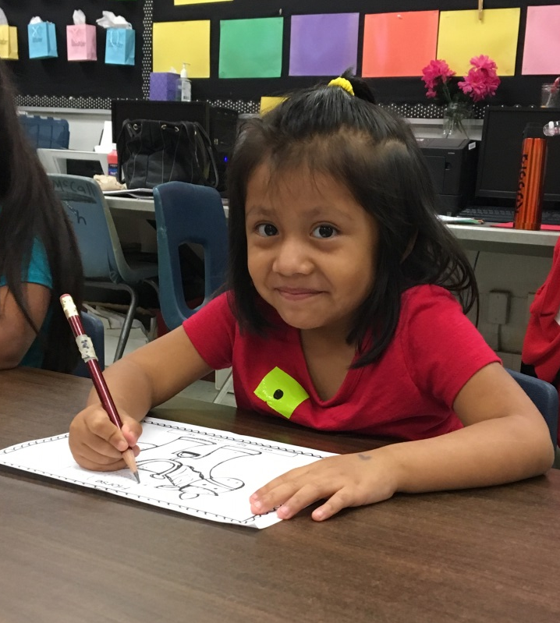
Resource and Ideas for Lessons
Carry a bag of supplies:
Books
Manipulatives, Games, Activities
Tablets/iPads
Ask Pre-K teachers for lesson
ideas and appropriate apps
or websites!

Slide 14
Reading to Children Using the START Strategy
From Rollins Center for Language and Literacy
https://app.readrightfromthestart.org/#!/courses/554d04d7e6105d1800ef742a/lesson/554d09cb202cc817003c66ca/step/556e132fea55751d000e4cbd/cd

Slide 15
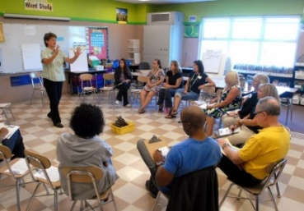
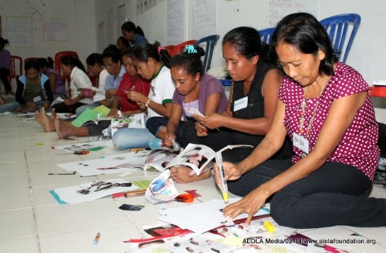
Professional Development Options for SSPs
Local District Trainings
RESA Trainings
Reading Instruction – Birth to Grade 12: Professional Learning Modules
https://www.gadoe.org/School-Improvement/Federal-Programs/Pages/Professional-Development.aspx
Comprehensive Reading Solutions:
http://comprehensivereadingsolutions.com/category/birth-to-pre-k/
Rollins Center for Language and Literacy
https://app.readrightfromthestart.org/#!/courses
Notes:
Professional Development opportunities via local LEA trainings, RESA, and online modules:
Literacy and Striving Readers Grant and Comprehensive Reading Solutions: modules that provide free access to professional learning that may be used to support preschool instruction.

Slide 16
More PD Options
Governor’s Office of Student Achievement
https://words2reading.com
PD Now! Early Childhood
177 Understanding Early Childhood Disabilities
178 Developmentally Appropriate Practices
in Early Childhood
228 Early Childhood Development: Early Literacy
231 Early Childhood Development: Early Math
233 Early Childhood Development: Early Science
Notes:
Professional Development modules available via PD Now.
Access will be provided from the RS shortly.

Slide 17
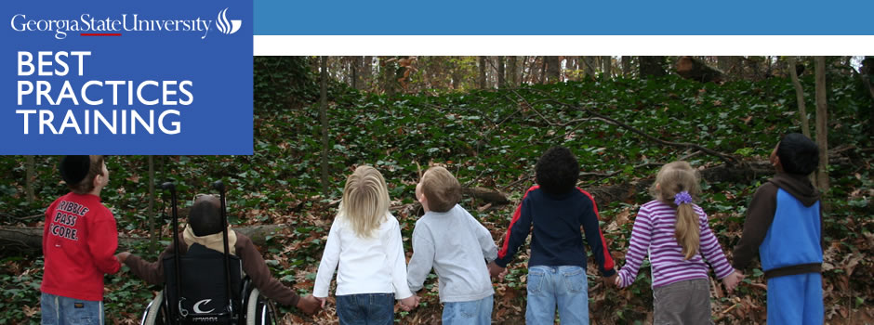
Professional Development cont.
Georgia State University: http://bestpractices.gsu.edu/?q=node/5

Slide 18
Professional Development cont.
Reading Rockets: Launching Young Readers

Slide 19
Professional Development cont.
Comprehensive Reading Solutions
http://www.comprehensivereadingsolutions.com/

Slide 20
Questions?
Contact us …………..
Miriam Ndaayezwi, mndaayez@doe.k12.ga.us
Sabrina Pineda, spineda@doe.k12.ga.us
Cindell Mathis, cmathis@doe.k12.ga.us
April Roberts, aroberts@doe.k12.ga.us
Mary Clare Tarpley, MCTarpley@doe.k12.ga.us

