Slide 1
#Iamthenewmigrantyouth
A modern approach to serving a new generation of Migrant youth
Title Programs Conference
June 2015
Resource Specialist Team
Georgia Migrant Education Program

Slide 2
Essential Questions:
Who is #thenewmigrantyouth?
Are our existing programs meeting their needs?
What can we do differently?

Slide 3
#threewords:
What three words come to mind when you hear “Migrant Youth”?

Slide 4
#migrantyouth
Educational gaps
First-generation college student
Low-income
Lack of motivation
English language learner
College may not be an option/expectation
Often has to work to contribute to household
At-risk
May drop out

Slide 6
We propose… #thenewmigrantyouth
Educational gaps
At-risk
Very Motivated
High-achieving
Goal-oriented
College-bound!
English language learner
Low-income
May not be expected to graduate
May have to work

Slide 7
#pausefordiscussion
Are we serving these students effectively?
What works?
What can we learn from what doesn’t?

Slide 8
#YouthLeadership
is both an internal and an external process leading to:
the ability to guide or direct others on a course of action, influence their opinion and behavior, and show the way by going in advance; and
the ability to analyze one’s own strengths and weaknesses, set personal and vocational goals, and have the self-esteem to carry them out.

Slide 9
#YouthDevelopment
A process that prepares young people to meet the challenges of adolescence and adulthood through a coordinated, progressive series of activities and experiences that will help them to become socially, morally, emotionally, physically, and cognitively competent.

Slide 11
#LeadershipAcademy@ABAC
Purpose:
The Georgia Migrant Education Leadership Academy invites participants to its summer leadership academy held at Abraham Baldwin Agricultural College (ABAC). The two week residential program exposes participants to campus life at ABAC through extracurricular activities and academic classes with ABAC faculty and staff - with the intent to convey the importance of a high school diploma and a post-secondary education.

Slide 12
#LeadershipAcademy@ABAC
Requirements:
Must be currently eligible migrant student
Must be currently enrolled / rising 9th, 10th, 11th, 12th grader
Must complete all parts of the
application & submit it by the
deadline.

Slide 13
#LeadershipAcademy@ABAC
Classes Offered:
Language Arts/Reading/ Essay Writing
Mathematics
Science/Social Studies
Study Skills
Career Awareness
Extracurricular Activities:
Team Building Exercises -- Daily afternoon activities to promote working in teams, develop better communication skills, and hone problem-solving skills.

Slide 14
#theimpact
Evaluation conducted at the end of the summer program.
I was encouraged/motivated to stay in school and graduate. | 30

Slide 15
#ittakesavillage
Leadership Without Limits! is a collaboration between the Georgia Migrant Education Program and the University of Georgia’s Fanning Institute in which 25 students from across the State are chosen to participate in a residential camp setting that:
Promotes Civic Engagement
Develops Leadership Skills
Allows Students the Opportunity to Envision Themselves in a College Environment
Introduces Students to Viable Post-Secondary Options

Slide 16
#LeadershipWithoutLimits (LWL)
In order for candidates to be considered for LWL, they must meet the following minimum criteria:
Must be a rising 9th, 10th, 11th, or 12th grader.
Must be at least 15 years of age.
Must not have participated in LWL in prior years.
Must not have reached End of Migrant Eligibility (EOE).

Slide 17
Participants:
Learn about college education admission processes
Financial aid and scholarships available for students
Learn about personal leadership styles
Learn how to initiate change through leadership
Gain a better understanding of issues that affect Georgia’s migrant community
Participate in forums for discussion and information sharing
Learn about the importance of civic engagement throughout the design and implementation of community service projects

Slide 18
ACTIVITIES
What it Takes to Success in High School Workshop
Road to College Activities
Individual Leadership Workshop
Group/ Community Leadership Workshop
Community Issues Forum
Community Issues Research Workshop
Designing and Implementing Community Service Project Sessions
Team Building Exercises
Science and Fine Arts Workshops
Language and Math Workshops
College Campus Life Activities

Slide 19
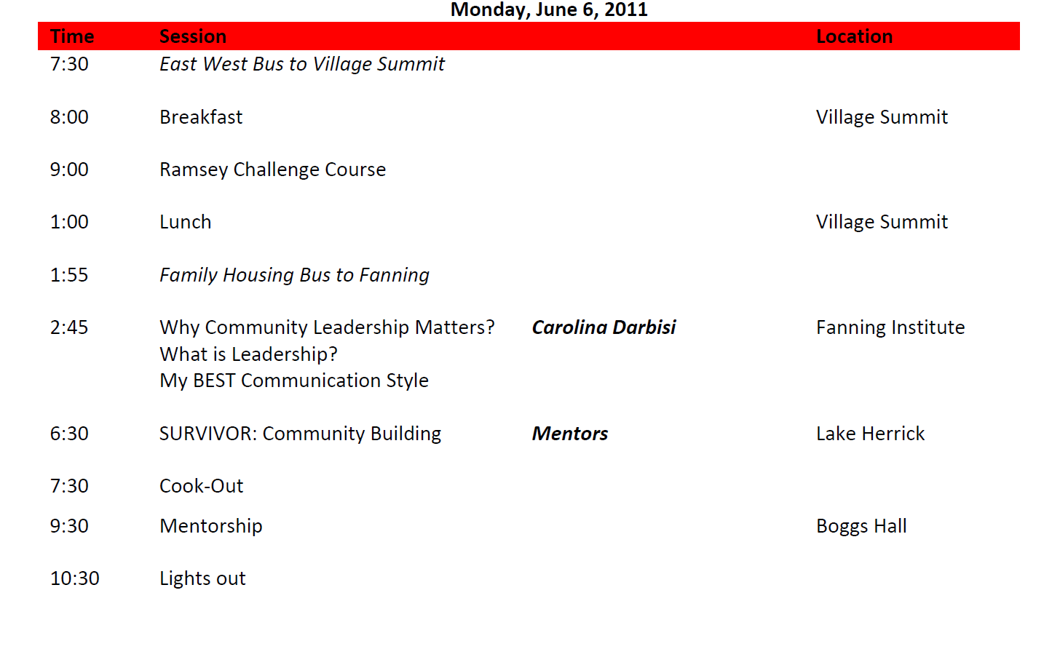

Slide 20
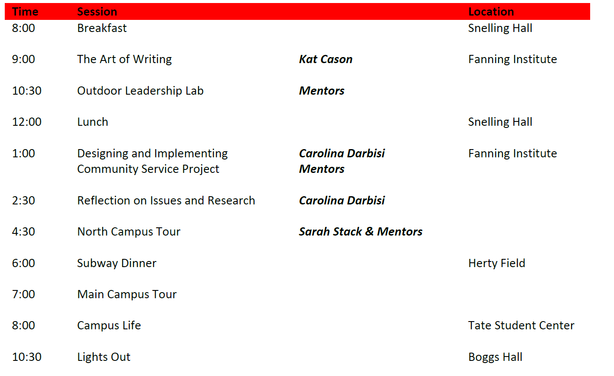

Slide 21
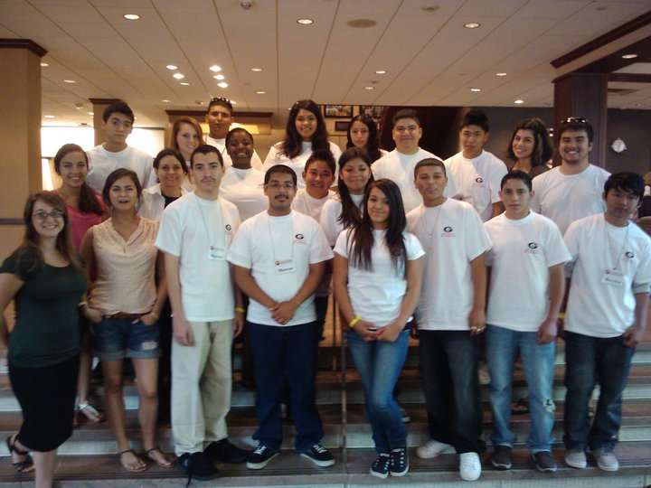
Migrant Education Program Leadership Without Limits! CLASS 2011

Slide 22
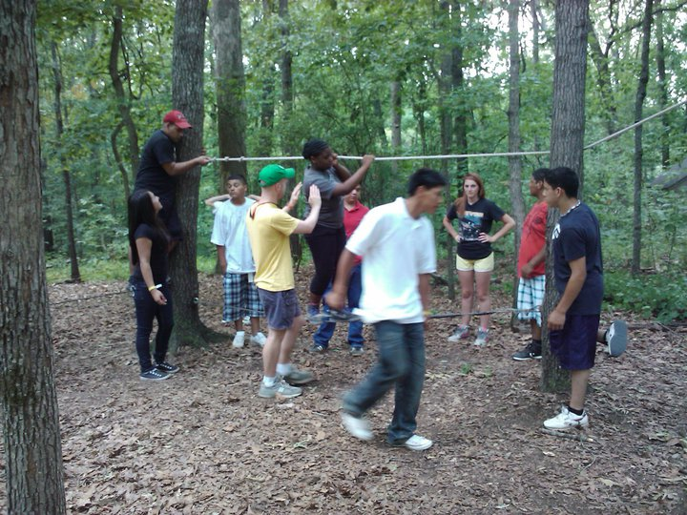
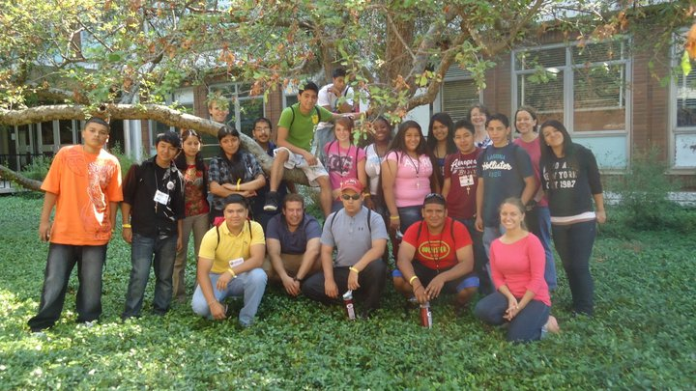
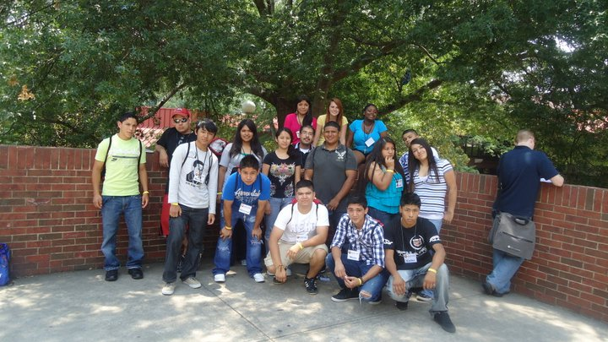
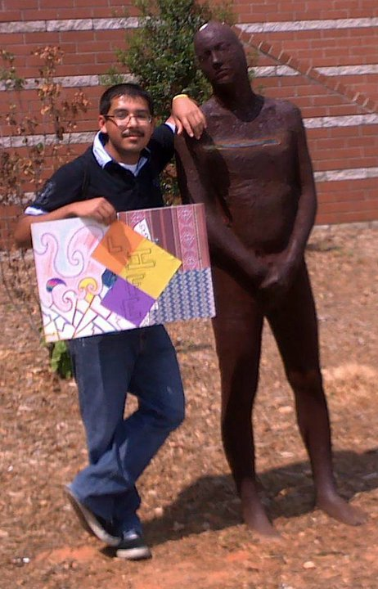

Slide 23
#thenewmigrantyouth
LWL 2011
Hand-written essays, often in Spanish
Very little parent buy-in; often RS had to conduct home visits to convince parents to allow student to attend.
Community service projects Incomplete/not implemented.
Paper application
LWL 2015
Typed essays, portfolios
Parents are more informed; cohorts have hosted younger siblings on several occasions.
Students investing time in community service projects; some gaining State-wide recognition.
Online application

Slide 24
#thenewmigrantyouth
LWL 2011
Less motivated students
B.D. (Before DACA): Unsure about financial options for pursuing post-secondary opportunities
Unmet basic necessities
Basic writing skills
LWL 2015
High-achieving students
A.D. (After DACA): Post-secondary opportunities seem more attainable.
Students have access to more resources at home and in the community.
Students often leave program with solid essays for college and scholarship applications.

Slide 25
#lessonslearned

Slide 26
#beyondthenorm
Remediation Acceleration
Increased Rigor
Utilize technology to engage students

Slide 27
#theimpact: Pre/Post Data

Slide 28
99 students
13 Community Service Projects implemented in the last 2 years

Slide 29
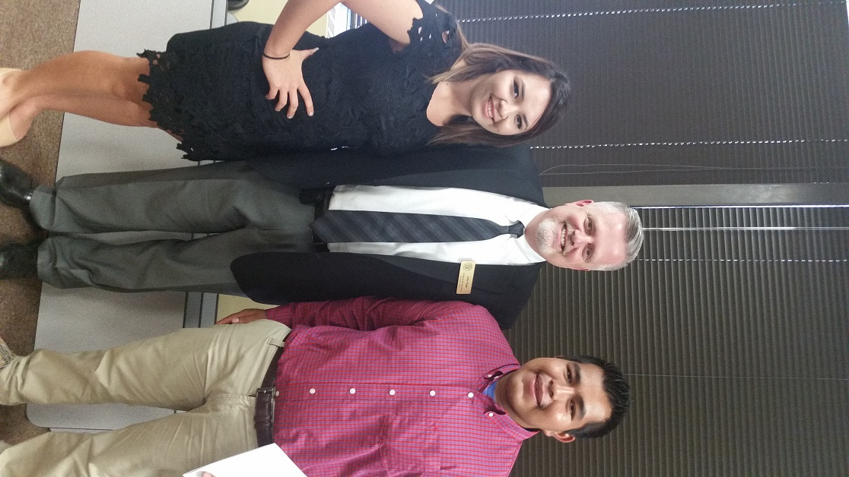
#MigrantStudentoftheYear
Highest GPA among State
Migrant students
Recognized at a ceremony with
State Superintendent of Schools
Former LWL participant
Leaders in their communities
College-bound
Overcome challenges
Motivated

Slide 30
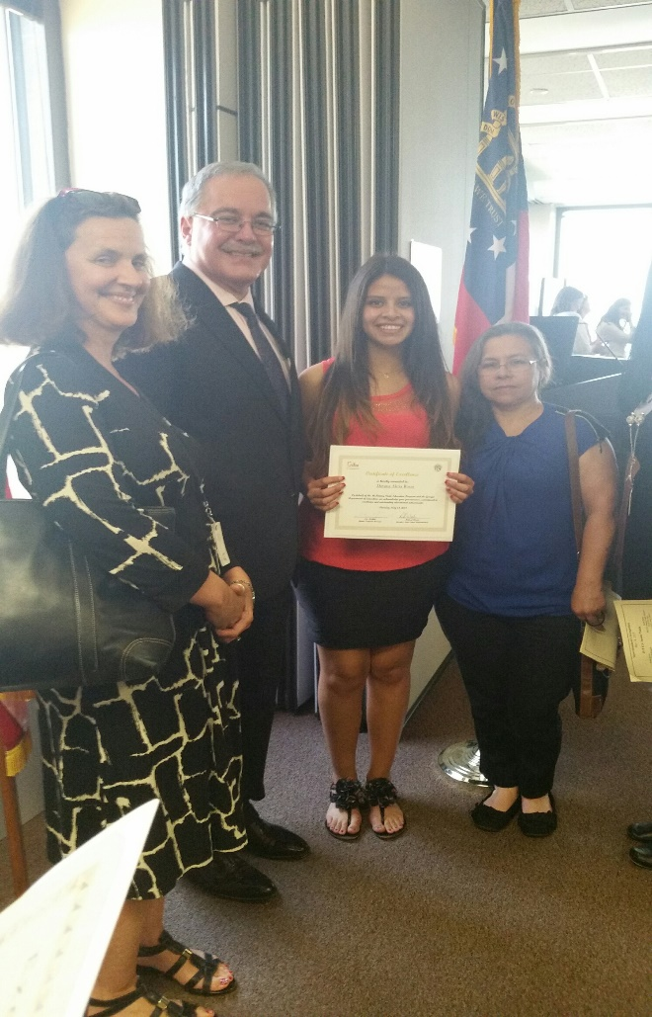
#shiningexample
Former LWL participant receives McKinney-Vento
Student of the Year Recognition for her leadership skills and perseverance.

Slide 31
#shiningexample
Former participant wins Georgia Youth Leadership Award for “Let-Us-Dream” Website – LWL Community Service Project

Slide 32
#thenewmigrantyouth
Graduating this year, with honors
A leader in her school and community.
Rosa was selected as one the 20 youth leader recipients for the 2015 Georgia Youth Leadership Awards, a very prestigious honor!
This year the GYLA received over 100 nominations for this honor, and all were highly competitive.
The nominations were reviewed and scored by a committee of leaders from the Atlanta Business Chronicle’s 40 Under 40, area professionals, and 21CL Youth Ambassadors.
The reviewers were very impressed by the quality of nominations and the projects they represented.
Rosa Borja, GYLA awardee, was recognized at the Georgia Youth Leadership Awards on Thursday, February 26, 2015 at the Omni Hotel at CNN Center.

Slide 33
Keeping them Engaged Throughout the Year

Slide 34
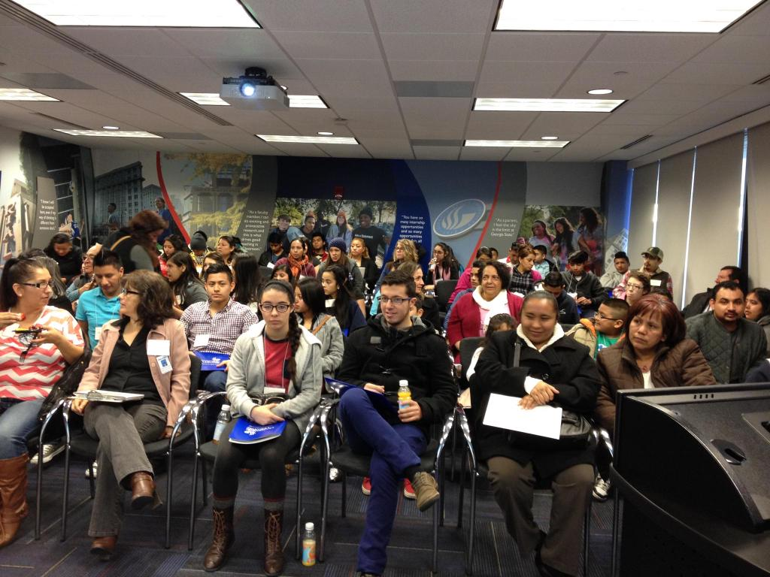
#collegeexperienceday
Coordination with local universities
High school students and their parents
Full day on campus
Campus tour
Guest speakers
Informational sessions
Student panel
Interactive activities
Open to Middle School
students.

Slide 35
What about #thenewoutofschoolyouth?

Slide 36
#forgottenyouth
Do not dismiss them because of their choice to not continue a traditional path to education.
Seek out alternative options.
Be persistent.
Be mindful of life circumstances, taking into consideration additional barriers they may face.
They, too, are #thenewmigrantyouth
They can be successful!
Two success stories

Slide 37
#MobileInformationTechnologyCenter

Slide 38
What is the MITC?
It’s a 48-foot mobile classroom equipped with:
50 inch flat screen video display
Wireless internet
DVD player
Laser printer
20 computer stations.
The Center serves as a major community outreach function of Ft. Valley State University and its College of Agriculture, Family Sciences and Technology.

Slide 39
The center provides many services, including the following:
Basic computer training
Software application training
Workforce development
K-12 academic computer training
Cybernet safety training
Migrant Education

Slide 40
#formoreinformation
Terrence Wolfork
Coordinator of Informational and Technology Services
478-952-4730
Yolanda McFerrin
Information Technology Curriculum Specialist
478-825-6706
mitcenter@fvsu.edu

Slide 41
Questions and Discussion

Slide 42
#thanksforlistening
Region 1
Resource Specialists
Georgia Migrant Education Program
Sabrina Rivera-Pineda Miriam Blaisdell Ndaayezwi
spineda@doe.k12.ga.us mndaayez@doe.k12.ga.us
Region 2
Resource Specialists
Georgia Migrant Education Program
Marisela Trejo Bonnie Larson-Brogdon
mtrejo@doe.k12.ga.us blarson@doe.k12.ga.us
Ignacia Trujillo
itrujillo@doe.k12.ga.us

