Slide 1
System for Effective
School Instruction
13th Annual Title Programs Summer Conference
Atlanta, Georgia
Will Rumbaugh, Ed.D.
Director
School and District Effectiveness
WRumbaugh@doe.k12.ga.us
404-463-1861
Dawn Ashmore, Ed.S.
School Effectiveness Specialist
School and District Effectiveness
Dashmore@doe.k12.ga.us
678-372-0791
Cheryl Hunley, Ed.S.
School Effectiveness Specialist
School and District Effectiveness
Chunley@doe.k12.ga.us
404-310-6564

Slide 2
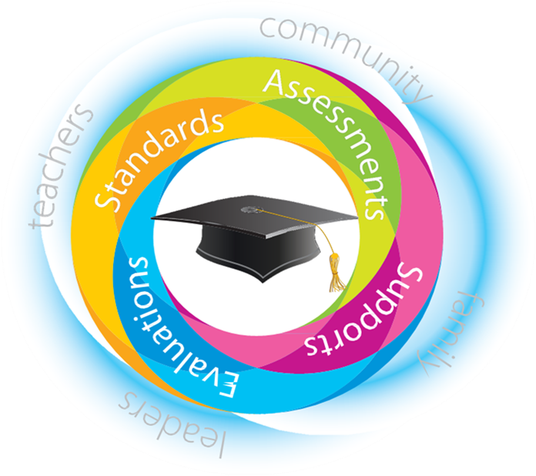

Slide 3

Learning Targets
Examine the need for a system of effective instruction
Identify the roles of district and building leaders in improving instruction
Introduce the “System for Effective Instruction Toolbox”
Explore support for district and building leaders
Notes:
Will – Welcome and introduce targets…

Slide 4

The Need for Improved Instruction: Are Our Students
College & Career Ready?
Notes:
Dawn -
Can we truly say our students are College AND Career Ready?

Slide 5

College Freshman
Well or Very Well Prepared
  High School Teachers – 89%
  College Instructors – 26%
Notes:
A survey of high school teachers and college professors showed a large gap in perception of college readiness for entering freshman.

Slide 6
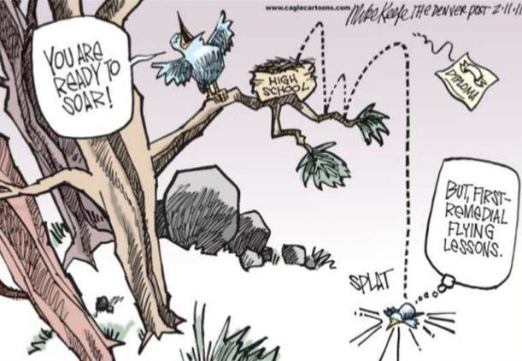
Freshmen Needing
Remediation
  Two Year College 51.7%
  Four Year College 19.9%
Notes:
2014 statistics on need for remedial courses.

Slide 7

2014 College Drop-Out Rate
First to Second Year
Two‐Year Colleges
44.5%
Four‐Year Colleges
34.8%
Notes:
Dropout rate of first year college students –

Slide 8

Average Graduation Rate
1983‐2014
Two‐Year Colleges in 3 years – 29.1%
Four‐Year Colleges in 5 years – 36.6%
Notes:
Students taking more time to complete degrees – 125-150%
Losing or extending time in school for 70% of students from 2yr institutes and over 60% from 4yr schools.
Economic impacts??

Slide 9
Georgia 4 Year Public College
24.0%
30th
Notes:
In perspective – Georgia is 30th in nation in percentage of 4yr graduates –
6yr graduates – taking 150% of time to earn 4yr degree – economic impact on their future???
Who in this room still have/had college loans after 10 years? 20 years? More?

Slide 10
Georgia 2 Year Public College
17.0%
18th
Notes:
Again 2yr students taking 150% time to graduate –
Better position in nation at 18th.

Slide 11
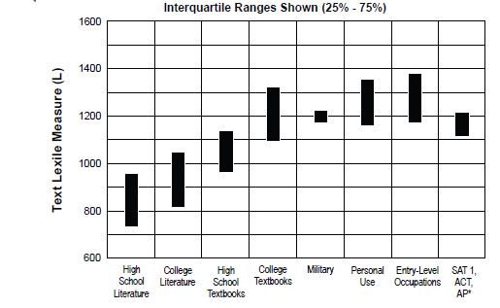

Reading Study Summary
Expected Performance on EOC/EOG Milestones:
American Literature – equal to or greater than 1275
Grade 8 - equal to or greater than 1050
Grade 5 - equal to or greater than 850
Grade 3 - equal to or greater than 650
* Source of National Test Data: MetaMetrics
Notes:
Lexile Level average for HS ELA texts and novels range from 750 to 950 –
CCRPI expects an 11th Grade students to reach a Lexile level of 1275 on the American Literature EOC Milestone
How can we get them there?
What implication do these lexile levels have on our elementary and middle school teachers?

Slide 12

Reading Study Summary
Expected Performance on EOC/EOG Milestones:
American Literature – equal to or greater than 1275
Grade 8 - equal to or greater than 1050
Grade 5 - equal to or greater than 850
Grade 3 - equal to or greater than 650
* Source of National Test Data: MetaMetrics
Notes:
Lexile Level for average for College Literature courses range between 825 and 1050 – top of range is just now getting the 8th grade lexile expectation of 1050.
What implication does this have for our middle school teachers?
What support and resources can you provide?

Slide 13

Reading Study Summary
Expected Performance on EOC Milestones:
American Literature – equal to or greater than 1275
* Source of National Test Data: MetaMetrics
Notes:
High school courses other than ELA – TB range from average of 975 to 1125.
What subjects do you believe have the highest lexile levels? (CTAE due to Technical Manuals)
With the high end average of HS textbook written at a Lexile of 1125 – how can our teachers raise Lexiles to the CCRPI expectation of 1275?
What will they need to do?
What support will they need to accomplish this demand?
What can your office do?
Talk at your tables……Share out
Science, Social Studies and the Technical Subjects must play a significant role in raising lexile levels!
Yet, we primary teach reading comprehension and reading strategies through ELA courses.
– thus push for Literacy standards in all content areas and a need for Close Reading instruction across the content using complex texts and resources outside of our TB and standard literature.

Slide 14
Reading Study Summary
Expected Performance on EOC Milestones:
American Literature – equal to or greater than 1275
* Source of National Test Data: MetaMetrics
Notes:
All other college TB range from an average of 1100 to 1310 – only now are we hitting our CCRPI target range of 1275.
High school textbook lexile levels do not prepare for college!
We must raise lexile to that 1275 CCRPI level to prepare student for post-secondary success by embedding reading of complex texts and writing in all courses.

Slide 15
Reading Study Summary
* Source of National Test Data: MetaMetrics
Notes:
Military Literacy Exam 1200 – over 35% of those tested fail and cannot enter Military.
7% of 4 year College Graduate also fail the Military Literacy Exam!!
Military Lexile levels are higher than SAT/ACT/AP courses!
SAT/ACT/AP have not changed the rigor/Lexile levels of their tests due to the national comparison they provide for college entrance.
School Improvement is not keeping up with world changes. Changing World is 4x faster.
Entry level occupations 1200-1380.

Slide 16
2013-2014 Georgia Assessment of Performance on School Standards Results (GAPSS)
The Instruction Strand received the five lowest scoring standards. (Operational or Exemplary in fewer than 10% of reviews.)
  I-8 Student Performance Feedback 8%
  I-4 Differentiated Instruction 5%
  I-5 Students Set Learning Targets 3%
  I-6 High Expectations/Students
  Monitoring Their Own Progress 3%
  I-7 Technology Integrated 3%
Notes:
Will -
Out of 37 Mandatory GAPSS Reviews

Slide 17
2011-2014 GAPSS Trend Data
Three year trend data shows the Instruction Strand has continued to receive the lowest scores on four standards.
I-2.2 Higher-order thinking skills, processes & habits
I-2.5 Flexible Grouping of students
I-3.3 Student personal efficacy/responsibility
I-2.3 Differentiated instruction
Notes:
GAPSS indicators were revised in 2013-14 – but consistency remains in the lowest scoring strands/indicators.

Slide 18

The Role of Leaders in Improving Instruction
Notes:
Will -

Slide 19
Georgia District Performance Standards (GDPS)
Learning and Teaching: District processes for implementing, supporting, and monitoring curriculum, instruction, and assessment systems and their impact on student learning
LT 1: Engages and supports all schools in systematic processes for curriculum design to align instruction and assessments with the required standards
LT 3: Guides, supports, and evaluates the implementation of curriculum, instruction, and assessments

Slide 20
Georgia District Performance Standards (GDPS)
Learning and Teaching: District processes for implementing, supporting, and monitoring curriculum, instruction, and assessment systems and their impact on student learning
LT 6: Guides and supports schools in the selection and implementation of effective strategies, programs, and interventions to improve student learning

Slide 21
Georgia District Performance Standards (GDPS)
Leader, Teacher, and Staff Effectiveness: The performance management system that maximizes the effectiveness of district leaders, teachers, and other staff to ensure optimal learning for all students
LTSE 2: Establishes and implements processes that increase the effectiveness of teachers, leaders, and staff
LTSE 4: Defines the roles, responsibilities, skill sets, and expectations of leaders at all levels of the district to improve student learning and staff performance

Slide 22
Georgia District Performance Standards (GDPS)
Planning, Organizing, and Monitoring: The data-driven processes, procedures, structures, and products that focus the operations of the district to ensure higher levels of student learning and staff effectiveness
POM 1: Uses a collaborative, data-driven planning process at the district and school levels for improving student learning

Slide 23
Georgia School Performance Standards (GSPS)
Curriculum Standard 1: Uses systematic, collaborative planning processes so that teachers share an understanding of expectations for standards, curriculum, assessment, and instruction
Curriculum Standard 2: Designs curriculum documents and aligns resources with the intended rigor of the required standards
Curriculum Standard 3: Uses a process to review curriculum documents to ensure alignment to the intent and rigor of the standards and revises as needed

Slide 24
Georgia School Performance Standards (GSPS)
Assessment Standard 2: Uses a balanced system of assessments including diagnostic, formative, and summative to monitor learning and inform instruction
Assessment Standard 4: Implements a process to collaboratively analyze assessment results to adjust instruction

Slide 25
Georgia School Performance Standards (GSPS)
Instruction Standard 2: Creates an academically challenging learning environment
Instruction Standard 4: Uses research-based instructional practices that positively impact student learning
Instruction Standard 5: Differentiates instruction to meet specific learning needs of students

Slide 26
Georgia School Performance Standards (GSPS)
Instruction Standard 6: Uses appropriate, current technology to enhance learning
Instruction Standard 9: Provides timely, systematic, data-driven interventions

Slide 27
Georgia School Performance Standards (GSPS)
Leadership Standard 3: Uses systems to ensure effective implementation of curriculum, assessment, instruction, and professional learning practices
Leadership Standard 4: Uses processes to systematically analyze data to improve student achievement

Slide 28

System for Effective
School Instruction
Toolbox

Slide 29
"Never use a long word where a minimalist, diminutive, and unassuming expression sufficiently and comprehensively circumscribes and delineates
the full connotations of the aforesaid utterance and adequately relays the exigent parameters being
thereby elucidated."
                Author Unknown
Notes:
Do you think that all the educational jargon used today gets in the way of creating true meaning for teachers and school administrators?
We have attempted to simplify a model Instructional System that can be used by Principals, Leadership teams and teachers to begin adapting or developing their own system.

Slide 30

Rationale for Implementing an Instructional System
Creates a shared vision of effective instruction
Guides how teachers plan for instruction
Guides instructional delivery
Determines effectiveness of instruction for individual students and school-wide
Notes:
Will -

Slide 31
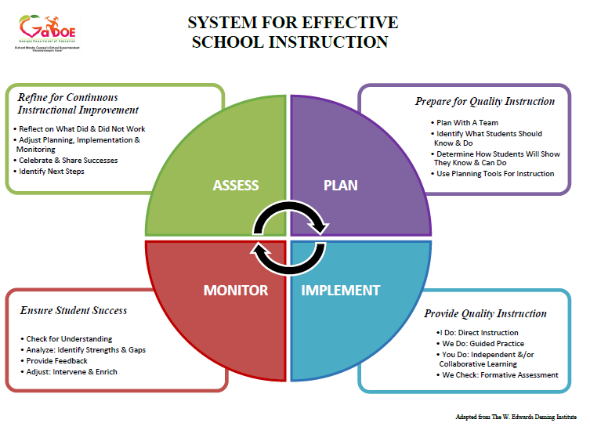
Notes:
Sample System

Slide 32
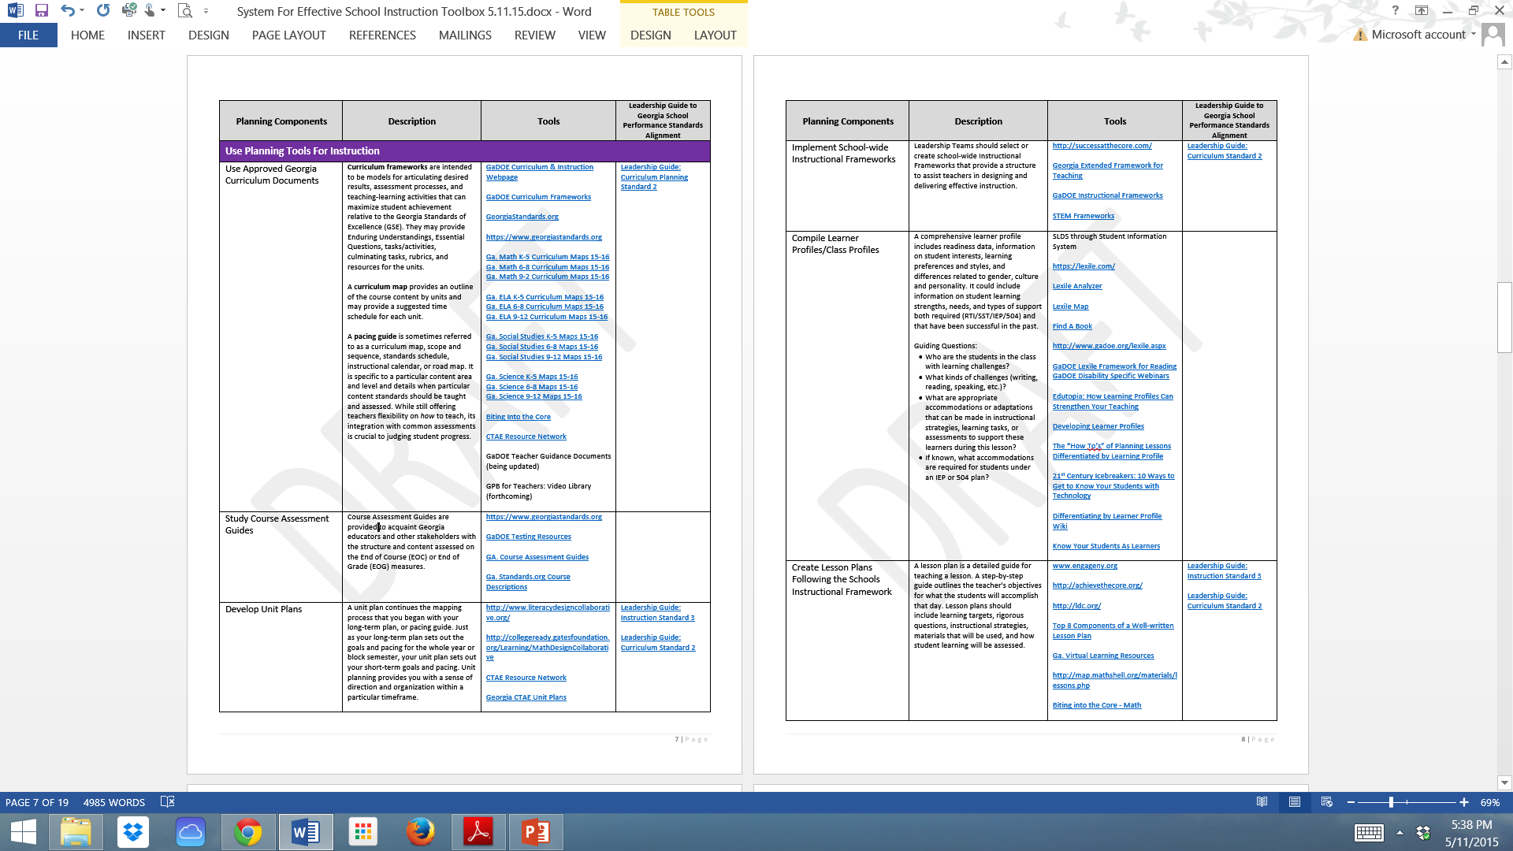
System for Effective School Instruction Toolbox
Notes:
The toolbox will be a living document housed on the SDE website.
Links to resources and tools, as well as the Leadership Guide to the Georgia School Performance Standards will provide Leadership teams and teachers with GaDOE and research –based instructional tools.

Slide 33
System of Instruction
PLAN
Prepare for Quality Instruction
Plan with a Team
Identify What Students Should Know & Do
Determine How Students Will Show They Know & Can Do
Use Planning Tools for Instruction
Notes:
The components listed under Plan are….

Slide 34
System of Instruction
PLAN
Prepare for Quality Instruction
Plan with a Team
Identify What Students Should Know & Do
Determine How Students Will Show They Know & Can Do
Use Planning Tools for Instruction
Notes:
Let’s take a closer look at what Collaborative Planning would look like in an effective system.

Slide 35
Plan with a Team
  Create Collaborative Planning Schedules
  Develop and Implement a Collaborative Planning Process
  Determine Purpose and Set Goals
  Select a Protocol Aligned to Purpose
  Monitor & Provide Feedback for Team Improvement
Notes:
Sub-components under plan with a team -

Slide 36
Plan with a Team
  Create Collaborative Planning Schedules
  Develop and Implement a Collaborative Planning Process
  Determine Purpose and Set Goals
  Select a Protocol Aligned to Purpose
  Monitor & Provide Feedback for Team Improvement
Notes:
Let’s take a look at one sub-components of planning with a team…Develop and Implement a Collaborative Planning Process
Collaborative planning and alignment of the standards to instruction are at the heart of increasing student achievement.

Slide 37
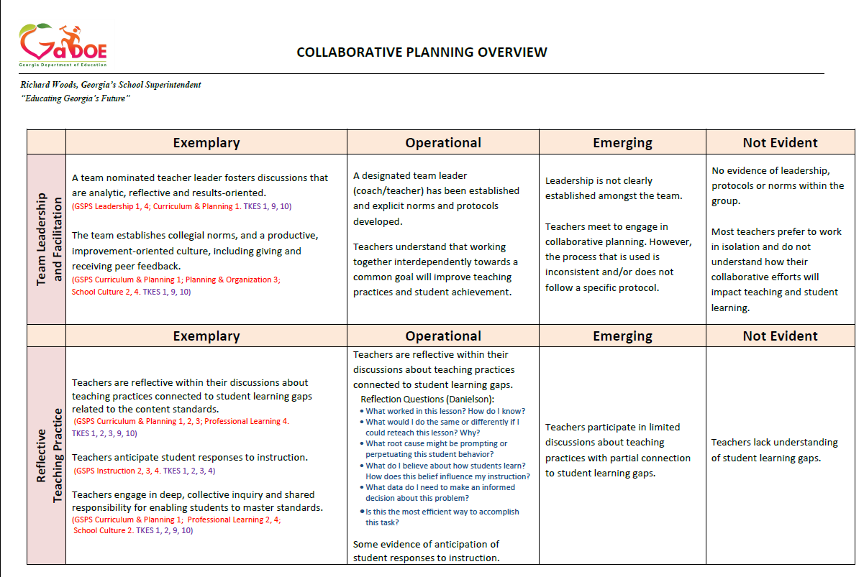
Collaborative Planning Rubric
Team Leadership and Facilitation
Reflective Teaching Practices
Standards-Based Instructional Practices
Lesson Planning
Assessment and Evidence of Student Learning
Notes:
See Handout--
GaDOE has developed a tool to assist collaborative planning teams, or PLC’s, to implement effective practices.
The tool is aligned with TKES and Georgia School Performance Standards to provide the connection for teachers and administrators.
There are 5 sections to the tool to guide teams to Exemplary practices…..
Team Leadership and Facilitation
Reflective Teaching Practices
Standards-Based Instructional Practices
Lesson Planning
Assessment and Evidence of Student Learning

Slide 38
Collaborative Planning Rubric
Team Leadership and Facilitation
Exemplary | Operational | Emerging | Not Evident
A team nominated teacher leader fosters discussions that are analytic, reflective and results-oriented. The team establishes collegial norms, and a productive, improvement-oriented culture, including giving and receiving peer feedback. | A designated team leader (coach/teacher) has been established and explicit norms and protocols developed. Teachers understand that working together interdependently towards a common goal will improve teaching practices and student achievement. | Leadership is not clearly established amongst the team. Teachers meet to engage in collaborative planning. However, the process that is used is inconsistent and/or does not follow a specific protocol. | No evidence of leadership, protocols or norms within the group. Most teachers prefer to work in isolation and do not understand how their collaborative efforts will impact teaching and student learning.
Notes:
Highlight critical expectations of Collaborative Planning Process

Slide 39
Collaborative Planning Rubric
Reflective Teaching Practices
Exemplary | Operational | Emerging | Not Evident
Teachers are reflective within their discussions about teaching practices connected to student learning gaps related to the content standards. Teachers anticipate student responses to instruction. Teachers engage in deep, collective inquiry and shared responsibility for enabling students to master standards. | Teachers are reflective within their discussions about teaching practices connected to student learning gaps. Some evidence of anticipation of student responses to instruction. | Teachers participate in limited discussions about teaching practices with partial connection to student learning gaps. | Teachers lack understanding of student learning gaps.
Notes:
You will see on the handout that Guiding Questions have been included on the rubric to assist with reflective practices.
What worked in this lesson? How do I know?
What would I do the same or differently if I could reteach this lesson? Why?
What root cause might be prompting or perpetuating this student behavior?
What do I believe about how students learn? How does this belief influence my instruction?
What data do I need to make an informed decision about this problem?
Is this the most efficient way to accomplish this task?
What misconceptions are likely, and what can we do to prevent or minimize these misconceptions?
What specific objectives must students achieve to master this standard?
How can we present concepts so that students see connections with their background and prior knowledge?
What vocabulary must students know and understand to discuss this concept comfortably?

Slide 40
Collaborative Planning Rubric
Standards-Based Instructional Practices
Exemplary | Operational | Emerging | Not Evident
Teachers deeply discuss Georgia Standards of Excellence, resulting in prioritized content standards, in order to create pacing guides and curriculum documents. Analysis of standards lead to the identification of teacher misconceptions, resulting in research and content knowledge development, and clarification of what students are expected to know, understand, and do. | Teachers analyze the Georgia Standards of Excellence to determine the intent of the standards and clarify what students are expected to know, understand, and do. Teachers embed the Georgia Standards of Excellence in the creation of pacing guides and curriculum documents. | Teachers embed the Georgia Standards of Excellence in the creation of curriculum documents and performance tasks. | Teachers depend solely on textbooks or performance tasks that may or may not be aligned to the Georgia Standards of Excellence.

Slide 41
Collaborative Planning Rubric
Standards-Based Instructional Practices Cont.
Exemplary | Operational | Emerging | Not Evident
Teachers identify end of unit and quarterly student learning targets, create standards-based common assessments, utilizing unpacked Georgia Standards of Excellence, and ensure student learning targets clearly align to prioritized standards Action plans are proactively developed to support at-risk students and students in need of enrichment. | Teachers analyze and agree upon student learning targets and assessments for unit and quarterly standards prior to instruction. | Teachers discuss student learning targets for unit or quarterly standards prior to instruction. | Teachers may discuss student learning targets for unit or quarterly standards.
Notes:
You will see here an alignment to the Effective School Instruction toolbox components.

Slide 42
Collaborative Planning Rubric
Lesson Planning
.
Exemplary | Operational | Emerging | Not Evident
Lesson Plans are aligned to the Georgia Standards of Excellence, developed collaboratively based on common student assessment data, and includes clear learning targets involving a high level of rigor as aligned to the standards. | Lesson Plans are aligned to the Georgia Standards of Excellence, developed collaboratively, and includes clear learning targets within an instructional framework. Assessments align to the learning targets. | Teachers create lesson plans that may be aligned to the Georgia Standards of Excellence, incorporating the instructional framework. A common lesson plan protocol is evident. | Teachers talk about ideas for lesson plans that are not clearly aligned to the Georgia Standards of Excellence.

Slide 43
Collaborative Planning Rubric
Lesson Planning Cont.
.
Exemplary | Operational | Emerging | Not Evident
Real-world connections, vocabulary development, differentiated instructional strategies, teacher and student technology integration, opportunities for guided and independent practice (I do, we do, you do), the use of multiple resources, and higher level questioning are imbedded throughout the lesson. | Vocabulary development, differentiated instructional strategies, technology integration, and opportunities for guided and independent practice (I do, we do, you do) are imbedded into the lesson plans. | Although the components of a good lesson plan may be present, there is little evidence of collaboration in the development of the lesson plans (i.e. teacher’s jigsaw lesson components or contents). | A common lesson plan format has not been established or implemented.

Slide 44
Collaborative Planning Rubric
Assessment & Evidence of Student Learning
.
Exemplary | Operational | Emerging | Not Evident
Teachers use a balanced system of common diagnostic, formative, and summative assessments aligned with the rigor of the Georgia Standards of Excellence. Teachers focus on analyzing what is and is not working based on disaggregated assessment data and student work, and develop remediation/enrichment action plans to meet student needs. | Teachers use common formative and summative assessments, aligned with the Georgia Standards of Excellence, to determine student learning targets, monitor student progress, inform instruction, and improve teacher practices. | Teachers use formative and/or summative assessments to monitor student progress. Teachers share assessment data results. Assessment data may or may not be utilized to guide instructional plans. Teachers may provide feedback to students regarding their work. | Teachers use assessments. However, neither assessment data nor student work are utilized to guide instructional planning.

Slide 45
Collaborative Planning Rubric
Assessment & Evidence of Student Learning Cont.
.
Exemplary | Operational | Emerging | Not Evident
Teachers analyze diagnostic assessments at the item level to assess students’ background knowledge and skills, determine learning targets, anticipate student progress and adjust instruction. Teachers analyze formative assessments at the item level to monitor student progress, inform instruction, and improve teacher practices. | Teachers focus on analyzing what is and is not working based on aggregated assessment data and student work, and develop remediation/enrichment action plans to meet student needs. Teachers provide standards-based feedback to students with regard to progression of achievement towards learning targets. | Teachers use formative and/or summative assessments to monitor student progress. Teachers share assessment data results. Assessment data may or may not be utilized to guide instructional plans. Teachers may provide feedback to students regarding their work. | Teachers use assessments. However, neither assessment data nor student work are utilized to guide instructional planning.

Slide 46
Collaborative Planning Rubric
Assessment & Evidence of Student Learning Cont.
.
Exemplary | Operational | Emerging | Not Evident
Teachers analyze summative assessments at the item level to determine mastery of standards, implement remediation, and improve teacher practices. Teachers provide standards-based feedback to students with regard to progression of achievement towards learning targets. | Teachers focus on analyzing what is and is not working based on aggregated assessment data and student work, and develop remediation/enrichment action plans to meet student needs. Teachers provide standards-based feedback to students with regard to progression of achievement towards learning targets. | Teachers use formative and/or summative assessments to monitor student progress. Teachers share assessment data results. Assessment data may or may not be utilized to guide instructional plans. Teachers may provide feedback to students regarding their work. | Teachers use assessments. However, neither assessment data nor student work are utilized to guide instructional planning.

Slide 47

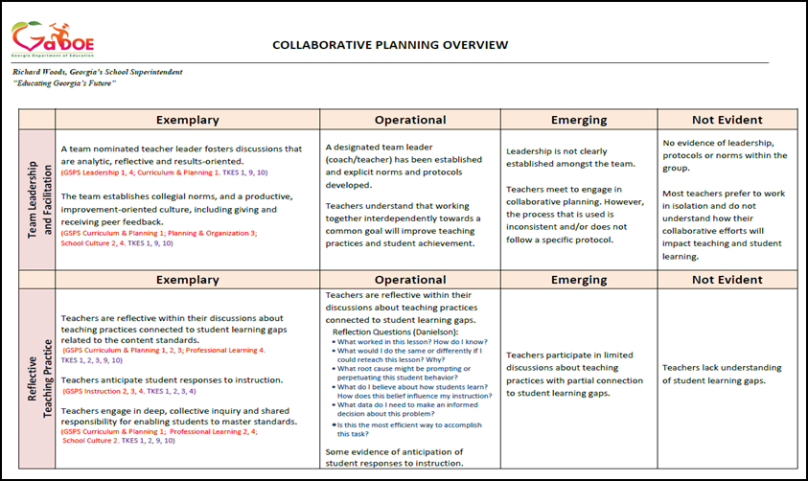
Review the Collaborative Planning Overview handout and discuss how school leaders could utilize this tool to guide their collaborative planning process.
Notes:
At your table…
Take a couple of minutes to review this tool and discuss how school’s may utilize it to guide collaborative planning.

Slide 48

How can school leaders utilize this tool to guide the collaborative planning process?
Notes:
At your table…
Take a couple of minutes to review this tool and discuss how school’s may utilize it to guide collaborative planning.

Slide 49
System of Instruction
PLAN
Prepare for Quality Instruction
Plan with a Team
Identify What Students Should Know & Do
Determine How Students Will Show They Know & Can Do
Use Planning Tools for Instruction
Notes:
The 2nd component under Plan is to Identify What Students Should Know & Do

Slide 50
Identify What Students Should Know & Do
  Use Approved Georgia State Standards
  Plan with the End In Mind
  Write Course Syllabus
  Create Learning Targets
  Identify Key Vocabulary
Notes:
Sub-sections under Identify What Students Should Know and Do are…

Slide 51
Identify What Students Should Know & Do
  Use Approved Georgia State Standards
  Plan with the End in Mind
  Write Course Syllabus
  Create Learning Targets
  Identify Key Vocabulary
Notes:
Let’s take a closer look at Create Learning Targets.

Slide 52
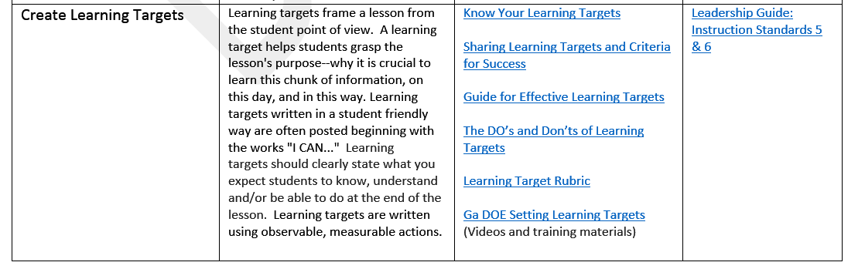
  Create Learning Targets
GaDOE Learning Targets Training Videos
Notes:
Discuss GADOE links to videos – use hyperlink to go to webpage.

Slide 53
System of Instruction
PLAN
Prepare for Quality Instruction
Plan with a Team
Identify What Students Should Know & Do
Determine How Students Will Show They Know & Can Do
Use Planning Tools for Instruction
Notes:
The third component under Plan is Determine How Students will Show They Know & Can Do

Slide 54
Determine How Students Will Show They Know & Can Do
  Develop Common Summative Assessments
  Create Common Formative Assessments
  Craft Standards-Based Performance Tasks, including a Rubric/Scoring Guide
Notes:
Sub-components include….

Slide 55
Determine How Students Will Show They Know & Can Do
  Develop Common Summative Assessments
  Create Common Formative Assessments
  Craft Standards-Based Performance Tasks, including a Rubric/Scoring Guide
Notes:
Let's look at Craft Standards-Based Performance Task tools….

Slide 56
Craft Standards-Based Performance Tasks, including a Rubric/Scoring Guide | A Performance Task is an assessment activity that requires a student to demonstrate his or her achievement of a learning target by producing a specific product (Nitko, 2001). Performance Tasks require students to: Create their responses to demonstrate their thinking Organize, interpret, evaluate, or synthesize information stored in long-term memory to solve a new problem Draw a conclusion or make a generalization and support it with evidence such as writing or illustrating to show depth of knowledge work independently (Newmann, Bryk, Nagaoka, 2001) A performance task may be a formative or summative assessment that checks for student understanding/misunderstanding and or progress toward the standards/learning goals at different points during a unit of instruction. Performance tasks involve the application of knowledge and skills rather than recall and result in tangible products or observable performances. They involve meaning making, encourage self-evaluation and revision, require judgment to score and are evaluated using predetermined criteria (rubrics). A rubric is based on a continuum of performance quality and a scale of different possible score points. A rubric identifies the following: Shows levels of quality Communicates standards Tells students expectations for assessment task Includes dimensions (criteria), indicators and a rating scale. Is NOT a checklist (yes or no answers) | GaDOE Selecting evidence based practices Creating Standards-Based Performance Tasks Teacher’s Guide to Performance Based Learning and Assessment Ch.1 Performance Assessment Links in Science http://pals.sri.com/ NETS-S Performance Tasks from Ga. Standards.org Inside Mathematics Performance Assessment Tasks http://www.insidemathematics.org/performance-assessment-tasks RDA Math Performance Task Bank http://www.rda.aps.edu/mathtaskbank/start.htm PALM: Performance Assessment Links in Math List of links to sample Performance Tasks Beyond the Bubble, History Performance Tasks Reading and Writing Project Performance tasks Biting Into the Core – Learning Assessments and Tasks Standards-based Math Rubric Rubric Maker http://rubistar.4teachers.org/ Assessment Rubrics | Leadership Guide: Instruction Standard 3 Leadership Guide: Curriculum Standard 2
Notes:
Another example of the many tools and links in the toolbox.

Slide 57
System of Instruction
PLAN
Prepare for Quality Instruction
Plan with a Team
Identify What Students Should Know & Do
Determine How Students will Show They Know & Can Do
Use Planning Tools for Instruction

Slide 58
Use Planning Tools for Instruction
Use Approved Georgia Curriculum Documents
Study Course Assessment Guides
Develop Unit Plans
Implement School-wide Instructional Frameworks
Compile Learner Profiles/Class Profiles
Create Lesson Plans Following the Schools Instructional Framework
Include Tools for Learner Differences
Choose Instructional Materials

Slide 59
System of Instruction
IMPLEMENT
Provide Quality Instruction
Direct Instruction (Opening/I Do)
Guided Practice (Transition/We Do)
Independent Practice (Work Session/You Do)
Collaborative Learning (Work Session/You Do)
Formative Assessment (Closing/We Check)

Slide 60
Instructional
Framework
TEACHERS |  | STUDENTS
I Do… Direct Instruction | Provides direct instruction Establishes goals and purposes Models Think Alouds | Actively listens Takes notes Asks clarifying questions
We Do... Guided Practice | Interactive instruction Works with students Checks, prompts, cues Provides additional modeling Meets with needs-based groups | Asks and responds to questions Works with teacher and classmates Completes process alongside each other
You Do… Independent Practice | Provide feedback Evaluates Determines level of understanding | Works alone Relies on notes, activities and classroom learning to complete assignment Takes full responsibility for outcome
You Do… Collaborative Learning | Observes and moves among groups Clarifies confusions Provide support | Works with classmates and shares outcomes Collaborates and contributes on authentic tasks Consolidates learning Completes process in small groups Looks to peers for clarification
We Check… Formative Assessment | Provide frequent prompts to check for understanding Connect knowledge to established goal or purpose Provides authentic, standards-based feedback Uses informal, formative assessments | Checks for connect of knowledge to established goal or purpose Engages in dialog (written or verbal) to ensure all expectations have been met Reflects and reviews individually after the lesson to check for retention of concepts
Meadowcreek HS, Gwinnett County adaption
Notes:
Schools must create their own Instructional Framework and Monitor implementation for consistency - creates routine for students school-wide.

Slide 61
System of Instruction
MONITOR
Ensure Student Success
Check for Understanding
Analyze: Identify Strengths & Gaps
Provide Feedback
Adjust: Intervene & Enrich

Slide 62
System of Instruction
ASSESS
Refine for Continuous Instructional Improvement
Reflect on What Did & Did Not Work
Adjust Planning, Implementation & Monitoring
Celebrate & Share Successes
Identify Next Steps

Slide 63
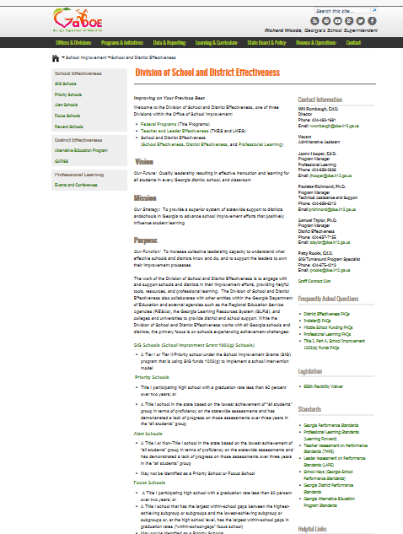
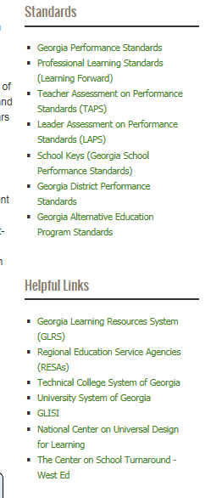
SESI Toolbox Location
Offices & Divisions
Division of School and District Effectiveness (SDE)
Right-side menu under Helpful Links
Notes:
Screen shots of SDE webpage (handout with directions)

Slide 64

How can you support your schools in developing their own effective instructional system?
How do you see the Toolbox being used by districts and schools?
What other resources would you like to see included in the Toolbox?
7 minutes:
Discuss questions
Chart answers

Slide 65

How can you support your schools in developing their own effective instructional system?
How do you see the Toolbox being used by districts and school?
What other resources would you like to see included in the Toolbox?

Slide 66


Slide 67
System for Effective
School Instruction
13th Annual Title Programs Summer Conference
Atlanta, Georgia
Will Rumbaugh, Ed.D.
Director
School and District Effectiveness
WRumbaugh@doe.k12.ga.us
404-463-1861
Dawn Ashmore, Ed.S.
School Effectiveness Specialist
School and District Effectiveness
Dashmore@doe.k12.ga.us
678-372-0791
Cheryl Hunley, Ed.S.
School Effectiveness Specialist
School and District Effectiveness
Chunley@doe.k12.ga.us
404-310-6564

