Slide 1
Best Practices for the Monthly Certification of Individuals (Teachers, Substitutes, Bus Drivers, Stipends, etc.) Paid with Federal Funds
Georgia Department of Education
13th Annual Title Programs Summer Conference
June 15-19, 2015

Slide 2
Presenters
Evelyn Maddox Ken Banter, EdD
GA Department of Education GA Department of Education
Title I Education Program Specialist Title I Education Program Specialist
Office of School Improvement Office of School Improvement
Federal Programs Division Federal Programs Division
emaddox@doe.k12.ga.us kbanter@doe.k12.ga.us
404 975-3145 478-960-2255
Ouida Freeman
Peach County Schools
Administrative Assistant
for the Director of Title Programs
ofreeman@peachschools.org
478-825-5933 – ext: 1070

Slide 3
SCHOOL IMPROVEMENT & DISTRICT EFFECTIVENESS

Slide 4
Purpose
This session is designed to provide an overview of Time and Effort in regards to using federal funds to pay for personnel costs. This session will also discuss one method for the monthly certification of individuals such as substitutes, bus drivers, teachers paid stipends, and Reward School awards who are paid using federal funds. The types of documents for certifying these individuals will also be discussed.

Slide 5
Time-and-effort reporting is important in ensuring that federal program funds are used to pay only their proportionate share of personnel costs.

Slide 6
Title I, Part A Program
Time and Effort
Time and Effort reporting is required when any part of an individual’s salary is charged to a federal program
Single Cost objective = semi annual certification
After the fact record (dated)
Signed by employee or in the absence of the employee a supervisor having direct knowledge of the employee’s work
Accounts for the total activity for which employee is compensated
Coincides with one or more pay periods (source data - sign-in sheets for payroll)
Includes substitutes, part-time employees , stipends, bus drivers

Slide 7
Documentation for Personnel Expenses 200.430(i) (The Administrator’s Handbook on EDGAR 2nd Edition pg 154)
NEW: Charges to Federal awards for salaries and wages must be based on records that accurately reflect the work performed.
How staff demonstrate allocability
If employee paid with federal funds, then must show that the employee worked on that specific federal program cost objective and be necessary and reasonable 200.403(a).

Slide 8
Who must participate? 200.430(i)(1) and (i)(4) (The Administrator’s Handbook on EDGAR 2nd Edition pg 154, 155)
Must be maintained for all employees whose salaries are:
Paid in whole or in part with federal funds
Used to meet a match/cost share requirement
NOT contractors

Slide 9
Does “X” Employee have to keep time and effort records?
Is she/he an employee?
Yes
No
I don’t know
Is she/he paid with federal funds?
Yes
No
Salary used for match?
No
Yes
T&E Required
No T&E Required
T&E Required
No T&E Required
Ask HR

Slide 10
The Prior A-87 Rule (SEAs and LEAs)
Semi-Annual Certifications
Personnel Activity Report (PAR)
If an employee works on a single cost objective:
After the fact
Account for the total activity
Signed by employee or supervisor
Every six months (at least twice a year)
If an employee works on multiple cost objectives:
After the fact
Account for total activity
Signed by employee
Prepared at least monthly and coincide with one or more pay periods

Slide 11
Documentation for Personnel Expenses 200.430(i)(1) (The Administrator’s Handbook on EDGAR 2nd Edition pg 154)
NEW: These records MUST:
Be supported by a system of internal controls which provides reasonable assurance charges are accurate, allowable and properly allocated;
Be incorporated into official records;
Reasonably reflect total activity for which employee is compensated;
Not to exceed 100-percent

Slide 12
Documentation for Personnel Expenses 200.430(i)(1) (The Administrator’s Handbook on EDGAR 2nd Edition pg 154)
Encompass all activities (federal and non-federal);
Comply with established accounting polices and practices; and
Support distribution among specific activities or cost objectives.

Slide 13
Cost Objectives 200.28 (The Administrator’s Handbook on EDGAR 2nd Edition pg 98)
Cost Objective means a…
Program, function, activity, award, organizational subdivision, contract, or work unit for which cost data are desired and for which provision is made to accumulate and measure the cost of processes, products, jobs, etc.

Slide 14
Use of Budget Estimates 200.430(i)(1)(viii) (The Administrator’s Handbook on EDGAR 2nd Edition pg 154)
Budget estimates alone do not qualify as support for charges to federal awards but may be used for interim accounting purposes if:
Produces reasonable approximations
Significant changes to the corresponding work activity are identified in a timely manner
Internal controls in place to review after-the-fact interim charges based on budget estimates

Slide 15
Reconciliation 200.430(i)(1)(viii)(C) (The Administrator’s Handbook on EDGAR 2nd Edition pg 154)
NEW: The internal controls must include processes to review after-the-fact interim charges made to a federal awards based on budget estimates. All necessary adjustment must be made such that the final amount charged to the federal award is accurate, allowable, and properly allocated.

Slide 16
Percentages 200.430(i)(1)(ix) (The Administrator’s Handbook on EDGAR 2nd Edition pg 154)
NEW: Because practices vary as to the activity constituting a full workload, records may reflect categories of activities expressed as a percentage distribution of total activities.

Slide 17
Time and Effort Guidance by Office of Chief Financial Officer? (The Administrator’s Handbook on EDGAR 2nd Edition pg 269)
Does it still apply?
It is possible to work on a single cost objective even if an employee works on more than one federal award or on a Federal award and a non-federal award.
The key to determining whether it is a single cost objective is whether the employee’s salary and wages can be supported in full from each of the federal awards on which the employee is working or from the federal award alone if the employee’s salary is also paid with non-federal funds.
http://www2.ed.gov/policy/fund/guid/gposbul/time-and-effort-reporting.html

Slide 18
Compliance 200.430(i)(2) (The Administrator’s Handbook on EDGAR 2nd Edition pg 154)
NEW: For records which meet the standards, the non-federal entity will not be required to provide additional support or documentation for the work performed.
Department of Labor (DOL) regulations for Fair Labor Standards Act must still be met (i.e. charges must be supported by records indicating the total number of hours worked each day).

Slide 19
Noncompliance 200.430(i)(8) (The Administrator’s Handbook on EDGAR 2nd Edition pg 155)
For a non-federal entity where the records do not meet these standards:
US DE may require personnel activity reports (PARs), including prescribed certifications or equivalent documentation that support the records as required in this section.
PARs are not defined!!

Slide 20
Title I, Part A Program
Time and Effort
Documentation
Monthly Certifications – Individuals who are funded from multiple funding sources can document their time and effort through monthly documentation
A sample assurance could state: For the month of October 2014 Jane Doe spent 50-percent of her time on Title I, Part A instructional activities and 50-percent of her time on general fund instructional activities as evidenced by the endorsed schedule.” One job (cost objective)

Slide 21
Time and Effort Letter to Chief State School Officers on Granting Administrative Flexibility for Better Measures of Success September 7, 2012 http://www2.ed.gov/policy/fund/guid/gposbul/time-and-effort-reporting.htm
To be eligible to document time and effort under the substitute system, employees must –
Currently work on a schedule that includes multiple activities or cost objectives that must be supported by monthly personnel activity reports;
Work on specific activities or cost objectives based on a predetermined schedule; and
Not work on multiple activities or cost objectives at the exact same time on their schedule.

Slide 22
One Method to Document Time and Effort
The following slides will examine one method to certify the personnel who are paid with federal funds. We will discuss what procedures are needed and the types of documents to collect.
Examples of these persons might include:
substitute teachers paid with federal funds
bus drivers for the after school tutoring, FLP, remediation programs
persons receiving monetary awards for working at a Reward School
teachers paid stipends for work after contractual hours such as:
after school tutoring
after school FLP
summer school remediation
professional development

Slide 23
One Method to Document Time and Effort
Identify which schools are using their Title I allocation to pay for personnel and for what purposes.
Identify those persons in your District that are paid with federal funds.
Develop process of collecting documents and who will be responsible for the collection and analysis.
Review all 400 account Program Codes (Federal Programs)
Possible Object Codes used to pay these persons:
All 100 Object Codes, 300, 580, 610, 810
Decide what documents are available to show what work was completed.

Slide 24
One Method to Document Time and Effort
Print the document from your financial software that summarizes payroll expenses such as the Detail Account Inquiry
Highlight any payroll expense paid with federal funds
Collect supporting documents (finance department, schools)
Time sheets (after school tutoring)
Pay Requests (substitutes)
Travel Expense Reports (PL)
Stipend/Award Summary Sheets (PL, Reward School bonus)
Labor History Report
Memos
Journal Entry Corrections

Slide 25
Time and Effort Time Sheet Example

Slide 26
Time and Effort Time Sheet Example

Slide 27
Time and Effort Labor History Example

Slide 28
Time and Effort Memo Example

Slide 29
Time and Effort Email Example

Slide 30
Time and Effort Labor History Example

Slide 31
Time and Effort Example of Reward School

Slide 32
One Method to Document Time and Effort
Create a spreadsheet to summarize Federally paid personnel
See the following Samples

Slide 33
Sample Summary Sheet of Time and Effort

Slide 34
Example of Completed Summary Sheet for T & E

Slide 35
One Method to Document Time and Effort
Use the Summary Sheet to create Monthly Certification form
See the following Samples

Slide 36
Monthly Certification
Example
Supervisor certifies after the fact

Slide 37
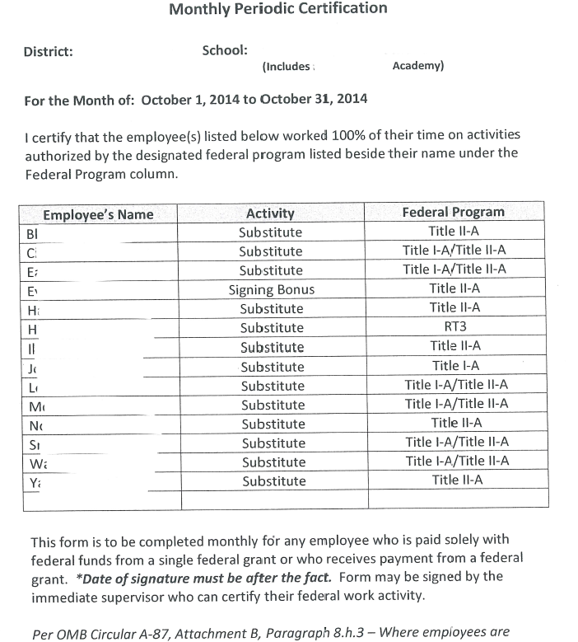
Monthly Certification
Example
Supervisor certifies after the fact

Slide 38
Semi-Annual Certification
Example

Slide 39
Benefits
Benefits
Establishment of Internal Controls for certifying federally paid personnel
Find and correct errors in a timely manner
If Google Drive is used, all documents can be scanned and then shared with the supervisor for certification to prevent documents being misplaced
Your documents can be filed monthly for upcoming cross-functional monitoring and for the auditors

Slide 40
Questions

Slide 41
Title I, Part A Program Specialists Contact Information
Area | Name | Office Telephone | Email
1 | Robyn Planchard | (404) 985-3808 | rplanchard@doe.k12.ga.us
2 | Randy Phillips | (770) 221-5232 | rphillips@doe.k12.ga.us
3 | Anthony Threat | (706) 615-0367 | anthony.threat@doe.k12.ga.us
4 | Evelyn Maddox | (404) 975-3145 | emaddox@doe.k12.ga.us
5 | Judy Alger | (229) 321-9305 | jualger@doe.k12.ga.us
6 | Grace McElveen | (912) 334-0802 | gmcelveen@doe.k12.ga.us
7 | Jimmy Everson | (229) 723-2664 | jeverson@doe.k12.ga.us

Slide 42
Title I, Part A Program Specialists’ Contact Information
Area | Name | Office Telephone | Email
8 | Marijo Pitts-Sheffield | (912) 269-1216 | mpitts@doe.k12.ga.us
9 | Kathy Pruett | (706) 540-8959 | kpruett@doe.k12.ga.us
10 | Elaine Dawsey | (478) 971-0114 | edawsey@doe.k12.ga.us
11 | Olufunke Osunkoya | (678) 704-3557 | oosunkoya@doe.k12.ga.us
12 | Bobby Trawick | (229) 246-1976 | btrawick@doe.k12.ga.us
13 | Ken Banter | (478) 960-2255 | kbanter@doe.k12.ga.us
14 | Tammy Wilkes | (478) 237-2873 | twilkes@doe.k12.ga.us

Slide 43
Best Practices for the Monthly Certification of Individuals (Teachers, Substitutes, Bus Drivers, Stipends, etc.) Paid with Federal Funds
Georgia Department of Education
13th Annual Title Programs Summer Conference
June 15-19, 2015

