Slide 1
Community Eligibility Provision (CEP), Title I, and Accountability
Georgia Department of Education
13th Annual Title Programs Summer Conference
June 15-19, 2015

Slide 2
Presenters
Ken Banter, Ed.D.
GA Department of Education
Title I Education Program Specialist
Office of School Improvement
Federal Programs Division
kbanter@doe.k12.ga.us
(478) 960-2255
Jennifer Davenport, Ed.D.
Title I, Part A Program Manager
School Improvement – Federal Programs
Georgia Department of Education
jedavenp@doe.k12.ga.us
(404) 463-1955
Evelyn Maddox, Ed.D.
GA Department of Education
Title I Education Program Specialist
Office of School Improvement
Federal Programs Division
emaddox@doe.k12.ga.us
(404) 975-3145

Slide 3
SCHOOL IMPROVEMENT & DISTRICT EFFECTIVENESS

Slide 4
Healthy, Hunger-Free Kids Act of 2010 (Act)
With the passage of the Healthy, Hunger-Free Kids Act of 2010 (Act), the National School Lunch Program now includes a new universal meal program, the Community Eligibility Provision (CEP), which is being phased in over several years by the U.S. Department of Agriculture (USDA). The CEP permits eligible schools to provide meal service to all students at no charge, regardless of economic status.

Slide 5
Implementation CEP
Implementation began in the 2011–2012 school year in local educational agencies (LEAs) in Illinois, Kentucky, and Michigan.
In the 2012–2013 school year, the USDA selected the District of Columbia, New York, Ohio, and West Virginia.
In the 2013–2014 school year Georgia was one of four states selected.
The Provision became available to all LEAs in the 2014–2015 school year.

Slide 6
Community Eligibility Provision
Uses only direct certification data, such as data from the Supplemental Nutrition Assistance Program (SNAP) or Temporary Assistance for Needy Families (TANF) program to determine the federal cash reimbursement provided by USDA.
Does not rely on annual household applications that are generally used to determine eligibility for free or reduced meals (FRM).

Slide 7
Community Eligibility Provision
A school is eligible for the CEP if at least 40-percent of its students are certified for free meals through means other than FRM applications (for example, students directly certified through SNAP).
Note: The 40 percent threshold may be determined school-by- school, by a group of schools with the LEA, or in the aggregate for the entire LEA. A percentage of 39.98 percent does NOT meet the threshold.

Slide 8
Community Eligibility Provision
To account for low-income families not reflected in the direct certification data, USDA will set meal reimbursement levels for Community Eligibility Provision schools by multiplying the percentage of students identified through the direct certification data by a multiplier established in the Act (initially, the multiplier is 1.6).

Slide 9
Community Eligibility Provision
Note: The law states that the multiplier is 1.6 through school year 2013-2014 (July 1, 2013, through June 30, 2014). After that time, Food and Nutrition Services (FNS) is permitted to change the multiplier to a number between 1.3 and 1.6 for any given fiscal year within the original four year timeframe. Otherwise, schools electing CEP will keep the same multiplier for an entire four-year cycle and do not have to implement changes to the multiplier until the next cycle if the CEP is elected again.

Slide 10
Community Eligibility Provision - Requirement
Schools must conduct direct certification once every four years. Schools may, however, conduct direct certification on a yearly basis. For the purposes of Title I, Part A, if the most current data show an increase in the percentage of enrolled students who are directly certified, the school may use that percentage for determining USDA reimbursement; if the data show a decrease, the school may continue to use the original percentage.

Slide 11
Impact on Title I, Part A
LEAs must rank its schools based on the percentage of economically disadvantaged students in each school to determine a school’s eligibility to receive Title I funds and to allocate funds to selected schools. (Section 1113 of the ESEA)
States and LEAs that receive funding under Title I must assess and report annually on the extent to which students are making progress toward meeting state academic achievement standards in reading or language arts and in mathematics. (Section 1113 of the ESEA)

Slide 12
Impact on Title I, Part A
Section 1113 of the ESEA
States and LEAs must measure and report publicly on the progress of all students and of students in various subgroups, including students who are economically disadvantaged. (Section 1113 of the ESEA)
LEAs must hold schools accountable for the achievement of subgroups. (Section 1116 of the ESEA or under ESEA flexibility for those states with an approved ESEA flexibility request)

Slide 13
Impact on Title I, Part A
To meet the requirements of ESEA, an LEA must have school-level data on individual economically disadvantaged students. In Georgia, information from the National School Lunch Program has been the source of data used to identify those students.

Slide 14
Guidance
Issues under the CEP:
CEP schools provide lunch at no charge to all students.
CEP schools may use the same direct certification percentage for up to four years, decided by the LEA.
CEP schools determine their poverty percentage based on data from students certified through means other than FRM applications (i.e., direct certification data).

Slide 15
Guidance
Issues under the CEP:
If a school within a district using the CEP option does not qualify for the CEP option, those schools will continue to use the FRM applications for free or reduced meals. In this case, a school will still continue to use the FRM application counts to determine a schools Title I allocation.

Slide 16
Guidance
Issues under the CEP:
For the purposes of Food and Nutrition Services (FNS), the identified student percentage must be established using the identified students and students enrolled with access to the program no later than April 1st of the prior year.
For the purposes of Title I, Part A, the identified student percentage must be established using the identified students and students enrolled with access to the program no later than October FTE count date of the prior year.

Slide 17
Guidance
For purposes of disaggregating assessment data by the economically disadvantaged subgroup for reporting and accountability, school officials would deem all students in a CEP school as economically disadvantaged. Accordingly, the economically disadvantaged subgroup in a CEP school would be the same as the all students group. Similarly, all students in a CEP school would be eligible for any services for which eligibility is based on poverty.

Slide 18
Annual Determination of the Eligibility of a CEP School for Title I Funds
An LEA must assume that the percentage of economically disadvantaged students in the school is proportionate to the percentage of meals for which that CEP school is reimbursed by the USDA for the same school year.
Because CEP schools conduct direct certification yearly, if data show an increase in the percentage of enrolled students eligible for direct certification, and the school therefore receives a higher level of reimbursement from USDA, then the figures used for Title I purposes would be adjusted accordingly.

Slide 19
From School Food Nutrition

Slide 20
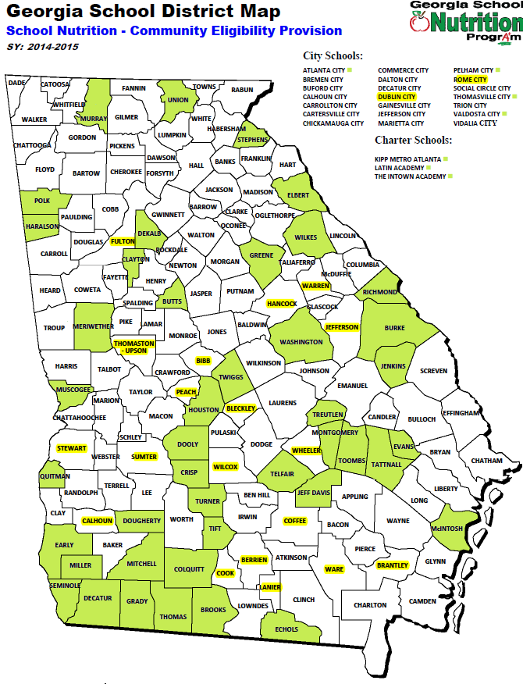
2013-14 – 51 systems
2014-15 – 72 systems
354,038 students
receiving benefits due
to CEP
Notes:
This is a map of Districts in Georgia that are participating in CEP. The first year Georgia participated which was a pilot year, was last SY13-14 - 51 systems - 455 Schools. This SY14-15 there are 72 systems 590 schools in which approximately 354, 038 students are receiving benefits.

Slide 21
Eligibility Criteria
Who are the identified students?
Supplemental Nutrition Assistance Program (SNAP)
Temporary Assistance for Needy Families (TANF)
Extended Eligibles (students “attached” to Direct Certifieds)
Matched to Official Lists
Homeless
Runaways
Migrant
Income Eligible Headstart
Foster children without an Application
Pre-K Evenstart

Slide 22
Eligibility Criteria
Enrolled Students:
Enrolled in a CEP participating school
Attending a CEP school
Has access to lunch or breakfast

Slide 23
Eligibility Criteria
School Defined:
Educational Unit – Public or nonprofit private
Single building or cluster of buildings
Private classes or preprimary grade conducted in aforementioned school

Slide 24
Important
The CEP designation is attached to the school, not the individual students in the school.

Slide 25
CEP and Title I
Determine data needed
Develop procedure and method of gathering information
Prepare training for Title I and School Nutrition
Communicate, communicate, communicate
Follow Up
Notes:
It is imperative to work with the state Title I Director, Program Manager and others that make the decisions as to how to implement the two programs together. A working relationship is imperative.
Will Title I use CEP the same in every state? NO. They have flexibility as to how to use and interpret the data. That is why it is so imperative to communicate and train. Once the training is established it is imperative to share the training and forms to be sure everyone is speaking the same language, because often we are not.

Slide 26
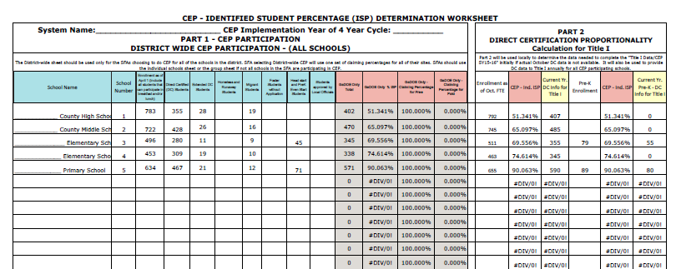
CEP- Identified Student Percentage (ISP) Determination Worksheets
Notes:
The Participation Worksheet has changed in order to allow the LEA School Food Nutrition department to provide current poverty data to Title I.
EXAMPLE OF CEP – ISP Determination Worksheet
The CEP-ISP Determination Worksheet has two parts, Part 1 and Part 2. The instructions state in Part 1 that this section is for determining Identified Student Percentages (ISPs) for schools as well as district and grouping ISPs depending on the sheet in the workbook selected. Part 2 is the Direct Certification Proportionality Calculation for Title I.
This is an example of a system that has chosen to go District Wide CEP. NOTE the ISP per school…..
But you also can see that the system wide free claiming percentage is 100%.
LEA School Food Nutrition Directors were informed in February that it is extremely important that the documentation used to complete this worksheet is kept five years plus the current year after the last year of the four year cycle for auditing purposes.

Slide 27
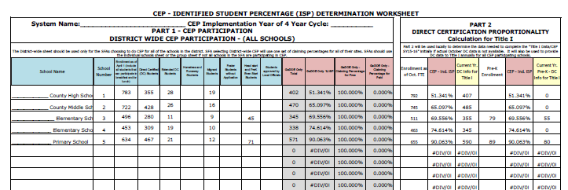
Part 2 – Direct Certification Proportionality Calculation Title I
Notes:
Let’s look at the CEP-ISP Determination Worksheet again, along with Georgia CEP and Title I for SY 16, Instructions for form determining Title I data and the Title I Data Form SY16.
Title I and CEP . CEP data needs to be collected April 1 of the year preceding implementation. Title I however needs data from October of the year preceding the implementation of CEP. The easiest and best way to gather this information is in October of the year preceding implementation if software can produce the data needed and if the system is considering CEP as an alternative to free and reduced meal applications.
If that information is NOT available now refer to HO –Instructions for completing Title I and CEP Data. The new CEP – ISP Determination Worksheet Part 2 – Direct Certification Proportionality – Calculation for Title I – It states that Part 2 will be used locally to determine the data needed to complete the “Title I Data/CEP SY15-16” initially if actual October DC data is not available. It will also be used to provide DC data to Title I annually for all CEP participating schools.

Slide 28
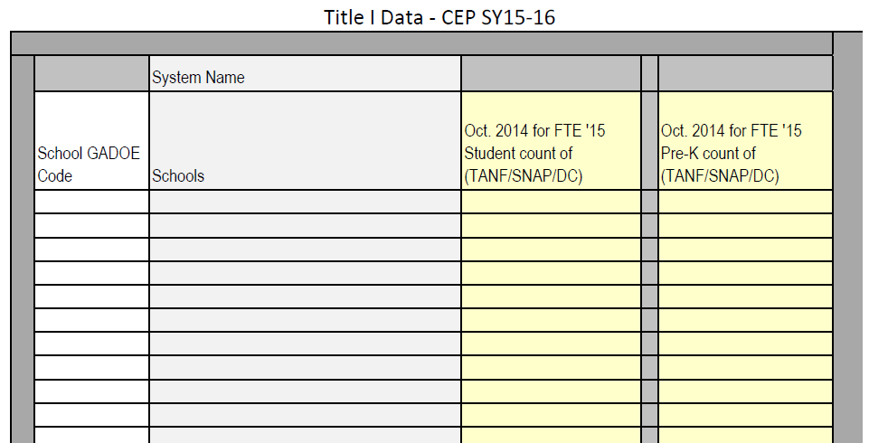
Title I Data Form SY16
Notes:
Title I Data – CEP SY15-16 Left hand side
Now What goes in the form? School Code, School Name, total DC’s of the FTE Oct. Enrollment for individual school and the DC’s of total Pre-K count for each individual school.
This is the only form that SNP gives to Title I. Let’s see where the numbers come from to enter into this form.
Enter information into a form on the screen. Show how the proportionality calculation works.

Slide 29
Allocations
An LEA has options in how it derives this metric. One approach is for the LEA to multiply the number of students identified by direct certification in a school by the 1.6 multiplier and divide by the enrollment in the school.

Slide 30
Allocations
A second approach is for the LEA to rank all of its schools solely on the basis of the percentage of students directly certified through SNAP (or another direct certification measure available annually) in both CEP and non-CEP schools. (Because all schools, not just CEP schools, must directly certify students through SNAP, an LEA should have direct certification data for each of its schools.)

Slide 31
Combination of CEP Schools and Non-CEP Schools
District: | EFG County |  |  |  |  |  |  |  |  |  |  | FY | 2015
Column 1 |  | Column 2 | Column 3 | Column 4 | Column 5 | Column 6 | Column 7 | Column 8 | Column 9 | Column 10 | Column 11 | Column 12 | Column 13 | Column 14 | Column 15 | Column 16
School |  | Community Eligibility Provision School (Y/N) | Grade Span | Total Enrollment | Pre-K Enrollment | Total Enrollment Minus Pre-K | If Column 2 = N, Total Free/ Reduced Meals Count; If Column 2 =Y, TANF, SNAP Directly Certified | If Column 2 = N, PK Free/ Reduced Meals Count; If Column 2 =Y, PK TANF, SNAP Directly Certified | Economically Disadvantaged Students Identified by Data for School Lunch Program Minus Pre-K (CEP or Household Applications) | Multiplier (1.6) | Column 10 * Column 9 if CEP =Y; Column 9 if CEP =N) | Number Used to Determine Percentage of Meals Paid by USDA (For CEP--Column 9 * Column 10; Otherwise, Column 9) | % of Economically Disadvantaged Students for Title I Allocation | % Directly Certified--Greene County Used to Determine the Rank Order for the LEA's Title I Schools | PPA | School Allocation PPA times Column 9
Lincoln |  | Y | 9-12 | 425 | 0 | 425 | 400 | 0 | 400 | 1.6 | 640 | 425 | 100.00% | 94.12% |  | $0
Washington |  | N | 6-8 | 500 | 0 | 500 | 475 | 0 | 475 | N/A | 475 | 475 | 95.00% | 95.00% |  | $0
Adams |  | Y | 3-5 | 600 | 0 | 600 | 350 | 0 | 350 | 1.6 | 560 | 560 | 93.33% | 58.33% |  | $0
Jefferson |  | N | K-2 | 450 | 0 | 450 | 400 | 0 | 400 | N/A | 400 | 400 | 88.89% | 88.89% |  | $0
Madison |  | N | K-5 | 400 | 0 | 400 | 200 | 0 | 200 | N/A | 200 | 200 | 50.00% | 50.00% |  | $0
Monroe |  | N | 6-8 | 500 | 0 | 500 | 100 | 0 | 100 | N/A | 100 | 100 | 20.00% | 20.00% |  | $0
District Total |  |  |  | 2875 | 0 | 2875 |  |  | 1925 |  |  | 2160 | 75.13% | 66.96% |  | 0

Slide 32
LEAs with All CEP Schools
If an LEA has all CEP schools, does it need to apply the 1.6 multiplier for Title I ranking and allocation purposes?
No. If an LEA has all CEP schools, the LEA may rank its schools by the percentage of directly certified students in each school, even though the multiplier is used to determine the USDA reimbursement amount.

Slide 33
All CEP Schools
District: | ABC County |  |  |  |  |  |  |  |  |  |  | FY | 2015
Column 1 |  | Column 2 | Column 3 | Column 4 | Column 5 | Column 6 | Column 7 | Column 8 | Column 9 | Column 10 | Column 11 | Column 12 | Column 13 | Column 14 | Column 15 | Column 16
School |  | Community Eligibility Provision School (Y/N) | Grade Span | Total Enrollment | Pre-K Enrollment | Total Enrollment Minus Pre-K | If Column 2 = N, Total Free/ Reduced Meals Count; If Column 2 =Y, TANF, SNAP Directly Certified | If Column 2 = N, PK Free/ Reduced Meals Count; If Column 2 =Y, PK TANF, SNAP Directly Certified | Economically Disadvantaged Students Identified by Data for School Lunch Program Minus Pre-K (CEP or Household Applications) | Multiplier (1.6) | Column 10 * Column 9 if CEP =Y; Column 9 if CEP =N) | Number Used to Determine Percentage of Meals Paid by USDA (For CEP--Column 9 * Column 10; Otherwise, Column 9) | % of Economically Disadvantaged Students for Title I Allocation | % Directly Certified--Greene County Used to Determine the Rank Order for the LEA's Title I Schools | PPA | School Allocation PPA times Column 9
ABC Co. High School |  | Y | 9-12 | 985 | 0 | 985 | 495 | 0 | 495 | 1.6 | 792 | 792 | 80.41% | 50.25% |  | $0
ABC Co. Middle School |  | Y | 6-8 | 958 | 0 | 958 | 573 | 0 | 573 | 1.6 | 916.8 | 917 | 95.70% | 59.81% |  | $0
ABC Co. Elem School |  | Y | 3-5 | 618 | 0 | 618 | 398 | 0 | 398 | 1.6 | 636.8 | 618 | 100.00% | 64.40% |  | $0
ABC Co. primary School |  | Y | k-2 | 805 | 0 | 805 | 538 | 0 | 538 | 1.6 | 860.8 | 805 | 100.00% | 66.83% |  | $0
 |  |  |  |  |  | 0 |  |  | 0 |  | 0 |  | #VALUE! | #DIV/0! |  | $0
 |  |  |  |  |  |  |  |  |  |  |  |  |  |  |  | $0

Slide 34
More Than One School at 100-Percent
If the application of the 1.6 multiplier results in more than one school at 100-percent poverty, must an LEA allocate the same per-pupil amount to each of these schools?
Not necessarily. At its discretion, an LEA may take into consideration the direct certification poverty percentage of each of these schools.

Slide 35
More Than One School at 100-Percent
Under 34 C.F.R. § 200.78(c), an LEA is not required to allocate the same per-pupil amount to each participating school, as long as it allocates higher per-pupil amounts for schools with higher concentrations of poverty than to schools with lower concentrations of poverty. In the case of an LEA that has more than one CEP school at 100-percent poverty by virtue of the 1.6 multiplier but the schools have different direct certification percentages, the LEA may allocate a greater per-pupil amount for the 100-percent school with the higher percentage of directly certified students because the direct certification data indicate that the school has a higher concentration of poverty than the other 100-percent schools.

Slide 36
More Than One School at 100-Percent
In other words, the direct certification data may be used to differentiate among multiple CEP schools with a 100-percent poverty rate. In order to differentiate among these schools based on the most current data, an LEA may wish to use annual direct certification data and update the rankings as appropriate even if the data are not updated during the four-year period for CEP purposes.
To ensure that it complies with 34 C.F.R. § 200.78(c), an LEA must make sure that the 100-percent CEP schools receive at least as much per pupil as CEP and non-CEP schools with poverty rates below 100-percent.

Slide 37
More Than One School at 100-Percent
A non-CEP school with a 95-percent poverty rate may not receive more per-pupil funding than a CEP school with a 100-percent poverty rate by virtue of the 1.6 multiplier. To ensure that it complies with 34 C.F.R. § 200.78(c), an LEA must make sure that the 100-percent CEP schools receive at least as much per pupil as CEP and non-CEP schools with poverty rates below 100-percent.
If two CEP schools have the same direct certification rate, they must be provided the same per-pupil allocation.

Slide 38
More Than One School at 100-Percent
District: | JKL County |  |  |  |  |  |  |  |  |  |  | FY | 2014
Column 1 |  | Column 2 | Column 3 | Column 4 | Column 5 | Column 6 | Column 7 | Column 8 | Column 9 | Column 10 | Column 11 | Column 12 | Column 13 | Column 14 | Column 15 | Column 16
School |  | Community Eligibility Provision School (Y/N) | Grade Span | Total Enrollment | Pre-K Enrollment | Total Enrollment Minus Pre-K | If Column 2 = N, Total Free/ Reduced Meals Count; If Column 2 =Y, TANF, SNAP Directly Certified | If Column 2 = N, PK Free/ Reduced Meals Count; If Column 2 =Y, PK TANF, SNAP Directly Certified | Economically Disadvantaged Students Identified by Data for School Lunch Program Minus Pre-K (CEP or Household Applications) | Multiplier (1.6) | Column 10 * Column 9 if CEP =Y; Column 9 if CEP =N) | Number Used to Determine Percentage of Meals Paid by USDA (For CEP--Column 9 * Column 10; Otherwise, Column 9) | % of Economically Disadvantaged Students for Title I Allocation | % Directly Certified--Greene County Used to Determine the Rank Order for the LEA's Title I Schools | PPA | School Allocation PPA times Column 9
Miller Middle |  | Y | 6-8 | 342 | 0 | 342 | 228 | 0 | 228 | 1.6 | 364.8 | 342 | 100.00% | 66.67% | 670 | $152,760
JKL County High |  | Y | 9-12 | 545 | 0 | 545 | 314 | 0 | 314 | 1.6 | 502.4 | 502 | 92.18% | 57.61% | 24 | $7,536
2nd Street Elementary |  | Y | K-5 | 642 | 120 | 522 | 481 | 98 | 383 | 1.6 | 612.8 | 522 | 100.00% | 73.37% | 998 | $382,234
Big Apple Elementary |  | Y | K-7 | 364 | 0 | 364 | 251 | 0 | 251 | 1.6 | 401.6 | 364 | 100.00% | 68.96% | 962 | $241,462
Lake Wobegone Elementary |  | Y | K-8 | 321 | 22 | 299 | 44 | 5 | 39 | 1.6 | 62.4 | 62 | 20.87% | 13.04% | 0 | $0
 |  |  |  |  |  | 0 |  |  | 0 |  | 0 |  | #VALUE! | #DIV/0!
 |  |  |  |  |  | 0 |  |  | 0 |  | 0 |  | #VALUE! | #DIV/0!
 |  |  |  |  |  | 0 |  |  | 0 |  | 0 |  | #VALUE! | #DIV/0!
District Total |  |  |  | 2214 | 142 | 2072 |  |  | 1215 |  |  | 1793 | 86.53% | 58.64%

Slide 39
LEAs Electing to Group CEP Schools
If an LEA chooses to group CEP schools to determine the reimbursement rate from USDA, does each school in a group then have the same poverty percentage for Title I ranking and allocation purposes?
No. Schools may be grouped to determine the USDA reimbursement rate. Under section 1113 of the ESEA, however, an LEA with an enrollment of at least 1,000 students must rank schools individually for ranking and allocation purposes. Thus, if an LEA groups schools in order for them to be eligible for CEP or to maximize CEP reimbursement, the LEA must still use the CEP data, either alone or multiplied by the 1.6 multiplier, for each individual school for Title I ranking and allocation purposes.

Slide 40
LEAs Electing to Group CEP Schools
For example:
School 1 has 425 enrolled students, of whom 400 are directly certified. By virtue of the 1.6 multiplier, the school’s poverty rate is 100-percent (400 directly certified students x the 1.6 multiplier = 680 (greater than the school’s enrollment of 425 students)).
School 2 has 600 students, of whom 350 are directly certified. By virtue of the 1.6 multiplier, the school’s poverty rate is 93-percent (350 directly certified students x the 1.6 multiplier = 560 divided by the enrollment of 600 = 93-percent).

Slide 41
LEAs Electing to Group CEP Schools
For USDA reimbursement, the LEA may combine the data for School 1 and School 2, resulting in a reimbursement rate of 100-percent for the schools as a group. (The reimbursement rate is 100-percent because: 750 directly certified students divided by the enrollment of 1,025 = 73.1-percent x 1.6 = 100-percent reimbursement.)
For Title I ranking and allocation purposes, however, the LEA must use the individual school percentages (School 1 = 100-percent; School 2 = 93-percent).

Slide 42
Cutoff Above Which Title I-Eligible Schools Are Served
If an LEA has traditionally established a cutoff above which Title I-eligible schools are served, does the LEA have any options if the use of CEP data increases the number of schools above the cutoff?
Yes, an LEA has several options. One option, and perhaps the most straightforward option, is for an LEA to raise its cutoff point. For example, if an LEA’s policy was to serve all schools above 60-percent poverty, the LEA could choose to serve schools above a higher poverty percentage (e.g., 67-percent).

Slide 43
Cutoff Above Which Title I-Eligible Schools Are Served
For the sole purpose of within-district Title I allocations, a second option would be for an LEA to use, as authorized by section 1113(a)(5) of the ESEA, another allowable poverty measure or combination of measures to rank its schools that might result in fewer schools above its cutoff.

Slide 44
Equitable Services
Does CEP change the guidance [Title I Services to Eligible Private School Children (Oct. 17, 2003)] on how an LEA allocates Title I funds to provide equitable services to eligible private school students?
No. The requirements described in that guidance have not changed. This guidance describes how the requirements can be met when NSLP data are comprised in whole or in part of CEP data.

Slide 45
Equitable Services
Is an LEA’s collection of poverty data on private school students affected by CEP data?
Possibly. After consultation and considering the views of private school officials, an LEA must identify the method it will use to determine the number of private school children from low-income families who reside in participating public school attendance areas. These methods include: (1) using the same poverty measure used by the LEA to count public school students (e.g., NSLP data);
(2) using comparable poverty data from a survey of private school families and extrapolating the results from a representative sample if complete actual data are unavailable;
(3) using comparable poverty data from a different source;

Slide 46
Equitable Services
4) applying the low-income percentage of each participating public school attendance area to the number of private school students who reside in each area (i.e., proportionality); and
(5) using an equated measure of low income correlated with the measure of low income used to count public school students. (See section 1120(c)(1) of the ESEA; 34 C.F.R. § 200.78(a)(2).) The method an LEA selects, after consultation with private school officials, will determine whether CEP data are relevant.

Slide 47
Equitable Services
If a private school is a CEP school, does every child in the private school automatically generate Title I funds for equitable services?

Slide 48
Equitable Services
No. As indicated in Section B of the Title I Equitable Services Guidance, Title I funds are generated to provide equitable services to eligible private school students on the basis of private school students from low-income families who reside in participating public school attendance areas and not on the basis of all students in a private school. Accordingly, even if a private school is a CEP school and all students in the school qualify for free meals, only those students who reside in a participating public school attendance area would generate funds with which an LEA would provide equitable services. If an LEA counts only directly certified students in participating public school attendance areas for Title I allocations to public schools, then only directly certified students in a CEP private school who reside in those areas would generate funds for equitable services.

Slide 49
Equitable Services
After consultation with private school officials, if an LEA chooses to use proportionality to calculate the amount generated for equitable services and a CEP public school’s poverty percentage for within-district Title I allocations is 100-percent, will every student in the private school that resides within the school’s attendance area generate funds for equitable services?
Yes.

Slide 50
Title I Accountability
How does CEP affect Title I accountability?
To meet some reporting and accountability requirements, an SEA or LEA must have data on individual economically disadvantaged students.

Slide 51
Title I Accountability
For example, each SEA and LEA that receives funding under Title I must assess and report annually on the extent to which the subgroup of economically disadvantaged students is making progress toward meeting the State’s academic achievement standards in reading/language arts, mathematics, and science. Moreover, an LEA must hold schools accountable for the achievement of this subgroup, whether under section 1116 of the ESEA or under ESEA flexibility for those states with an approved ESEA flexibility request.

Slide 52
Title I Accountability
How does CEP affect Title I accountability?
Finally, under section 1116 of the ESEA, an LEA must offer priority for public school choice to economically disadvantaged students in any school identified for improvement, corrective action, or restructuring and supplemental educational services to any economically disadvantaged student who attends a school that is in the second year of school improvement, in corrective action, or in restructuring (these requirements have been waived under ESEA flexibility). For most LEAs, NSLP data, including CEP data, may be the best source to identify individual economically disadvantaged students.

Slide 53
Title I Accountability
How may economically disadvantaged students in a CEP school be identified for accountability?
Although for NSLP purposes a CEP school may maintain the same reimbursement rate over four years and therefore would not need to update its direct certification count, an SEA may wish its LEAs to use the most recently available direct certification data for other purposes, such as Title I. One such Title I purpose is the disaggregation of assessment data by the economically disadvantaged subgroup for reporting and accountability.

Slide 54
Title I Accountability
With respect to this purpose, an SEA may prefer to include only identified students to ensure that the subgroup includes only students who are economically disadvantaged. Accordingly, an SEA may decide that only directly certified students would be eligible for any services for which eligibility is based on poverty (such as SES under section 1116 of the ESEA). To the extent that survey data are available, the SEA may also use those data to identify students in the economically disadvantaged subgroup.

Slide 55
Title I Accountability
Finally, because CEP schools generally have higher poverty levels than other schools and consequently have a smaller number of students who would not be deemed economically disadvantaged if poverty data were available for each student in the school, an SEA may elect to base reporting and accountability on all students in a CEP school. In this case, the economically disadvantaged subgroup would be the same as the “all students” group and all students in the school would then be eligible for any services for which eligibility is based on poverty.

Slide 56
Things That Have Not Changed
LEAs must annually, rank without regard to grade spans. Eligible school attendance areas in which the concentration of children from low-income families that exceeds 75-percent from highest to lowest according to the percentage of children from low-income families.
LEAs must serve eligible school attendance areas in rank order.
LEAs may either rank schools districtwide or by grade span grouping.

Slide 57
What Questions Do You Have?

Slide 58
Title I, Part A Program Specialists’ Contact Information
Area | Name | Office Telephone | Email
1 | Robyn Planchard | (404) 985-3808 | rplanchard@doe.k12.ga.us
2 | Randy Phillips | (770) 221-5232 | rphillips@doe.k12.ga.us
3 | Anthony Threat | (706) 615-0367 | anthony.threat@doe.k12.ga.us
4 | Evelyn Maddox | (404) 975-3145 | emaddox@doe.k12.ga.us
5 | Judy Alger | (229) 321-9305 | jualger@doe.k12.ga.us
6 | Grace McElveen | (912) 334-0802 | gmcelveen@doe.k12.ga.us
7 | Jimmy Everson | (229) 723-2664 | jeverson@doe.k12.ga.us

Slide 59
Title I, Part A Program Specialists’ Contact Information
Area | Name | Office Telephone | Email
8 | Marijo Pitts-Sheffield | (912) 269-1216 | mpitts@doe.k12.ga.us
9 | Kathy Pruett | (706) 540-8959 | kpruett@doe.k12.ga.us
10 | Elaine Dawsey | (478) 971-0114 | edawsey@doe.k12.ga.us
11 | Olufunke Osunkoya | (678) 704-3557 | oosunkoya@doe.k12.ga.us
12 | Bobby Trawick | (229) 246-1976 | btrawick@doe.k12.ga.us
13 | Ken Banter | (478) 960-2255 | kbanter@doe.k12.ga.us
14 | Tammy Wilkes | (478) 237-2873 | twilkes@doe.k12.ga.us

Slide 60
Presenters
Ken Banter, Ed.D.
GA Department of Education
Title I Education Program Specialist
Office of School Improvement
Federal Programs Division
kbanter@doe.k12.ga.us
(478) 960-2255
Jennifer Davenport, Ed.D.
Title I, Part A Program Manager
School Improvement – Federal Programs
Georgia Department of Education
jedavenp@doe.k12.ga.us
(404) 463-1955
Evelyn Maddox, Ed.D.
GA Department of Education
Title I Education Program Specialist
Office of School Improvement
Federal Programs Division
emaddox@doe.k12.ga.us
(404) 975-3145

Slide 61
Community Eligibility Provision (CEP), Title I, and Accountability
Georgia Department of Education
13th Annual Title Programs Summer Conference
June 15-19, 2015

