Slide 1
Changing Face of a Nation
June, 2015

Slide 2
Speaker
 | Gerson D. Vasquez Data Dissemination Specialist Media Relations U.S. Census Bureau gerson.d.vasquez@census.gov 770.543.9900
Notes:
Once again, I am Gerson Vasquez with the Atlanta Region of the U.S. Census Bureau, joined by Nesreen Khashan, my colleague who covers the D.C. area, among other assignments.
Along with our team named here, we comprise the data dissemination initiative…which is to say, that we sort of serve as your tour guide to and within our various data sets on census.gov.

Slide 3
National Level Stats
Current Population Survey
Survey of Income and Program Participation
American Housing Survey
Building Permits Survey
Foreign Trade Statistics
Notes:
There is a lot of information on the national level that provides detail at the national level that is not available at the local level. For example the national income and poverty rates come from the Current Population Survey, but you can also find this information for your area through other surveys.

Slide 4
Local Area Stats
American Community Survey
Population Estimates
County Business Patterns
Census (decennial census history)
Economic Census
Notes:
The Census Bureau releases statistics from many different sources that can be localized to small areas. We will discuss each, beginning with the American Community Survey.

Slide 5
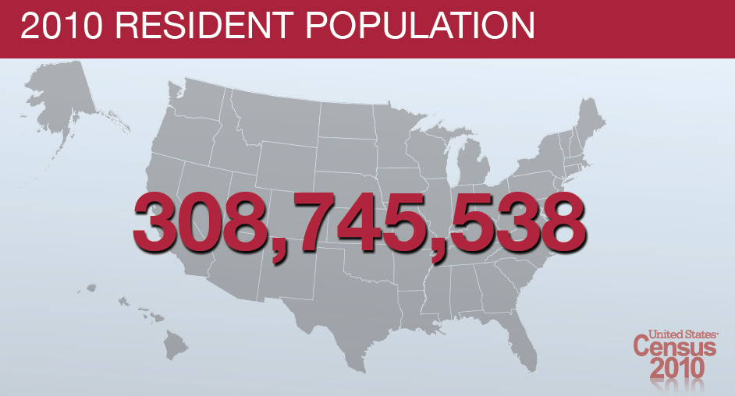
The National Count
318,857,056

Slide 6
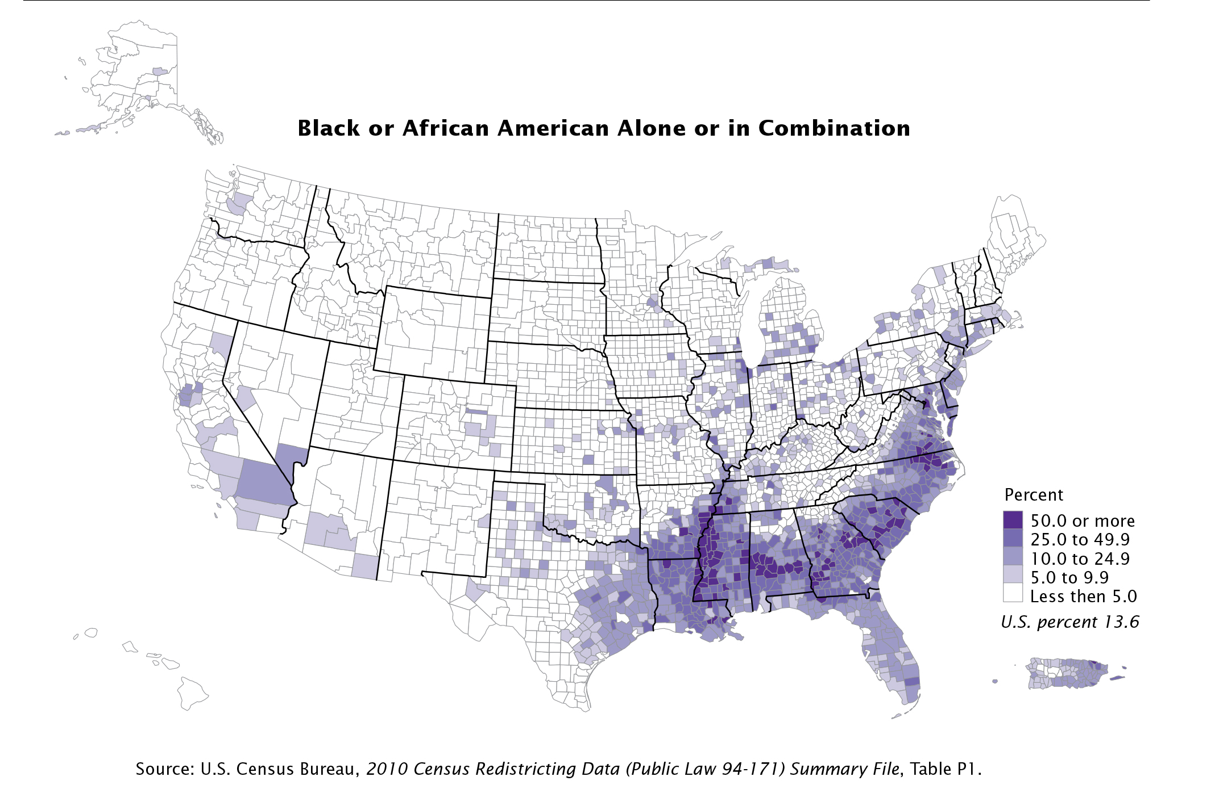

Slide 7
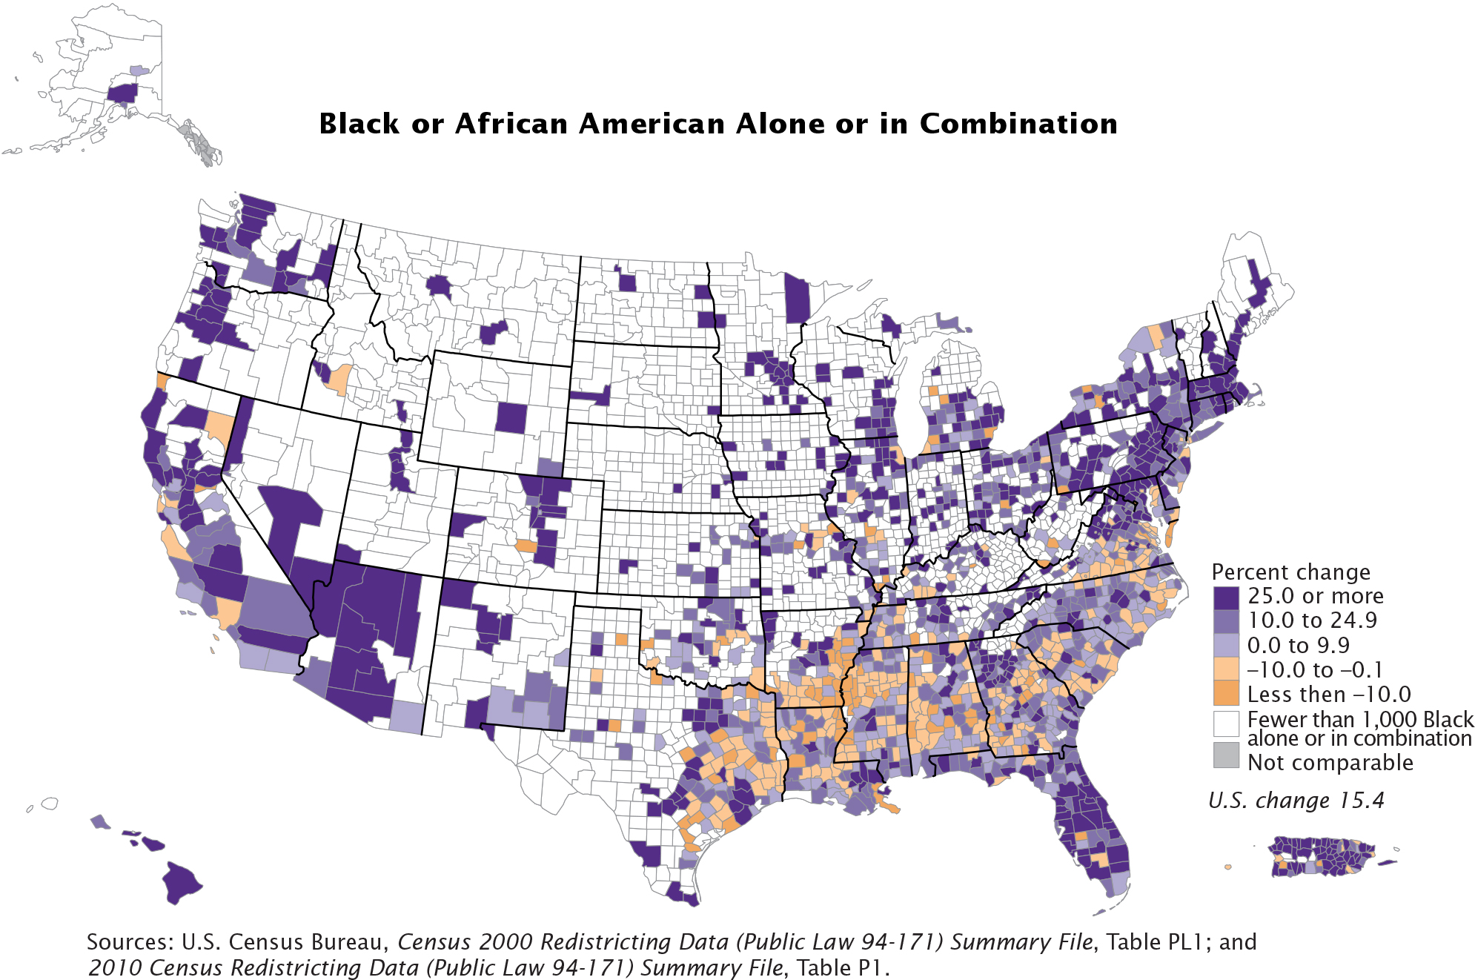

Slide 8
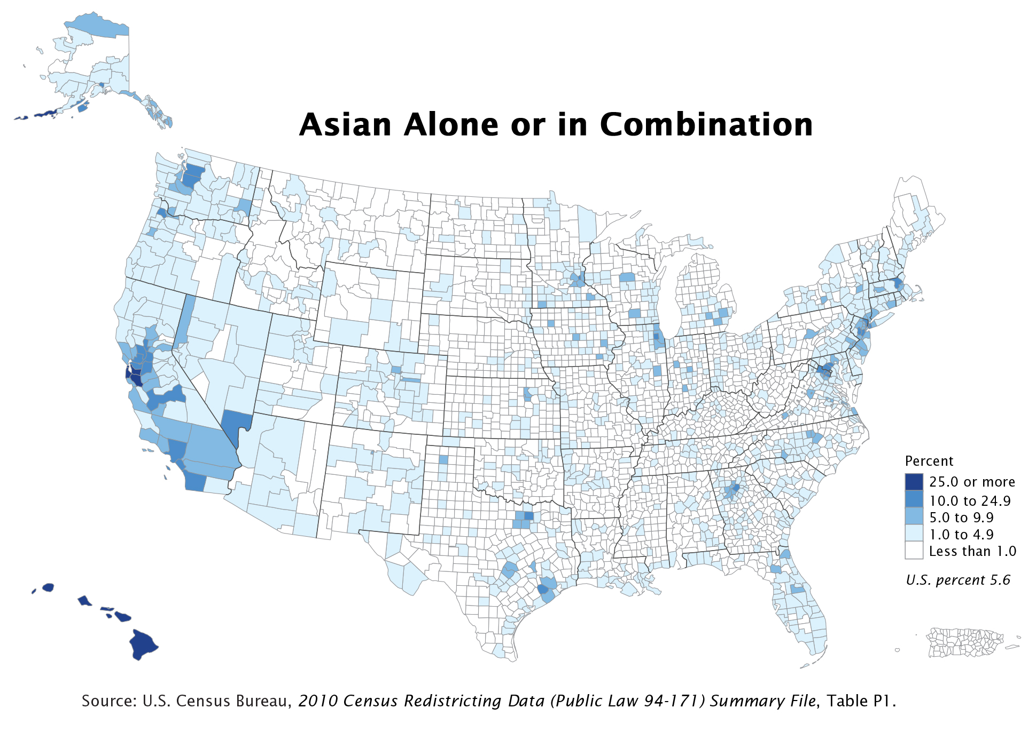

Slide 9
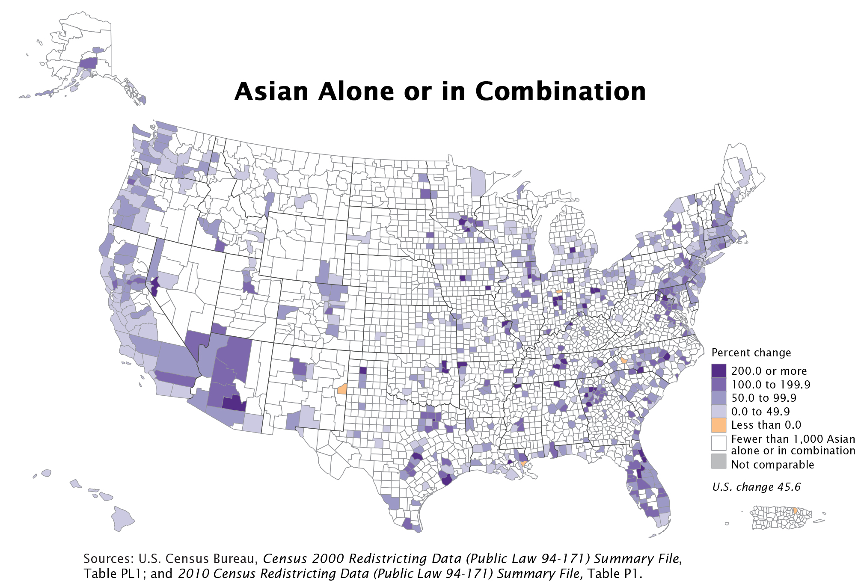

Slide 10
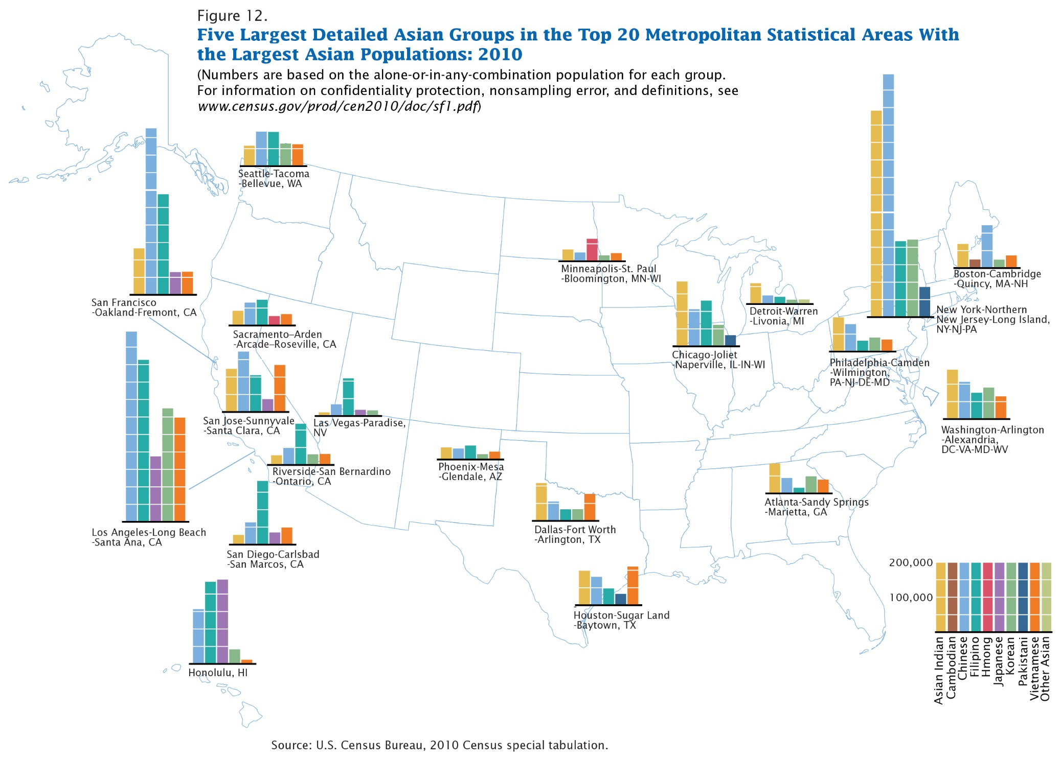

Slide 11
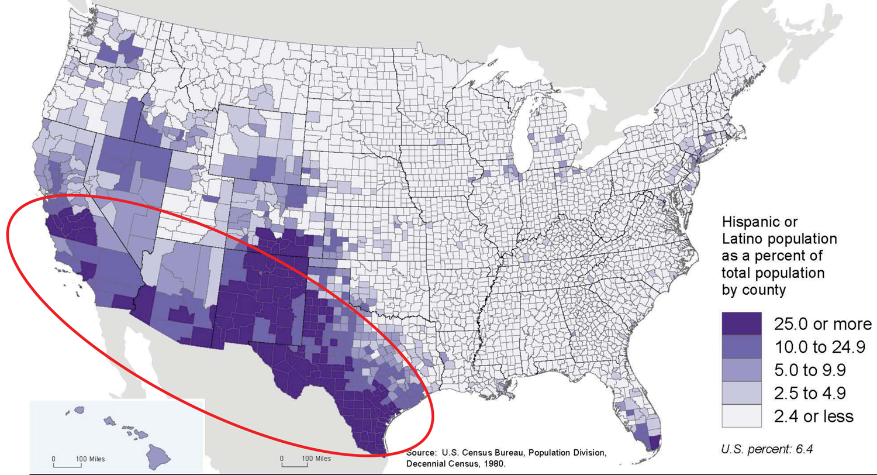
Census 1980 Geographic Distribution - Hispanic Population
Notes:
Source: U.S. Census Bureau

Slide 12
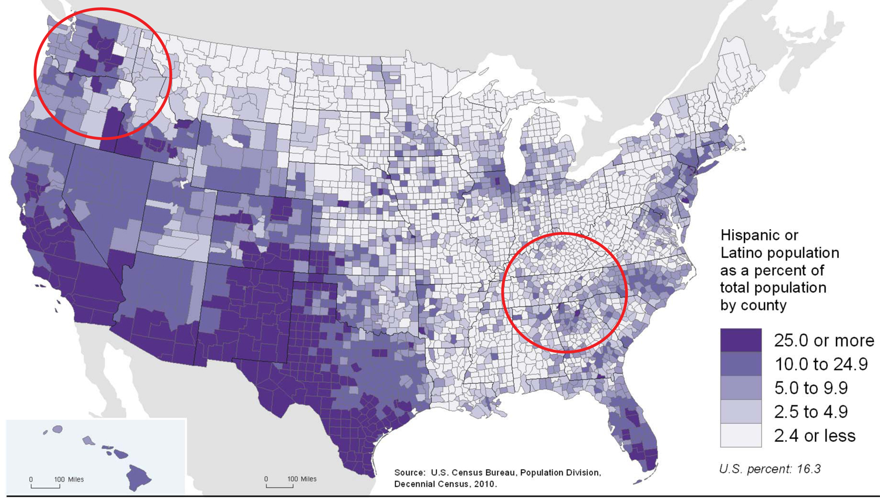
2010 Census Geographic Distribution - Hispanic Population
Notes:
Source: U.S. Census Bureau

Slide 13
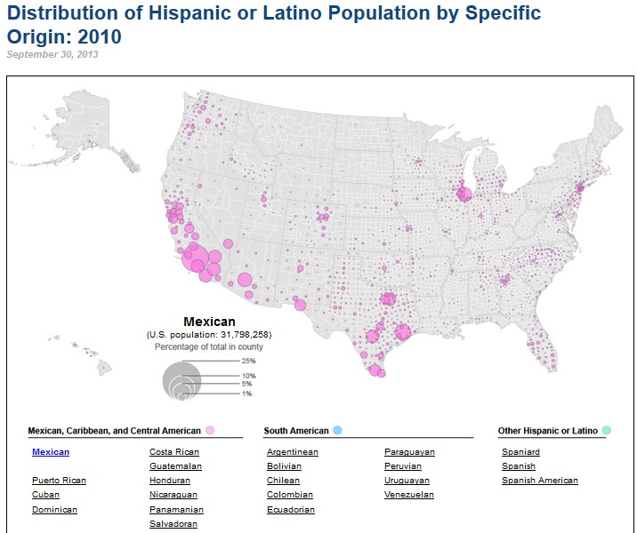
Notes:
http://www.census.gov/dataviz/visualizations/072/

Slide 14
Notes:
Many slides were borrowed from recent press release links (http://www.census.gov/newsroom.html) and from slides presented on the C-SPAN By The Numbers: http://www.census.gov/newsroom/cspan.All.html

Slide 15
Notes:
Many slides were borrowed from recent press release links (http://www.census.gov/newsroom.html) and from slides presented on the C-SPAN By The Numbers: http://www.census.gov/newsroom/cspan.All.html

Slide 16
36
28
33
Notes:
Table Link: http://factfinder2.census.gov/bkmk/table/1.0/en/PEP/2013/PEPASR6H?slice=hisp~nhisp!year~est72013
Many slides were borrowed from recent press release links (http://www.census.gov/newsroom.html) and from slides presented on the C-SPAN By The Numbers: http://www.census.gov/newsroom/cspan.All.html

Slide 17
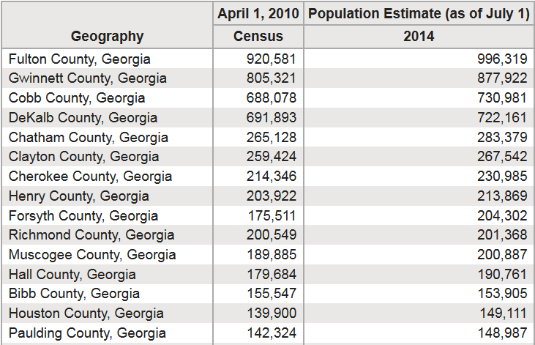
2014 Population Estimates
Notes:
Table Link: http://factfinder.census.gov/bkmk/table/1.0/en/PEP/2014/PEPANNRES/0400000US13.05000

Slide 18
Gwinnett | ranking the diversity within Georgia
#1
Hispanic or Latino Population
Asian Population
#1
#3
Black or African American Population

Slide 19
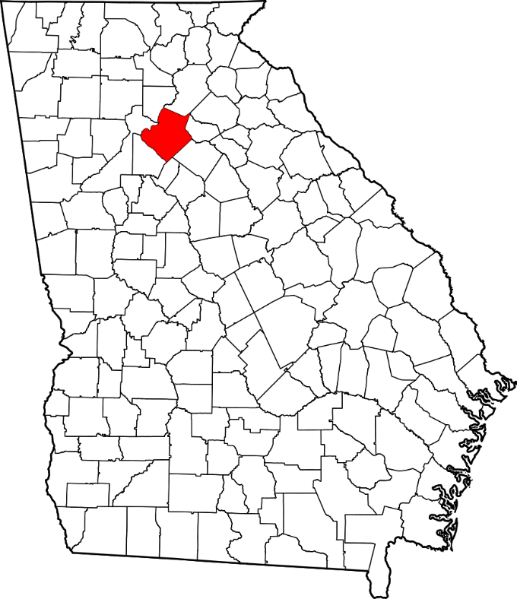
Gwinnett County, Georgia
2010 Census counted – 805,321
2014 Population Estimate– 877,922
Land area in square miles – 430.38
Persons per square mile – approx. 2,000

Slide 20
Gwinnett County, Georgia
American Community Survey (ACS)
Social Characteristics
Economic Characteristics
Housing Characteristics
Demographic Characteristics

Slide 21
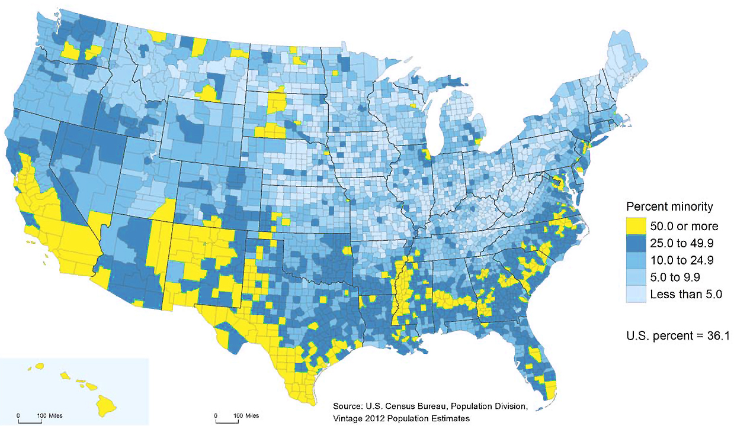
Gwinnett | one of the 11% of Majority-Minority Counties
1

Slide 22
Gwinnett | 42% are White Non-Hispanic
25% Black or African American
11% Asian or Native Hawaiian & Other Pacific Islander
20% Hispanic or Latino (of any race)

Slide 23
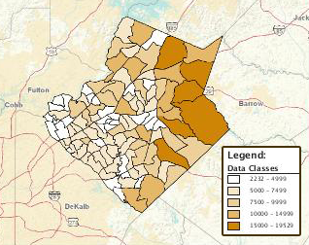
Gwinnett | 2nd most populated county within Georgia
2

Slide 24
Gwinnett | even more diversity figures
26% Foreign born persons
33% Speak language other than English at home
28% Persons under 18 years
8% Persons 65 years and over
51% Female persons

Slide 25
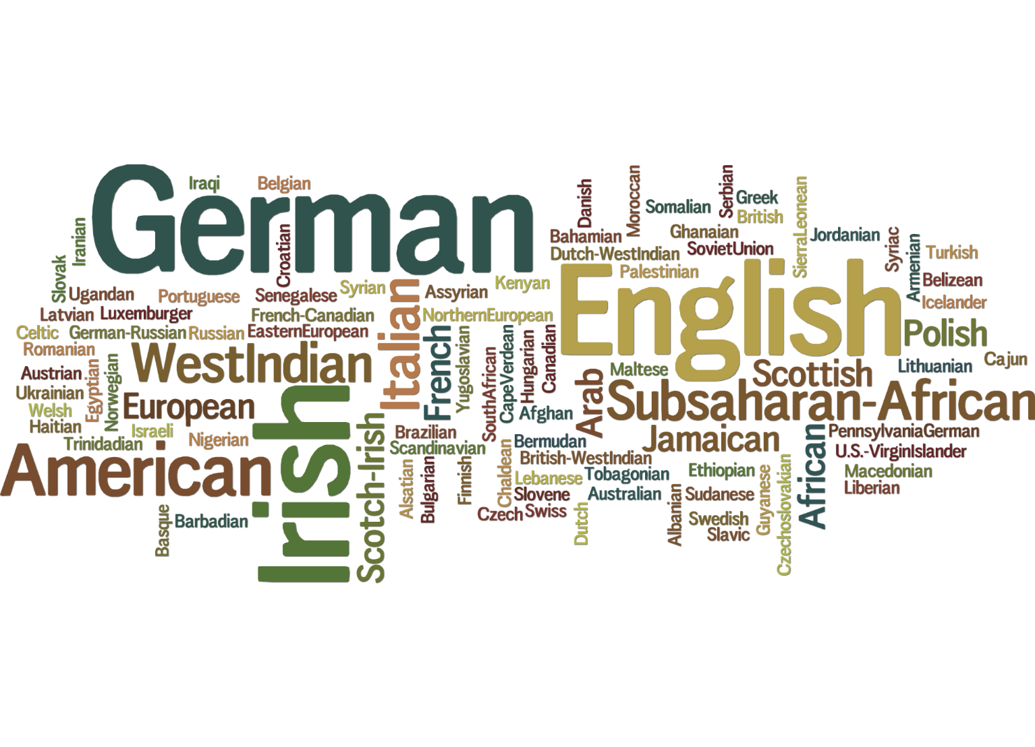
Gwinnett | over 100 ancestries reported
100

Slide 26
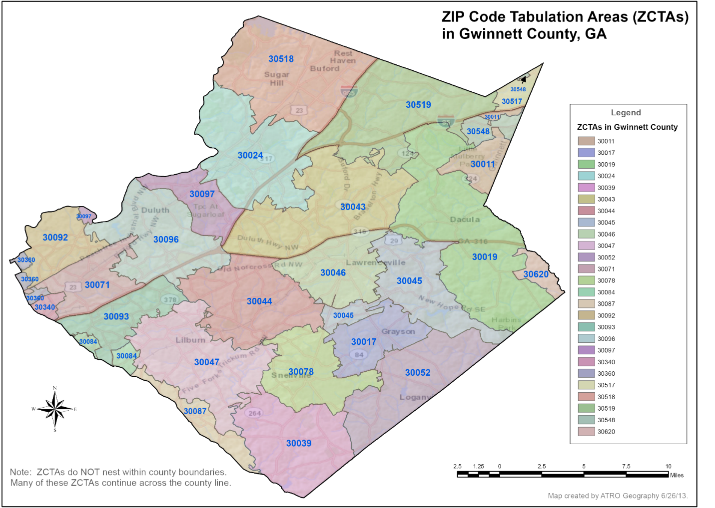
Gwinnett | 3 population groups highlight local diversity
3

Slide 27
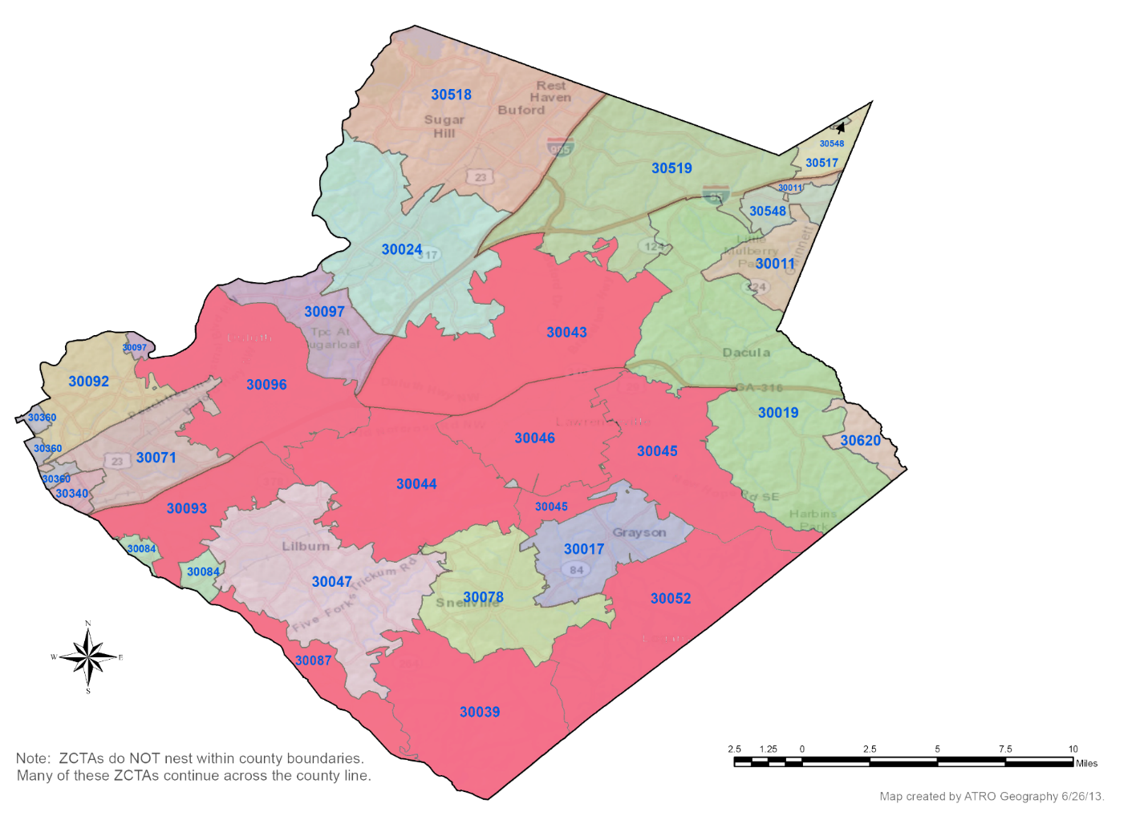
Gwinnett | nine Zip Codes of 10,000+ Black or African American
9

Slide 28
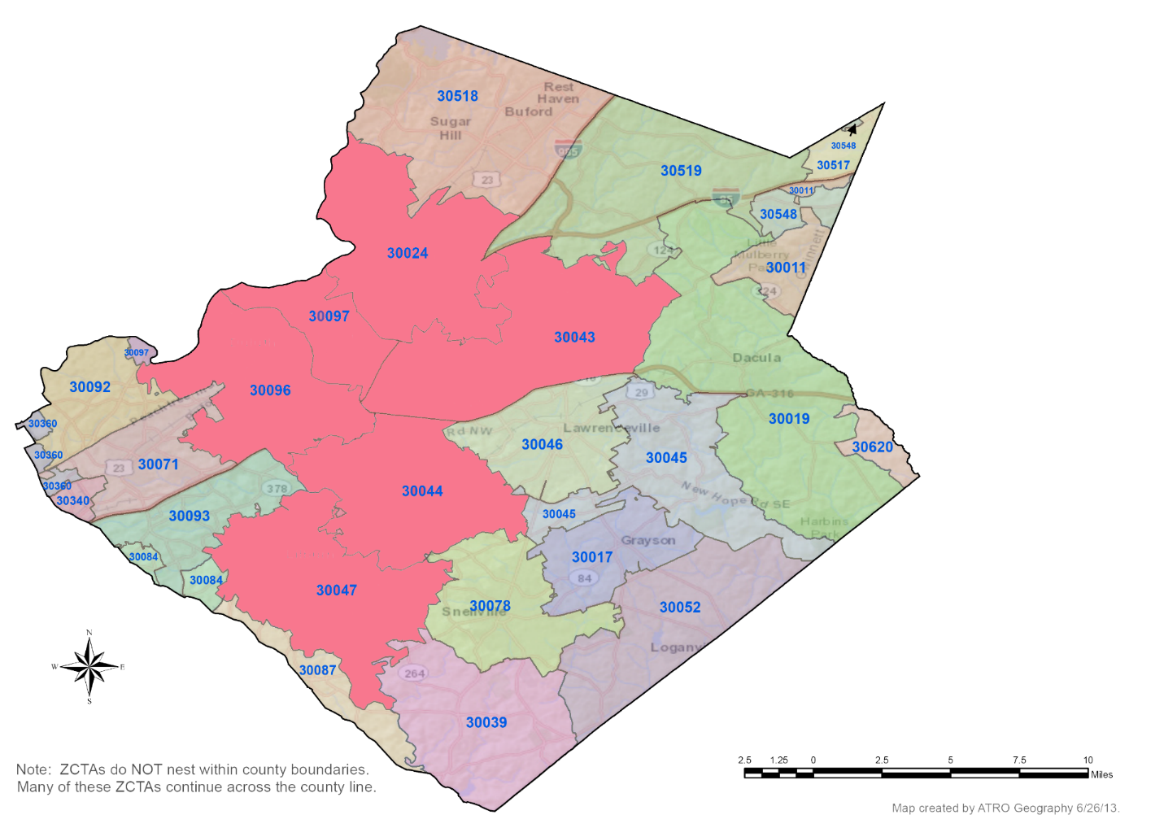
Gwinnett | six Zip Codes of 5,000+ Asian
6

Slide 29
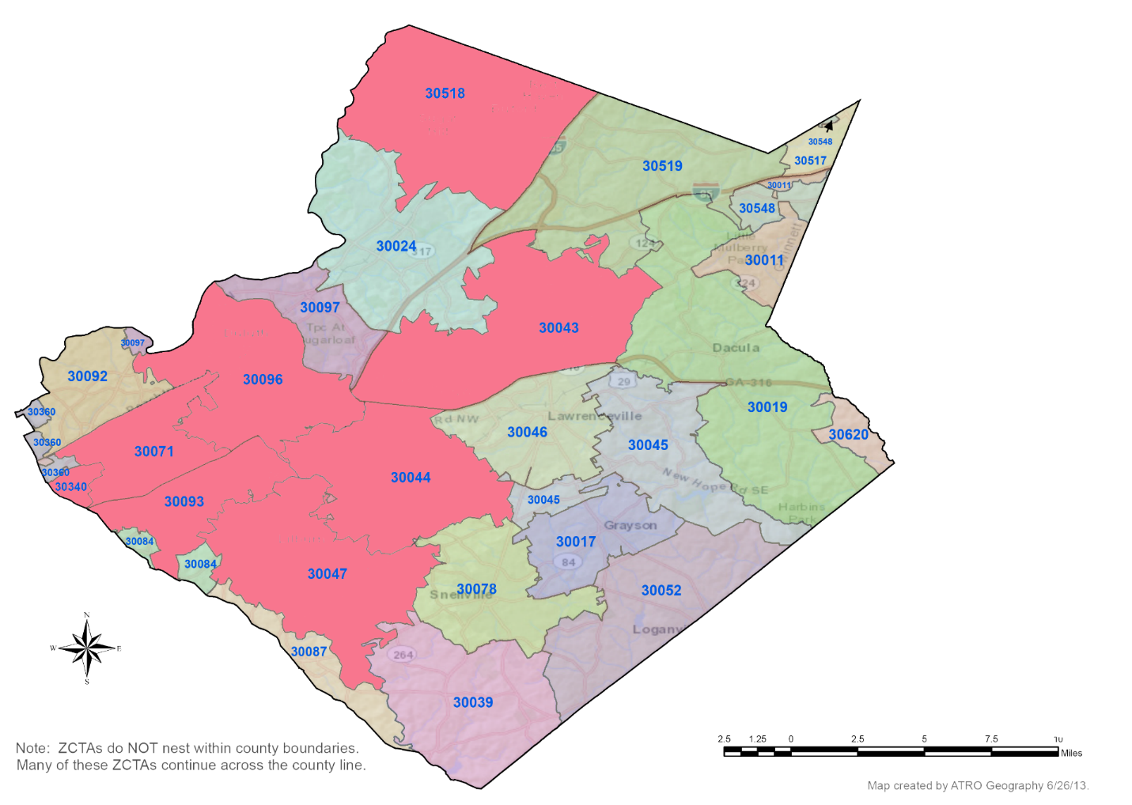
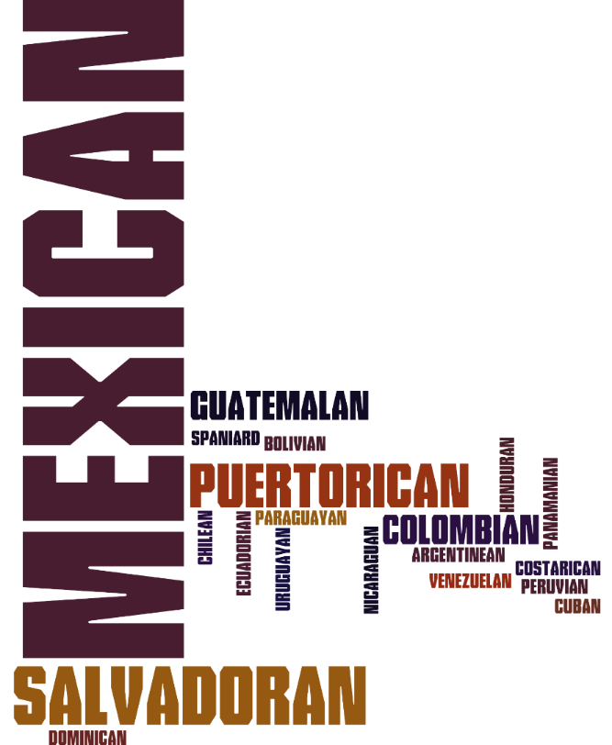
Gwinnett | eight Zip Codes of 5,000+ Hispanic or Latino
8

Slide 30
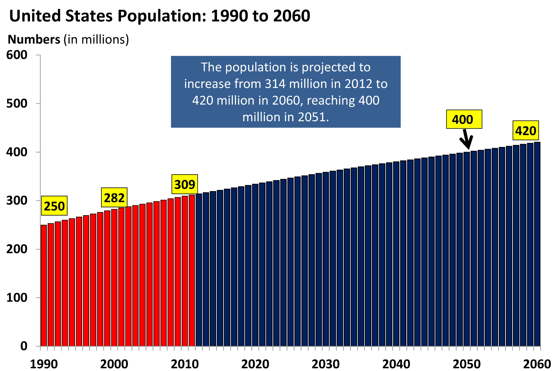
Notes:
Many slides were borrowed from recent press release links (http://www.census.gov/newsroom.html) and from slides presented on the C-SPAN By The Numbers: http://www.census.gov/newsroom/cspan.All.html

Slide 31
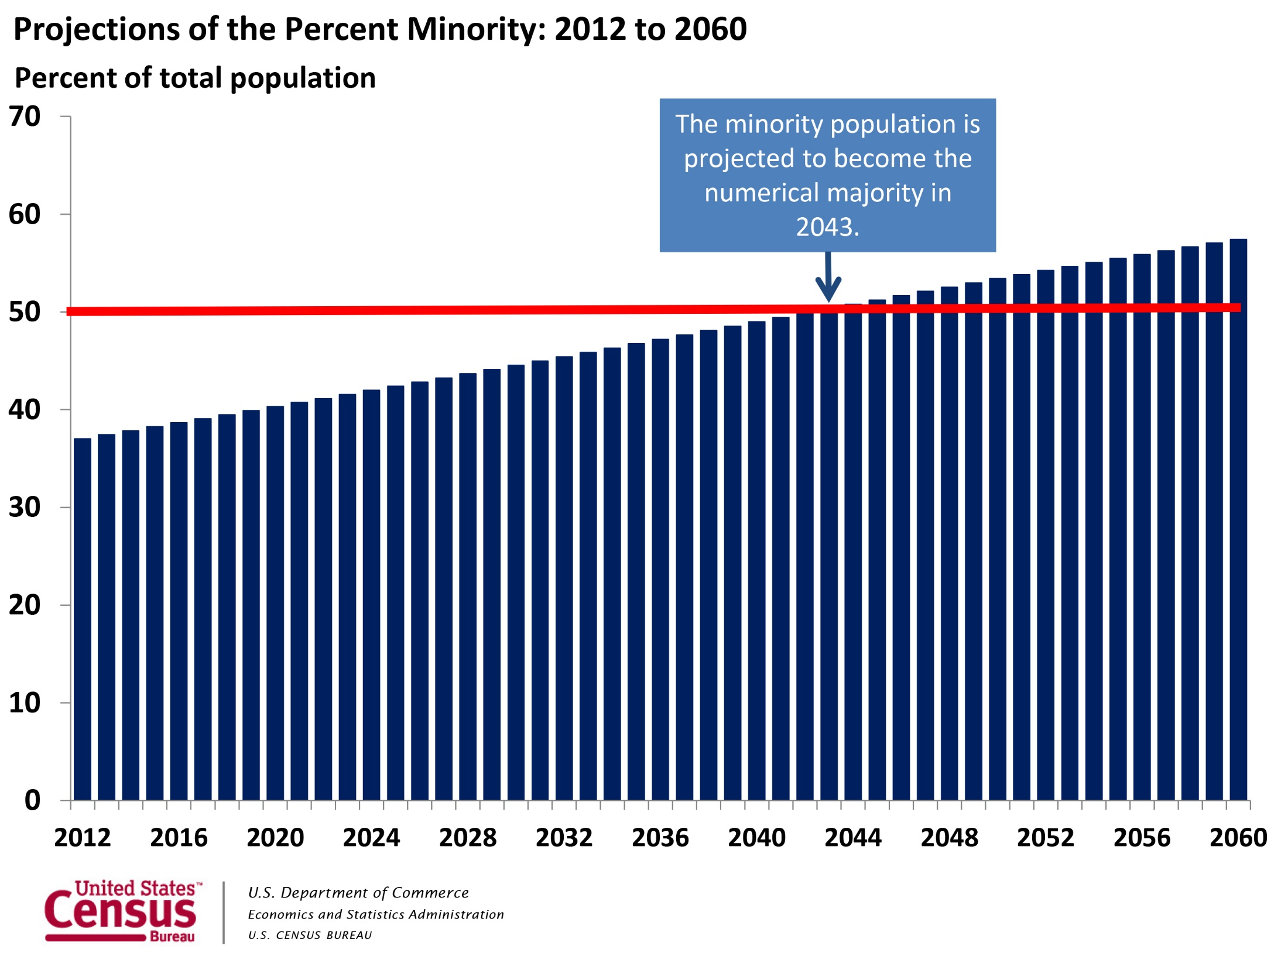
Notes:
Many slides were borrowed from recent press release links (http://www.census.gov/newsroom.html) and from slides presented on the C-SPAN By The Numbers: http://www.census.gov/newsroom/cspan.All.html

Slide 32
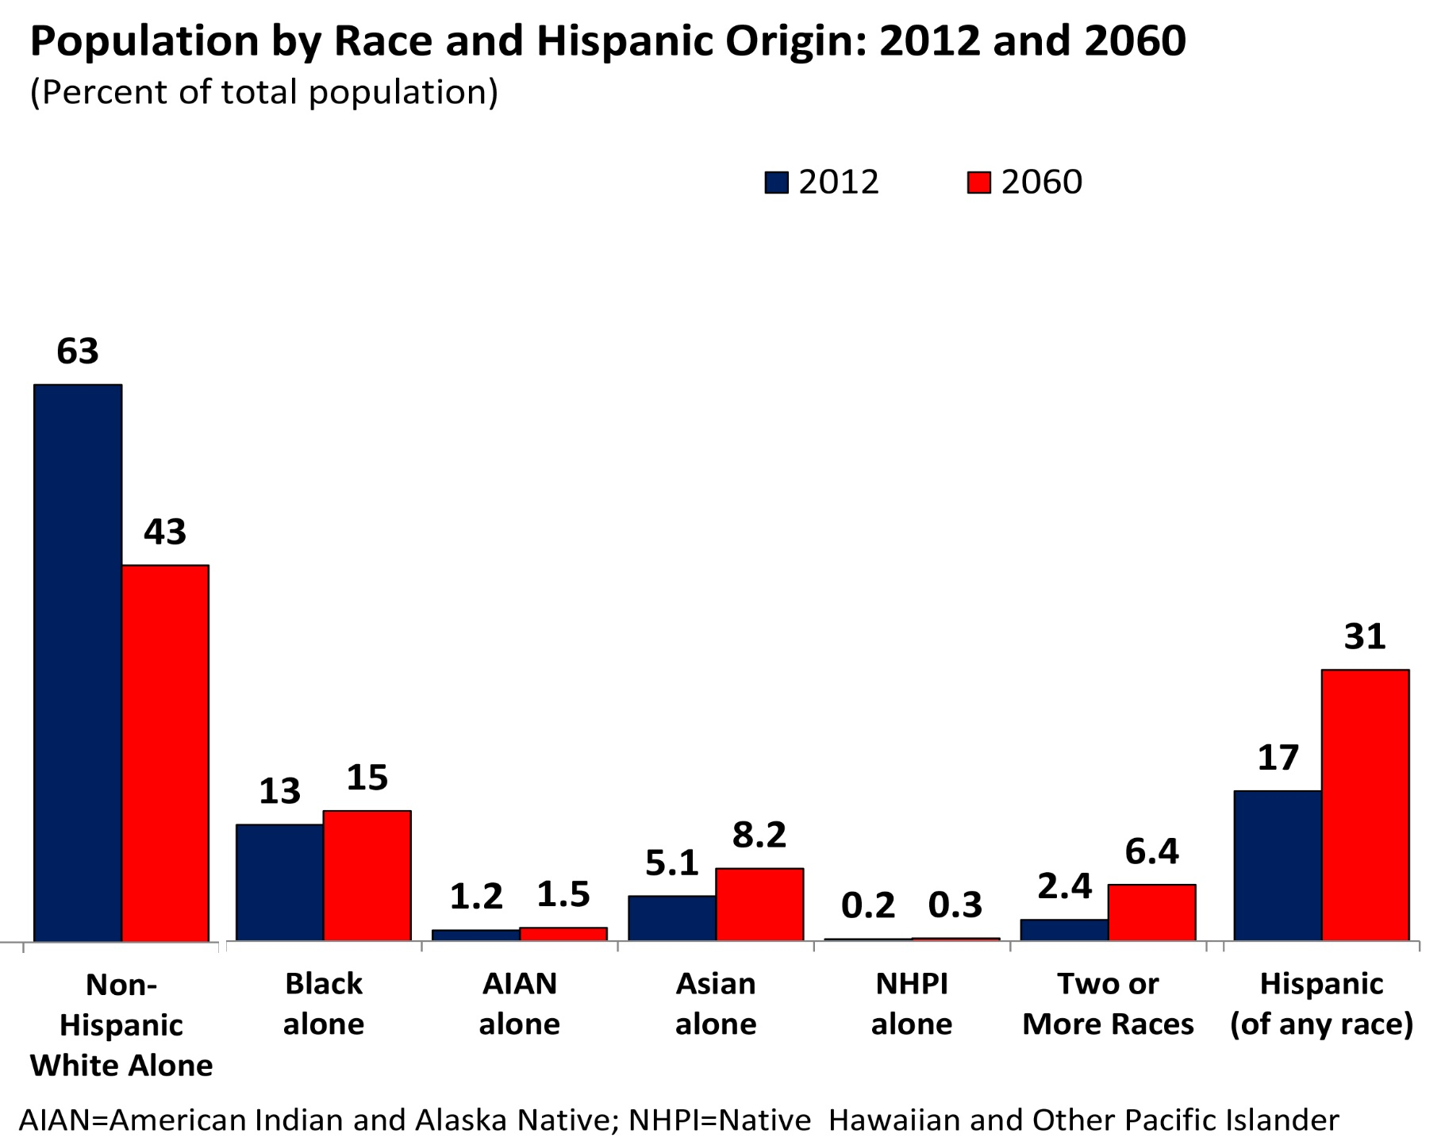
Notes:
Many slides were borrowed from recent press release links (http://www.census.gov/newsroom.html) and from slides presented on the C-SPAN By The Numbers: http://www.census.gov/newsroom/cspan.All.html

Slide 33
Taking it Mobile

Slide 34
Additional Tools - apps
dwellr
http://www.census.gov/mobile/Dwellr/
America’s Economy
www.census.gov/mobile/economy
Application Programming Interface (API)
www.census.gov/developers
Notes:
Find Your Ideal Place with Census Bureau's Newest App — A Census Bureau mobile app named "dwellr" can help people on the go access key demographic, socio-economic and housing statistics for thousands of places across the nation. Users can also learn more about where they are by a simple tap of the screen that reveals educational levels, housing values and total population drawn from the American Community Survey. Internet address: <http://www.census.gov/mobile/>.
Stay Connected to the Economy with Census Bureau Mobile App — Every week, the Department of Commerce releases key Census Bureau economic indicators. Get the latest business news on-the-go as it is released through the Census Bureau's free, easy-to-use mobile app, America's Economy, available for download for both Apple and Android phones and tablets. The app provides real-time updates for 20 key economic indicators from the Census Bureau, Bureau of Labor Statistics and Bureau of Economic Analysis. Internet address: <http://www.census.gov/mobile/economy/>.
The Census Bureau’s Application Programming Interface (API) allows developers to design Web and mobile apps to explore or learn more about America's changing population and economy.
The new API lets developers customize Census Bureau statistics into Web or mobile apps that provide users quick and easy access from the American Community Survey and 2010 census.

Slide 35
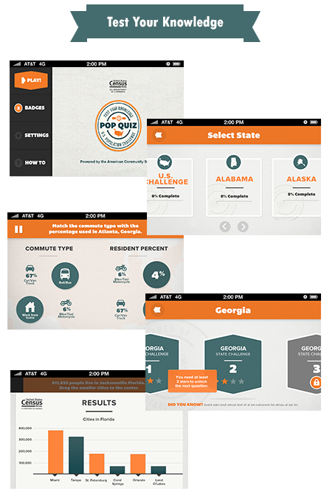
Additional Tools - apps
Pop Quiz Test your knowledge with Census Pop Quiz, a new population challenge about the 50 states and the District of Columbia from the U.S. Census Bureau.
Notes:
Find Your Ideal Place with Census Bureau's Newest App — A Census Bureau mobile app named "dwellr" can help people on the go access key demographic, socio-economic and housing statistics for thousands of places across the nation. Users can also learn more about where they are by a simple tap of the screen that reveals educational levels, housing values and total population drawn from the American Community Survey. Internet address: <http://www.census.gov/mobile/>.
Stay Connected to the Economy with Census Bureau Mobile App — Every week, the Department of Commerce releases key Census Bureau economic indicators. Get the latest business news on-the-go as it is released through the Census Bureau's free, easy-to-use mobile app, America's Economy, available for download for both Apple and Android phones and tablets. The app provides real-time updates for 20 key economic indicators from the Census Bureau, Bureau of Labor Statistics and Bureau of Economic Analysis. Internet address: <http://www.census.gov/mobile/economy/>.
The Census Bureau’s Application Programming Interface (API) allows developers to design Web and mobile apps to explore or learn more about America's changing population and economy.
The new API lets developers customize Census Bureau statistics into Web or mobile apps that provide users quick and easy access from the American Community Survey and 2010 census.

Slide 36
Questions?

Slide 37
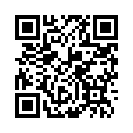
Please take a minute to tell us what you think.
http://bit.ly/censuseval
Gerson D. Vasquez
Data Dissemination Specialist
Partnership & Data Services
Notes:
Please take a few moments to tell us what you think at http://bit.ly/censuseval, and you can also scan the QR Code to take you right to the brief evaluation form. Your feedback is essential towards continuing to improve our data dissemination outreach efforts locally, and nationally. Thank you!

