Slide 1
Using Data Visualization and Reporting to Improve Federal Programs
Adam Churney Business Intelligence Manager Atlanta Public Schools
Nicholas L. Handville Operations Analyst III Georgia Department of Education

Slide 2
SCHOOL IMPROVEMENT AND DISTRICT EFFECTIVENESS

Slide 3
Session Description
This session will cover the basics of using data visualization and reporting to improve Federal programs. Attendees will learn the basics of data visualization and how to collaborate with internal data experts based upon best practices from the field and experiences from ongoing work in Atlanta Public Schools. The session is designed to be beneficial to both new and experienced data users.

Slide 4
Session Outline
Brief introduction to data visualization
Demonstration of real-world applications for Title programs
Q&A and group conversation

Slide 5
Goals of Data Visualization
Present more data than otherwise feasible
Present data in a way that is actionable
To support decision making
Illustrate patterns that are not immediately obvious, identify relationships that are meaningful
Inspire new questions and further exploration
Identify trends and outliers
Compare values, show change over time

Slide 6
Questions to Consider
Does the visualization contain too much information? Too little?
Is the data presented in a clear and comprehensible way?
Does each data element in the visualization add meaning? Does any feature of the visualization distract from the intended focus or meaning?
Will the visualization support action toward desired program outcomes?

Slide 7
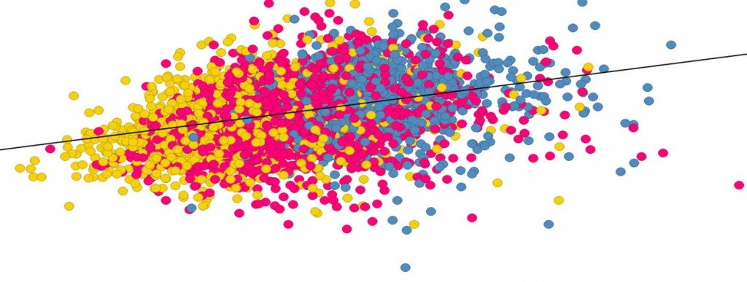
Visualization Demonstration

Slide 8
Q&A and Group Conversation
What are your visualization interests and needs?
What challenges do you face?
What programmatic need will be addressed by utilizing data visualization?

Slide 9
References
Iliinsky, N. and J. Steele (2011). Designing Data Visualizations: Intentional Communication from Data to Display. O’Reilly.
Mazza, R. (2009). Introduction to Information Visualization. Springer.
Stacey, M., J. Salvatore, and A. Jorgensen. (2013). Visual Intelligence: Microsoft Tools and techniques for Visualizing Data. Wiley.
Telea, A. (2015). Data Visualization: Principles and Practice. CRC Press.

Slide 10
Contact Information
Adam Churney
Nicholas L. Handville
Business Intelligence Manager Research & Evaluation for School Improvement Atlanta Public Schools Office: (404) 802-2657 achurney@atlanta.k12.ga.us
Operations Analyst III Office of School Improvement Georgia Department of Education 1854 Twin Towers East 205 Jesse Hill Jr. Drive, SE Atlanta, Georgia 30334 Office: (404) 657-9864 nhandville@doe.k12.ga.us www.doe.k12.ga.us

