Slide 1
Fundamentals of the Consolidated Application
Robyn S. Planchard
School Improvement – Federal Programs
Title I Education Program Specialist
rplanchard@doe.k12.ga.us
(404) 985-3808

Slide 2
SCHOOL IMPROVEMENT & DISTRICT EFFECTIVENESS

Slide 3
Basics of the ConApp
This session will focus on the overall components of the consolidated application (ConApp) and how to navigate within the ConApp for initial
Comprehensive LEA Improvement Plan(CLIP) submissions
Plan amendments
Budget submissions
Budget revisions
Transferability
Manage schools
Running reports

Slide 4
Purpose
The purpose of the LEA ConApp overall is to leverage resources across programs to ensure that all children have an opportunity to meet state academic achievement standards
By consolidating the planning and program requirements across all programs participating in the LEA ConApp process, the need for LEAs to submit multiple plans is eliminated
This makes the application process more efficient for applicants
4

Slide 5
Background
In 1999, Georgia began participating in the federal consolidated application
The signing of No Child Left Behind (NCLB) in 2001 led to some modifications in the application process for FY02

Slide 6
Background
NCLB reverted back to the Elementary and Secondary Education Act of 1965 (ESEA) in FY10 which led to additional modifications with the inception of the American Recovery and Reinvestment Act of 2009 (ARRA)
The current programs that utilize the local educational agency (LEA) ConApp Web site, as well as several additional programs that have come online in the last few years, single-handedly dispense over $1 billion dollars to school systems in Georgia
6

Slide 7
Today’s Agenda
Identify the roles of the Work Flow
Review the LEA ConApp Web site
Identify the general parts of the ConApp
Explore the CLIP submissions and plan revisions
Explore the Flexible Learning Program (FLP) submissions and plan revisions

Slide 8
Today’s Agenda
Inspect budget submissions and review budget amendments
Investigate the Transferability of Funds Function
Examine how to use the Manage Schools Function
Perform Queries to track application status
Run Reports to obtain data

Slide 9
Identifying the Roles and Work Flow
Five distinct roles are available
LEA ConApp Coordinator
Superintendent
State ConApp Coordinator
State Program Manager, State Plan Approver, and
State Grants Accounting

Slide 10
Roles and Work Flow
Role | Access
LEA Consolidated Application Coordinator | Full edit rights to the application. This role is automatically applied to the Consolidated Application Coordinator identified within the GaDOE portal.
Superintendent | Read-only access to the application, but has final sign-off for the district.
State Consolidated Application Coordinator | Read-only access to the application, compiles all approvals and requests for revision at the state level and recommends approval or request for revision.
State Program Manager | Read-only access to the application, but has final sign-off to approve specific program(s) at the State level.
State Plan Approver | Read-only access to the application, but has final sign-off to approve the State Plan for a district at the State level.
State Grants Accounting | Read-only access to the application, but has final sign-off to approve the budget at the State level.

Slide 11
Web Site
Within a Web browser, logon to the following site: http://www.gadoe.org
11

Slide 12
The GaDOE Portal
Within the LEA ConApp Web site, enter your username and password

Slide 13
Parts of the Con App
Prayer Certification
In order to receive funds under the ESEA, a LEAmust certify in writing to the Georgia Department of Education (Department) that no policy of the LEA prevents, or otherwise denies participation in constitutionally protected prayer in public elementary and secondary schools as set forth in this guidance
An LEA must provide this certification to the Department by October 1 of each subsequent year during which the LEA participates in an ESEA program. Only the Superintendent can sign off on the Prayer Certification.

Slide 14
CLIP Submissions
With each new fiscal year, the ConApp opens
The prior CLIP entries will be auto-populated into the new FY’s CLIP Descriptors
The text clean-up process should not be performed by selecting the icon

Slide 15
CLIP Submissions and Revisions
Select applicable Descriptor and type in new information or revisions
Do not select the Clean-Up Icon because this will remove text that was recently formatted
Submission process—work flow
Plan Revisions
Audit Trail

Slide 16
CLIP Submissions and Plan Revisions
Click on the Implementation Plans tab
Performance Goals from the previous year’s application will be displayed
Uploaded files to the Attachment tab are allowed and do not have to be added within the online application

Slide 17
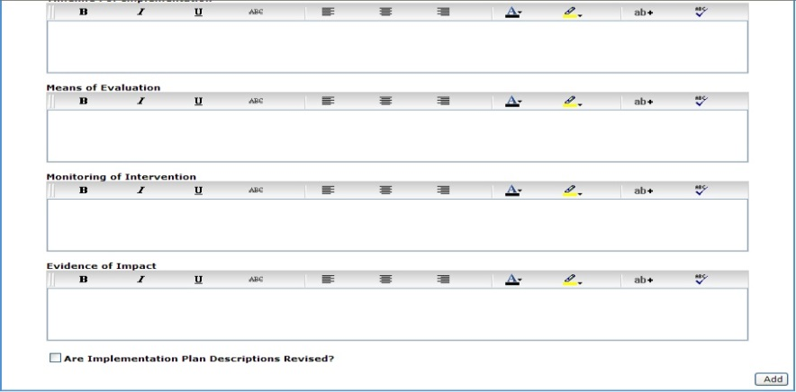
CLIP Submissions and Plan Revisions
Implementation Plans
Select the goal from the drop-down menu to update individual goals
Select the checkbox for “Are Implementation Plan Descriptions Revised?” and the Update button to save changes

Slide 18
Flexible Learning Plan (FLP) Submissions
The Flexible Learning Program (FLP) Plan tab is located in the ConApp on the Planning tab

Slide 19
FLP Submissions and Plan Revisions
FLP plans are submitted and follow the same work flow as the CLIP
LEA ConApp Coordinator
Superintendent
State ConApp Coordinator,
State Program Manager, State Plan Approver

Slide 20
Budget Submissions
Title I, Part A is a federally funded program under the Elementary and Secondary Education Act of 1965 (ESEA). This Act provides federal funds through the Department to LEAs and public schools with high percentages of poor children to help ensure that all children meet challenging state academic content and student academic achievement standards

Slide 21
Budget Submissions
LEAs must submit, through the ConApp, the Title I, Part A budget
Prior to review of any budget submitted for approval, the Title I Education Program Specialist reviews the changes made to the CLIP. The CLIP contains 31 Descriptors, 24 of which must be reviewed for revision and/or approval by the Title I Education Program Specialist

Slide 22
Budget Submissions
Complete all parts of the Program Information Page:
Fiscal Effort
Set-Asides

Slide 23
Budget Submissions
Required set-asides
FLPs for Priority and Focus Schools
FLPs for Alert Schools, if applicable
Professional development for highly qualified teachers
Professional development for district effectiveness
Parental Involvement
Eligible private school children
Homeless children and youth in non-participating schools; and
Neglected and Delinquent students

Slide 24
Budget Submissions
Optional district wide set-asides
LEA level and/or districtwide activities only
Activities cannot be charged to a school’s facility code, but rather the LEA’s facility code—8010
LEA must have a well-crafted districtwide program plan that places these personnel at Title I schools according to clear criteria to overcome unintentionally serving schools out of rank order, due to having schools with lower rates of poverty receiving a higher per-pupil amount than schools with a higher amount of poverty

Slide 25
Budget Submissions
Other Funds
This section is for documentation of other funding sources for professional development
School Allocations:
Public Schools
Private Schools

Slide 26
Budget Submissions
Private School Proportionality
Equitable services fall into three categories
Parental Involvement
Instruction
Professional Learning
The amount of the reserved funds that must be used for private schools must be proportionate to the number of private school children from low-income families residing in Title I, Part A participating public school attendance areas

Slide 27
Budget Submissions
Eligible Attendance Area Worksheet
The LEA must allocate funds per-pupil amount (PPA) to schools or attendance areas in rank order, or rank order by grade span. If the LEA is unable to serve all eligible attendance areas, then schools above 75-percent must receive allocations first in rank order

Slide 28
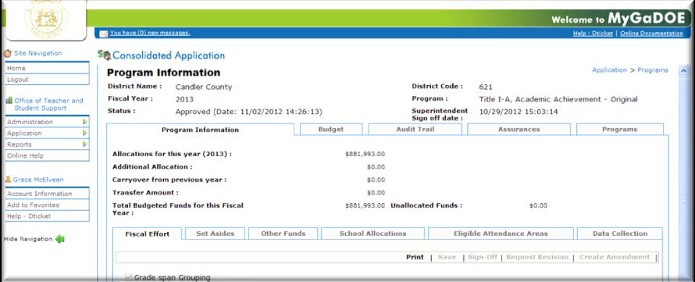
Budget Submissions
Data Collections:
Indirect Cost Worksheet
Highly Qualified (Hi-Q) Request for Lesser Amount Worksheet
Equitable Services for Participating Private Schools

Slide 29
Budget Submissions
Budget Detail
The budget detail must include all expenditures from the Set-Aside page and the School Allocation tab
The descriptions of all budgeted items must be specific and clearly describe the intent of the expenditure
LEAs must refrain from using these words: such as, will include, including but not being limited to, and etc.

Slide 30
Budget Submissions
Budget Detail
The set-aside page and the school allocation page link to one another, but they do not link to the budget detail pages. If all funds have been budgeted, there should be no unallocated funds
All budgeted items must be supplemental. Supplanting occurs when Title I funds are used in place of state and/or local funds that the school/LEA earned

Slide 31
Budget Submissions
Detail Examples
Adequate example: After-school tutoring for the children at Flowering Branch Children’s Shelter (N&D set-aside)
Inadequate example: After-school tutoring
Adequate example: Differentiated Instruction training for all teachers at ABC Middle School (Professional Learning set-aside)
Inadequate example: Professional Learning
Budget Function and Object Codes
Refer to the Department Chart of Accounts

Slide 32
Budget Submissions
The following function and object codes should be used:
Before/after-school tutoring by employee – 1000-199
Before/after-school contracted tutoring – 1000-300
Software license leases – 1000-612
E-books – 1000-642
Schoolwide consolidation of funds – 1000-881
Academic Coach – 2210-191
Title I Director – 2230-190
Homeless Liaison – 2230-191
Audit cost – 2300-300; Indirect cost – 2300-880
Bus transportation (energy) –2700-620;
Bus transportation (driver) – 2700-180

Slide 33
Budget Submissions
The following function and object codes should be used:
Parental Involvement Coordinator – 2900-177
Parent notification letters – 2900-530
Child care for parent meetings – 2900-595;
Light snacks for parent meeting from a vendor – 2900-595
Light snacks for parent meeting purchased from a grocery store or school lunchroom – 2900-610
Object code “700” – Property –Capital Outlay. LEAs must have prior approval from Title I Program Manager before this type of expenditure can be approved

Slide 34
Budget Review
If after review of the above steps is complete and all areas are acceptable, then the Title I Education Program Specialist will sign off on the budget indicating approval. An email is automatically sent to Grants Accounting requesting approval of the program
Once Grants Accounting has approved the budget, funds are available through Georgia ’s Grants Accounting Online Report System (GAORS)

Slide 35
Budget Review
If a revision request is needed, the Title I Education Program Specialist must provide detailed information indicating what is needed for revision, additions, deletions and/or clarifications. This information is provided in the Request for Revision box inside the individual program

Slide 36
Budget Revisions
Once the requested revision is completed and the Superintendent signs off again, the budget will be reviewed again to ensure that all areas are addressed
The sign-off and revision requests create an audit trail of the approval process. Emails are automatically sent to the LEA (superintendent and ConApp coordinator) once the budgets have been approved and/or a revision is requested

Slide 37
Budget Amendments
LEAs must submit budget amendments for any changes in the original approved budget that exceed 25-percent in any function code using the LEA ConApp approval process
Budget amendments must also be made if there are changes in the scope of the plan or if there are expenditures for function or object codes that are not in the approved budget

Slide 38
Budget Amendments
Just as with the original budgets, once the superintendent has signed off a program, the ConApp coordinator and Department Title Programs Director will receive an email message stating that budget amendment has been signed off
At this time the approval process begins for an amendment. The sign-off and/or Request for Revision process is the same for amendments as for original budgets

Slide 39
Printing Budgets
Printing Through Reports : Choose Miscellaneous Reports, Program Summary Report, the fiscal year the program Title !, Part A. Click Review Report to print the Program Summary report
This summary report will not print the embedded Indirect Cost or Highly-Qualified (Hi-Q) Request for Lesser Amount worksheets. These worksheets are found within the Data Collection tab inside the Title I, Part A budget

Slide 40
Transferability of Funds Function
The funds you transfer into Title I become Title I funds subject to all rules and regulations for Title I. Once the funds become Title I funds the funds can never be moved back out to another program
Districts should think about how the transfer of funds will impact any of their required set-asides. The transferred funds may impact the required set-asides including those for parental involvement and private schools

Slide 41
Transferability of Funds Function
The Title II, Part A consultant/specialist who works with the district must be notified in writing (email) about the district’s intent to transfer Title II, Part A funds to Title I prior to submitting the Title II, Part A budget for approval

Slide 42
Transferability of Funds Function
The district must notify in writing (email) Department’s Grants Accounting Department about the district’s intent to transfer Title II, Part A funds to Title I, Part A prior to the transfer. The emails should be directed to Regina Hailey (RHailey@doe.k12.ga.us) and in Grants Accounting

Slide 43
Transferability of Funds Function
The district superintendent must notify the Department’s Title Programs Director in writing, stating the district’s intent to transfer Title II, Part A funds into Title I, Part A, sign the letter, scan the letter to a pdf file, and attach the letter to the Attachment tab in the ConApp prior to signing off on the Title I, Part A budget. (The letter is not mailed…just attached.)

Slide 44
Transferability of Funds Function
In the Title II, Part A Budget:
From Program Title II, Part A
To Program Title I, Part A
Function 5000--Object 930
Amount

Slide 45
Manage Public Schools Function
Go to ConApp and then go to Manage Public Schools
Select Your System and then choose Program Category is Title Programs
Click Load and now you can Add/Remove Schools by selecting from the Add/Remove Drop Down box, choosing the school and giving a reason
You cannot add a school that is not in the Department facility database

Slide 46
Manage Public Schools
Once you remove a school, it removes the school from the list populated in the consolidated application budget pages and the embedded School Allocations and Eligible Attendance Area Tabs
Title I Directors can do this before doing their budget
Very helpful if a school in the district has closed; if there are two facility codes for a school, or if school has a new number

Slide 47
Queries to Track Application Status
Three queries are available within the ConApp
ConApp Status Queries
Title I-A School Allocation Queries
Budget Comparison Queries

Slide 48
Run Reports to Obtain Data
Five reports are available within the LEA ConApp
Application Summary
Program Summary
Budget Summary
Budget Transferability
Unbudgeted Funds

Slide 49
Technical Questions
Trouble Shooting in the ConApp FY2016
Go to Tools, Internet Options, Clear Browsing History (Delete, Delete, OK)
Close out Internet and reboot computer
Are you using IE8 or IE9 (Internet Explorer 8 or Internet Explorer 9)?
You may have to use the compatibility mode under tools
ConApp does not work properly with Apple computers
ConApp does not work properly with Google Chrome or Firefox
ConApp does not work properly with Internet Explorer 10 or Internet Explorer 11
Contact the Help Desk / D-ticket

Slide 50
Fixing the Browser for the FLP
How to fix the browser in order to enter data into the FLP portion of the ConApp in Internet Explorer 11.
Open Internet Explorer
Tools > Compatibility View Settings >
In the “Add this Website” box type: k12.ga.us > ADD > Close
Open up the ConApp

Slide 51
Top 10 Problems for Title I Directors
Can’t work in CLIP—it will not let you add or revise information
Are you using IE8 or IE9? ConApp is not compatible with higher versions, Chrome, Firefox, or Apple computers
You receive a server error message
You may not be provisioned; check with the Security Officer in your district prior to submitting a dticket
The CLIP will not save because it keeps “churning”
The application is not designed to have graphs, charts, and tables; remove them and stick to a narrative

Slide 52
Top 10 Problems for Title I Directors
Can’t Sign Off on CLIP
Is it in your Access Role—Check the Audit Trail to see which role has access
Locked out of the ConApp after October I
Prayer Certification must be signed off by Superintendent prior to October 1
The LEA has a school that is not listed on the Allocation Page—what should they do?
Use the Manage Public Schools Function

Slide 53
Top 10 Problems for Title I Directors
Can’t Sign Off on Budget
Is it in your Access Role—Check the Audit Trail to see which role has access
The LEA can’t create an amendment
You cannot create an amendment unless the budget is with the Title I Director. If the Title I Director and Superintendent signed off it is with the Area Specialist and you cannot create an amendment

Slide 54
Top 10 Problems for Title I Directors
The LEA wants to move funds from Title II into Title I and Title I won’t let it begin
Use the Transferability of Funds option and begin with Tittle II-A
Can’t Sign Off on Data Collections because it is grayed out
Is it in your Access Role—Check the Audit Trail to see which role has access

Slide 55
Technical Questions
If you experience problems within the application, please contact Robyn Planchard at 404-985-3808 or rplanchard@doe.k12.ga.us .
For problems within the application, you may also contact the helpdesk at dticket@doe.k12.ga.us.
55

Slide 56
Program-Specific Questions
Program-specific names, phone numbers, and e-mail addresses can also be found at the following link:
http://www.gadoe.org/School-Improvement/FederalPrograms/Pages/LEA-Consolidated-Application.aspx
by selecting Guidance & Contact List

Slide 57
Questions
Consolidated Application
Transferability
Manage Schools
Queries
Reports

Slide 58
Title I, Part A Program Specialists’ Contact Information
Area | Name | Office Telephone | Email
1 | Robyn Planchard | (404) 985-3808 | rplanchard@doe.k12.ga.us
2 | Randy Phillips | (770) 221-5232 | rphillips@doe.k12.ga.us
3 | Anthony Threat | (706) 615-0367 | anthony.threat@doe.k12.ga.us
4 | Evelyn Maddox | (404) 975-3145 | emaddox@doe.k12.ga.us
5 | Judy Alger | (229) 321-9305 | jualger@doe.k12.ga.us
6 | Grace McElveen | (912) 334-0802 | gmcelveen@doe.k12.ga.us
7 | Jimmy Everson | (229) 723-2664 | jeverson@doe.k12.ga.us

Slide 59
Title I, Part A Program Specialists’ Contact Information
Area | Name | Office Telephone | Email
8 | Marijo Pitts-Sheffield | (912) 269-1216 | mpitts@doe.k12.ga.us
9 | Kathy Pruett | (706) 540-8959 | kpruett@doe.k12.ga.us
10 | Elaine Dawsey | (478) 971-0114 | edawsey@doe.k12.ga.us
11 | Olufunke Osunkoya | (678) 704-3557 | oosunkoya@doe.k12.ga.us
12 | Bobby Trawick | (229) 246-1976 | btrawick@doe.k12.ga.us
13 | Ken Banter | (478) 960-2255 | kbanter@doe.k12.ga.us
14 | Tammy Wilkes | (478) 237-2873 | twilkes@doe.k12.ga.us

Slide 60
Fundamentals of the Consolidated Application
Robyn S. Planchard
School Improvement – Federal Programs
Title I Education Program Specialist
rplanchard@doe.k12.ga.us
(404) 985-3808

