Slide 1
What are Internal Controls
Presented by:
William Smith, CFE
Federal Internal Auditor
Notes:
This elluminate session will cover:
What are internal controls is needed (from a Federal regulations standpoint)
Definition of internal control
Types of controls
COSO internal control framework
Evaluating internal control
Documentation of internal control
Types of internal control
Different categories of internal control
Internal control as it relates to the new Super-circular (Edgar)
At the end of the presentation you should know:
-The definition of internal control
-The new Super Circular as it relates to internal control
-Elements and principles of internal control
-The different types of internal control

Slide 2
What are Internal controls
Definition of internal controls:
Activities undertaken by management to increase the likelihood of achieving management objectives in the areas of efficiency and effectiveness, reliability of financial reporting, compliance with laws and regulations, and safeguarding of assets.

Slide 3
What are Internal Controls
History of Internal Controls:
One significant development concerning internal control occurred when The national Commission on Fraudulent Financial Reporting, known as the Treadway Commission, was created in 1985 to identify the causal factors of fraudulent financial reporting and to make recommendations to reduce its incidence.

Slide 4
What are Internal controls
These recommendations led to a review of internal control literature by a task force called the Committee of Sponsoring Organizations of the Treadway Commission (COSO). This task force issued a report in September 1992 called Internal Control-Integrated Framework. The report, referred to as the COSO report.

Slide 5
What are Internal controls
These recommendations led to a review of internal control literature by a task force called the Committee of Sponsoring Organizations of the Treadway Commission (COSO). This task force issued a report in September 1992 called Internal Control-Integrated Framework. The report, referred to as the COSO report.

Slide 6
What are Internal controls
Important Elements of Internal Controls:
Internal control is:
a process
impacted by people at every level of an organization
pervasive throughout an organization
people, processes, and systems
limited – can only provide reasonable assurance

Slide 7
What are internal controls
Basic Principles of Internal Control
1. Must benefit rather than hinder the organization
2. Must make sense within each organization’s unique operating environment
3. Internal controls are not stand-alone practices
4. Should be cost effective

Slide 8
What are internal controls
Types of Internal Control
Preventive
Detective
Compensating
Corrective
Notes:
There are four general types of controls.
Preventive (also called Prevent): In laymen terms, these are controls to stop something bad from happening. Preventative controls are before-the-fact controls. Preventative controls define and enforce acceptable behaviors.
Detective (also called Detect): These are controls designed to detect something bad in a timely manner. Are designed to detect an error or adverse event after it occurs but within a reasonable time to permit correction and through awareness of the problem, helps prevents other errors from occurring.
Compensating: These are controls designed to address the weaknesses of other controls. Compensating controls can compensate for shortcomings elsewhere, so at times, what appears to be a weakness in control is not really a problem, due to the presence of compensating controls. Compensating controls represent a fail-safe approach to limiting risk exposure.
Corrective: These are controls which correct problems found in detective controls. Correct the problems identified by detective controls. Many corrective controls rely on computer automation.

Slide 9
What are internal controls
Examples of Controls:
Preventative – An LEA cannot draw funds until it has an approved budget in consolidated application.
Detective – You review draws in GAORS and discover that some systems have drawn too much money while others have not made any draws.
Corrective – You spend more than you have in your bank account. Bank covers the difference and then charges you a fee.
Compensating – Employee given a p-card but spending limit is set to $100.
Notes:
Preventative – An LEA cannot draw funds until it has an approved budget in consolidated application.
Detective – You review draws in GAORS and discover that some systems have drawn too much money while others have not made any draws.
Corrective – You spend more than you have in your bank account. Bank covers the difference and then charges you a fee.
Compensating – Employee given a p-card but spending limit is set to $100.

Slide 10
What are internal controls
How Controls Are Executed
Automated
IT dependent manual
Manual
Notes:
It is important to know how controls are implemented or executed. There are three methods in which controls are implemented.
1. Automated – done by an information system. Example – travel reimbursement is completed by the employee and routed automatically to the employee’s supervisor for approval. If supervisor does not approve it – then the travel reimbursement does not proceed further in the process.
2. IT dependent manual controls – relying on an information system to produce information then reviewing that information. Example – want to make sure that people who are no eligible for overtime (exempt from the FLSA) are not paid overtime. Run overtime report and scan it for exempt people paid overtime.
3. Manual controls – controls which have to be done completely by people. Example – AP clerk has to obtain and verify agenda for an out-of-state trip in order to approve out-of-state travel.
Which is best – automated, but it is also the most expensive and can result in negative consequences. For example, items which are okay are rejected because of a poorly written computer program. All controls, but especially automated controls need to be carefully planned and thought out before they are implemented.

Slide 11
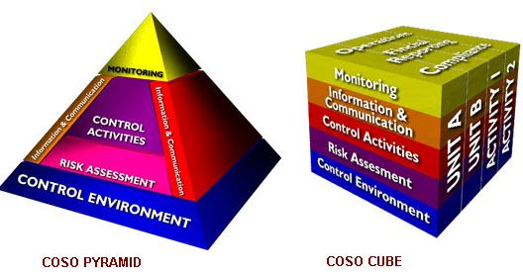
What are internal controls
Internal Control Components
Notes:
The COSO report describes the internal control process as consisting of five interrelated components that are derived from and integrated with the management process. Each component affects and is affected by the other four. According to COSO these components provide an effective framework for describing and analyzing the internal control system implemented in an organization.
COSO Internal Control Framework– the COSO framework is the most frequently used by management and auditors
Control Environment
Risk Assessment
Control Activities
Information and Communication
Monitoring
The pyramid, which was later replaced by the cube graphically demonstrate how the five components are interrelated.

Slide 12
What are internal controls
Control Environment:
Sets the tone of an organization
Foundation for all other components of internal control
Integrity, ethical values, and competence of staff
Management’s philosophy and operating style
Notes:
What is the control environment? The control environment sets the tone of an organization, influencing the control consciousness of its people. It is the foundation for all other components of internal control, providing discipline and structure. Control environment factors include the integrity, ethical values, management's operating style, delegation of authority systems, as well as the processes for managing and developing people in the organization.
Internal controls are likely to function well if management believes these controls are important and communicates that view to employees at all levels.
Commitment to competence includes a commitment to hire, train, and retain qualified staff. It encompasses both technical competence and ethical commitment.
How to implement a strong control environment
Assign authority and responsibility
-Place control related standards in job descriptions

Slide 13
What are internal controls
Risk Assessment:
The process used to identify, analyze, and manage the potential risks that could hinder or prevent an agency from achieving its objectives.
Notes:
What is a risk assessment? the identification and analysis of relevant risks to the achievement of assigned objectives. Risk assessment is a prerequisite for determining how the risks should be managed. In other words, what can go wrong?
What is risk?
Risk is the probability of an event or action having an adverse affect on your organization. It is directly tied to your control objectives and is those events or actions that can prevent you from achieving these objectives.
To quantify risk. You can do a simple formula. Likelihood times magnitude.
Take two risks for example.
1. The risk that the S: drive crashes. The likelihood would be small (1%) but the magnitude would very great ($500K a day in lost productivity and the server could be down anywhere between 3 and 14 days). The impact of this risk could be calculated to be from $15,000 to $70,000 (1% X $500,000 X 3 days or 14 days). T
2. The risk that a $3 million contract goes bad is 10%. The impact of this risk could be calculated to be $300,000 (10% X $3,000,000).
Controls put in place to mitigate these risks should be less than the potential impact of the risk. It would not make sense to put in a back servers, which cost $200,000 if the potential impact of a server crash is only $15,000 to $70,000.
The risk to reaching objectives increases dramatically during a time of change – new programs or services increase risk.
How to conduct a risk assessment.
Formal risk assessment – evaluate and prioritize risk
For each risk – 1. accept; 2. prevent or reduce to an acceptable level; 3. avoid.

Slide 14
What are internal controls
Control Activities:
Policies and procedures that help ensure management directives are carried out.
Notes:
What are control activities? They are activities that help ensure that necessary actions are taken to address ricks to achievement of the entity’s objectives. Control activities occur throughout the organization, at all levels and in all functions.
They include a range of activities as diverse as approvals, authorizations, verifications, reconciliations, reviews of operating performance, security of assets, segregation of duties, job descriptions, and organizational charts.
How to implement strong control activities
- Written policies and procedures
Program Operations manuals

Slide 15
What are internal controls
Information and Communication:
Information must be identified, captured, and communicated in a form and timeframe that enables people to carry out their responsibilities.
Notes:
What is information and communication? Information systems play a key role in internal control systems as they produce reports, including operational, financial and compliance-related information, that make it possible to run and control the business. In a broader sense, effective communication must ensure information flows down, across and up the organization.
Includes both internally generated data and external events, activities and conditions necessary to informed business decision-making and external reporting. Effective communication also must occur in a broader sense, flowing down, across, and up the organization.
For example, an organization may have well written policies and procedures; but how are these policies and procedures communicated to employees? Do employees know where to find them? Do employees know when they are updated?
How to implement strong information and communication internal control
Staff meetings
e-mail list serves

Slide 16
What are internal controls
Monitoring:
Internal control systems need to be monitored.
Monitoring is a process that assesses the quality of the internal control system’s performance over time.
Notes:
What is monitoring? Internal control systems need to be monitored—a process that assesses the quality of the system's performance over time. Internal control deficiencies detected through these monitoring activities should be reported upstream and corrective actions should be taken to ensure continuous improvement of the system.
Monitoring is accomplished through ongoing monitoring activities, separate evaluations, or a combination of the two.
How to implement strong monitoring activities (see attachment 2)
-Policies and procedures to monitor the reliability of financial reporting systems
-Develop a system to capture and evaluate complaints
One essential component of monitoring is documentation. To be effective, the monitoring activities need to be well documented and noted deficiencies need to be corrected.

Slide 17
What are internal controls
Evaluating Internal Controls:
Five step approach
Analyze the Control Environment
Assess Risk
Assess Control Activities
Communicate Information
Monitoring
Notes:
This is the five-step approach or COSO approach.
1. Review the control environment including attitudes and actions. If a specific procedure requires constant exceptions, it is better to change or eliminate the procedure than establishing an attitude of “rules are made to be broken.”
2. Assess Risk this step contains two major steps. (1) identify and prioritize activities that are most likely to have problems. (2) analyze those specific activities to determine their components.

Slide 18
What are internal controls
Testing Internal Controls:
Inquiry
Inspection of physical evidence
Analytical Procedures
Re-performance
Observation
Notes:
This information comes from the IMPROVE project.
Inquiry – interviewing people who enforce the controls
Inspection of physical evidence – examine the actual documents. This is done to confirm that manual controls are working.
Re-performance – redo a calculation to ensure that the calculation was correct. Review supporting documentation.
Analytical procedures – analyzing large volumes of transactions or data. This technique is used to identify trends, statistical outliers, and impact analysis.
Observation – watching the actual activity. Looking at the input – useful for assessing some IT dependent manual controls.
When testing important to know what the results of the test should be. Also important is the extent of the testing:
How often the test will be done
Sampling strategy
Type of control which will be tested
Nature of control (prevent, detect, etc.)
Persuasiveness of the evidence
Also important is the timing
For the testing to be effective need to develop a testing plan. This plan should include:
Objective of the test
Source of sample
Time period
Population
Sample approach
Test attributes

Slide 19
What are internal controls
Documentation of Internal Controls
Documenting internal controls will help identify key:
Risks
Controls
Opportunities for Improvement
Notes:
The most important point here is documentation, documentation, documentation.
Documentation will help you better your organization and will help you deal with auditors and program monitors. Both (especially auditors) love documentation. It is extremely important to auditors. If something is not documented to an auditor it did not happen

Slide 20
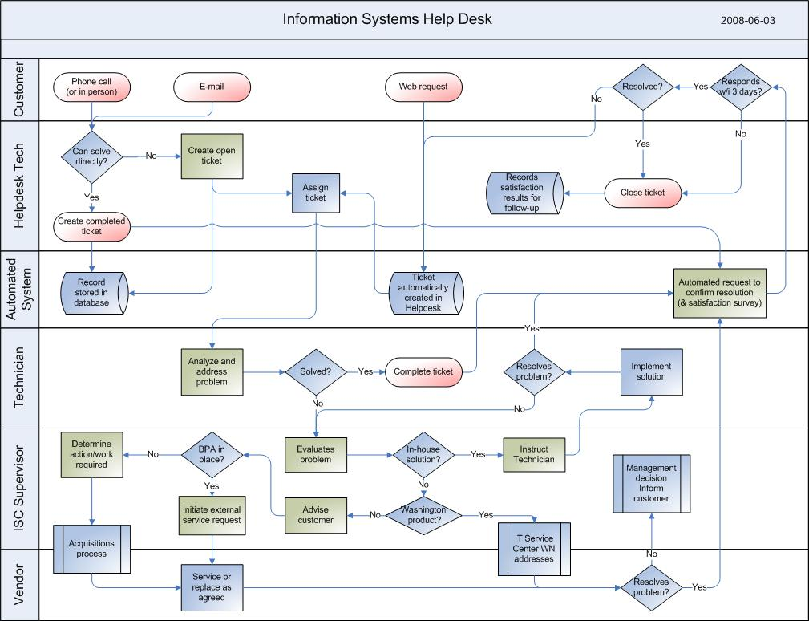
What are internal controls
Flowcharts
Notes:
One way to document internal controls is to develop a flowchart.
Flowchart – a diagram that shows step-by-step progression through a procedure or system especially using connecting lines and a set of conventional symbols (Source: Merriam-Webster Online Dictionary).
Why? Can help analyze processes, identify interdependencies, links system and manual activities, identify control gaps, and inefficiencies.
A flowchart can be used to identify control points. Control points are where internal controls are most important.

Slide 21
What are internal controls
Control Descriptions
Control Descriptions should include:
Why? What is the control trying to stop or ensure?
How? How is the control performed?
What? What does the control seek to do?
Who? Who performs the control?
When? When is the control performed?
Notes:
Why – why do we need a control.
How – be specific to the procedures performed, include details
What – is the control working? How do you know?
Who – use job titles not a person’s name, who performs if primary person is unavailable?
When – frequency (answers the question of how often - daily, monthly, annually), is it performed after another control?

Slide 22
What are internal controls
WALKTHROUGH
What is it?
Traces a transaction through a process from beginning to end.
You follow the transaction step by step and note who processes the transaction, the forms need to process it and the systems used to do the processing.
Notes:
Performing a walkthrough can be a very informative process. It will allow you to see how things are actually done in practice. This is important because what is actually done may differ considerably from the process as it is documented in policies and procedures or from the perception of how the process is done.
Confirms the following:
Understanding of the significant flow of transactions
Understanding of the relevant controls
That relevant controls have been placed in operation
Process documentation

Slide 23
What are internal controls
Who is responsible for internal control?
Notes:
Ask this question to the class. See what responses they come up with.

Slide 24
What are internal controls
The chief executive officer (the top manager) of the organization has the overall responsibility for designing and implementing effective internal control.
Notes:
In a large company, the chief executive fulfills this duty by providing leadership and direction to senior managers and reviewing the way they controlling the business.

Slide 25
What are internal controls
More than any other individual, the chief executive officer sets the ‘tone at the top” that affects integrity and ethics and other factors of a positive control enviroment.

Slide 26
What are internal controls
Board of Directors
Management is accountability to the board of directors, which provide governance, guidance and oversight. Effective board members are objective, capable and inquisitive.
Notes:
Board members should also have a knowledge of the entity’s activities and enviroment, and commit the time necessary to fulfill their board responsibilities.

Slide 27
What are internal controls
Auditors:
The internal auditors and external auditors of the organization also measure the effectiveness of internal control through their efforts. They assess whether the controls are properly designed, implemented and working effectively, and make recommendations on how to improve internal control.

Slide 28
What are internal controls
Limitations:
Internal control can provide reasonable, not absolute, assurance that the objectives of an organization will be met. The concept of reasonable assurance implies a high degree of assurance, constrained by the cost and benefits of establishing incremental control procedures.
Notes:
The cost of implementing an internal control should not outweigh the benefit it produces. Do not implement a control costing $10,000 to catch a $100 mistake.

Slide 29
What are internal controls
Limitations (continued)
Effective internal controls implies the organization generates reliable financial reporting and substantially complies with the laws and regulations that apply to it. However, whether an organization achieves operational or strategic objectives may depend on factors outside the organization, such as competition or technological innovation.
Notes:
These factors are outside the scope of internal control. Therefore, effective internal control provides only timely information or feedback on progress towards the achievement of operational and strategic objectives, but cannot guarantee their achievement

Slide 30
What are internal controls
Describing Internal Controls
Internal controls may be described in terms of
1.) the pertinent objective or financial statement assertion
2.)the nature of the control activity itself.

Slide 31
What are internal controls
Controls that are defined against a particular financial statement assertion to which they relate are as follows:
Existence/Occurrence/Validity
Completeness
Rights and obligations
Valuation
Presentation and Disclosure
Notes:
Existence – only valid or authorized transaction are processed
Completeness – all transactions are processed that should be
Rights and obligations – Assets are the rights of the organization and the liabilities are its obligations as of a given date
Valuation – Transactions are valued accurately using the proper methodology, such as a specified means of computation or formula
Presentation and Disclosure – Accounts and disclosures are properly described in the financial statements of the organization.
For example, a validity control objective might be “Payments are made only for authorized products and services received”. A typical control procedure would be “the payable system compares the purchase order, receiving record, and vendor invoice prior to authorizing payment”. Management is responsible for implementing appropriate controls that apply to all transactions in their area of responsibility.

Slide 32
What are internal controls
Activity Categorization:
Control activities may also be explained by the type or nature of activity. These include (but not limited to):
● Segregation of Duties
● Authorization of transaction
● Retention of Records
●Supervision or monitoring of operations
Notes:
Segregation of duties – separating authorization, custody, and record keeping roles to prevent fraud or error by one person.
Authorization of transaction – review of particular transactions by an appropriate person
Retention of records – maintaining documents to substantiate transactions.
Supervision – observation or review of ongoing operational activity.

Slide 33
What are internal controls
Activity Categorization (continued):
● Physical safeguards
● Top level reviews –analysis of actual results versus
organization goals and plans
● IT General Controls
● IT Application Controls
Notes:
Physical – usage of cameras, locks, physical barriers, etc. to protect property such as inventory
Top level reviews – periodic and regular operational reviews, metrics, and other key performance indicators (KPI).
IT General Controls – Controls related to A.) security, to ensure access to systems and data is restricted to authorized personnel, such as usage of passwords, and review of access logs and B.) Change management, to ensure program code is properly controlled, such as separation of production and test environments, system and user testing of changes prior to acceptance, and controls on migration of code into production.
IT Application Control – controls over information processing enforced by IT applications, such as edit checks to validate data entry, accounting for transactions in numerical sequences and comparing file totals with control accounts.

Slide 34
What are internal controls
Control Precision:
Describes the alignment or correlation between a particular control procedure and a given control object or risk. A control with direct impact on the achievement of an objective (or mitigation of a risk) is said to be more precise than one with indirect impact on the objective or risk.
Notes:
Precision is an important factor in performing a SOX 404 top-down risk assessment. After identifying specific financial reporting material misstatement risks, management and the external auditors are required to identify and test controls that mitigate the risk.

Slide 35
What are internal controls
Fraud and Internal Control:
Internal control plays an important role in the prevention and detection of fraud. Under the Sarbanes Oxley Act, companies are required to perform a fraud risk assessment and assess related control.
Notes:
This typically involves identifying scenarios in which theft or loss could occur and determining if existing control procedures effectively manage the risk to an acceptable level. The risk that senior management might override important financial controls to manipulate financial reporting is also a key area of focus in fraud risk assessment.
The AICPA, IIA, and ACFE also sponsored a guide published during 2008 that includes a framework for helping organizations manage their fraud risk.

Slide 36
What are internal controls
Internal Controls and Process Improvement:
Controls can be evaluated and improved to make a business operation run more effectively and efficiently. For example, automating controls that are manual in nature can save costs and improve transaction processing.
Notes:
If the internal control system is thought of by executives as only a means of preventing fraud and complying with laws and regulations, an important opportunity may be missed. Internal controls can also be used to systematically improve businesses, particularly in regard to effectiveness and efficiency.

Slide 37
What are internal controls
Continuous Control Monitoring:
Advances in technology and date analysis have led to the development of numerous tools which can automatically evaluate the effectiveness of internal control. Used in conjunction with continuous auditing, continuous control monitoring provides assurances on financial information flowing through business processes.

Slide 38
What are internal controls
Future of Internal Controls:
On December 26, 2014 the federal government issued a new guidance on how we account and manage federal grants. The New Edgar, PART 200, Uniform Administrative Req, Cost Principals, and Audits for Federal Awards is what school districts will adhere to.

Slide 39
What are internal controls
Future of Internal Controls:
PART 200 has a MAJOR emphasis on strengthening accountability by improving policies that protect against waste, fraud and abuse.

Slide 40
What are internal controls
INTERNAL CONTROLS
200.302(b)(4)(pg119)
Essentially the same as prior 80.209b)(3)
Effective control over and accountability for:
All funds, Property and Other Assets.
Must adequately safeguard all assets
Use assets solely for authorize purpose
Notes:
Refers to non-equipment items.

Slide 41
What are internal controls
Definition of Internal controls 200.61 (pg102):
Internal controls means a process, implemented by a non-federal entity, designed to provide reasonable assurance regarding the achievement of objectives in the following areas:
1. Effectiveness and efficiency of operations,
2. Reliability of reporting for internal and external use; and
3. Compliance with applicable laws and regulations.

Slide 42
What are internal controls
Internal Control Over Compliance Req for Federal Awards 200.62 (pg102)
Means a process implemented by a non-Federal entity designed to provide reasonable assurances regarding the achievement of the following objectives for federal awards:
Transactions are properly recorded and accounted for, in order to:
Permit the preparation of reliable financial statements and federal reports;
Maintain accountability over assets; and,
Demonstrate compliance with federal statues, regs, and the terms and conditions of the federal award.

Slide 43
What are internal controls
Internal Control Over Compliance Req for Federal Awards (cont.) 200.62 (pg102)
Transactions are executed in compliance with:
Federal statues, regulations, and the terms and conditions of the federal award that could have a direct and material effect on a federal program; and Any other Federal statues and regulations that are identified in the Compliance Supplement; and
Funds, property and other assets are safeguarded against loss from unauthorized use or disposition

Slide 44
What are internal controls
Internal Controls 200.303 (pg 119):
a. Non-Federal entities must establish and maintain effective internal control over the Federal award that provides reasonable assurances that the entity is managing the award in compliance with federal statues, regs, and terms of the award,
New: Internal controls “should” be in compliance with:
The U.S Comptroller General’s Standard for Internal Control Integrated Framework: and
Internal Control Integrated Framework issued by the Committee of Sponsoring Organization of the Treadway Commission (COSO)

Slide 45
What are Internal controls
Internal Controls (cont) 200.303 (pg119):
b. Comply with Federal statues, regs, and the terms and conditions of the Federal awards,
c. Evaluate and monitor the non-Federal entity’s compliance with statues, regs, and the terms and conditions of federal awards,
d. Take prompt action when instances of noncompliance are identified including in audit findings,

Slide 46
What are internal controls
Internal Controls (cont) 200.303 (pg119):
e. Take reasonable measures to safeguard protected personally identifiable information (PII) and other information designated or deemed sensitive.

Slide 47
What are internal controls
Questions?

Slide 48
What are internal controls
Thank You
If you have additional questions contact:
William Smith, Federal Internal Auditor
404.657.2528
Email:wsmith@doe.k12.ga.us

