Slide 1
College and Career Ready Performance Index
(CCRPI)
Leading with CCRPI…
An Overview
Leadership and Data Strategies
Division of School & District Effectiveness

Slide 2
What is CCRPI telling us?
How do we use CCRPI to get better as a school and/or district?
How do I lead with this tool?
Notes:
The main focus of these modules is to learn how do we use the data points of the CCRPI and what do they mean. Then we will look at how we use the CCRPI data points for improving our schools and districts.
This module is not directly about instructional strategies. That’s the work of you and your leadership teams as professionals. Instead we are going to be sharing leadership and data strategies, not instructional strategies as it relates to CCRPI. So don’t get discouraged if you don’t hear your favorite reading comprehension strategy, just know that is not the focus of these modules.

Slide 3
A caveat:
This not AYP
Participation Rate

Slide 4
Why make data-driven decisions?

Slide 6
CCRPI –
Your Data Toolbox
Notes:
If using data is a good tool, CCRPI is a comprehensive toolbox. While CCRPI has many important parts, it is summative data. You can leverage the power of this tool by involving your staff in monitoring and using this data to develop formative measures or leading indicators.
For example….

Slide 7
Involving your Staff with CCRPI
Involve all staff members with specific data sources
Keep a jot list of names throughout this module
Establish a point person for specific data areas
Determine formative measures or leading indicators
Notes:
There is something for everyone with CCRPI.
As we discuss a data point, think, “Who in my building needs to monitor this data source?”
4. There is so much power in establishing formative measures or leading indicators. Let’s take attendance as an example. Let’s say you’ve established a small group of staff members who will monitor attendance. Following attendance would be your formative measure. After this group drills down into attendance, they may decide to look at attendance by grade level, gender, SWD, by a particular neighborhood or bus route, and/or absences triggered by suspensions, etc. This small group of staff members may look at attendance by causes of absences. This information can be very helpful in determining root causes. I know of one district that after doing this analysis realized that students who had been suspended oftentimes was absent 1-3 days after the suspension. They were surprised by this discovery and that triggered some district problem solving around this pattern of absences.

Slide 8
Involving your Staff with CCRPI
Determine what data will be shared and when
Calendarize what you expect to happen
Learn with your staff
Model for your staff what you expect
Reassure your “math phobic” staff
Notes:
It’s all add, subtract, multiply, and divide.

Slide 9
Learning with Data
Looking at data raises new questions
Look at trend data
Look deeply at data sources
Consider selecting a mentor school or mentor district
Notes:
Allow time for teachers to look at the data together in pairs or very small groups.

Slide 10
Modules
Achievement Points
Progress
Achievement Gap
Challenge Points and Climate Star Ratings
Notes:
These modules are in the order from left to right in the CCRPI online ____. But may be viewed individually in any order, depending on the needs of you and your staff.

Slide 11
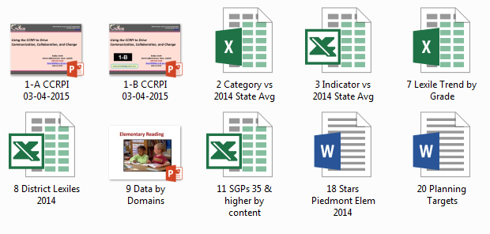

Slide 12
Let’s get started…

Slide 13
College and Career Ready Performance Index
(CCRPI)
Achievement Points
Leadership and Data Strategies
Division of School & District Effectiveness

Slide 14
Emphasis on how the CCRPI
can assist leaders in thinking about
how to work collaboratively
to find, create, and implement
effective strategies to
increase student success

Slide 15
CCRPI Performance Categories
Achievement Points (60 pts) |  |  | Progress Points (SGPs) (25 pts) | Achievement Gap (15 pts) | Challenge Points (10 pts)
Content Mastery (Tests) (24 pts) | Readiness (18 pts) | Graduation (18 pts) |  |  | ED/EL/SWD Performance (Flags) | Exceeding the Bar Indicators
Notes:
Will Use of Graphic Organizer to understand First 100 pts.+ Challenge Points-
Does everyone have a copy?

Slide 16
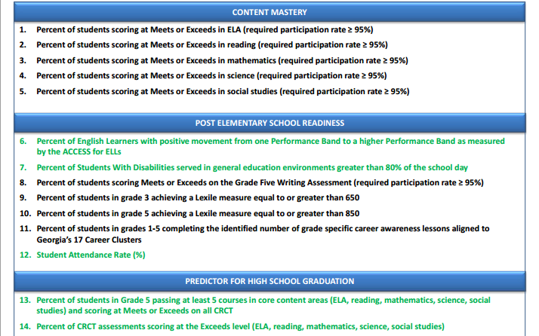
2014 College and Career Ready Performance Index,
Elementary School, Grades K- 5
Notes:
Should all have copy! 2014 – CCRPI indicators to understand WHAT is measured within the components of the index.
Changes with Georgia Milestone: Grades 3 – 8 End of Grade (EOG) in language arts, mathematics, science, social studies
= READING at MS and ES will not be separate test with GA Milestones …conversion charts will be used for comparison. Other changes in 2015.

Slide 17
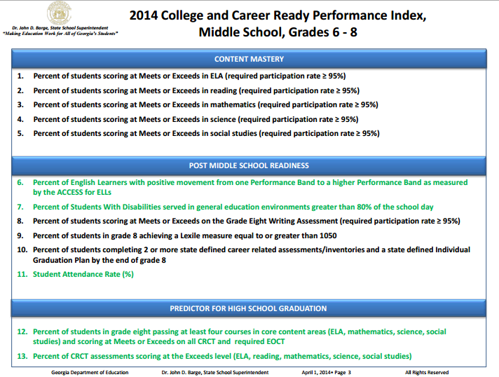
2014 College and Career Ready Performance Index,
Middle School, Grades 6 - 8
Notes:
MS
Changes with Georgia Milestone: Grades 3 – 8 End of Grade (EOG) in language arts, mathematics, science, social studies
= READING at MS and ES will not be separate test with GA Milestones …conversion charts will be used for comparison. Other changes in 2015.

Slide 18
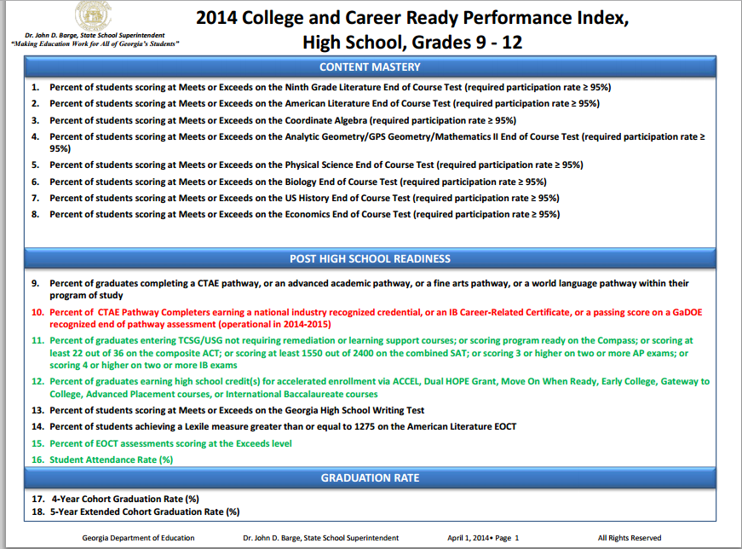
2014 College and Career Ready Performance Index,
High School, Grades 9 - 12
Note Colors
Notes:
HS –

Slide 19
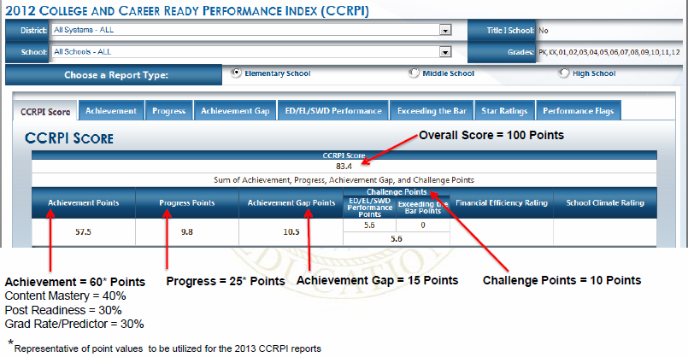
Notes:
Let’s look: brief overview of the CCRPI Score report that you see here – this is just an example of the screen you see on the website/electronic platform.
total is the sum of the first 3 areas/arrows you see here at the bottom. Start breaking down points here!
Note that the Achievement “category” maximum total is 60 points. The Achievement “category” has 3 components/parts or “buckets”. The Progress “category” is 25 points, Achievement Gap “category” is 15 points = 100! … and the Challenge Points “category” is an extra 10 points.

Slide 20
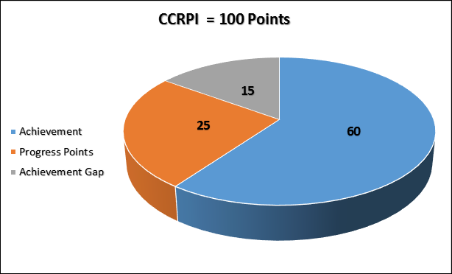

Slide 21
CCRPI Performance Categories
Achievement Points (60 pts) |  |  | Progress Points (SGPs) (25 pts) | Achievement Gap (15 pts) | Challenge Points (10 pts)
Content Mastery (Tests) (24 pts) | Readiness (18 pts) | Graduation (18 pts) |  |  | ED/EL/SWD Performance (Flags) | Exceeding the Bar Indicators
Notes:
Will Use Graphic Organizer to understand – Starting with Achievement Points. Use for Note taking; share in SLT meetings, department meetings..

Slide 22
60 Achievement Points
Content Mastery (Tests) . . . . .. . . 24 points
ES/MS: Indicators 1-5
HS: Indicators 1-8
Readiness . . . . . . . . . . . . . . . . . . . 18 points
ES: Indicators 6-12
MS: Indicators 6-11
HS: Indicators 9-16
Graduation . . . . . . . . . . . . . . . . . . 18 points
ES: Indicators 13-14
MS: Indicators 12-13
HS: Indicators 17-18
Notes:
Look at your indicators here and match up to the points possible (% = 40, 30, 30)
This is where you either pass (meet) or fail (meet or exceed).

Slide 23
CCRPI Performance Categories
Achievement Points (60 pts) |  |  | Progress Points (SGPs) (25 pts) | Achievement Gap (15 pts) | Challenge Points (10 pts)
Content Mastery (Tests) (24 pts) | Readiness (18 pts) | Graduation (18 pts) |  |  | ED/EL/SWD Performance (Flags) | Exceeding the Bar Indicators
Content Mastery pulls in assessment data and matches it to student records. Districts submit data…ensure accuracy.
Notes:
First – Content Mastery. If you use a term “content mastery” they should know what it means. Use the language! Go for rigor and understanding not just passing.

Slide 24
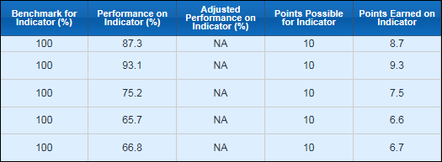
Content Mastery ES/MS School Example
Content
ELA
RDG
Math
Science
Social Studies
Notes:
Quick look – but there is so much more to look at….state avg.
File 3 – Strategy to dig into content areas and find your danger zones – priorities should rise.
Look for root causes.

Slide 25
Content Mastery ES/MS School Example
File 3
Notes:
As a leader, staff look at difference from the state average. What do the numbers tell you? Look how close you are in Reading to state average. Then look at the comparison drops in math, science, and social studies. Significant. Look at Percentage difference. Why are our science kids are doing so poor.

Slide 26
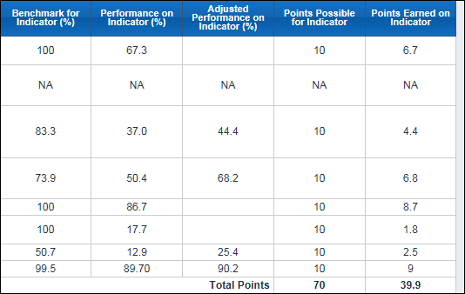
Content Mastery HS Example
Content
9th Gr. Literature
American Literature
Coordinate Algebra
Analytic Geometry/ GPS Geometry/Math II
Physical Science
Biology
U.S. History
Economics
Notes:
Look at strongest content area….Economics and Physical Science. Look at weak areas: Biology, US. History, Coor Algebra.

Slide 27
Content Mastery HS Example
Notes:
Discuss low hanging fruit. Look at how close we are to state average; what are our low areas; why are we so far away from state average?

Slide 28
Content Mastery HS Example
Notes:
This is the strategy to use to help all teachers and staff see the comparison to the state average. Look at Physical Science and Econ! Look at Biology?

Slide 29
Drilling for the WHO and the WHAT
WHO?
WHAT?
Student Groups
Content Domains
Notes:
Then you want to drill down – into the who and the what. Analyze student performance at the domain level.

Slide 30
Content Mastery
Improvement Strategies
Drill into the WHO and the WHAT:
Which domain has the lowest scores by the most students?
Which domain is weighted the most?
What can we act upon quickly?
Notes:
The domain is the group of related curricular standards within a content area. Class and school reports will give you the mean number correct and percent correct for each content domain. They can be used to evaluate curricular and instructional strengths and weaknesses.

Slide 31
Test Domain Performance
Fourth Grade Social Studies
Domains | % of CRCT
History | 50%
Geography | 15%
Government/Civics | 20%
Economics | 15%
Weakest Domain: History
*Domains found in School Reports and SLDS
Who will pull this information by domains?
Notes:
Ex. Domains, weighted %, look at your school performance in each of the domains. ADD people to your JOT LIST!
Who will pull together your scores for each domain, by teacher? Department chair, instructional coaches, assistant principal…teachers during PLC.

Slide 32
U. S. History EOCT Domain Performance
Domains | % of EOCT
Colonization through the Constitution | 19%
New Republic through Reconstruction | 19%
Industrialization, Reform, and Imperialism | 16%
Establishment as a World Power | 24%
Modern Era | 22%
Weakest Domains: Establishment as a World Power and Modern Era
Identify problem area. Determine root causes.
Notes:
It only makes sense that the domains that are given the most weight, should also be given the most attention.
Over the last three years look at how you scored in each domain where your weakest…look in SLDS or written reports..
LOOK at Modern Area – your school is not doing well in this….never get to it.

Slide 33
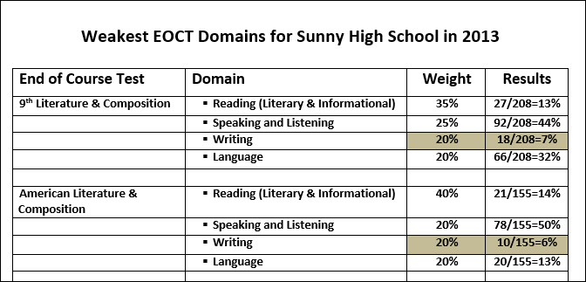
*Trend Data of Pass Rates (3 yrs.) – Use all resources/workgroups
Notes:
Example: Look at the results by department, test, domain, weight, results (passing rates). Use all your resources – instructional coaches,…PLC, strong instruction assistant principal. And, not just human resources…time allotments, PLC – whatever committee and work groups you have formed. Make sure all work groups in your school concentrate on the elements of CCRPI. As you go through the school week – make sure one of your agenda items is on CCRPI or some school improvement initiative/some component. Constantly brainstorming how we can improve an area we are weak on. This should be part of the language we use everyday.

Slide 34
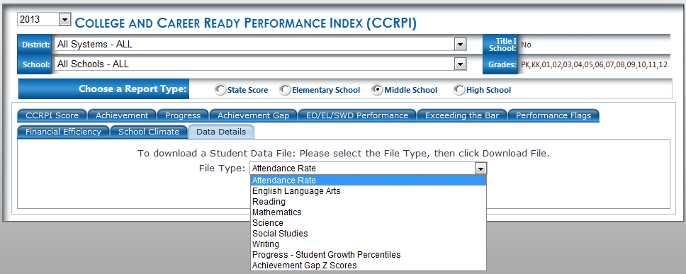
CCRPI Reports in Principal’s Section of MyGaDOE Portal
*Share with counselor, data clerk, leadership team.
*Achievement results can impact up to 70% of total CCRPI.
34
Notes:
Principals have portal access which provides data details - files/spreadsheets which help to validate performance that is displayed under each CCRPI tab. That is how you drill into the “who” – Work the portal… Play with it? Counselors, grad coach – use portal in meetings. During leadership team meetings, pull it up.
If you are unsure about this, contact your district office or the state accountability.

Slide 35
Explore Data Details In Principal’s Section of MyGaDOE Portal:
Spreadsheets that help to sort by students’ performance. Determine root cause; design interventions when necessary.
Dropdown choice: Attendance, Content Performance, Progress – SGP, Achievement Gap Z scores
Pull up and download spreadsheet, Filter by FAY = Y vs N Filter by content (remember some are combined US History & Econ) Sort High to Low to determine lowest 25%.....(Gap)
Special Note: GAA & CRCT M are not included
Notes:
FAY = For content mastery in Achievement, Progress, and GAP sections – subject assessment for Georgia Milestones (CRCT, EOCT)
Looking at HS 65% from state date of marking period to end date of marking period.
ES-MS = start date of year to close of test window.
(one family or situation can permeate more than one grade level. Keep that in mind before throwing out strategies that may be working.

Slide 36
CCRPI Performance Categories
Achievement Points (60 pts) |  |  | Progress Points (SGPs) (25 pts) | Achievement Gap (15 pts) | Challenge Points (10 pts)
Content Mastery (Tests) (24 pts) | Readiness (18 pts) | Graduation (18 pts) |  |  | ED/EL/SWD Performance (Flags) | Exceeding the Bar Indicators
Notes:
Now, onto Readiness

Slide 37
60 Achievement Points
Content Mastery . . . . . . . . . . . . . . . . 24 points
ES/MS: Indicators 1-5
HS: Indicators 1-8
Readiness . . . . . . . . . . . . . . . . . . . 18 points
ES: Indicators 6-12
MS: Indicators 6-11
HS: Indicators 9-16
Graduation . . . . . . . . . . . . . . . . . . 18 points
ES: Indicators 13-14
MS: Indicators 12-13
HS: Indicators 17-18
Notes:
Match with your indicators

Slide 38
2014 College and Career Ready Performance Index,
Middle School, Grades 6 - 8
Notes:
READINESS is all about preparing students for the next level. Post ES, MS, or HS readiness.

Slide 39
Notes:
Blow up of each; mention examples: SWD being served in general ed (Co-teaching) Taken from FTE count. Lexile measures – Score comes from test that matches a student’s reading ability with difficulty of textual material. An indicator of a student’s reading ability. Look at 10 – do you have an Intake and Exit process to ensure all student complete this career assessment/ and IGP by grade 8? Student attendance! Important! (changing this year… credit for students absent fewer than six days. (without exception)

Slide 40
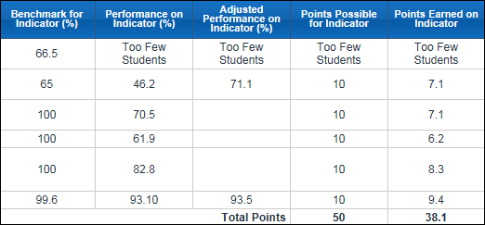
Post School Readiness Middle School Example
% of Students…
ELL Positive Movement
SWD served in general education 80%
Meets or Exceeds 8th Writing Assessment
Gr. 8 Lexile ≥ 1050
2+ Career assessment inventories/IGP Gr. 8
Student Attendance Rate
Notes:
Example
38.1 ÷ 50 = Category performance of 0.762 X 18 points = 13.72 out of 18. Compare to state average – again. (shows later slide with grad rate)

Slide 41
Improvement Strategies for Post School Readiness
Ensure all indicators are understood; know how they apply to your students. (ES, MS, HS)
Assign person responsible for each indicator.
Do you have an Intake and Exit process to ensure all students complete this career assessment and Individual Graduation Plan by grade 8? Who is responsible?
Notes:
Every level, every school must look at each indicator and how it applies to their students. Must have conversations with parents about How to take education seriously. Are you explaining attendance rate up front. Important individually and the school as whole. Direct correlation between attendance and good performance. Have contests! By grade! Free ice cream; field day; dance. Publicize – celebrate good performance. Wall of Fame….every homeroom, set goal.

Slide 42
More Strategies for Post School Readiness
Who will track attendance? (attendance committee, AP, grad coach)
Do you have a plan in place and on radar? Who is notified; when, and what action is taken?
Show tracking of attendance – emphasize correlation to good performance.

Slide 43
Leading Indicator:
Monthly Student Attendance
S&D
Notes:
Example: Are you tracking attendance at the school level, district level? Are you posting the information, challenging each other, providing incentives, celebrating?
Look at it by month. Districts…are you tracking attendance, sharing at principal meetings? 2015 = Percent of students missing fewer than 6 days of school.

Slide 44
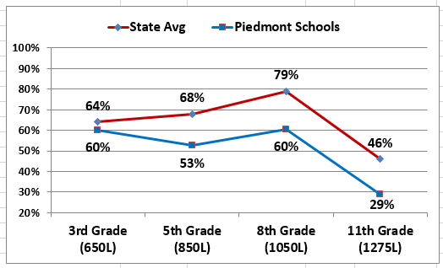
A District Look at 2014 Lexile Performance
File 7
File 8
Notes:
District look – find out where and why Lexile scores are not progressing between MS and HS? Use work groups – look at data on monthly basis before problems gets big. Encourage Data ROOMS – where information is easily accessible. How many of you have data rooms. Grade 3 = or greater than 650, Grade 5 = or greater than 850,
Grade 8 = or greater than 1050
HS – AM. Lit = or greater than 1275

Slide 45
CCRPI Performance Categories
Achievement Points (60 pts) |  |  | Progress Points (SGPs) (25 pts) | Achievement Gap (15 pts) | Challenge Points (10 pts)
Content Mastery (Tests) (24 pts) | Readiness (18 pts) | Graduation (18 pts) |  |  | ED/EL/SWD Performance (Flags) | Exceeding the Bar Indicators
Notes:
Finally, third component of Achievement is Predictor for Graduation or Graduation.

Slide 46
60 Achievement Points
Tests . . . . . . . . . . . . . . . . . . . . . . . . . . 24 points
ES/MS: Indicators 1-5
HS: Indicators 1-8
Readiness . . . . . . . . . . . . . . . . . . . 18 points
ES: Indicators 6-12
MS: Indicators 6-11
HS: Indicators 9-16
Graduation . .. . . . . . . . . . . . . . . . . 18 points
ES: Indicators 13-14
MS: Indicators 12-13
HS: Indicators 17-18

Slide 47
2014 College and Career Ready Performance Index,
Middle School, Grades 6 - 8
Notes:
Preparing students for next level & finally college and career

Slide 48
ES
 |  | Benchmark | Performance | Adjusted Performance | Points Possible | Points Earned
13 | Percent of Grade 5 students passing all 5 core classes and tests. | 91.6 | 65.1 | 71.1 | 10 | 7.1
14 | Percent of CRCT assessments scoring at the Exceeds level | 65.7 | 20.9 | 31.8 | 10 | 3.2
 |  | Total Points |  |  | 20 | 10.3
 |  | Category Performance % |  |  | .515
48
Notes:
13. Tests and grades – aligned? If not aligned, take a look at what is missing? Look at failure rates by teacher. Conferences: Homework – why aren’t they turning it in for you if they are turning it in for others? Other classes not have failure rate. Are you not communicating with students, parents, or are you not motivating them? You’ve got to do all the extras. Flip it around. Teacher performance issue – be prepared to deal with.
14. Look at rigor – how many students are exceeding. That should be a personal goal for some.

Slide 49
MS
 |  | Benchmark | Performance | Adjusted Performance | Points Possible | Points Earned
12 | Percent of students in grade eight passing at least four courses in core content areas (ELA, mathematics, science, social studies) and tests | 88.2 | 45.9 | 52 | 10 | 5.2
13 | Percent of CRCT assessments scoring at the Exceeds level | 59.1 | 20.8 | 35.2 | 10 | 3.5
 |  | Total Points |  |  | 20 | 8.7
 |  | Category Performance % |  |  | .435
Notes:
Rigor

Slide 50
HS
(HS: Use these % on file 3.)
 |  | Benchmark | Performance | Adjusted Performance | Points Possible | Points Earned
17 | 2013 4-Year Cohort Graduation Rate % | 100 | 82.6 |  | 6.66667 | 5.5
18 | 2012 5-Year Extended Cohort Graduation Rate % | 100 | 77.6 |  | 3.33333 | 2.6
 |  | Total Points |  |  | 10 | 8.1
 |  | Category Performance % % |  |  | .81
Not needed when Benchmark is 100%.
Not needed when Benchmark is 100%.
Have you built in Credit Recovery?
Notes:
Four year cohort of students – determined by the students who enter 9th grade at a particular time in a school year (Ex. 2012-2013 --- expected to graduate 2016).
That cohort of students expected to graduate in four years. Do you have built in credit recovery programs, make it up as they go….so they can stay with their cohort and not get behind. (7 period day – can take courses over in a typical day) Summer school, Saturday school, After school. What is your strategy? Help prepare them for college. ..allows students to get more courses in, but also prep transcript (appealing).
Five year Extended cohort – those allowed an extra or extended time period. Notice the two are weighted differently. More points possible for finishing in 4 yr.

Slide 51
Improvement Strategies
Predictor for HS Graduation
Track pass/failure core content classes each grading period. Conversations with teachers.
Ask for district content support when necessary.
Track pass/failure rate on CRCT/EOCT (Georgia Milestones).
Compare all readiness and graduation indicators to state average.
Notes:
District administrators should know the performance numbers of each school. Performance and student achievement should direct the conversation at each evaluation stage. Ask if there are supports needed from the district. Content specialists, PL, ideas from peers (partners within the district). What rewards are in place; how do you celebrate successes.
Remember: only you can know what will work for your school/district. Conversations you need to have with district and school leaderships. Not checklist.

Slide 52
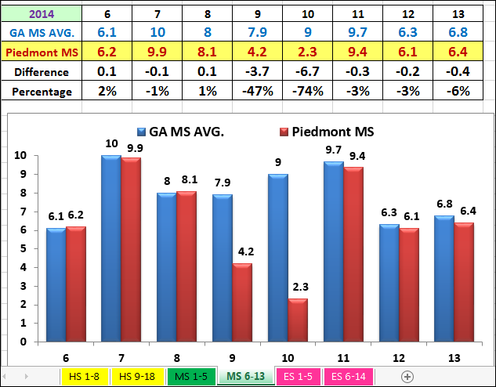
CCRPI Indicator Analysis
Notes:
From this graph of the state avg and your school, which of the indicators would you attack? Way off state average? Which one, is it significant at our school?
Add HS example – manipulate it to show low performing area. Attendance is low, so the leadership team may want to brainstorm.

Slide 53
Leading Indicator
Passing ALL Classes
First Nine Weeks
Notes:
Visual example of publicizing your performance – encouraging competition and growth.

Slide 54
District CCRPI Scores by School Level
File 6
Notes:
District comparisons to be discussed. What is Elm MS doing that we can all do? Break it down by content.

Slide 55
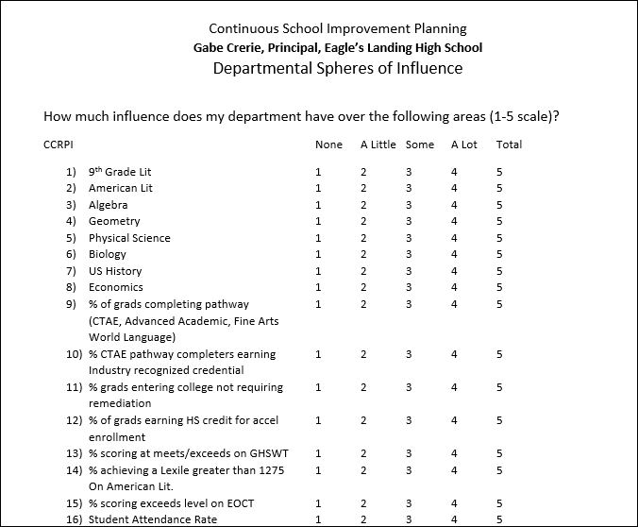
One example to build goals
Notes:
Staff buy-in. Evaluate and re-evaluate where your staff is….train in small groups.

Slide 56
2014 College and Career Ready Performance Index,
High School, Grades 9 - 12
Colors
Notes:
HS –

Slide 57
Jot list – Identifying who’s responsible!
CCRPI Webinar Scout – Assistant Principal
Student Records – Data Clerk, Counselor
Content Data Results – Department Chairpersons
Content Domain Dig – Department Chairpersons
Each Readiness Indicator (i.e. ELL students, SWD Co-Teaching classes, Attendance, etc.)
Intake and Exit Process – Lead Counselor
Pass/Fail Rate by Grading Period – Department Chair or Grade Level Lead
Notes:
Not solely about increasing the CCRPI scores of individual schools but emphasizing how the CCRPI can assist leaders in thinking about how they can work collaboratively to find, create, and implement effective strategies and interventions to improve student success.

Slide 58
Summary of Achievement
Content Mastery – passing, failing, exceeding on Milestones. Has major impact across all components = quality instruction and teaching to the standards. (24 points)
Readiness is about getting them ready for the next level = Success! (18 points)
Predictor for graduation – getting them ready for graduation = College and Career! (18 points)
Notes:
You can use CCRPI to drill into each component and fine tune your focus. (District/school level) This is not solely about increasing the CCRPI scores of individual schools but emphasizing how the CCRPI can assist leaders in thinking about how they can work collaboratively to find, create, and implement effective strategies and interventions to improve student success.

Slide 59
Additional Resources
Office of Accountability
Cowen Harter, Director
charter@doe.k12.ga.us
http://www.gadoe.org/Curriculum-Instruction-and-Assessment/Accountability/Pages/default.aspx
Office of Assessment
Melissa Fincher, Ph.D., Deputy Superintendent of Assessment
mfincher@doe.k12.ga.us
http://www.gadoe.org/Curriculum-Instruction-and-Assessment/Assessment/Pages/default.aspx
Statewide Longitudinal Data System (SLDS)
https://www.gadoe.org/Technology-Services/SLDS/Pages/SLDS.aspx

Slide 60
Additional Tool Effective Practices for CCRPI
Steps to find:
Go to GaDOE Website
Click on Accountability
Scroll down to Additional Resources
Upper left corner – Choices by level
Choose indicator

Slide 61
College and Career Ready Performance Index
(CCRPI)
Student Growth Percentiles
(SGPs)
Leadership and Data Strategies
Division of School & District Effectiveness

Slide 62
Additional Information
Allison Timberlake
Growth Model Program Manager
atimberlake@doe.k12.ga.us
gsgm@gadoe.org

Slide 63
CCRPI Performance Categories
Achievement Points (60 pts) |  |  | Progress Points (SGPs) (25 pts) | Achievement Gap (15 pts) | Challenge Points (10 pts)
 |  |  |  |  | ED/EL/SWD Performance (Flags) | Exceeding the Bar Indicators
Points for students who have typical or high growth
(35% - 99%)
NEW DATA

Slide 64
Student Growth Percentiles (SGPs)
Data used for:
Student performance (Statewide Longitudinal Data System/SLDS)
Instructional improvement (School Improvement Planning)
School accountability (College and Career Ready Performance Index)
Teacher Effectiveness Measure (TEM)

Slide 65
Surviving the Data Drought
SGPs are:
Consistent data
Impacted by effective teaching
Count 50% of teacher evaluation and leader evaluation

Slide 66
Background on
Student Growth Percentiles
Students obtain growth percentiles, ranging from 1 to 99, which indicate how their current achievement compares with that of their statewide academic peers who had similar score histories.
Georgia Student Growth Model
http://www.youtube.com/watch?v=dyArv7184ZY&feature=player_embedded

Slide 67
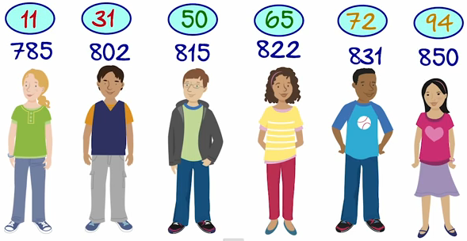

Slide 68
What a Student’s Individual SGP Means
If this student has a 65 SGP in Science, it means that she outperformed 65% of the students in her statewide academic peer group.
It also means that she was outperformed by 35% of that peer group.
1
99

Slide 69
in CCRPI
SGPs for FAY Students
34%
66%
Low
Growth
Typical
Growth
High
Growth

Slide 70
Types of Growth for Students
SGP Ranges | Type of Growth
1-34 | Low Growth
35-65 | Typical Growth
66-99 | High Growth

Slide 71
Achievement Data Versus Student Growth Data
Snapshot of student achievement
Scale scores/cut scores
Does Not Meet,
Meets, Exceeds
to
to
Students starting point is used
Students compared to “like students”
All levels of achievement can demonstrate all levels of growth
Growth is independent of cut scores

Slide 72
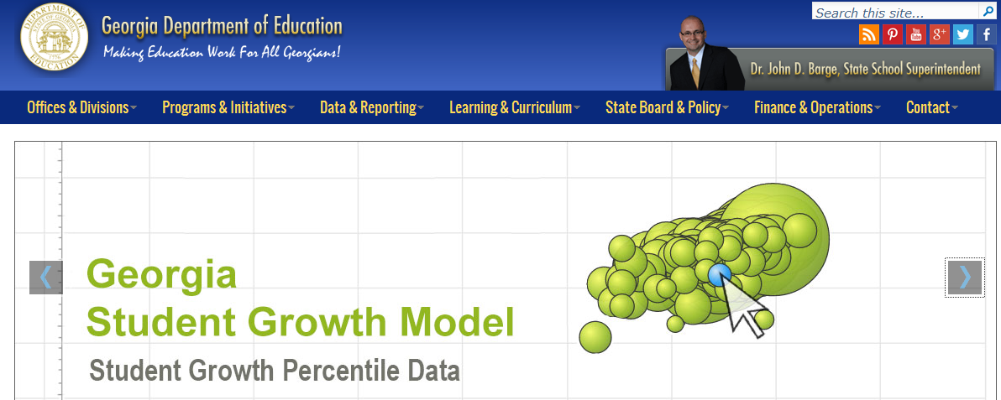
What the Public Can View
www.gadoe.org

Slide 73
in SLDS
Higher Achievement
Lower Growth
Higher Achievement
Higher Growth
ACHIEVEMENT
% Meets & Exceeds
GROWTH
Lower Achievement
Lower Growth
Lower Achievement
Higher Growth
Median Student Growth Percentile

Slide 74
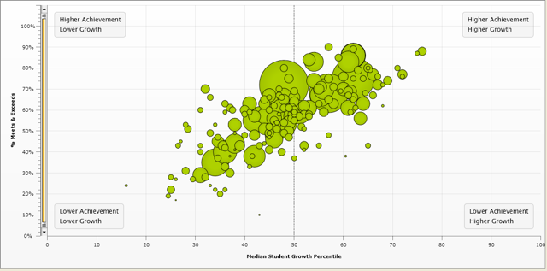
SGPs for Districts
100%
90%
80%
70%
60%
50%
40%
30%
20%
10%
0%
Higher Achievement
Higher Achievement
Higher Growth
Lower Growth
% Meets & Exceeds
Lower Achievement
Lower Growth
Lower Achievement
Higher Growth
0% 10% 20% 30% 40% 50% 60% 70% 80% 90% 100%
Median Student Growth Percentile

Slide 75
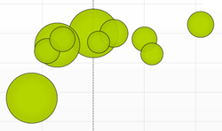
SGPs for Schools
100%
90%
80%
70%
60%
50%
40%
30%
20%
10%
0%
Higher Achievement
Higher Growth
Higher Achievement
Lower Growth
% Meets & Exceeds
50% of a teachers evaluation will come from SGP data.
Lower Achievement
Lower Growth
Lower Achievement
Higher Growth
0% 10% 20% 30% 40% 50% 60% 70% 80% 90% 100%
Median Student Growth Percentile

Slide 76
Teacher Resource
SLDS (Statewide Longitudinal Data System) provides the information for Student Growth data that can be manipulated in a variety of ways.
Teachers can disaggregate the data in a variety of ways. One example is by class period or teaching segment. This provides the teacher the opportunity to analyze his/her teaching and how student growth is similar or different depending on a variety of factors.

Slide 77
Teacher Effectiveness Measure Table
Needs Development
Proficient
Exemplary
Exemplary
IV
(66-99)
Needs Development
Proficient
Proficient
Exemplary
III
(41-65)
Overall SGP Rating
Ineffective
Needs Development
Needs Development
Proficient
II
(30-40)
Ineffective
Ineffective
Needs Development
Needs Development
I
(1-29)
I
(0-6)
II
(7-16)
III
(17-26)
IV
(27-30)
Overall TAPS Rating
Different Use of SGPs

Slide 78
CCRPI Reports in Principal’s Section of MyGaDOE Portal
Data can be sorted by:
Race
Gender
Subgroup (ED, SWD, EL)
Scale Score
Data can be sorted by:
SGP Score
SGP Growth
Content Comparisons

Slide 79
CRCTs | % 35 or above | # Students Meeting Typical/High Growth | Count of Students with SGPs
ELA | 60% | 672 | 1127
Reading | 68% | 766 | 1126
Mathematics | 61% | 681 | 1120
Science | 28% | 325 | 1156
Social Studies | 39% | 450 | 1152
Total | 3592 |  | 5681
Percent Meeting Typical/High Growth | (3592 divided by 5681) .63228
Weighted Performance | .63228 X 25 points for the Category
Progress Points Earned | 15.8 Points

Slide 80
EOCTs | % 35 or above | # of Students with Typical/High Growth | Count of Students with SGPs
9th Grade Lit./Amer. Lit. | 64% | 342 | 536
Math I, Alg./Math II, Geo. | 71% | 407 | 573
Biology/Physical Science | 64% | 167 | 260
US History/Economics | 31% | 150 | 483
Total | 1254 |  | 1852
Percent Meeting Typical/High Growth | (1254 divided by 1852) .67711
Weighted Performance | .67711 X 25 Points for the Category
Progress Points Earned | 16.9 Points

Slide 81
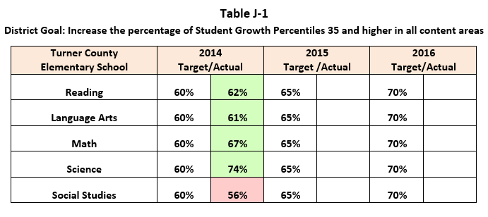
CCRPI Targets
Elementary Goal: Increase the percentage of Student Growth Percentiles 35 and higher in all content areas.
Notes:
In 2011-2012, there were 1,373 students who obtained a Growth Percentile for English Language Arts. Of those 1373 students, 819 students demonstrated typical to high growth as defined by a pre-determined rubric set by the GaDOE. For each content area, we compare potential for growth to actual growth until we have a total number of students meeting typical/high growth and a total number of SGPs.
Dividing the 4544 students with typical/high growth by 6960 gives a weighted performance of .65287. This number is then multiplied by the possible 15 points for a total progress score of 9.8 points.
It should be noted that this is the SECOND time that core content mastery has an impact on the total CCRPI score. However, can still fail test, but earn points because you make 35 – 99% “typical or high” growth…based on Academic Peers. (High fliers – they may not grow enough to get points – unless there ahead of the bottom 35%.)

Slide 82
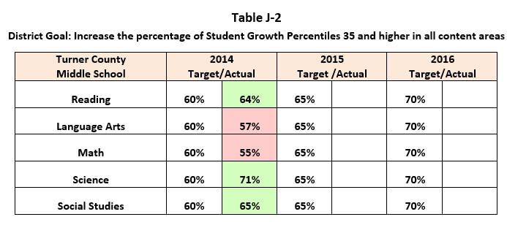
CCRPI Targets
Middle School Goal: Increase the percentage of Student Growth Percentiles 35 and higher in all content areas.

Slide 83
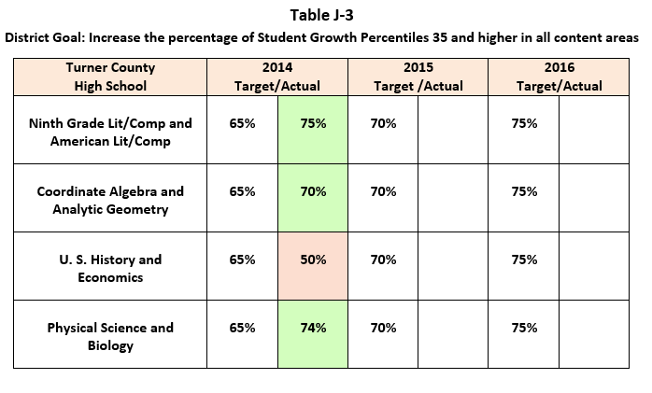
CCRPI Targets
High School Goal: Increase the percentage of Student Growth Percentiles 35 and higher in all content areas.

Slide 84
Progress Points by School
GA ES Avg | 15.9
District ES Avg | 14.8
Smith ES | 14.1
Jones ES | 16.7
Lamar ES | 11.5
Lee ES | 15.4
Evans ES | 13.5
Moore ES | 13.9
Preston ES | 13.9
Gates ES | 12.5
River ES | 16.3
Bloom ES | 9.8
Turner ES | 16.4
Lake ES | 16.1
Creek ES | 16.3
Pond ES | 16.4
Rex ES | 18.7
Webb ES | 14.6
Compare SGP data by school to achievement data by school!

Slide 85
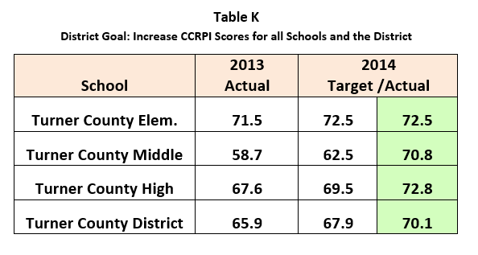
CCRPI Targets
District Goal: Increase the SGPs for all schools and the district.
Oak Elementary
Middle School
Cyprus High School
Cyprus District

Slide 86
Summary of SGPs
50% of a teacher’s and leader’s evaluation will come from SGP data.
A SGP is separate and independent of achievement (cut scores).
A SGP describes a student’s growth relative to other students with similar prior achievement.
Every student’s SGP has potential to earn points toward the progress score.
SGPs provide a valuable piece of information, in addition to student test scores, that can be useful in understanding and improving student performance.

Slide 87
Jot List
District leaders should use SGP data to identify strengths and areas of concern within the district.
School leaders should use individual teacher and student SGP data (subgroup, gender, race, scale score) to do the following:
Identify strengths and weaknesses within the school.
Compare with other schools in the district and state.
Identify the most effective teachers with all students.

Slide 88
Each teacher should know his/her percentage of students making typical or high growth, and analyze the data to discover the root causes of the growth and lack of growth (schedules, subgroups, instructional strategies, co-teaching, etc.)
Each student should know his/her growth from year to year and set goals based on growth percentiles.
Parents should know their children’s growth from year to year (apple to apple comparison).

Slide 89
Additional Information
Allison Timberlake
Growth Model Program Manager
atimberlake@doe.k12.ga.us
gsgm@gadoe.org

Slide 90
College and Career Ready Performance Index
(CCRPI)
Gap
Leadership and Data Strategies
Division of School & District Effectiveness

Slide 91
CCRPI Performance Categories
Achievement Points (60 pts) |  |  | Progress Points (SGPs) (25 pts) | Achievement Gap (15 pts) | Challenge Points (10 pts)
Content Mastery (Tests) (24 pts) | Readiness (18 pts) | Graduation (18 pts) |  |  | ED/EL/SWD Performance (Flags) | Exceeding the Bar Indicators
Notes:
Will Use Graphic Organizer to understand First 100 pts.+ Challenge Points-
For ED/EL/SWD you must determine what % of your students fall in here. This is where you need to refer to the Performance Targets (trigger subgroup flags) identified in the ESEA Waiver: Perhaps this document should be on the “windshield of your school bus!”

Slide 92
CCRPI Points
Tests 24 points
Readiness 18 points
Graduation 18 points 60 points
Student Progress -- 25 points
Closing the GAP -- 15 points
100 Points
Challenge Points 10 Points
Total 110 Points
}
40 Points

Slide 93
Links Teacher, Leader, and School Accountability
50% SGP Plus 20% GAP= 70% of Evaluation
LKES
TKES
CCRPI
50 % SGP

Slide 94
CCRPI Reports in Principal’s Section of MyGaDOE Portal
Where are the lowest 25%
Achievement Gap Z Scores
94
Notes:
Principals have portal access which provides data details - files/spreadsheets which help to validate performance that is displayed under each CCRPI tab. That is how you drill into the “who” – Work the portal… Play with it? Counselors, grad coach – use portal in meetings. During leadership team meetings, pull it up.
If you are unsure about this, contact your district office or the state accountability.

Slide 95
State’s mean performance of FAY students
(reference group)
THE GAP in Scale Scores
School’s lowest quartile of FAY students
(focal group)
Notes:
Utilize the school’s lowest quartile of FAY students based on scale scores (focal group).
Utilize the state’s mean performance of FAY students based on scale scores (reference group).
Standardize the scale scores for the school and the state using the 2011 (baseline year) state mean and standard deviation.
Calculate the gap size by finding the difference between the mean scale scores for the state and the school.
Assign a score for the gap size utilizing the rubric:
A “Z Score” represents the distance between a score and the average in units of the standard deviation.
Thus, a positive “Z Score” represents a score above the mean, while a negative “Z Score” represents a score below the mean.

Slide 96
2014 ACHIEVEMENT GAP SIZE
GAP SIZE | SCORE
1.2 or Greater | 0
0.9 – 1.19 | 1
0.5 – 0.89 | 2
Less than 0.5 | 3
BIG
SMALL
Big Gap = Fewer Points
Small Gap = More Points

Slide 97
ACHIEVEMENT GAP CHANGE
GAP CHANGE | SCORE
0.05 or Greater | 0
-0.04 – 0.04 | 1
-0.15 – -0.05 | 2
Less than -0.15 | 3
SMALL
BIG
Big Gap Reduction = More Points
Small Gap Reduction = Fewer Points
Notes:
To calculate Achievement Gap, GaDOE will:
Calculate the gap change.
Current year gap size minus prior year gap size
Assign a score for the gap change utilizing the rubric:

Slide 98
High School
EOCTs (4 Content Areas) | Gap Size | Gap Change | Higher of Gap Size/Gap Change | Points Possible
9th Grade Lit/Amer. Lit. | 0 | 3 | 3 | 3
Math I-Alg./Math II-Geo. | 1 | 2 | 2 | 3
Biology/Phy. Science | 1 | 2 | 2 | 3
US History/Econ. | 0 | 1 | 1 | 3
Total |  |  | 8 | 12
Percent of Higher of Gap Size/Gap Change | .66667
Weighted Performance | (.66667) X 15
Achievement Gap Points Earned | 10 Points

Slide 99
Content Mastery HS Example
Notes:
Discuss low hanging fruit. Look at how close we are to state average; what are our low areas; why are we so far away from state average?

Slide 100
EOCTs | # of Students with Typical/High Growth | Count of Students with SGPs
9th Grade Lit./Amer. Lit. | 342 | 536
Math I, Alg./Math II, Geo. | 407 | 573
Biology/Physical Science | 167 | 260
US History/Economics | 201 | 483
Total | 1254 | 1852
Percent Meeting Typical/High Growth | (1254 divided by 1852) .67711
Weighted Performance | .67711 X 25 Points for the Category
Progress Points Earned | 16.9 Points
64%
71%
64%
41%

Slide 101
Elementary or Middle School
CRCTs (5 Content Areas) | Gap Size | Gap Change | Higher of Gap Size/Gap Change | Points Possible
ELA | 1 | 2 | 2 | 3
Reading | 2 | 2 | 2 | 3
Mathematics | 0 | 1 | 1 | 3
Science | 0 | 3 | 3 | 3
Social Studies | 1 | 1 | 1 | 3
Total |  |  | 9 | 15
Percent of Higher of Gap Size/Gap Change | .60
Weighted Performance | (.60) X 15
Achievement Gap Points Earned | 9.0 Points

Slide 102
Six Solutions for Goal Development
Set goals as if CRCTs and EOCTs will still be in place, but make a note that the goals will be revised when the waiver targets for each content area are revised.
Set goals to increase the percentage of students with a SGPs 35 or higher (typical or high growth) by X% in each content area.
Set goals to increase the average SGP in each content area by X% in each content area. (Aligned with TEM)
Set goals to score at or above the state average on the Milestones for each content area.
Set goals to decrease the Achievement Gap Size from the previous year by X% in each content area.
Set goals using locally developed assessments or professionally developed assessments that have been used in the school.

Slide 103
Leadership Strategies
Use Gap Scores – along with Achievement/Progress – to find domain weakness
Drill down to domain level – look for three-year trend
Focus on level of growth – 0, 1, 2, or 3
Develop SMART goals that address reducing the Gap at the Domain Level
Use as a monitoring tool for school’s remediation efforts – summer school, after school tutoring, FLP, outside vendors

Slide 104
Jot List – whose in charge?
Department Heads -Three-year trend by Domain
Classroom Teachers - Action Strategies specific by Domain
Principal, API, Department Head, SWD Lead, ELL Lead, ED Lead - Student list bottom 25%

Slide 105
Summary
It’s all about bottom 25% – NOT subgroups
It’s all about showing growth for points
Know your trends and focus on the DOMAIN level
Use Gap score to measure remediation efforts

Slide 106
Additional Resources
Ga DOE office of Accountability
http://www.gadoe.org/Curriculum-Instruction-and-Assessment/Accountability/Pages/default.aspx
Statewide Longitudinal Data System (SLDS)
https://www.gadoe.org/Technology-Services/SLDS/Pages/SLDS.aspx
My GaDOE Portal
https://portal.doe.k12.ga.us/Login.aspx
Cowen Harter – Director of Accountability
404-463-1168 / charter@doe.k12.ga.us

Slide 108
CCRPI Improvement Strategies
Improve CCRPI understanding of school and district leaders.
Develop a communication plan.
Implement SIG/DOA concepts.
Push understanding to the teacher level.
Improve portal proficiency of administrators.
Improve teacher and leader proficiency with SLDS.
Understand the math behind the numbers.
Appoint Webinar/Accountability scouts.

Slide 109
CCRPI Improvement Strategies
Teach Science and Social Studies.
Find the “low hanging” fruit.
Monitor and improve RTI, FLP, ILT (Lowest quartile gap).
Improve co-teaching practices.
Recognize that the big problems are district problems (grad rate, literacy, math, etc.)
Use the spreadsheet tools to drill into CCRPI category and indicator performance.
Use the spreadsheet tools to project the content mastery category score.

Slide 110
CCRPI Improvement Strategies
Re-examine adult expectations for all quartiles of students.
Develop district Waiver experts.
Know your GaDOE Accountability Specialist.
Understand Focus and Priority criteria (entering and exiting criteria).
Brainstorm problems with Georgia School Performance Standards.
Self assess with Georgia School Performance Standards.
Increase descriptive feedback to teachers.
Increase descriptive feedback to students.

Slide 111
CCRPI Improvement Strategies
Drill into domain performance in all content areas on CRCTs/EOCTs.
Use the modified 80/20 principle.
Examine lessons, units, and assessments of the weakest domains.
Drill into subgroup performance.
Know your flag targets.
Understand the “stars.”
Use regression analysis when possible.

Slide 112
CCRPI Improvement Strategies
Develop leading indicators such as “passing four core classes” in all grades.
View CRCT performance with new performance levels.
Harvest formative data from CCRPI.
Use CCRPI data to determine the effectiveness of professional learning.
Implement great school and district planning practices.
Crosswalk the strategies in all plans, including SIP, with CCRPI indicators.

Slide 113
CCRPI Improvement Strategies
Be upfront with teachers regarding the upcoming evaluations.
Align the intended, taught, and tested curricula.
Increase staff understanding of SGPs.
Create healthy competition between content areas (with SGPs 35 and higher).
Avoid layering on extra work.

Slide 114
College and Career Ready Performance Index
(CCRPI)
Challenge Points
Leadership and Data Strategies
Division of School & District Effectiveness

Slide 115
CCRPI Performance Categories
Achievement Points (60 pts) |  |  | Progress Points (SGPs) (25 pts) | Achievement Gap (15 pts) | Challenge Points (10 pts)
Content Mastery (Tests) (24 pts) | Readiness (18 pts) | Graduation (18 pts) |  |  | ED/EL/SWD Performance (Flags) | Exceeding the Bar Indicators

Slide 116
1. Performance Flags
Red, Green, Yellow Flags
2. Exceeding the Bar Indicators
.5 per indicator
P
P-SG
P
10

Slide 117
CCRPI Points
Tests 24 points
Readiness 18 points
Graduation 18 points 60 points
Student Progress -- 25 points
Closing the GAP -- 15 points
100 Points
Challenge Points 10 Points
Total 110 Points
}
40 Points

Slide 118
“Challenge” or Bonus Points
Maximum points allowed – 10 points
ED/EL/SWD Performance
The number of possible points determined by the percentage ED/EL/SWD students in the school.
EX. A school with a 60% ED/EL/SWD population can earn 6 points.
The percentage of Green and Yellow (SG) Performance Flags with 95% participation rate (P).
2. Exceeding the Bar Supplemental Indicators
FLAGS

Slide 119
How many points can you earn with Performance Flags?
Notes:
Let’s look at a specific school. Please bear with me with a little math to illustrate how many points a school may be able to earn in the Performance Flags category. This school has a total of 2895 total students but 1398 fall into those three subgroups of ED, EL, and SWD. That 1398 is .48 or 48% of the students. As a result, this school can earn up to 4.8 points of the 10 points available. This school could earn 20 flags total. For this school year, they earned 15 out of the 20 or 75% of the flags. That means

Slide 120
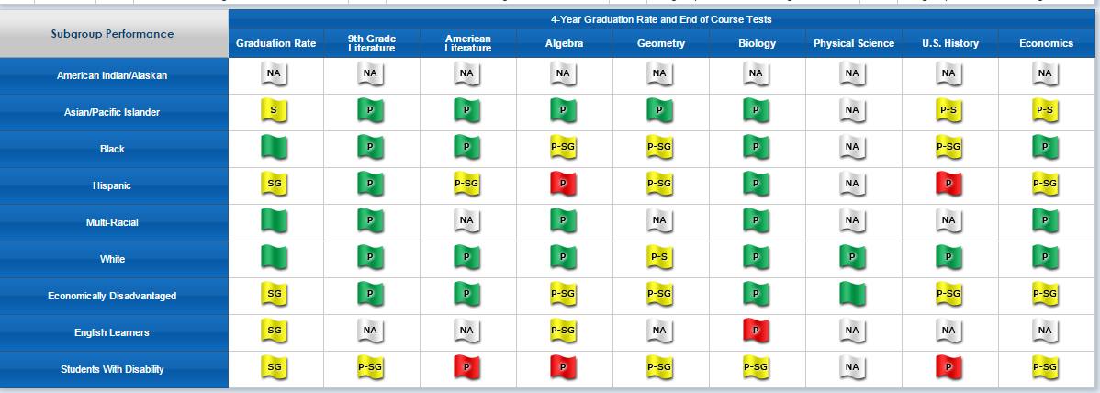

Slide 121
Performance Targets
Biology EOCT
2011
2012
2013
2014
2015
2016
2017
Notes:
There are two targets to keep in mind. One is the State Target for all Students and the other target is the Subgroup Target. Note that each subject area has it own state and subgroup targets.

Slide 122
Only Three Flags Count
P-S
Met Participation and State Target
P-SG
Met Participation and
State Subgroup Target
P
Met Participation, State, and
Subgroup Targets

Slide 123
Performance Targets
2015-2016 Targets will change based on Milestones results
Targets will be reset each time there are significant changes to an state assessment
Targets will continue to be based on a 100-point scale

Slide 124
All of the Performance Targets are located on the GaDOE homepage, www.gadoe.org
GaDOE Office of Accountability webpage, http://www.gadoe.org/Curriculum-Instruction-and-Assessment/Accountability/Pages/default.aspx

Slide 125
Flag Meanings
Notes:
Just a reminder that the meanings of all of the flags are located on the Performance Flags tab itself for easy reference.

Slide 126
“Challenge” or Bonus Points
Maximum points allowed – 10 points
ED/EL/SWD Performance
The number of possible points determined by the percentage ED/EL/SWD students in the school.
EX. A school with a 60% ED/EL/SWD population can earn 6 points.
The percentage of Green and Yellow (SG) Performance Flags with 95% participation rate (P).
2. Exceeding the Bar Supplemental Indicators
FLAGS

Slide 127
Exceeding the Bar Indicators: A Companion to the CCRPI for High Schools
Percent of graduates taking a nationally recognized college entrance examination
Percent of graduates earning credit in a physics course
Percent of first time 9th grade students with disabilities earning 3 Carnegie Unit Credits in 3 core content areas (ELA, mathematics, science, social studies)
Percent of first time 9th grade students earning 4 Carnegie Unit Credits in 4 core content areas (ELA, mathematics, science, social studies)
School has earned a Georgia Science, Technology, Engineering and Math (STEM) Program Certification
6. Percent of English Learners with positive movement from one Performance Band to a higher Performance Band based on the ACCESS for ELLs
7. *Percent of graduates completing a career-related Work-Based Learning Program or a career-related Capstone Project
(moves to face of CCRPI in 2016-2017)
8. Percent of students in IB High Schools completing IB Career-Related Certificates (oper. in 2012-13)
School or LEA-defined innovative practice accompanied by documented data supporting improved student achievement: examples include but are not limited to-participation in Charter System status, students enrolled in a Georgia College and Career Academy, partner participation in Race to the TOP award, participation in Striving Reader initiative, participation in dual language immersion program, participation in Literacy Design Collaborative (LDC) and/or Mathematics Design Collaborative (MDC), comprehensive implementation of Response to Intervention (RTI) and/or Positive Behavioral Interventions & Supports (PBIS)
10. School or LEA-defined interventions or practices designed to facilitate a personalized climate in the school: examples include but are not limited to-comprehensive Teachers as Advisors program; comprehensive mentoring program; PBIS; service-learning programs; peer mediation; conflict mediation. (oper. in 2013-2014)
To be considered at a later date for inclusion on the mandatory indicators or as an Exceeding the Bar indicator:
*Percent of tested students scoring at a proficient level on a Soft Skills Assessment (moves to face of CCRPI in 2014-2015)
School’s average score on the Georgia Teacher Effectiveness Measurement
School’s average score on the Georgia Leader Effectiveness Measurement
(One half point each)
Notes:
Just to highlight a couple of indicators:
2. Percent of graduates earning credit in a physics course.
6. The percent of EL with positive movement from one Performance Band to a high Performance Band based on the ACCESS assessment for EL.

Slide 128
(One half point each)
Notes:
Green indicators have a benchmark target that must be reached in order to earn the .5 points.
Example- #4 - Percent of teachers using SLDS.

Slide 129
(One half point each)

Slide 130
All of the Extending the Bar indicators are located on the GaDOE homepage, www.gadoe.org
GaDOE Accountability webpage, http://www.gadoe.org/Curriculum-Instruction-and-Assessment/Accountability/Pages/default.aspx

Slide 131
Summary for School Leaders
Know your “high impact students”
Remember that scoring on the CCRPI is heavily influenced by good practices for teaching and learning
Work on good practices rather than chasing half points here and there
Carefully consider ETB indicators that meet the needs of your students and have a compounding effect
Notes:
For school leaders.

Slide 132
Summary for District Leaders
Know your “high impact” subgroups across all schools
Involve district coordinators for Title I, SWD, etc.
Determine effectiveness of district’s RTI process
Examine ways to support schools with ETB indicators and performance flags
Notes:
For Districts
Here is an opportunity for district coordinators such as Title I or SWD to monitor subgroups.
These performance flags can also be indicators for the efficacy of your district’s RTI process.
What is the quality of teaching and learning like in your Tier 1 classrooms?
How can the district support schools with ETB indicators and challenges with performance flags?

Slide 133
College and Career Ready Performance Index
(CCRPI)
Star Ratings
School Climate
Leadership and Data Strategies
Division of School & District Effectiveness

Slide 134
The Stars Are Out
School Climate
Financial Efficiency
Notes:
The 2014 ratings are based on survey results and data from the 2013-2014 school year. The School Climate Star Rating helps determine whether a school is on the right path to school improvement.

Slide 135
The School Climate Star Rating
helps determine whether a school is on the right path to school improvement.
Notes:
Each school in Georgia received a 1-5 star rating, with five stars representing an excellent school climate, and one star representing a school climate most in need of improvement. School Climate Star Ratings are an informational tool for schools, administrators, and parents; they do not affect the school’s College & Career Ready Performance Index (CCRPI) score.

Slide 136
5-star schools – excellent
4-star schools – above average
3-star schools – average
2-star schools – below satisfactory
1-star schools – unsatisfactory

Slide 137
Four Areas:
Surveys – 25%
School Discipline – 25%
Safe and Drug Free Learning – 25%
School Wide Attendance – 25%
Additional Considerations +/- points

Slide 138
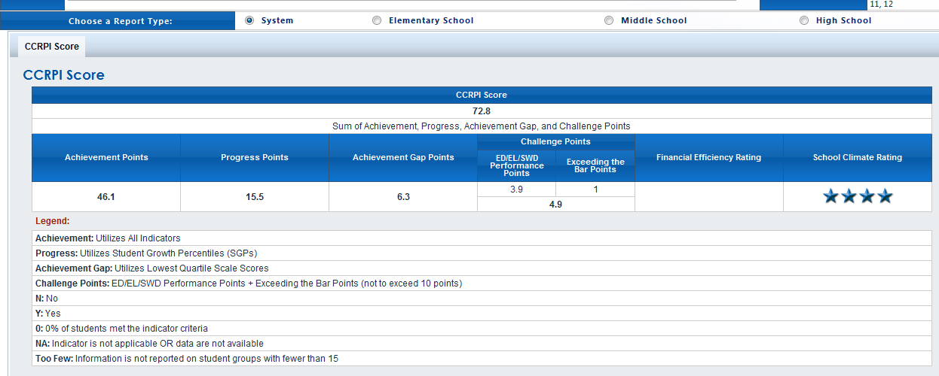
Notes:
Note that star ratings do not figure into the CCRPI score. However, research does indicate that school climate can influence student attendance, discipline, and achievement.

Slide 139
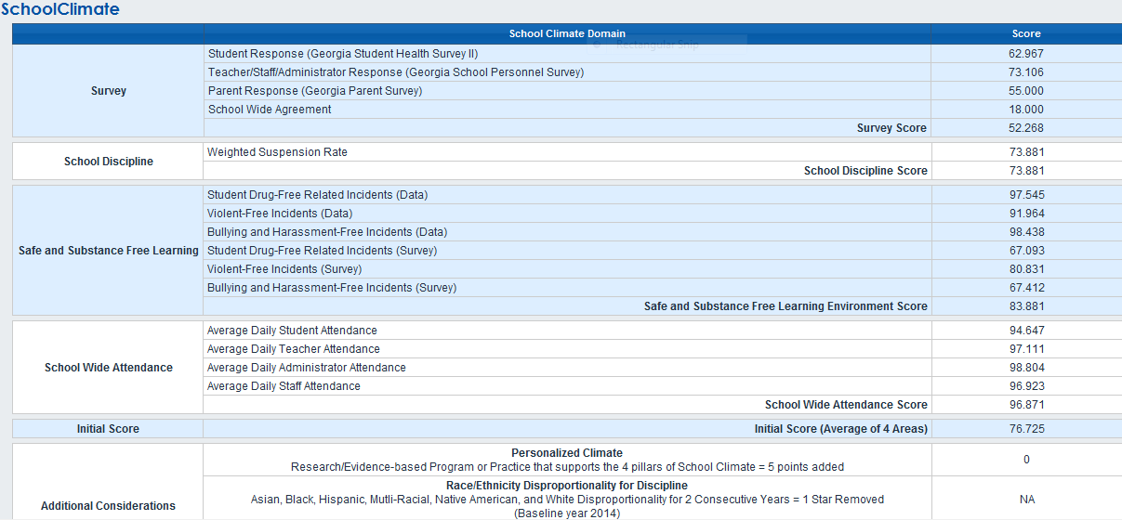

Slide 140
Score Ranges for Stars
Elementary Schools | Middle/High Schools
81.3 and below | 70.2 and below | 1 Star
81.4 to 85.8 | 70.3 to 76.3 | 2 Stars
85.9 to 90.3 | 76.4 to 82.4 | 3 Stars
90.4 to 94.8 | 82.5 to 88.5 | 4 Stars
94.9 and above | 88.6 and above | 5 Stars
4.4
6
4.44
6

Slide 141
Link to Detailed Explanation
of Star Ratings for Climate
Governor’s Office of Student Achievement
https://gosa.georgia.gov/overview-gadoes-school-climate-star-rating

Slide 142
25% School Climate Perceptions
Uses responses from three annual surveys of school climate:
GA Student Health Survey II
GA School Personnel Survey
Parent Survey
Survey results located at:
http://www.gadoe.org/Curriculum-Instruction-and-Assessment/Curriculum-and-Instruction/GSHS-II/Pages/Georgia-Student-Health-Survey-II.aspx
Notes:
All survey results are provided by school, district, and state results and are available to the public.
http://www.gadoe.org/Curriculum-Instruction-and-Assessment/Curriculum-and-Instruction/GSHS-II/Pages/Georgia-Student-Health-Survey-II.aspx

Slide 143
25% Student Discipline
Uses student-level discipline data and school FTE enrollment counts to determine a school’s weighted suspension rate.

Slide 144
25% Safe and Substance-Free Learning Environment
Uses surveys and discipline data to determine the ratio of a school’s Drugs and Alcohol, Bullying, and Dangerous Incidents to all reported incidents in the school.
Notes:
School, district and state results of all surveys are located at http://www.gadoe.org/Curriculum-Instruction-and-Assessment/Curriculum-and-Instruction/GSHS-II/Pages/Georgia-Student-Health-Survey-II.aspx

Slide 145
25% Schoolwide Attendance
Calculates a school’s attendance rate based upon student, teacher, administrator, and staff attendance records and certified/classified personnel records.

Slide 146
Additional Considerations
Points can be subtracted if a school is on the Unsafe School Choice Option list or demonstrates discipline disproportionality.
Points can be added if a school implements a School Personalized Climate Evidence-Based Program or Practice with fidelity and shows improvement in one of the four dimensions of school climate.

Slide 147
District View
Star Rating
ES (#) | 3 | 14 | 18 | 12 | 11
ES (%) | 5% | 24% | 31% | 21% | 19%
Notes:
What are the 11 ES schools with 5 stars doing differently from the 17 schools that are either below satisfactory or unsatisfactory?

Slide 148
Suggestions
Enter the data correctly
Do the surveys
Set the tone for honest feedback
Monitor your discipline and attendance data
Consider a school personalized climate evidence-based program or practice based on your data
Notes:
Have your team(s) that are getting their head around this component of CCRPI to view the information on the Safe and Substance Free webpage and the Discipline webpage on the GaDOE website.

Slide 149
Additional Resources
GaDOE office of Accountability
http://www.gadoe.org/Curriculum-Instruction-and-Assessment/Accountability/Pages/default.aspx
School Climate and Student Discipline
Marilyn Watson – mawatson@doe.k12.ga.us (404) 651-7179
Jeff Hodges – jhodges@doe.k12.ga.us (404) 463-7891
http://www.gadoe.org/Curriculum-Instruction-and-Assessment/Curriculum-and-Instruction/Pages/Safe-and-Drug-Free-Schools.aspx

Slide 150
CCRPI Performance Categories
Achievement Points (60 pts) |  |  | Progress Points (SGPs) (25 pts) | Achievement Gap (15 pts) | Challenge Points (10 pts)
Content Mastery (Tests) (24 pts) | Readiness (18 pts) | Graduation (18 pts) |  |  | ED/EL/SWD Performance (Flags) | Exceeding the Bar Indicators
What actions, strategies, practices, initiatives, programs, or interventions are we using to impact each category?

Slide 151
CCRPI Improvement Strategies
Redeliver this presentation – in small chunks – to your leadership team.
Make connections to TKES and LKES.
Push understanding of the categories, indicators, and scoring to the teacher level.
Engage them with the spreadsheets.
Charge School Leadership Team members with redelivering the presentation and spreadsheets to the staff.
Use your staff as ambassadors of information to the outside stakeholders.

Slide 152
CCRPI Improvement Strategies
Perform data analysis to identify greatest areas of need (low hanging fruit).
Review strategies in your current School Improvement Plan to see if the greatest areas of need are addressed.
Determine root causes of areas of greatest need.
Begin to design new strategies to address greatest areas of need.
Remember that the big problems require K-12 solutions.
Establish leading indicators for monitoring.
Celebrate whenever possible.

Slide 154
Cowen Harter – Director of Accountability
404-463-1168 / charter@doe.k12.ga.us
Nancy Haight – Accountability Specialist
404-463-1166 / nhaight@doe.k12.ga.us
Michelle Christensen – Accountability Specialist
404-463-1175 / mchristensen@doe.k12.ga.us
Paula Swartzberg – Accountability Specialist
404-463-1539 / pswartzberg@doe.k12.ga.us
http://www.gadoe.org/Curriculum-Instruction-and-Assessment/Accountability/Pages/default.aspx

