Slide 1
Maximizing Schedules for Title I, Part C Migrant Education Program (MEP) Local Staff (SSPs and Recruiters)
Title Programs Conference
Atlanta, GA
June 2015

Slide 2
Session Objectives
Learn about the various service delivery designs in use in Georgia
Learn about the ways to set up schedules within different service delivery designs
Review examples of successful local MEP staff schedules
Understand the role of “flexibility” when creating schedules

Slide 3
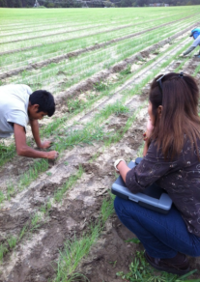
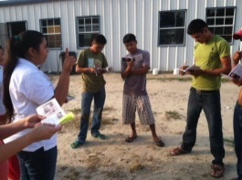
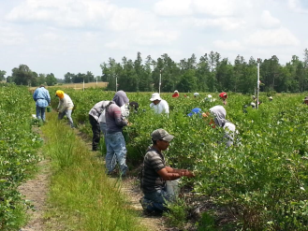
What is the Migrant Education Program (MEP)?
The purpose of the MEP in Georgia (and the United States) is to ensure that migrant children fully benefit from the same free public education provided to all children and that the unmet education-related needs resulting from their migrant lifestyle are met.

Slide 4
Legal Authority for Priority For Services (PFS)
PFS is given to migratory children who: are failing, or are most at risk of failing, to meet the State’s challenging academic content and student achievement standards: AND whose education has been interrupted during the regular school year.
Statute
Elementary and Secondary Education Act (ESEA) of 1965, Title I, Part C-Sections 1304(b)(5) and 1304(d)
Code of Federal Regulation, 34 CFR 200.84
Guidance
MEP Guidance, October 2010, Pages 69-71

Slide 5
Title I, Part C Migrant Education Program

Slide 6
What is the definition of “migratory child”?
Is younger than 22; and
has not graduated from high school or does not hold a high school equivalency certificate; and
is a migrant agricultural worker or has a parent, spouse, or guardian who is a migrant agricultural worker; and
has moved from one school district to another within the preceding 36 months in order to obtain (or seek) temporary or seasonal employment in qualifying agricultural work.

Slide 7
Service Delivery Designs
During the school day: Inclusion and Pull-out
Extended day programs
Before/after school programs
Saturday programs
In-home instruction (e.g., the MEP provides family/literacy services to the child at home)
Summer or intersession programs; and
Distance learning programs (e.g., web-based or portable courses).

Slide 8
Inclusion and Pull Out
During the school day
Advanced planning and collaboration with the classroom teacher
Additional instructional time – in addition to the CORE instructional time
Peer tutoring program
Faculty tutoring
Hiring academically high-achieving college students
Hiring retired teachers
Volunteers

Slide 9
Bulloch County Tutoring Program
Georgia Southern University /Community Liaisons - recruits GSU volunteers to work with EL/Migrant students.
Community Liaison recruits volunteers for a minimum for 6 to 9 weeks, 1-2 hours a week.
The volunteers' areas of academic strength are identified.
Community Liaison surveys the school teachers in the district to determine the need for volunteers and content areas that need to be addressed.
Spring - 39 volunteers logged in over 200 hours.
Fall - 400 hours of volunteer time.
5th year of utilizing this resource.
Tutor is in the classroom or media center always under the supervision of a certified teacher.
Tutor works either one on one or with a small group to better explain complex standards.
Days and times:
Monday/Wednesday 9:41-11:11
Thursdays 12:15-1:15
Monday/Wednesday 10:00-12:00

Slide 10
Extended Day Programs
Before and Afterschool
Focus on gaps in learning
Acceleration of learning
Additional practice
Previewing

Slide 11
Extended Day Programs
Before and after school
Students who participate in before or after school programs are more likely to demonstrate increased academic performance, improved attendance and be more excited to learn and achieve.
Parents can drop off their children to, or pick up their children from a safe environment.

Slide 12
Toombs County After School Program
Time: January 12 - March 19. Monday-Thursday- 3:30PM to 5:00 PM
Locations: 5 locations for the program - LPS, LUES, TCES, TCMS, and TCHS.
Tutors: Certified teachers familiar with CCGPS/GPS content. 3 tutors at LPS, LUES, TCMS, 1 at TCES, and 1 full time (manned by 2 part-time math teachers) at TCHS.
Students: Serve K-12. Priority goes to those students who are PFS, then those who are not served by an SSP during the day, then any other left.
Content: Tutors help with homework, remediation and enrichment on any skills that students need.
Cost: Shared fuel costs with 21st Century CCLC.

Slide 13
Gordon County Tutoring Program
Tutoring at two elementary schools.
Tutoring delivered by three certified teachers: two at Tolbert Elementary, and one at Fairmount Elementary.
At Tolbert Elementary School, the services were provided after school from 2:30-3:30, twice a week, on Tuesdays and Thursdays.
Students in 2nd, and 3rd grade were served.
The students were separated by grade level and received instruction from the two certified teachers.
At Fairmount Elementary, 1st grade students received tutoring instruction three days per week, for 45 minutes, first thing in the morning. These two students were served by one certified teacher.

Slide 14
Saturday Programs
Saturday Programs-
Can be geared toward providing additional learning opportunities for specific core content-reading, writing, math, science, etc.
Help students who are experiencing trouble with classes during the week – additional instructional time
Help students who have missed instruction due to migrant lifestyle – it gives them the chance to catch up with their peers
Students have the opportunity to receive instruction from different teachers

Slide 15
In-Home Instruction
The MEP provides family literacy services and academic tutoring to the child at home.
Students receive the exclusive and personalized tutoring they need.
Students feel at ease learning in the surroundings of their own home.
Serves as a way to prepare students for regular school experience.

Slide 16
Summer and Intersession Programs
Allow students to catch up and progress to the level of their peers
Make up credits
Preview material
Smaller classes help some students to learn better
Provide individualized attention
Help students to work on the subject or subjects that they have failed
May increase student social language
Available for migrant students in GA for the summer months only

Slide 17
Distance Learning
Distance learning programs (e.g., web-based or portable courses of instruction)
Students can study more subjects-make up credits
Are more flexible than traditional styles of classroom instruction
Students work at their own pace
Flexible schedule
A student may learn better at his own pace and in a different format than traditional schooling options offer

Slide 18
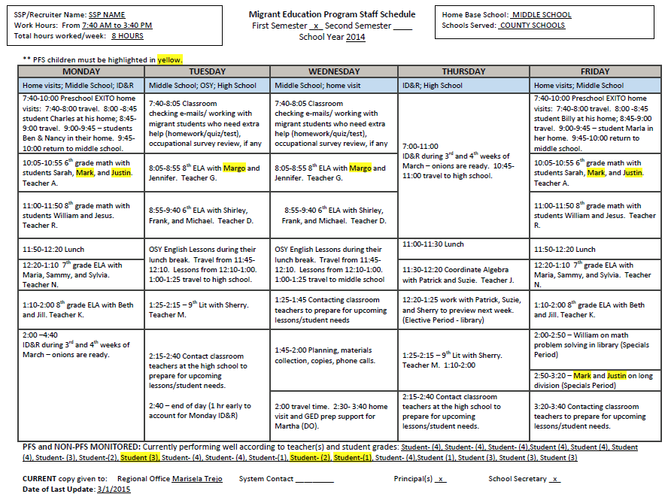
Sample MEP Staff Schedule
Preschool
OSY
Increased recruiting due to peak season
Flexible hours
Coordinating with teachers

Slide 19
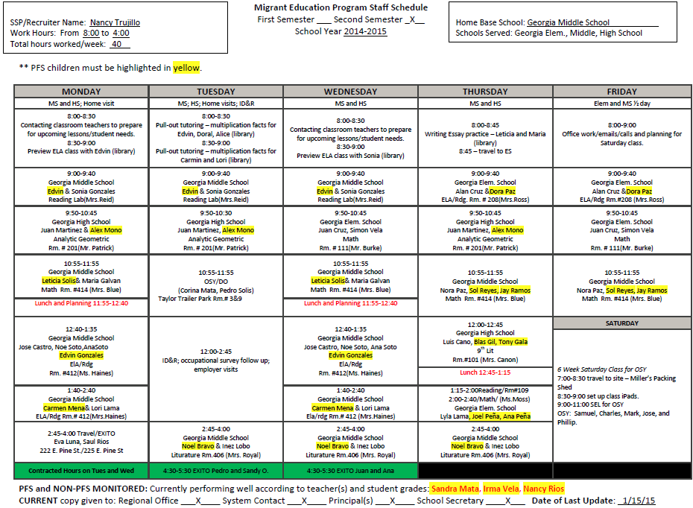
Sample MEP Staff Schedule
Maximizing Time
ID&R
Flexible Scheduling; OSY
Preschool

Slide 20
Tips for Designing MEP Staff Schedules
LEAs must first address the needs of PFS migrant children who are failing, or at risk of failing, to meet the State’s challenging academic content and achievement standards, and whose education has been interrupted during the regular school year.

Slide 21
Tips for Designing MEP Staff Schedules
Supplemental Services
Academic
Support
Schedules for Staff
Flexible to include time to provide services (academic and support) before and after school, evenings, and weekends
Flexible to recruit (based on local ID&R plan) at different times and days during the week and varying intensity based on monthly migration patterns
Specific and intentional time for OSY and PS
SSPs - inclusion or pull-out as the delivery model – can be flexible and a combination of both
Tutoring – before and after school, Saturdays

Slide 22
Tips for Designing MEP Staff Schedules
Avoid making school day schedules that are not fluid and flexible: PFS served first
Vary the number of times an SSP works with a child during the week
Group migrant students to increase services to those needing support
No required “seat-time” for supplemental services – duration and intensity of support can be adjusted to maximize impact of SSP on all participants in the district

Slide 23
Tips for Designing MEP Staff Schedules
Review students’ grades regularly (progress reports, report cards, grade summaries, etc.)
Refer to IPs for information on gap/need, frequency of sessions, length of time per session, projected outcome, etc.
Communicate with migrant students’ teachers often and intentionally; support this communication process
Ensure that classroom teachers understand the roles of the MEP and MEP staff
Review high school transcripts and graduation plans
Check/assist with credit recovery
Review graduation and testing requirements

Slide 24
Tips for Designing MEP Staff Schedules
Update schedules, as needed
Make changes when students enroll or depart
Check the progress of monitored PFS students regularly, and adjust your schedule if these students need additional support
Keep an updated copy: SSP, migrant contact, school principal(s), MEP regional office
In addition to schedule, keep a daily log of activities. Include all home visits and recruiting activities.

Slide 25
Tips for Designing MEP Staff Schedules
Account for all of the time in the schedule(s)
Include the names of all of the schools served
For each tutorial block, include the time, teacher, grade level, subject/course, and student(s)
Highlight in yellow all Priority for Service (PFS) students
List the names of PFS students who are not being tutored and are being monitored only at the bottom of your schedule

Slide 26
Title I, Part C Migrant Education Program

Slide 27
Questions?
Contact Information
John Wight, jwight@doe.k12.ga.us
Margarita Munoz, mmunoz@doe.k12.ga.us
Israel Cortez, jcortez@doe.k12.ga.us

