Slide 1
Using Data and Evaluation to Improve Your Flexible Learning Program
Georgia Department of Education 2015 Title Conference
Tammy Wilkes Nicholas L. Handville
Education Program Specialist, Title I Operations Analyst III
Office of School Improvement Office of School Improvement
Georgia Department of Education Georgia Department of Education

Slide 2
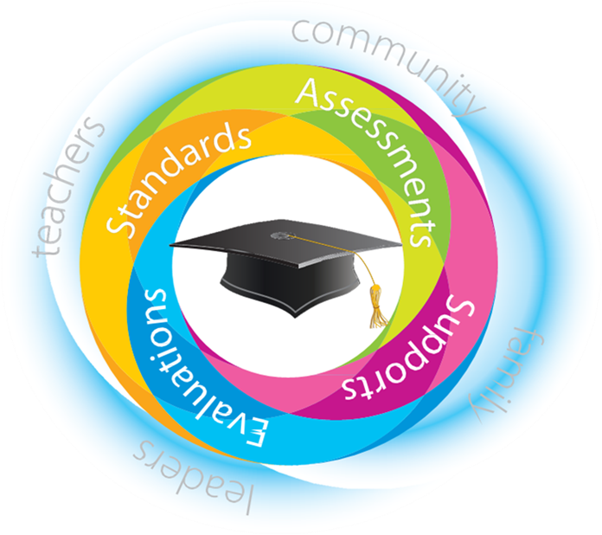
School Improvement and District Effectiveness

Slide 3
Session Description
This session will introduce tools, resources, and methods that support district evaluation of the Flexible Learning Program (FLP). Attendees will learn how to address programmatic challenges through data analysis, how to use data to monitor FLP, and how to measure program outcomes and impact. The session is suggested for Title I directors implementing an FLP in FY16.

Slide 4
Types of Evaluation
Source: Shakman and Rodriguez (2015)

Slide 5
Needs Assessment: Setting Up Your FLP
What is needs assessment?
An attempt to estimate deficiencies that have not been previously recognized
Steps
Define the parameters of the needs assessment
Identify the information needed for decision making
Determine what information already exists (check all available data sources)
Structure data collection process and collect the data
Conduct analysis
Share findings with key stakeholders
Use data-informed decision making to determine action
Source: Adapted from Royse, Thyer, and Padgett (2010). Program Evaluation: An Introduction.

Slide 6
Needs Assessment: Setting Up Your FLP
Opportunity to design supplemental extended learning to increase student achievement
Assessing the Need:
Data review - achievement data, graduation rate
Content area(s) - reading, language arts, math, science, social studies
Delivery method - during the school day, before school, after school, intercession, Saturday school, summer school
Staffing - teachers, paraprofessionals, contracted services

Slide 7
Process Evaluation: Monitoring Your FLP
What is process evaluation?
An evaluation that analyzes the effectiveness of program operations, implementation, and service delivery
When process evaluation is ongoing it is called program monitoring
Used to determine:
Whether services and goals are properly aligned
Whether services are delivered as intended to the appropriate recipients
How well service delivery is organized
How efficiently program resources are used
Sources: Poverty Action Lab (povertyactionlab.org); Rossi, Peter, et al. (1999). Evaluation: A systemic approach

Slide 8
Process Evaluation: Monitoring Your FLP
Opportunity to design and provide supplemental extended learning to increase student achievement
Monitoring the Process:
Participation - number of hours offered/number of hours served
Engagement - quality of services
Obstacles - transportation, scheduling conflicts, technology
Perception - feedback from stakeholders

Slide 9
Outcome Evaluation: Determining the Results
What is an outcome evaluation?
Analysis of immediate outcomes following the implementation of a program. Emphasis is placed on easily observed characteristics of program participants. Does not address causality.
Used to Determine:
Change in participants (behaviors, attitudes, etc.)
Measureable outcomes resulting from program
Success of program in meeting goals

Slide 10
Outcome Evaluation: Determining the Results
Opportunity to provide supplemental extended learning to increase student achievement
Evaluating Outcomes:
Student Achievement - pretest/posttest data, State assessment results
Stakeholder feedback from students, parents, and teachers
Did individual students make academic gains?
Qualitative and quantitative data

Slide 11
Impact Evaluation: Establishing Causation
Why do impact evaluations?
To decide whether or not to continue or expand an intervention.
To learn how to successfully adapt a successful intervention to suit another context.
To reassure funders, including donors and taxpayers (upward accountability), that money is being wisely invested.
To inform intended beneficiaries and communities (downward accountability) about whether or not, and in what ways, a program is benefiting the community.
Source: Bonbright (2012). Use of Impact Evaluation Results. InterAction.org

Slide 12
Q&A and Conversation

Slide 13
Resources
Bennett, J. (2003). Evaluation Methods in Research. Continuum.
Dinsmore, P. (1993). The AMA Handbook of Project Management. New York: AMACOM.
Harris, E. (2011). Afterschool Evaluation 101: How to Evaluate and Expanded Learning Program. Harvard Family Research Project.
Holden, D. and M. Zimmerman. (2009). A Practical Guide to Program Evaluation Planning: Theory and Case Examples. Sage.
Royse, D., B. Thyer, and D. Padgett. (2010). Program Evaluation: An Introduction. Wadsworth.
Shakman, K., & Rodriguez, S. M. (2015). Logic models for program design, implementation, and evaluation: Workshop toolkit (REL 2015–057). Washington, DC: U.S. Department of Education, Institute of Education Sciences, National Center for Education Evaluation and Regional Assistance, Regional Educational Laboratory Northeast & Islands. Retrieved from http://ies.ed.gov/ncee/edlabs.
Stockmann, R. (Ed.) (2011). A Practitioner Handbook on Evaluation. Edward Elgar.
Stufflebeam, D. and C. Coryn. (2014). Evaluation Theory, Models and Applications. Jossey-Bass.
W.K. Kellogg Foundation (2004). Logic Model Development Guide: Using Logic Models to Bring Together Planning, Evaluation, and Action. W.K. Kellogg Foundation.
Weiss, C. (1997). Evaluation: Second Edition. New Jersey: Prentice Hall.
Wholey, J. et. Al. (2010). Handbook of Practical Program Evaluation. San Francisco: John Wiley & Sons.

Slide 14
Contact Information
Tammy Wilkes
Nicholas L. Handville
Education Program Specialist, Title I Office of School Improvement Georgia Department of Education 1854 Twin Towers East 205 Jesse Hill Jr. Drive, SE Atlanta, Georgia 30334 (478) 237-2873 twilkes@doe.k12.ga.us www.doe.k12.ga.us
Operations Analyst III Office of School Improvement Georgia Department of Education 1854 Twin Towers East 205 Jesse Hill Jr. Drive, SE Atlanta, Georgia 30334 (404) 657-9864 nhandville@doe.k12.ga.us www.doe.k12.ga.us

