Slide 1
Preparing for the Return of Kids After Social Isolation
Notes:
TS
As children will be allowed to return to group and organizational activities, it is now our time to step up to the challenge of taking care of the vulnerable.
So many people have helped us weather this storm. But as the national conversation turns to ending “shelter-in-place”, who will be called on next to lookout for the wellbeing of children? It will be those YSO, faith communities, daycares who receive these kids out of isolation. This is a different kind of transition that requires a unique preparation.
Cheryl doing intro/housekeeping
Tiffany doing trauma signs/symptoms/how to address
Angie doing signs/symptoms of abuse types
Julia doing disclosures and resources

Slide 2
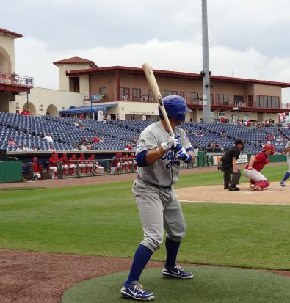
You’re On-Deck
You may be among the first to have the opportunity to interact with children out of isolation.
Notes:
TS
In baseball, the batter that is next up stands in the “on-deck” circle. He/she steps out of the dugout and into the circle and prepares to be the next one to bat. You and your organization are “on-deck”. You may be among the first to have the opportunity to receive these kids out of isolation. The return of kids to your program after this unprecedented lockdown is different than restarting your programs in the fall or when your program year begins. Kids aren’t returning after a summer break. They are coming out of isolation. Prepare now to be the next ones to step up and answer the call.

Slide 3
COVID-19 Lockdown The Impact on Kids
Patterns of mobility and connectedness are changing
Mobile & Socially Connected
Home at night/out in day
Interacted with other adults in charge
Interacted with peers face-to-face
Homebound and Socially Separated
Home night and day
Exclusive supervision by parents/caregivers
Interaction with friends limited and online
Notes:
TS
The impact of the lockdown will be different for every child. It is impossible to even try to predict how the children we serve will respond when they are allowed to return to group activities. Each child’s environment and individual resilience skills are different. The impact on the child will be based in large part on the resilience of the parents/caregivers and their access to resources that help them cope. The impact will be as varied as the number of children you serve. What these children share in common is having had to make a major adjustment in their daily routine when the lockdown started and now a second major adjustment as things begin to open back up.
Home and Outside: We all have felt the impact of being homebound. The loss of mobility over time is hard. For kids, it probably isn’t as difficult. In fact for some it has been great. At home with mom and dad all day long. No school, etc. At least for a while it seemed good.
Interaction with other adults in charge: How difficult will it be for a child who has been under a parents authority for 24 hours a day for 90 days when a different adult is in charge?
Interaction with peers: Children may have to learn how to be in groups again (re-learn how to share, how to resolve conflict, etc.).
This is the first major transition these kids have had to make. (This sentence seems weirdly placed. Should we move it or adjust the wording?) For this transition the adults who were helping them navigate to the new normal was a parent or caregiver. With this second transition back to a more mobile daily existence they will be dependent on different adults to help them make that transition.

Slide 4
Current Stressors for Youth
Worry and fear about the virus
Disrupted sleep schedules
Confusion about changing expectations
Adjustment to new routines
Loss
Possible strain at home:
Financial impact of caregiver job loss
Food insecurity
Abuse/neglect
Notes:
TS

Slide 5
What We Do Know:
The ability of a child to cope and adjust is directly related to the presence of a trusted adult
Your staff/volunteers need to become the trusted adults outside of the home to help kids adjust
Notes:
TS
So think about those parents/caregivers these kids have been dependent on. Mom’s have added to their job description: educator, counselor, playmate while having to deal with their own challenges of coping during the lockdown.
Re-opening your organization after COVID-19 it not like restarting your program in the fall after a summer break. They aren’t moving from a summer of fun activities and vacation trips. They are coming out of isolation. The transition for them will be different and some will need help navigating the transition. They will need help recalibrating to a second major change in 6 months.

Slide 6
What We Do Know:
An increase in isolation can increase a child’s risk for abuse and trauma.
Notes:
TS

Slide 7
Children Are At An Increased Risk
Children are most often abused by family, caregivers and people in authority
Isolation increases stress. Some adults take it out on the most vulnerable
Children are online more, which increases risk of exposure to pornography and online predators
The duration of COVID-19 has compounded already toxic environments for some children
All this leads to an exponential increase in risk of abuse and trauma
Notes:
TS
Safety is such a basic need for children. When it is threatened, our children can be harmed and often pay a heavy price. Our preparation for their return and our diligence in checking on their well-being after they return will, for some, be critical in restoring a sense of safety and protection.

Slide 8
Child Abuse and Stressful Times
During the last recession, rates of abusive head trauma in children
Increased from 9 to 15 per 100,000 children (between 2004 and 2009)
Doubled in children 2-years-old and younger
-Pediatrics, Official Journal of the American Academy of Pediatrics, October & April 2011
For every 1% increase in the 90-day mortgage-delinquency rate there was a
3% annual increase in the rate of child abuse requiring hospital admission (between 2000 and 2009)
5% annual increase in the rate of traumatic brain injury suspected to be caused by child abuse (between 2000 and 2009)
-American Association of Neurological Surgeons
Notes:
TS

Slide 9
Stress and Parenting during COVID-19
A majority of parents (52%) said financial concerns and social isolation (50%) are getting in the way of their parenting.
About 1 in 5 parents (20%) said they had spanked or slapped their child or children at least once in the past two weeks, and 12% had a few times or more.
The rates of shouting, yelling and screaming at children are high, with 4 out of 10 parents saying they had done this a few times or more in the past two weeks.
When asked whether or not these behaviors are an increase over their usual behaviors, 19% said they are yelling or screaming more and 15% said they increased their use of discipline since the pandemic.
-Shawna Lee & Kaitlin Ward, March 2020 https://news.umich.edu/coronavirus-causing-conflict-between-parents-children/
Notes:
TS

Slide 10
Key Components of Your Program and Activities
Give kids opportunity to talk.
Listen for clues on how they are doing?
Offer them choices to help them feel like they have some control
Let them be upset
Keep a routine, but plan to be flexible
Have realistic expectations
Get them excited about something
Notes:
TS
This change back to mobility and connectedness can produce negative reactions in some. Fear and anxiety in others.
Here are some thing you already know to do but it might be helpful to be reminded.
TALK: as often as you can give kids the opportunity to share their experiences during lockdown, how they feel about being around other children. Keep in mind that some children will have trouble finding words to express their feelings. Use different types of activities to encourage sharing such as art and journaling.
LISTEN: Make sure each individual child knows you are paying attention to what they say.
CHOICES: When appropriate, let the child make decisions to help them feel like they have some control over their circumstances: “Which one of these books would you like to read?” or “Would you like to color now or play with your favorite toy?”
LET THEM BE UPSET: Use that time to help them recalibrate. Your language is important: Rather than saying ”Calm down” say “How can I help you?” Rather than “Stop crying” say ”I can see this is hard for you”. Rather than say “You’re ok” ask “are you ok?” Rather than say “Don’t get upset” say “It’s ok to feel sad”
Routine: Routine builds security as they know what is coming. Offer a road map of what is going to happen in the next hour to help them feel secure
EXCITED: If you can get them excited about something you are doing it might help make them want to come back the next day.

Slide 11
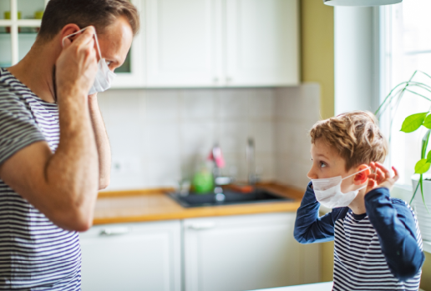
Address Concerns Related to COVID-19
Be honest and direct
Keep it developmentally appropriate
Stick to the facts
Give frequent reminders
Gradually prepare for any new changes
Notes:
TS

Slide 12
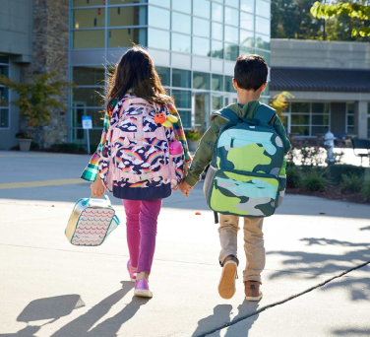
Building Resilient Kids
Resilience is the ability to handle life’s ups and downs.
Having the ability to adapt well to adversity, trauma, tragedy, threats, or even everyday sources of stress, can help children manage feelings of anxiety and uncertainty.
Children who are resilient, are better able to:
Cope with challenges
Manage stress
Make healthy choices
Notes:
TS

Slide 13
Be Mindful
Be aware of your own feelings
Be patient with:
Yourself
Coworkers
The kids
Practice:
Pause
Breathe
Respond
Notes:
TS

Slide 14
Prepare Now for Your Specific Role
Know
Know the basic signs of abuse and trauma and their corresponding behavioral indicators
Equip
Equip your team to talk with children about abuse and how to react responsibly to suspicions or a disclosure.
Review
Review your mandated reporter protocol. If you don't have one, contact us for help.
Notes:
TS

Slide 15
Common Responses to Stress and Trauma
Confusion or disorientation
Difficulty concentrating
Irritability/Physical Complaints
Mood swings
Feeling sad or hopeless
Feeling disconnected or numb
Nightmares
Notes:
TS

Slide 16
Be Aware
Children will need time to acclimate returning to a group setting.
This may take several days for some or a bit longer for others.
Pay attention to those who take longer to adjust.
Notes:
TS
Kids returning to your organization after COVID 19 is not like returning in the fall after summer break. This is different because the isolation we are experiencing is elevating the risk to your children in ways we have never before had to face. The combination of a total lockdown across the spectrums and the length of time this isolation will occupy means exponential increase in risk factors for kids and more opportunity for maltreatment to occur. Bottom line… Follow your gut! If a child seems ”off”, look deeper. Children do not always show obvious signs of maltreatment. You have to look for clues and red flags. Engage with courage and diligence.

Slide 17
Listen and Engage
Don’t overschedule time with activities
Build in time for conversations with each child
Include writing or drawing activities that would provide children a way to communicate when they are having trouble finding words.
Notes:
TS
Does this slide work in the camp setting or is it more appropriate for schools? Should we change the first point? Camps are all about scheduled activities to keep kids engaged and occupied.

Slide 18
Engage Through Intentional Conversation
Start with general “check-in” questions
Not just one conversation
If there are red flags, circle back to that child and follow up
Frequent check-ins through the day
Notes:
TS
You may want to assign adults (maybe say counselors since camps tend to use high school staff?) to specific children to make sure no child is missed.
Don’t just check in first day. Check in several times a day for as long as it takes to have a sense the child is doing well.
Add examples of general check-in questions

Slide 19
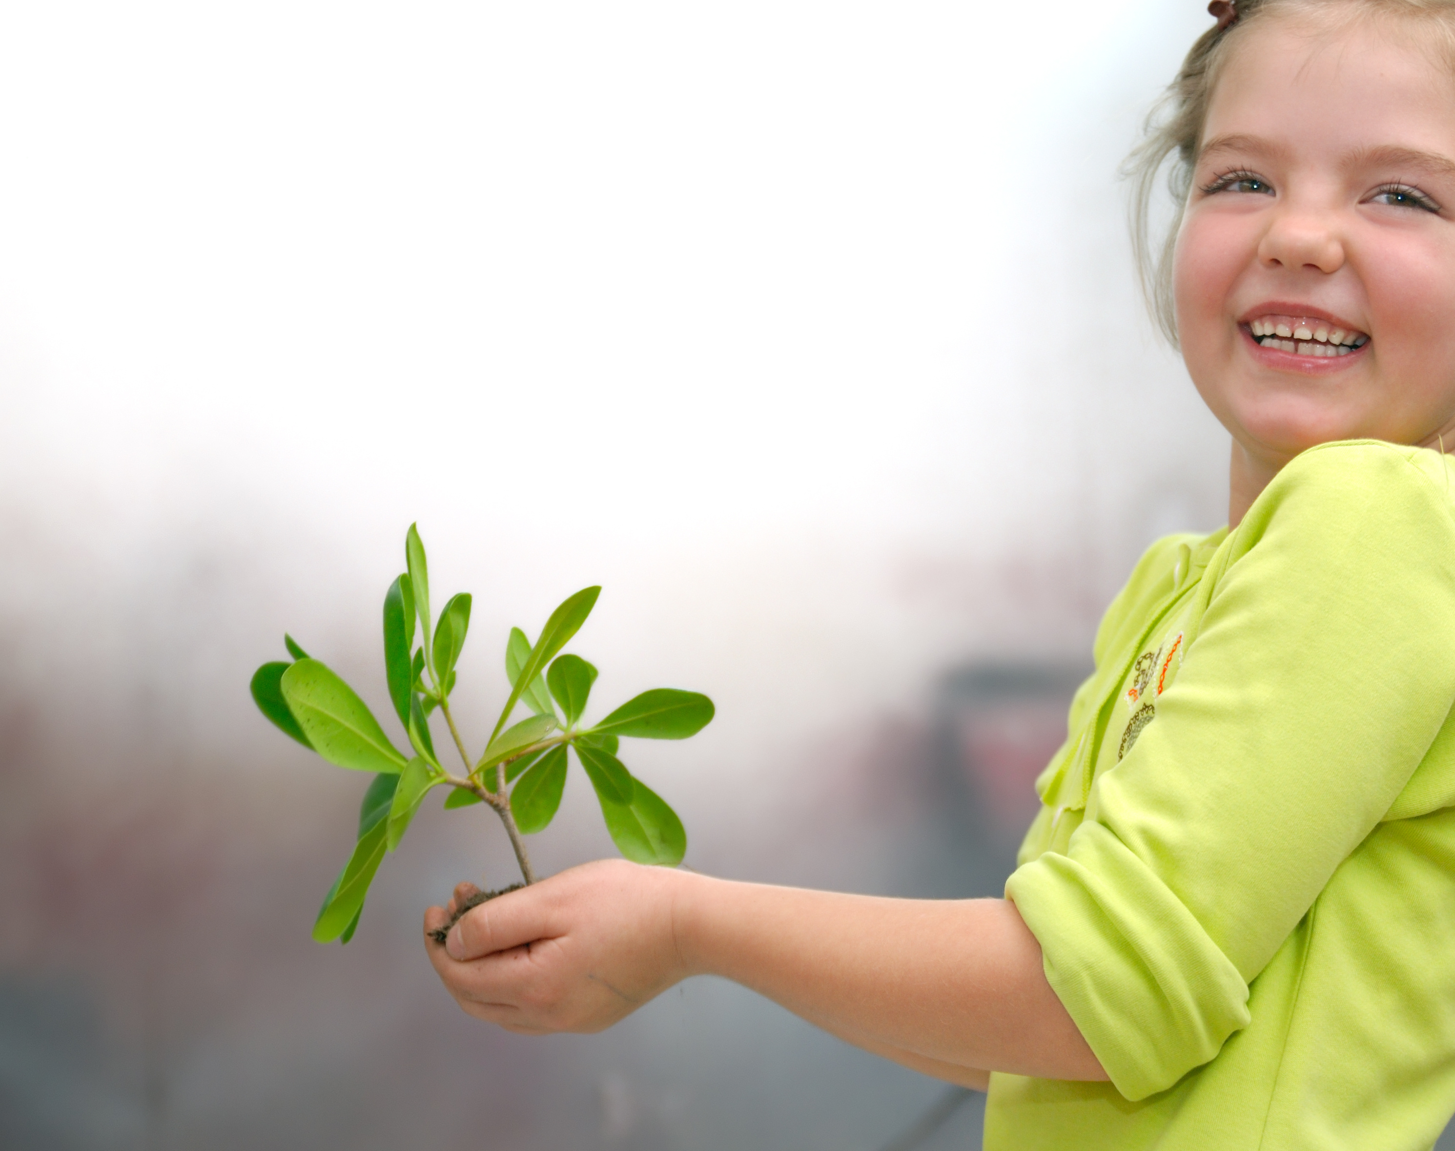
Primary Objectives
You are gathering information and impressions of a child’s wellbeing.
You may discover that a child needs help and support.
When you have a reasonable suspicion that abuse has occurred, follow your protocol and make a report.
Notes:
AB

Slide 20
General Signs of Maltreatment
Panic Attacks
Fear
Anger
Withdrawal/Lack of eye contact
Less interaction with others
Lack of interest in activities previously enjoyed
Easily startled
Fatigue/Exhaustion
Insomnia
Vague complaints of aches and pains throughout body
Notes:
AB
These signs come up in two sets of bullet points on a click when in presentation mode. The full list is below.
These are signs that may be more easily recognized
Lack of interest in activities previously enjoyed
Easily startled
Fatigue/Exhaustion
Insomnia
Vague complaints of aches and pains throughout body
Panic Attacks
Fear
Anger
Withdrawal/Lack of eye contact
Less interaction with others

Slide 21
Signs of Online Abuse
Pay attention to language and terms that indicate exposure
1
Listen for language that is not age appropriate
2
Look for behaviors that mimic what they might have seen
3
Listen for clues they have made a new friend online
4
Notes:
AB
Children are always at risk when they are online; however during this time of isolation they have an increased risk of exposure to pornography and accessibility to online predators.

Slide 22
Physical Abuse:
Any non-accidental physical injury suffered by a child as the result of the acts or omissions of a person responsible for the care of a child
Important Points to Remember
Injuries are often unexplained or explanation is vague
Consistent history is often a determining factor
“Those who don’t cruise rarely bruise”
Corporal punishment is legal, physical abuse or injury is not
Lasting marks or injuries are reportable
Photos- GA law says photos may be taken of child’s injury without parental permission only by hospital employees or volunteers, law enforcement, school officials, or employees or volunteers of child protective agencies
Notes:
AB

Slide 23
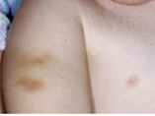
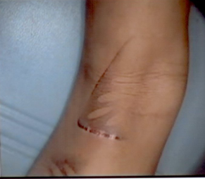
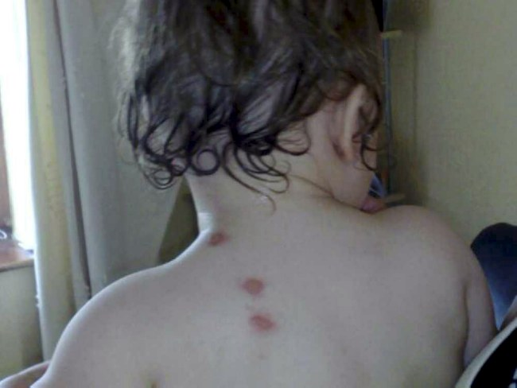
Physical Abuse:
Any non-accidental physical injury suffered by a child as the result of the acts or omissions of a person responsible for the care of a child
Bruises
Burns
Unexplained
Pattern (shape resembles object like hand)
Inconsistent with age of child
Location
Ears, soft part of cheek, neck, inner thighs/genitals, trunk, buttocks, hands/feet
Accidental burns vary in depth of burn
Will likely see splash marks or streaks, borders aren’t distinct
Inflicted burns are uniform in depth
Likely patterned as well
Immersion burns are almost always intentional
Notes:
AB

Slide 24
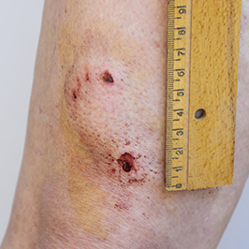
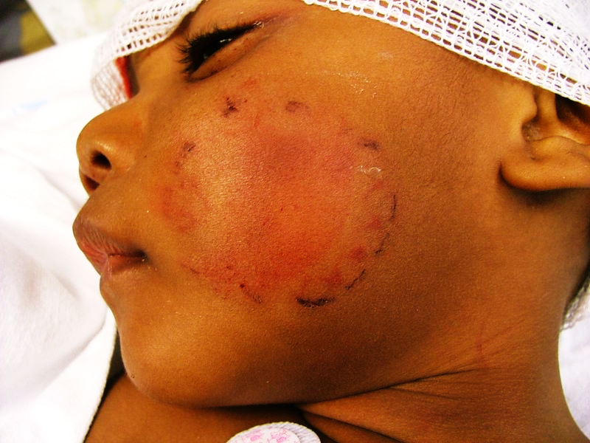
Physical Abuse:
Any non-accidental physical injury suffered by a child as the result of the acts or omissions of a person responsible for the care of a child
Bites
Emotional Indicators
Adult vs. Child
Human vs. Non-Human
Non-human bite typically leads to tearing of the skin
Feels deserving of punishment
Wary of adult/physical contact
Frightened of parents/afraid to go home
Self-destructive behaviors
Wears clothing to cover body –inappropriate for weather
Dog bite
Human bite
Notes:
AB

Slide 25
Sexual Abuse:
“Exploitation of a child for the sexual gratification of an adult or older/more powerful child.”
Forcing, coercing or persuading a child to engage in any type of sexual act
Commercial sexual exploitation of children (sex trafficking)
It includes non-contact acts
Exhibitionism
Exposure to pornography
Voyeurism
Communicating in a sexual manner by phone or internet
Notes:
AB

Slide 26
Sexual Abuse:
“Exploitation of a child for the sexual gratification of an adult or older/more powerful child.”
Physical Indicators
Behavioral Indicators
Difficulty walking or sitting
Torn, stained or bloody underclothes
Pain, swelling or itching in the genital area
Bruises, bleeding or laceration in external genitalia area
Presence of STI or other infections
Inappropriate sex play or advanced sexual knowledge
Sudden school difficulties
Difficult peer relationships
Self-imposed isolation, avoid physical contact
Sudden massive weight change (loss or gain)
Notes:
AB

Slide 27
Sexual Abuse:
“Exploitation of a child for the sexual gratification of an adult or older/more powerful child.”
Emotional Indicators
Withdrawal
Fear
Depression
Unexplained anger
Nightmares
Excessive worrying about siblings
Notes:
AB

Slide 28
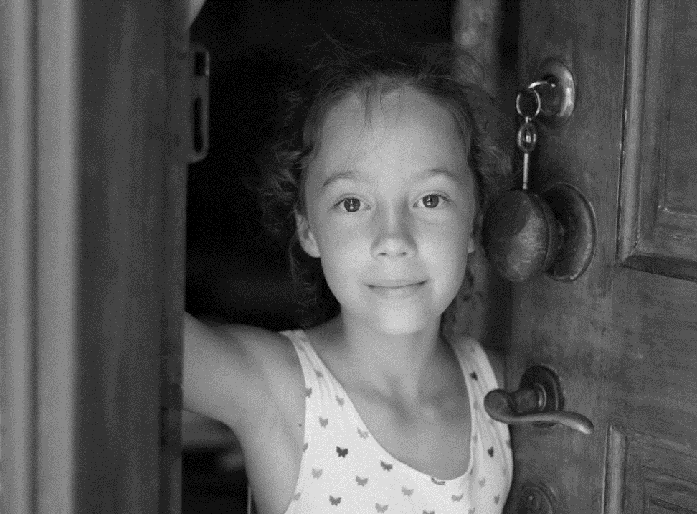
Neglect:
“The failure to provide proper parental care or control, subsistence, or other care or control necessary for a child's physical, mental, or emotional health or morals; the failure to provide adequate supervision necessary for such child's well-being; or the abandonment of a child by his or her parent, guardian, or legal custodian.”
Most common form of child maltreatment
Can be difficult to identify
Parents who abuse substances (alcohol & drugs) and/or have inadequate parenting skills are responsible for many of the neglect cases
Many cases go unreported and is a much larger problem than statistics indicate
Notes:
AB

Slide 29
Neglect:
“The failure to provide proper parental care or control, subsistence, or other care or control necessary for a child's physical, mental, or emotional health or morals; the failure to provide adequate supervision necessary for such child's well-being; or the abandonment of a child by his or her parent, guardian, or legal custodian.”
Different Types of Neglect
Failure to provide:
Physical- adequate food, shelter, clothing, hygiene and/or supervision
Medical- necessary medical or mental health treatment
Educational- learning or special educational needs
Emotional- love, affection, security, and emotional support that result in serious cognitive, affective, or other behavioral health problems
There is no legal requirement for a parent to provide any medical treatment, if that treatment is against the parent’s religious beliefs.
Notes:
AB
”No child who in good faith is being treated solely by spiritual means through prayer in accordance with the tenets and practices of a recognized church or religious denomination by a duly accredited practitioner thereof, shall, for that reason alone, be considered to be an abused child.”

Slide 30
Neglect:
“The failure to provide proper parental care or control, subsistence, or other care or control necessary for a child's physical, mental, or emotional health or morals; the failure to provide adequate supervision necessary for such child's well-being; or the abandonment of a child by his or her parent, guardian, or legal custodian.”
Physical Indicators
Emotional Indicators
Consistent hunger/underweight
Consistent lack of supervision
Unattended physical/medical needs
Failure to thrive/poor growth
Poor hygiene
Inappropriate dress
Self-destructive behaviors
Begging, stealing food
Constant fatigue, listlessness
Assuming adult responsibilities
Says no caretaker at home
Frequently absent / tardy
Notes:
AB

Slide 31
Emotional/Psychological :
“Failure to provide psychological care and spousal abuse in front of a child.”
Excessive or aggressive parental behavior that places unreasonable demands on a child to perform above his/her capabilities
It frequently occurs as verbal abuse, but also includes:
Rejection
Terrorizing
Shameful forms of punishment
Withholding physical/emotional contact
A pattern over time
Notes:
AB

Slide 32
Child Endangerment:
Child (<18) witnesses DV/Family Violence Battery
Driving under the influence with a child <14 in the vehicle
Child is present where methamphetamine is manufactured
Prenatal substance abuse resulting in infant withdrawals, substance in meconium, or other medical diagnosis
Notes:
AB

Slide 33
Types of Disclosures
Indirect Hints: “My uncle wears funny underwear.”
Disguised disclosure: “I know someone who is being touched in a bad way.”
Disclosure with strings attached: “I’ll tell if you promise not to say anything.”
Notes:
JN

Slide 34
When A Child Discloses Abuse
Find a quiet place to talk
Reassure the child
”I believe you”
“I’m proud of you for telling me”
“What happened to you is not your fault”
“Abuse is wrong. I am sorry this happened to you”
Listen calmly and don't overreact
Don’t ask leading questions, only open ended
”What happened next?”
“Tell me more.”
Once the disclosure is made, stop asking questions
Notes:
JN

Slide 35
What Not to Say
“Why didn’t you stop him/her?”
“Why are you telling me this?”
“Are you sure this happened?”
“Are you telling me the truth?”
“Let me know if this happens again.”
“What did you do to make this happen?”
Notes:
JN

Slide 36
Disclosure Scenario 1
Chelsea is a 7 year old girl on your soccer team. One afternoon Chelsea’s mom is late picking her up and sends the sitter to pick her up. When Chelsea finds out, she begins to sulk and expresses that she ‘hates going with the sitter because she always bothers me and I don’t like it.’ She pleads with you and the other coach to let her stay until her mom gets off of work. She becomes increasingly agitated as the time approaches.
What type of disclosure is this? How would you handle it?
Notes:
JN

Slide 37
Disclosure Scenario 2
Dante’ is a 12 year old boy in your class. You noticed that for the past week he has been holding his side like he is in pain. You ask him if he is okay and he replies ‘I sort of have something to tell you but you cant tell anybody. My mom couldn’t take it.’ Dante’ reveals that his mom’s new husband gets angry and punches him sometimes. This time he left a large bruise near Dante’s rib cage.
What type of disclosure is this? How would you handle it?
Notes:
JN

Slide 38
Prevention Resources for Professionals
Share signs of abuse and mandated reporting tips with frontline helpers
Build rapport and provide encouragement
Ask open-ended questions to engage children. Ex: “How is learning from home going?” "How do you feel today?" "Tell me more about that."
Participate in online prevention trainings
Darkness to Light's Stewards of Children training – free at www.FlipTheSwitchCampaign.org
Protecting Children During a Crisis – www.D2L.org
Call/Zoom and check in on children you are concerned about
Darkness to Light's Safe Online Learning: For Teachers
Notes:
JN

Slide 39
Prevention Resources for Parents
Participate in online prevention trainings
Darkness to Light's Talking to Children about Safety from Sexual Abuse –free using code TALK2020
Help parents create a COVID-19 Family Safety Plan
Use this example from Stop It Now!
Talk to children about safe touch, consent and personal boundaries
Hot Chocolate Talk from Committee for Children – What to Say at Every Age
Blog for Parents about Online Safety – NetSmartz
https://www.missingkids.org/blog/2020/child-online-safety
Notes:
JN

Slide 40
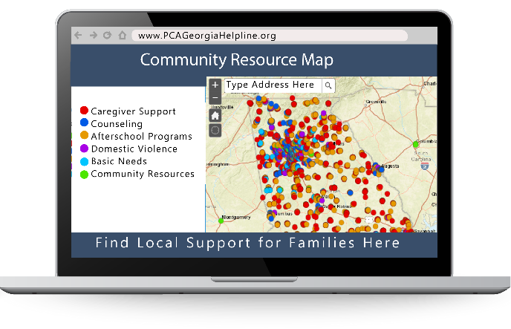
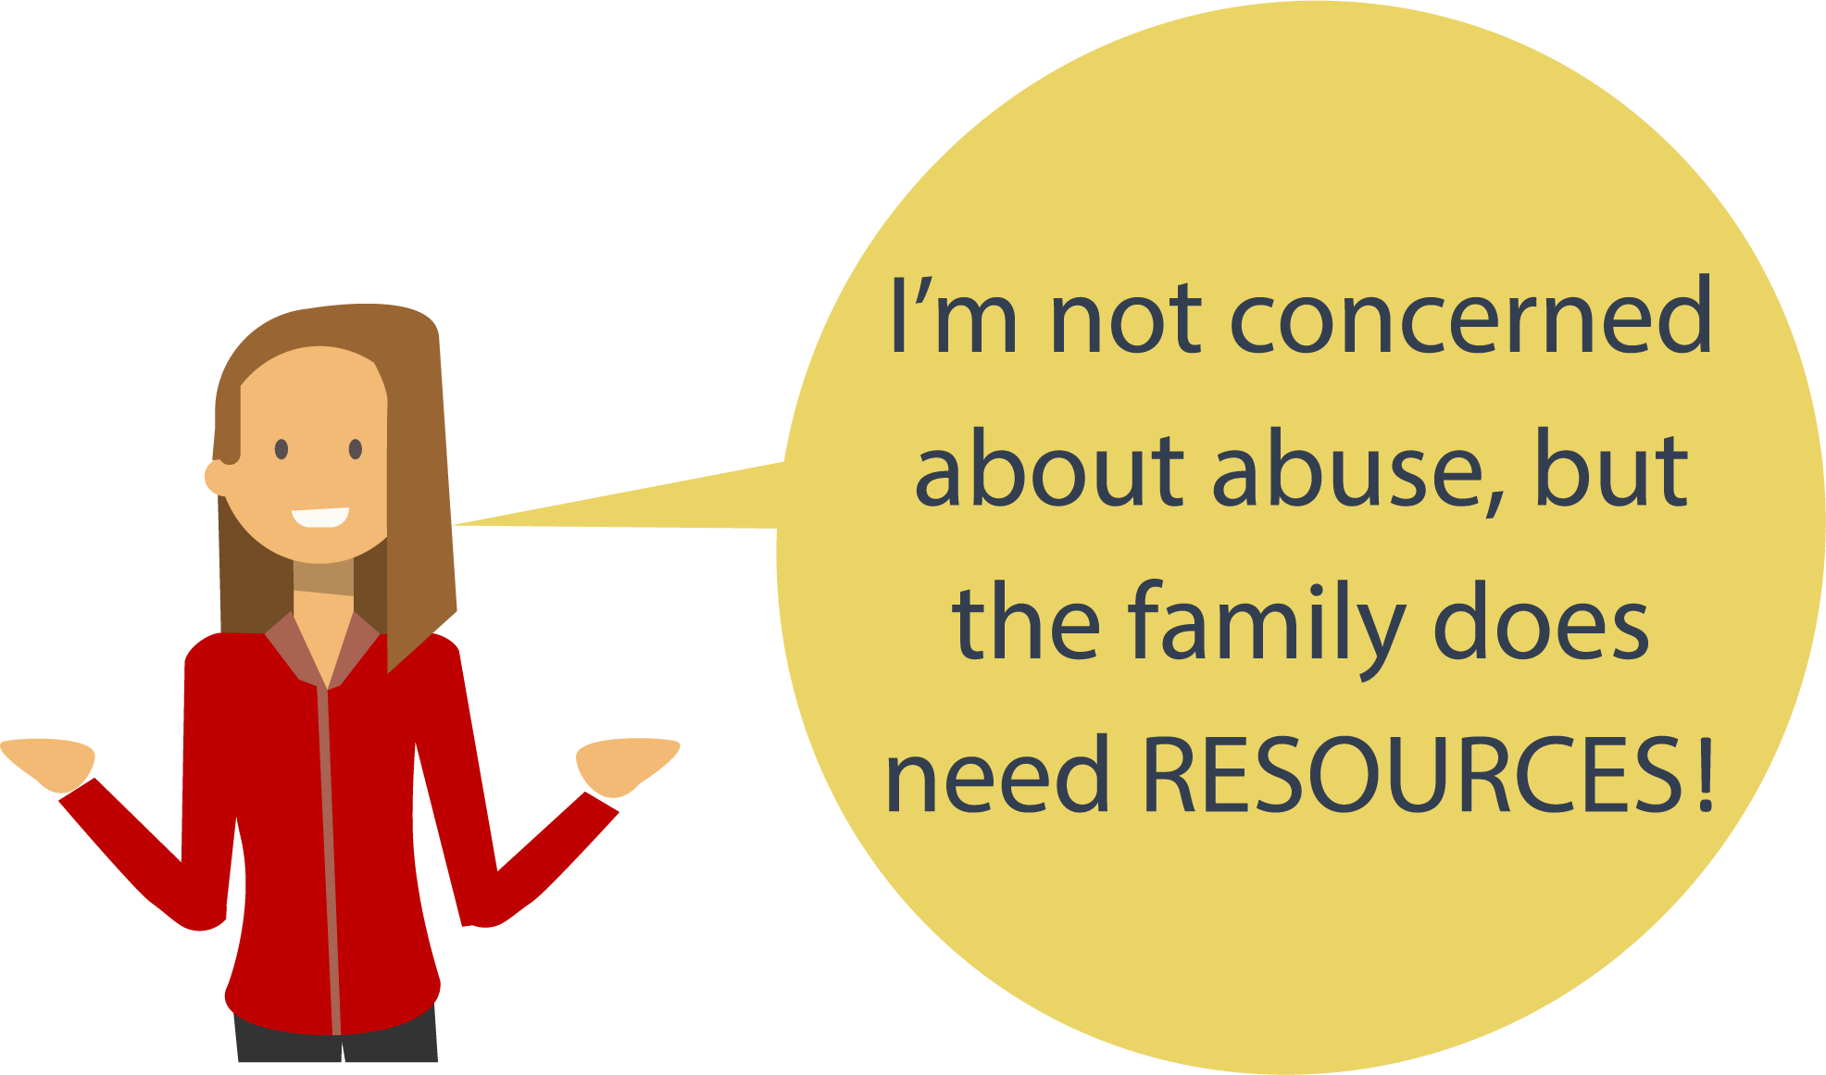
1-800-CHILDREN (1-800-244-5373) Se Habla Español
Why People Call
Caregiver Support, Counseling
Community Programs
Domestic Violence
Housing and Basic Needs
Afterschool and Child Programs
www.PCAGeorgiaHelpline.org
Sometimes a family may just need RESOURCES!
The Helpline Serves
Professionals that work with families
Parents and Grandparents
Relatives or Other Caregivers
Crime Victims or Survivors of Abuse
Faith Communities
Connects Families to Supportive Programs and Resources in your Community
Notes:
JN
The 1-800-CHILDREN number is a great option when there is not a concern for abuse or neglect but simply a need for resource linkage. Children need stable and nurturing relationships and environments as they develop from infancy into adulthood.
It takes parents, caregivers and RESOURCES to make that happen. The 1-800-CHILDREN Helpline is a free statewide helpline that will give parents and caregivers information they can use wherever they live in Georgia. The Helpline is open Monday through Friday from 8:00 a.m. until 6:00 p.m. and it is staffed by trained professionals. The helpline provides information to parents, grandparents, or others helping to raise children. It is a safe place for those concerned about the wellbeing of children to discuss options.
Take Note:
See Appendix M for half sheet fliers for the 1-800-CHILDREN Helpline.

Slide 41
Strong4Life.com/COVID19
Notes:
JN

Slide 42
Remember This…
Connections Matter!
The most important factor in helping a child overcome adversity is the presence of just one caring adult.
Notes:
JN

Slide 43
Evaluation Survey
Complete the evaluation link below, also sent via email, to receive a certificate of attendance.
https://www.surveymonkey.com/r/on-deck
Notes:
JN

Slide 44
Thank You
Cheryl Galloway-Benefield
Program Manager - Safe and Supportive Schools
Georgia Department of Education
cbenefield@doe.k12.ga.us
Notes:
JN

Slide 45
Thank You
Tiffany Sawyer
Director of Prevention Services
Georgia Center for Child Advocacy
tiffanys@gacfca.org
Notes:
JN

Slide 46
Thank You
Angie Boy, DrPH
Program Manager, Prevention and Training
Stephanie V. Blank Center for Safe and Healthy Children
angela.boy@choa.org
Notes:
JN

Slide 47
Thank You
Julia Neighbors, JD
Executive Director
Prevent Child Abuse Georgia
jneighbors@gsu.edu
Notes:
JN

