Slide 1
Dr. Schonfeld is a developmental-behavioral pediatrician and Director of the National Center for School Crisis and Bereavement at Children’s Hospital Los Angeles, as well as Professor of Clinical Pediatrics at Keck School of Medicine at USC. He is a member of the Executive Committee of the American Academy of Pediatrics Council on Disaster Preparedness and Recovery and the National Biodefense Science Board.
School Climate:
An Epidemiological Approach to Improving Schools and Serving Children

Slide 2
David J Schonfeld, MD, FAAP Director, National Center For School Crisis And Bereavement Children’s Hospital Los Angeles
Talking to and supporting students and ourselves during the pandemic
schonfel@usc.edu
SchoolCrisisCenter.org | GrievingStudents.org
1-877-536-NCSCB (1-877-536-2722)

Slide 3
Outline
Principles of communication during crisis
Children’s (and adults’) (mis)understanding of illness
Talking with and supporting children
Serving as a model for coping
Remembering to take care of yourself

Slide 4
Communication during a crisis
Communication about a crisis should not be a source of further crisis
Two basic reasons for public communications in setting of crisis:
Reassurance
Information to direct actions to decrease risk
Provide relevant information, without unnecessary detail

Slide 5
Role of educators in crisis communications
One voice, one message is a good goal; many voices with conflicting messages is likely
Misinformation often travels faster than accurate information and is usually more interesting and compelling
Those who are ill-informed often use explanations that are convincing to others who are ill-informed
Educators can play a critical role in translating information for children and families – need experts in explaining things to children

Slide 6
Crafting messages
Use language that is direct and easy to understand
“If you prepare an explanation that you think a 5-year-old will understand, chances are 50% of adults will understand it”
People decide what information is correct mainly by trust; they often base trust on interpersonal factors
People don’t learn well when stressed; people don’t explain things well when stressed – script important messages before you deliver them
Common sense is uncommon during a crisis

Slide 7
Avoid fear-based approaches
Excess fear can lead to:
Sense of fatalism
Reactance
Reactive risk-taking and counter-phobic behavior
Trying to “reassure” people by telling them it could be worse is likely to make them think it will get worse
Find out fears, concerns, skepticism
The pandemic may remind children of past, ongoing or future losses or crises – these children may be particularly vulnerable

Slide 8
Children/adults may have limited understanding
Limited information – they weren’t told about it
Misinformation – they were told incorrect information
Misinterpretations or misconceptions – they were told correct information, but misunderstood it (either because they got the facts wrong or they understood the facts but didn’t understand an underlying concept)
Accurate information alone often does not correct pre-existing misinformation or misunderstandings

Slide 9
Talking with and supporting children
Initiate the conversation with children – start by asking them what they have heard, how they are feeling, and what questions they have
Don’t pretend everything is OK – children pick up when parents and other adults are not genuine and honest
Children may pick up on concerns primarily of adults

Slide 10
Talking with and supporting children (continued)
Provide appropriate reassurance, but don’t give false reassurance
Don’t tell children that they shouldn’t be worried; help them learn to deal with their uncertainty and fear
Include positive information; present a hopeful perspective

Slide 11
Establish a predictable routine
Goal is to restore a sense of predictability
We likely won’t know what is going to happen next during this pandemic until it happens
Children may be particularly sensitive to changes in routine; communicate with them when changes do become necessary

Slide 12
Strategies for dealing with distress
Reading or hobbies that promote healthy distraction
Journaling, blogging, art, music to promote expressions of feelings
Exercise, yoga
Appropriate use of respectful humor
Relaxation techniques, mindfulness, self-hypnosis and guided imagery
Cognitive behavioral therapy

Slide 13
Allow input by children Stay informed, but not overwhelmed
Help children identify steps they can take personally to protect their own health and to help others
Adults should try to keep informed through focused/periodic attention to trusted sources of information (e.g., CDC or AAP)
Limit amount of media exposure – this is a good time to unplug and connect instead with children and family

Slide 14
Remember to take care of yourself
Educators will have concerns about their own health and those of family/friends – don’t just focus on needs of students
Burden of extra work demands has impact professionally and personally
Children may need to focus first on their own needs, before able to think of needs of others
While crisis can bring out the best in people, it also brings out their stress – we likely won’t be at our best all of the time

Slide 15
What you are doing is of value
Just because we don’t know everything, doesn’t mean we know nothing of value
You know strategies that have helped in the past to decrease distress – try them now
Reach out to colleagues/resources in school district and community when more is critically needed
Celebrate positive contributions you make
Set reasonable expectations
The curriculum has changed – teaching children how to cope → helping them learn life skills that will make them more resilient

Slide 16
Compassion fatigue
Exposure to trauma and suffering of others can lead to compassion fatigue
Empathy: understanding and taking perspective of another
Compassion: requires empathy but includes wanting to help and/or desiring to relieve suffering – “to bear or suffer together”
Warnings about compassion fatigue imply that compassion is necessarily tiring
Compassionate approaches can be gratifying and bring meaning to the work

Slide 17
Supporting those in need can be gratifying
Realistic objectives of purpose of interactions
Have skills and resources to provide meaningful assistance
Are aware of and have sufficient support to deal with personal impact of work
Especially difficult during a pandemic when you have other challenges

Slide 18
For further information about NCSCB visit us, call us, like us, share us
1-888-53-NCSCB (1-888-536-2722)
www.SchoolCrisisCenter.org | info@schoolcrisiscenter.org
@schoolcrisisorg
National Center for School Crisis and Bereavement

Slide 20
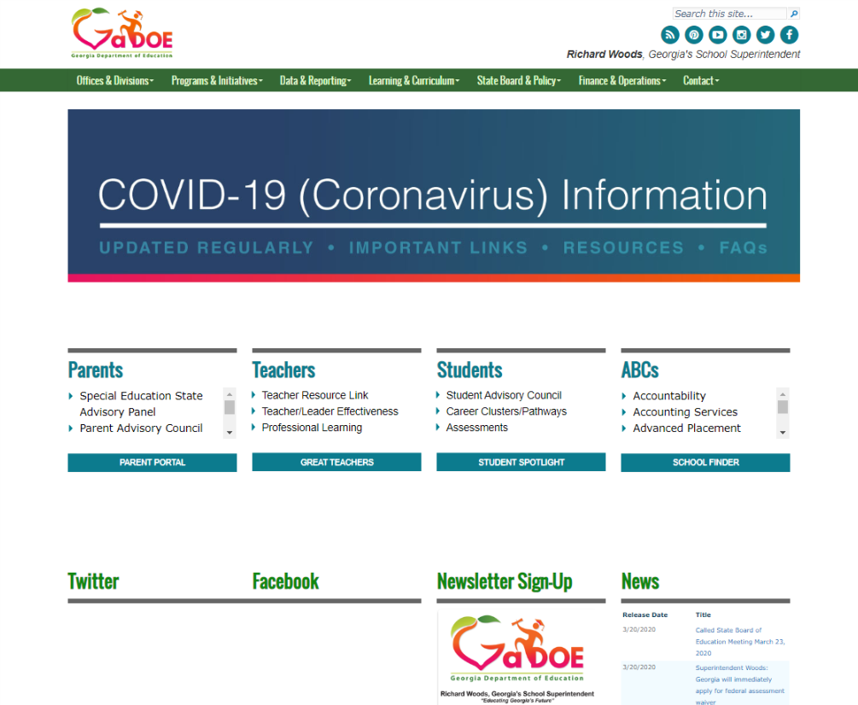

Slide 22
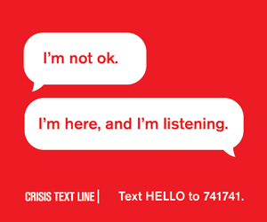

Slide 23
Send Questions To:
schoolsafety@doe.k12.ga.us

