Slide 1


Capacity Connectors
Protocol Partnership Prevention

Slide 2

Shannon Lawson
slawson@twincedars.org
Troup County Prevention Coalition
Twin Cedars Youth Services, Inc
Kay Hill, LPC
hillkj@troup.org
Coordinator for Social Emotional Health
Troup County School System

Slide 3
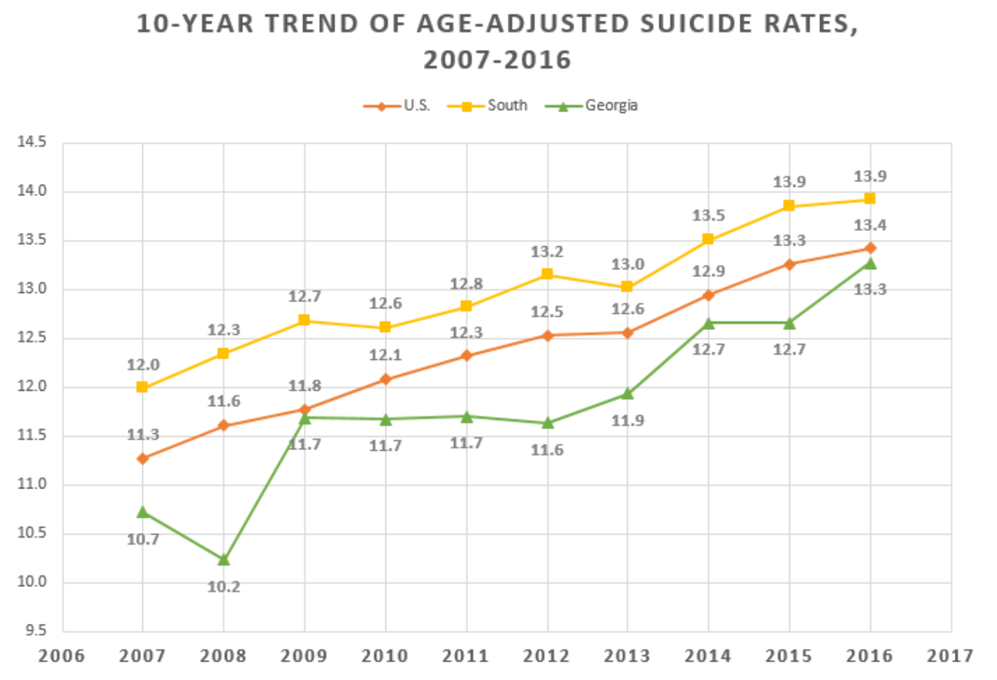
FOCUS ON SUICIDE PREVENTION
AS OF NOVEMBER 6, 2018, THERE HAVE BEEN 34 YOUTH SUICIDES REPORTED IN GEORGIA FOR 2018.
SUICIDE IS THE 2nd LEADING CAUSE OF DEATH FOR AGES 12-18.
REFERENCES: GBI PRESS RELEASE 11.6.2018 ; CENTER FOR DISEASE CONTROL & PREVENTION
Notes:
US, South and in GA – From 2007 to 2016 – general trend upward……

Slide 4

Challenges
Policy that met law, but lacked clarity in practice
Kids missing lot of days of school due to medical clearance
Training needs
Inconsistent use of a screening tool
Little to no communication with providers despite a requirement for them to “clear” our students
Access to the “protocol”
Traumatized work force
Notes:
We were meeting the law – but not necessarily helping kids

Slide 5
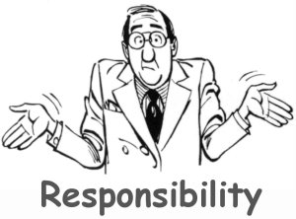

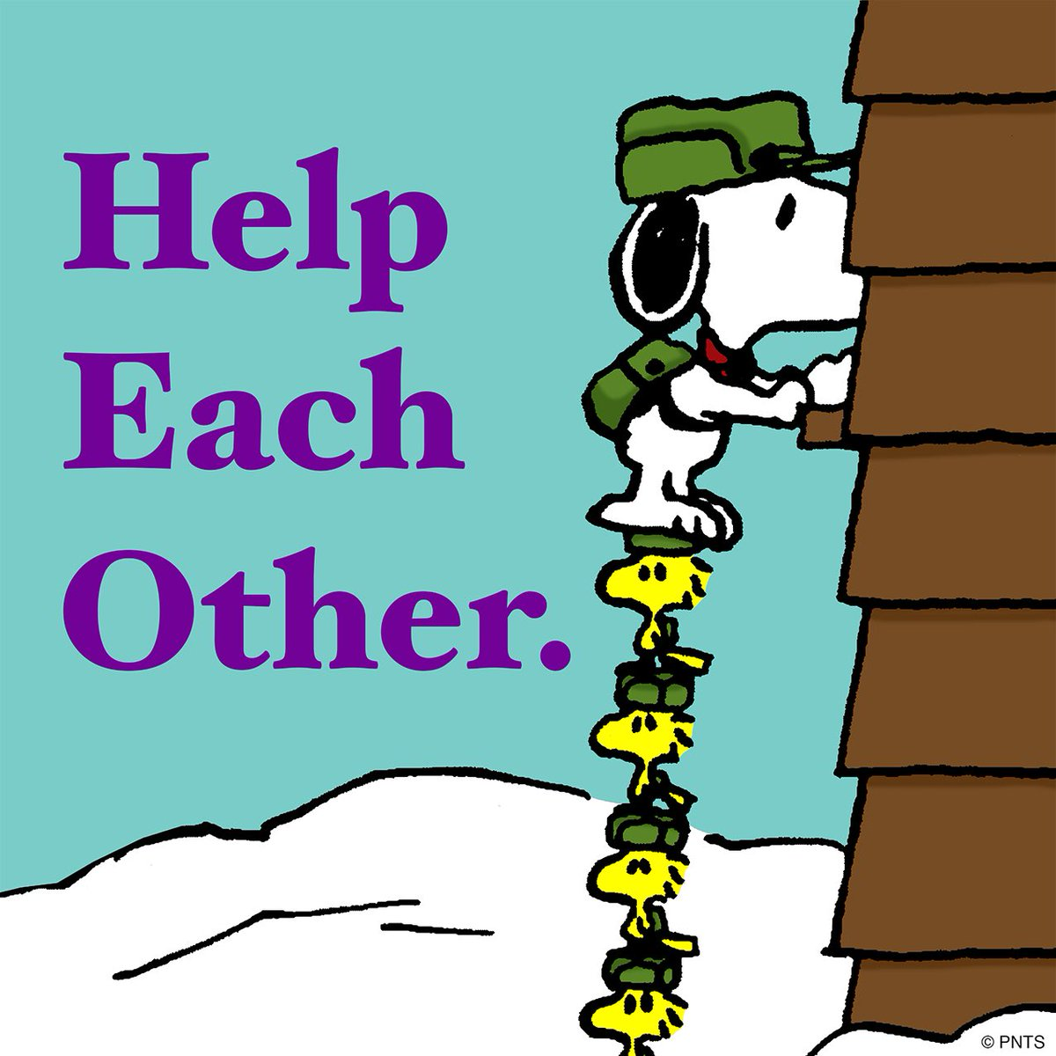
Who is Responsible for Screening
Response Team
Counselors
Nurses
Social Workers
Coordinator for Social Emotional Health
School Counselors
Where is the protocol?
What are we supposed to document?
Who knows how to do this?

Slide 6
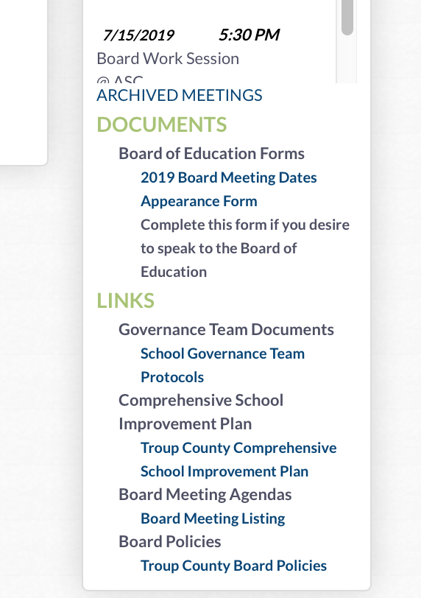
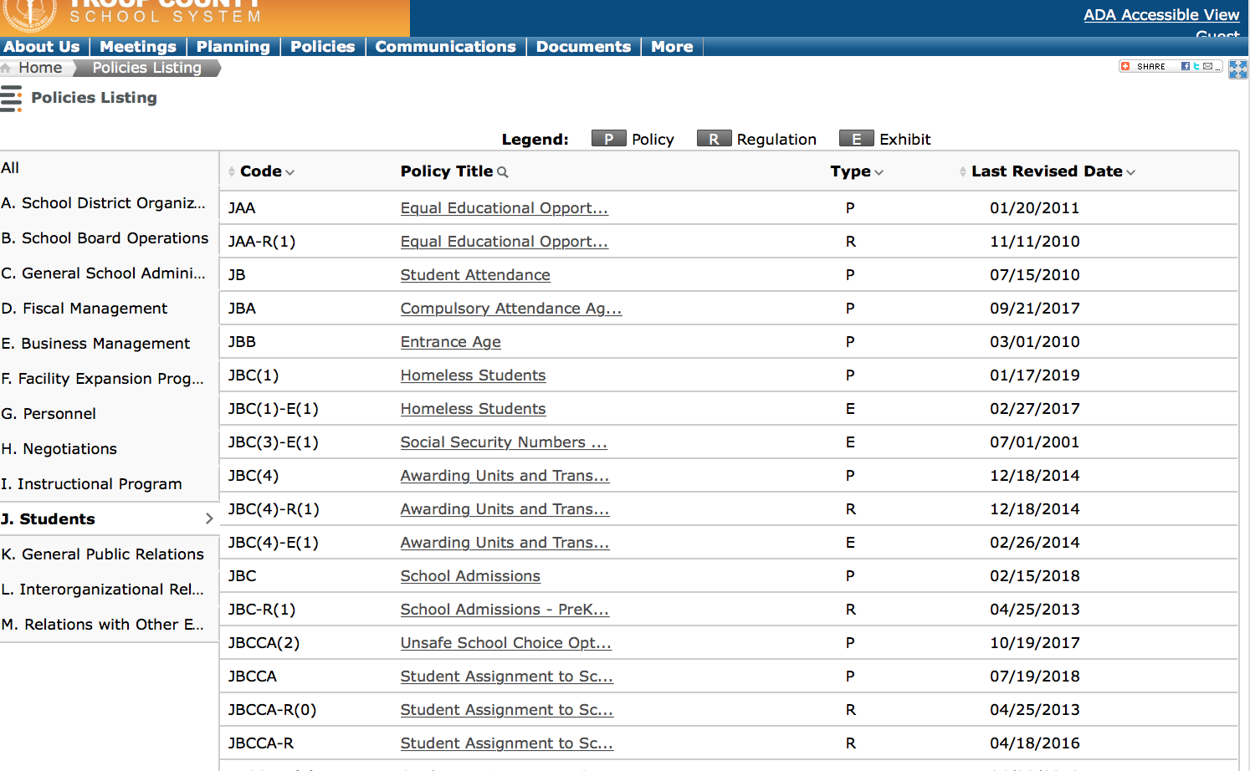
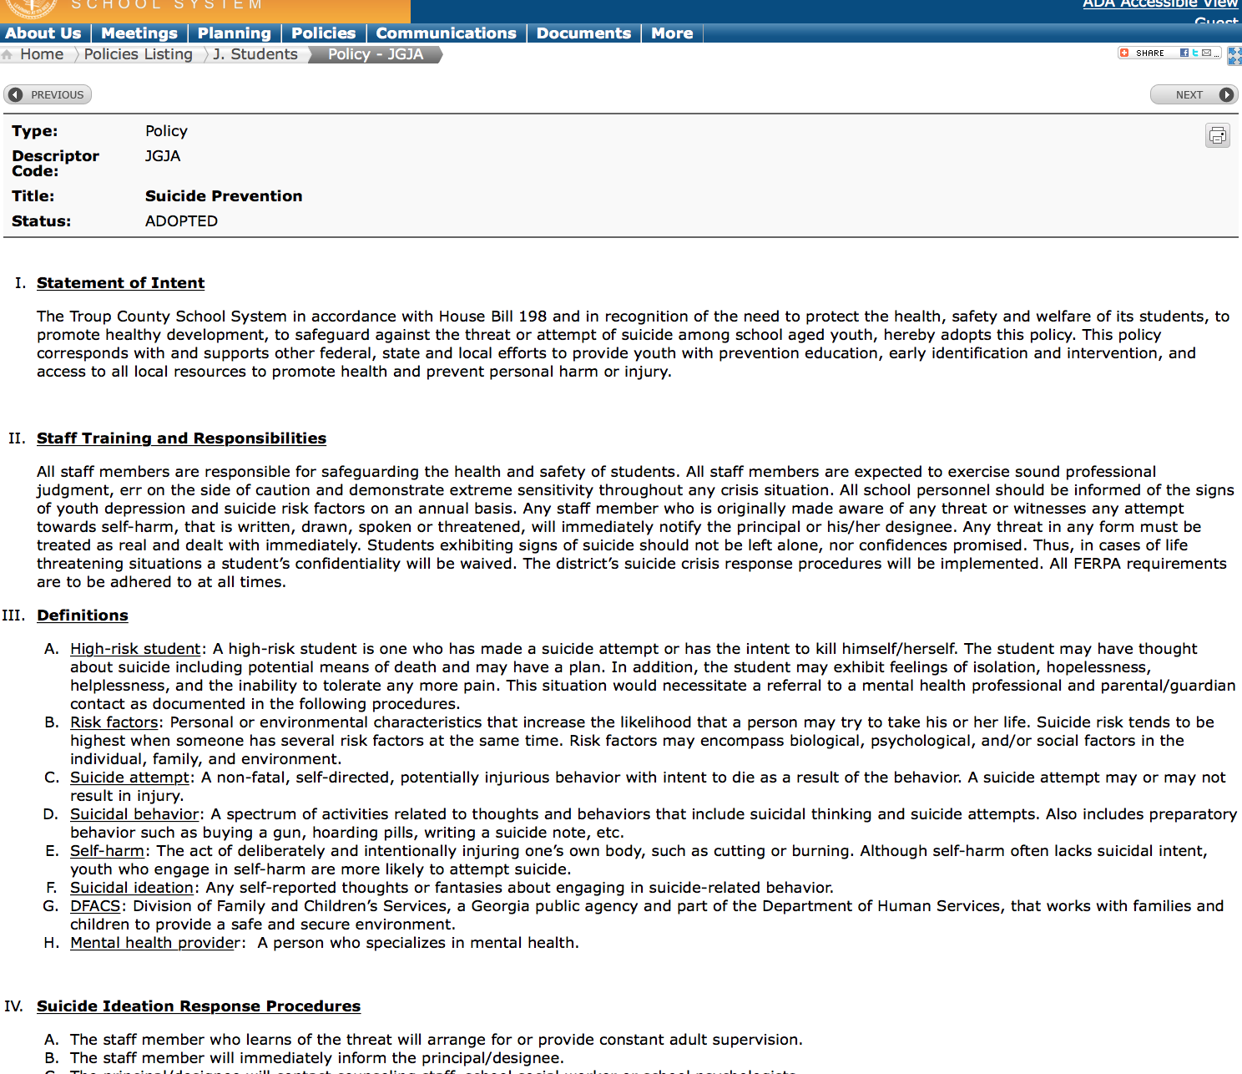
Notes:
Compare with screen shot of the policy
Emphasize importantance of living brething document
Separate from policy
Something that we can be user friendly - and not cumbersome

Slide 7

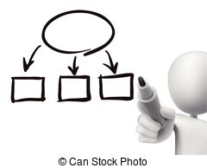
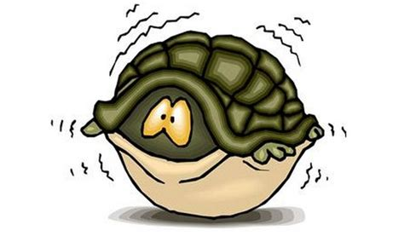



Medical Clearance
Notes:
Stimga and fear
Capacity around the knowledge
If we don’t get them out of there – we are liable – myth –
Change our thinking – bringing resources to the school
How to you do this? Is medical clearance a concept/issue in your district

Slide 8
MEDICAL CLEARANCE
Fear and Stigma
Concerns about
Liability
Attendance
Awareness and Education
Triage Guidelines & School Saftey Plan
Connection with Support System (stay in school)
Access to MH services / Connection to Resources
Mad Parents
Notes:
Sharing the pieces that make up ours - handouts

Slide 9
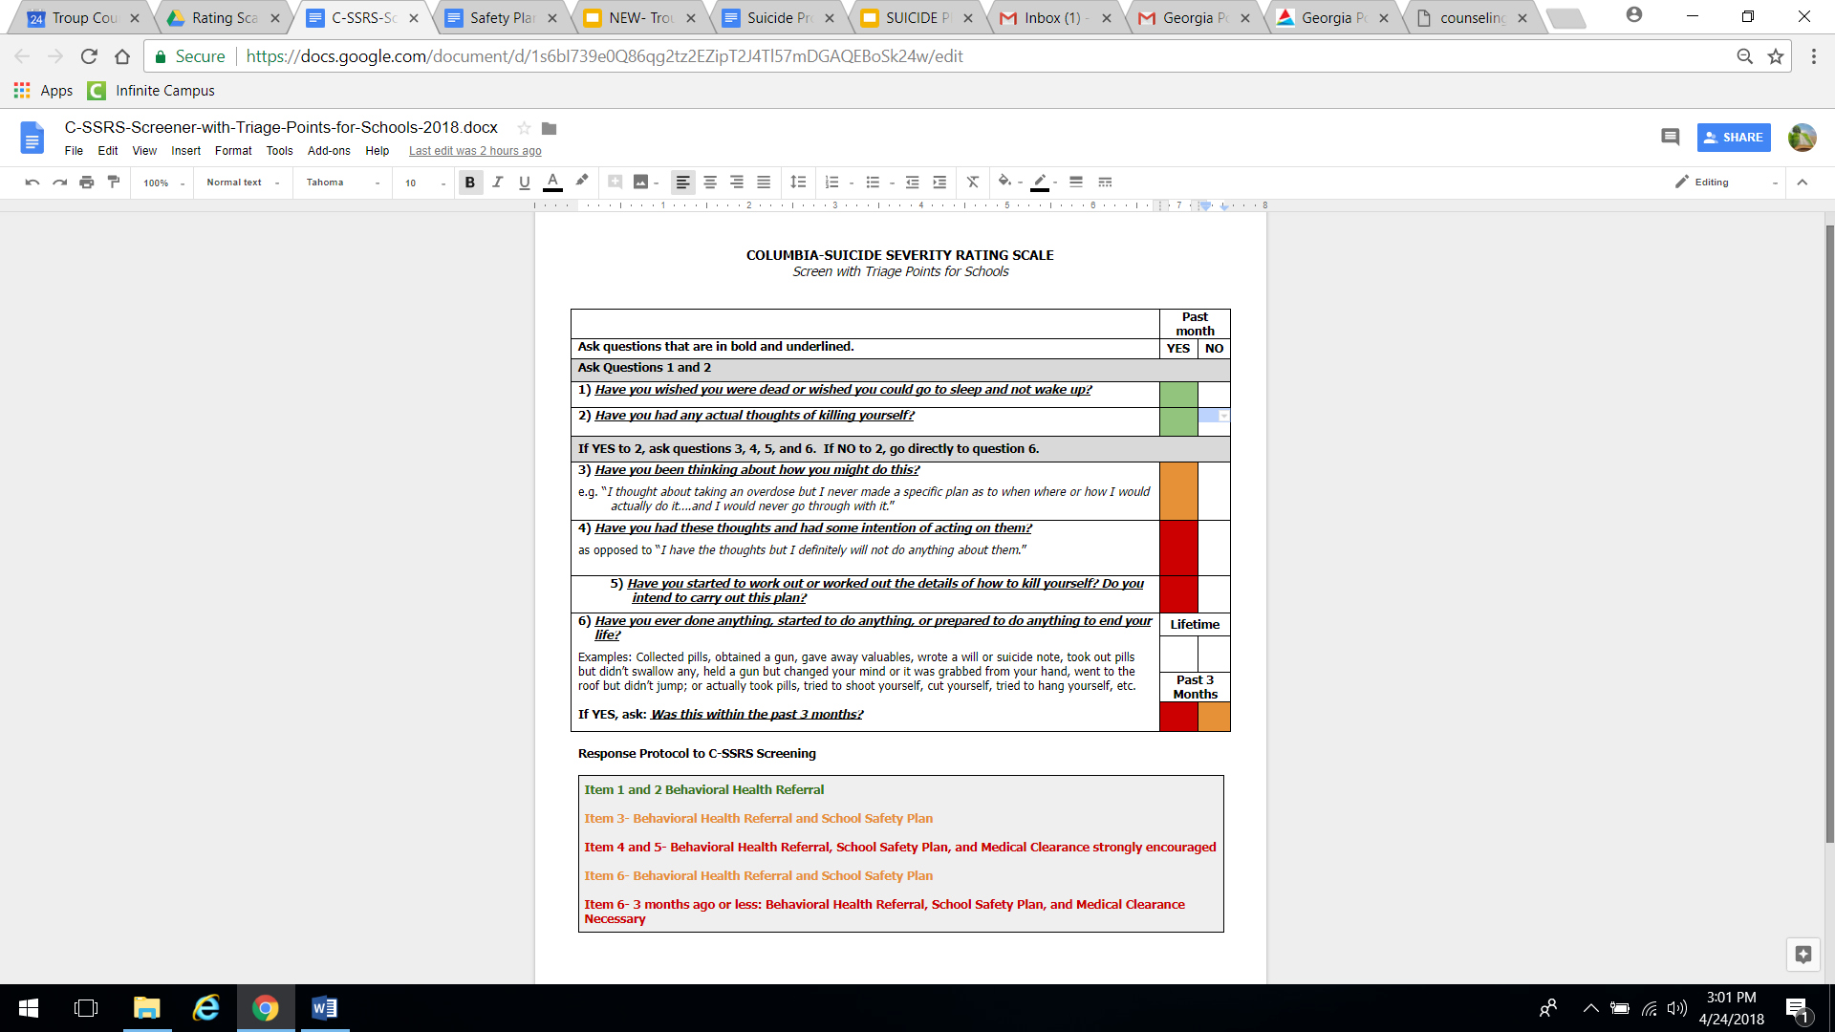





Columbia SuicideRating Scale
EVIDENCED BASED
SIMPLE
EFFICIENT
FREE
Notes:
Why do we need to use a screening tool?
Helps us to be more consistent in how we address suicidal ideation/bx
Provides an evidenced based framework for decision making
Both of those helps us to increase the fidelity with which we implement our protocol - which result is less risk and better care.
C-SSRS - was developed out of Columbia University -
was developed as a screening for a 2007 study of treatments to decrease suicide risk in adolescents with depression.
Based on 20 + years of research
In 2011, the CDC adopted the scales definitions for suicidal bx - which we will go over in a minute
In 2012, it was declared as the standard for measuring suicidal ideation and bx in clinical trials
Now used across many settings - including schools and mental health agencies, hospitals, etc..

Slide 10
Guidelines for Triage
Item 1 and 2 Behavioral Health Referral Item 3- Behavioral Health Referral and School Safety Plan Item 4 and 5- Behavioral Health Referral, School Safety Plan, and Medical Clearance strongly encouraged Item 6- Behavioral Health Referral and School Safety Plan Item 6- 3 months ago or less: Behavioral Health Referral, School Safety Plan, and Medical Clearance Necessary

Slide 11
Parent Conference Summary Form
Completed for each incident
Revised to narrative format
More engaging/caring
Notes:
Old form – check boxes –
Serious subject –
Every incident doesn’t fit into a box

Slide 12
Community Counseling Resource List
Vet your resources
Payer sources
Identify crisis providers
Update regularly
Include surrounding communities
Notes:
Will be updated over summer.
Pediatric offices are implementing policies to not medically clear suicidal kids for the school. Will need to ID MH providers who can do this - will work to identify them over summer and include on the updated resource list.
If parents have current provider - that is who they should call.

Slide 13
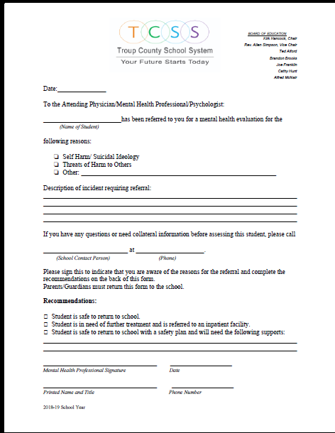

Clinician Referral Letter
Always give parent copy
Closing the GAP b/t school and community
Continuity of Care
Notes:
Talk about the clinicians perspective from the community – importance of getting good information……….

Slide 14
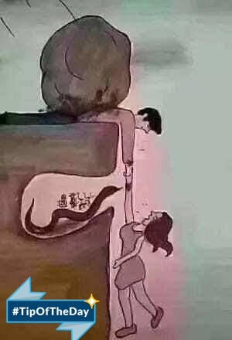

Slide 15
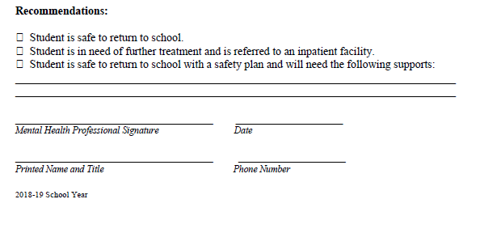
Closing the Gap

Slide 16
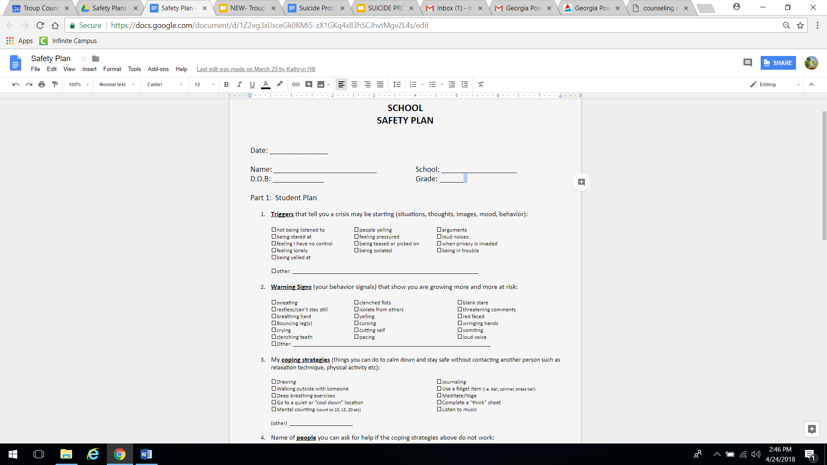
Student Safety
Plans
Completed WITH the student
Includes a School Plan
Who needs a copy?
Living and Breathing Document

Slide 17
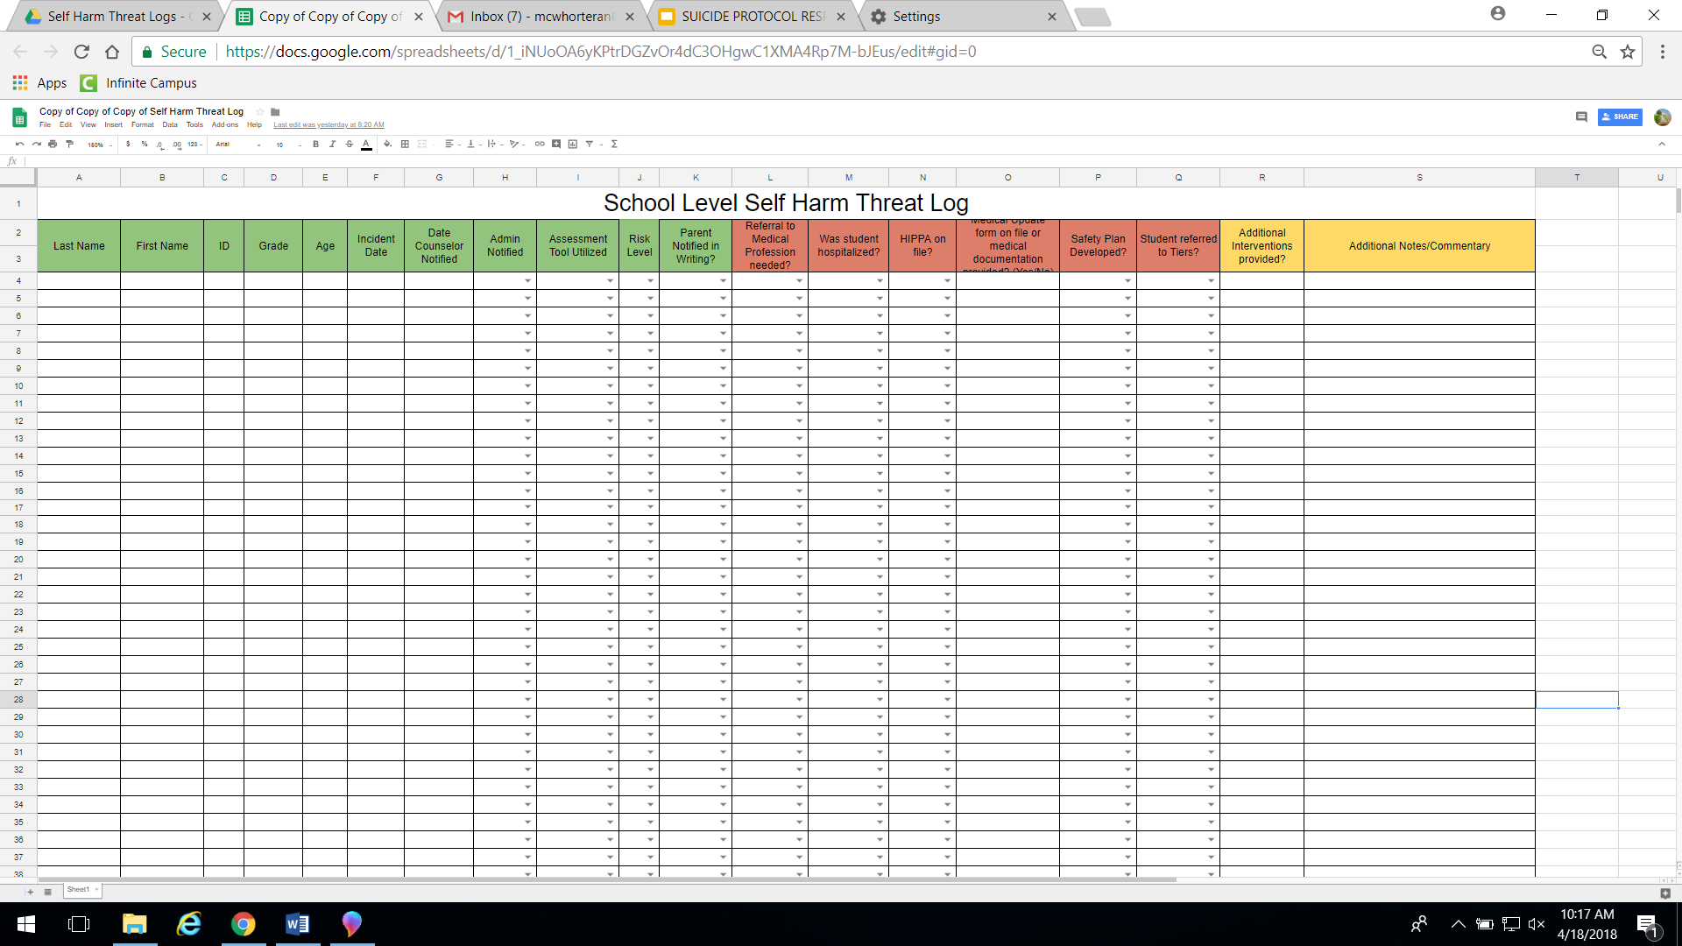
Self Harm Threat Log
Monitoring
Implications for SST
Data
Notes:
Green is required for all
Red is required when Risk level is high based on Screening

Slide 18

What’s next
Addendum or protocol for weekends and holidays
Wording on clinician referral letter to include date/time of assessment
Clarification on “Referral” vs. “Assessment”

Slide 19
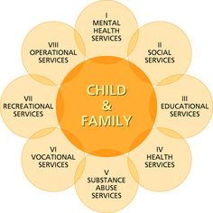

Building Capacity creates HOPE
LIPT
Family Connections
Courts & Social Services
Prevention Partners
SBMH - partnerships
Student Led Initiatives

