Slide 1
David J Schonfeld, MD, FAAP Director, National Center For School Crisis And Bereavement Children’s Hospital Los Angeles
When School Starts Back: Helping students and
yourself cope with crisis and loss during a pandemic
schonfel@usc.edu
SchoolCrisisCenter.org | GrievingStudents.org
1-877-536-NCSCB (1-877-536-2722)

Slide 2
Outline
Common reactions to a crisis
Psychological first aid
Helping children cope with the pandemic
Supporting grieving students during the pandemic
Professional self-care

Slide 3
Psychological First Aid
Provide broadly to those impacted
Supportive services to promote normative coping and accelerate natural healing process
All adults should understand likely reactions and how to help children cope

Slide 4
Anyone that interacts with children can be a potential source of assistance and support – if unprepared, they can be a source of further distress.

Slide 5
PFA Actions source: American Red Cross
Observation or Awareness
Make a Connection
Help People Feel Comfortable and at Ease
Be Kind, Calm, & Compassionate
Assist with Basic Needs
Listen
Give Realistic Reassurance
Encourage Good Coping
Help People Connect
Give Accurate and Timely Information
Suggest a Referral Resource
End the Conversation

Slide 6
Watch your media consumption
Make sure it is a healthy diet; don’t consume too much
Keep informed through focused/periodic attention to trusted sources of information
If you aren’t getting reassured or learning practical actions to take, then disconnect from media
Limit amount of media exposure – this is a good time to unplug and connect instead with children and family

Slide 7
PFA Actions source: American Red Cross
Observation or Awareness
Make a Connection
Help People Feel Comfortable and at Ease
Be Kind, Calm, & Compassionate
Assist with Basic Needs
Listen
Give Realistic Reassurance
Encourage Good Coping
Help People Connect
Give Accurate and Timely Information
Suggest a Referral Resource
End the Conversation

Slide 8
Potential Symptoms of Adjustment Reactions
Fears & Anxiety; School Avoidance
Sleep problems; Change in Appetite
Difficulties with Concentration & Academic Performance
Sadness & Depression
Physical Symptoms
Grief
Guilt
Alcohol & Other Substance Use
Anger & Irritability; Distrust & Suspiciousness

Slide 9
Talking with and supporting children
Don’t pretend everything is OK – children pick up when parents/adults are not genuine and honest
Children may pick up on concerns primarily of adults
Find out individual child’s fears, concerns, skepticism
Don’t tell children that they shouldn’t be worried or minimize their concerns; help them learn to deal with their uncertainty and fear
Include positive information; present a hopeful perspective

Slide 10
Strategies for dealing with distress
Reading or hobbies that promote healthy distraction
Journaling, blogging, art, music to promote expressions of feelings
Exercise, yoga
Appropriate use of respectful humor
Relaxation techniques, mindfulness
Help children identify steps they can take personally to protect their own health and to help others

Slide 11
Some children may need more assistance
The pandemic and discussion about the impact on families may remind children of other difficulties – events in the past, ongoing challenges, or concerns about future losses or crises
Children who were anxious or depressed before the pandemic will likely need more support
Children may need to focus first on their own needs before they are able to think of needs of others; try not to make them feel guilty for thinking about how this crisis impacts them personally

Slide 12
Being with someone in distress
Do not try to “cheer up” survivors
Do not encourage to be strong or cover emotions
Express feelings and demonstrate empathy
Avoid statements such as: “I know exactly what you are going through” (you can’t), “You must be angry” (don’t tell person how to feel), “Both my parents died when I was your age” (don’t compete for sympathy)
Allow child/family to be upset while suspending judgment – intervene only when safety/health is concern

Slide 13
Initiating the conversation
Express concern
Be genuine
Invite conversation
Listen and observe
Limit personal sharing
Offer practical advice
Offer reassurance without minimizing concerns
Maintain contact

Slide 14
Academic accommodations
It is common for students to experience temporary academic challenges after a death; pre-existing learning challenges often become worse
Offer academic support proactively – don’t wait for academic challenges to become academic failure
Change an assignment, e.g.,
Allow student to work with a partner
Adapt formal research paper into more engaging assignment
Change focus or timing of lesson
Reschedule or adapt tests

Slide 15
Grief during a pandemic
After a death, children often concerned about the health of themselves or others close to them
Important to help children deal with fears/concerns about the pandemic
Social distancing measures/school closure increase social isolation; makes it difficult to provide support
Secondary losses become even more of an issue
Family members may be overwhelmed by the pandemic in addition to their own grief
Some grief may not be related to death
Supporting grieving students can be difficult in the best of times; this is not the best of times

Slide 16
What you are doing is of value
Just because we don’t know everything, doesn’t mean we know nothing of value
You know strategies that have helped in the past to decrease distress – try them now
Reach out to colleagues/resources in school district and community when more is critically needed
Celebrate positive contributions you make
Set reasonable expectations
The curriculum has changed – teaching children how to cope → helping them learn life skills that will make them more resilient

Slide 17
Compassion fatigue
Exposure to trauma and suffering of others can lead to compassion fatigue
Empathy: understanding and taking perspective of another
Compassion: requires empathy but includes wanting to help and/or desiring to relieve suffering – “to bear or suffer together”
Warnings about compassion fatigue imply that compassion is necessarily tiring
Compassionate approaches can be gratifying and bring meaning to the work

Slide 18
Supporting those in need can be gratifying
Realistic objectives of purpose of interactions
Have skills and resources to provide meaningful assistance
Are aware of and have sufficient support to deal with personal impact of work
Especially difficult during a pandemic when you have other challenges

Slide 19
Challenges to self-care
Making time when there is so much to do and everyone needs your help
Feeling shame or guilt for attending to your own needs
Assuming others are having less trouble adjusting
Lack of modeling of professional self-care

Slide 20
www.schoolcrisiscenter.org

Slide 21
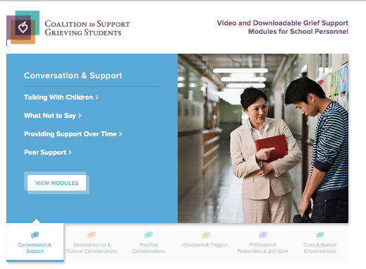
www.grievingstudents.org

Slide 22
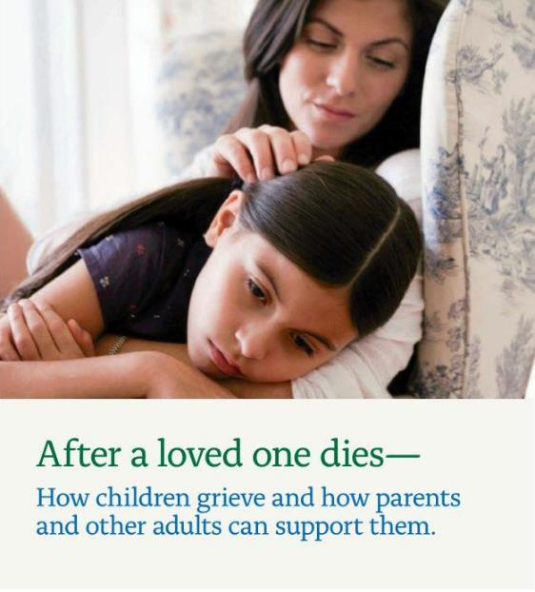
www.grievingstudents.org
Order Free Materials (download)

Slide 23
For further information about NCSCB visit us, call us, like us, share us
1-888-53-NCSCB (1-888-536-2722)
www.SchoolCrisisCenter.org | info@schoolcrisiscenter.org
@schoolcrisisorg
National Center for School Crisis and Bereavement

