Slide 1
David J Schonfeld, MD, FAAP Director, National Center For School Crisis And Bereavement Children’s Hospital Los Angeles
When School Starts Back:
Supporting grieving students during a pandemic
schonfel@usc.edu
SchoolCrisisCenter.org | GrievingStudents.org
1-877-536-NCSCB (1-877-536-2722)

Slide 2
Loss is Common in the Lives of Children
5%
of children experience the death of parent by 16
93%
of classroom educators have never received any training in how to support a grieving student
Vast majority of children
experience the death of a family member and/or friend by the time they complete high school
(9 of 10)

Slide 3
Children may not appear to be grieving
Adults may communicate death is not discussed
Children may
not yet understand what has happened or its implications
be overwhelmed by feelings
express grief indirectly through behavior or play

Slide 4
Being with someone in distress
Do not try to “cheer up” survivors
Do not encourage to be strong or cover emotions
Express feelings and demonstrate empathy
Avoid statements such as: “I know exactly what you are going through” (you can’t), “You must be angry” (don’t tell person how to feel), “Both my parents died when I was your age” (don’t compete for sympathy)
Allow child/family to be upset while suspending judgment – intervene only when safety/health is concern

Slide 5
Addressing cultural diversity
Some people are worried they will say or do the wrong thing because they feel ill informed about another culture
Although there are differences in cultural practices, the fundamental experience of grief is universal
When we recognize that there is a range of ways to experience and express grief, we can explore ways to bridge cultural differences in order to help grieving children and families

Slide 6
Supporting children of a different culture
Ask questions when you are unsure what would be most helpful for a family or individual
Assumptions may result in stereotypes that cloud our perceptions and make us miss opportunities to be helpful
Approach the family with an open mind and heart
Help families identify and communicate what is important to them about cultural practices; work with them to find solutions and compromises when realities require modifications in cultural practices

Slide 7
Initiating the conversation
Express concern
Be genuine
Invite conversation
Listen and observe
Limit personal sharing
Offer practical advice
Offer reassurance without minimizing concerns
Maintain contact

Slide 8
Peer support
Most children want to help friends, yet often have limited experience
May make insensitive comments, ask repetitive or detailed questions, or tease grieving peer
Study of children ages 6-15 who experienced death of parent: 20% “experienced direct, raw taunting about their loss”
Educators can help students develop skills to support a peer who is grieving

Slide 9
Initiating the conversation
Express concern
Be genuine
Invite conversation
Listen and observe
Limit personal sharing
Offer practical advice
Offer reassurance without minimizing concerns
Maintain contact

Slide 10
Children’s guilt
Young children tend to be:
Egocentric
Have limited understanding of cause of death
→ Magical thinking
Results in guilt
Reassure children of lack of responsibility

Slide 11
Academic accommodations
It is common for students to experience temporary academic challenges after a death; pre-existing learning challenges often become worse
Offer academic support proactively – don’t wait for academic challenges to become academic failure
Change an assignment, e.g.,
Allow student to work with a partner
Adapt formal research paper into more engaging assignment
Change focus or timing of lesson
Reschedule or adapt tests

Slide 12
Helpful responses to a grief trigger
Provide a safe space or an adult the student can talk to
Set procedures for the student to obtain support
Let the student call a parent or family member if necessary
Provide permission and encouragement to see school nurse, counselor, or social worker
Offer private time with teacher to talk about feelings

Slide 13
Grief during a pandemic
After a death, children often concerned about the health of themselves or others close to them
Important to help children deal with fears/concerns about the pandemic
Physical distancing/school closure increase social isolation; makes it difficult to provide support
Secondary losses become even more of an issue
Family members may be overwhelmed by the pandemic in addition to their own grief
Some grief may not be related to death
Supporting grieving students can be difficult in the best of times; this is not the best of times

Slide 14
Coalition to Support Grieving Students
American Federation of School Administrators (AFSA)
American Federation of Teachers (AFT)
American School Counselors Association (ASCA)
National Association of Elementary School Principals (NAESP)
National Association of Secondary School Principals (NASSP)
National Association of School Nurses (NASN)
National Association of School Psychologists (NASP)
National Education Association (NEA)
School Social Workers Association of America (SSWAA)
School Superintendents Association (AASA)

Slide 15
Supporting Organizational Members

Slide 16
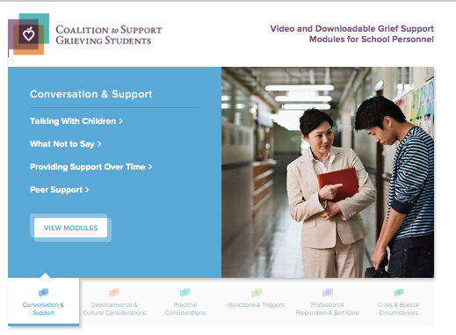
www.grievingstudents.org

Slide 17
Modules Placed into Six Sections
Each section contains 2-4 video modules; each video is accompanied by handout that summarizes major points
Conversation and Support
Developmental and Cultural Considerations
Practical Considerations
Reactions and Triggers
Professional Preparation and Self-Care
Crisis and Other Special Circumstances

Slide 18
Additional Resources
Additional Modules (e.g., police or military deaths)
Guidance Documents
Practical guidelines developed by the NCSCB on how to respond to the death of a student or staff, from all causes or from suicide
Training module
Family and school staff booklets
Articles
Online Resources

Slide 19
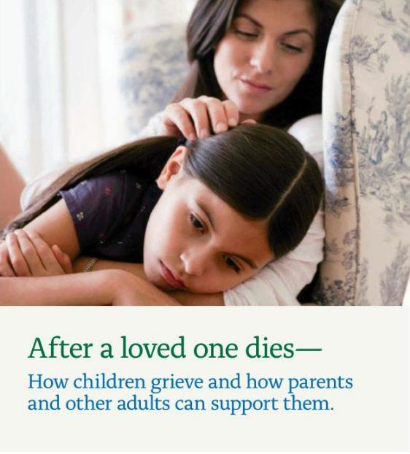
www.grievingstudents.org
Order Free Materials (download)

Slide 20
For further information about NCSCB visit us, call us, like us, share us
1-888-53-NCSCB (1-888-536-2722)
www.SchoolCrisisCenter.org | info@schoolcrisiscenter.org
@schoolcrisisorg
National Center for School Crisis and Bereavement

